Slide 1
From last class: Selectivity vs Specificity

Slide 2
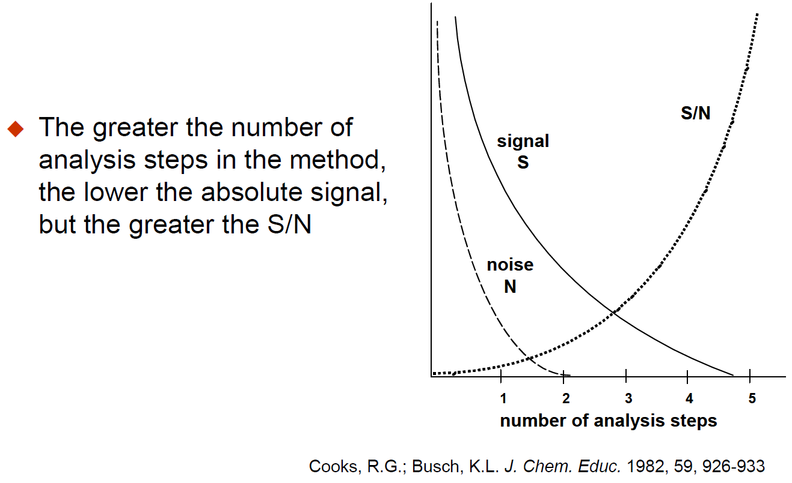

Slide 3
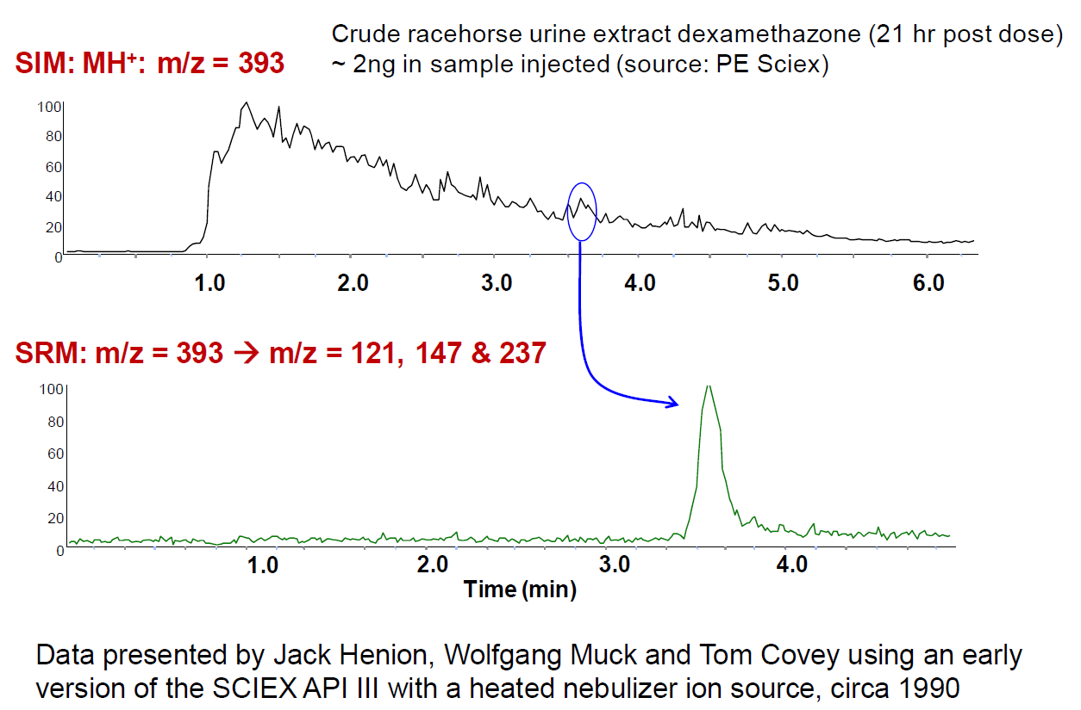

Slide 4
Fluorescence Advantage
Fluorescence is measured over a dark background, while absorbance is measured over a bright background.
Measuring signal over a large background is hard.
Chemical noise/background is a major limitation.

Slide 5
Quantitative Analysis 101
What does it mean to be quantitative?

Slide 6
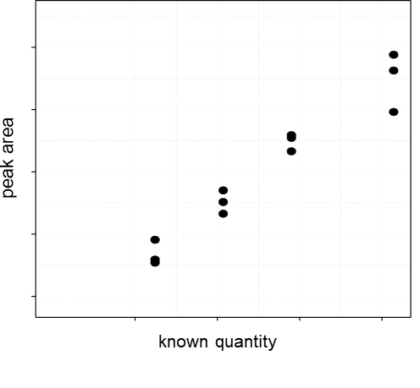
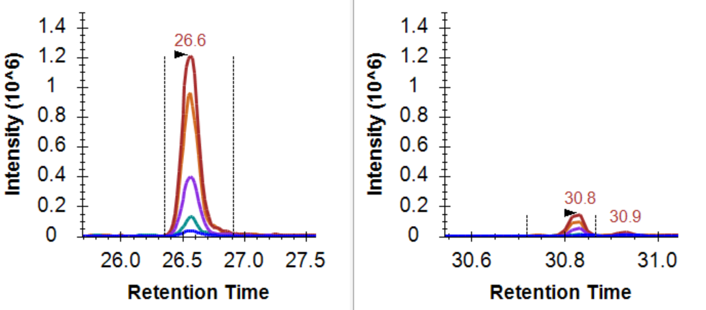
The change in signal should reflect the change in quantity

Slide 7
Quantitative Analysis 101
ULOQ
Linear Dynamic Range
Measured Intensity (Area)
LOD
LLOQ
Amount (moles)
LOD: Limit of Detection
LLOQ: Lower Limit of Quantitation
ULOQ: Upper Limit of Quantitation

Slide 8
Quantitative Analysis 101: Using an Internal Std
ULOQ
Linear Dynamic Range
Intensity Ratio (Area Ratio)
LOD
LLOQ
Amount (moles)
LOD: Limit of Detection
LLOQ: Lower Limit of Quantitation
ULOQ: Upper Limit of Quantitation

Slide 9
Quantitative Analysis 101
What does it mean to be quantitative?
What does signal calibration mean?

Slide 10
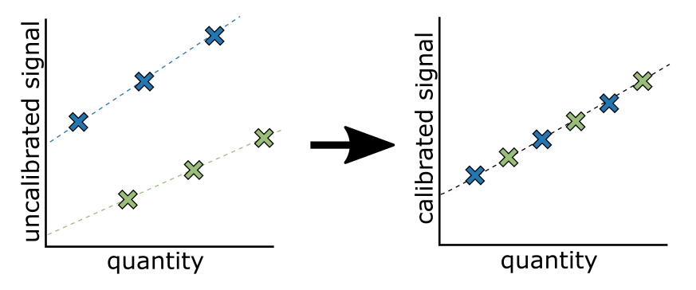
Measurements on different platforms are not measured on the same scale

Slide 11
Between Batch/Platform/Lab Signal Calibration
Purpose of signal calibration
Placing signal on the same scale
Often the scale is arbitrary
Kilogram = mass of a liter of water at freezing point
Meter = 1/10,000,000 the distance from the equator to the north pole
Pee dee belomnite (PDB) = reference for 13C, fossil found in Peedee Formation in South Carolina
Standard mean ocean water (SMOW) = reference for 18O, arbitrary mix of distilled water from different regions of the world.

Slide 12
What you calibrate against is important

Slide 13
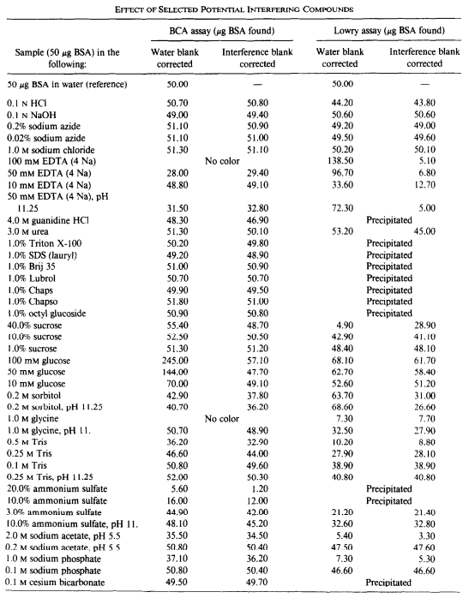
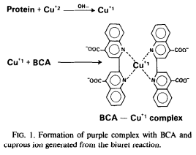
What you calibrate against is important
Bicinchoninic acid (BCA) is the current standard for measuring protein abundance.

Slide 14
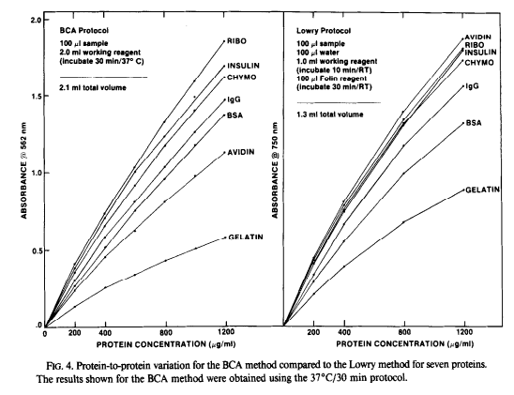
What you calibrate against is important
Smith et al., Anal Biochem 1985

Slide 15
What is the difference between relative and absolute quantitation?

Slide 16
Major Quantitative Figures of Merit
LOD – Limit of Detection
LOQ – Limit of Quantitation
Precision
Within batch/day
Between batch/day

Slide 17
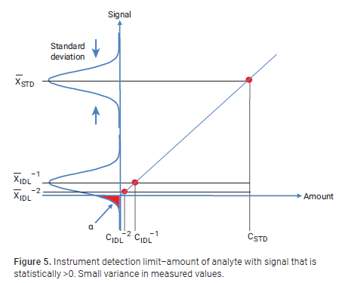
Limit of detection
Is a signal statistically different from a blank?

Slide 18
Limit of Quantitation
Does the change in quantity reflect the change in signal?

