Slide 1
From last class: Selectivity vs Specificity

Slide 2
Fluorescence Advantage
Fluorescence is measured over a dark background, while absorbance is measured over a bright background.
Measuring signal over a large background is hard.
Chemical noise/background is a major limitation.

Slide 3
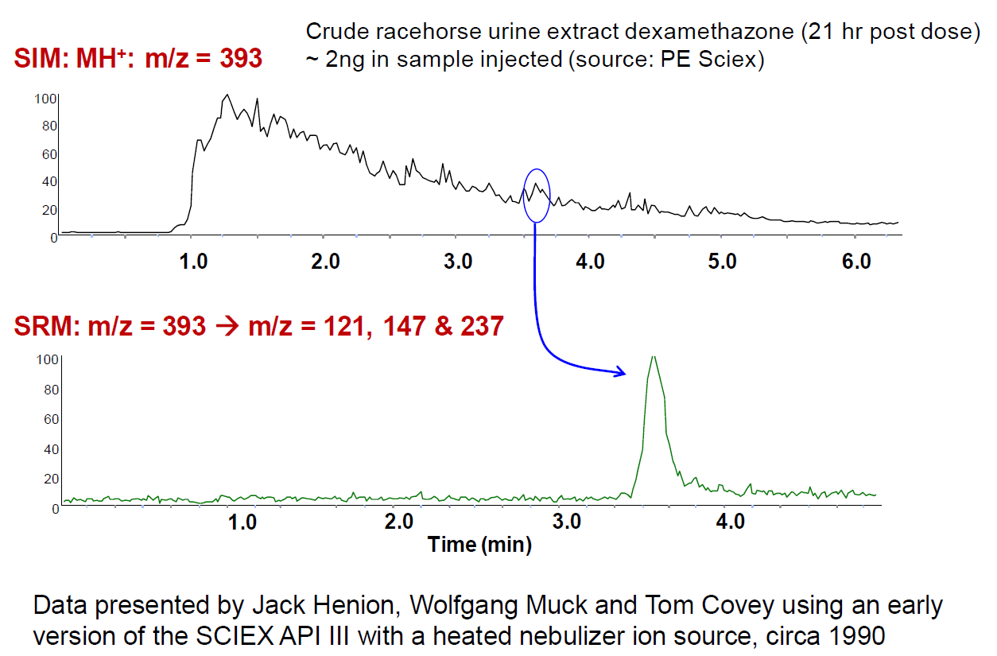

Slide 4
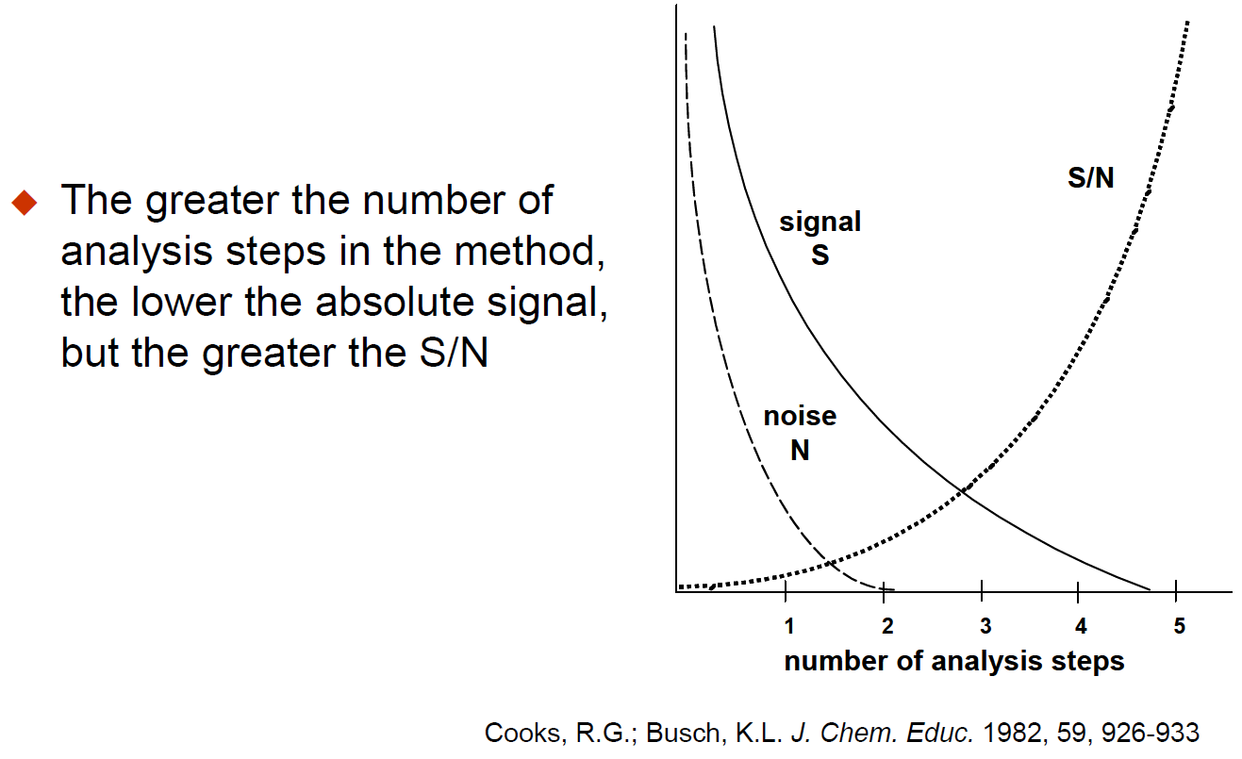

Slide 5
What is the purpose of calibration?

Slide 6
Quantitative Analysis 101
What does it mean to be quantitative?

Slide 7
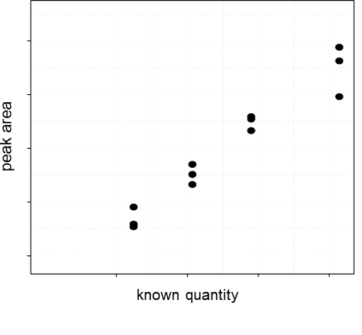
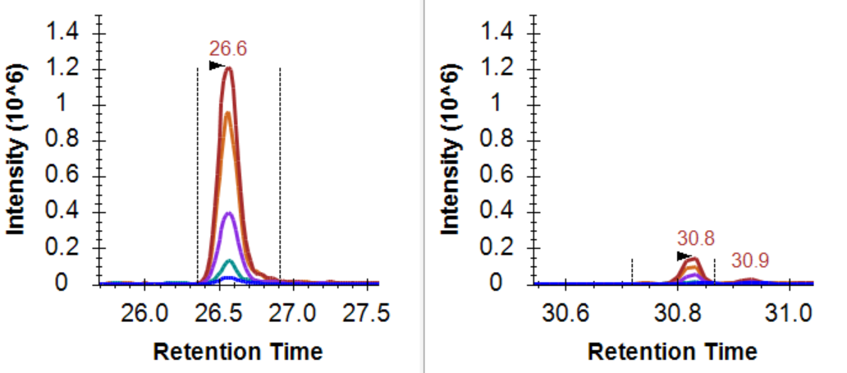
The change in signal should reflect the change in quantity

Slide 8
Quantitative Analysis 101
ULOQ
Linear Dynamic Range
Measured Intensity (Area)
LOD
LLOQ
Amount (moles)
LOD: Limit of Detection
LLOQ: Lower Limit of Quantitation
ULOQ: Upper Limit of Quantitation

Slide 9
Quantitative Analysis 101: Using an Internal Std
ULOQ
Linear Dynamic Range
Intensity Ratio (Area Ratio)
LOD
LLOQ
Amount (moles)
LOD: Limit of Detection
LLOQ: Lower Limit of Quantitation
ULOQ: Upper Limit of Quantitation

Slide 10
Quantitative Analysis 101
What does it mean to be quantitative?
What does signal calibration mean?

Slide 11
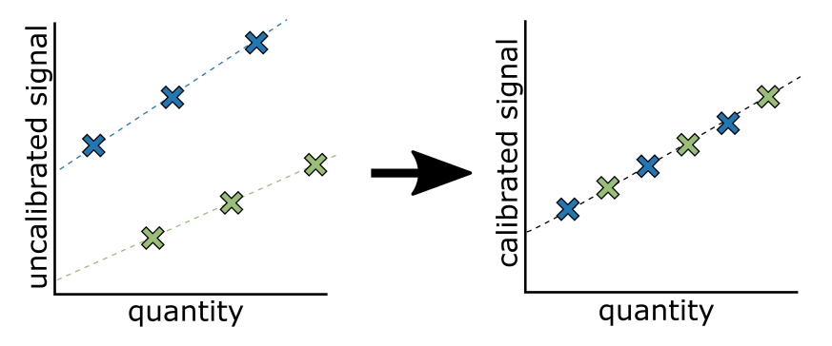
Measurements on different platforms are not measured on the same scale

Slide 12
Between Batch/Platform/Lab Signal Calibration
Purpose of signal calibration
Placing signal on the same scale
Often the scale is arbitrary
Kilogram = mass of a liter of water at freezing point
Meter = 1/10,000,000 the distance from the equator to the north pole
Pee dee belomnite (PDB) = reference for 13C, fossil found in Peedee Formation in South Carolina
Standard mean ocean water (SMOW) = reference for 18O, arbitrary mix of distilled water from different regions of the world.

Slide 13
What you calibrate against is important

Slide 14
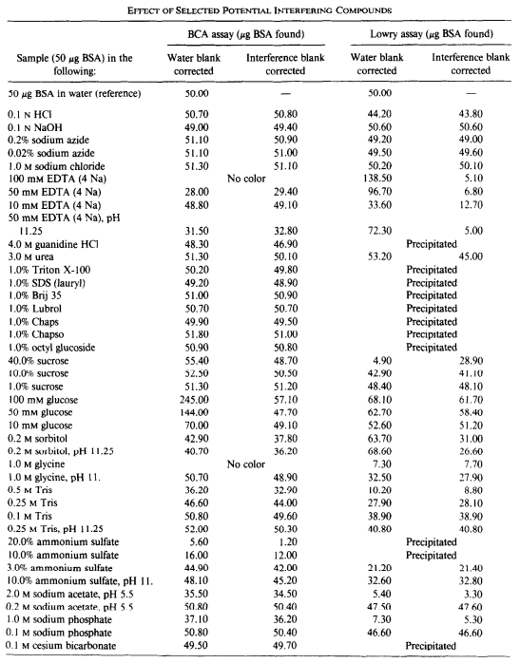
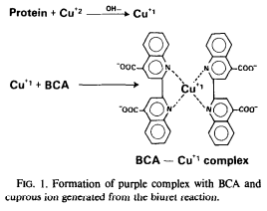
What you calibrate against is important
Bicinchoninic acid (BCA) is the current standard for measuring protein abundance.

Slide 15
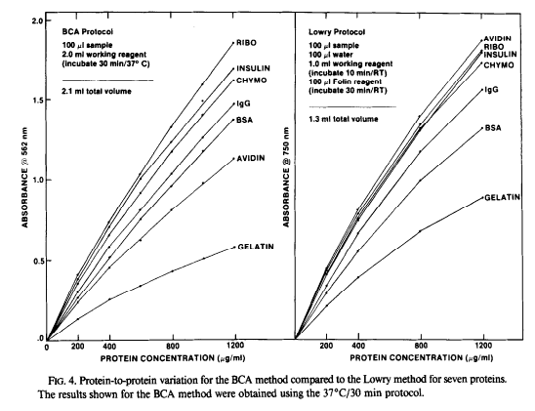
What you calibrate against is important
Smith et al., Anal Biochem 1985

Slide 16
What is the difference between relative and absolute quantitation?

