Slide 1
Light Sources
Genome 575: Fundamentals of Biomedical Instrumentation
Brian Beliveau

Slide 2
Recap from the first module
There are many questions to ask about data
Continuous information can be evaluated or thresholded
Discrete information can be binarized around threshold values
The performance of a given threshold choice can be evaluated with ROC curves

Slide 3

The competition…
2022
2023
https://dnm.nflximg.net/api/v6/2DuQlx0fM4wd1nzqm5BFBi6ILa8/AAAAQYwP3BYZ2Ri_-P-sY4_vtR9_fv6KPptWKKniY2_VxxOzqurvjAbe7bi4XPq2NbcH4vw99f1gFDyU_TZe7bkeHOBKNYccZkoFBoRsCHFtqWFtHPYk16RT26YMxUs8PffGpvROrvismA_Kt8PHRAuviZLp.jpg?r=b5e

Slide 4
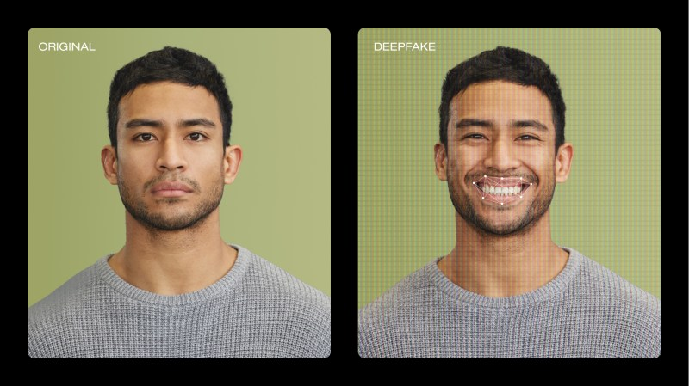
2024
https://vimeo.com/blog/post/video-deepfakes/

Slide 5
2025
https://vimeo.com/blog/post/video-deepfakes/

Slide 6


Returning to information…
How are these different?
Wikipedia

Slide 7
Barcode information content
UPC-A barcode
V4 QR code (33x33)
10e+80 atoms
in the known
universe!
95 black/white modules (bits of infomration)
Up to 12 positions, 0–9 value at each
10^12 possibilities
1089 black/white modules (bits of information)
Digits, characters, symbolic character encodings
Up to 114 alphanumeric characters 45^144 = 10^187 possibilities
Wikipedia

Slide 8

Discussion point
What is the most surprising thing you’ve learned in the class so far?
https://images.emojiterra.com/google/android-11/512px/1f914.png

Slide 9
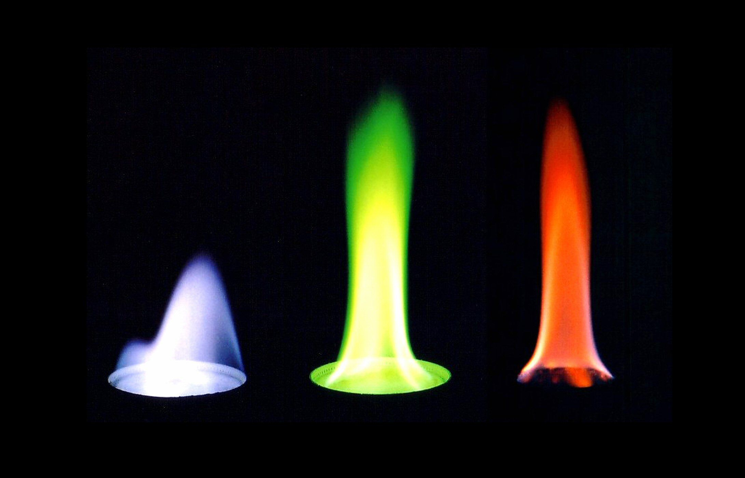
Let’s talk about (visible) light
What is light?
Where does it come from?
https://www.thoughtco.com/thmb/jEWJTLUBQRRgWgmKng6JPuX5E0M=/2180x1400/filters:fill(auto,1)/90191671-56a1322a3df78cf772684fbf.jpg

Slide 10
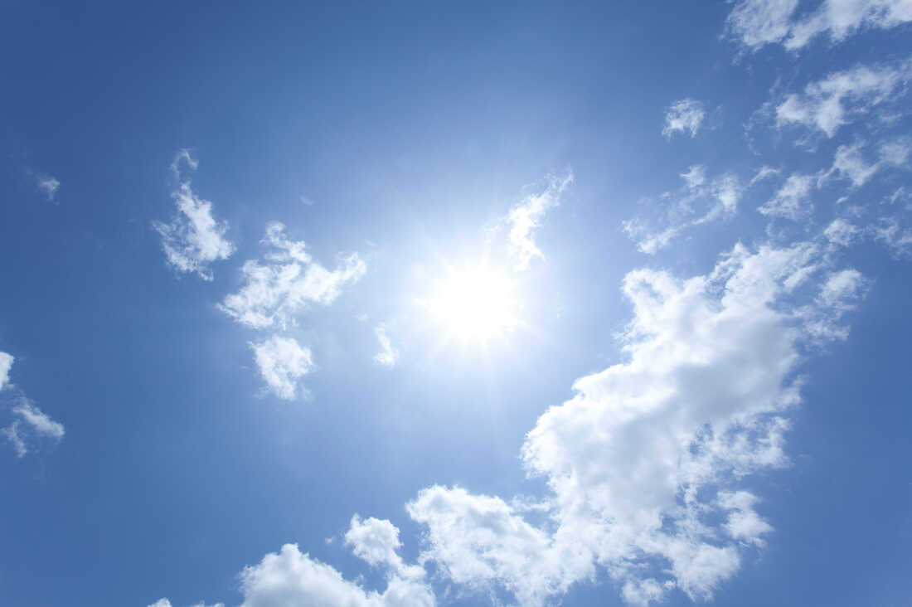
Sunlight
What is the source of visible sunlight?
https://media.npr.org/assets/img/2020/04/17/gettyimages-102853378_custom-322a77f3aa92129f4a84f4d2dd98ac2ca1a078b8-s1100-c50.jpg

Slide 11
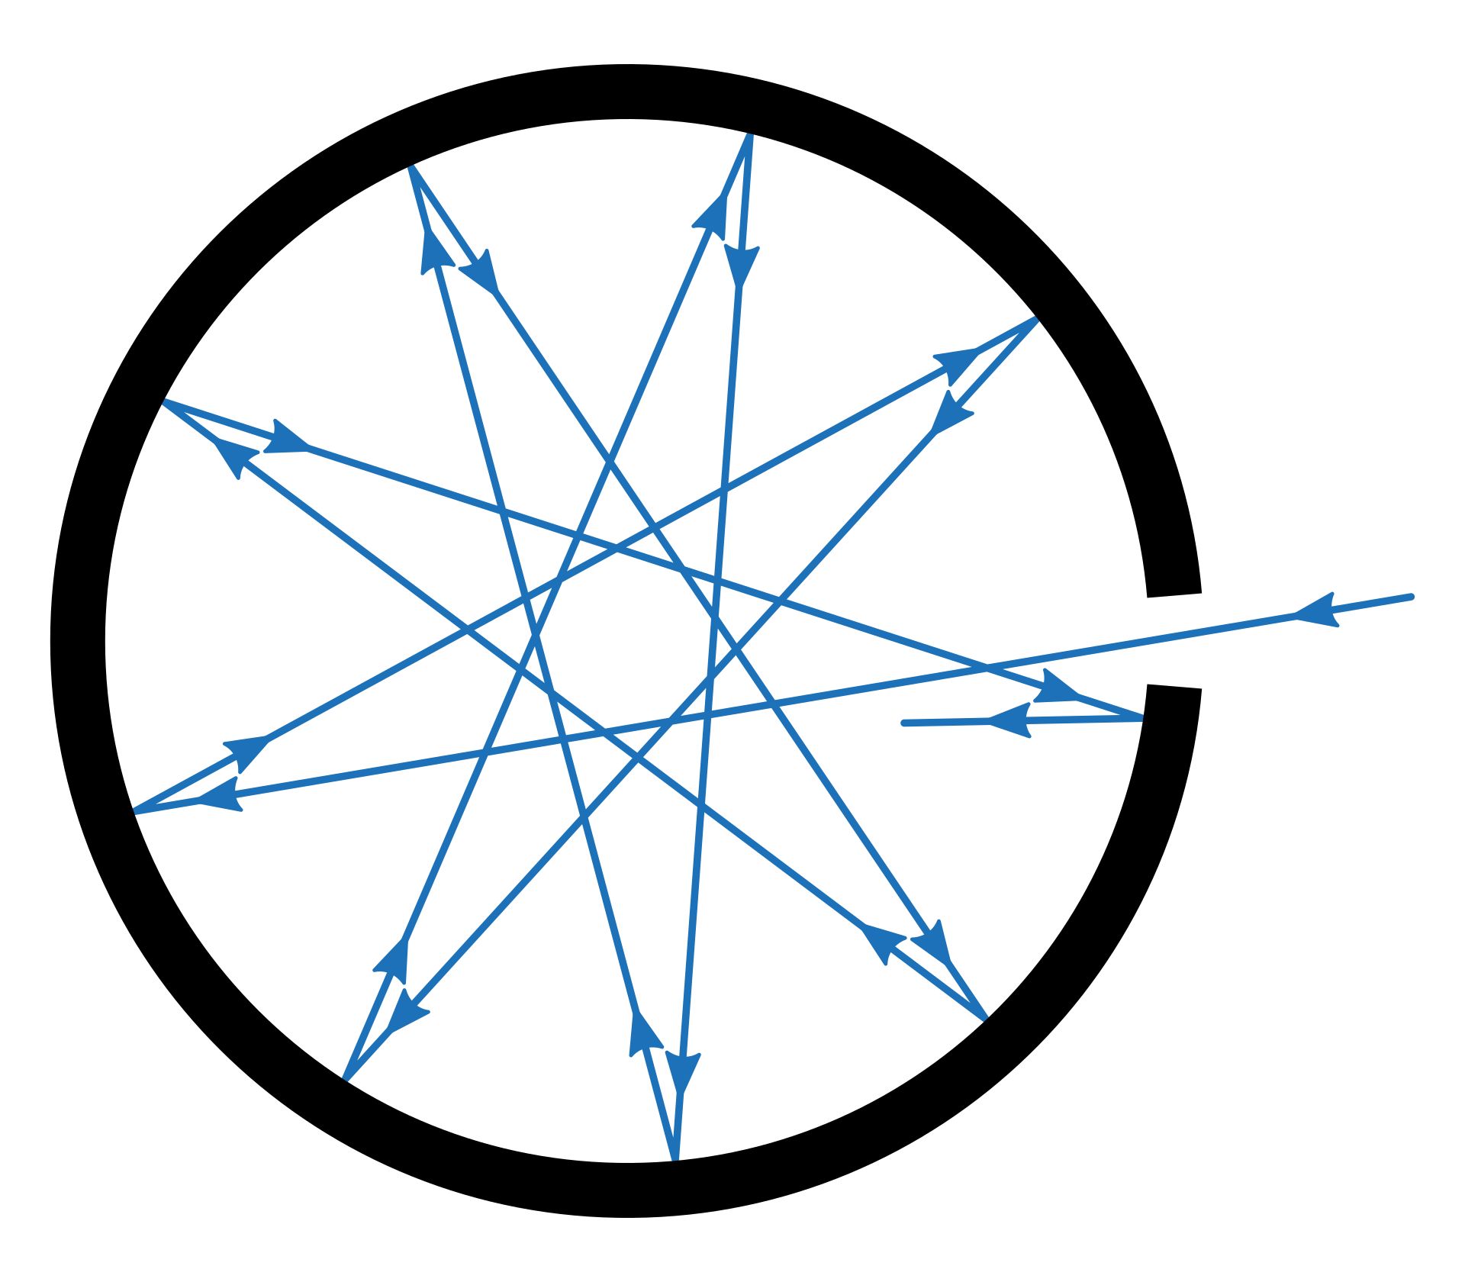
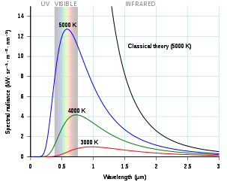
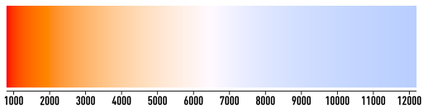
Black body radiation
Radiation emitted by all matter above 0 K due to thermal motion of elementary particles (e⁻, p⁺)
“Black body”: isolated system in thermal equilibrium
E = hf (Planck’s constant originated by quantizing changes in black body radiation as a function of f)
https://upload.wikimedia.org/wikipedia/commons/thumb/d/d8/Black_body_realization.svg/1920px-Black_body_realization.svg.png, https://upload.wikimedia.org/wikipedia/commons/thumb/e/e9/Color_temperature_black_body_800-12200K.svg/1024px-Color_temperature_black_body_800-12200K.svg.png, https://upload.wikimedia.org/wikipedia/commons/thumb/1/19/Black_body.svg/606px-Black_body.svg.png

Slide 12
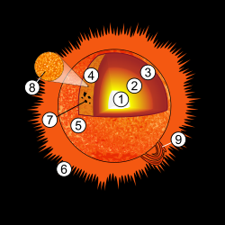
Black body radiation and the sun
EM radiation from the sun matches closest to black body radiation with T = ~5800K
EM radiation from sun is emitted from the photosphere (4 in diagram above), which has a T of ~5800k
https://upload.wikimedia.org/wikipedia/commons/thumb/7/76/Sun_diagram.svg/500px-Sun_diagram.svg.png , https://media.npr.org/assets/img/2020/04/17/gettyimages-102853378_custom-322a77f3aa92129f4a84f4d2dd98ac2ca1a078b8-s1100-c50.jpg, svg.png, https://upload.wikimedia.org/wikipedia/commons/thumb/e/e9/Color_temperature_black_body_800-12200K.svg/1024px-Color_temperature_black_body_800-12200K.svg.png

Slide 13
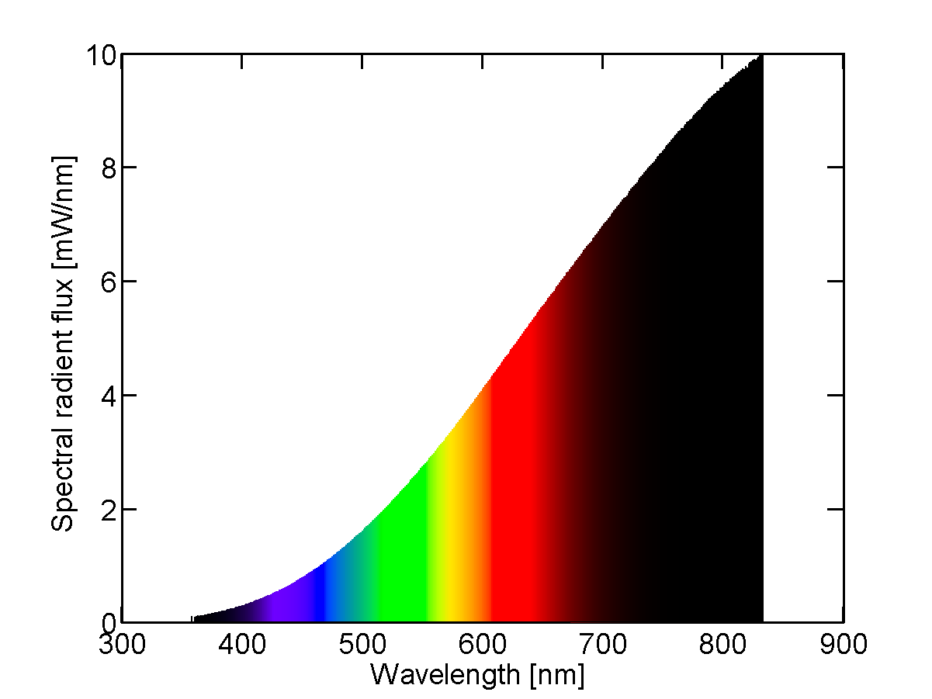
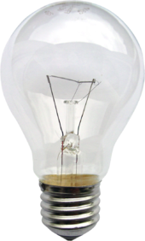
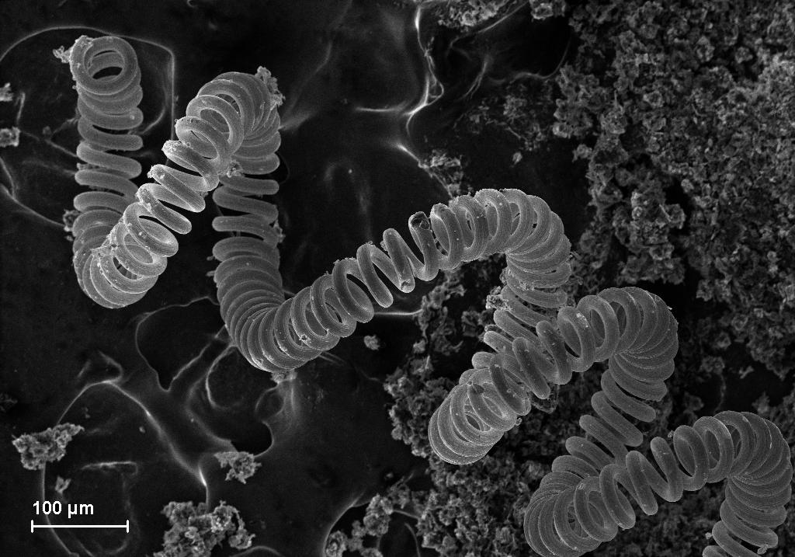
Incandescent lights
Electric current used to heat a filament -> thermal radiation
Inefficient: most energy lost as heat (5% goes to visible light)
https://upload.wikimedia.org/wikipedia/commons/thumb/b/b4/Gluehlampe_01_KMJ.png/340px-Gluehlampe_01_KMJ.png, https://upload.wikimedia.org/wikipedia/commons/1/17/Tungsten_filament.JPG, https://upload.wikimedia.org/wikipedia/commons/b/be/Spectral_power_distribution_of_a_25_W_incandescent_light_bulb.png

Slide 14
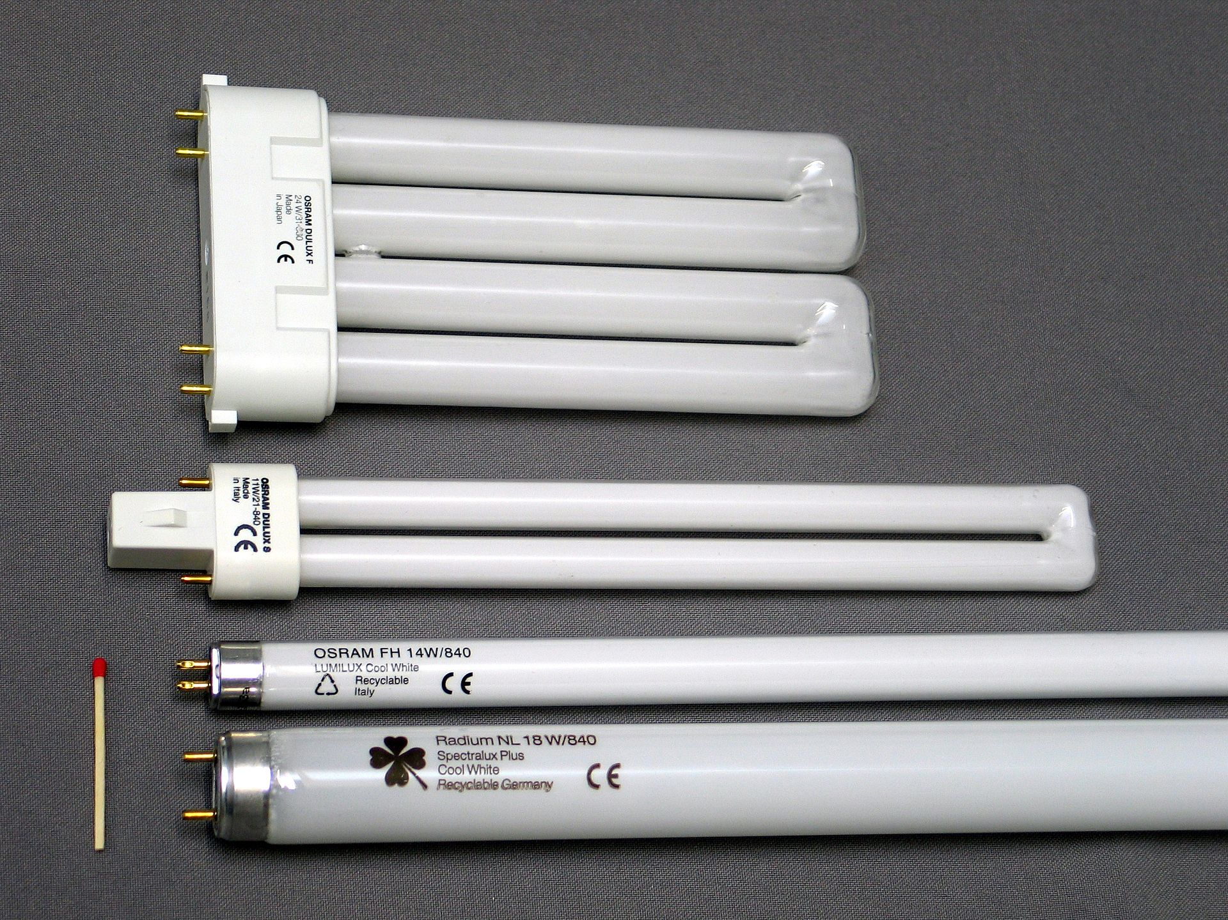
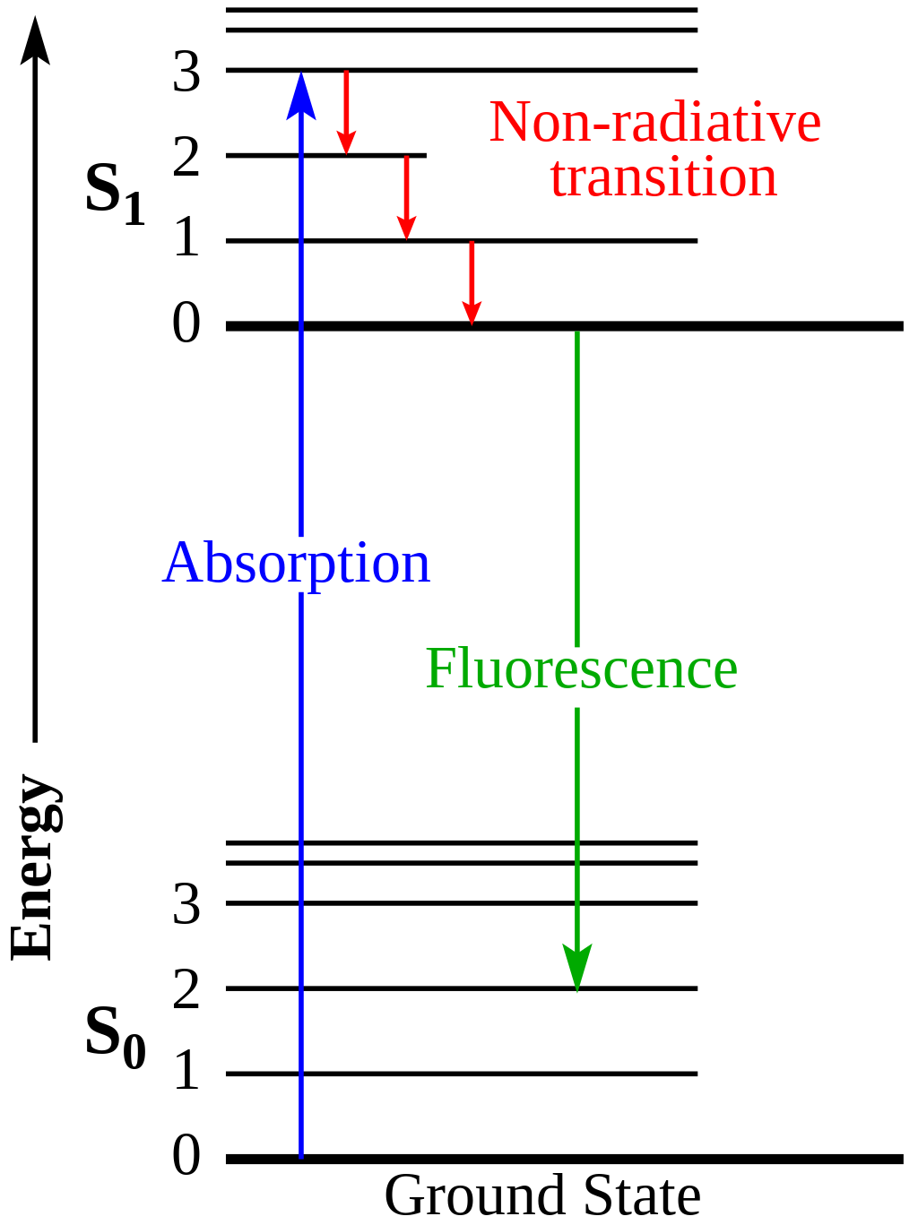
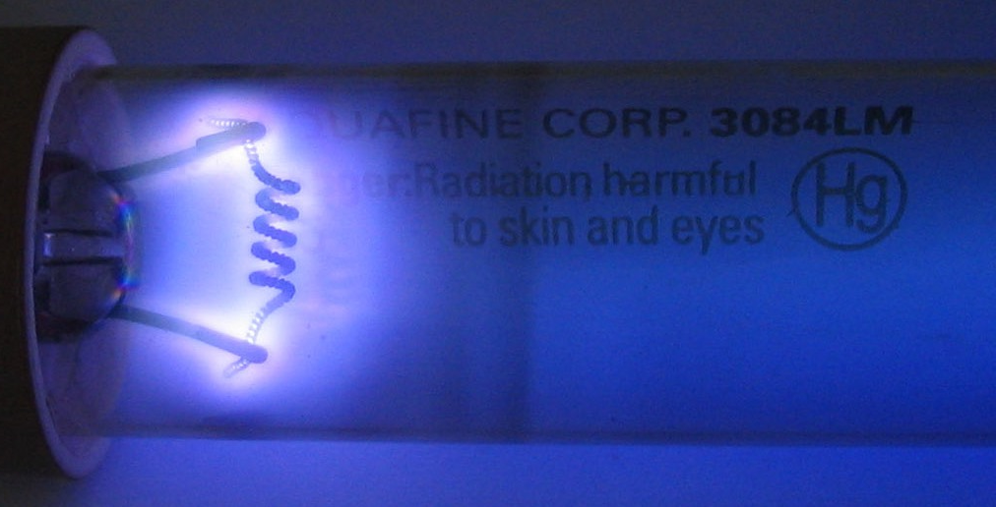
Fluorescent lights
Jablonski diagram
An ionized (ie, plasma) mix of Hg and inert gas sealed
Electrical discharge sent through bulb, electrons collide with Hg
Collisions -> UV photons -> collision with surface coating -> vis photons
https://upload.wikimedia.org/wikipedia/commons/thumb/5/5b/Leuchtstofflampen-chtaube050409.jpg/1920px-Leuchtstofflampen-chtaube050409.jpg, https://upload.wikimedia.org/wikipedia/commons/8/8e/Germicidal_UV_discharge_tube_glow.jpg https://upload.wikimedia.org/wikipedia/commons/thumb/5/53/Jablonski_Diagram_of_Fluorescence_Only-en.svg/1024px-Jablonski_Diagram_of_Fluorescence_Only-en.svg.png

Slide 15
What makes a good light source?
Brightness
Wavelength availability
Spectral bands
Dispersion
Collimation
Stability
Modulation/control
Lifetime
Cost
Engineering concerns (e.g. cooling, noise)
Safety
Durability

Slide 16
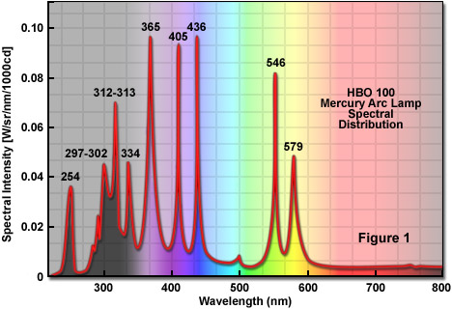
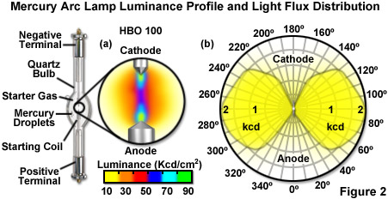
HBO “Burner” lamps
Specialized version of fluorescent lights using Hg
Useful bands of intensity for common fluorescent labels
Do not last super long; break easily
https://zeiss-campus.magnet.fsu.edu/articles/lightsources/images/mercurylampsfigure2.jpg, https://zeiss-campus.magnet.fsu.edu/articles/lightsources/images/mercurylampsfigure1.jpg

Slide 17
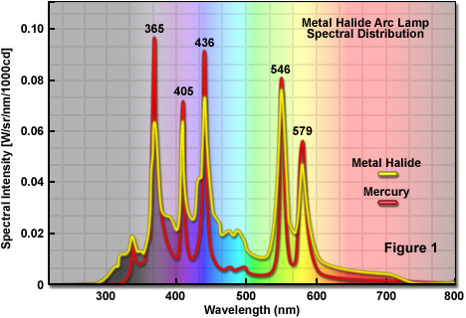
Metal halide lamps
Similar to HBO in mechanism of action
Better coverage of “dip” in blue/green part of spectrum
Longer lasting than HBO (have largely replaced)
https://zeiss-campus.magnet.fsu.edu/articles/lightsources/images/metalhalidelampsfigure1.jpg

Slide 18
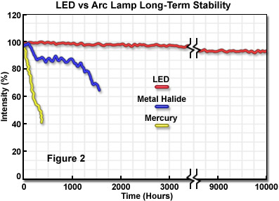
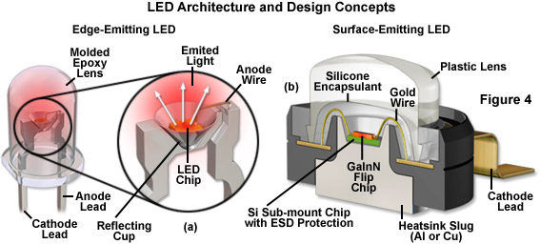
LEDs
Semi-conductor driven excitation/relaxation of e⁻ over defined ‘band gaps’
Possible to precisely tune 𝝀, generate high power
Single wavelength and white light options
Extremely durable. The new standard.
https://zeiss-campus.magnet.fsu.edu/articles/lightsources/images/ledsfigure4.jpg, https://zeiss-campus.magnet.fsu.edu/articles/lightsources/images/ledsfigure2.jpg

Slide 19
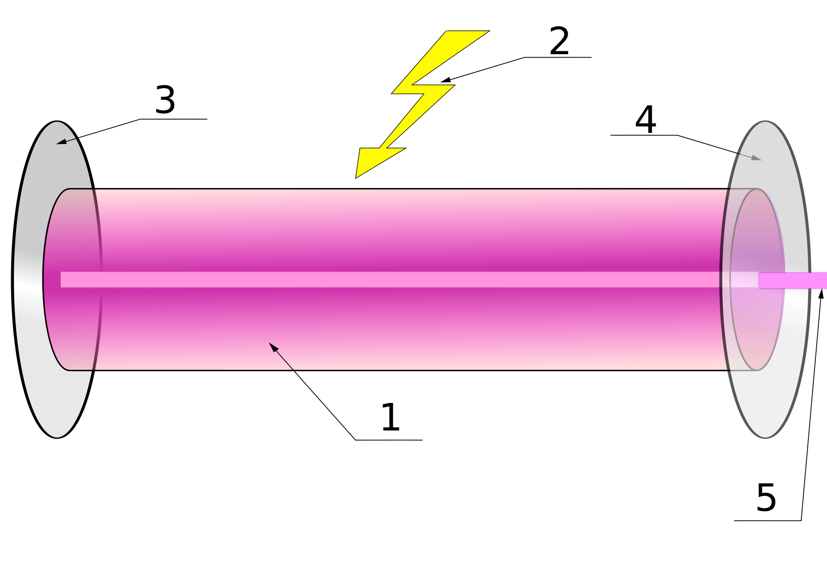
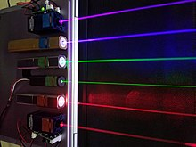
Lasers
LASER = “Light Amplification by Stimulated Emission of Radiation”
More accurately: LOSER / “Light Oscillation by Stimulated Emission of Radiation”
As name suggests, works via stimulated emission
https://en.wikipedia.org/wiki/File:Lasers.JPG, https://en.wikipedia.org/wiki/File:Laser.svg

Slide 20
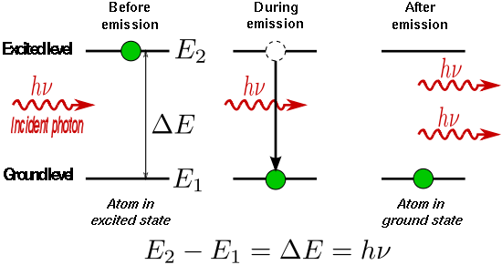
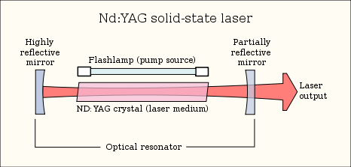
Stimulated Emission
Initial excitation events driven by spontaneous emission
Collisions between incident photons and excited gain medium lead to stimulated emission events
Stimulated emission -> monochromatic, coherent light
Very high powers, “clean” point sources can be generated
https://en.wikipedia.org/wiki/File:Stimulated_Emission.svg, https://upload.wikimedia.org/wikipedia/commons/thumb/9/92/Lasercons.svg/466px-Lasercons.svg.png

Slide 21
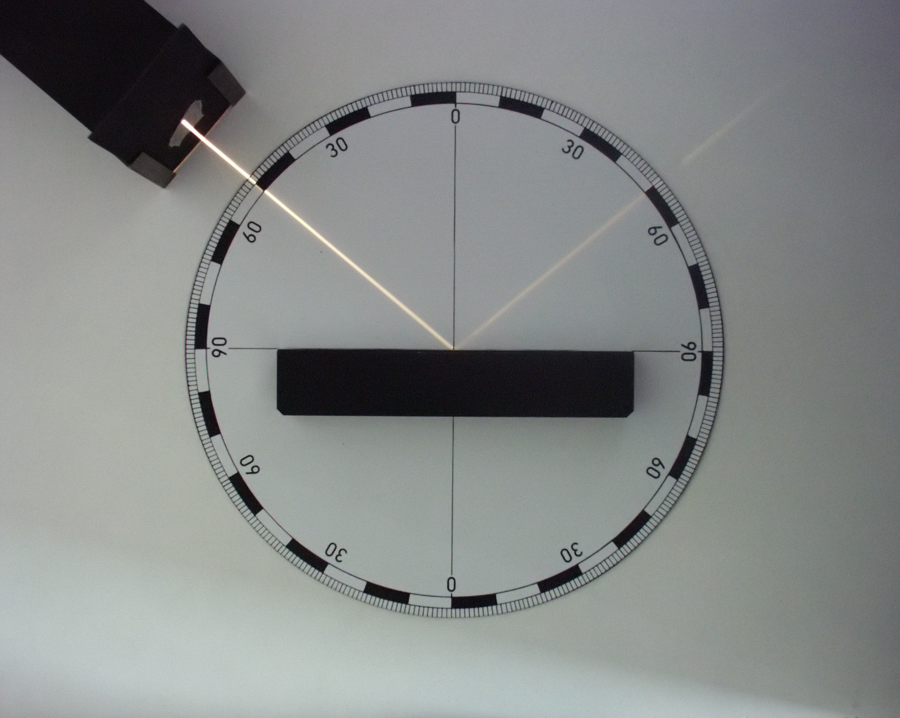
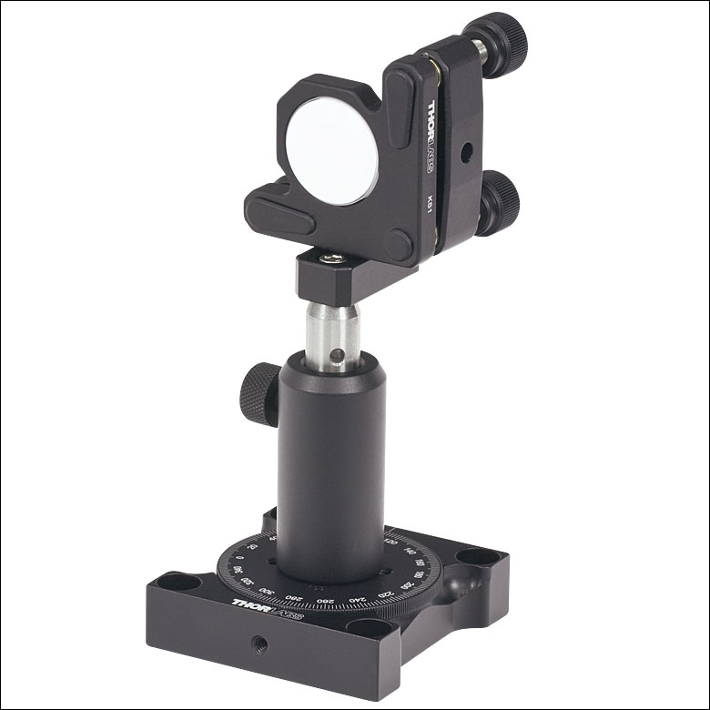
Properties of light: Reflection
Mirror
https://upload.wikimedia.org/wikipedia/commons/e/e3/F%C3%A9nyvisszaver%C5%91d%C3%A9s.jpg, https://www.thorlabs.com/images/TabImages/Variable_Centering_Plate_A1-150.jpg

Slide 22
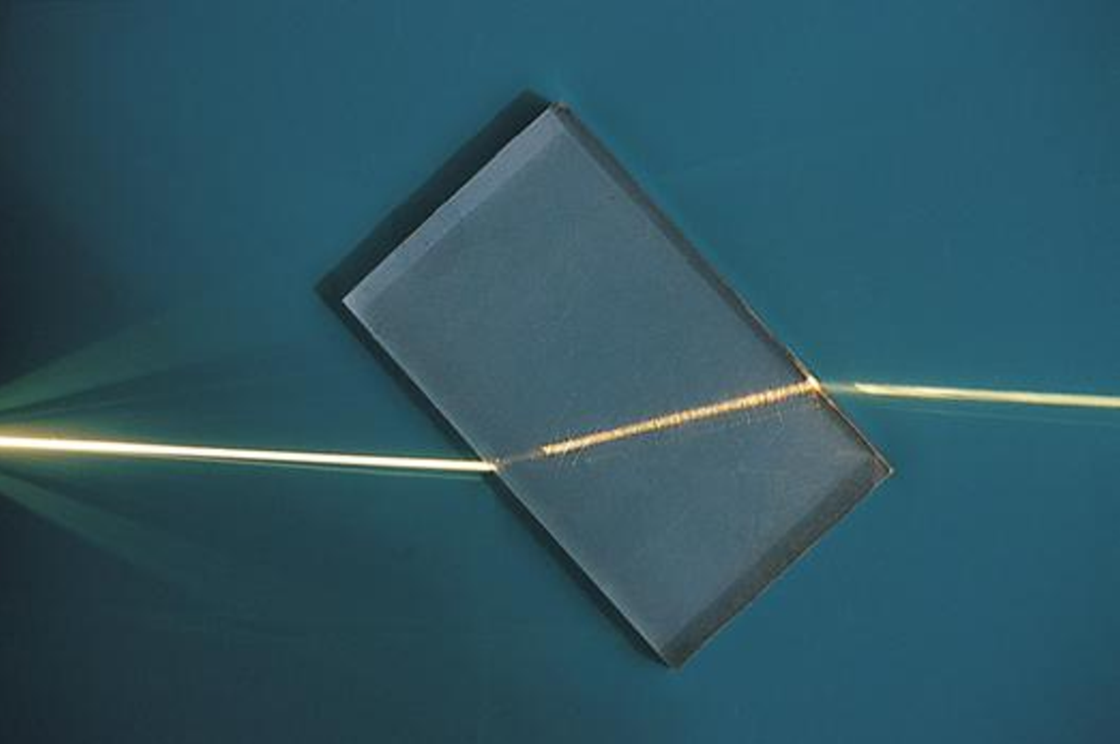
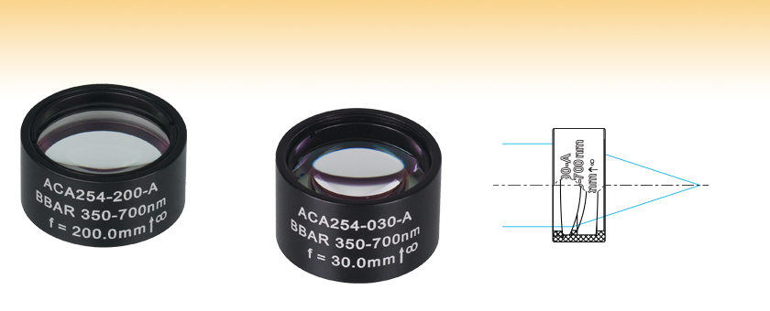
Properties of light: Refraction
Lenses
https://upload.wikimedia.org/wikipedia/commons/8/85/Refraction_photo.png,

Slide 23
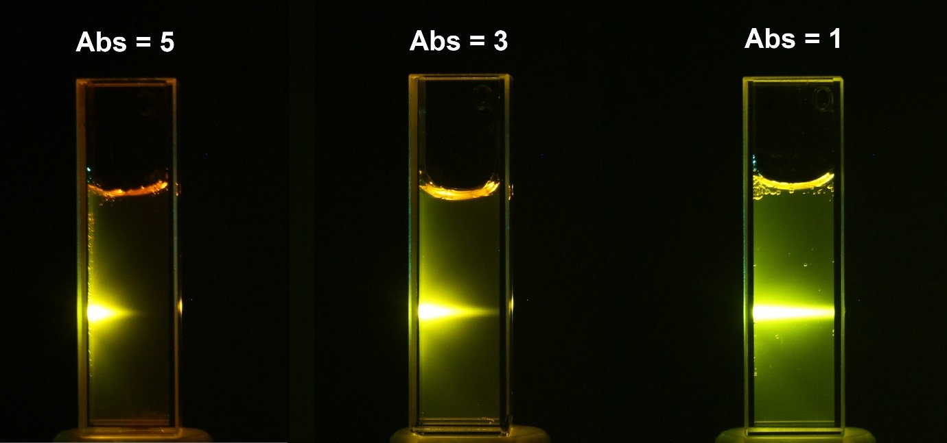
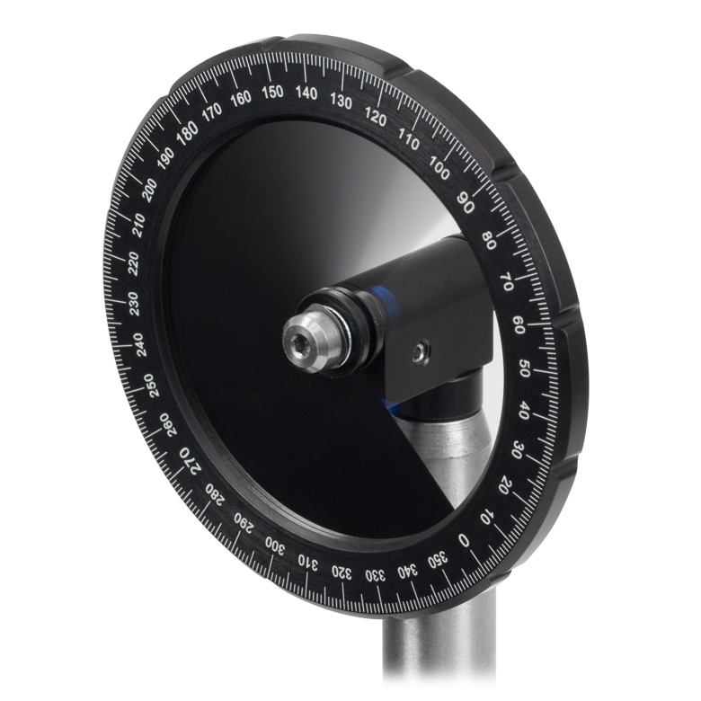
Properties of light: Absorption
Filters
https://www.edinst.com/wp-content/uploads/2019/08/BLL-2.jpg, https://www.thorlabs.com/images/TabImages/Variable_ND_Filter_A5-780.jpg

Slide 24
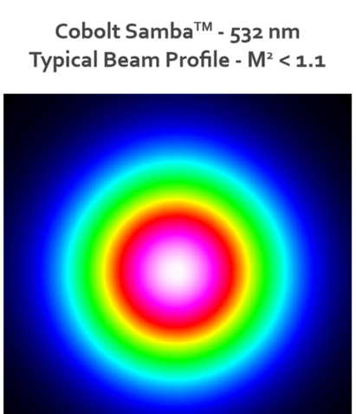
Challenge: Power density “consultants”
Your camera chip (white) and Gaussian laser beam profile are shown ->
Is this set-up ideal for quantitative imaging? Why or why not?
Given the assumptions below, calculate the power density of the cyan box in kW/cm^2. How does this compare to the intensity of the sun?
The central white + purple area is roughly uniform in intensity at 100 mW
The cyan box is 1024 x 1024 100 nm pixels
Devise an engineering solution to make the illumination intensity uniform over the white box
https://hubner-photonics.com/wp-content/uploads/2020/05/Performance-data-beam-profile-04-01-Series.png

Slide 25
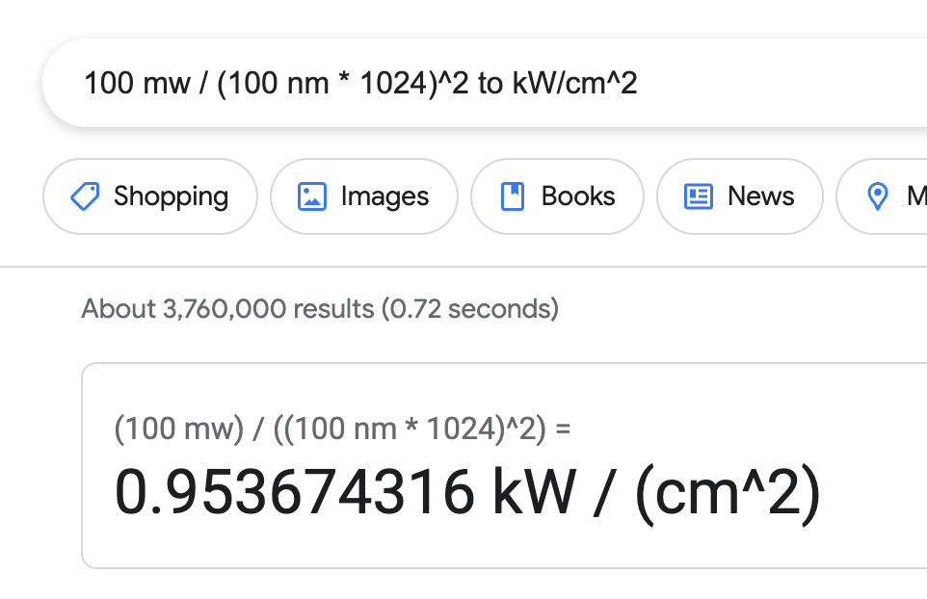
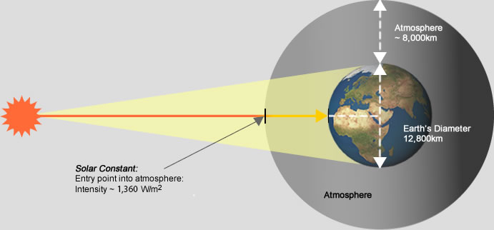
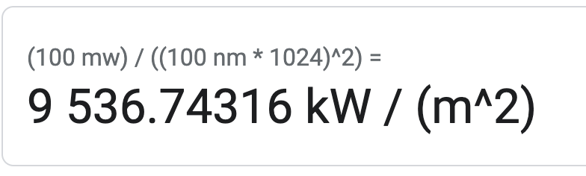
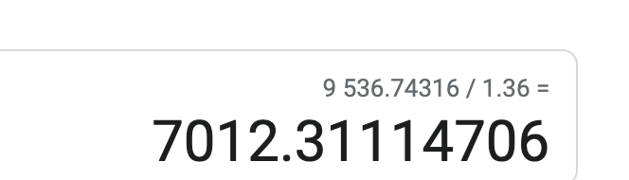
Challenge: Power density “consultants”
~1 kW/m^2 at surface
https://hubner-photonics.com/wp-content/uploads/2020/05/Performance-data-beam-profile-04-01-Series.png

