Slide 1
Objectives and PSFs
Genome 575: Fundamentals of Biomedical Instrumentation
Brian Beliveau

Slide 2
Recap from last time
Commonly used sensors are (EM)CCD and sCMOS cameras and Photomultipler tubes (PMTs)
Optical sensors use the photoelectric effect to convert incident photons into electrons
Conversion of photoelectrons to digital information occurs via an analog-digital converter (ADC)
Tradeoffs center around dynamic range and sensitivity

Slide 3
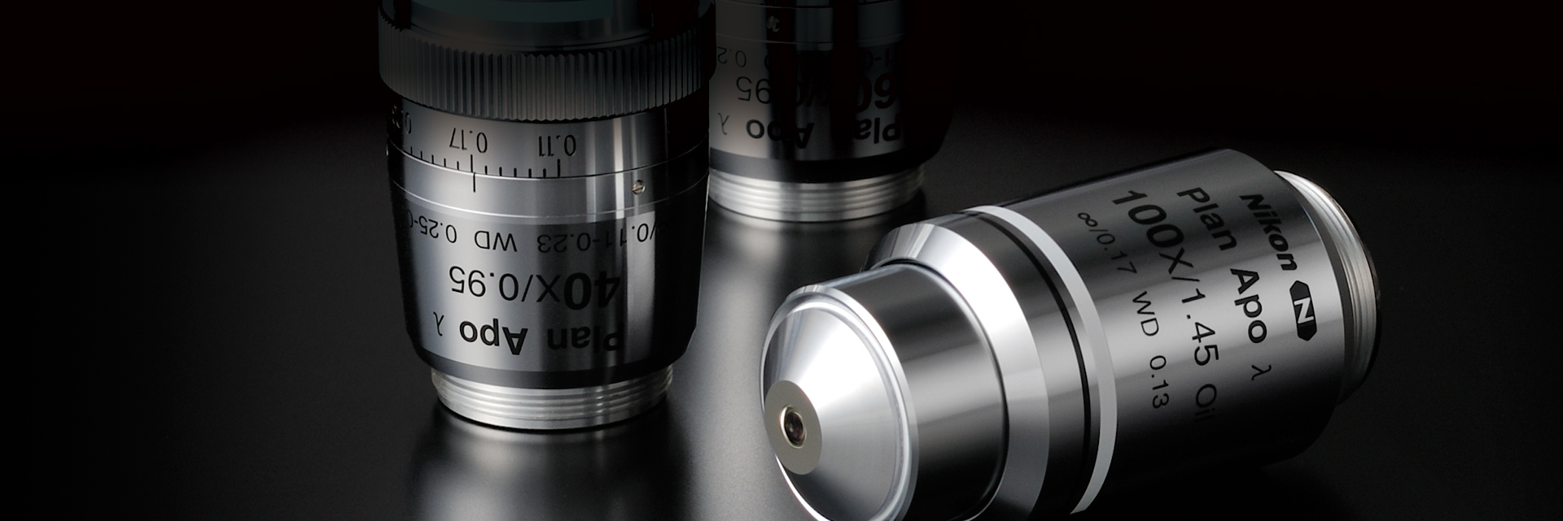
Objective lenses
https://www.microscope.healthcare.nikon.com/images/mastheads/Imaging-Centers/objective-selector_1920d.jpg

Slide 4
What factors impact objective lens choice? (5 mins)
https://www.microscope.healthcare.nikon.com/images/mastheads/Imaging-Centers/objective-selector_1920d.jpg

Slide 5
What factors impact objective lens choice?
Magnification
Immersion media
Geometry (eg, dipping?)
Working distance
Aberration correction
Correction collars
N.A.
Cost
Compatibility
Transmission/collection 𝝀

Slide 6
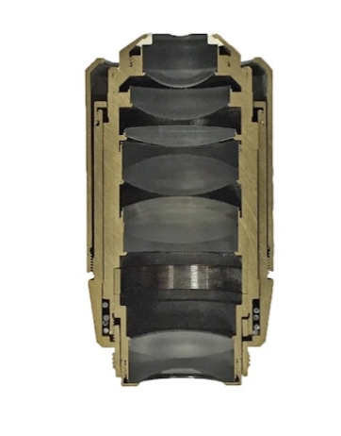
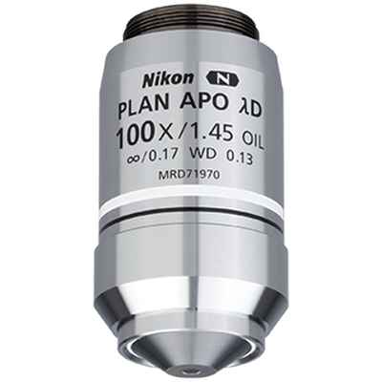
Objective lenses
https://d33b8x22mym97j.cloudfront.net/production/imager/productphotos/Objectives/177867/cfi-plan-apo-lambda-d-100x-oil_12689bef50ba806ed3bb0881891e8655.jpg, https://www.pinterest.com/pin/227642956134450167/

Slide 7
Deciphering the objective code
https://d33b8x22mym97j.cloudfront.net/production/imager/productphotos/Objectives/177867/cfi-plan-apo-lambda-d-100x-oil_12689bef50ba806ed3bb0881891e8655.jpg

Slide 8
Objective lenses: magnification
Determined by focal lengths of internal lenses
1x -> 150x or more
Typical: 4x, 10x, 20x, 40x, 60/63x, 100x
Magnification ≠ Resolution!
https://d33b8x22mym97j.cloudfront.net/production/imager/productphotos/Objectives/177867/cfi-plan-apo-lambda-d-100x-oil_12689bef50ba806ed3bb0881891e8655.jpg

Slide 9
Objective lenses: corrections
Achieved by internal elements
Plan Apo = planar correction, chromatic correction (achromatic), spherical correction
Cheaper objectives correct for fewer than 3 and/or correct less well
https://d33b8x22mym97j.cloudfront.net/production/imager/productphotos/Objectives/177867/cfi-plan-apo-lambda-d-100x-oil_12689bef50ba806ed3bb0881891e8655.jpg

Slide 10
Objective lenses: immersion
Immersion choice influences light collection ability (N.A.)
Typical: air, water, glycerol, silicone, oil, oil++
Costs/benefits to consider
Dry objectives easiest to work with, lowest N.A.
Water/Oil hardest to work with, highest N.A.
https://d33b8x22mym97j.cloudfront.net/production/imager/productphotos/Objectives/177867/cfi-plan-apo-lambda-d-100x-oil_12689bef50ba806ed3bb0881891e8655.jpg

Slide 11
Objective lenses: N.A.
N.A. = numerical aperture
N.A. describes light collection ability of objective
N.A. effectively determines resolution (higher N.A. = better resolution)
Abbe formula
d = 𝝀 / 2 * N.A.
For 520 nm: d = 520 / (2 * 1.45) = ~180 nm
https://d33b8x22mym97j.cloudfront.net/production/imager/productphotos/Objectives/177867/cfi-plan-apo-lambda-d-100x-oil_12689bef50ba806ed3bb0881891e8655.jpg

Slide 12
Objective lenses: working distance
Typically a function of immersion/N/A.
~100 µm to mm+
Important to consider for volumetric imaging
https://d33b8x22mym97j.cloudfront.net/production/imager/productphotos/Objectives/177867/cfi-plan-apo-lambda-d-100x-oil_12689bef50ba806ed3bb0881891e8655.jpg

Slide 13
Objective lenses: optical path length
Was finite in older systems, depended on manufacturer
Modern microscopes are “infinity corrected”
Collected light is collimated, converges at infinity
Allows placement of internal optics without introducing aberration
https://d33b8x22mym97j.cloudfront.net/production/imager/productphotos/Objectives/177867/cfi-plan-apo-lambda-d-100x-oil_12689bef50ba806ed3bb0881891e8655.jpg

Slide 14
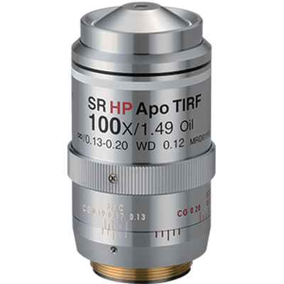
Objective lenses: coverslip thickness
Typically 0.17 mm (#1.5)
#1 = thinner (0.15 mm)
#2 = thicker (0.22 mm)
Coverslips have a “tolerance” of thicknesses (eg 0.16–0.19 mm for #1.5)
“High tolerance” glass = less deviation
Purpose of correction collar
https://d33b8x22mym97j.cloudfront.net/production/imager/productphotos/Objectives/177867/cfi-plan-apo-lambda-d-100x-oil_12689bef50ba806ed3bb0881891e8655.jpg

Slide 15
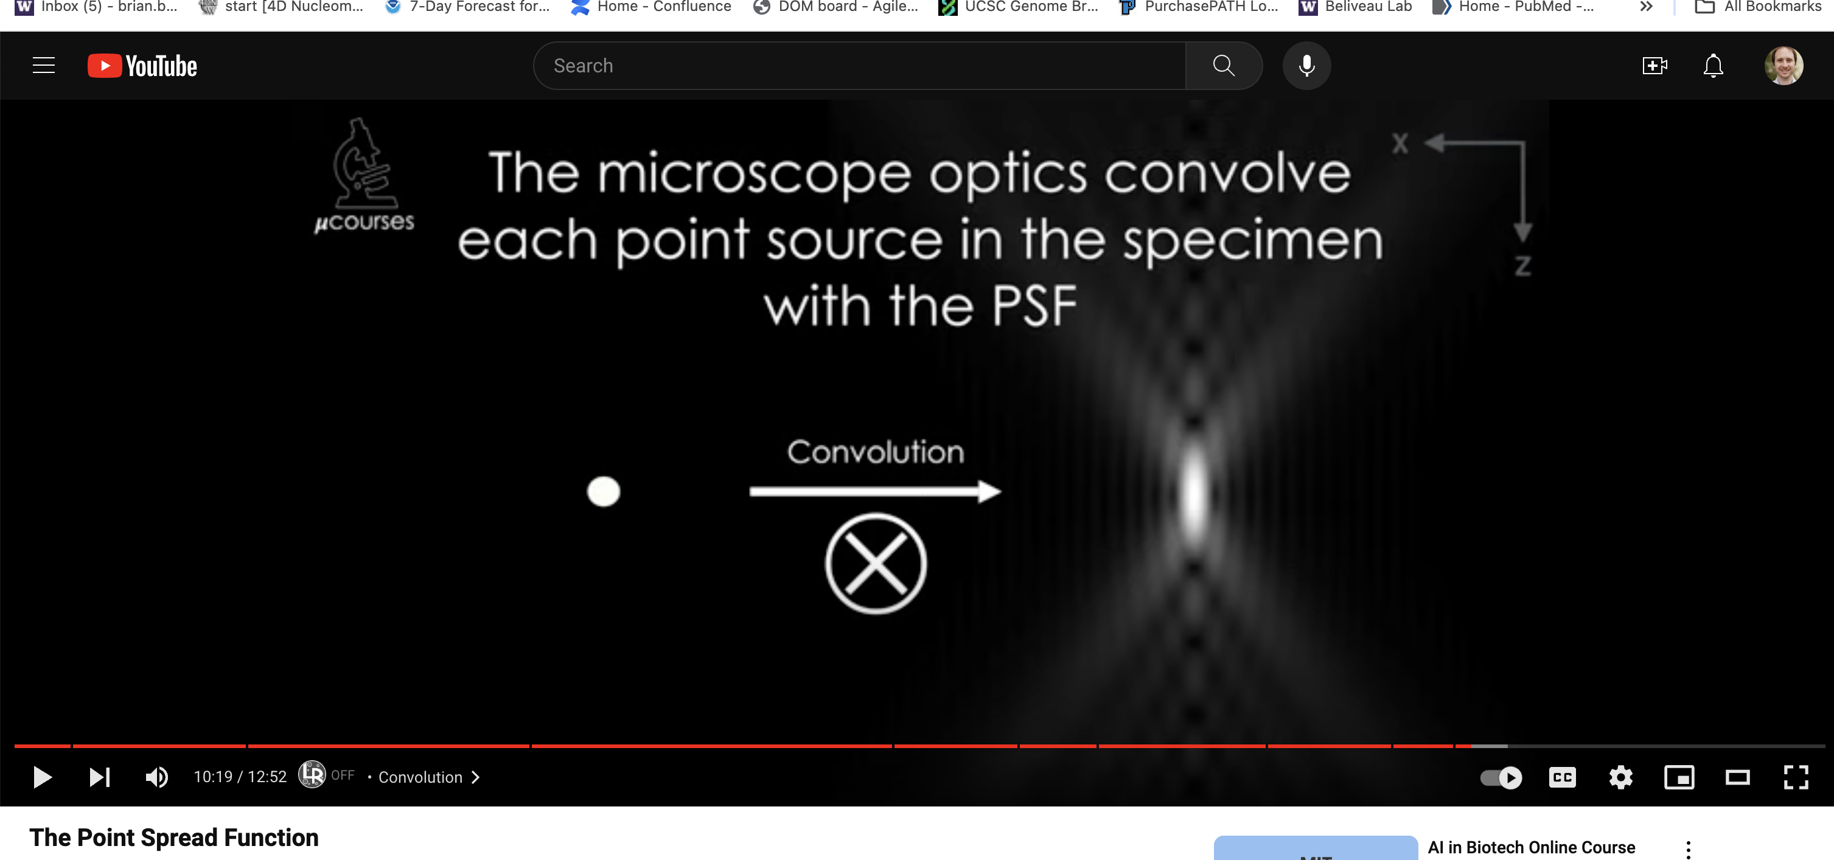
µCourse video on PSFs
https://www.youtube.com/watch?v=Tkc_GOCjx7E

Slide 16
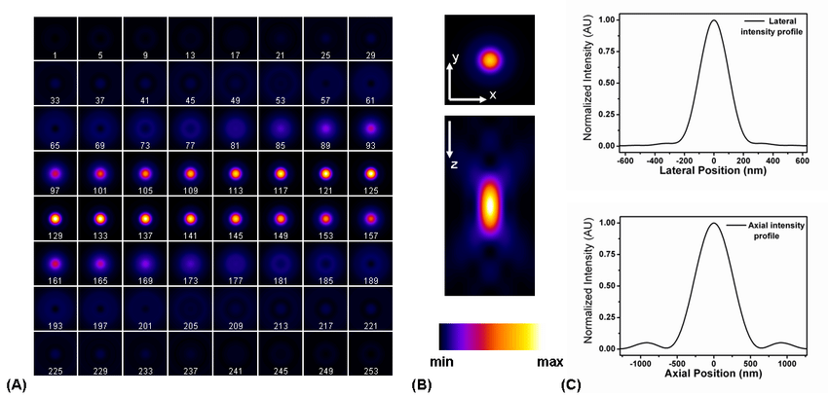
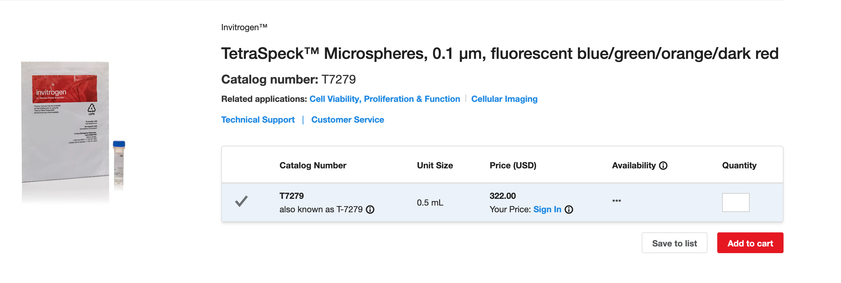
How do we QC an objective?
https://www.google.com/url?sa=i&url=https%3A%2F%2Fwww.researchgate.net%2Ffigure%2FPoint-spread-function-of-a-wide-field-microscope-Different-representations-can-be-used_fig4_288823823&psig=AOvVaw0vynZnpQVxZadEFd3C2EHt&ust=1651597254907000&source=images&cd=vfe&ved=0CAwQjRxqFwoTCJC-vrGlwfcCFQAAAAAdAAAAABAD, https://www.thermofisher.com/order/catalog/product/T7279?ef_id=CjwKCAjwgr6TBhAGEiwA3aVuIUnKf56Ublkjpd5MONdtz-dR4jxdMs97Nz2LJB-4qaZZJjN8RApQihoCKU0QAvD_BwE:G:s&s_kwcid=AL!3652!3!205117794361!!!g!!&cid=bid_pca_ift_r01_co_cp1359_pjt0000_bid00000_0se_gaw_dy_pur_con&gclid=CjwKCAjwgr6TBhAGEiwA3aVuIUnKf56Ublkjpd5MONdtz-dR4jxdMs97Nz2LJB-4qaZZJjN8RApQihoCKU0QAvD_BwE

Slide 17
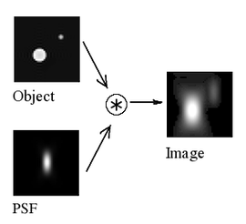
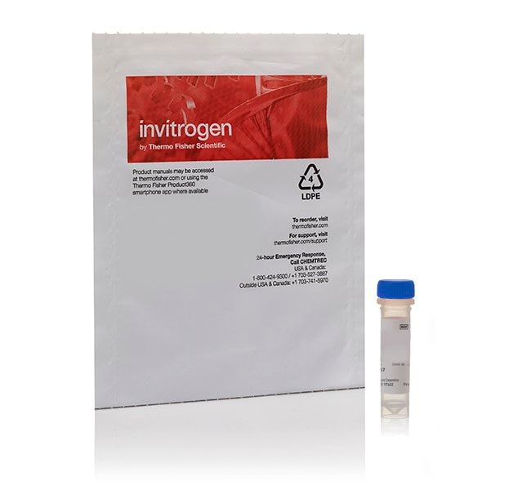
Point Spread Functions (PSFs)
Microscopy images are a convolution of real light sources with the PSF of the optical system
PSFs are governed by diffraction
PSFs let us compare performance to theory, across t
https://upload.wikimedia.org/wikipedia/commons/thumb/c/c2/Convolution_Illustrated_eng.png/270px-Convolution_Illustrated_eng.png, https://assets.thermofisher.com/TFS-Assets/BID/product-images/bender_bag_with_one_blue_vial.jpg-650.jpg

Slide 18
PSFs and 3D imaging
Microscopy systems are anisotropic (XY ≠ Z)
Lateral (XY): d = 𝝀 / 2 * N.A
Axial (Z): d = 2𝝀 / N.A²
For N.A. 1.45, 520 nm:
d_{XY} = ~180 nm
d_{Z} = ~495 nm
Resolution also impacted by aberration (eg, depth)
https://www.google.com/url?sa=i&url=https%3A%2F%2Fwww.researchgate.net%2Ffigure%2FPoint-spread-function-of-a-wide-field-microscope-Different-representations-can-be-used_fig4_288823823&psig=AOvVaw0vynZnpQVxZadEFd3C2EHt&ust=1651597254907000&source=images&cd=vfe&ved=0CAwQjRxqFwoTCJC-vrGlwfcCFQAAAAAdAAAAABAD

Slide 19
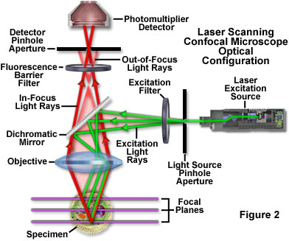
Confocal 101
Pinhole used to block out of focus light
Pinhole size matched to “Airy disc” (XY PSF)
Confocality = having the same focus
https://static3.olympus-lifescience.com/data/olympusmicro/primer/techniques/confocal/images/confocalintrofigure2.jpg?rev=39B2

Slide 20
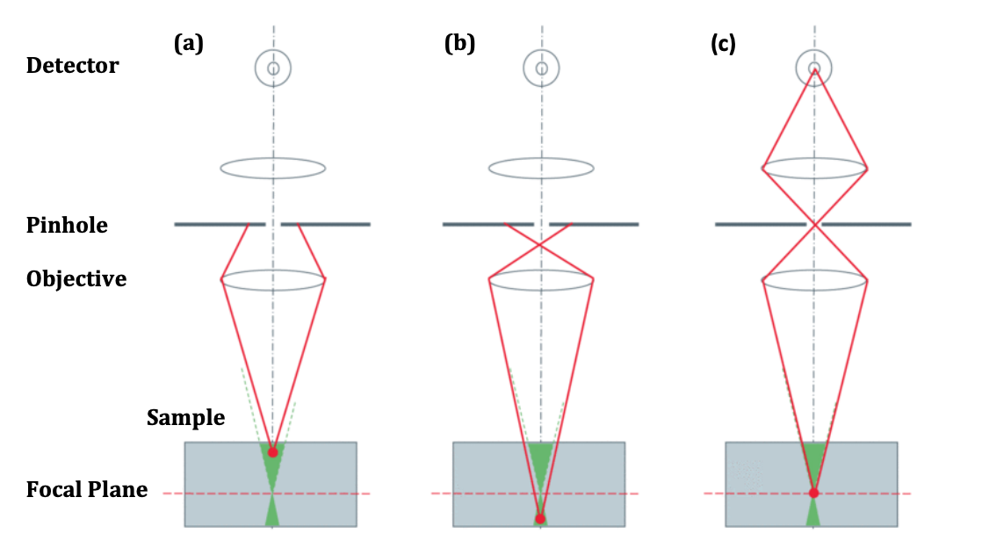
Selecting confocal light
https://www.photometrics.com/wp-content/uploads/2019/10/Spinning-Disk-Confocal-Microscopy-AppNote.pdf, pg 2

Slide 21
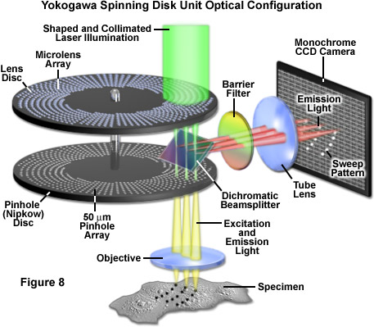
Spinning disc confocal
An array of pinholes on a disc is rotated at high speed
A second microlens disc can increase excitation efficiency
Allows the use of an EMCCD/sCMOS
Much faster, more sensitive, gentler
Pinhole size fixed
https://www.google.com/url?sa=i&url=https%3A%2F%2Fzeiss-campus.magnet.fsu.edu%2Farticles%2Fspinningdisk%2Fintroduction.html&psig=AOvVaw1HYx6BR1qmLhVcactLqzLd&ust=1651598362705000&source=images&cd=vfe&ved=0CAwQjRxqFwoTCIDTwMOpwfcCFQAAAAAdAAAAABAD

Slide 22
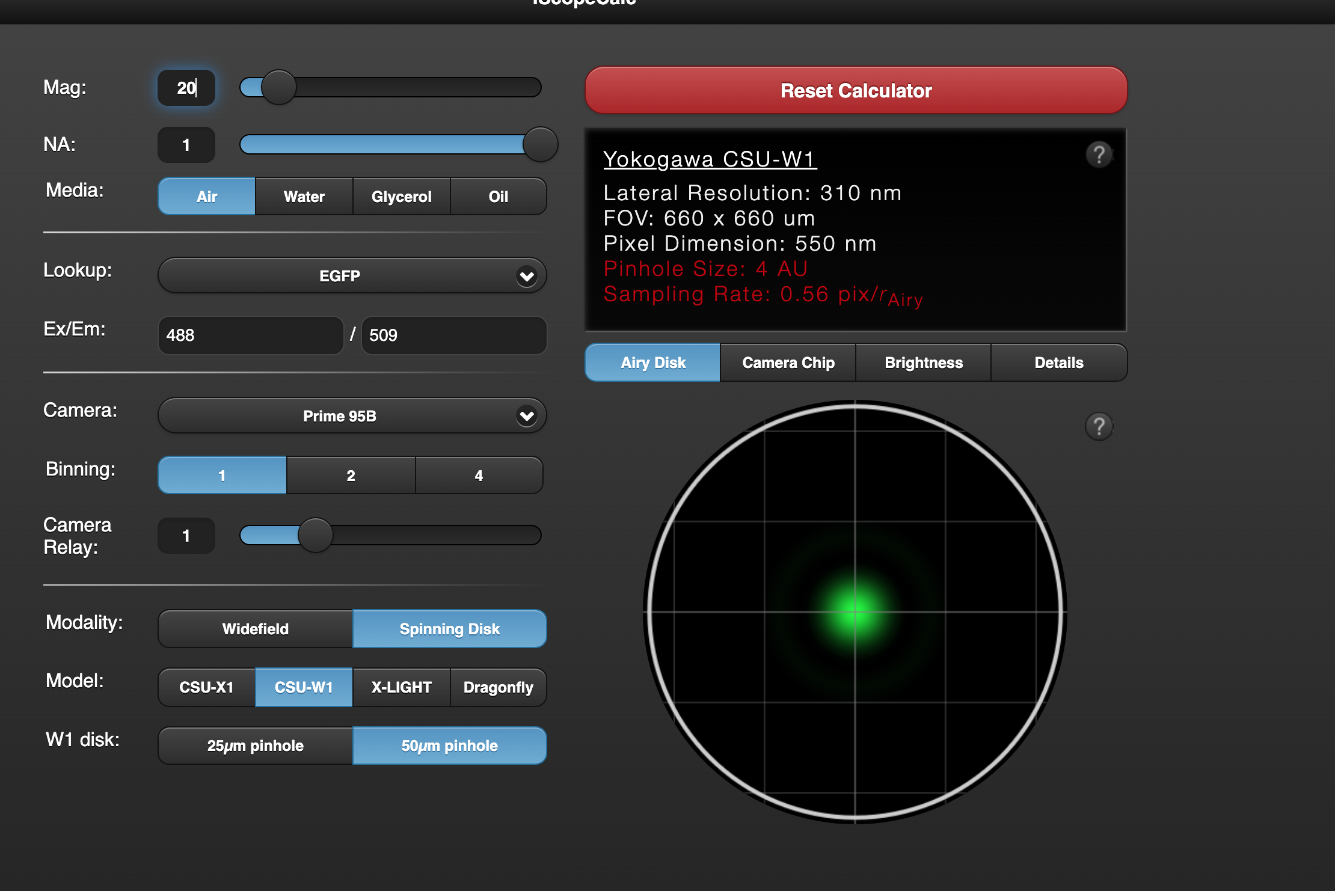
Challenge 1: Which objective?
Go to iscopecalc.com, start with these options:
Which objective do we use of the following?
1: 60x N.A. 1.45 oil 2: 60x N.A. 1.27 water 3: 100x N.A. 1.49 oil
http://www.iscopecalc.com/

Slide 23
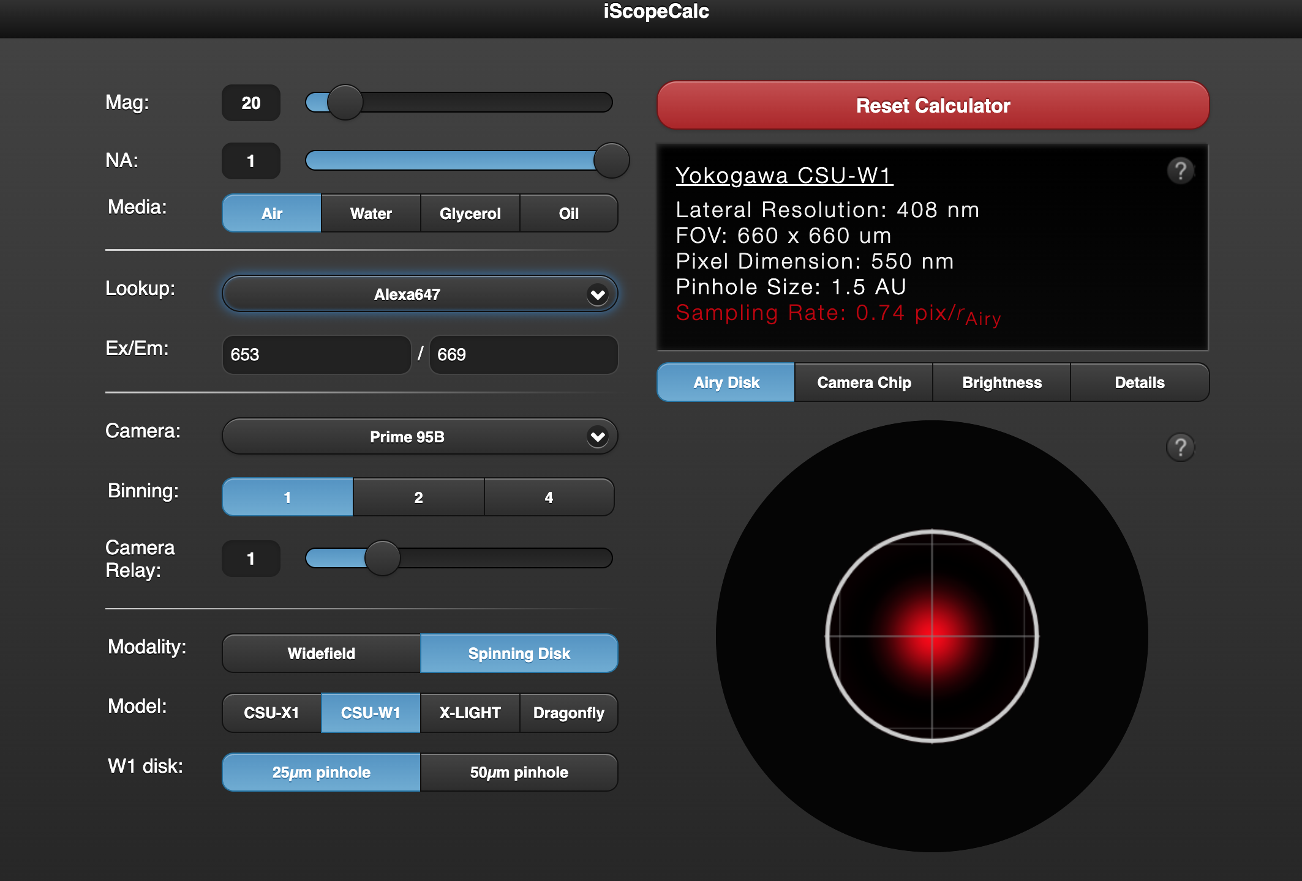
Challenge 2: Which objective?
Go to iscopecalc.com, start with these options:
Which objective do we use of the following?
1: 60x N.A. 1.45 oil 2: 40x N.A. 1.2 water 3: 100x N.A. 1.49 oil
http://www.iscopecalc.com/

Slide 24
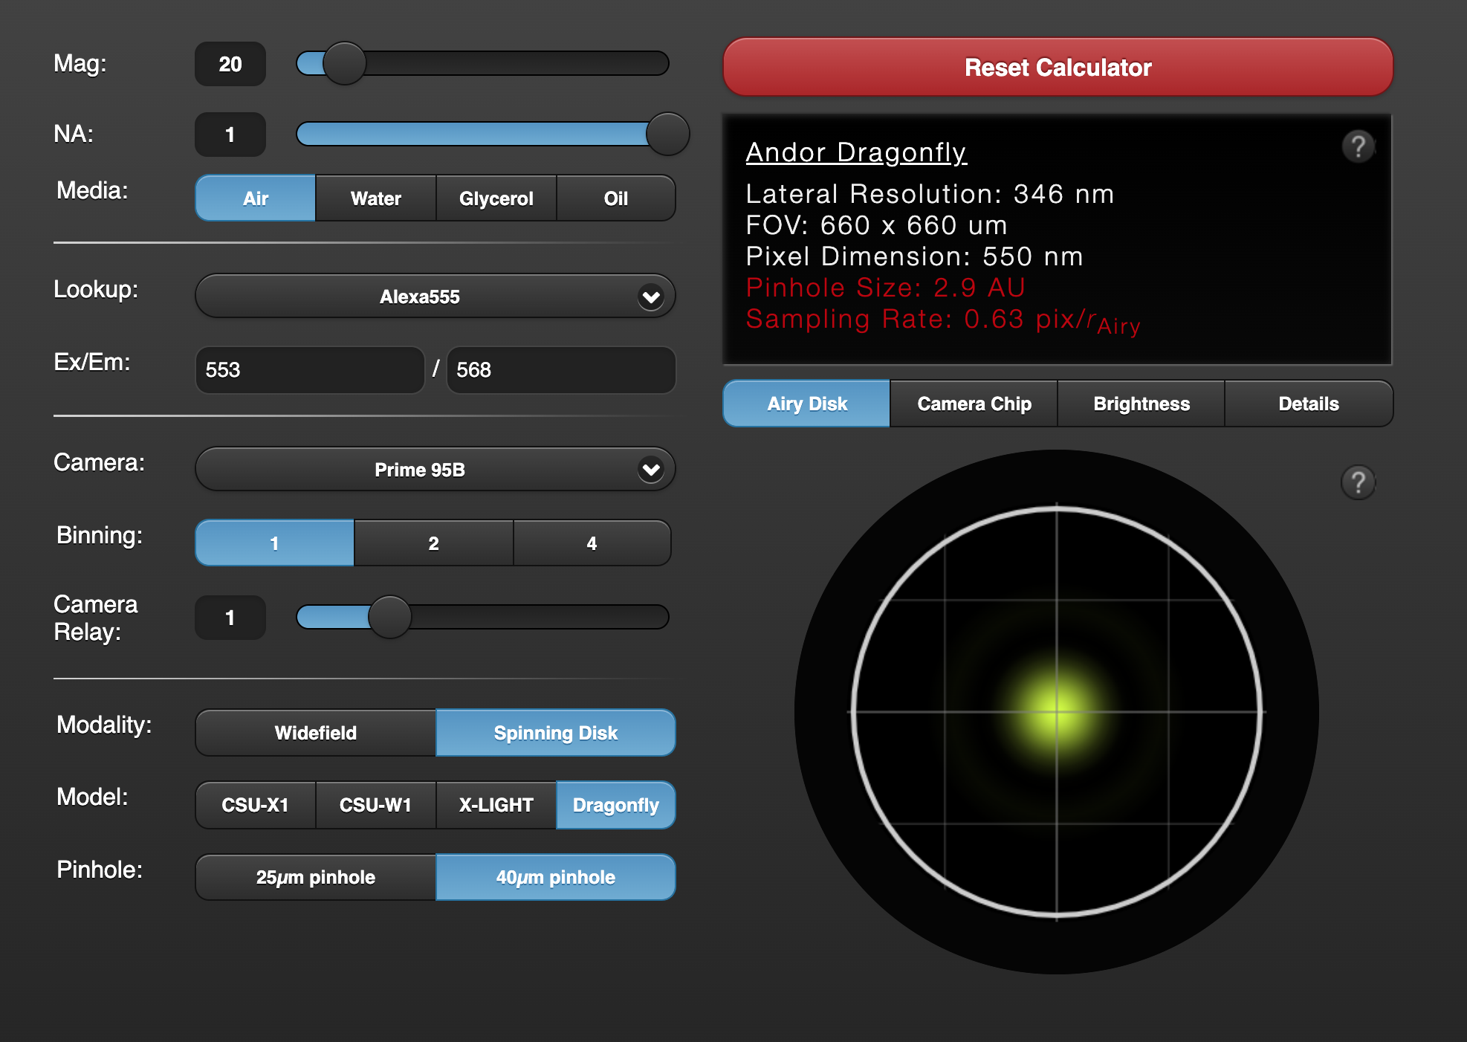
Challenge 3: Which objective?
Go to iscopecalc.com, start with these options:
Identify the ideal objective using the iscopecalc sliders
Go to https://www.microscope.healthcare.nikon.com/products/optics/selector and pick out the best fit you can find
http://www.iscopecalc.com/

