Slide 1
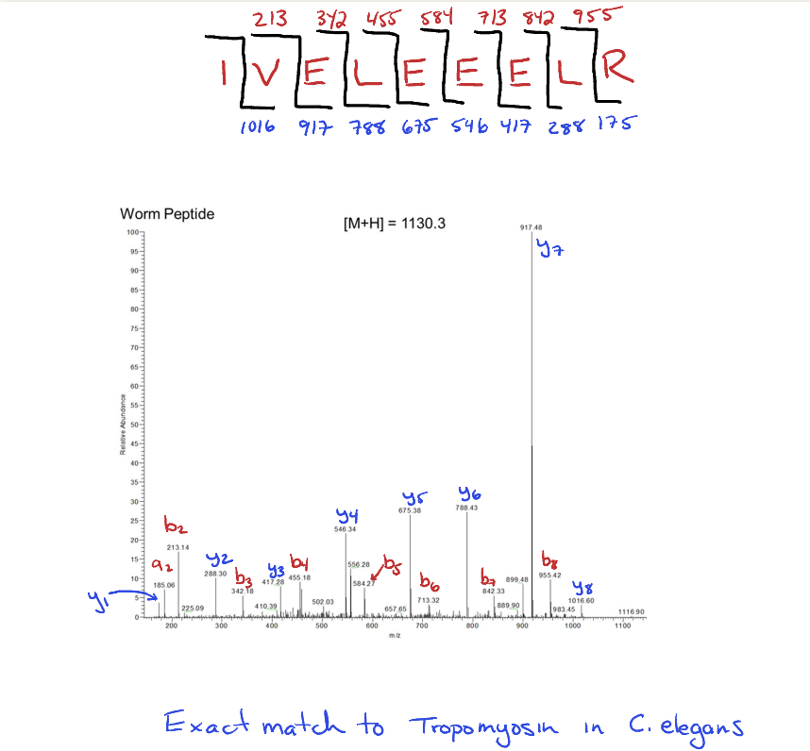

Slide 2
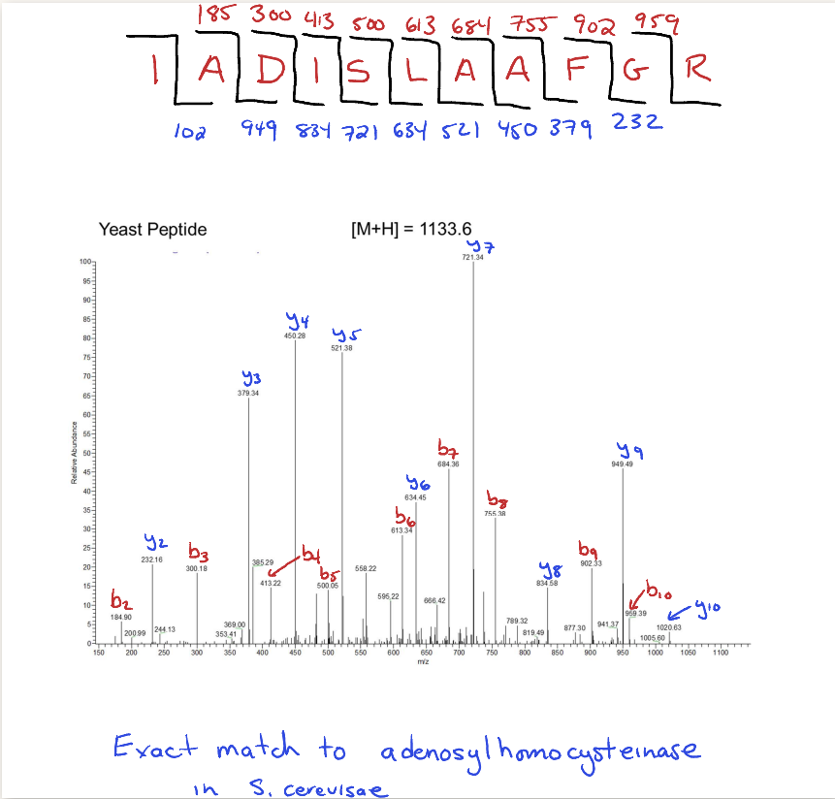

Slide 3
Bottom-Up Proteomics
Protein Mixture
MS/MS
1
2
3
3
proteolysis
2
µLC
MS
1
Peptide Mixture

Slide 4
Data Dependent Acquisition (DDA)
Mass Spectrum
1
2
3
Tandem Mass Spectra of Peptides
~1 Second per cycle
Acquire mass spectrum
Select peptides for tandem mass spectrometry
Selectively isolate and fragment peptides.
Repeat for 3 different peptides

Slide 5
Automated Interpretation of MS/MS Spectra
MS/MS Spectrum
Cross Correlation (Sequest)
Theoretical MS/MS Spectra
Search Database for Precursor Mass
HTTLDEM
DTTEMIH
TMETIDH
Automated
Sequence and
Modification Identification
Eng et al. JASMS, 5, 976 (1994)

Slide 6
Why Use Mass Spectrometry to Measure Proteins?
Problems with clinical immunoassays
Single-plex
Poor standardization
Hook effect
Autoantibodies
Hoofnagle and Wener, J Immunol Methods (2009)

Slide 7
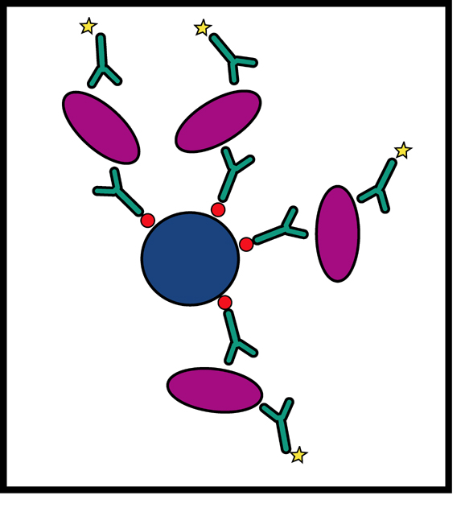
Traditional Automated Immunoassays
Capture antibody selects sandwiches detected by enzyme-conjugated secondary Generally, one at a time

Slide 8
Can We Multiplex Immunoassays?
Y
Y
Y
Y
Y
Y
vs.

Slide 9
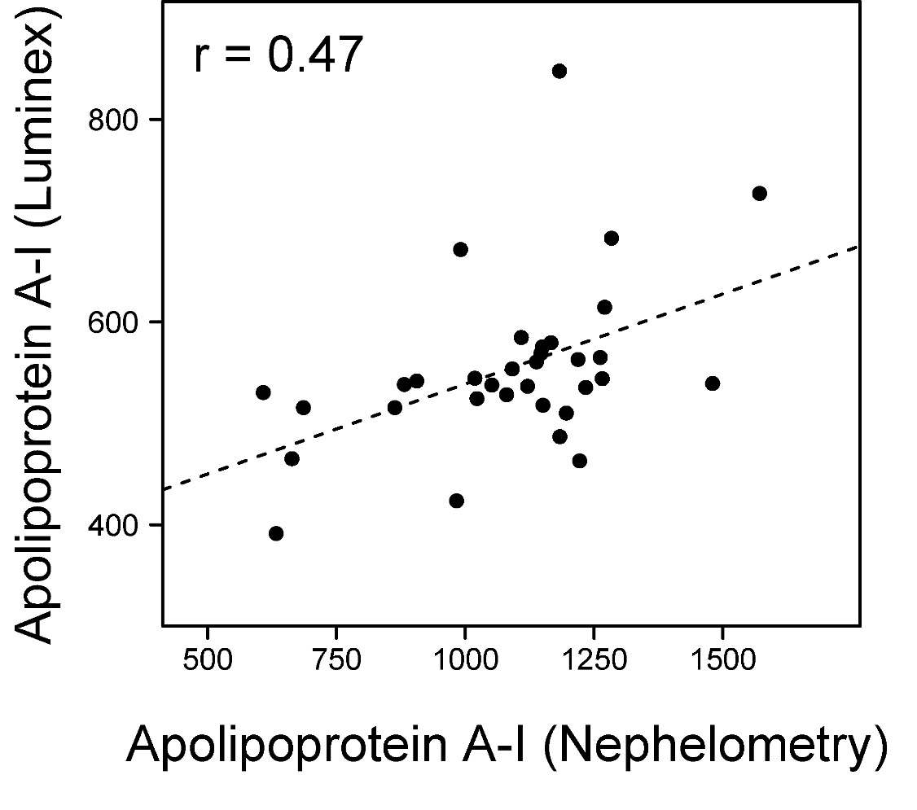
Can We Multiplex Immunoassays?
Not easily.

Slide 10
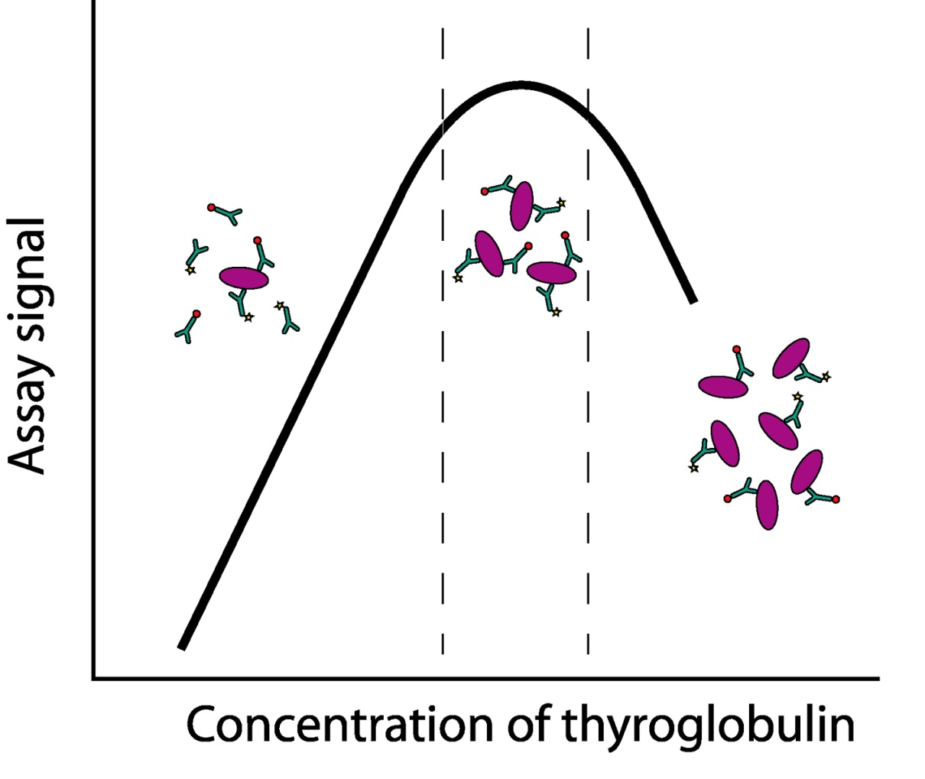
Hook Effect
Too much tumor antigen can lead to negative result

Slide 11
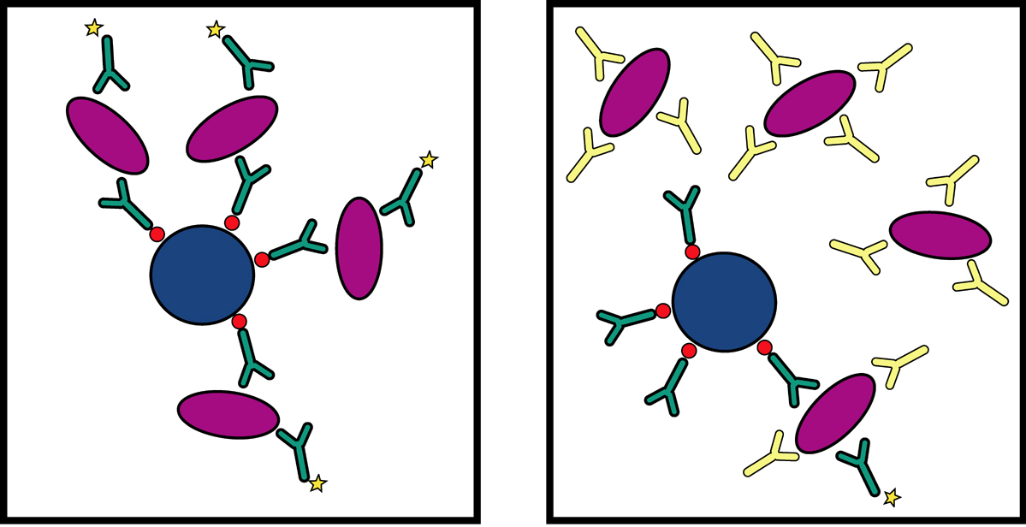
Autoantibody Interference
Autoantibodies can sequester antigen away from detectable complexes
Falsely negative results with sandwich assays

Slide 12
Mass Spectrometry: A Potential Solution
Direct detection of analyte by mass spectrometry
Interlaboratory calibration
Improved specificity
No sandwiches formed
No hook effect
Saturation of signal – plateau of calibration curve
Digestion of all proteins
Destroy autoantibodies

Slide 13
Discovery Proteomics: Is it suitable to replace immunoassays?

Slide 14
Bottom Up Proteomics
Protein Mixture
MS/MS
1
2
3
3
proteolysis
2
µLC
MS
1
Peptide Mixture

Slide 15
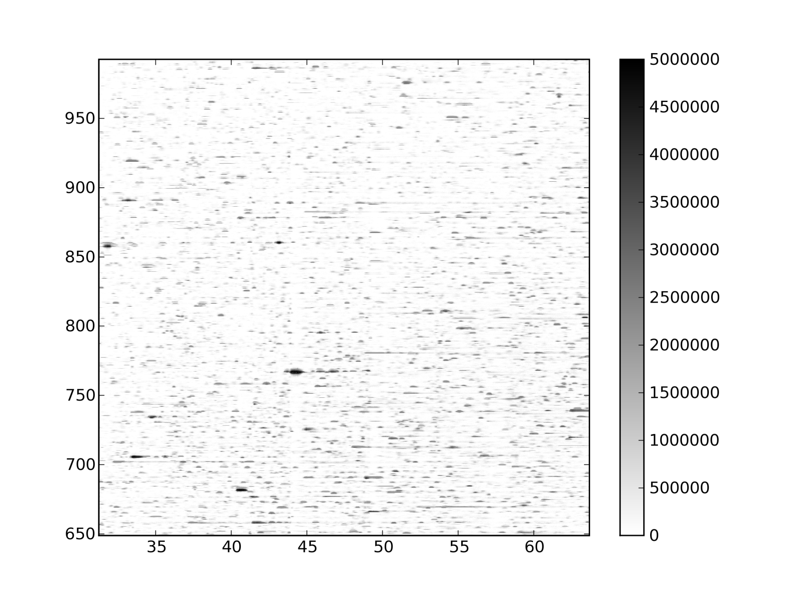
These Mixtures are Complicated!
MS Scan
MS/MS
MS/MS
MS/MS
m/z
Time (Min)

Slide 16

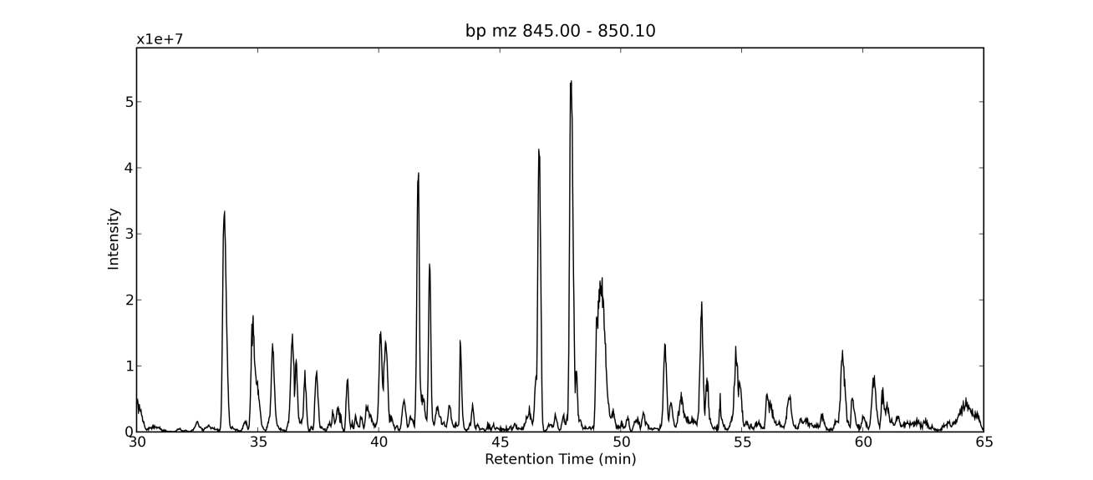
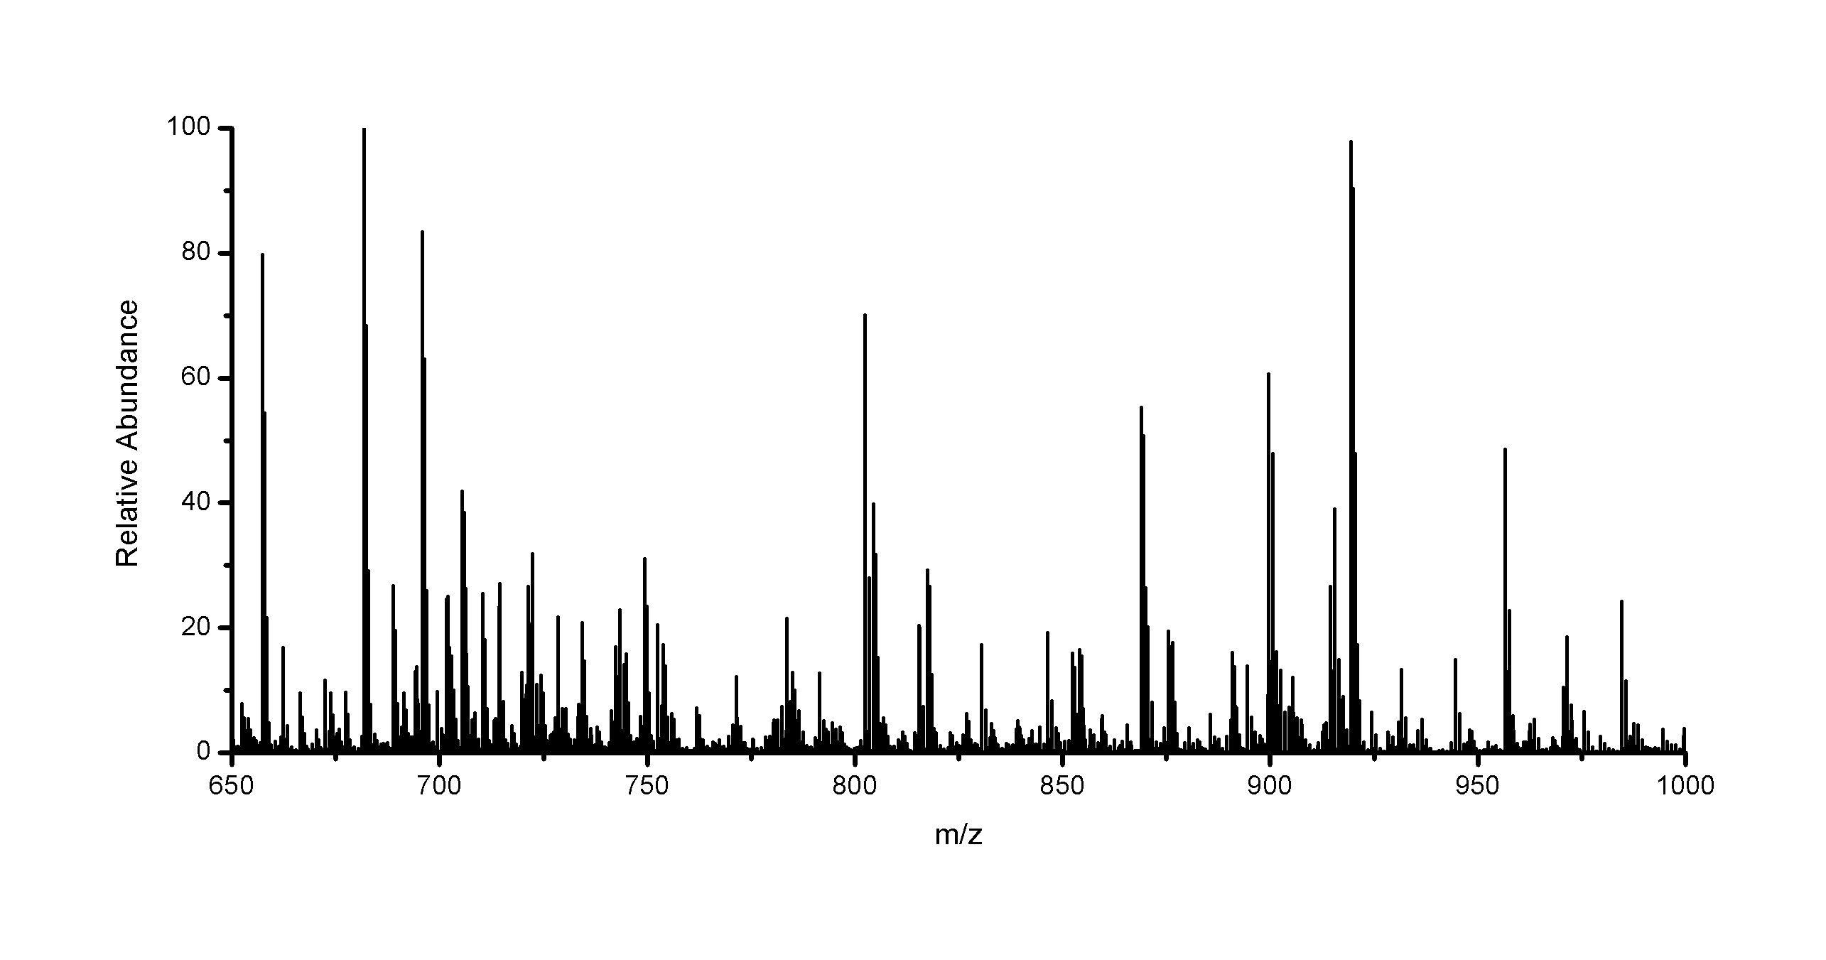
These Mixtures are Complicated!
m/z
Time (Min)

Slide 17
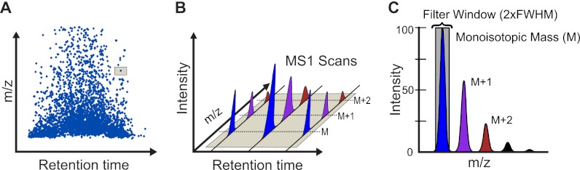
Measure Signal Across Time
Schilling et al MCP 2012

Slide 18
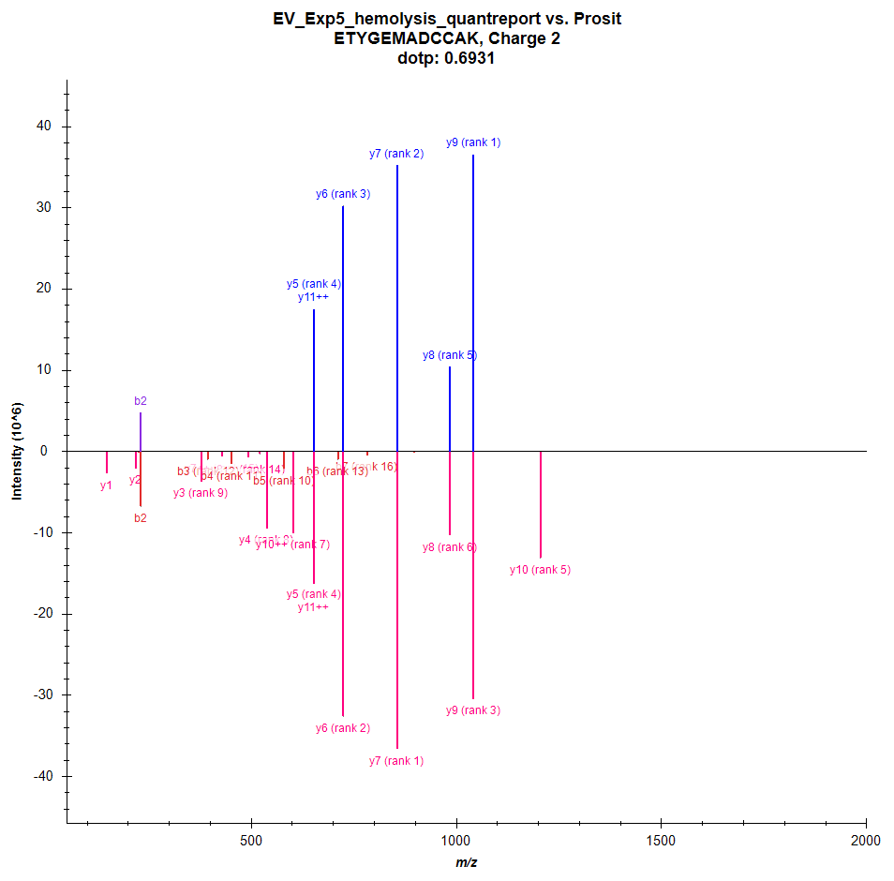
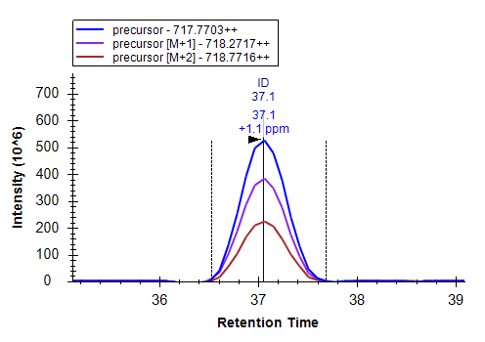
Measure signal versus time

Slide 19
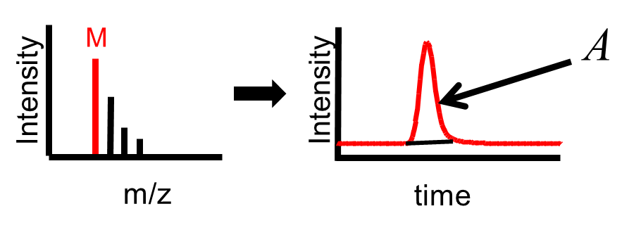
Peptide Quant 101
ULOQ
Linear Dynamic Range
Measured Intensity (Area)
LOD
LLOQ
Amount (moles)
LOD: Limit of Detection
LLOQ: Lower Limit of Quantitation
ULOQ: Upper Limit of Quantitation

Slide 20
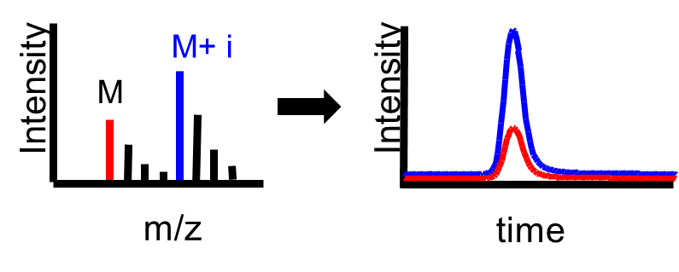
Peptide Quant 101
ULOQ
Linear Dynamic Range
Intensity Ratio (Area Ratio)
LOD
LLOQ
Amount (moles)
LOD: Limit of Detection
LLOQ: Lower Limit of Quantitation
ULOQ: Upper Limit of Quantitation

Slide 21

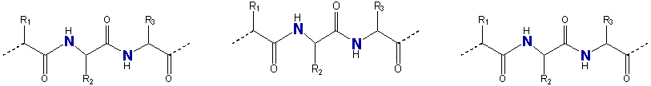
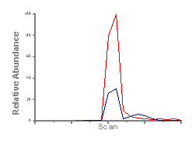
Metabolically Labeling as an Internal Standard
¹⁵N Enriched Media
¹⁵N Internal Standard
Protein Synthesis
Sample
Cell Lysis
Reduction and Alkylation
Digestion
µLC/µLC/MS/MS
Sample & Int Std Combined

Slide 22
Sample
Internal Std
Sample
Internal Std
Normal Media
¹⁵N Enriched Media
Normal Media
¹⁵N Enriched Media
Cell Lysis
Mix
Derivatization
Cell Lysis
Mix
Proteolytic Digestion
Proteolytic Digestion
µLC-MS/MS
µLC-MS/MS
Identify Peptide
Measure Ratio A
Identify Peptide
Measure Ratio B

Slide 23
Sample
Internal Std
Sample
Internal Std
Normal Media
¹⁵N Enriched Media
Normal Media
¹⁵N Enriched Media
Cell Lysis
Mix
Derivatization
Cell Lysis
Proteolytic Digestion
Proteolytic Digestion
Mix
µLC-MS/MS
µLC-MS/MS
Identify Peptide
Measure Ratio A
Identify Peptide
Measure Ratio B

Slide 24
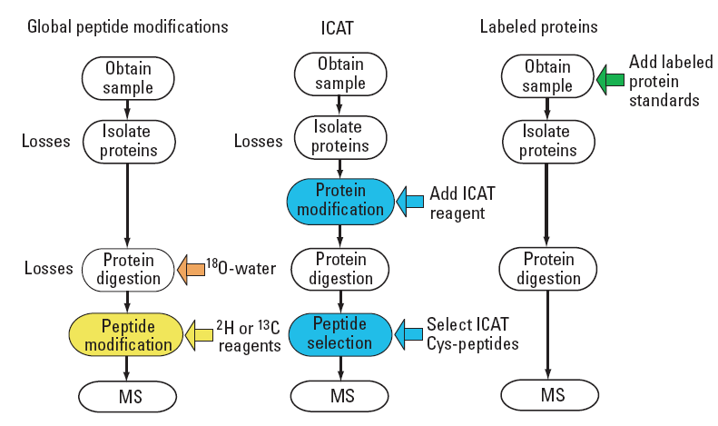
There are lots of different ways to incorporate an internal standard

Slide 25
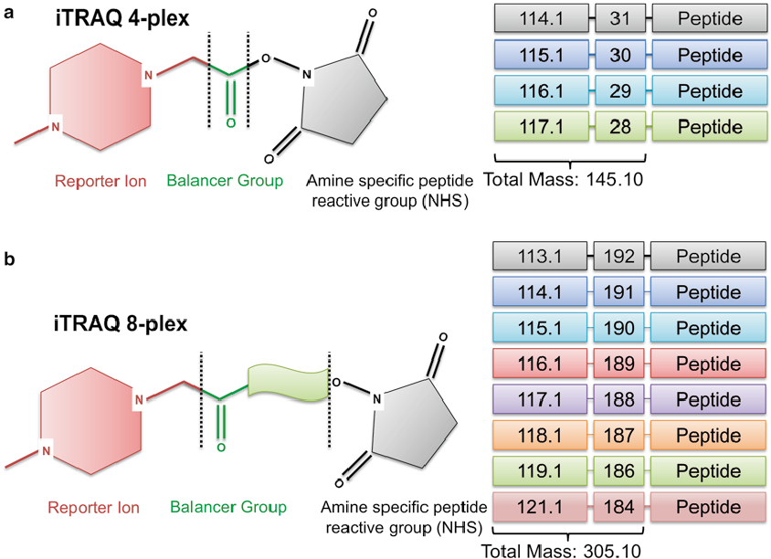
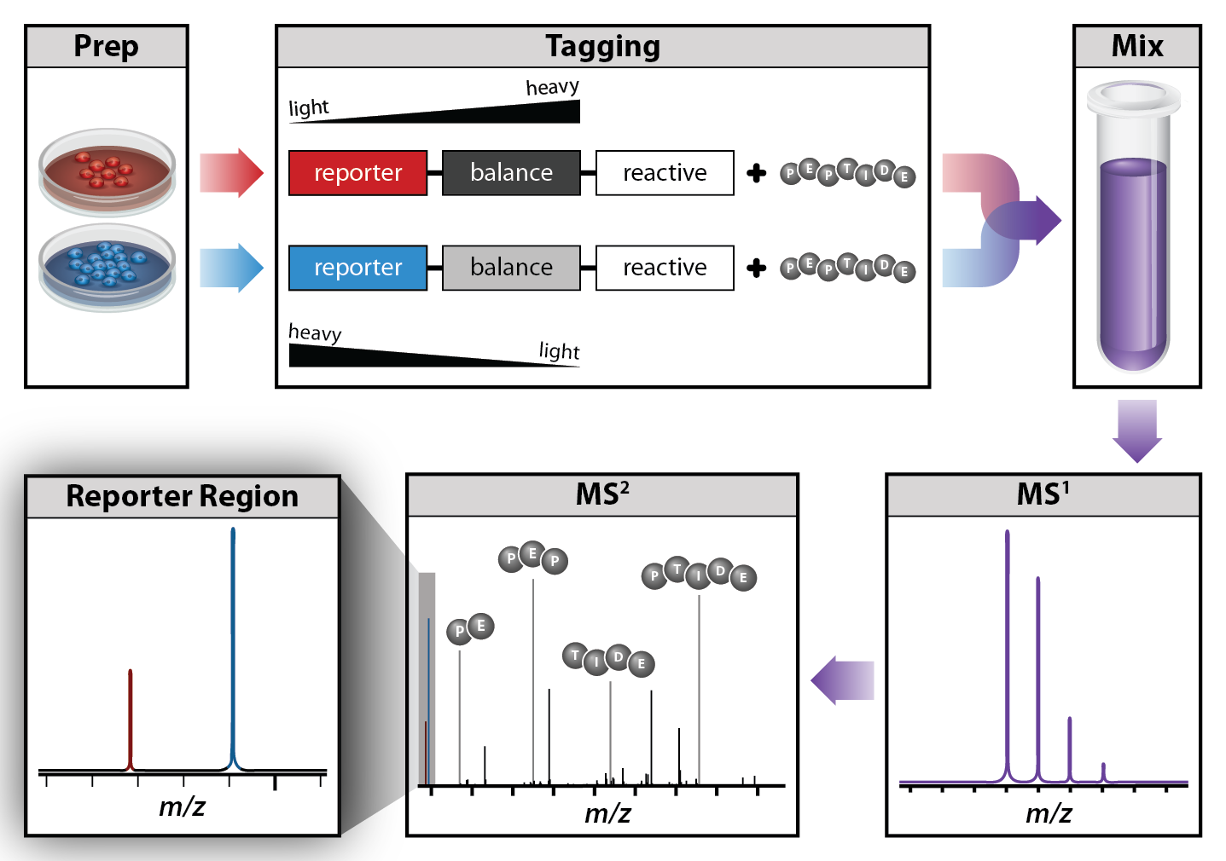
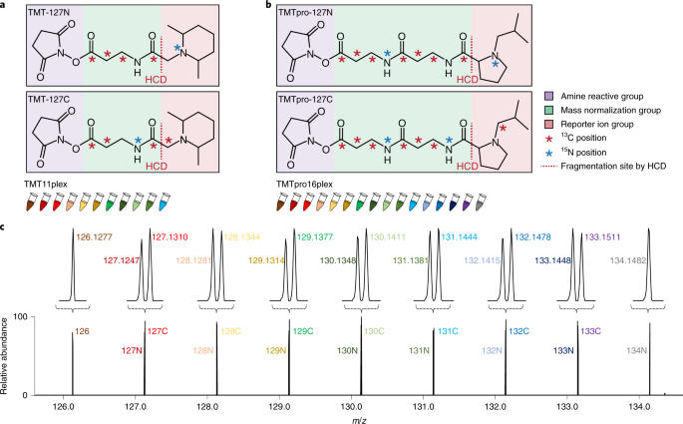
Tandem Mass Tags (TMT)

Slide 26
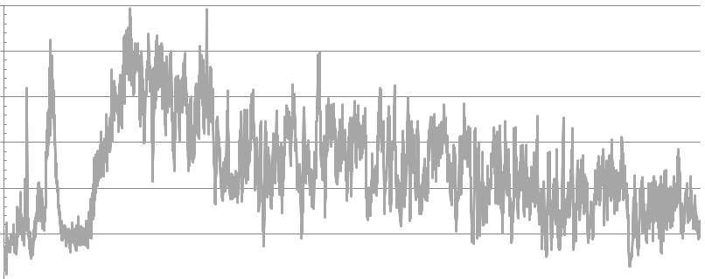
Sampling Every Precursor Using DDA
Number of precursors from m/z 400 to 1,000
300
250
200
Number of precursors
Average:
120.58
150
100
50
0
Scan index
To get every precursor using DDA, we would have to collect 121 MS/MS spectra on average per chromatographic peak
Notes:
We count the number of precursor in each scan

Slide 27
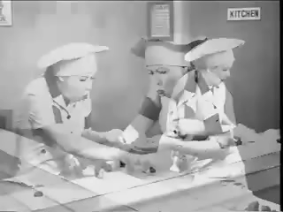
Data Dependent Acquisition will Always Under Sample

Slide 28
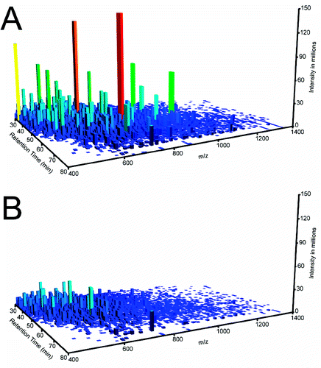
DDA always misses and is least reproducible on the low abundant signals
Hoopmann et al, JPR 2009

Slide 29
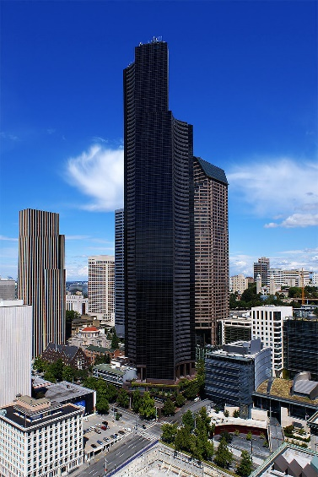
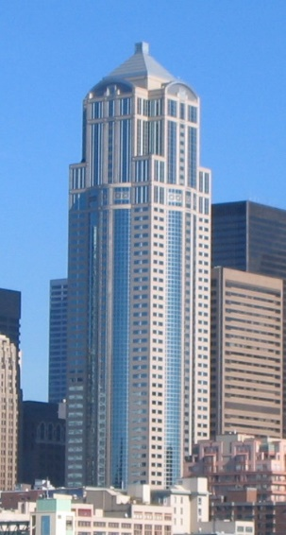
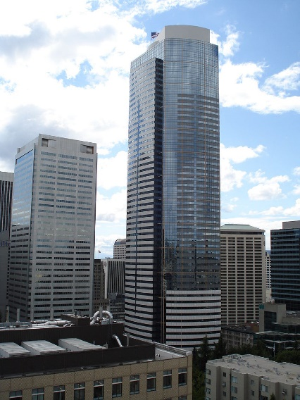
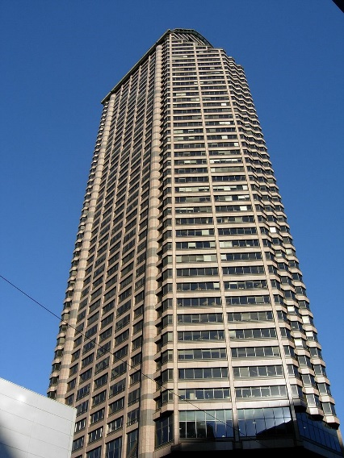
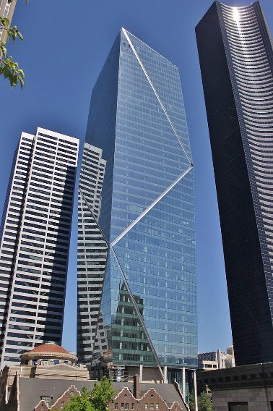
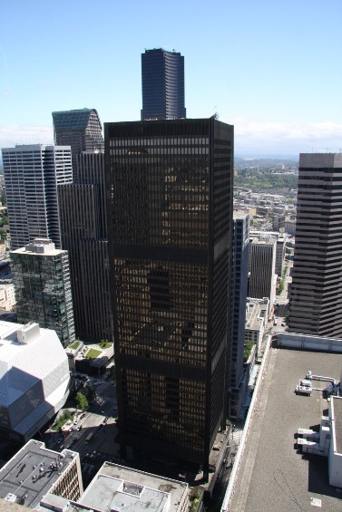
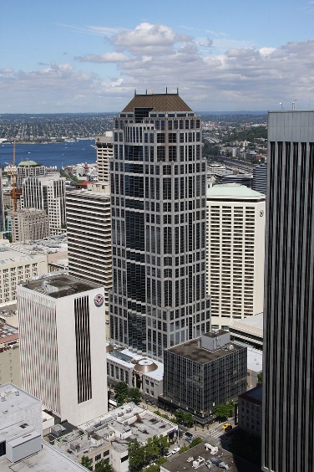
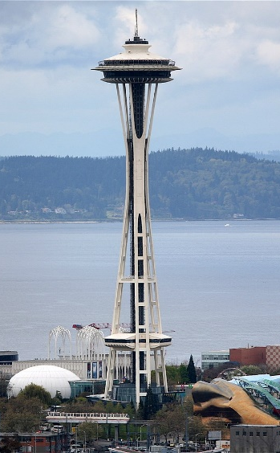
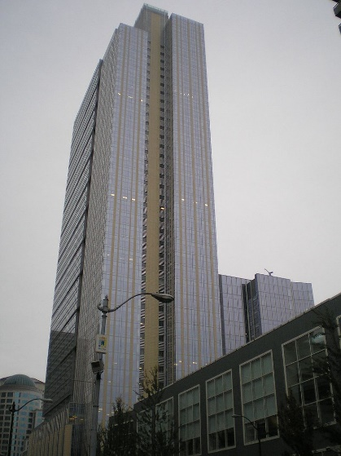
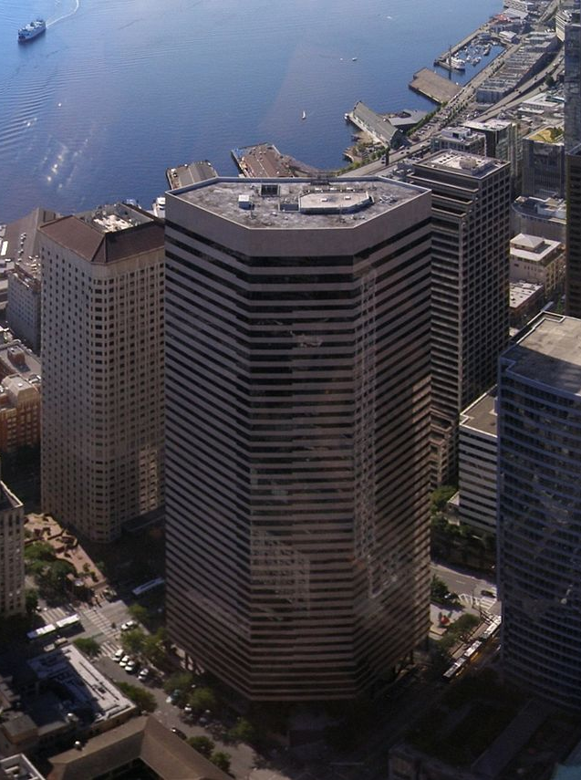
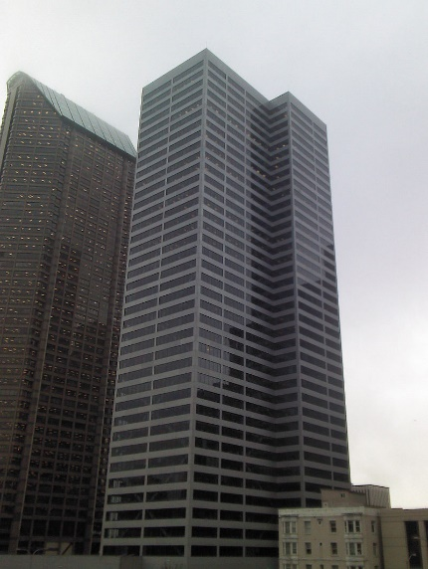
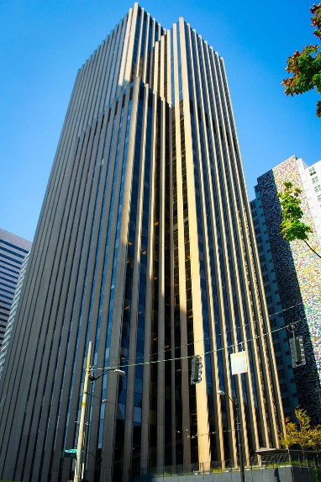
Visiting Seattle from Tallest to Smallest
1) Columbia Center
2) Washington Mutual Tower
3) Two Union Square
4) Seattle Municipal Tower
5) F5 Tower
6) Safeco Plaza
7) US Bank Center
8) Space Needle
9) Russell Investments Center
10) DocuSign Tower
11) 800 Fifth Ave
12) 901 Fifth Ave

Slide 30
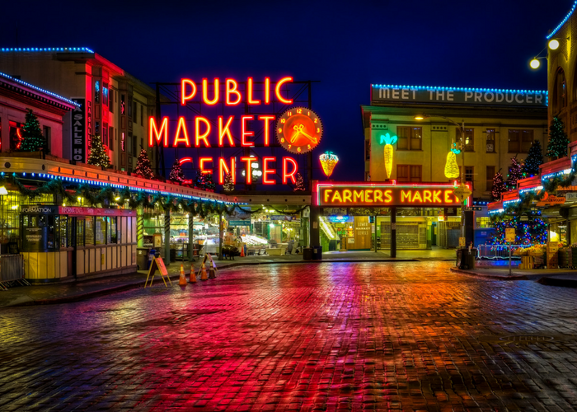
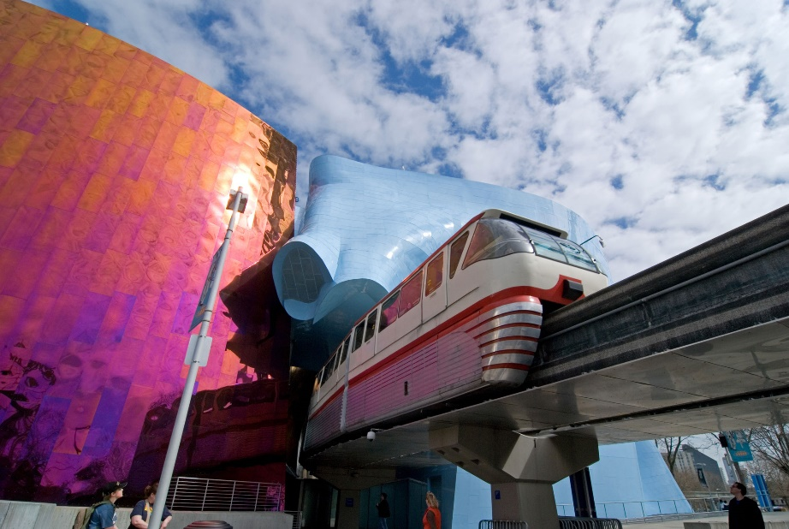
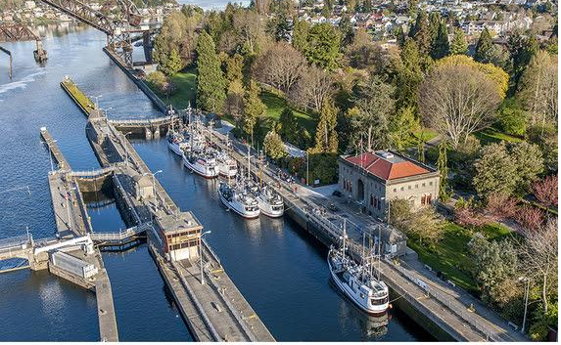
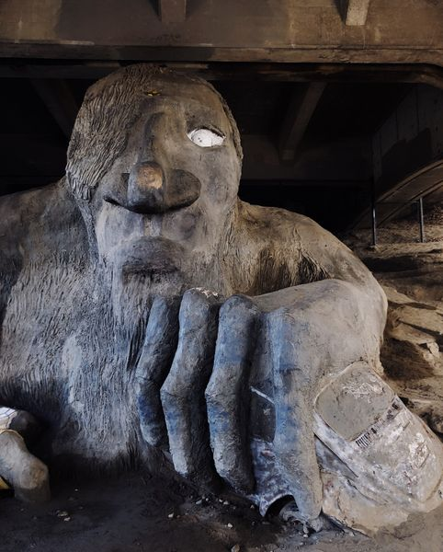

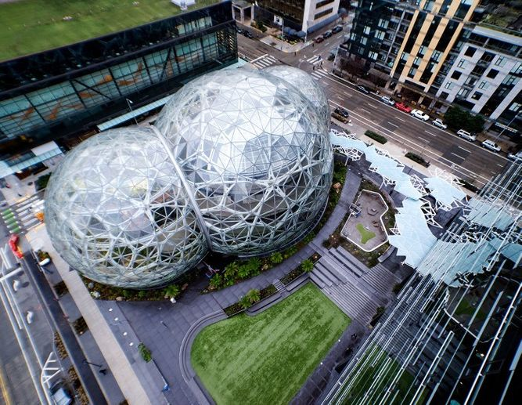
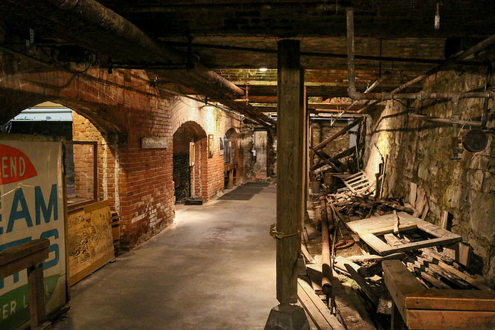
You would miss …
If you wouldn’t visit Seattle by going to the tallest structures, why would we use this approach to understand protein mixtures???

Slide 31
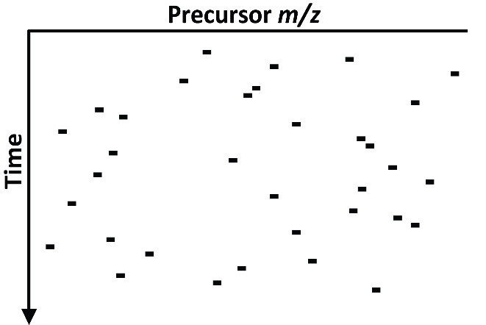
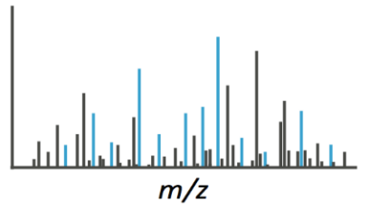
Mass Spectrometry Data Acquisition Strategies Used in Proteomics
Data Dependent Acquisition (DDA)
NLPFSVENK
Database Searching
Peptide Identification

Slide 32
So what do we do?
Build on Other People’s Knowledge

Slide 33

So what do we do?

Slide 34
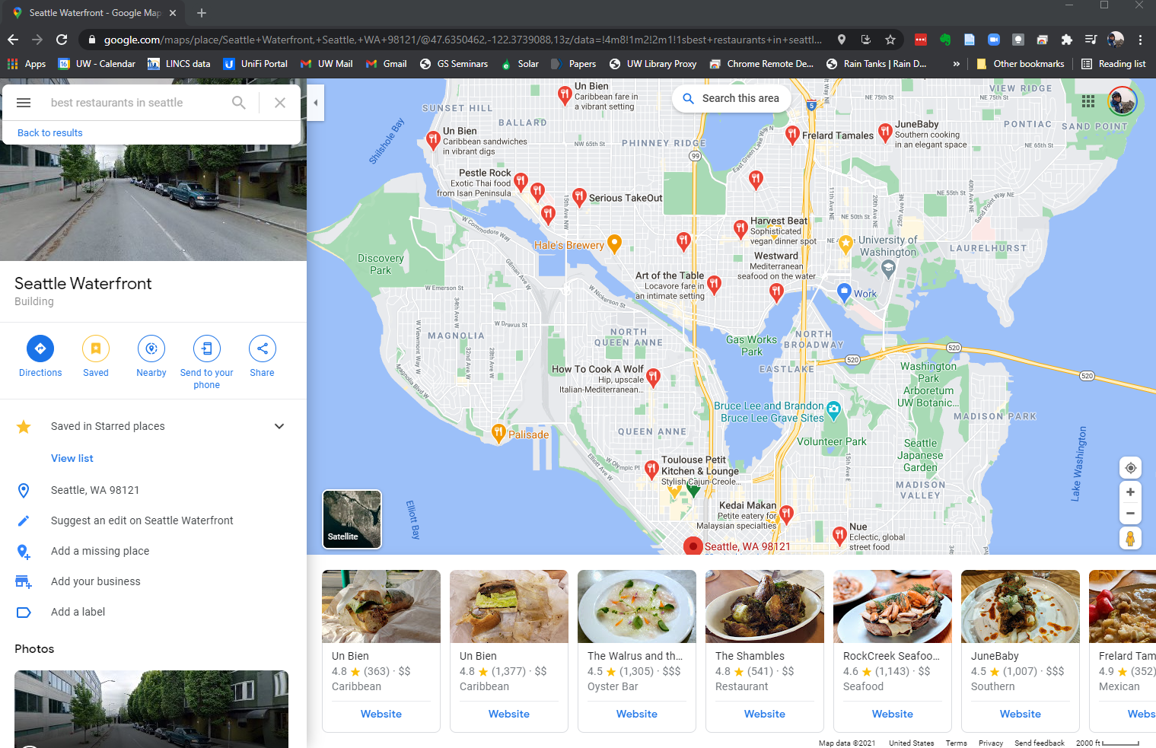
So what do we do?

Slide 35
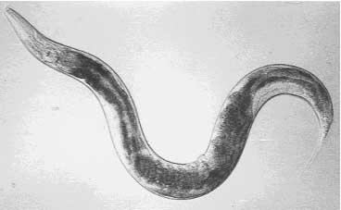
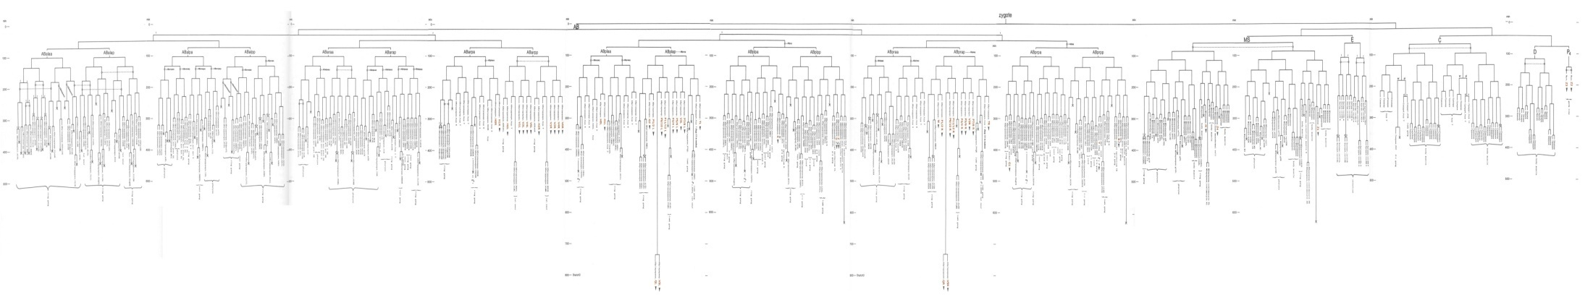
C. elegans as an In Vivo Model System for Proteomics
The only multicellular organism with a genome sequenced to completeness
Complete Lineage for all 959 Somatic Cells

Slide 36
Humans
C. elegans
Insulin Receptor
DAF-2
IRS1-4
IST-1
pi 3-kinase
AGE-1
PDK1
PDK-1
AKT/PKB
AKT-1/AKT-2
FKHR
FKHRL1
AFX
DAF-16

Slide 37
Fractionation to Improve the Coverage of Proteins Involved in Insulin / IGF-1 Signaling
Soluble Proteins
Insoluble Proteins
0 Proteins Identified that are Known to be Involved in the Insulin / IGF-1 Signaling Pathway
Reversed Phase 10 Fractions
(NH₄)₂SO₄ Cuts 8 Fractions
Density Centrifugation 10 Fractions
10 MudPITs
8 MudPITs
10 MudPITs
>6,000,000 MS/MS Spectra, 67,047 Unique Peptide Identifications, and 6,779 Unique Protein Identifications

Slide 38
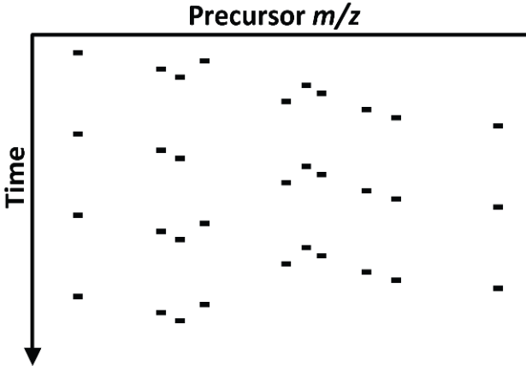
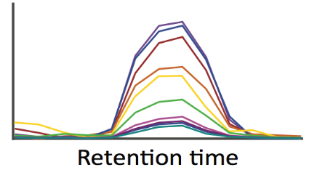
Mass Spectrometry Data Acquisition Strategies Used in Proteomics
Data Dependent Acquisition (DDA)
Parallel Reaction Monitoring (PRM)
Cycle time
NLPFSVENK
NLPFSVENK
Database Searching
Targeted Analysis
Peptide Identification
Peptide Quantification

Slide 39
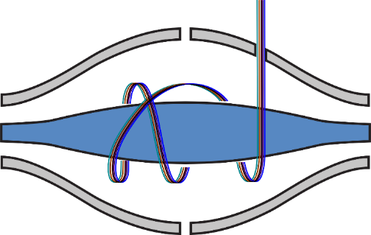
SRM
Targeted Acquisition
Mass Filter
Unit Resolution
Targeted Extraction
Mass Analysis
Full Spectrum
Often Accurate mass
PRM

Slide 40
Q1
CID
Q3
Ion Source
521.7
757.6

Slide 41
Precursor Ion > Product Ion
TGASEAVPSEGK > GK
TGSAEAVPSEGK > EGK
TGSAEAVPSEGK > SEGK
TGSAEAVPSEGK > PSEGK
TGSAEAVPSEGK > VPSEGK
TGSAEAVPSEGK > AVPSEGK
TGSAEAVPSEGK > EAVPSEGK
TGSAEAVPSEGK > AEAVPSEGK
TGSAEAVPSEGK > SAEAVPSEGK
SRM Chromatograms
y2
566.78 > 204.13
y3
566.78 > 333.18
y4
566.78 > 420.21
y5
566.78 > 517.26
y6
566.78 > 616.33
y7
566.78 > 687.37
y8
566.78 > 816.41
y9
566.78 > 903.44
y10
566.78 > 1031.5

Slide 42
IDATTHIGGVQIK DAF-16
QEDVVIEGWLHK AKT-1
Worm Homogenate 25 µg
75 attomole IDATTHIGGVQIK
7.5 femtomole QEDVVIEGWLHK
Synthetic Peptide Standards

Slide 43
Dilution of the Yeast Protein PGI1 in Undepleted Human Plasma
Peptide: ILFDYSK
R = 0.99992

Slide 44
Dilution of the Yeast Protein PGI1 in Undepleted Human Plasma
Peptide: ILFDYSK
R = 0.99992

Slide 45
Dilution of the Yeast Protein PGI1 in Undepleted Human Plasma
Peptide: ILFDYSK
R = 0.99992

Slide 46
12 Attomoles of ILFDYSK on Column in 10 µg of Unfractionated Human Plasma
*

Slide 47
Questions When Developing a Targeted Assay
What peptides are 1) detectable, 2) chromatograph well, 3) are unique to, and 4) are stable and robust over time.
What transitions provide a sensitive and unique measure of that peptide

Slide 48
Quantitative Analysis 101
What is does it mean to be quantitative?
Notes:
Poll 3 … what does it mean to be quantitative

Slide 49
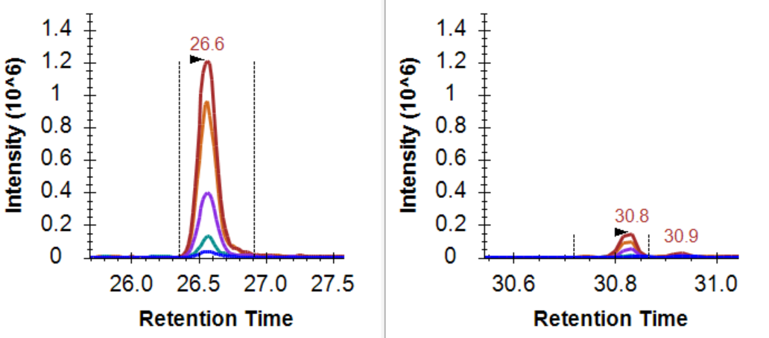
Peak area measurements should scale with the amount of peptide in the sample
known quantity

Slide 50

Assessment of LOD and LOQ
Definitions
Limit of Detection:
Signal is statistically different from a blank
Assumption is if a peptide is below the FDR in a peptide-centric search it is >LOD
Limit of Quantification:
Point where a change in signal is reflective of the change in quantity
Usually apply a precision threshold too
Differential Measurement:
Two signals are statistically different
Pino et al, Anal Chem 2018

Slide 51
Quantitative Analysis 101
What is does it mean to be quantitative?
What does signal calibration mean?
Notes:
Poll 4
What does signal calibration mean

Slide 52

Measurements on different platforms are not measured on the same scale

Slide 53
Between Batch/Platform/Lab Signal Calibration
Purpose of signal calibration
Placing signal on the same scale
Often the scale is arbitrary
Kilogram = mass of a liter of water at freezing point
Meter = 1/10,000,000 the distance from the equator to the north pole
Pee dee belomnite (PDB) = reference for 13C, fossil found in Peedee Formation in South Carolina
Standard mean ocean water (SMOW) = reference for 18O, arbitrary mix of distilled water from different regions of the world.

Slide 54
Questions:
Can a method be quantitative if you don’t know the range over which the signal reflects the quantity?

Slide 55
What does it mean if these are the two points?
ULOQ
Linear Dynamic Range
Measured Intensity (Area)
LOD
LLOQ
Amount (moles)
LOD: Limit of Detection
LLOQ: Lower Limit of Quantitation
ULOQ: Upper Limit of Quantitation

Slide 56
Questions:
Can a method be quantitative if you don’t know the range over which the signal reflects the quantity?
Design an approach to confirm linearity and LLOQ for peptides in a complex matrix?
Assume you have < 50 peptides in your assay.
Assume you have >1000 peptides in your assay?

Slide 57


Matched Matrix Dilution Curves
Building on: Grant and Hoofnagle, Clin Chem 2014
Pino et al, JPR 2020

Slide 58

Not all Peptides are Equal Quantitative Proxies for a Protein
Pino et al, JPR 2020
Notes:
plasma membrane ATPase (PMA1

Slide 59
Two other ways we can think of
Take two samples with extremes in the signal measured from a discovery experiment
Mix samples in different ratios and demonstrate that there is a linear response between the extremes
Method of standard addition

Slide 60
A key reminder: We measure peptides and not proteins.
Plubell et al, BioRxiv 2021

Slide 61

Proteoforms complicate protein level measurements
Plubell et al, BioRxiv 2021
Notes:
Take for example some theoretical protein as indicated on the left – by bottom up proteomics we can possibly detect 4 tryptic peptides that map to our database sequence.

Slide 62
Proteoforms complicate protein level measurements
Plubell et al, BioRxiv 2021
Notes:
Take for example some theoretical protein as indicated on the left – by bottom up proteomics we can possibly detect 4 tryptic peptides that map to our database sequence.

Slide 63

Proteoforms complicate protein level measurements
Plubell et al, BioRxiv 2021
Notes:
Take for example some theoretical protein as indicated on the left – by bottom up proteomics we can possibly detect 4 tryptic peptides that map to our database sequence.

Slide 64

Peptide level quant can reflect protein level differences
Example: GAPDH (glyceraldehyde-3-phosphate dehydrogenase) in cerebrospinal fluid
Protein-level quantification
Notes:
So here we have a protein from this cerebrospinal fluid, GAPDH, and for the protein quantification we are assuming that all the peptides that map to the protein coding sequence and used for generating that value will be increased in the Parkinson’s compared to the other two groups,

Slide 65

Peptide level quant can reflect protein level differences
Example: GAPDH (glyceraldehyde-3-phosphate dehydrogenase) in cerebrospinal fluid
Protein-level quantification
Peptide-level quantification
Notes:
In this case all our peptides have the same trend across the experimental groups, and based on this data it is probably fine to aggregate these peptides to a single value.

Slide 66


Summing to protein-level can mask interesting differences
Example: SCG2 (secretogranin-2) in cerebrospinal fluid
Protein-level quantification
Peptide-level quantification
Notes:
However, we have cases in which the protein quant doesn’t seem to be changing across experimental groups, but on the individual peptide level we have some peptides that do appear to change, sometimes in opposite directions from one another.

