Slide 1
Mass Spectrometry 101 Ionization and Analyzers

Slide 2
Biology/Medicine
“I feel sure that there are many problems in chemistry which could by solved with far greater ease by this than any other method. The method is surprisingly sensitive - more so than that of spectrum analysis - requires an infinitesimal amount of material and does not require this to be specially purified...”
Thomson, 1913

Slide 3
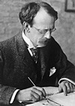
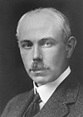
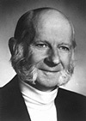
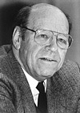
Nobel Prizes in Mass Spectrometry
J.J. Thomson (1906 in Physics) – Cambridge, UK
For the theoretical and experimental investigations of the behavior of gas phase ions in a magnetic fields (e.g. the mass spectrometer)
J.J. Thomson
Francis William Aston (1922 in Chemistry) – Cambridge, UK
For his discovery, by means of his mass spectrograph, of isotopes
F.W. Aston
Hans Dehmelt and Wolfgang Paul (1989 in Physics) – UW, USA and University of Bonn, Germany
For the development of the quadrupole mass filter and the quadrupole ion trap
H. Dehmelt
W. Paul

Slide 4
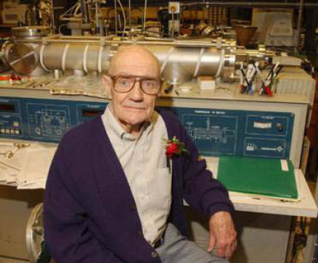
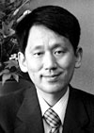
Nobel Prizes in Mass Spectrometry
2002 Nobel Prize in Chemistry
“for the development of methods for identification and structure analyses of biological macromolecules”
“for their development of soft desorption ionization methods for mass spectrometric analyses of biological macromolecules “
John Fenn – Electrospray Ionization
Koichi Tanaka – Laser Desorption Ionization

Slide 5
How is mass defined?
Assigning a numerical value to the intrinsic property of “mass” is based on using carbon 12, ¹²C, as the reference point.
One unit of mass is defined as a Dalton (Da)
One Dalton is defined as 1/12 the mass of a single carbon-12 atom
Thus, one ¹²C atom has a mass of 12.0000 Da.

Slide 6
Isotopes
Most elements have more than one stable isotope
For example, most carbon atoms have a mass of 12 Da, but in nature 1.1% of C atoms have an extra neutron, making their mass 13 Da
Why do we care?
Mass spectrometers can “see” the isotope peaks given sufficient resolution.
If an instrument has resolution high enough to resolve isotopes, better mass accuracy can be achieved.

Slide 7
Stable isotopes of most abundant elements of peptides
Element | Mass (amu) | Abundance (%)
H | 1.00783 | 99.985
 | 2.01410 | 0.015
C | 12.00000 | 98.89
 | 13.00336 | 1.11
N | 14.00307 | 99.64
 | 15.00011 | 0.36
O | 15.99491 | 99.76
 | 16.99913 | 0.04
 | 17.99916 | 0.20

Slide 8
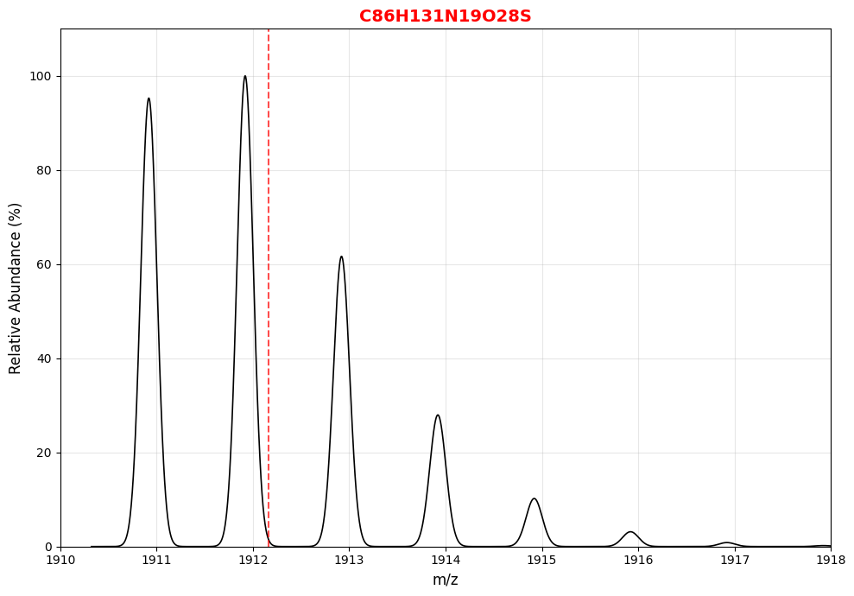
Monoisotopic mass and isotopes
Monoisotopic (no heavy isotopes)
One ¹³C, ¹⁵N, ¹⁷O, or ²H
Average Mass
Two ¹³C, ¹⁵N, ¹⁷O, ²H or one ¹⁸O
Three heavy isotopes

Slide 9
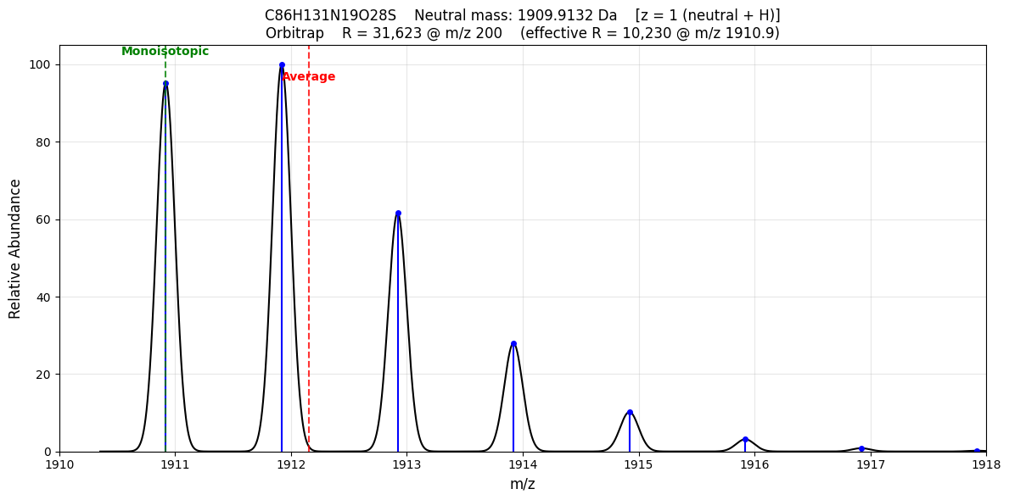
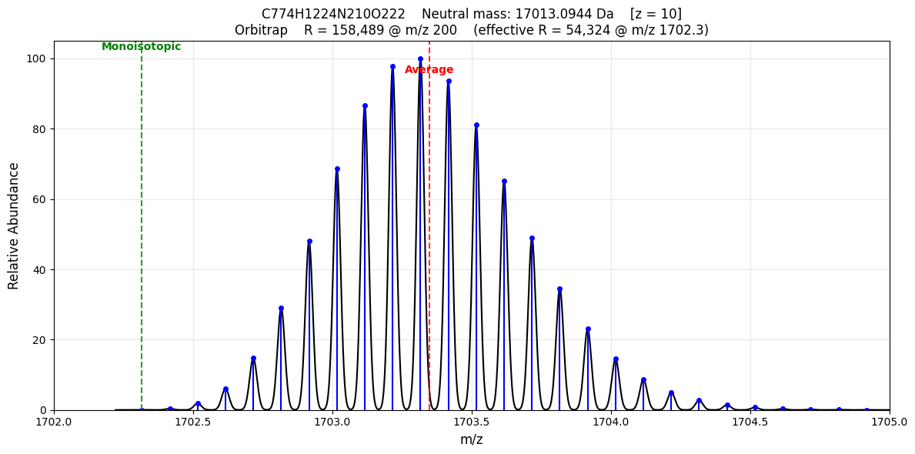
Isotope Distribution Depends on The Elemental Composition
MYFAVRITEPEPTIDE
Myoglobin

Slide 10
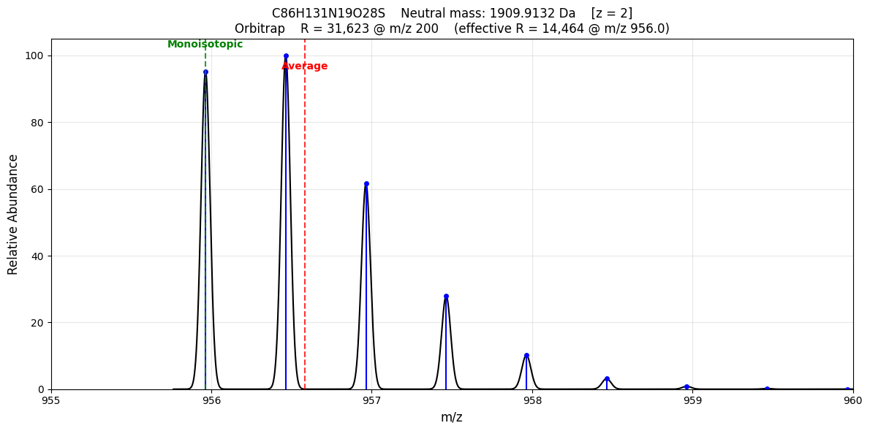
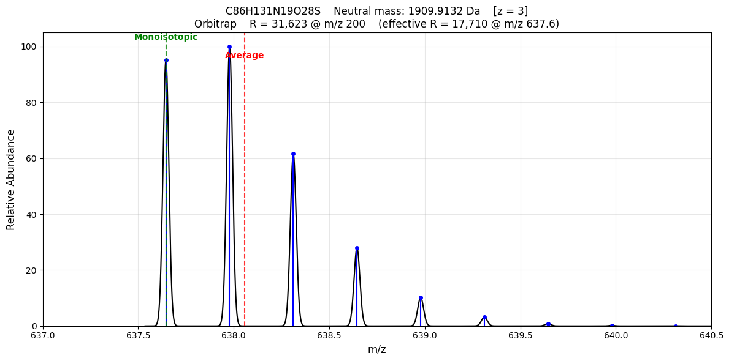
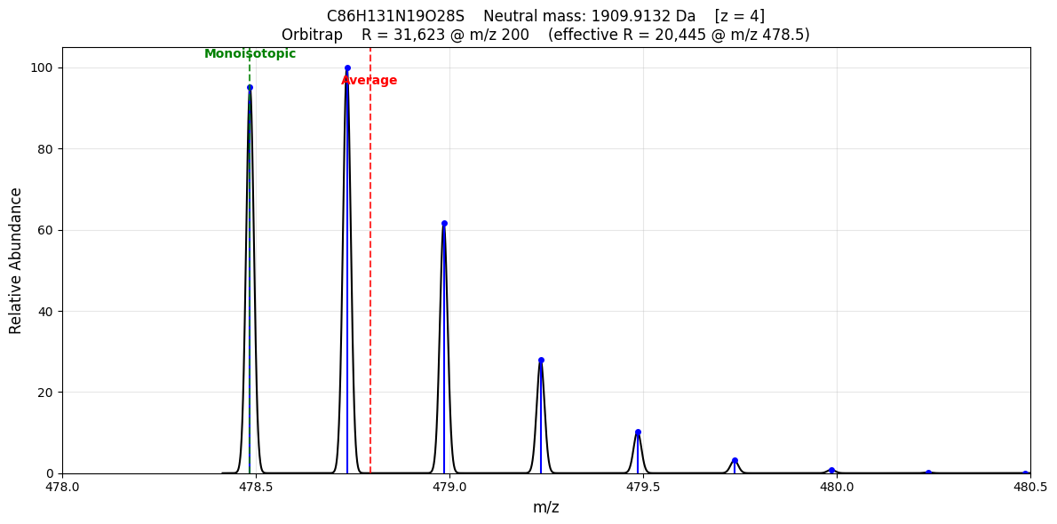
Charge State Effects Isotope Spacing
MYFAVRITEPEPTIDE
2+
1+
3+
4+

Slide 11

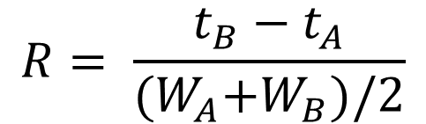
Mass Resolution in Mass Spectrometry
In Chromatography
In Mass Spectrometry
$$R= \frac{t_{B}−t_{A}}{{(W}_{A}+W_{B})/2}$$
$$R=\frac{m}{∆m}$$
depends on the mass
Quadrupole and Quadrupole Ion Traps: Delta Mass is constant across mass range. So R increases with m/z normally report just delta mass
Time of Flight: Resolving power is constant across mass range. So, the delta mass increases with m/z
Orbitrap Mass Analyzer: Resolving power decreases by the square-root of m/z
Ion Cyclotron Resonance Mass Analyzer (FTICR): Resolving power is inversely proportional to m/z

Slide 12
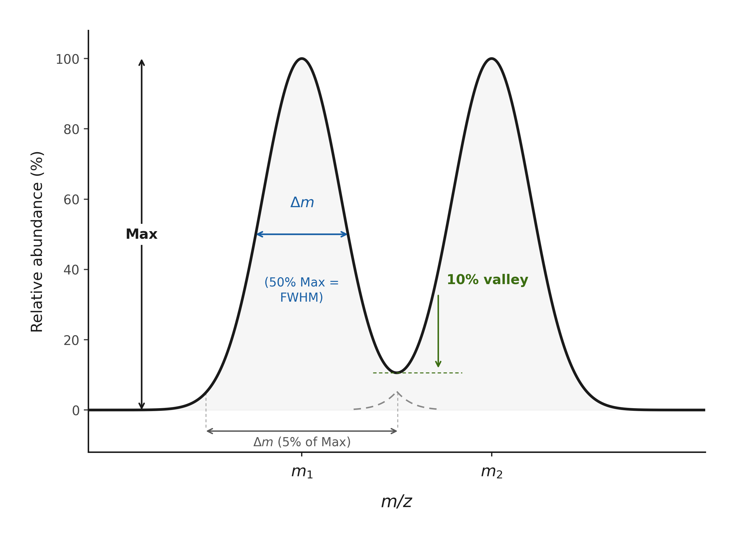
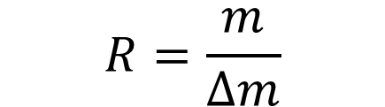
Mass Resolution
$$R=\frac{m}{∆m}$$
Notes:
R is a function of m … so m/deltaM should be given a at a specific mass. Most frequently resolution is defined at the FWHM (50% of the max)

Slide 13
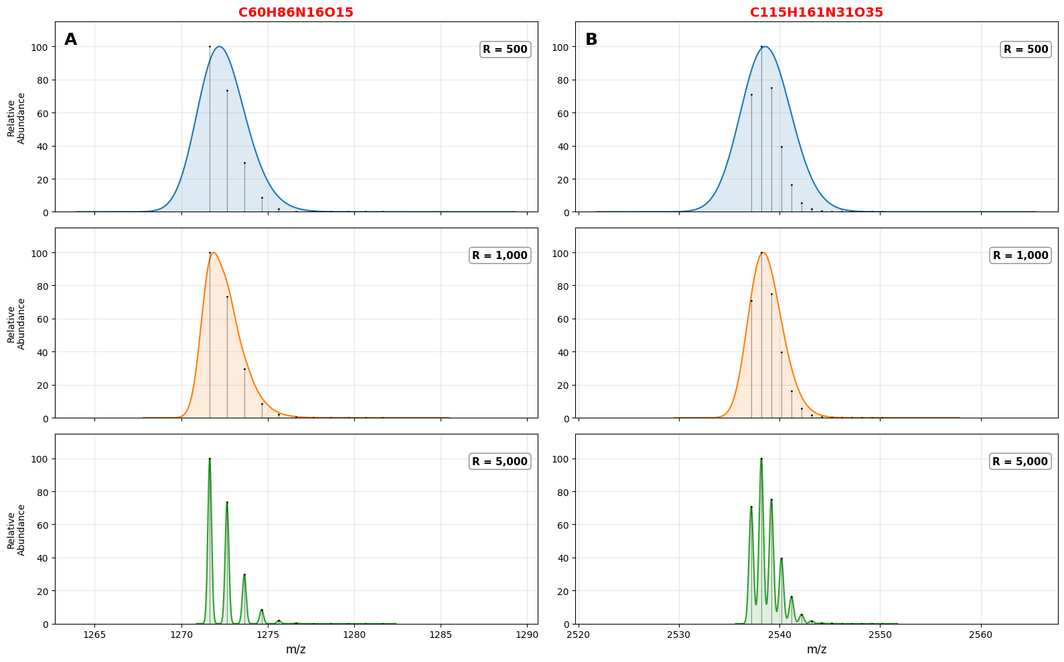
Effect of Resolving Power on the Intensity of Isotope Envelopes for Peptides

Slide 14
Basic Features of a Mass Spectrometer
Sample
In
Ion
Source
Mass
Analyzer
Detector
“High” Vacuum
You
PC
Work Station
Answers
Out

Slide 15
Mechanism of Electrospray Ionization (ESI)
Charged
Capillary
Needle
Heated
Capillary
+
+
+
+
+
+
+
+
+
+
+
+
+
-
+
+
+
+
+
+
+
+
+
+
+
+
+
+
+
+
+
+
+
+
-
+
+
-
+
+
+
+
+
+
+
+
+
+
+
+
+
+
+
+
+
+
+
+
-
+
+
+
-
+
+
+
+
+
+
+
+
+
+
+
+
+
+
+
+
+
+
+
+
+
+
+
+
+
+
+
+
+
Taylor cone
Rayleigh
limit hit:
Coulombic
explosion
+3-8 kV

Slide 16
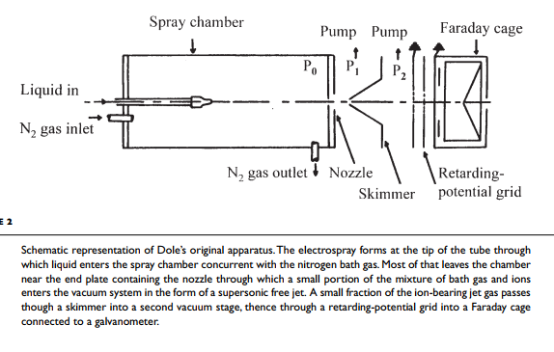

Slide 17
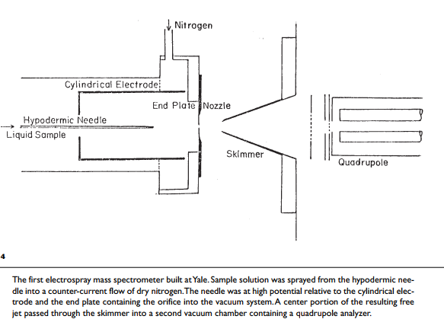

Slide 18
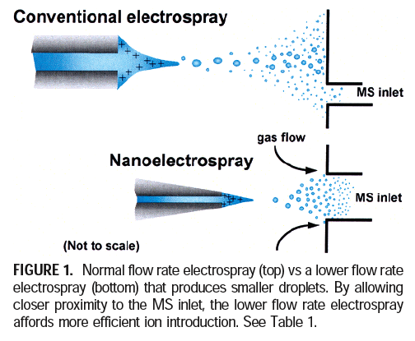
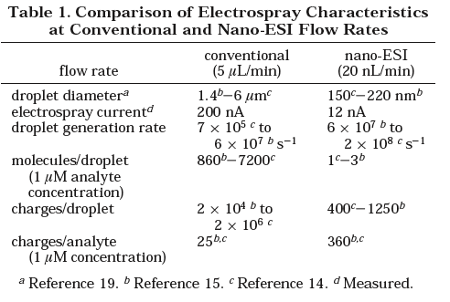
Nanospray: How Sensitivity is Obtained
Improved Droplet Collection Efficiency
Smaller Droplets = More Surface Area
d ≈ k.(flow)^{2/3} (Mann-Wilm Theory)
Tang, Smith Acc. Chem. Res. 2004, 37, 269

Slide 19
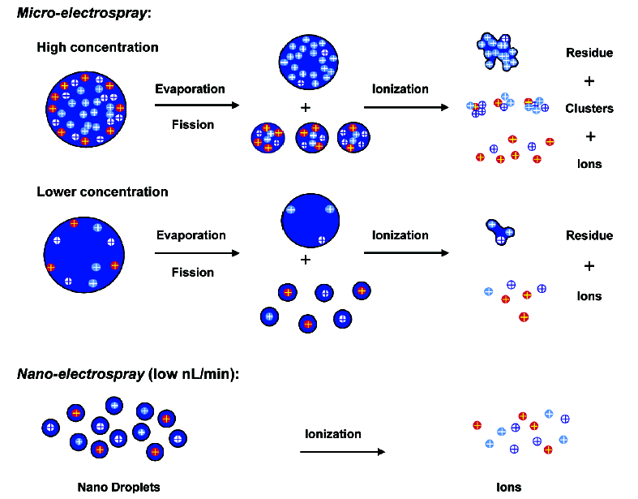
How Does Nanospray Yield Sensitivity?
From Tang & Smith, Acc. Chem. Res. 2004, 37, 269-278

Slide 20
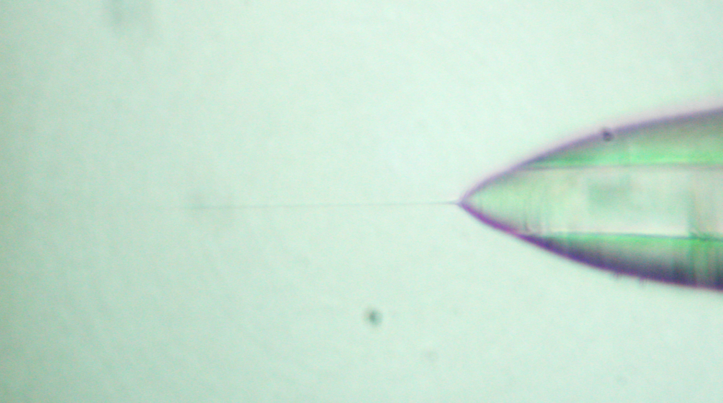
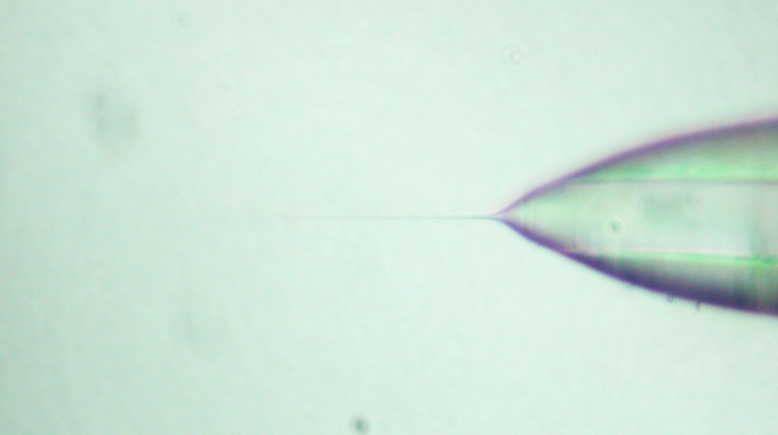
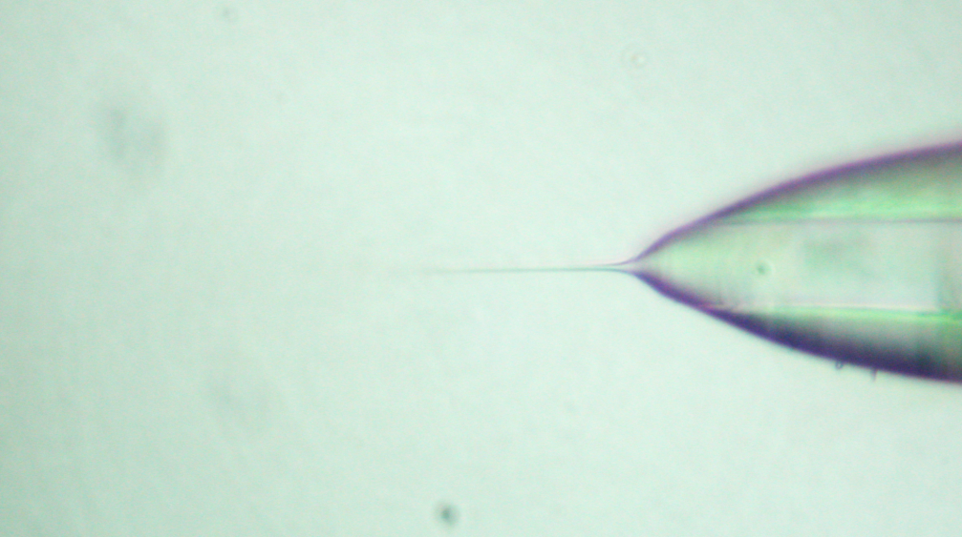
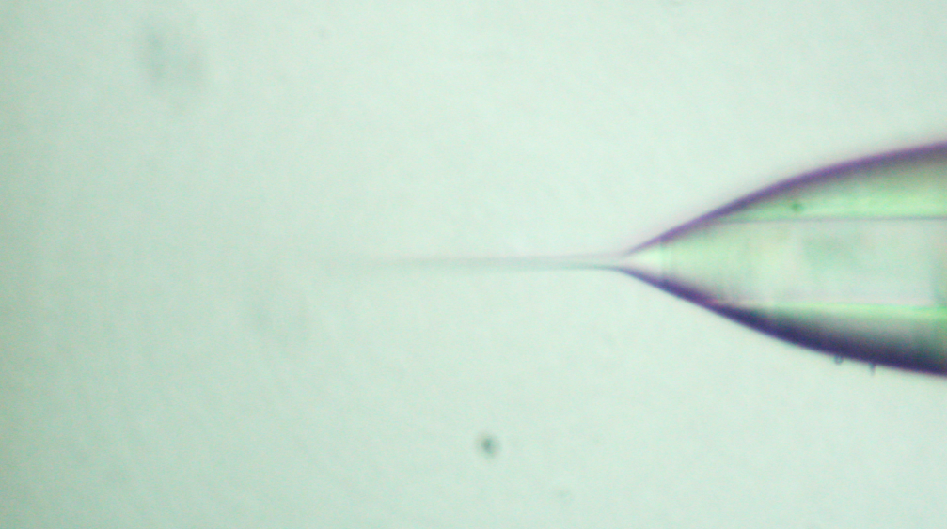
Nanospray:Emission from a Liquid “Tip”
160 nL/min
300 nL/min
10 µm Emitter, 50% ACN (0.1% FA)
500 nL/min
1000 nL/min

Slide 21
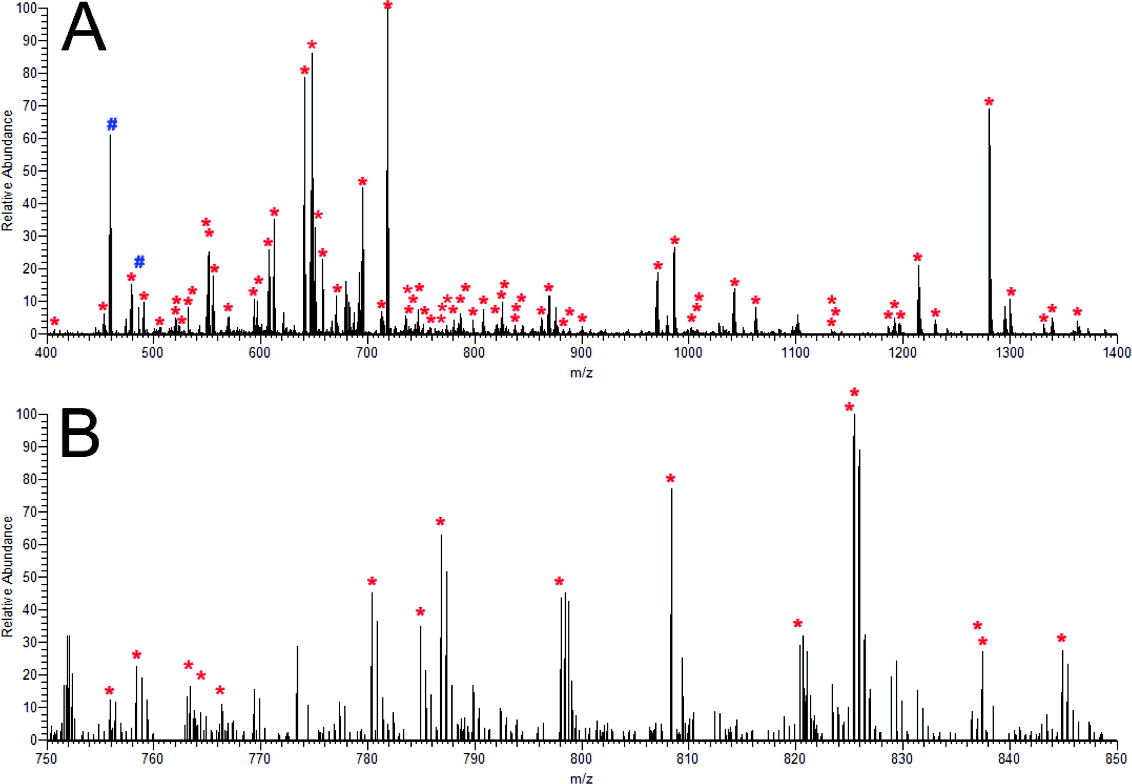
Single Electrospray Mass Spectrum of a Peptide Mixture

Slide 22
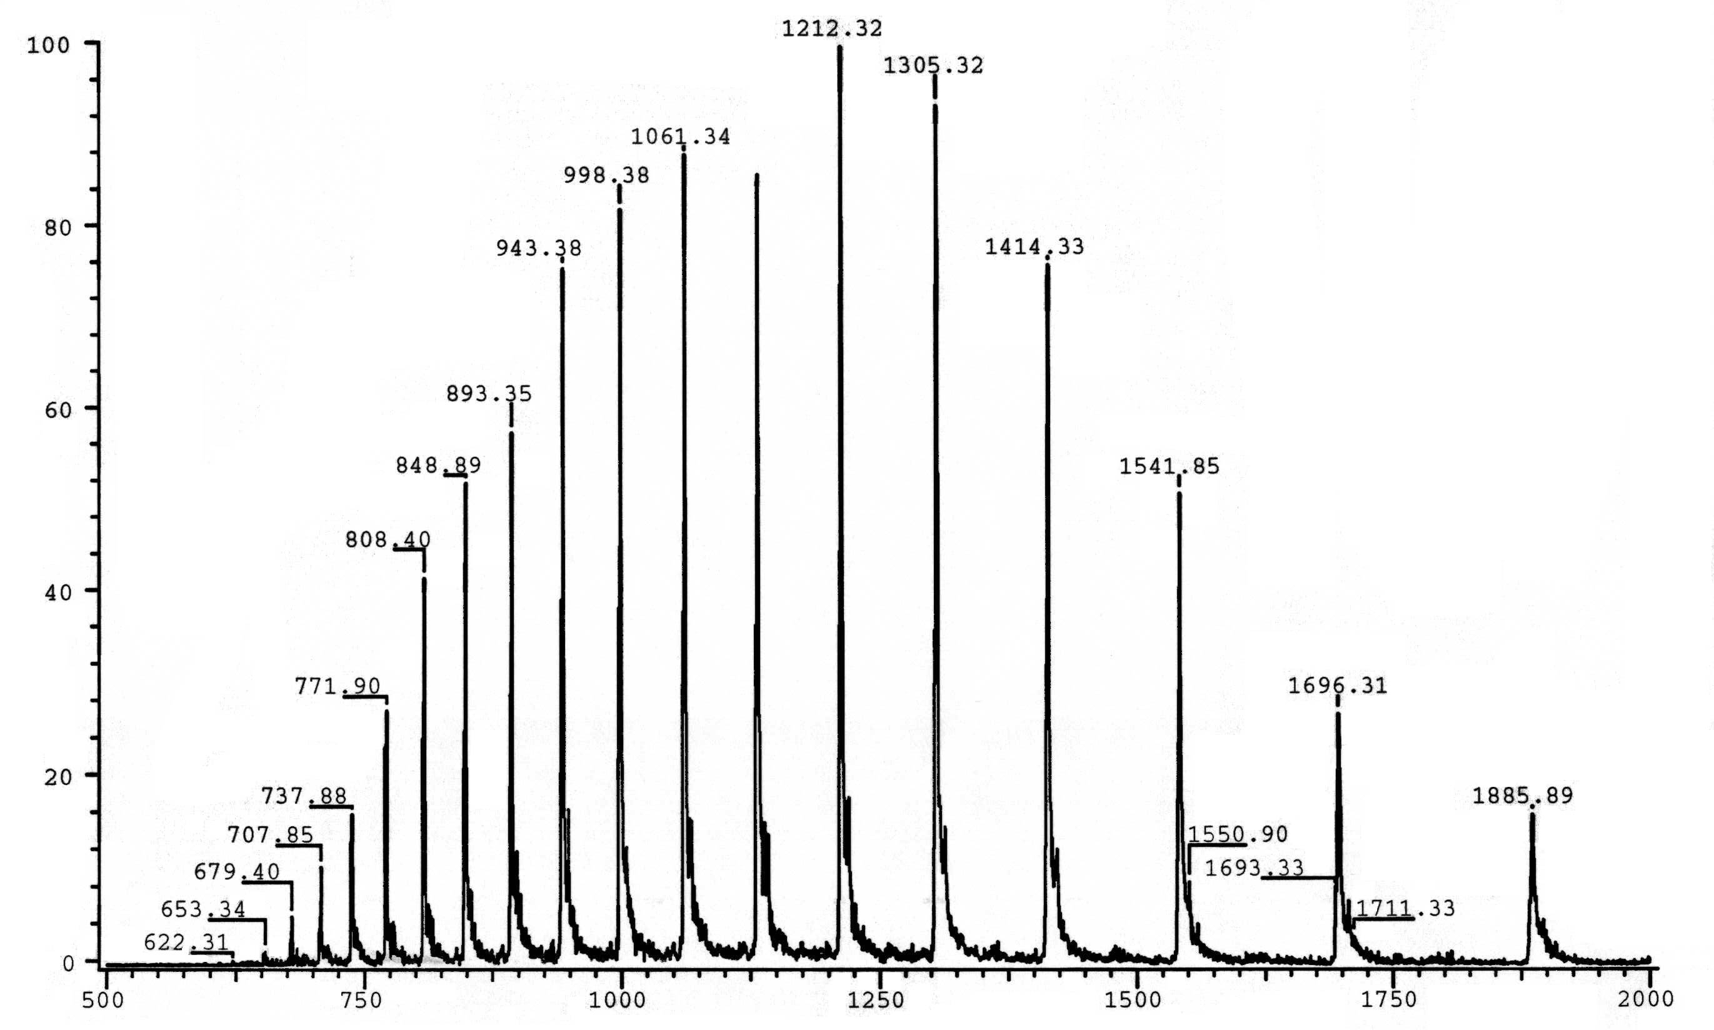
ESI-MS Spectrum of Horse Apomyoglobin
+14
Apomyoglobin
MW=16,951.2
+16
+18
+20
+12
+22
+10
m/z

Slide 23
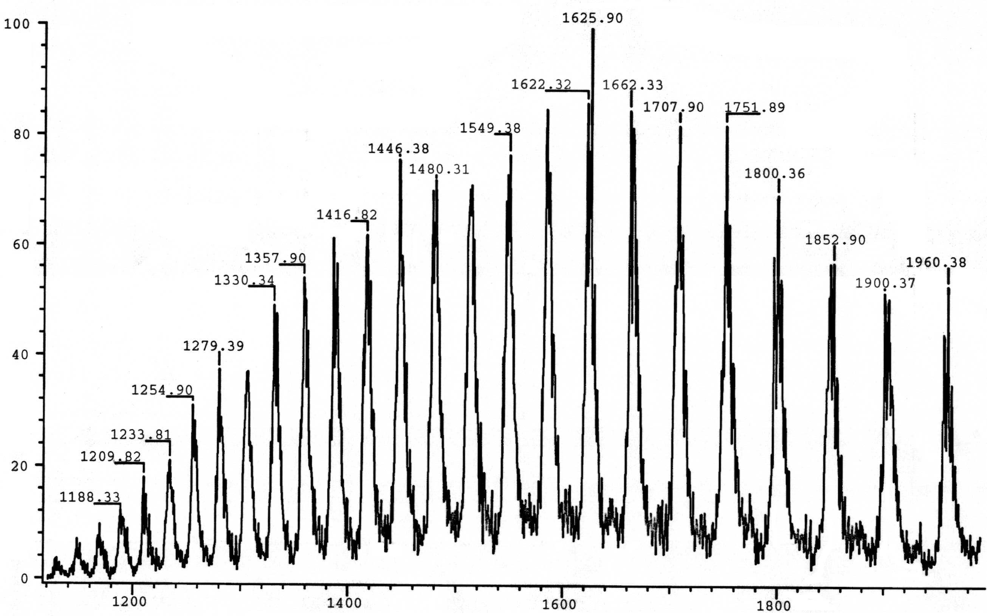
ESI-MS Spectrum of Bovine Serum Albumin
Albumin
MW=66,621
+41
+34
+52
m/z

Slide 24

$$z_{i}=\left(\frac{P_{j}−1}{P_{i}−P_{j}}\right)$$
Where:
z_{i} = charge of m/z = P_{i}
P_{j} = m/z with charge z_{i} + 1
m/z

Slide 25
Quadrupole Mass Filter
U + V cos(ωt)
-
+
-
+

Slide 26
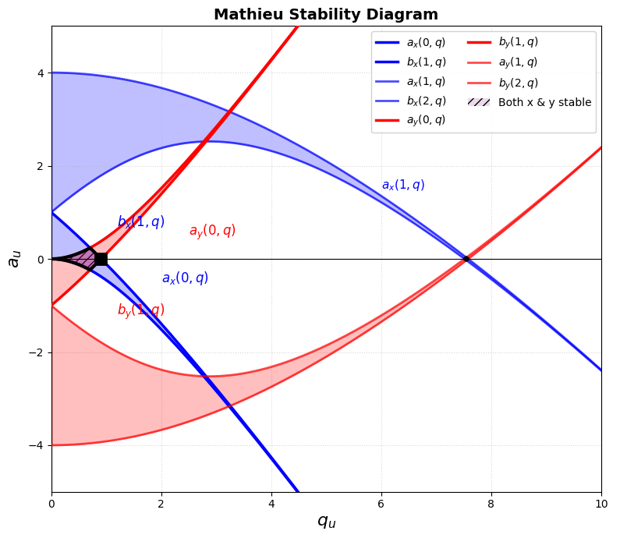
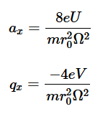
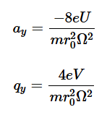
The Mathieu Equation Defines Stability in Quadrupolar Field
Where:
U = DC voltage applied to rods
V = RF voltage amplitude (0-to-peak)
m = ion mass (in amu)
r₀ = inscribed radius of quadrupole rods
Ω = angular frequency of RF (2πf)
e = elementary charge

Slide 27
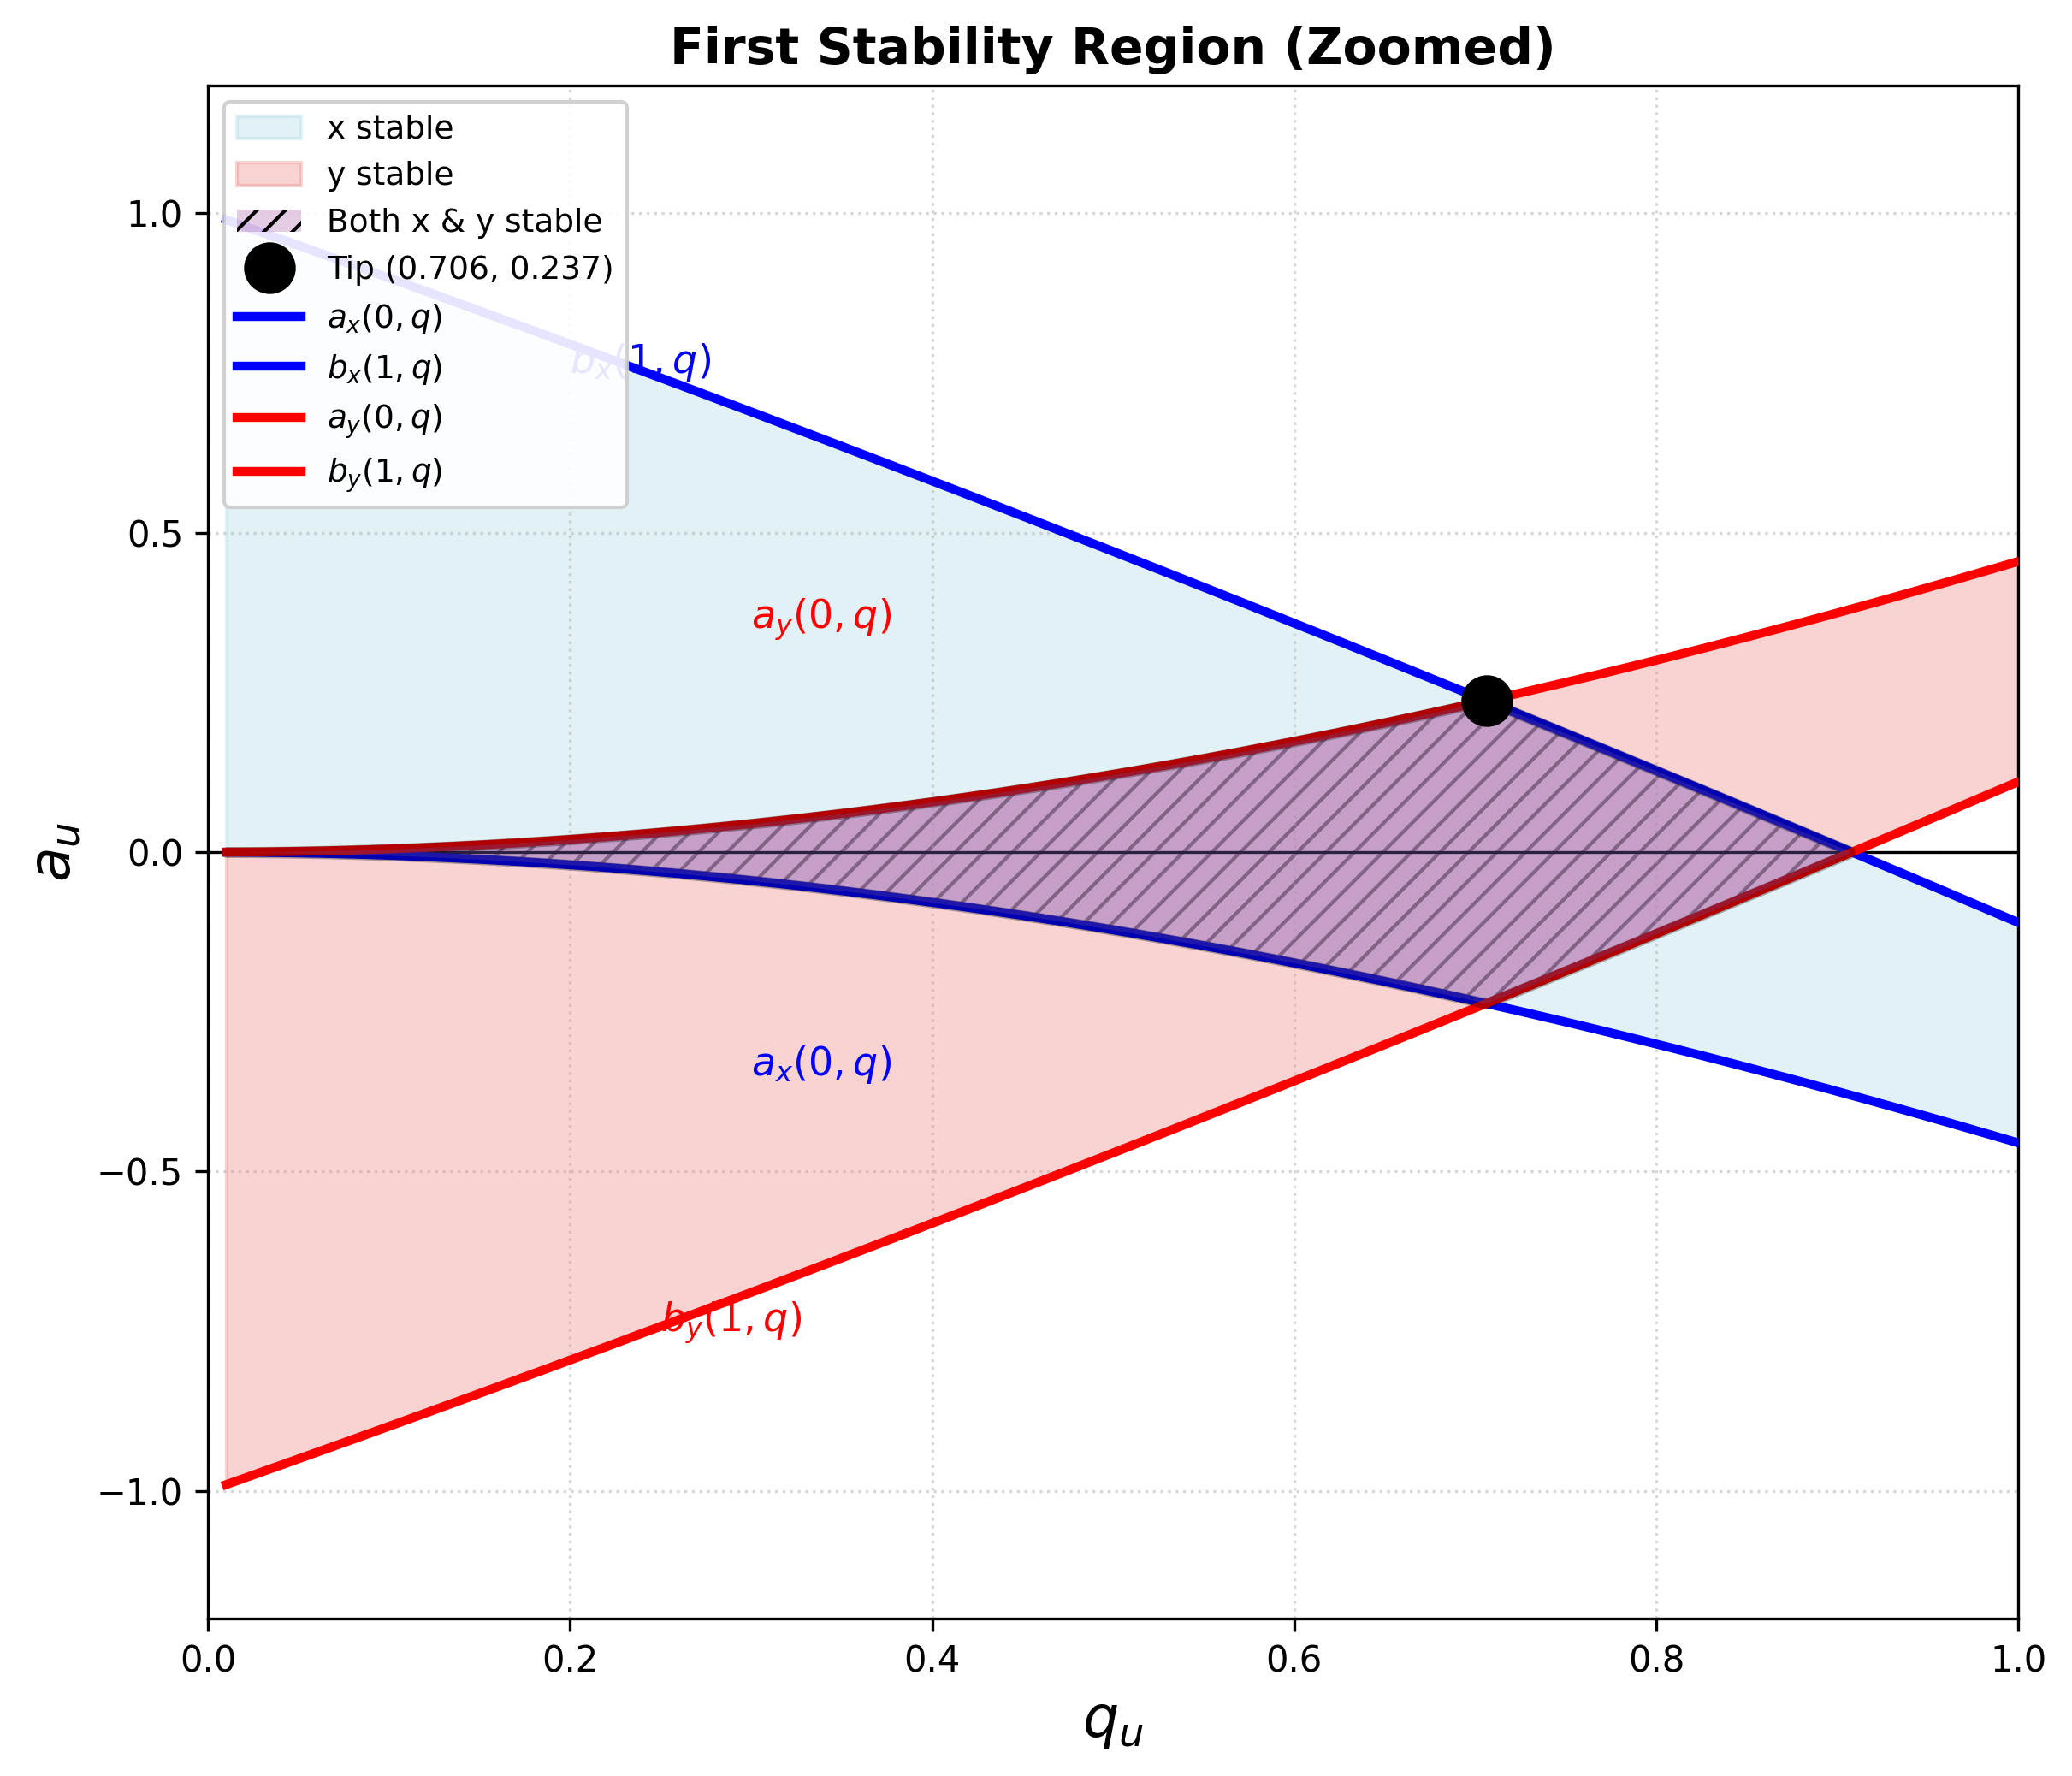
The Mathieu Equation Defines Stability in Quadrupolar Field
Where:
U = DC voltage applied to rods
V = RF voltage amplitude (0-to-peak)
m = ion mass (in amu)
r₀ = inscribed radius of quadrupole rods
Ω = angular frequency of RF (2πf)
e = elementary charge

Slide 28
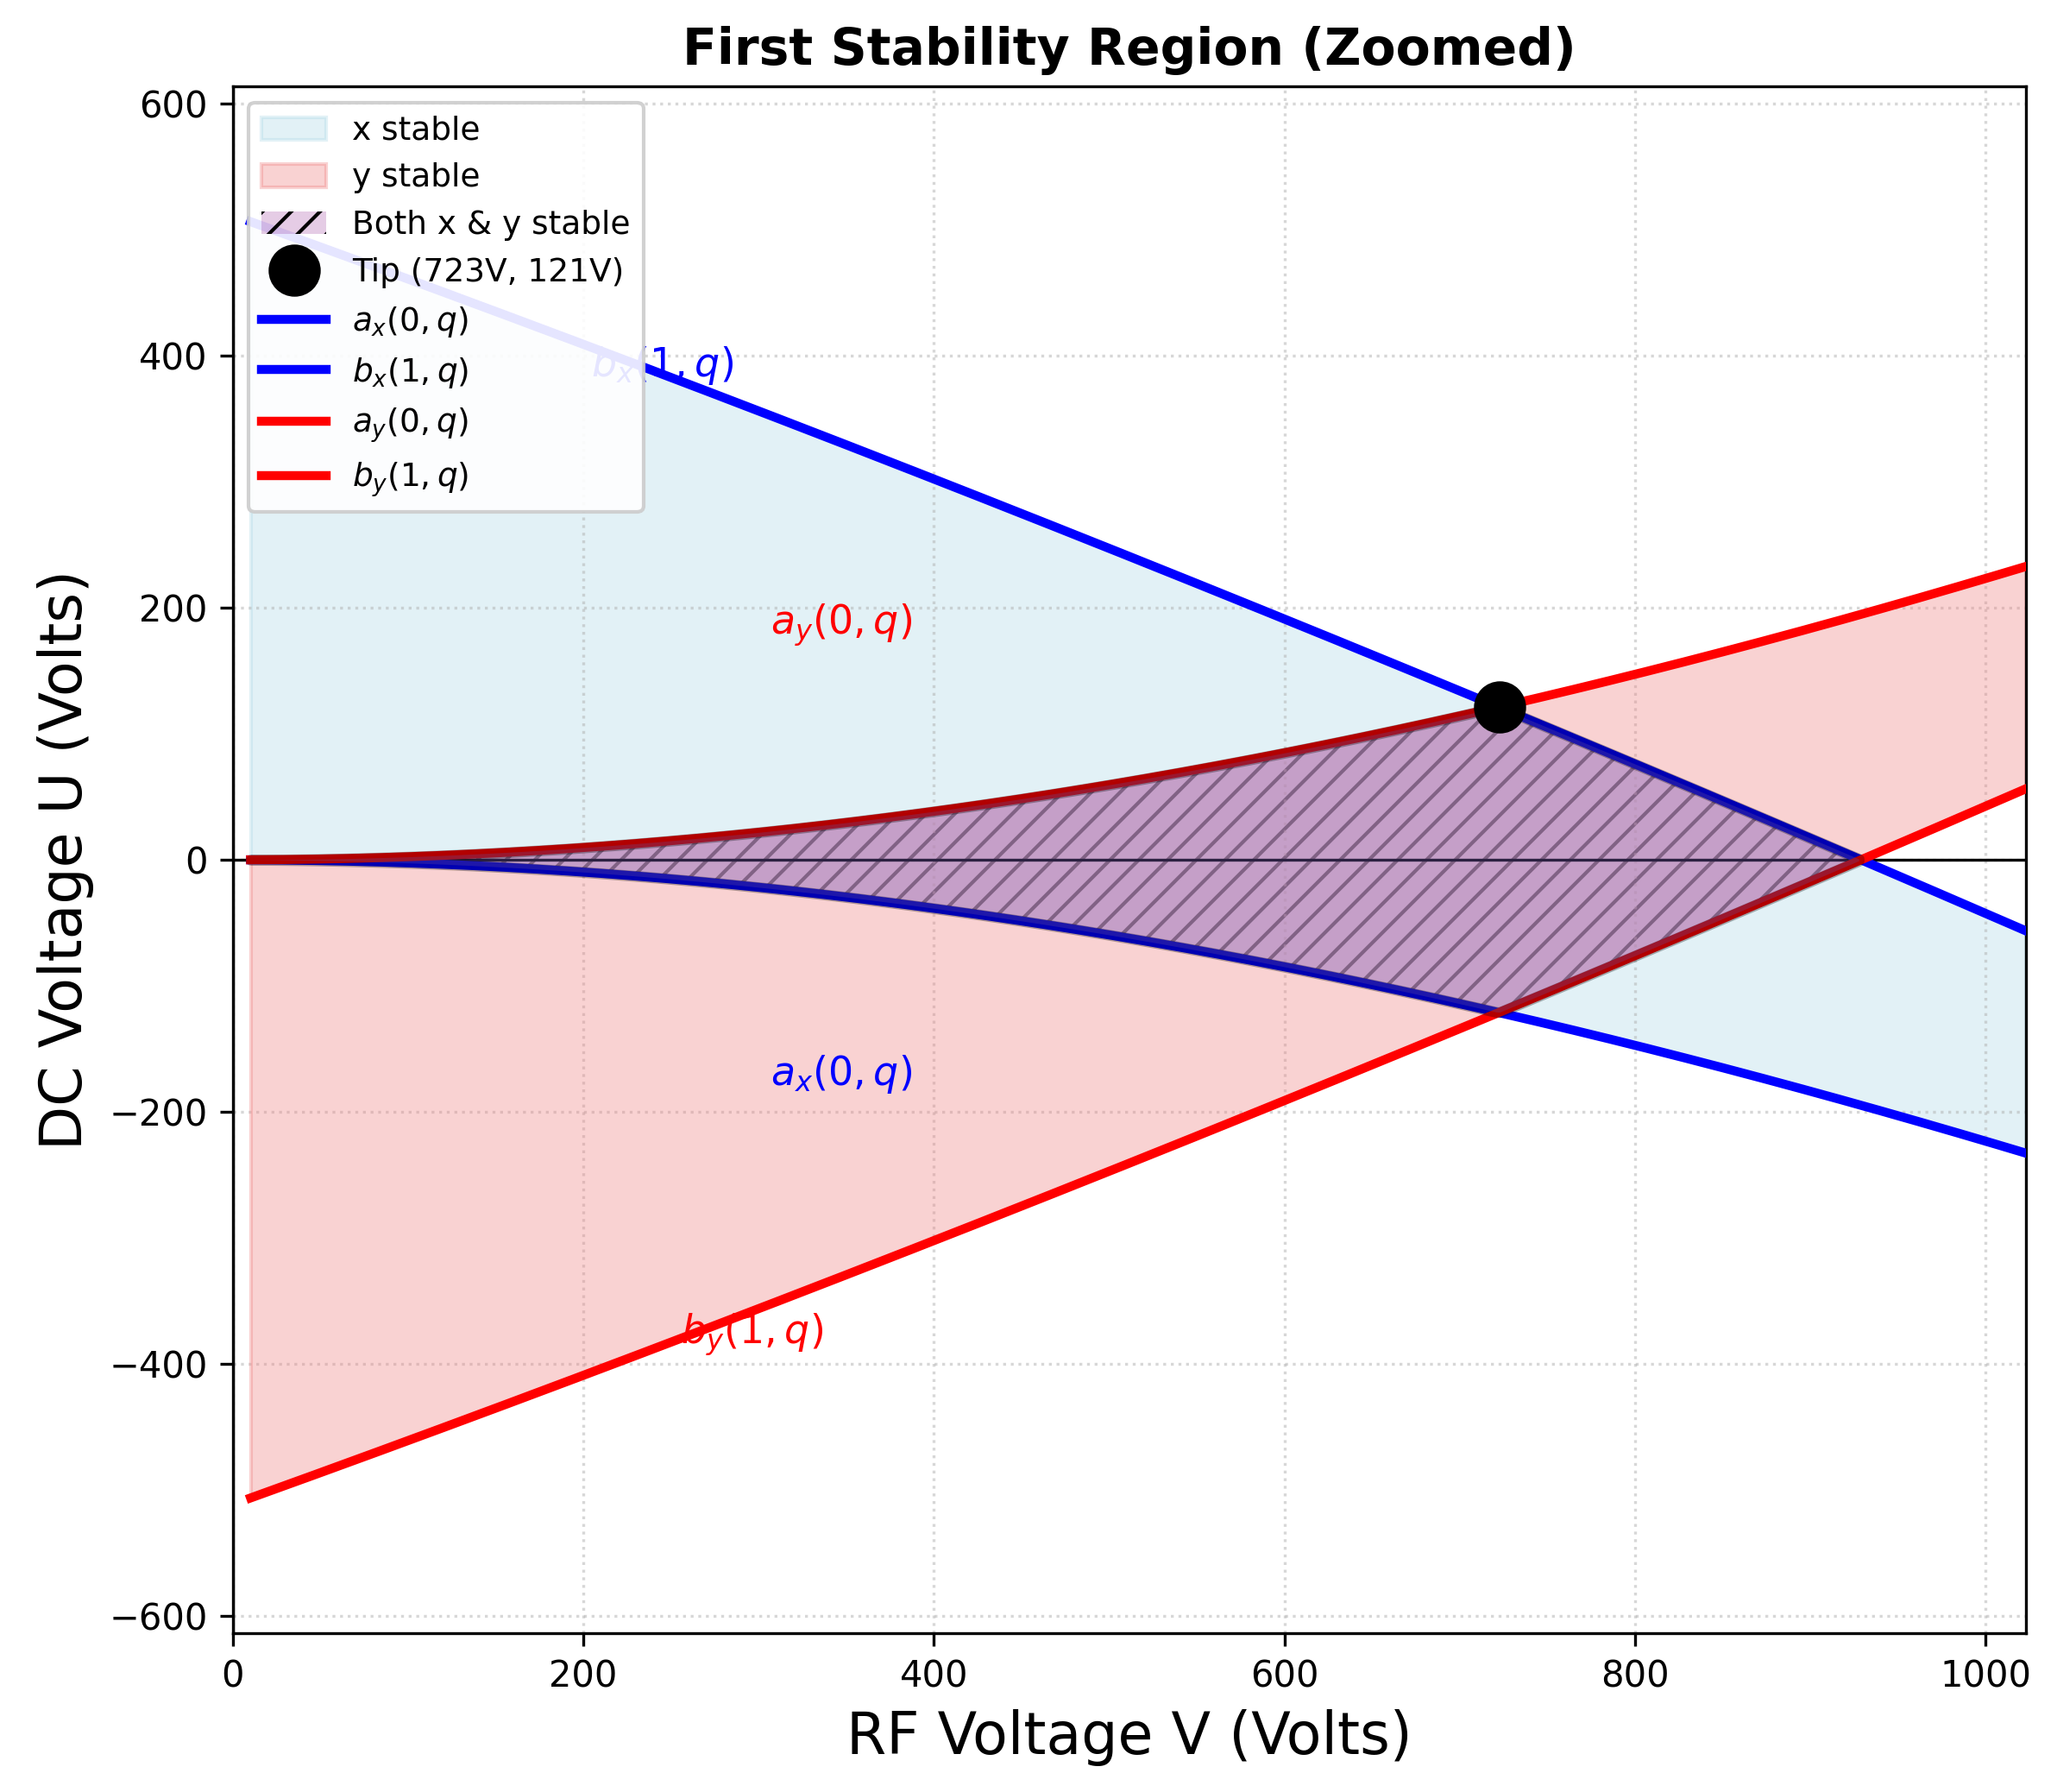
The Mathieu Equation Defines Stability in Quadrupolar Field
Where:
U = DC voltage applied to rods
V = RF voltage amplitude (0-to-peak)
m = ion mass (in amu)
r₀ = inscribed radius of quadrupole rods
Ω = angular frequency of RF (2πf)
e = elementary charge

Slide 29
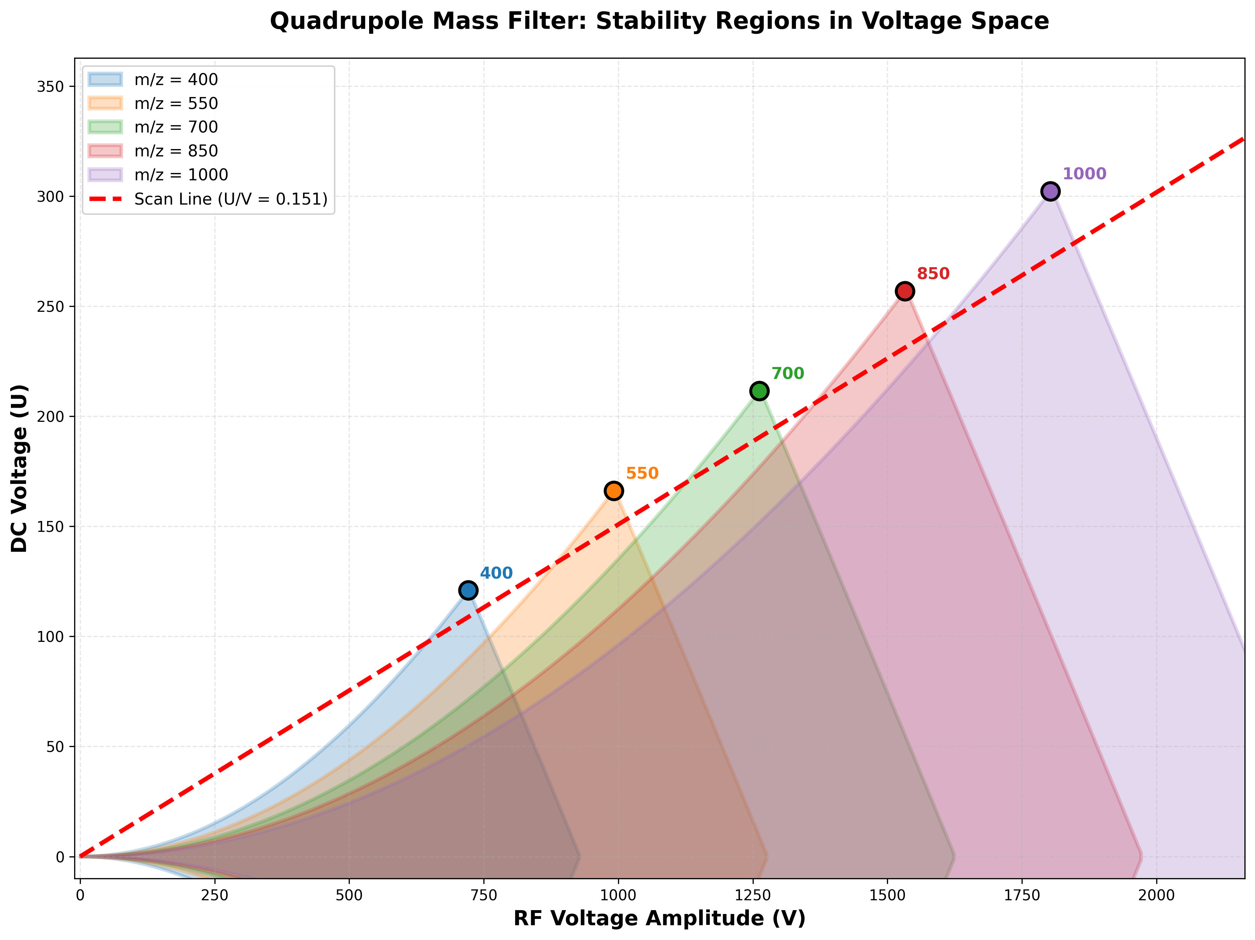
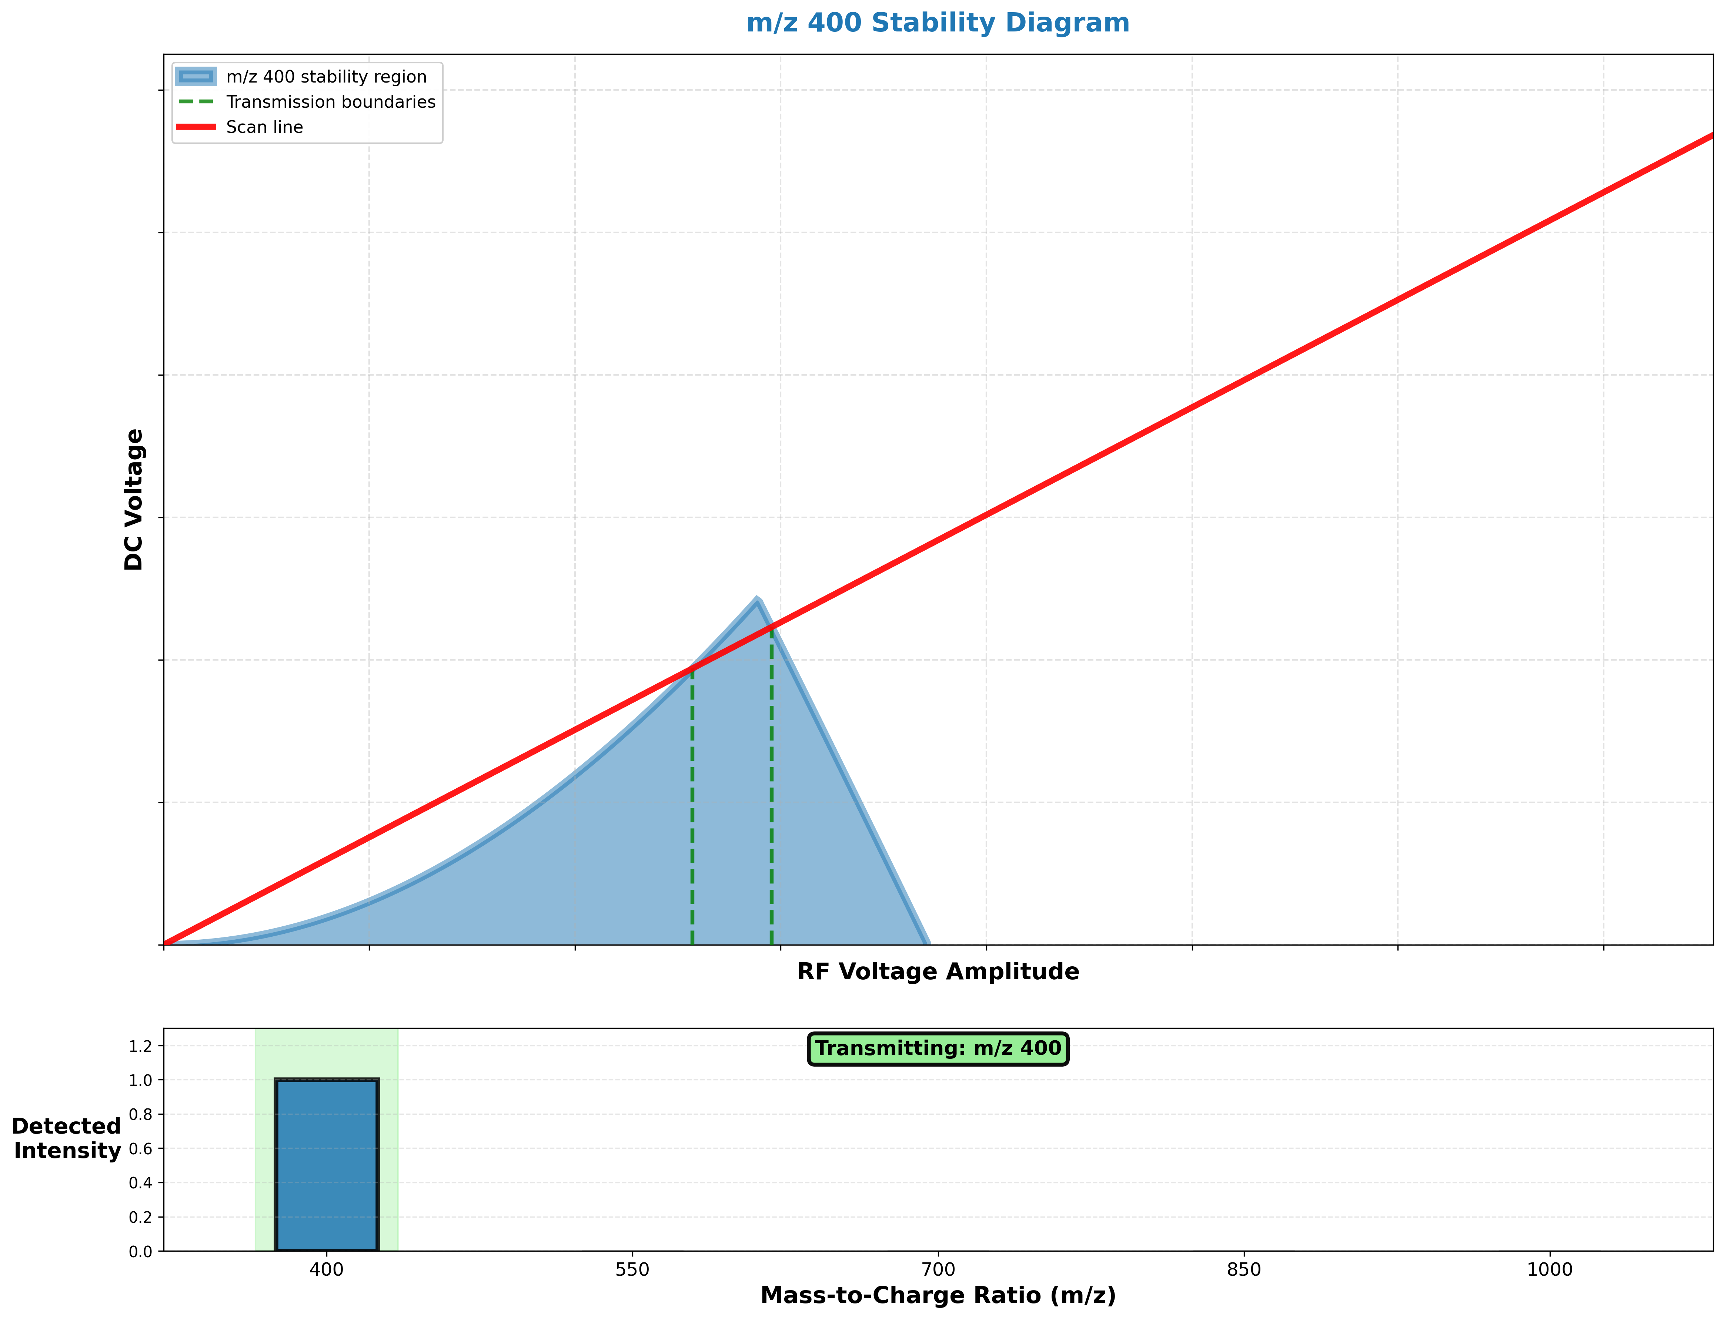
Scan RF and DC Voltages

Slide 30
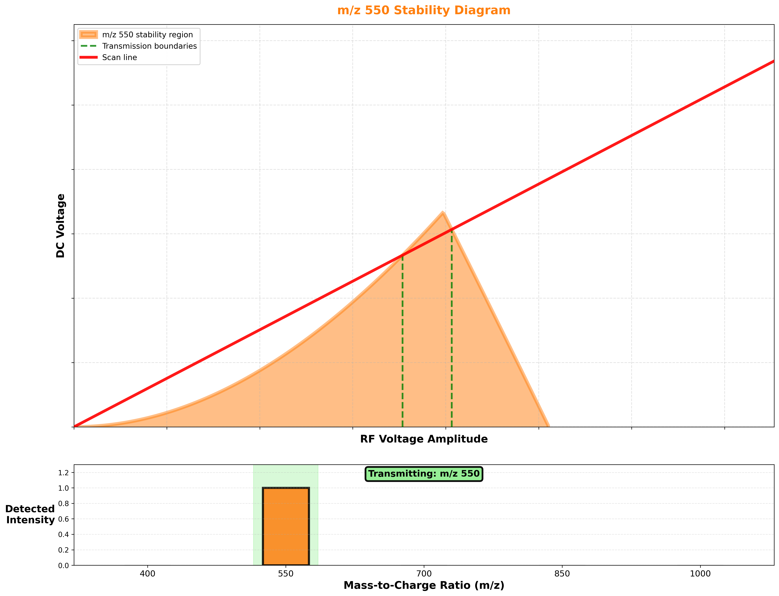
Scan RF and DC Voltages

Slide 31
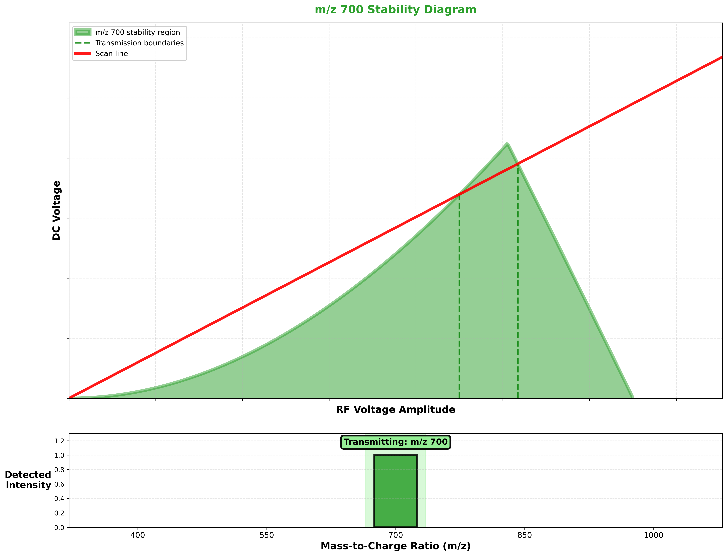
Scan RF and DC Voltages

Slide 32
Quadrupole Mass Filter
The high pass rods filter out ions
with too low of a m/z
The low pass rods filter
out ions with too high of
a m/z
A combination of DC and
RF potential is applied
and varied with time to
separate ions
high pass (+)
low pass (-)

Slide 33
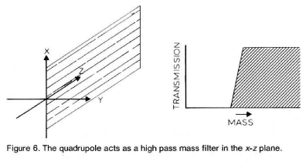
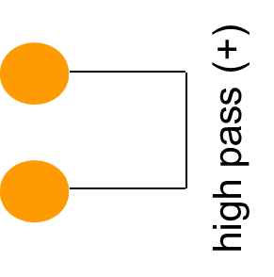
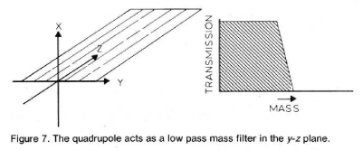
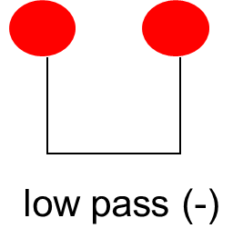
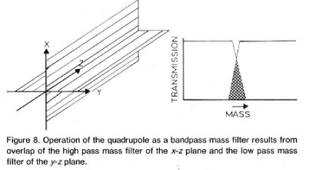
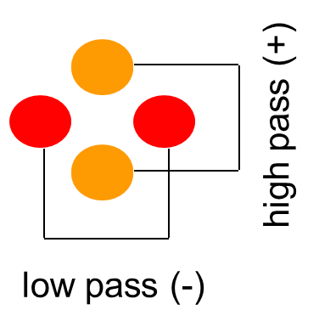
How a quadrupole mass filter works
+ DC Voltage will focus + ions on Z axis
The negative portion of an RF V will have a larger effect on a low mass ion.
Result: Only high mass ions pass
- DC Voltage will draw + ions away from Z axis
The positive portion of an RF V will have a larger effect on a low mass ion steering it along the Z axis.
Result: Only low mass ions pass
Combination of the high pass and low pass filters creates a “notch” where a narrow mass can pass.
Notes:
If an ion is very heavy and/or the frequency of the RF potential is very rapid, an ion will tend only to feel the effect of the average potential applied to the electrode structure. That is, heavy ions will tend only to be influenced by the positive dc potential. The small time when the electrodes are negative will have negligible effect on heavy ions because of the + DC field
With a negative DC voltage, a positive ion is being drawn to the electrodes. A light ion will respond better to the positive portions of the RF field.

Slide 34
Tandem Mass Spectrometry (MS/MS)
MS1
CID
MS2
ESI
100
80
60
Relative Abundance
40
20
0
400
600
800
1000
1200
1400
1600
1800
m/z
from MS1
from CID+MS2
Tandem In Space

Slide 35
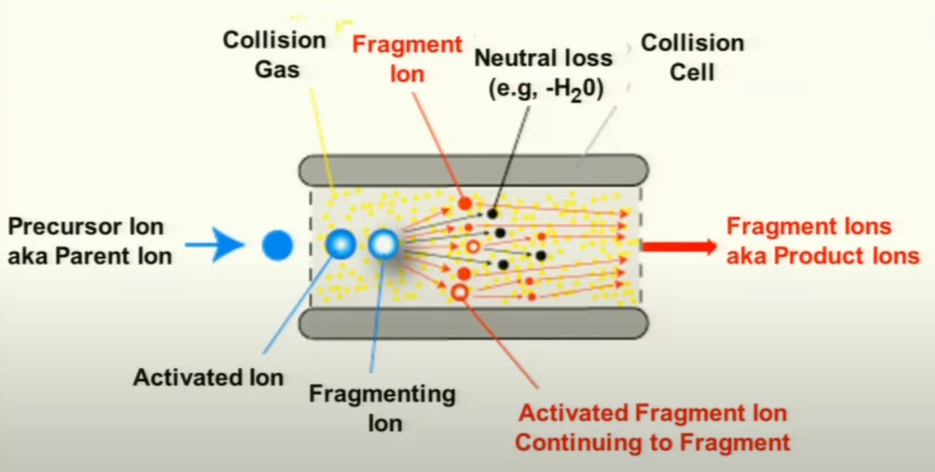
Peptides can be sequenced by breaking them into overlapping pieces by collision induced dissociation (CID)

Slide 36
Tandem Mass Spectrometry (MS/MS) Analysis Peptides
MS1
CID
MS2
Ion Source
b₁
b₂
Data System
y₂
y₁

Slide 37
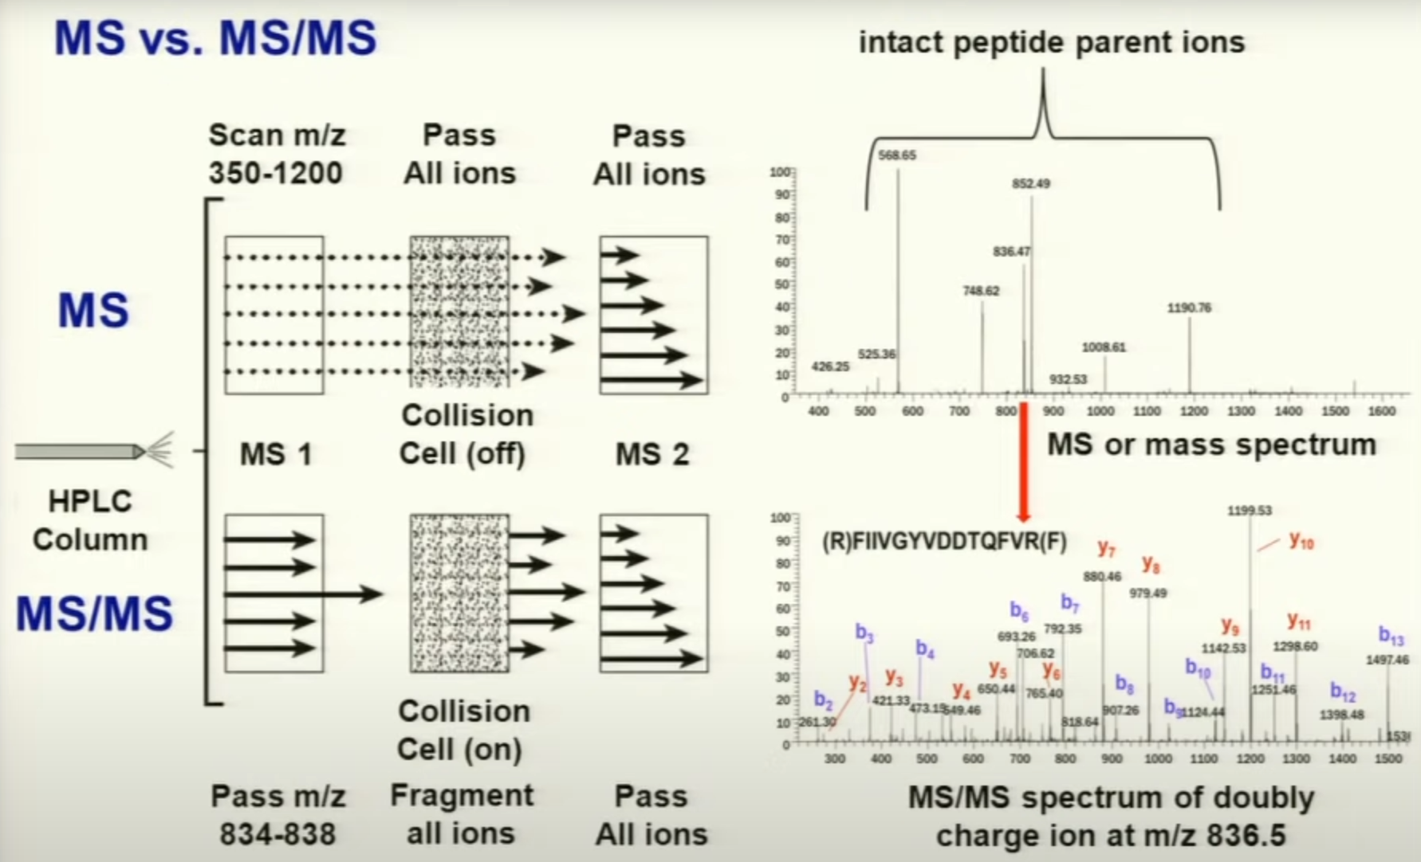

Slide 38
S Q H L F A P I S E K
Notes:
How do we derive a peptide sequence from it’s MS/MS spectrum. Predominantly amino acids are fragmented at amide bonds and because amino acids have different side chains we can the amino acid sequence from the difference in mass in adjacent fragments.

Slide 39
88
216
353
467
614
685
782
895
982
1111
S Q H L F A P I S E K
1170
1042
905
792
645
574
477
363
276
147
1042 / 2
792
M-NH₃
905
574
644
467
685
1042
353
895
1111
982
Notes:
When you look at all the spectra data together you can deduce the sequence of this peptide ion. You can see in red the masses of the peptides fragmented between the Leu and Phe residues.

Slide 40
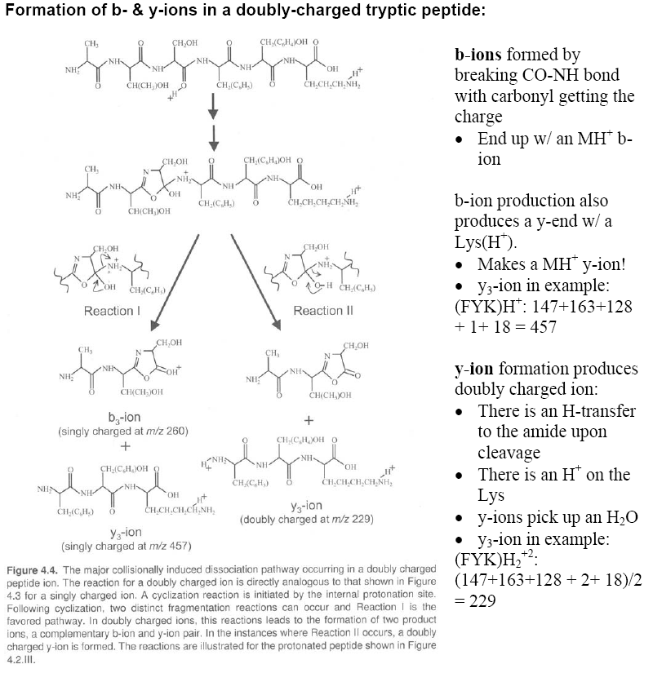

Slide 41
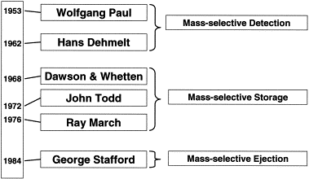
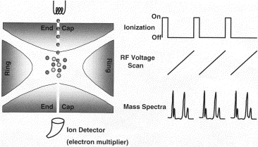
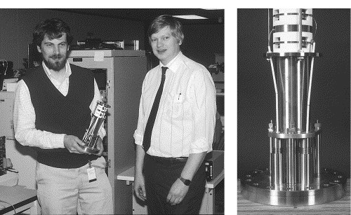

Modern ion traps make use of mass selective instability
Stafford, JASMS 2002
Notes:
John Syka and George Stafford in the bottom left

Slide 42

Acquiring Mass Spectrometry Data of Peptides
Microcapillary Column
2 kV
30 V
Peptides from the column are ionized and transmitted into the vacuum system using electrospray and trapped in the 2-dimensional ion trap

Slide 43
Acquiring Mass Spectrometry Data of Peptides
Peptides from the column are ionized and transmitted into the vacuum system using electrospray and trapped in the 2-dimensional ion trap
Ions are selectively ejected radially by their m/z to produce a mass spectrum
The instrument data-system automatically selects a m/z for further analysis
Selected m/z
Abundance
m/z

Slide 44
Acquiring a Fragmentation Spectrum
The trap is then refilled

Slide 45
Acquiring a Fragmentation Spectrum
The trap is then refilled
All ions are ejected from the trap except the predetermined m/z
The energy of the isolated ion is increased resulting in collisions with the helium gas in the trap

Slide 46
Acquiring a Fragmentation Spectrum
The collisions with the helium molecules result in structure specific fragment ions
The fragment ions are then selectively ejected to produce a tandem mass spectrum
Abundance
m/z

Slide 47

Matrix Assisted Laser Desorption/Ionization (MALDI)
Sample / Matrix
25 kV
N₂ Laser – 337 nm

Slide 48
Matrix Assisted Laser Desorption/Ionization (MALDI)
Sample / Matrix
25 kV
N₂ Laser – 337 nm

Slide 49
Matrix-Assisted Laser Desorption (MALDI) Time of Flight (TOF) Mass Spectrometry
Detector
Vacuum
337 nm N₂ UV
Laser Pulse
25 kV

Slide 50


Slide 51


Slide 52

Notes:
Heavy chains: 50-55 kDa (kilodaltons)
Light chains: 20-25 kDa
Under non-reducing conditions, intact antibody molecules or fragments, such as a full IgG at approximately 150 kDa.

Slide 53


Proteomics: Traditional Technology
2D Gel
1D Gel
N
C
N
C
Characterize peptides by mass spectrometry

Slide 54
Peptide Mass Fingerprinting
(1) Digest
protein
(2) Time of Flight
MALDI
Detector
…R ASDEWK LHPSR WEQCPEFGR…
(3) Set up
mass list
609
735
1152
…
(4) Compare mass list against protein database of peptides

Slide 55

MALDI-TOF is used for imaging

Slide 56


Slide 57


Orbitrap Mass Spectrometer

Slide 58

m/z Dependency of Resolving Power
Zubarev and Makarov, Anal Chem 2013
Notes:
Magnitude mode discards the phase information. Absorption mode corrects for the phase. The phase correction depends on the delay between excitation and detection, space charge effects, etc… enhanced FT or eFT is phase correction on the Orbitraps.

