Slide 1
Information Theory
Genome 575: Fundamentals of Biomedical Instrumentation
Brian Beliveau

Slide 2
Open questions from last week 1
How do decibels relate to SI units?
How does a speedometer know if the car is moving?
How are speedometers robust to tire/wheel size?
How does a boat speedometer work?
DBs are dimensionless
Sound pressure: Pa (kg, m, s)
It doesn’t 😓
They aren’t 😓
“Pitot tube” (water pressure -> air pressure). Or, GPS

Slide 3
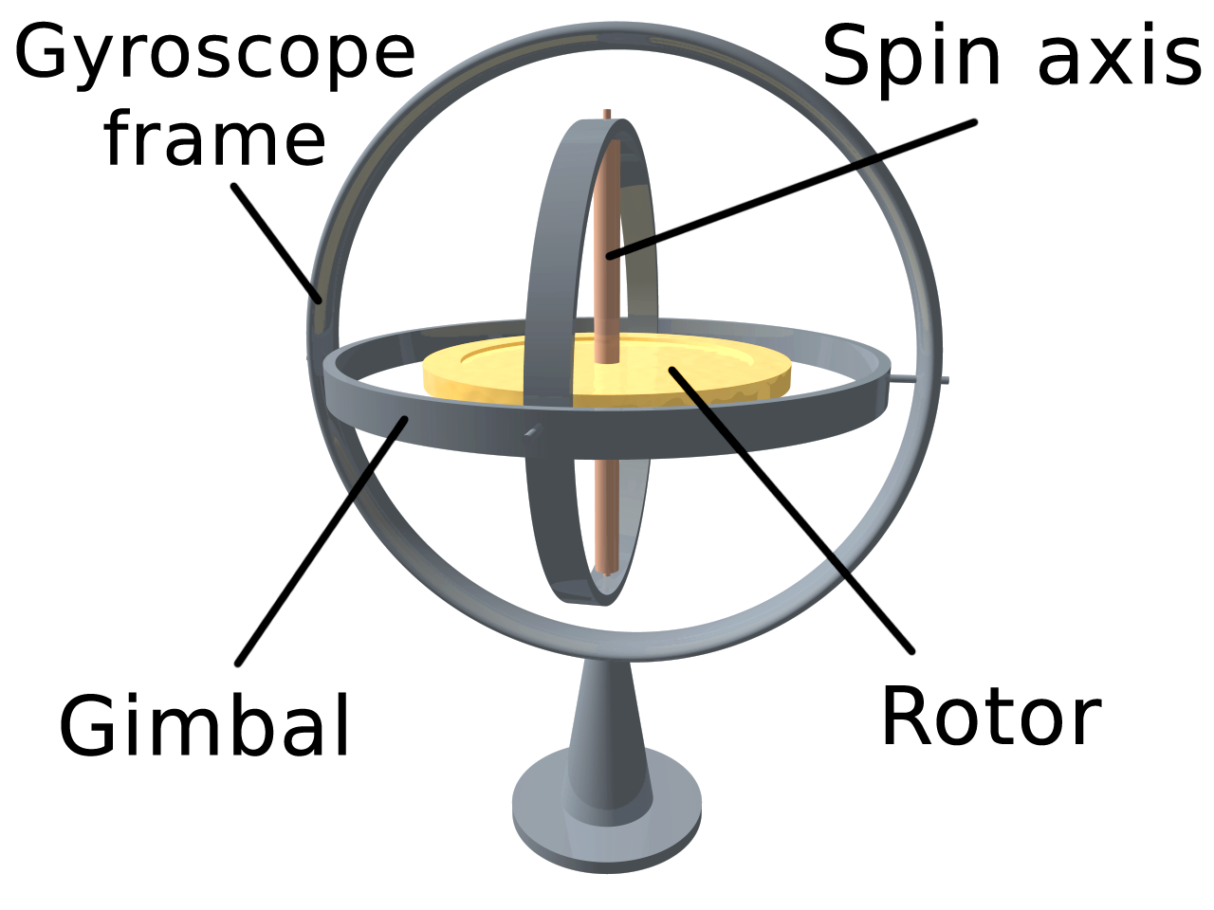
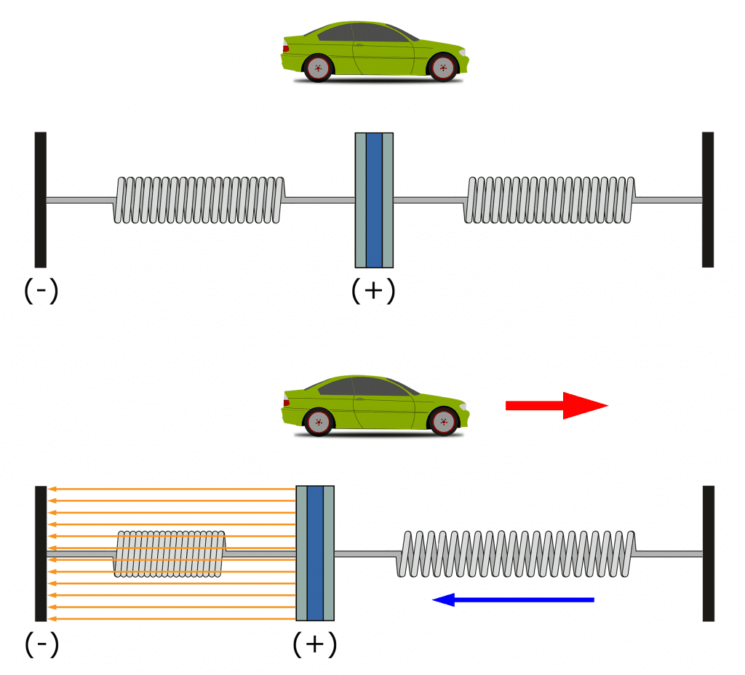
Open questions from last week 2
How do gyroscopes/accelerometers work?
Gyroscope: conservation of angular momentum
(practically, sensed similarly as accelerometers)
Accelerometer: motion-induced changes in capacitance
https://upload.wikimedia.org/wikipedia/commons/thumb/e/e2/3D_Gyroscope.png/500px-3D_Gyroscope.png, https://www.circuitbasics.com/wp-content/uploads/2021/09/How-to-Setup-an-Accelerometer-on-the-Arduino-Acceleration-Diagram.png

Slide 4
Recap from last time
The SI is defined by 7 base units and 7 associated constants
EM radiation behaves as both a wave and a particle
Photoelectric effect: incident photons with sufficient energy (h * f) can generate e⁻
Transducers convert energy between forms

Slide 5
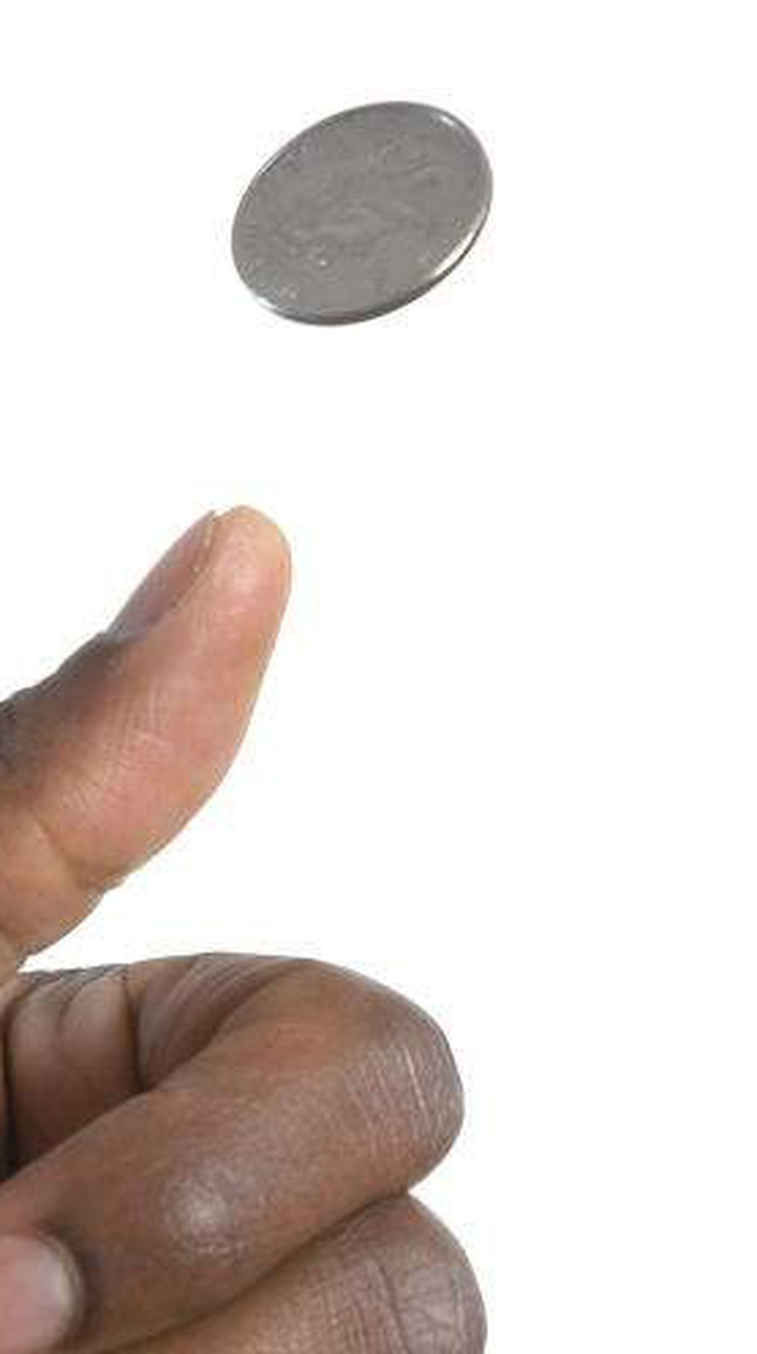

What is information?
Class activity (2 mins): What is your 1–2 sentence definition of ‘information’?
Information is the resolution of uncertainty.
Heads
❌
Tails
✅
https://www.tampabay.com/resizer/geVYWof5v2nP75k6cGzYunNkMRc=/1400x2500/smart/arc-anglerfish-arc2-prod-tbt.s3.amazonaws.com/public/KAE7GFWHDQI6TBKNIBWI6S7HAY.jpg

Slide 6
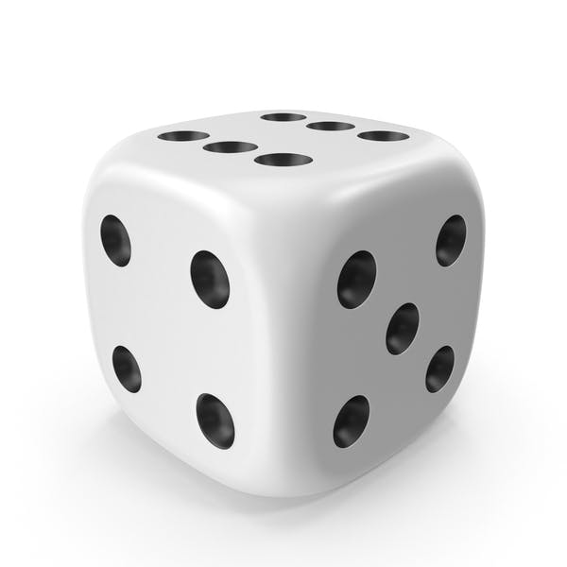
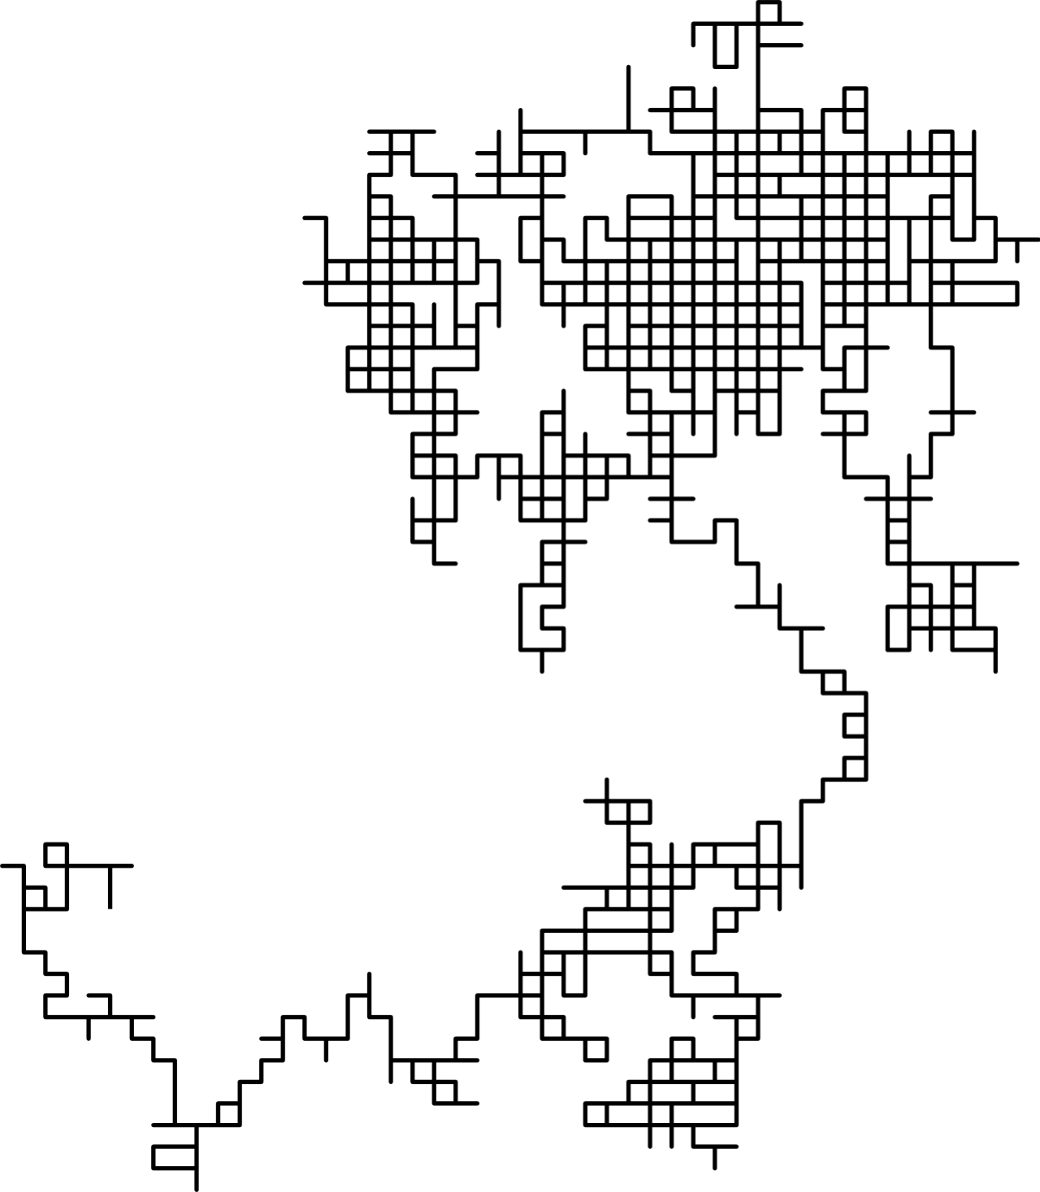
How do we use information?
Resolve/reduce uncertainty about the value of a random variable
Eg, a 6-sided die was rolled, the outcome was NOT {3, 5}
Resolve/reduce uncertainty about the outcome of a random process
Eg, N iterations of a 2D random walk
https://elements-cover-images-0.imgix.net/4452067a-740e-4bae-b81c-bb9f8e972ac4?auto=compress%2Cformat&fit=max&w=632&s=179f69732594f3c5dc283b11f4a800ca, https://upload.wikimedia.org/wikipedia/commons/thumb/7/7c/Random_walk_2500.svg/1280px-Random_walk_2500.svg.png

Slide 7

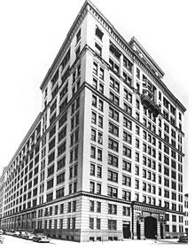
Information Theory: the backdrop
R&D branch of AT&T / Bell Systems conglomerate (monopoly)
Science and engineering powerhouse
Radio astronomy
Transistor
Laser
Photovoltaic cell
Charge-coupled device (CCD)
UNIX, C, C++, AWK, others
9 Nobel Prizes
Information Theory
https://upload.wikimedia.org/wikipedia/commons/thumb/4/4c/Bell_Laboratories_West_Street.jpg/440px-Bell_Laboratories_West_Street.jpg

Slide 8
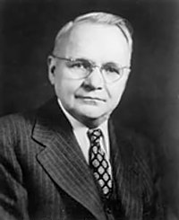
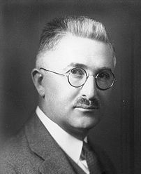
Information Theory: early contributions
Harry Nyquist
Ralph Hartley
Certain Factors Affecting Telegraph Speed (1924)
Framework for quantifying information transmission
Transmission of Information (1928)
Explicitly defined information as measurable
https://upload.wikimedia.org/wikipedia/en/b/b4/Harry_Nyquist.jpg, https://upload.wikimedia.org/wikipedia/commons/thumb/0/01/Hartley_ralph-vinton-lyon-001.jpg/440px-Hartley_ralph-vinton-lyon-001.jpg

Slide 9
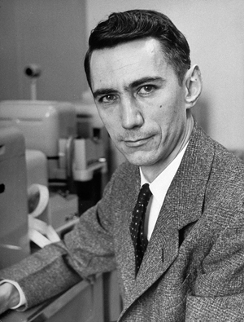
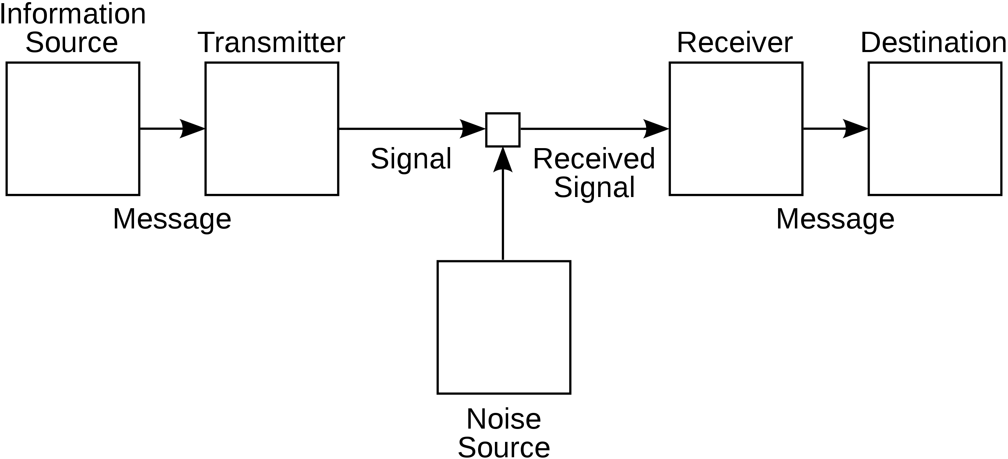
Information Theory
A Mathematical Theory of Communication (1948)
Established Information Theory
Claude Shannon
https://spectrum.ieee.org/media-library/img.jpg?id=25583467&width=600&quality=80, https://upload.wikimedia.org/wikipedia/commons/thumb/f/f3/Shannon_communication_system.svg/2880px-Shannon_communication_system.svg.png

Slide 10
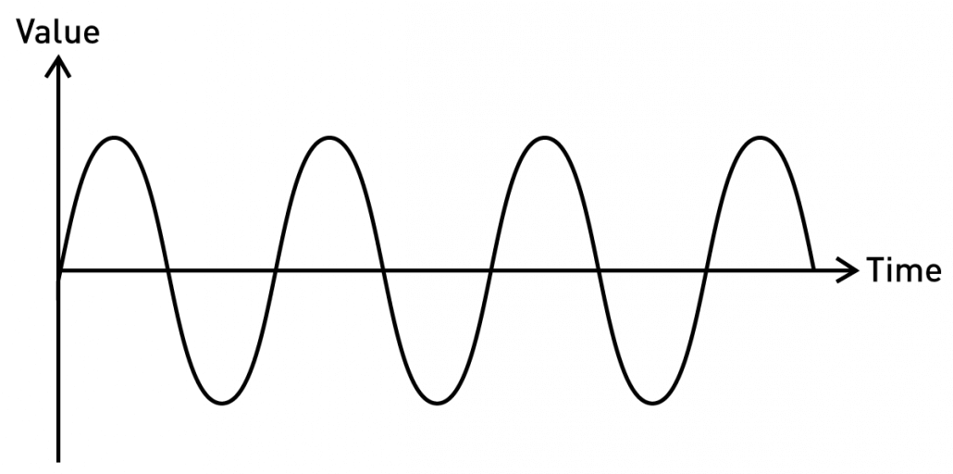
Types of information
Continuous / Analog
Fully defined. Ie, f(t) == val for any t (in some interval)
Properties such as f, wavelength, amplitude can convey information
https://blog.seeedstudio.com/wp-content/uploads/2020/06/sine-new-1030x512.png

Slide 11
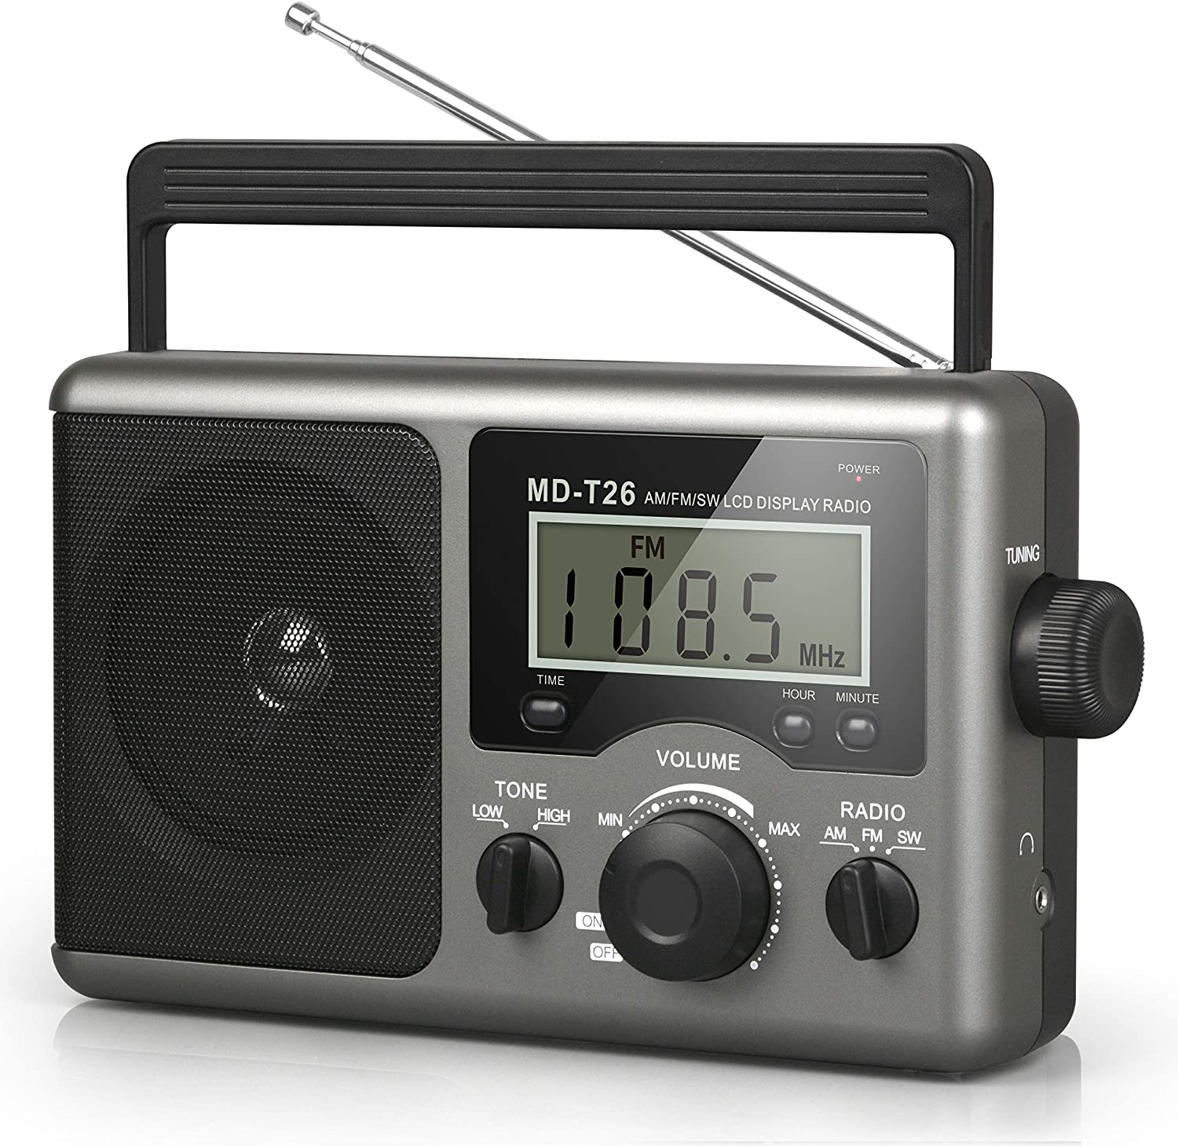
Information sources
Continuous / Analog
https://m.media-amazon.com/images/I/919+p6SXzfL._AC_SL1500_.jpg, https://upload.wikimedia.org/wikipedia/commons/a/a4/Amfm3-en-de.gif

Slide 12
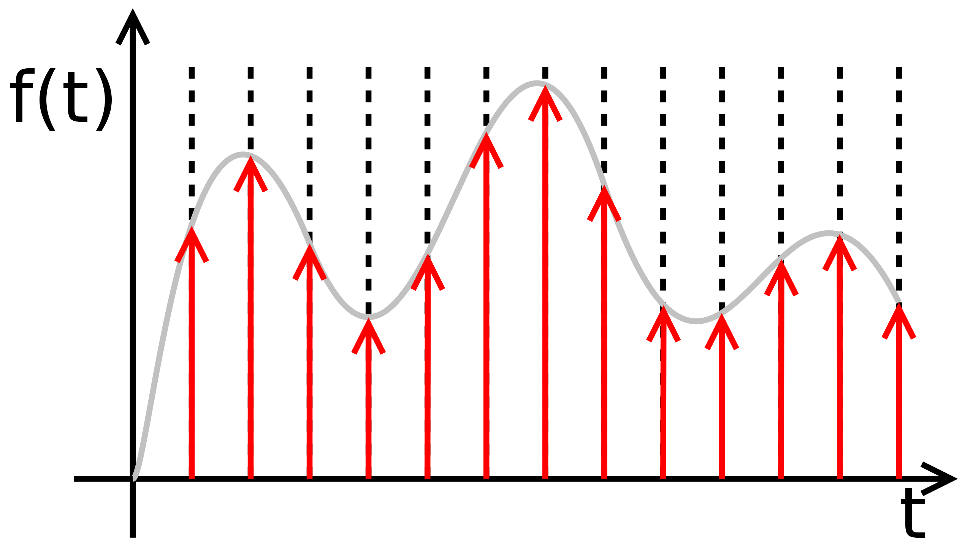
Sampling information
Continuous information can be sampled at discrete points
Choice of sampling rate / positions important
https://upload.wikimedia.org/wikipedia/commons/thumb/8/88/Sampled.signal.svg/2560px-Sampled.signal.svg.png

Slide 13
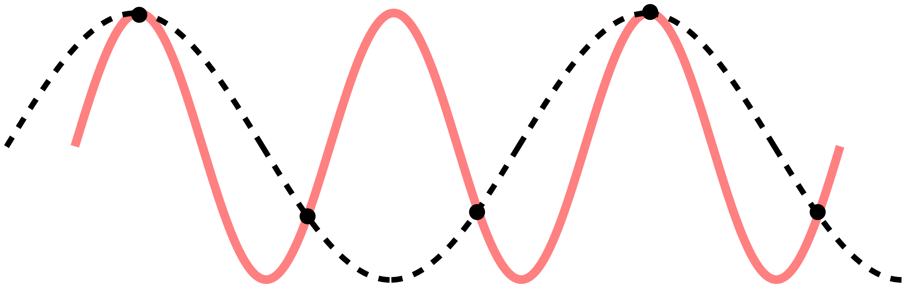
Shannon-Nyquist sampling
Sampling rate needs to be ≥2X the highest f
Undersampling can lead to aliasing
https://upload.wikimedia.org/wikipedia/commons/thumb/a/af/CPT-sound-nyquist-thereom-1.5percycle.svg/2880px-CPT-sound-nyquist-thereom-1.5percycle.svg.png

Slide 14
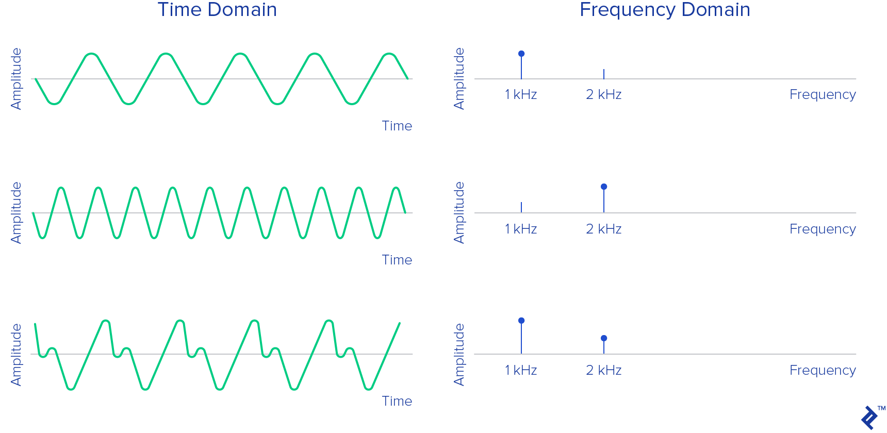
Discretizing continuous information
Discrete Fourier Transform / Fast Fourier Transform (DFT/FFT)
https://uploads.toptal.io/blog/image/125591/toptal-blog-image-1520338035137-556134ab6978d28ec618893041189e54.png

Slide 15
Digitizing continuous information
1
0
1
0
1
Discrete Fourier Transform / Fast Fourier Transform (DFT/FFT)
https://commons.wikimedia.org/wiki/File%3AFourier_synthesis_square_wave_animated.gif

Slide 16
Quantizing information
Heads
❌
Tails
✅
How do we quantize information?
How much information is contained in a coin flip?
https://www.tampabay.com/resizer/geVYWof5v2nP75k6cGzYunNkMRc=/1400x2500/smart/arc-anglerfish-arc2-prod-tbt.s3.amazonaws.com/public/KAE7GFWHDQI6TBKNIBWI6S7HAY.jpg

Slide 17
Quantizing information
Heads
❌
Tails
✅
Two possible outcomes (discrete, binary)
Fair coin: P(Heads) = P(Tails) = 1/2
Given Tails is observed, how much information was gained?
https://www.tampabay.com/resizer/geVYWof5v2nP75k6cGzYunNkMRc=/1400x2500/smart/arc-anglerfish-arc2-prod-tbt.s3.amazonaws.com/public/KAE7GFWHDQI6TBKNIBWI6S7HAY.jpg

Slide 18
Information entropy
Claude Shannon
H = entropy
X = a discrete random variable
P(x_{i}) = P(X = x_{i})
Log₂: bits/“shannons”
Ln: “nats”
Log₁₀: “dits” / “bans” / “hartleys”
https://spectrum.ieee.org/media-library/img.jpg?id=25583467&width=600&quality=80

Slide 19
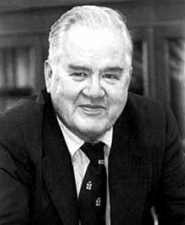
Storing information
John Tukey
Claude Shannon
Binary Digit -> “bit” (portmanteau)
8 bits = 1 byte (256 possible values)
16-bit camera (bounds value space) vs 25 MB file (size of chunked data for compute)
https://upload.wikimedia.org/wikipedia/en/e/e9/John_Tukey.jpg, https://spectrum.ieee.org/media-library/img.jpg?id=25583467&width=600&quality=80

Slide 20
Calculating information entropy
Heads
❌
Tails
✅
H(coin toss) = - [P(Heads) * log₂(P(Heads)) + P(Tails) * log₂(P(Tails))]
Fair coin: P(Heads) = P(Tails) = 1/2
H(coin toss) = - [1/2 * log₂(1/2) + 1/2 * log₂(1/2) ] = - [-1/2 + -1/2] = 1 bit
https://www.tampabay.com/resizer/geVYWof5v2nP75k6cGzYunNkMRc=/1400x2500/smart/arc-anglerfish-arc2-prod-tbt.s3.amazonaws.com/public/KAE7GFWHDQI6TBKNIBWI6S7HAY.jpg

Slide 21
Calculating information entropy
Heads
❌
Tails
✅
H(coin toss) = - [P(Heads) * log₂(P(Heads) + P(Tails) * log₂(P(Tails)]
Unfair coin: P(Heads) ≠ P(Tails); P(Heads) = 0.7, P(Tails) = 0.3
H(coin toss) = - [7/10 * log₂(7/10) + 3/10 * log₂(3/10) ] = - [0.7 * -0.52 + 0.3 * -1.7 ] = [-0.36 + -0.52] = 0.88 bits
Why is there less information?
https://www.tampabay.com/resizer/geVYWof5v2nP75k6cGzYunNkMRc=/1400x2500/smart/arc-anglerfish-arc2-prod-tbt.s3.amazonaws.com/public/KAE7GFWHDQI6TBKNIBWI6S7HAY.jpg

Slide 22
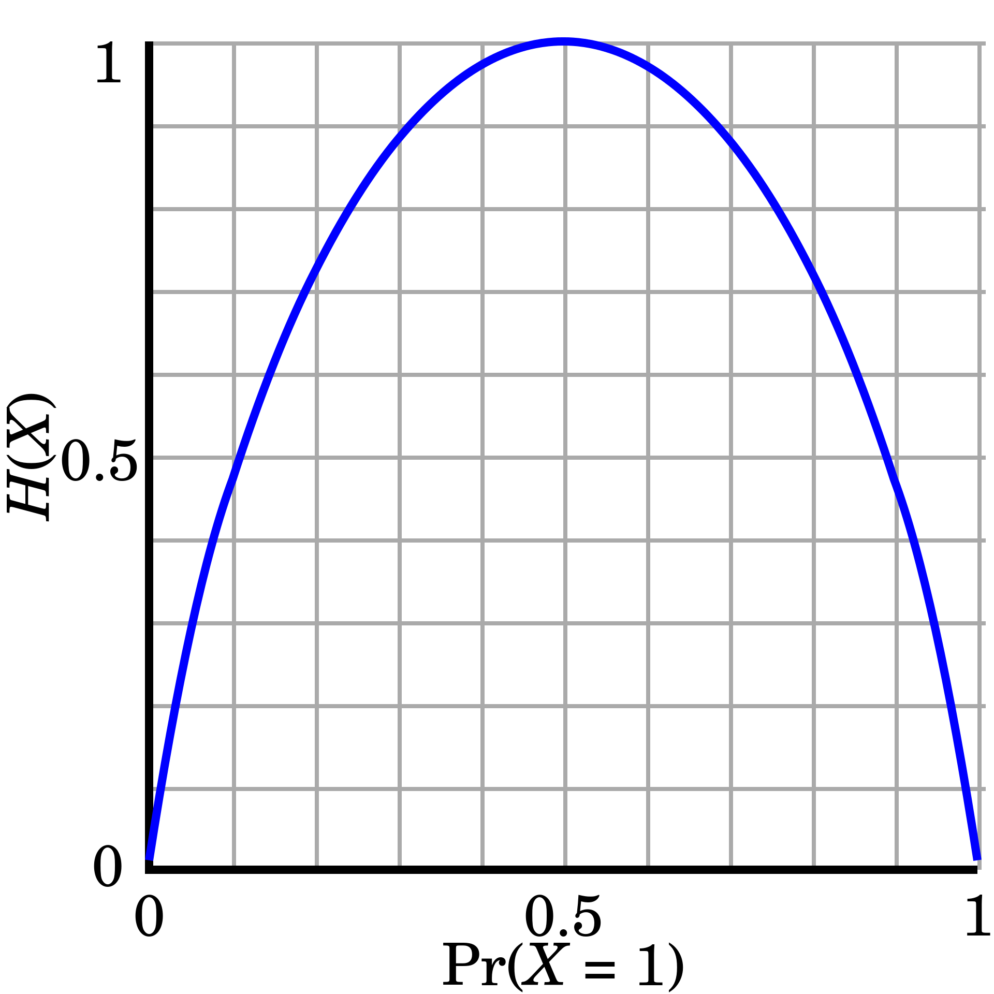
Entropy measures “surprisal”
Outcomes where P=1: no surprise, H=0
As uncertainty increases, H increases
Greater uncertainty in outcome, more likely to be “surprised”
https://upload.wikimedia.org/wikipedia/commons/thumb/2/22/Binary_entropy_plot.svg/1920px-Binary_entropy_plot.svg.png

Slide 23
Information gains
Heads
❌
Tails
✅
I(x) = - log(P(X=x))
Fair coin: I(Tails) = - log₂(1/2) = 1 bit
Unfair coin with P(Tails) = 0.7: I(Tails) = - log₂(7/10) = 0.52 bits
Unfair coin with P(Tails) = 0.3: I(Tails) = - log₂(3/10) = 1.74 bits
Why does scenario three have the greatest I?
https://www.tampabay.com/resizer/geVYWof5v2nP75k6cGzYunNkMRc=/1400x2500/smart/arc-anglerfish-arc2-prod-tbt.s3.amazonaws.com/public/KAE7GFWHDQI6TBKNIBWI6S7HAY.jpg

Slide 24
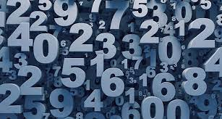
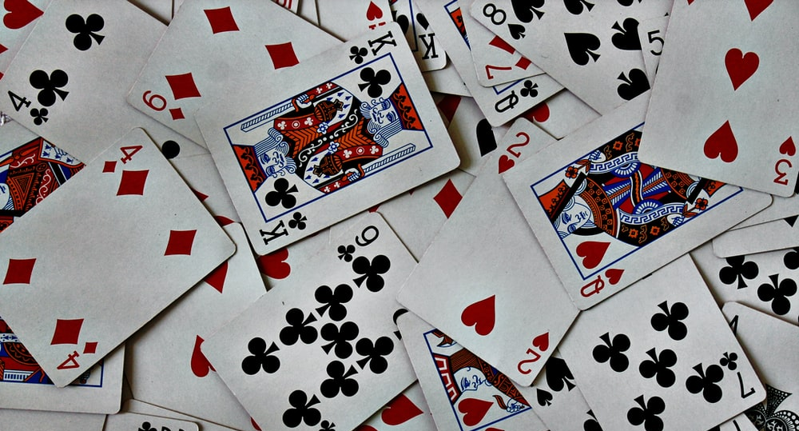
Game time!
Two teams
Phones/computers away
https://www.sciencenews.org/wp-content/uploads/2018/05/050718_EC_numbers_feat.jpg, https://images.unsplash.com/photo-1541278107931-e006523892df?ixlib=rb-1.2.1&ixid=MnwxMjA3fDB8MHxzZWFyY2h8MXx8Y2FyZHN8ZW58MHx8MHx8&w=1000&q=80

Slide 25
Game 1: Guess that number!
N = randint(1,100)
Your guess: a integer between 1–100
The reveal: “Match” OR “higher” OR “lower”

Slide 26
Game 2: Guess that card!
Hidden: a single card draw, standard 52-card deck
Guess | Reveal
Value | “Match” OR “higher” OR “lower”
Suit | “Yes” OR “No”
Color | “Yes” OR “No”

