Slide 1
Fluorescent Labels
Genome 575: Fundamentals of Biomedical Instrumentation
Brian Beliveau

Slide 2
Recap from last time
Optical systems typically have a defined number of channels
The number of channels is bounded by several factors including label availability and transmission/detection efficiencies
Filters and dichroic mirrors are typically short pass, band pass, or long pass
Adding more channels -> reduced information you can get from any single channel

Slide 3

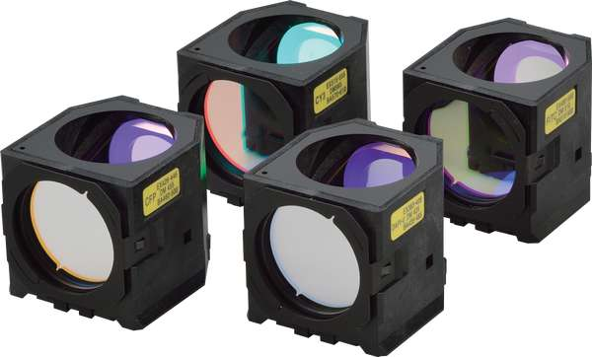
On filters…
It’s complicated!
Let’s walk through some real use cases
https://i.ytimg.com/vi/y4dJOFUVk30/maxresdefault.jpg, https://d33b8x22mym97j.cloudfront.net/production/imager/productphotos/827/filter-cubes-main_ec7d1033075031a0254a7350f4e87eb4.jpg

Slide 4
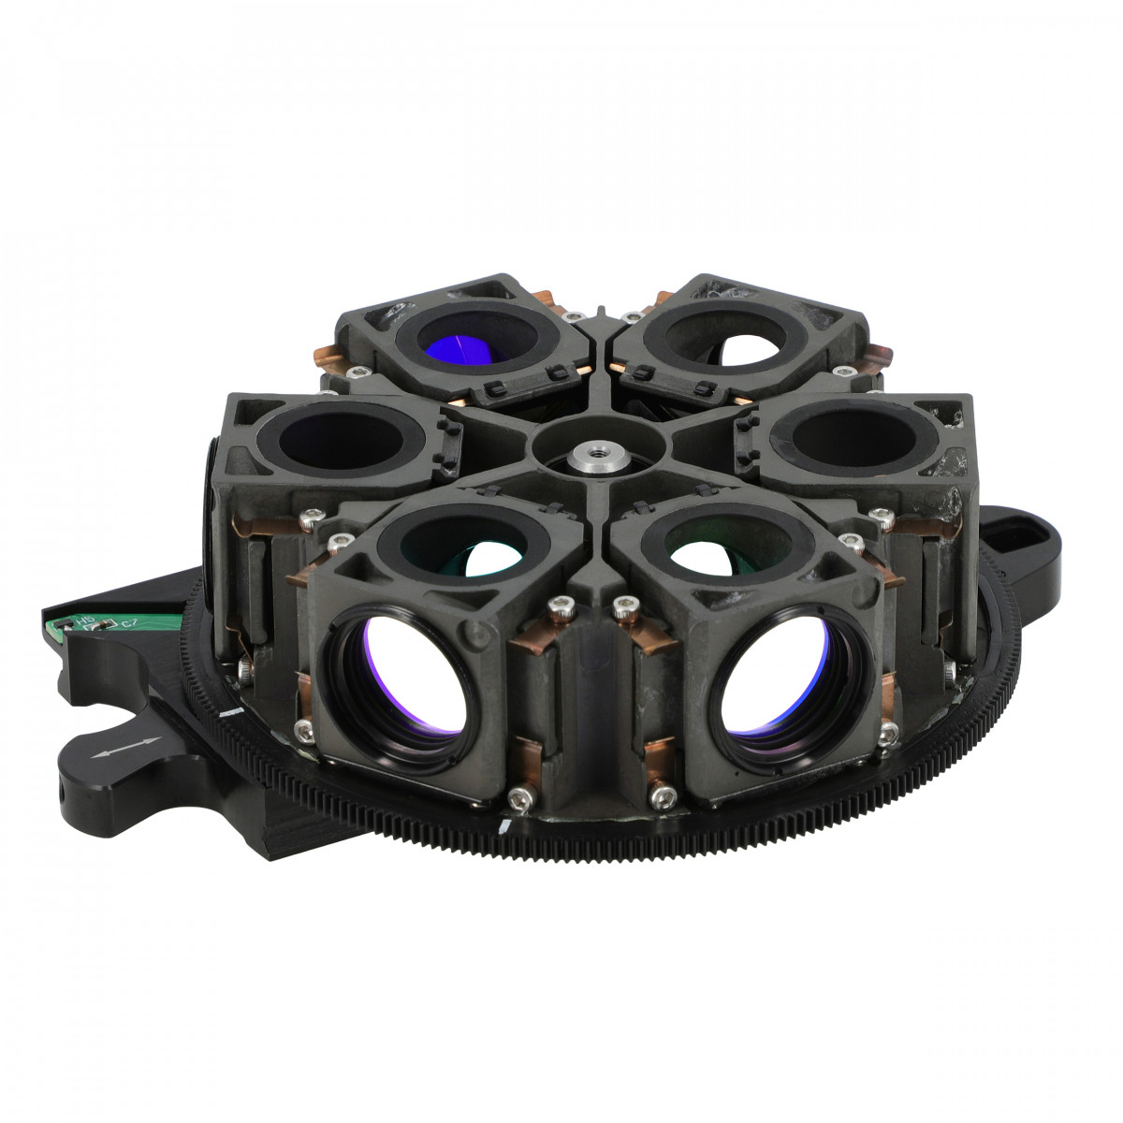
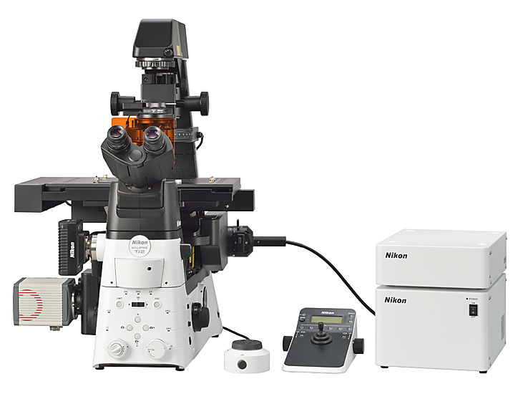
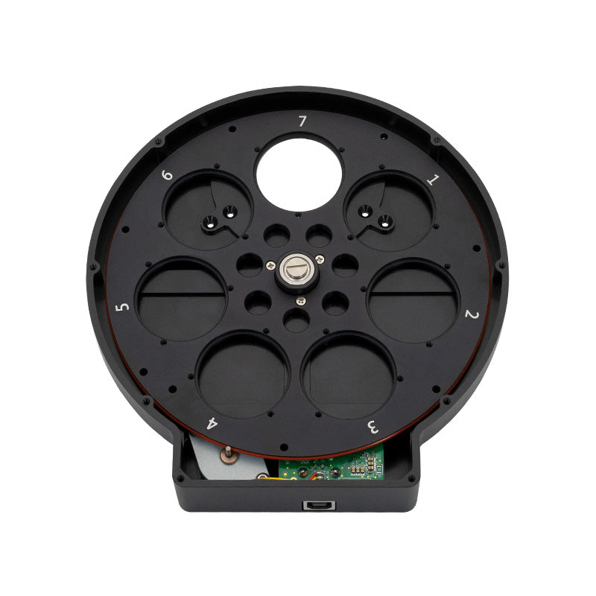
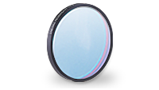
The Beliveau Lab microscopes
6 filter cubes
7 individual (Em) filters
https://www.nikon.com/news/2016/img/pic_161109_01.jpg, https://accu-scope.com/media/catalog/product/cache/1/thumbnail/1200x/17f82f742ffe127f42dca9de82fb58b1/6/0/600-3232.jpg, https://cdn.shopify.com/s/files/1/1594/4815/products/061_1200x.jpg?v=1618498984, https://i.ytimg.com/vi/y4dJOFUVk30/maxresdefault.jpg, https://d33b8x22mym97j.cloudfront.net/production/imager/productphotos/827/filter-cubes-main_ec7d1033075031a0254a7350f4e87eb4.jpg, https://www.chroma.com/sites/default/files/individual-filters-small.png

Slide 5
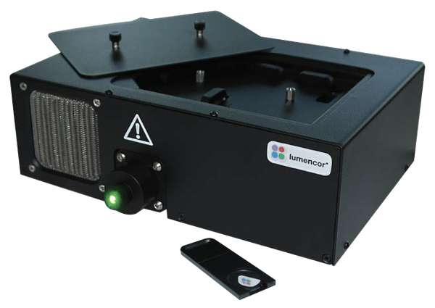
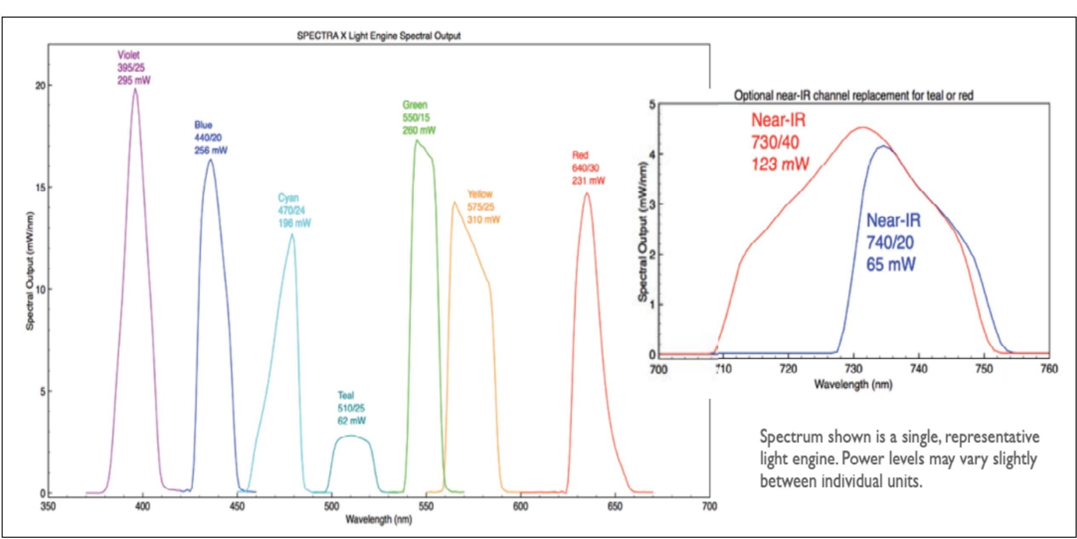
Use case 1: widefield LED imaging
Goal: Speed
7 -line LED system
395/25
438/29
474/28
510/25
555/28
640/30
730/40
https://cms.lumencor.com/system/uploads/fae/image/asset/565/xl_Lumencor_SPECTRAX_ProductGallery-5_2021.jpg, https://cms.lumencor.com/system/uploads/fae/file/asset/30/SPECTRA_X_Light_Engine.pdf?_gl=1*h2z2ow*_ga*OTc4OTE4MzE0LjE2NDk5NjUxNDk.*_ga_364GJZVK77*MTY1MDY2MjAzOS4xLjAuMTY1MDY2MjA1MS40OA..

Slide 6
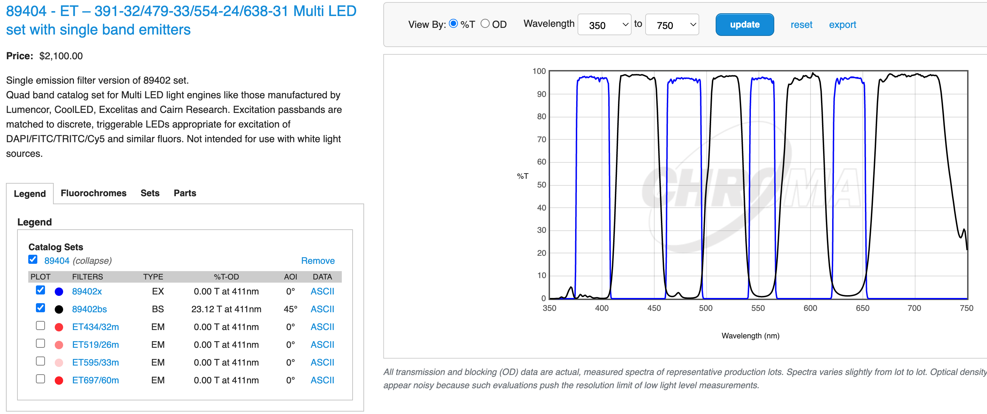
Use case 1: widefield LED imaging
Goal: Speed
7-line LED system
395/25
438/29
474/28
510/25
555/28
640/30
730/40
https://cms.lumencor.com/system/uploads/fae/image/asset/565/xl_Lumencor_SPECTRAX_ProductGallery-5_2021.jpg, https://www.chroma.com/products/sets/89404-et-391-32-479-33-554-24-638-31-multi-led-set-with-single-band-emitters, https://cdn.shopify.com/s/files/1/1594/4815/products/061_1200x.jpg?v=1618498984, https://i.ytimg.com/vi/y4dJOFUVk30/maxresdefault.jpg, https://d33b8x22mym97j.cloudfront.net/production/imager/productphotos/827/filter-cubes-main_ec7d1033075031a0254a7350f4e87eb4.jpg, https://www.chroma.com/sites/default/files/individual-filters-small

Slide 7
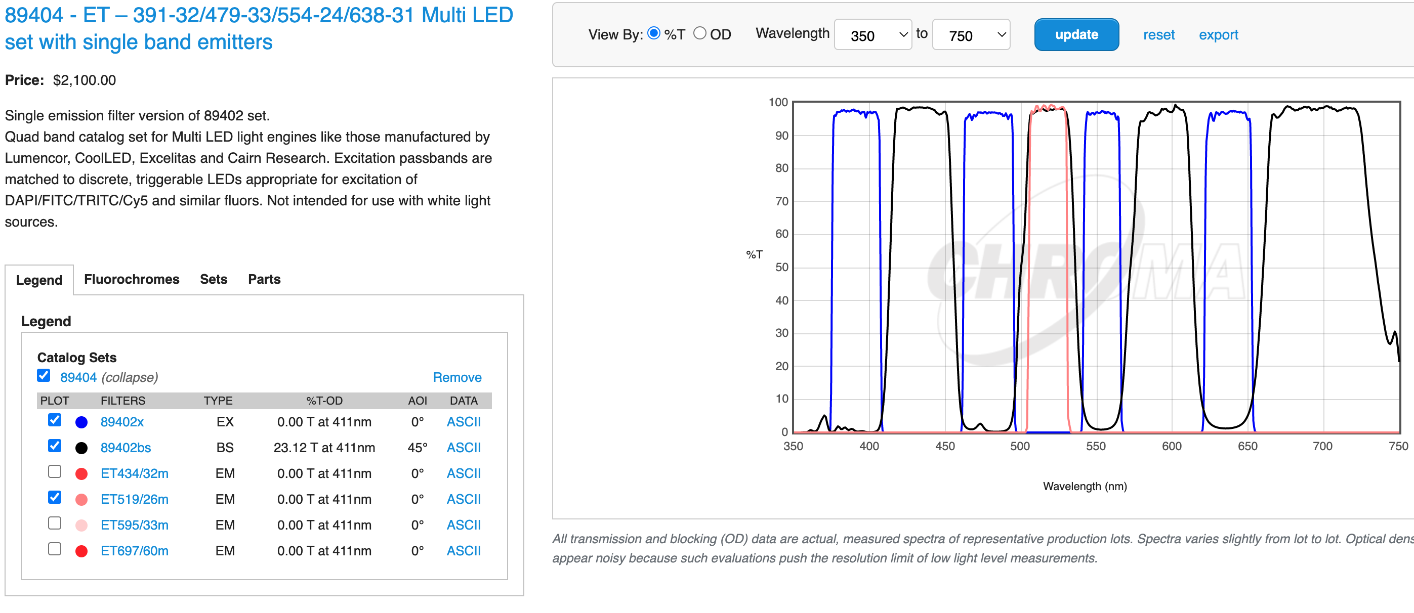
Use case 1: widefield LED imaging
Goal: Speed
7-line LED system
395/25
438/29
510/25
555/28
640/30
730/40
https://cms.lumencor.com/system/uploads/fae/image/asset/565/xl_Lumencor_SPECTRAX_ProductGallery-5_2021.jpg, https://www.chroma.com/products/sets/89404-et-391-32-479-33-554-24-638-31-multi-led-set-with-single-band-emitters, https://cdn.shopify.com/s/files/1/1594/4815/products/061_1200x.jpg?v=1618498984, https://i.ytimg.com/vi/y4dJOFUVk30/maxresdefault.jpg, https://d33b8x22mym97j.cloudfront.net/production/imager/productphotos/827/filter-cubes-main_ec7d1033075031a0254a7350f4e87eb4.jpg, https://www.chroma.com/sites/default/files/individual-filters-small

Slide 8
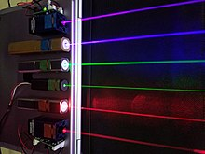
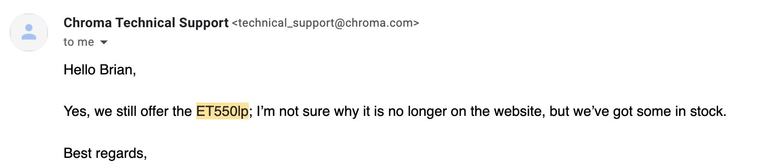
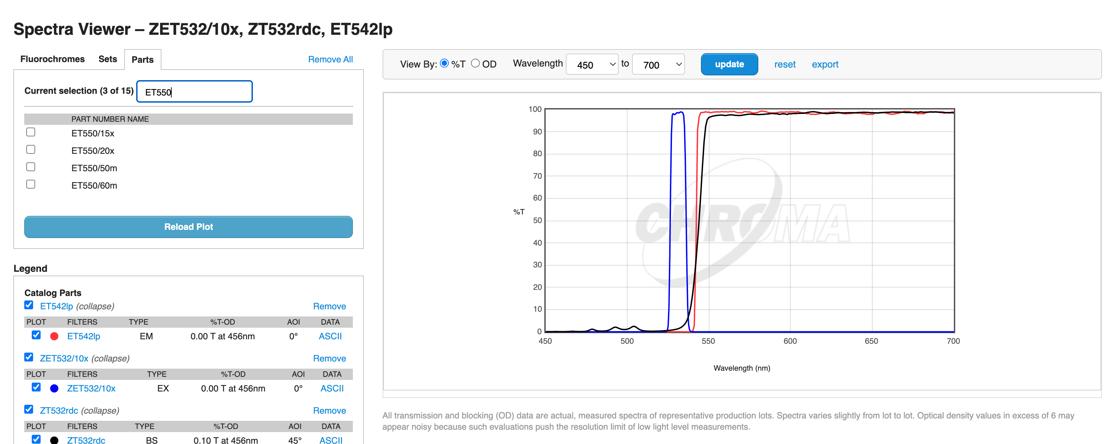

Use case 2: Super Resolution
532 nm
Goal: Photons
https://i.ytimg.com/vi/y4dJOFUVk30/maxresdefault.jpg, https://d33b8x22mym97j.cloudfront.net/production/imager/productphotos/827/filter-cubes-main_ec7d1033075031a0254a7350f4e87eb4.jpg, https://www.chroma.com/sites/default/files/individual-filters-small, https://www.chroma.com/spectra-viewer?parts=25787%2C25416%2C25506#tabs-spectra_viewer_plot-left-3

Slide 9
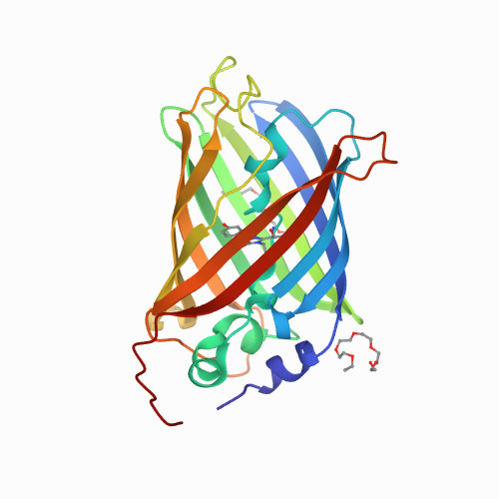
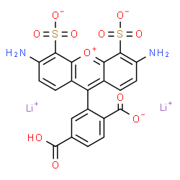
What makes a good label? (5 mins)
https://www.idtdna.com/site/Catalog/Modifications/Dyes, http://www.chemspider.com/Chemical-Structure.23107060.html

Slide 10
What makes a good label?
Brightness
Photostability
Duty cycle
Bio-orthogonality / inertness
Chemical stability (pH)
Size
Monovalency
Cost / availability
Thermal stability
Stokes shift
Em/Ex wavelengths
Solubility
https://www.idtdna.com/site/Catalog/Modifications/Dyes, http://www.chemspider.com/Chemical-Structure.23107060.html

Slide 11
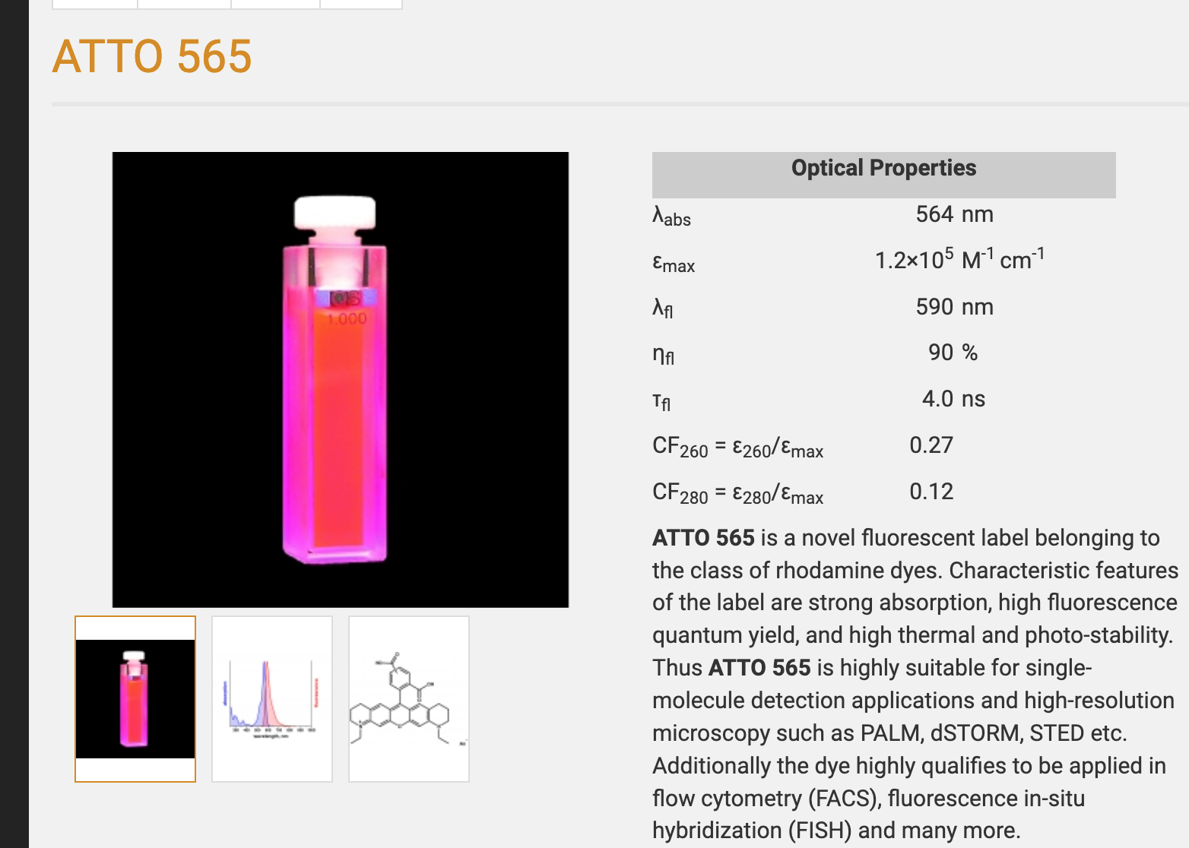
How do we evaluate labels?
https://www.atto-tec.com/ATTO-565.html?language=en

Slide 12
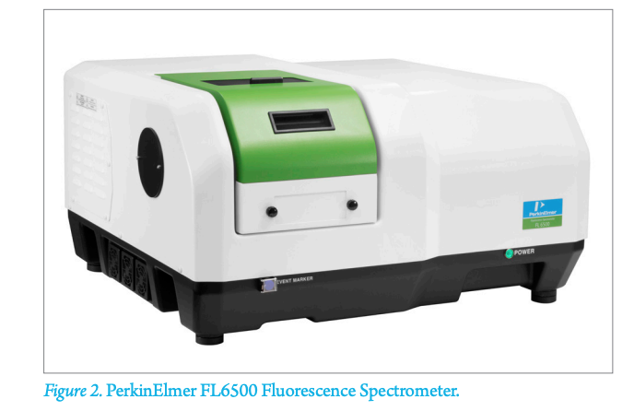
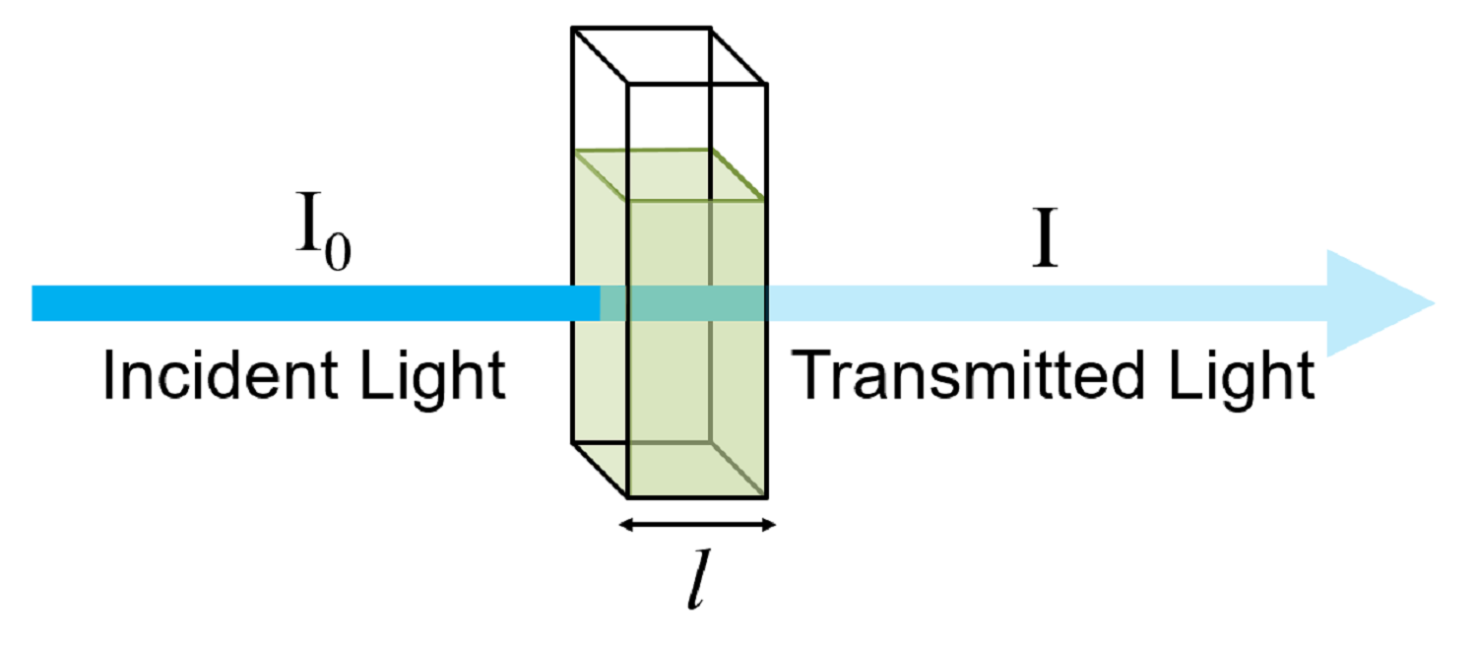
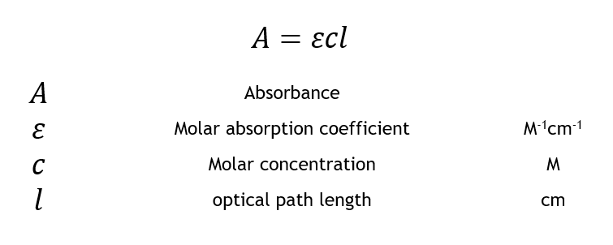
Measuring brightness: molar absorbance coeffcient (ε)
https://resources.perkinelmer.com/lab-solutions/resources/docs/APP_Determination_of_Relative_FluorescenceQuantum_Yields_using_FL6500_Fluorescence_Spect.pdf, https://www.edinst.com/wp-content/uploads/2019/08/BLL-1.png, https://www.edinst.com/wp-content/uploads/2019/08/BLL-E4.png

Slide 13
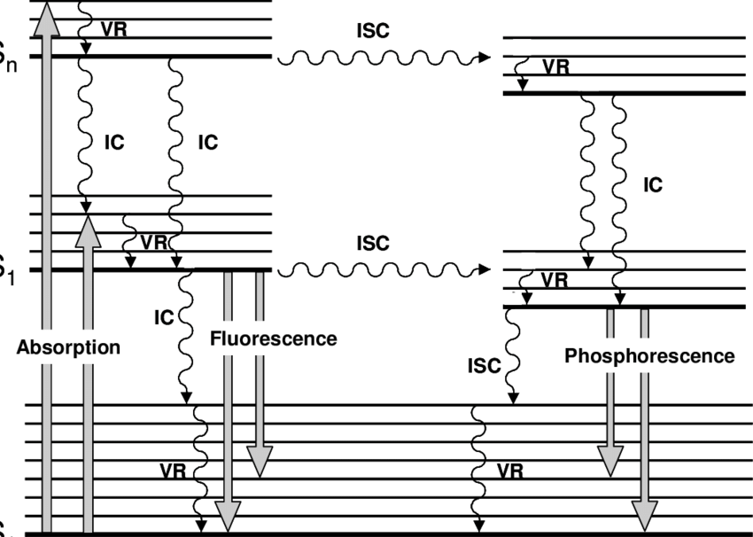
Measuring brightness: Quantum Yield (ɸ)
S_{n}
S₁
S₀
ɸ = emitted photons / absorbed photons
https://www.edinst.com/wp-content/uploads/2019/08/BLL-1.png , https://www.researchgate.net/profile/Henri-Pierre-Lassalle/publication/30513452/figure/fig1/AS:913119526273024@1594716068206/Jablonski-diagram-where-IC-stands-for-internal-conversion-ICS-for-intersystem.png

Slide 14
Measuring brightness
Brightness = ε * ɸ
https://www.atto-tec.com/ATTO-565.html?language=en

Slide 15
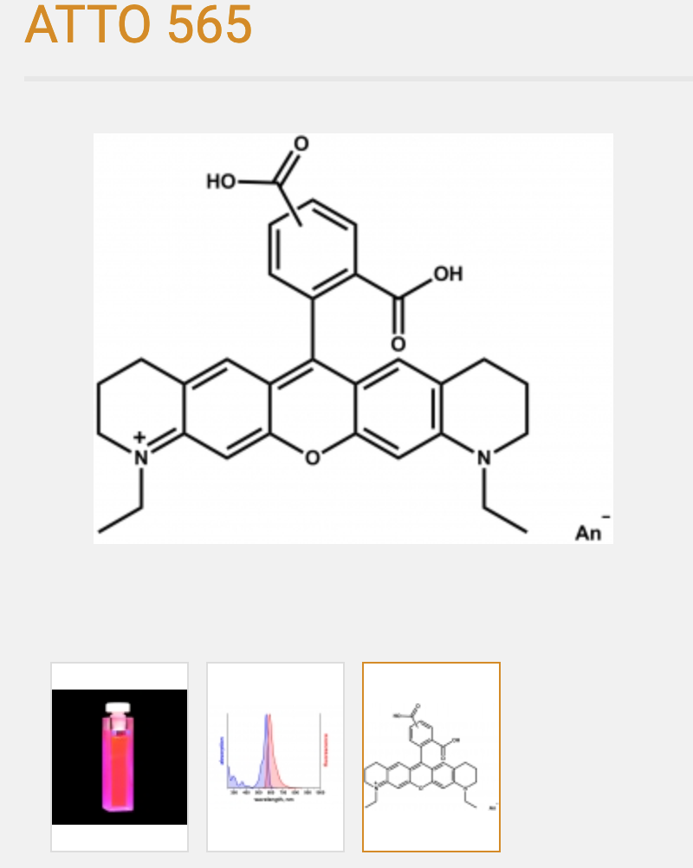
Labels: organic dyes
Hydrocarbon-based
~1 nm in size
Typically the best bang for buck in terms of brightness/stability, sample compatibility
https://www.atto-tec.com/ATTO-565.html?language=en, https://www.idtdna.com/site/Catalog/Modifications/Dyes

Slide 16
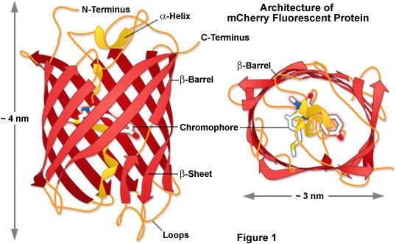
Labels: Fluorescent proteins
Genetically encoded
~5–10 nm in size
Typically 2–10x dimmer than organic dyes
Often multimeric (aggregation artifacts)
http://www.chemspider.com/Chemical-Structure.23107060.html, https://zeiss-campus.magnet.fsu.edu/articles/probes/images/anthozoafpintrofigure1.jpg

Slide 17
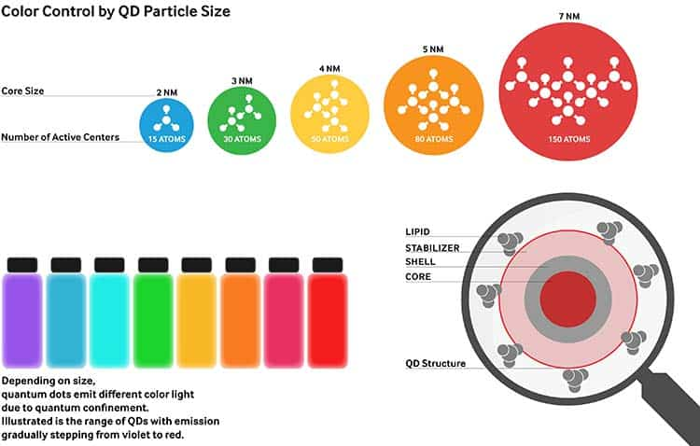
Labels: Quantum Dots
Have complex structure
~20–50 nm in size after coatings
Typically 2–10x brighter than organic dyes
Difficult to use in cellular systems*
https://www.displayninja.com/wp-content/uploads/2019/06/what-is-qled-technology.jpg

Slide 18
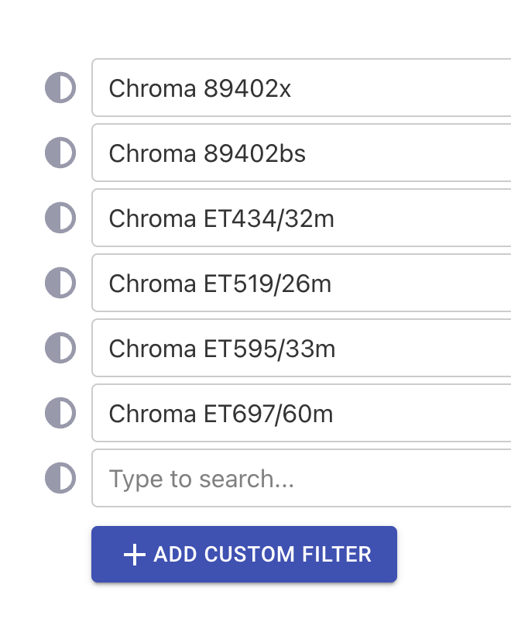
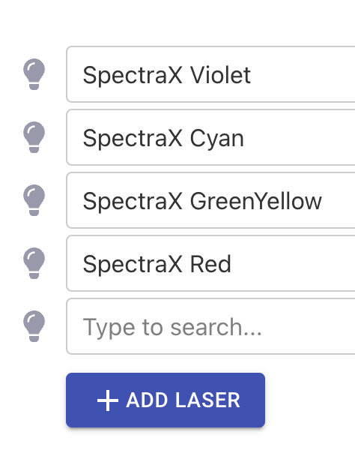
Class activity 1: Dye selection
Go to https://www.fpbase.org/spectra/ and add the filters and light sources below
Select one ATTO or Alexa Fluor dye for the “Cyan”, “GreenYellow”, and “Red” channels. Add “DAPI” for “Violet”
Aim to balance excitation and emission efficiencies. Calculate “arbitrary brightness units” for each: Ex. % * brightness * Collection %

Slide 19
Class activity 2: FP slection
Go to https://www.fpbase.org/spectra/ and add the filters and light sources below
Select one fluorescent protein for the “Cyan”, “GreenYellow”, and “Red” channels. Add “DAPI” for “Violet”.
Aim to balance excitation and emission efficiencies

