Slide 1
Single Cell and Spatial Proteomics

Slide 2
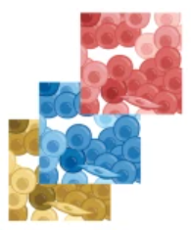
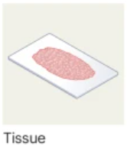
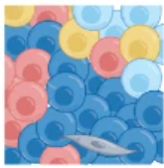


Single Cell versus Spatial
Single Cell Measurements Lose Spatial Information
Heterogeneous and Spatially Organized
Dissociate Cells
High Information Content Low Spatial Resolution
Low/Poor Information Content High Spatial Resolution
Moderate Information Content Narrow FOV

Slide 3
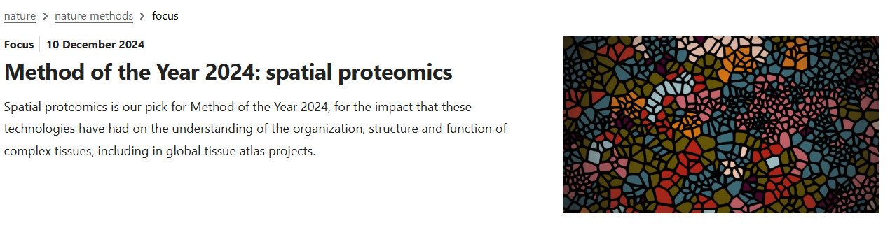

Slide 4
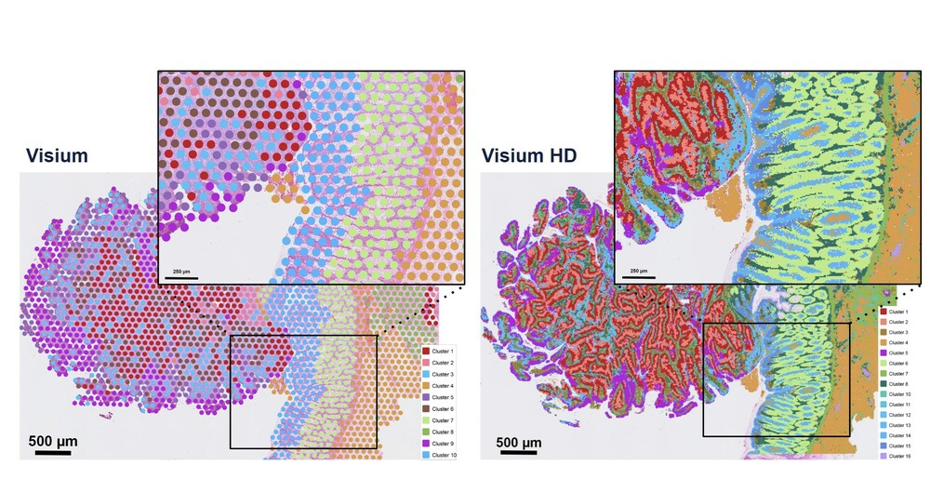
Spatial Transcriptomics Has Improved Our Ability to Probe Tissue
10x Genomics Visium HD Released March 2024

Slide 5
Why Spatial Organization of Proteins is Important
1. Post-Transcriptional Regulation Creates Discrepancies
Proteins and their corresponding mRNAs often show different spatial distribution patterns. This occurs because:
Translation Timing and Location: Protein synthesis doesn't always occur at the same location as the mRNA. Some mRNAs are transported to specific subcellular locations before translation occurs.
Protein Trafficking: After synthesis, proteins can be transported to different cellular compartments through various targeting mechanisms, creating distribution patterns that don't match their mRNA origins.
Protein Stability: Proteins generally have much longer half-lives than mRNA, leading to temporal and spatial discrepancies between mRNA presence and protein abundance.

Slide 6
Why Spatial Organization of Proteins is Important
2. Post-Translational Modifications Change Function
A particularly critical reason to study protein spatial organization is that the same protein can exist in multiple forms with different functions:
Dynamic Modifications: Proteins undergo numerous post-translational modifications (phosphorylation, glycosylation, ubiquitination, etc.) that aren't visible at the mRNA level.
Compartment-Specific Modifications: These modifications often occur in specific cellular compartments, creating functionally distinct protein populations that can't be detected through mRNA analysis.
Functional States: The active or inactive state of a protein is frequently determined by its spatial location in combination with these modifications.

Slide 7
Why Spatial Organization of Proteins is Important
3. Protein-Protein Interactions Are Spatially Regulated
The location of proteins directly impacts their functional interactions:
Protein Complexes: Most proteins function as parts of larger complexes that assemble in specific cellular locations.
Signaling Hubs: The spatial organization of signaling molecules creates microenvironments that facilitate specific pathway activation.
Enzymatic Activities: Many enzymatic reactions require precise spatial positioning of multiple proteins that wouldn't be evident from mRNA data.

Slide 8
Why Spatial Organization of Proteins is Important
4. Disease Relevance
Many pathological conditions involve protein mislocalization rather than just altered expression:
Aberrant Localization: In diseases like cancer and neurodegeneration, proteins often maintain normal expression levels but show abnormal localization.
Aggregation Diseases: Conditions like Alzheimer's and Parkinson's are characterized by protein aggregates forming in inappropriate cellular locations.
Therapeutic Implications: Understanding spatial protein organization can reveal new therapeutic targets focused on correcting localization rather than just expression.

Slide 9
Why Spatial Organization of Proteins is Important
5. Technological Benefits of Protein Analysis
Modern spatial proteomics offers some advantages over spatial transcriptomics:
Direct Functional Assessment: Proteins represent the actual functional molecules, not just the intermediate messenger.
Protein Modifications: Technologies like multiplexed ion beam imaging (MIBI-TOF) and imaging mass cytometry (IMC) can detect both protein presence and modification state.
Higher Stability: Proteins are generally more stable than RNA, sometimes making them more reliable analytes for spatial studies in clinical samples.

Slide 10
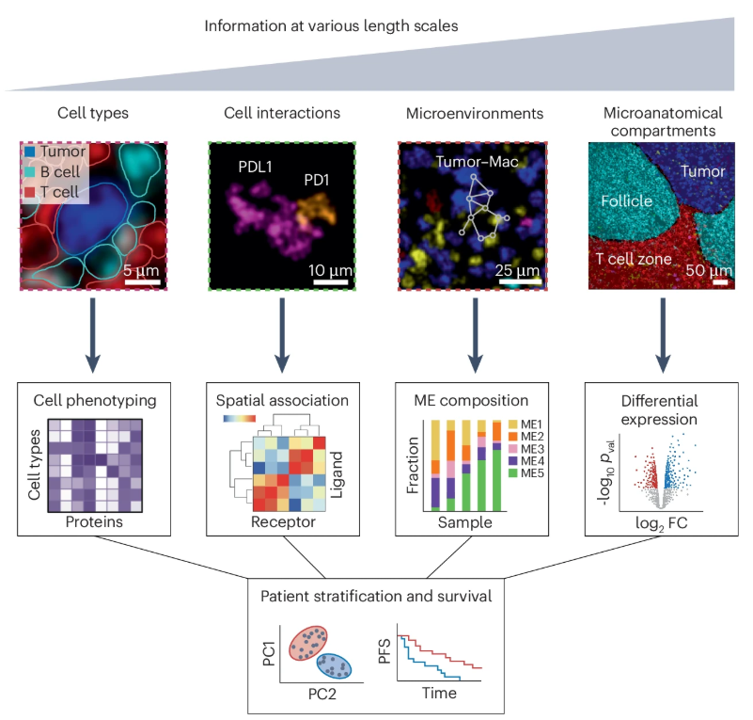
What sort of information can we get out of this?
Bussi, Y., Keren, L. Multiplexed image analysis: what have we achieved and where are we headed?. Nat Methods 21, 2212–2215 (2024).

Slide 11
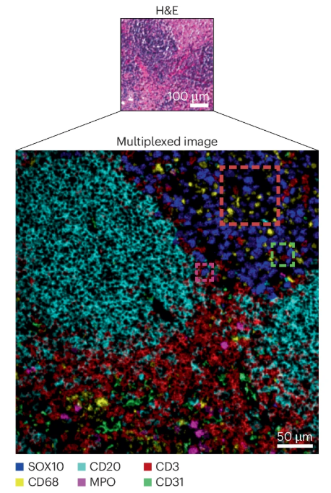
Increasing the information content
H&E stain introduced in 1877.
Hematoxylin stains the nucleus blue-purple
Eosin stains the cytoplasm and extracellular matrix pink
Want to replace it with high spatial resolution information about proteins.
Can we add many proteins at a time.
Notes:
H&E staining is a common histological technique used to visualize tissue structures by staining different cell components with two dyes: hematoxylin and eosin. Hematoxylin stains the nucleus blue-purple, while eosin stains the cytoplasm and extracellular matrix pink. This allows pathologists to differentiate between various tissue types and identify abnormalities.

Slide 12
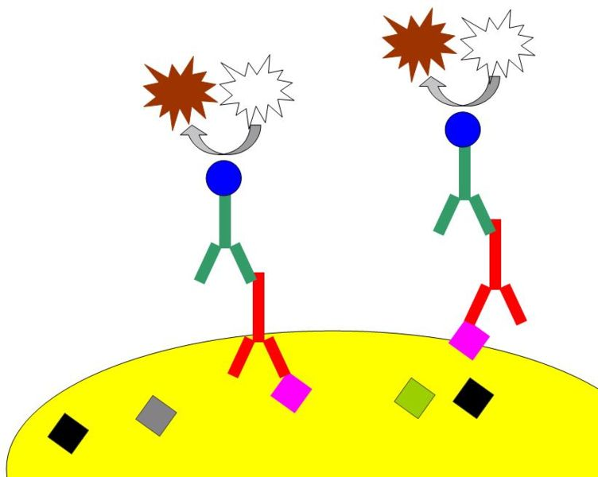
Immunohistochemistry (IHC):
Albert Hewett Coons, Ernest Berliner, Norman Jones and Hugh J Creech were the first to develop immunofluorescence in 1941.
This led to the later development of immunohistochemistry.
Tissue sectioned 4-10 µm
Provides unprecedented cellular and subcellular visualization of specific proteins.
Enables differentiation between closely related cell types
Transformed cancer diagnosis
accurate tumor typing, grading, and identification of the tissue of origin for metastatic cancers
Generally, one antigen at a time
https://en.wikipedia.org/wiki/Immunohistochemistry
Notes:
In addition to immunofluorescence the antibodies can be linked to an enzyme that converts a substrate into an insoluble colored precipitate that can be viewed under a standard light microscope. This is called chromogenic immunohistochemistry.
The most widely used chromogen is 3,3'-diaminobenzidine (DAB), which produces a brown precipitate. Other common chromogens include aminoethyl carbazole (AEC, red), Fast Red (red), and nitroblue tetrazolium/5-bromo-4-chloro-3-indolyl phosphate (NBT/BCIP, blue/purple).
A key advantage of chromogenic IHC is that it creates permanent stains that can be viewed with conventional light microscopy, without requiring specialized fluorescence equipment. The stained slides can be counterstained (often with hematoxylin for nuclear visualization), coverslipped, and archived for long-term storage and future reference, as the signal doesn't fade over time like fluorescent labels.

Slide 13
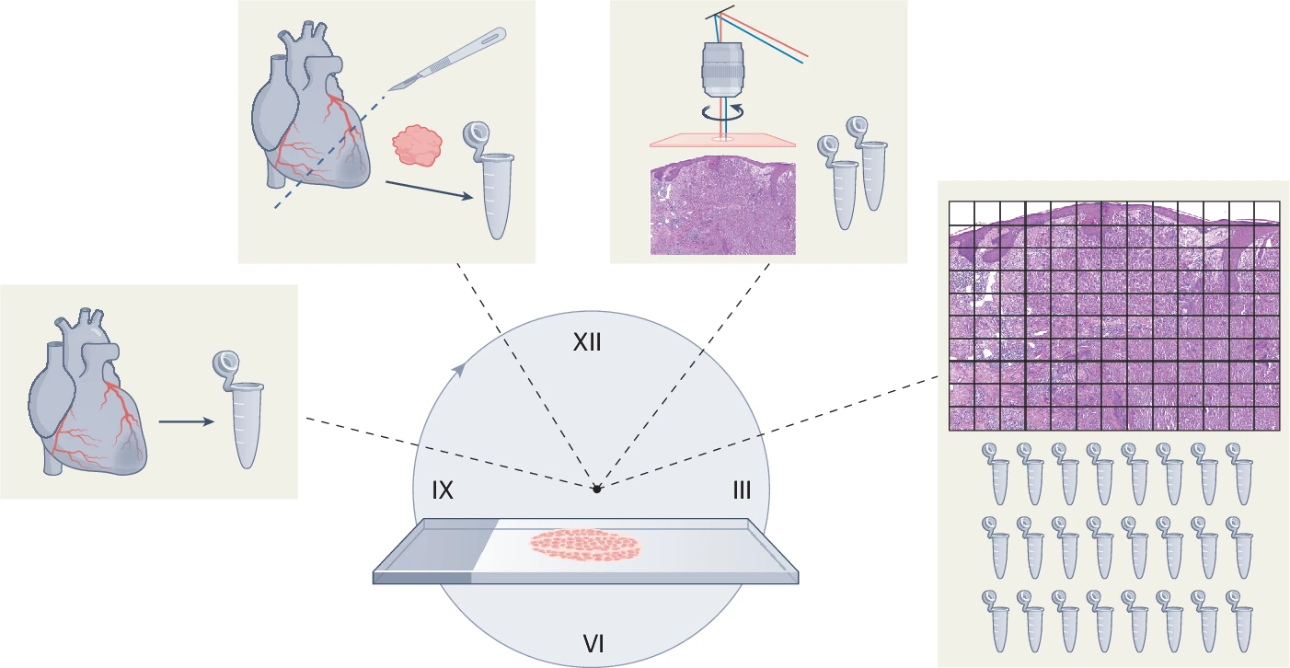
Nordmann et al, Nature Methods 2024
Notes:
his figure illustrates the technological progression of MS-based proteomics over time. The journey begins with bulk tissue analysis (left), which provided averaged protein profiles without spatial context, and proceeds to grid-like approaches with higher spatial resolution (right).

Slide 14
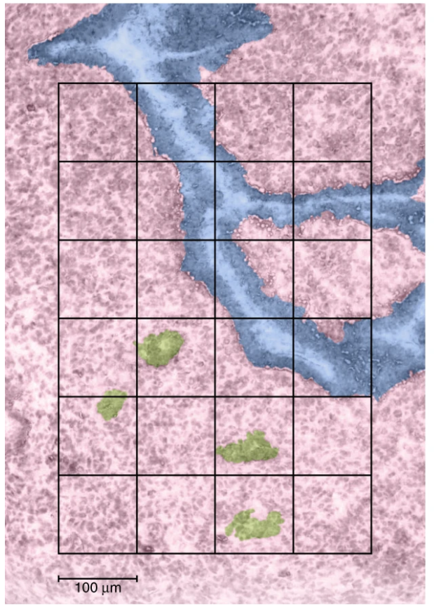
Problems with spatial and single cell proteomics?
We can’t amplify proteins.
As you increase the spatial resolution you decrease the amount of protein.
Increased spatial resolution requires more runs
Proteins are sticky … you lose a portion of protein to every surface they touch.
Proteomics experiments are slow.

Slide 15
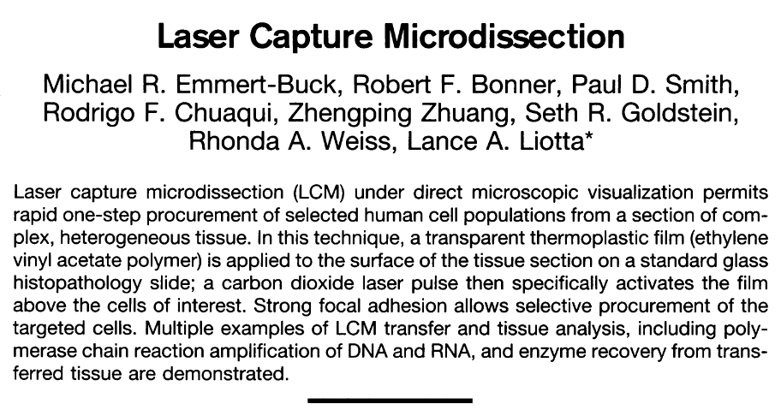
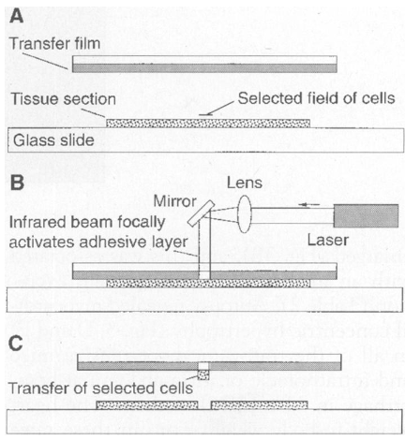
Laser Capture Microdissection circa 1996
Science 1996
Transparent film (ethylene vinyl acetate polymer) applied to tissue sections
CO2 laser to activate the film above cells of interest. Basically used IR laser to melt the plastic
Results in the focal adhesion of the cells to the polymer.
Notes:
Fig. 1. (A) Transparent EVA thermoplastic film isapplied to the surface of a routine tissue sectionmounted on a glass slide. The tissue-EVA filmsandwich is viewed under a microscope, and thecells of interest are positioned in the center of thefield. (B) A focused laser beam coaxial with themicroscope optics is pulsed to activate the film,causing it to become focally adhesive and fuse tothe selected underlying cells in the tissue section.(C) When the EVA film is removed from the tissuesection, the selected cells remain adherent to thefilm surface. The film is then placed directly intothe DNA, RNA, or enzyme buffer. The cellular ma-terial detaches from the film and is ready for stan-dard processing.

Slide 16
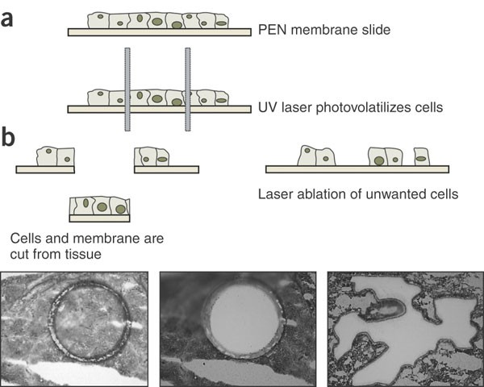
Emmert-Buck et al Science 1996

Slide 17
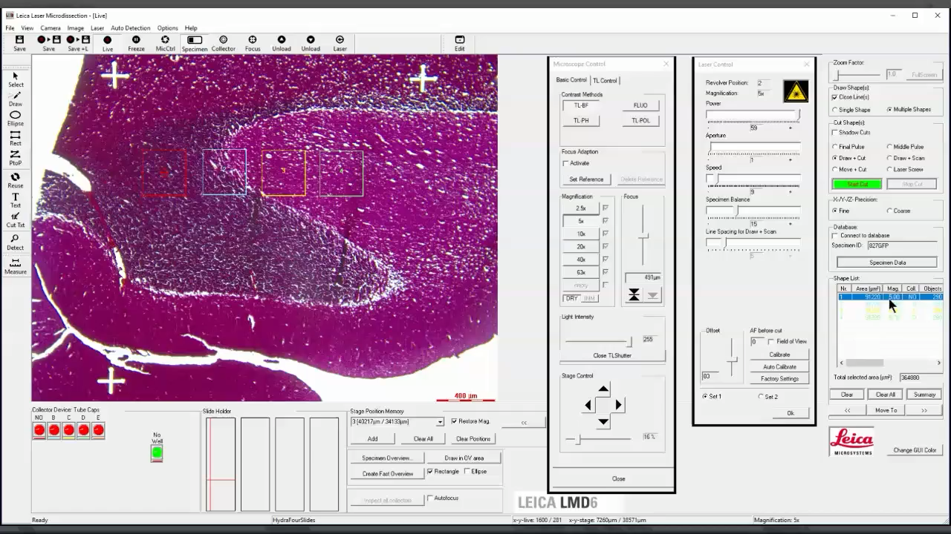
Laser Capture Microdissection Today
Leica started using UV lasers to ablate cells of interest.
Use gravity-assisted collection where cut samples fall into collection tubes.
Faster cutting
Pattern recognition for identifying cells/regions of interest.

Slide 18
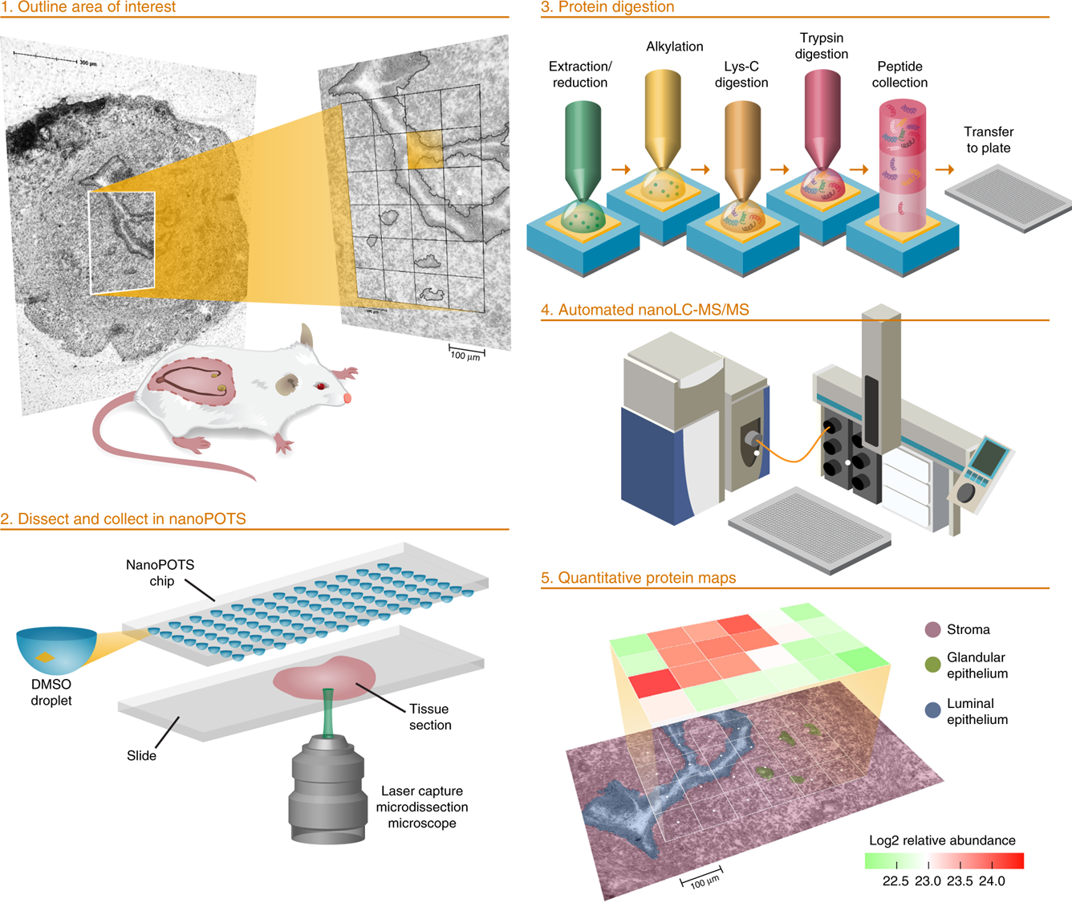
Piehowski et al Nature Communications 2020

Slide 19
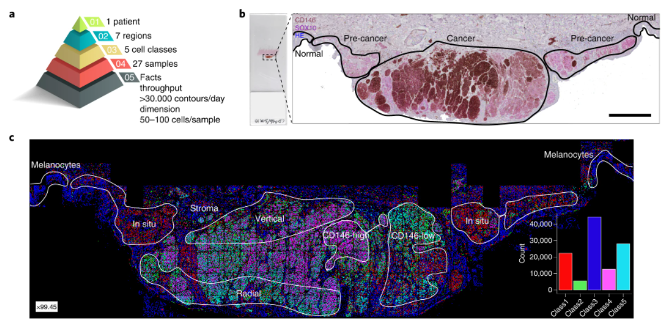
Mund et al Nature Biotech 2022
Notes:
a, DVP sample isolation workflow to profile primary melanoma. b, DVP applied to primary melanoma immunohistochemically stained for the melanocyte marker SOX10 and the melanoma marker CD146. Left panel: stained melanoma tissue on a PEN glass membrane slide. Right panel: pathology-guided annotation of different tissue regions. Scale bar, 1 mm. c, Pathologist-guided and ML-based cell classification based on CD146 and SOX10 staining intensity and spatial localization: normal melanocytes, stromal cells, melanoma in situ, CD146-low melanoma, CD146-high melanoma, radial growth melanoma and vertical growth melanoma. Right lower panel: frequency of classes predicted by unsupervised ML (k-means clustering).

Slide 20
Some statistics
3 million protein molecules per 1 µm³
yeast 30 µm³ = 100 million molecules
HeLa 3000 µm³ (~15 µm diameter) = 10 billion molecules … approx. 200 picograms
Many people focus on ~10-100 cell regions (2-20 ng)

Slide 21
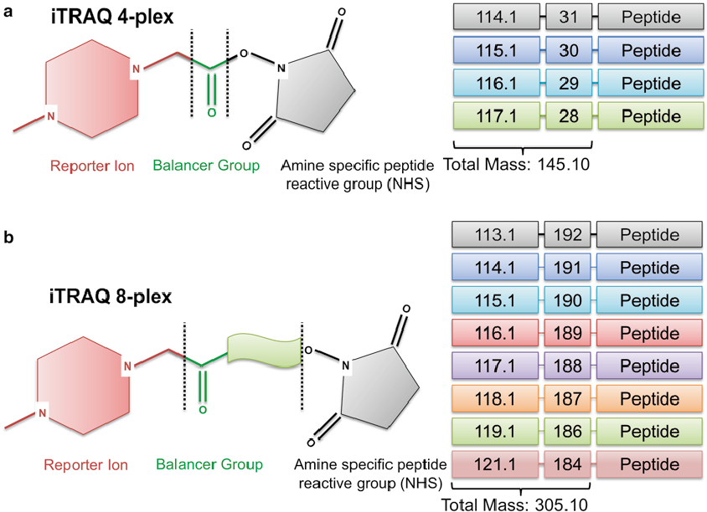
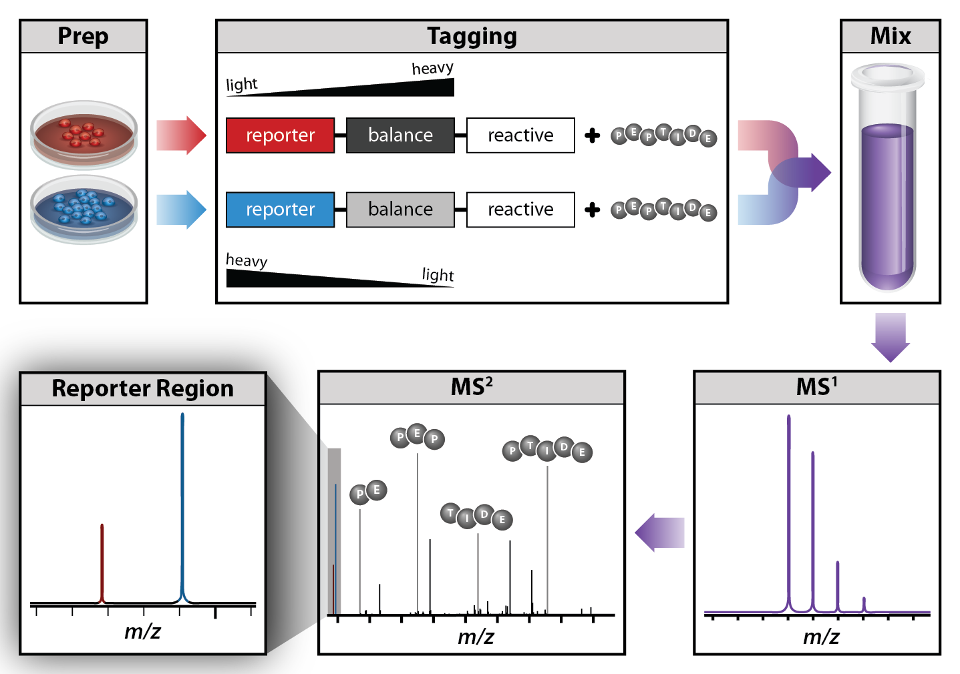
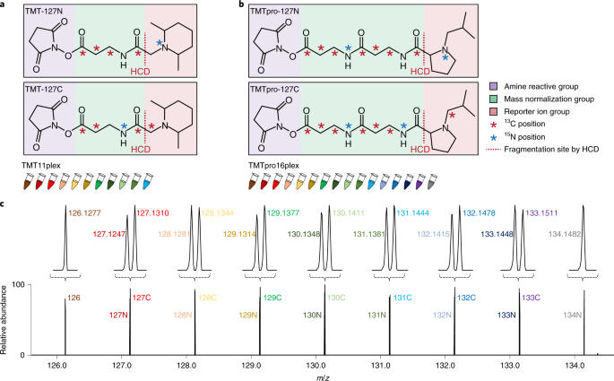
Review: Tandem Mass Tags (TMT)

Slide 22
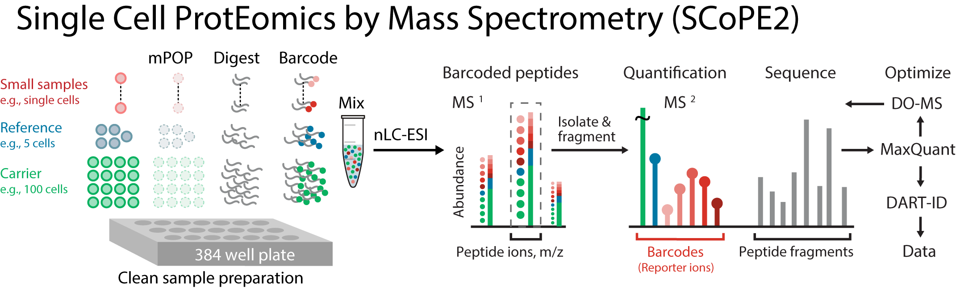
https://scope2.slavovlab.net/

Slide 23
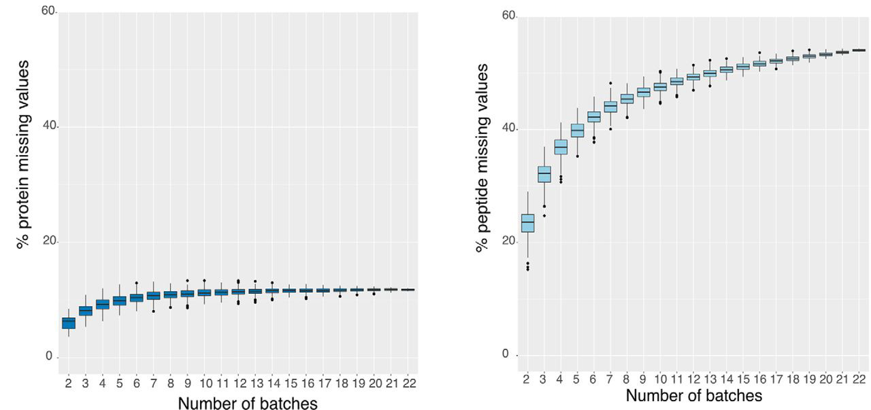
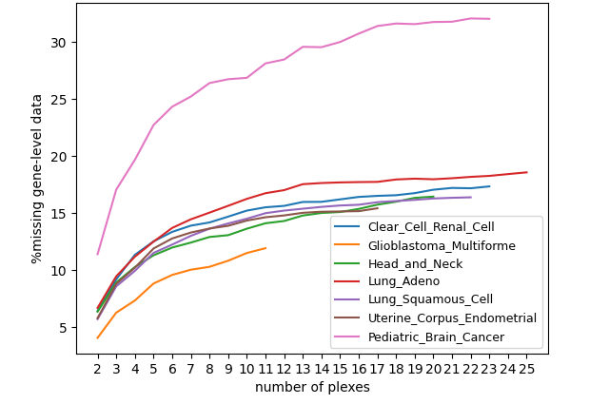
Struggle with Missing Values Between Batches
Alejandro Brenes et al MCP 2019
CPTAC Data

Slide 24
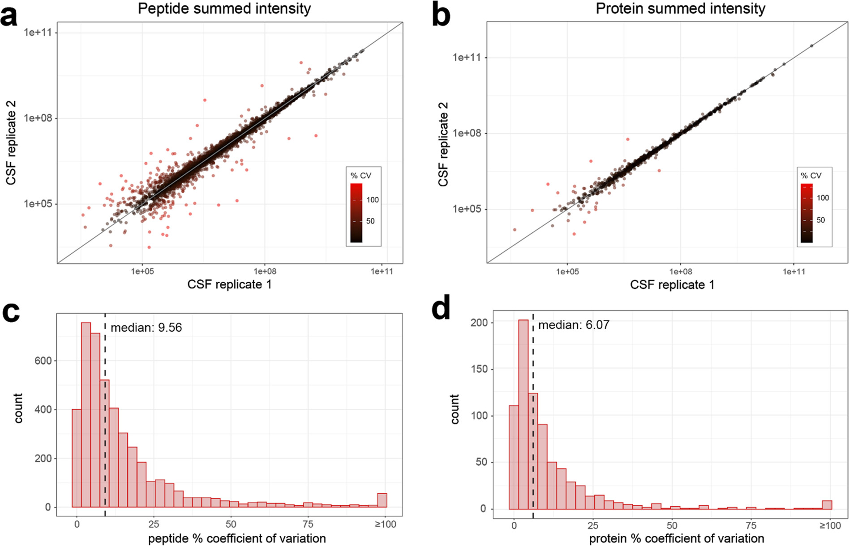

Slide 25
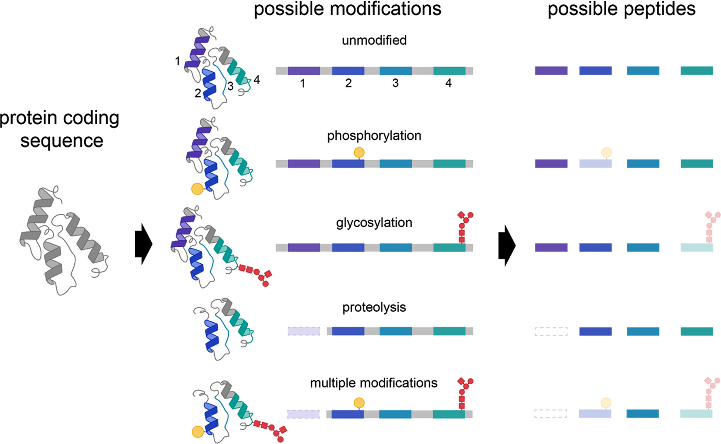

Slide 26
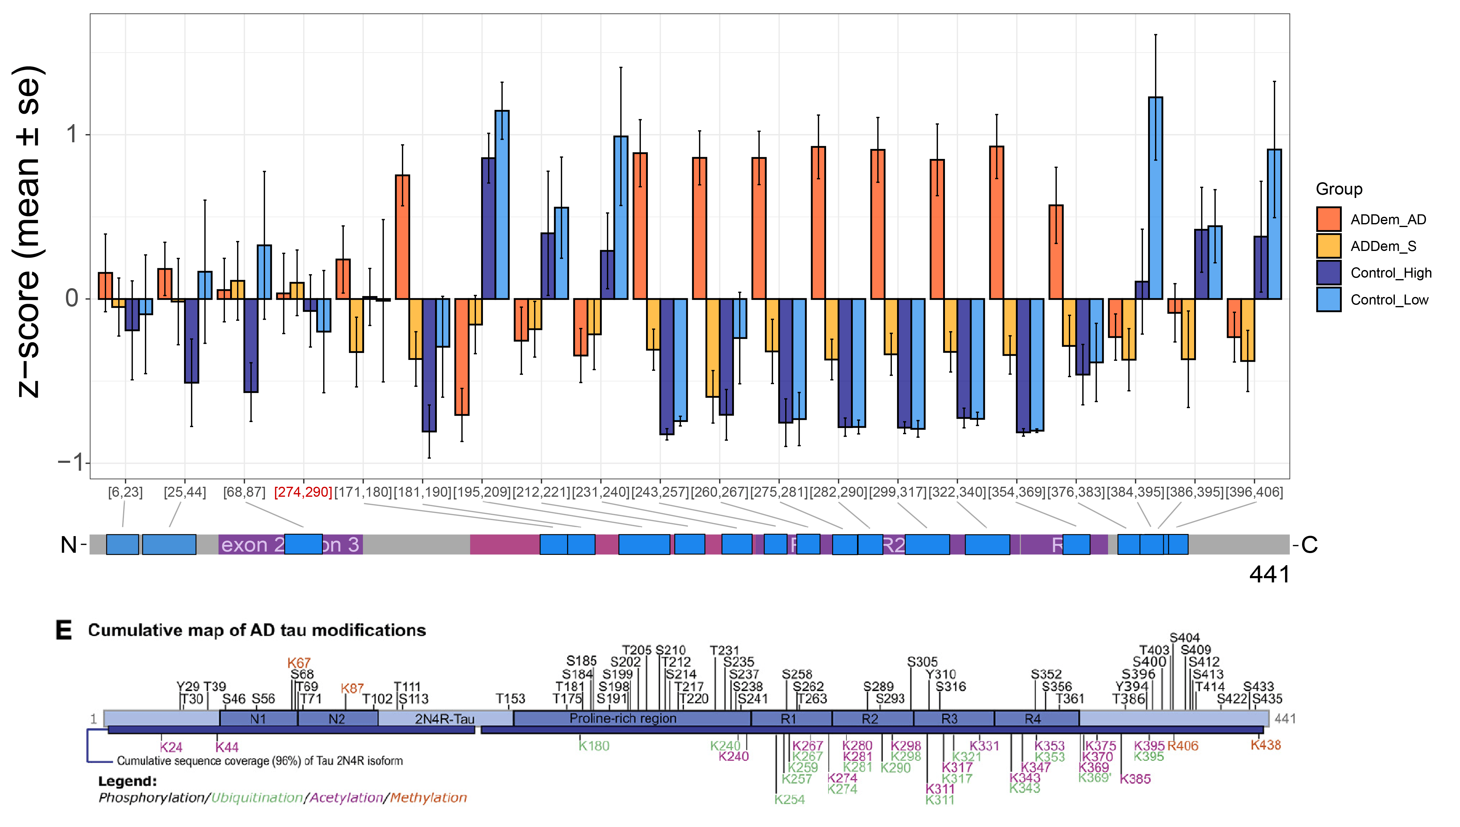
Tau has peptide abundance profiles that differ by domain
Adapted Wesseling et a., Cell 2020
Notes:
Exon 4a – PNS-Tau … Tau that circulates in peripheral nervous system

Slide 27
Tau has peptide abundance profiles that differ by domain
Adapted Wesseling et a., Cell 2020
Notes:
Exon 4a – PNS-Tau … Tau that circulates in peripheral nervous system

Slide 28
Tau has peptide abundance profiles that differ by domain
Adapted Wesseling et a., Cell 2020
Notes:
Exon 4a – PNS-Tau … Tau that circulates in peripheral nervous system

Slide 29
Tau has peptide abundance profiles that differ by domain
Adapted Wesseling et al., Cell 2020
Notes:
Exon 4a – PNS-Tau … Tau that circulates in peripheral nervous system

Slide 30
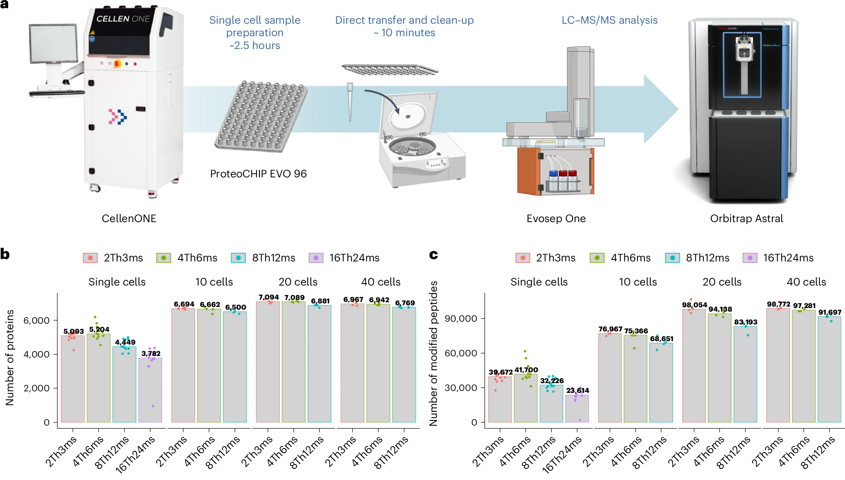
Instruments can now detect proteins from single cells without multiplexed tags
Ye, Z et al. Enhanced sensitivity and scalability with a Chip-Tip workflow enables deep single-cell proteomics. Nat Methods 22, 499–509 (2025)

Slide 31
Flow Cytometry
Technology that measures properties of single cells
Measures fluorescence, light scatter, and other properties of cells and particles
Can provide correlated data that links different population profiles

Slide 32
What can Flow Cytometry Do?
Enumerate particles in suspension
Determine “biologicals” from “non-biologicals”
Separate “live” from “dead” particles
Evaluate 10⁵ to 5x10⁶ particles in less than 1 min
Measure particle-scatter as well as innate fluorescence or 2º fluorescence
Sort single particles for subsequent analysis

Slide 33
Single Cell versus Spatial
Single Cell Measurements Lose Spatial Information
Heterogeneous and Spatially Organized
Dissociate Cells
High Information Content Low Spatial Resolution
Low/Poor Information Content High Spatial Resolution
Moderate Information Content Narrow FOV

Slide 34
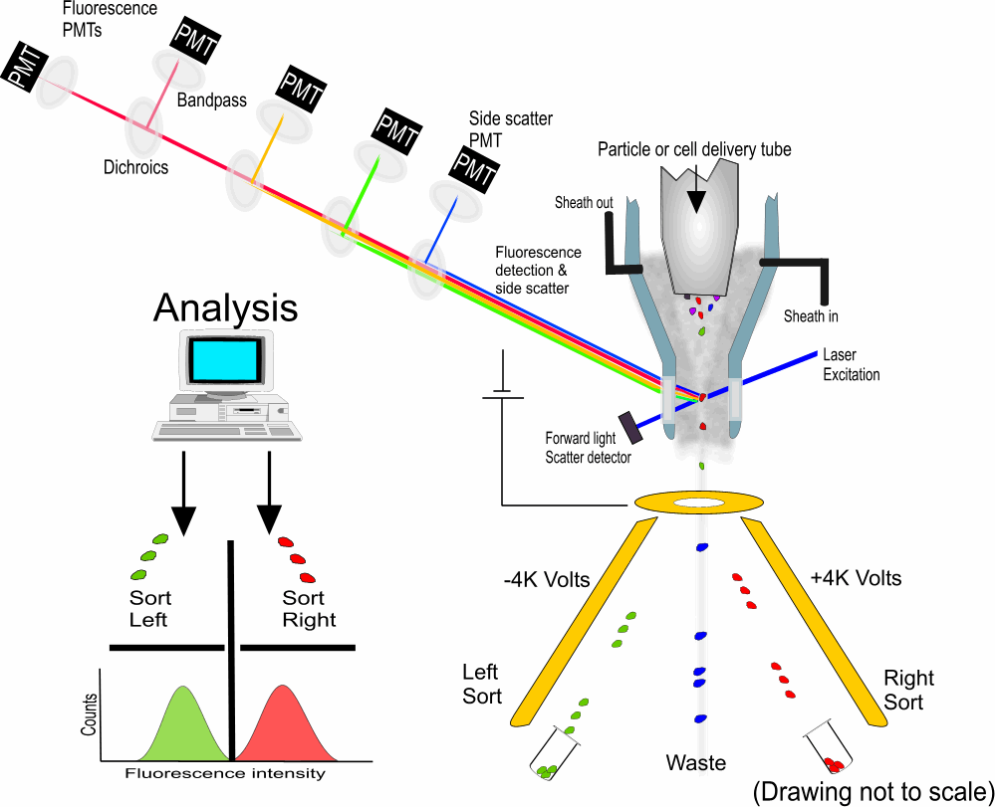
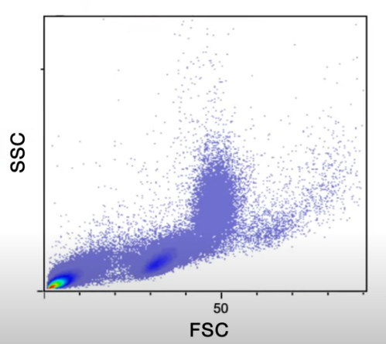
Fundamentals of a Flow Cytometer
Each Point on the Plot Represents data from a Single Cell
Notes:
Side scatter

Slide 35
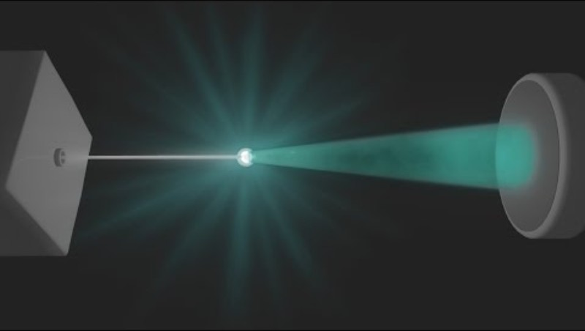

Slide 36
Fundamentals of a Flow Cytometer
Side scatter (SSC) provides information about the internal complexity and granularity of cells.
Granularity includes factors like cytoplasmic complexity, the presence of granules, and the shape of the nucleus.
Measure of internal complexity
Forward Scatter (FSC)
correlates with cell size
Each Point on the Plot Represents data from a Single Cell
Notes:
Side scatter

Slide 37
Fundamentals of a Flow Cytometer
Side scatter is useful for distinguishing between different cell types in a mixed population. For example:
Granulocytes (like neutrophils) have high side scatter due to their granular cytoplasm
Lymphocytes have low side scatter because they have relatively simple cytoplasm with few granules
Monocytes typically have intermediate side scatter
Each Point on the Plot Represents data from a Single Cell
Notes:
Side scatter

Slide 38
Fundamentals of a Flow Cytometer
Side scatter is useful for distinguishing between different cell types in a mixed population. For example:
Granulocytes (like neutrophils) have high side scatter due to their granular cytoplasm
Lymphocytes have low side scatter because they have relatively simple cytoplasm with few granules
Monocytes typically have intermediate side scatter
Each Point on the Plot Represents data from a Single Cell
Notes:
Side scatter

Slide 39
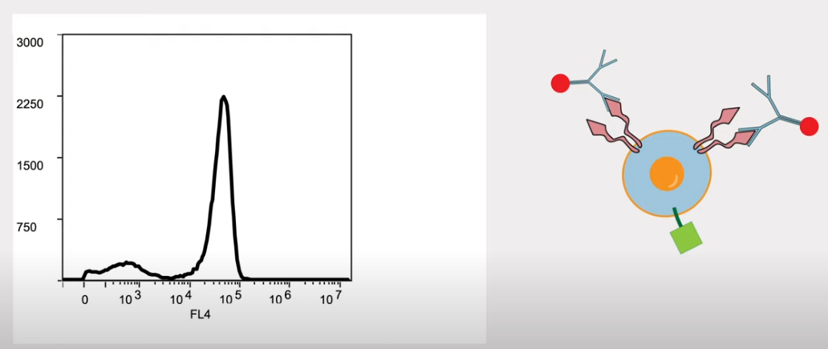
Fundamentals of a Flow Cytometer
At the same time, you can also measure fluorescence. Y-axis is the number of cells with a certain intensity (X-axis).
Notes:
Side scatter

Slide 40
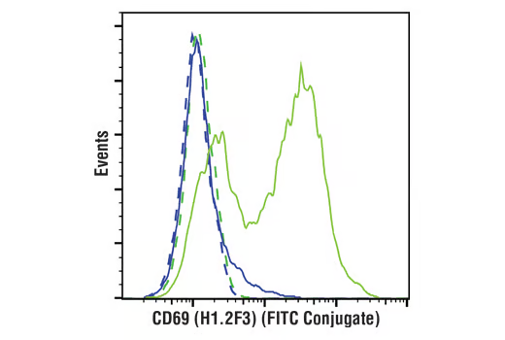
Fundamentals of a Flow Cytometer
Can do this under different conditions:
Mouse splenocytes untreated (blue)
Concanavalin A treated – stimulates the immune response(green)
Notes:
Side scatter

Slide 41
Fundamentals of a Flow Cytometer
Can do this for multiple antigens at the same time.
Notes:
Side scatter

Slide 42
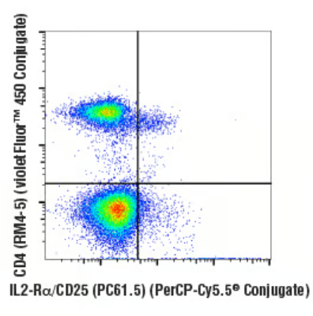
Fundamentals of a Flow Cytometer
Can do this for multiple antigens at the same time.
Notes:
Side scatter

Slide 43
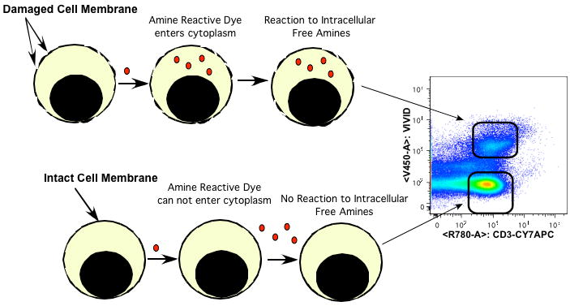
Staining for cell viability
Notes:
propidium iodide (PI), 7-aminoactinomycin D (7-AAD), and DRAQ7 are used to stain non-viable cells. Antibodies exhibit nonspecific binding in dead cells. Greater fluorescence due to increased content of accessible free amines allows dead cells to be easily distinguished from live cells.

Slide 44
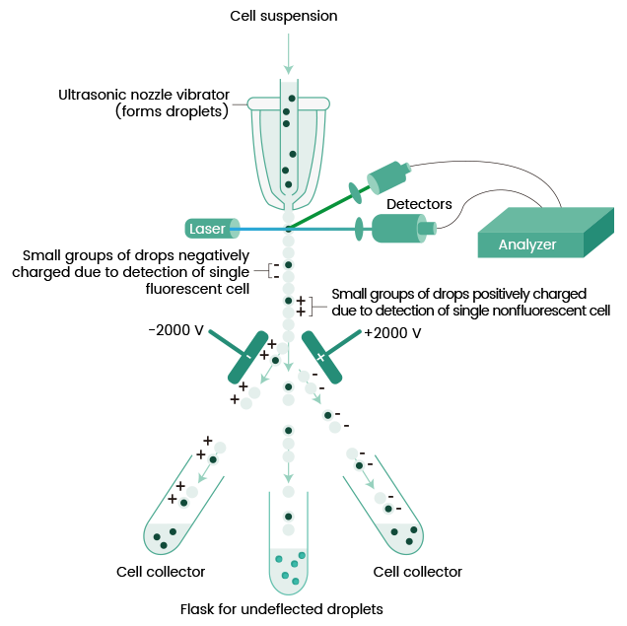
Some flow cytometers can sort cells
Becton Dickinson: Fluorescence-activated cell sorting (FACS)
A voltage (+ or -) is applied to an electrode in contact with the liquid surrounding the cell.
Tags the droplet with a charge.
Those charged droplets can be deflected by high voltage deflectors

Slide 45
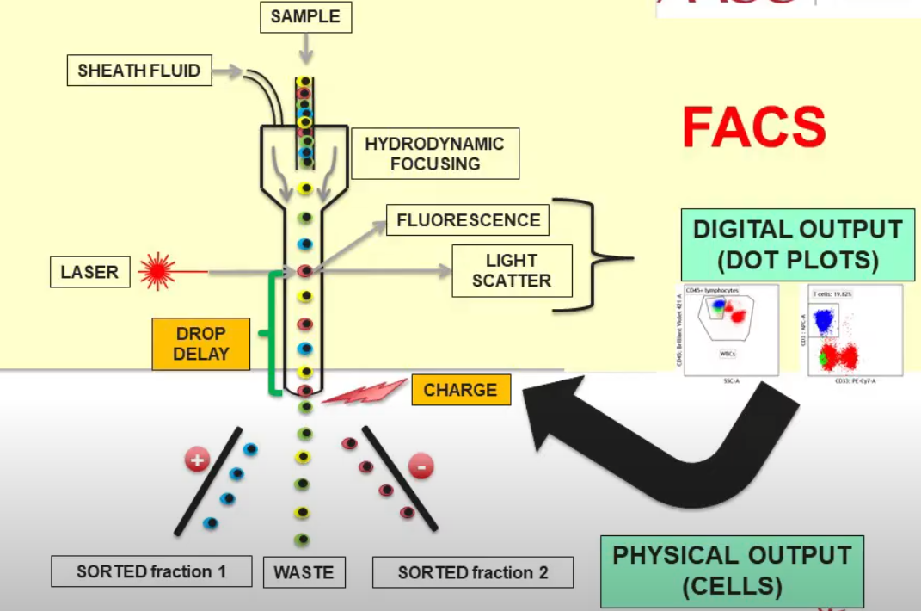
Some flow cytometers can sort cells
Becton Dickinson: Fluorescence-activated cell sorting (FACS)
A voltage (+ or -) is applied to an electrode in contact with the liquid surrounding the cell.
Tags the droplet with a charge.
Those charged droplets can be deflected by high voltage deflectors

Slide 46
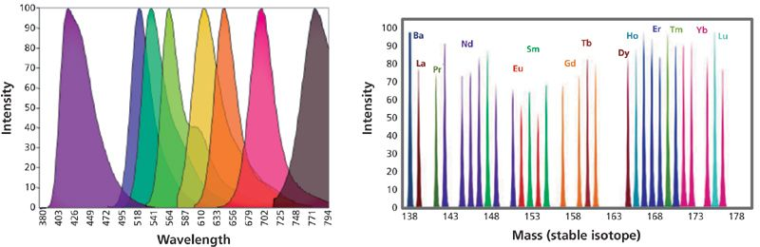
Multiplexing with Heavy Metals
Multiplexing with fluorescence is hard.

Slide 47
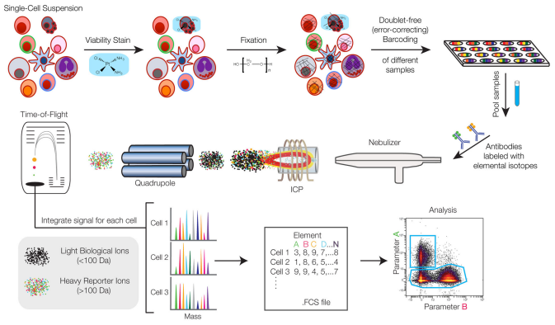
Mass Cytometry

Slide 48
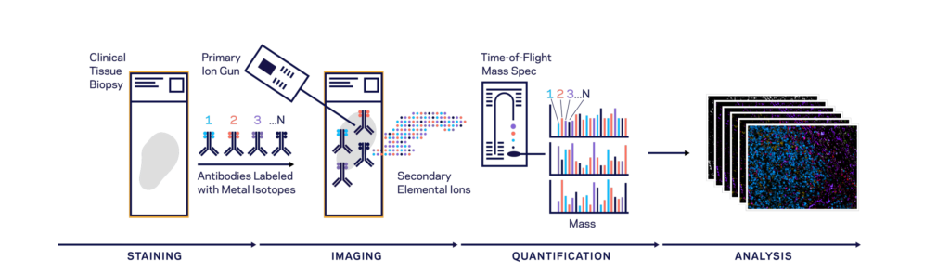
Multiplexed Ion Beam Imaging
Keren et al. Science Advances 2019

Slide 49
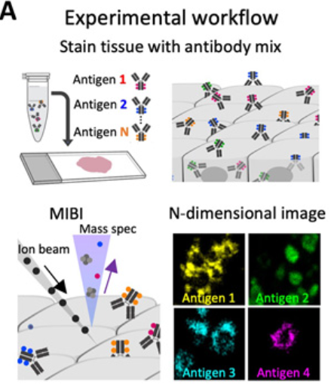
MIBI-TOF Imaging Experiment
Keren et al. Science Advances 2019

Slide 50
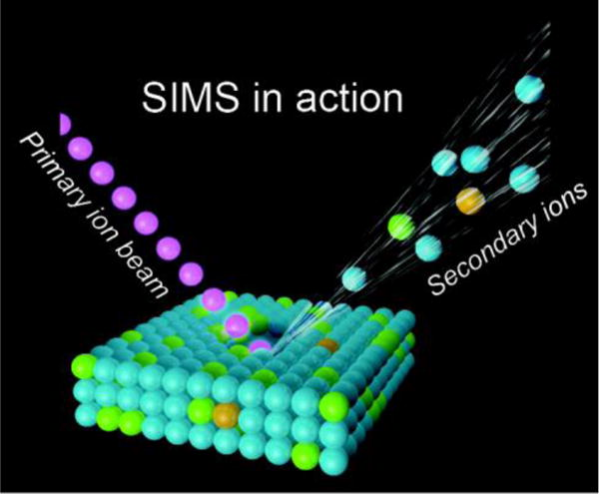
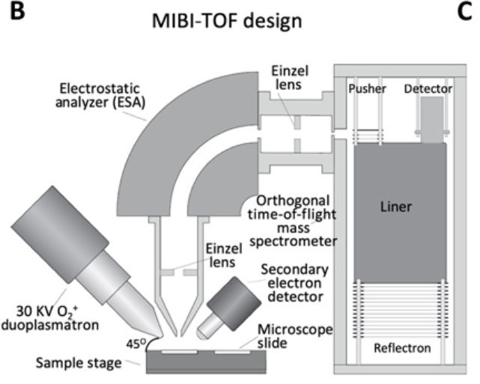
MIBI-TOF
Keren et al. Science Advances 2019

Slide 51
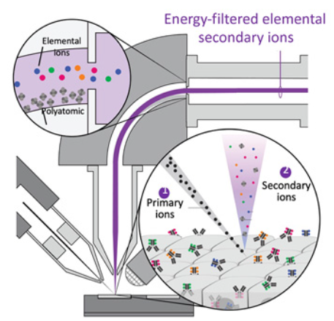
MIBI-TOF
Keren et al. Science Advances 2019

Slide 52
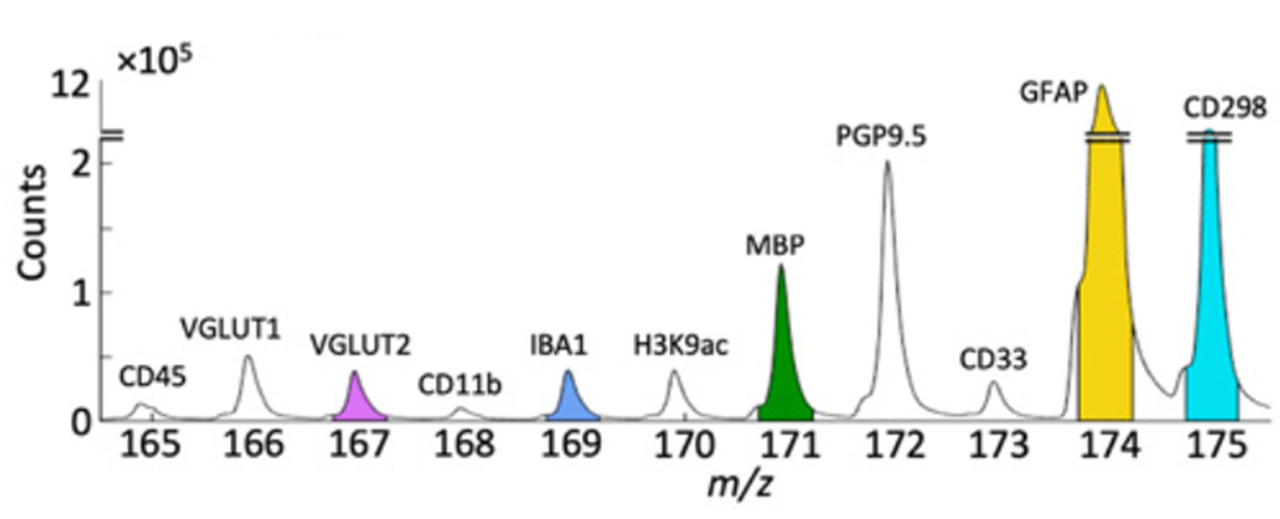
MIBI-TOF: mass range 1 to 240 m/z
Keren et al. Science Advances 2019

