Slide 1
Optical Detection
Genome 575: Fundamentals of Biomedical Instrumentation
Brian Beliveau

Slide 2
Recap from last time
Commonly used fluorescent labels are organic dyes, fluorescent proteins, and quantum dots
Many factors affect label performance including brightness, stability, cost, and Ex/Em spectra
Brightness is a function of molar extinction coefficient (normalized molar absorbance) ε and quantum yield ɸ
The Stokes shift (Em_{max} – Ex_{max}) is an important label property, especially for multiplexing

Slide 3
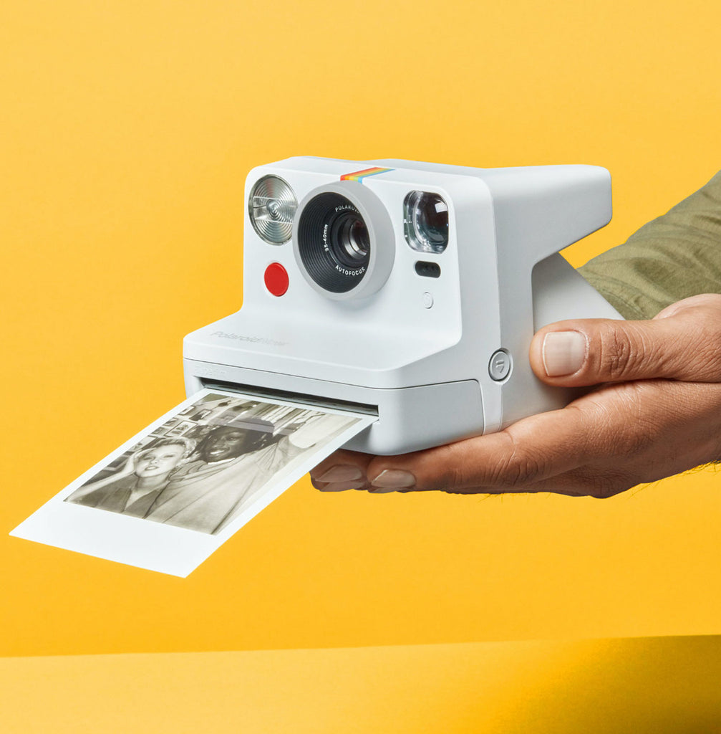
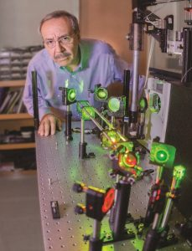
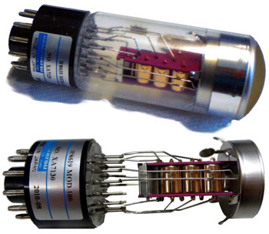
Detecting light
https://www.cientificos.pe/wp-content/uploads/2018/10/pinzas3.jpg, http://cdn.shopify.com/s/files/1/1135/7914/collections/image_all_cameras_holidays_thumbnail_1024x1024.jpg?v=1609772997, https://www.sense-pro.org/images/lll-sensors/pmt_working-devices_w350.jpg

Slide 4
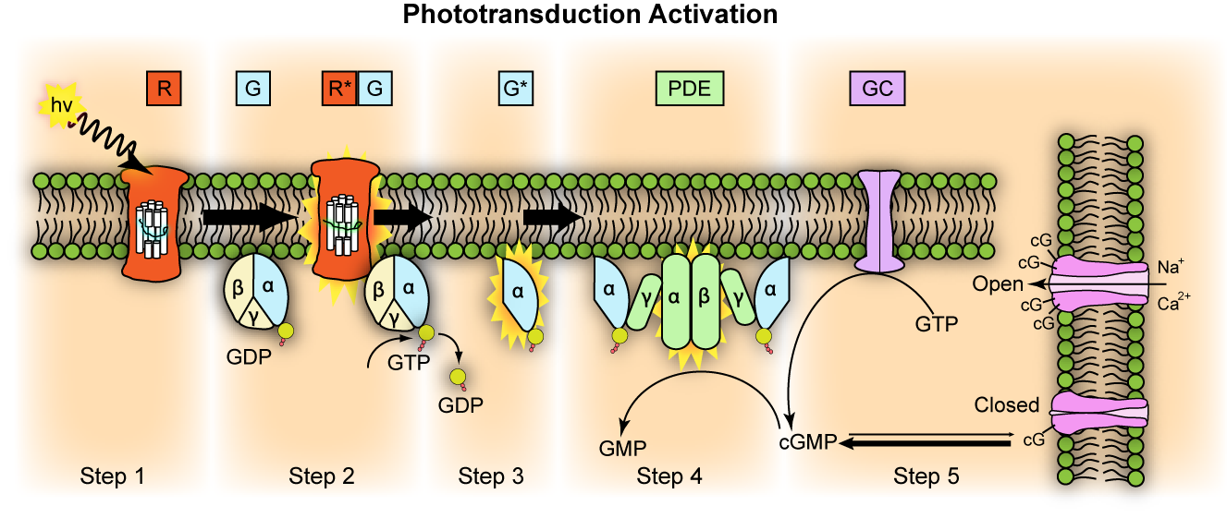
How do we “see” light?
Light in, electrical signal out
https://www.cientificos.pe/wp-content/uploads/2018/10/pinzas3.jpg, https://upload.wikimedia.org/wikipedia/commons/d/de/Phototransduction.png

Slide 5
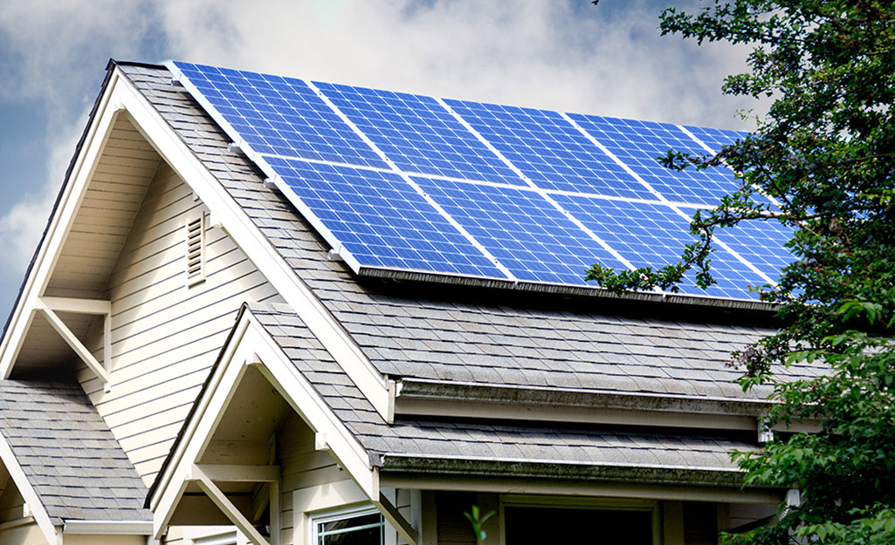
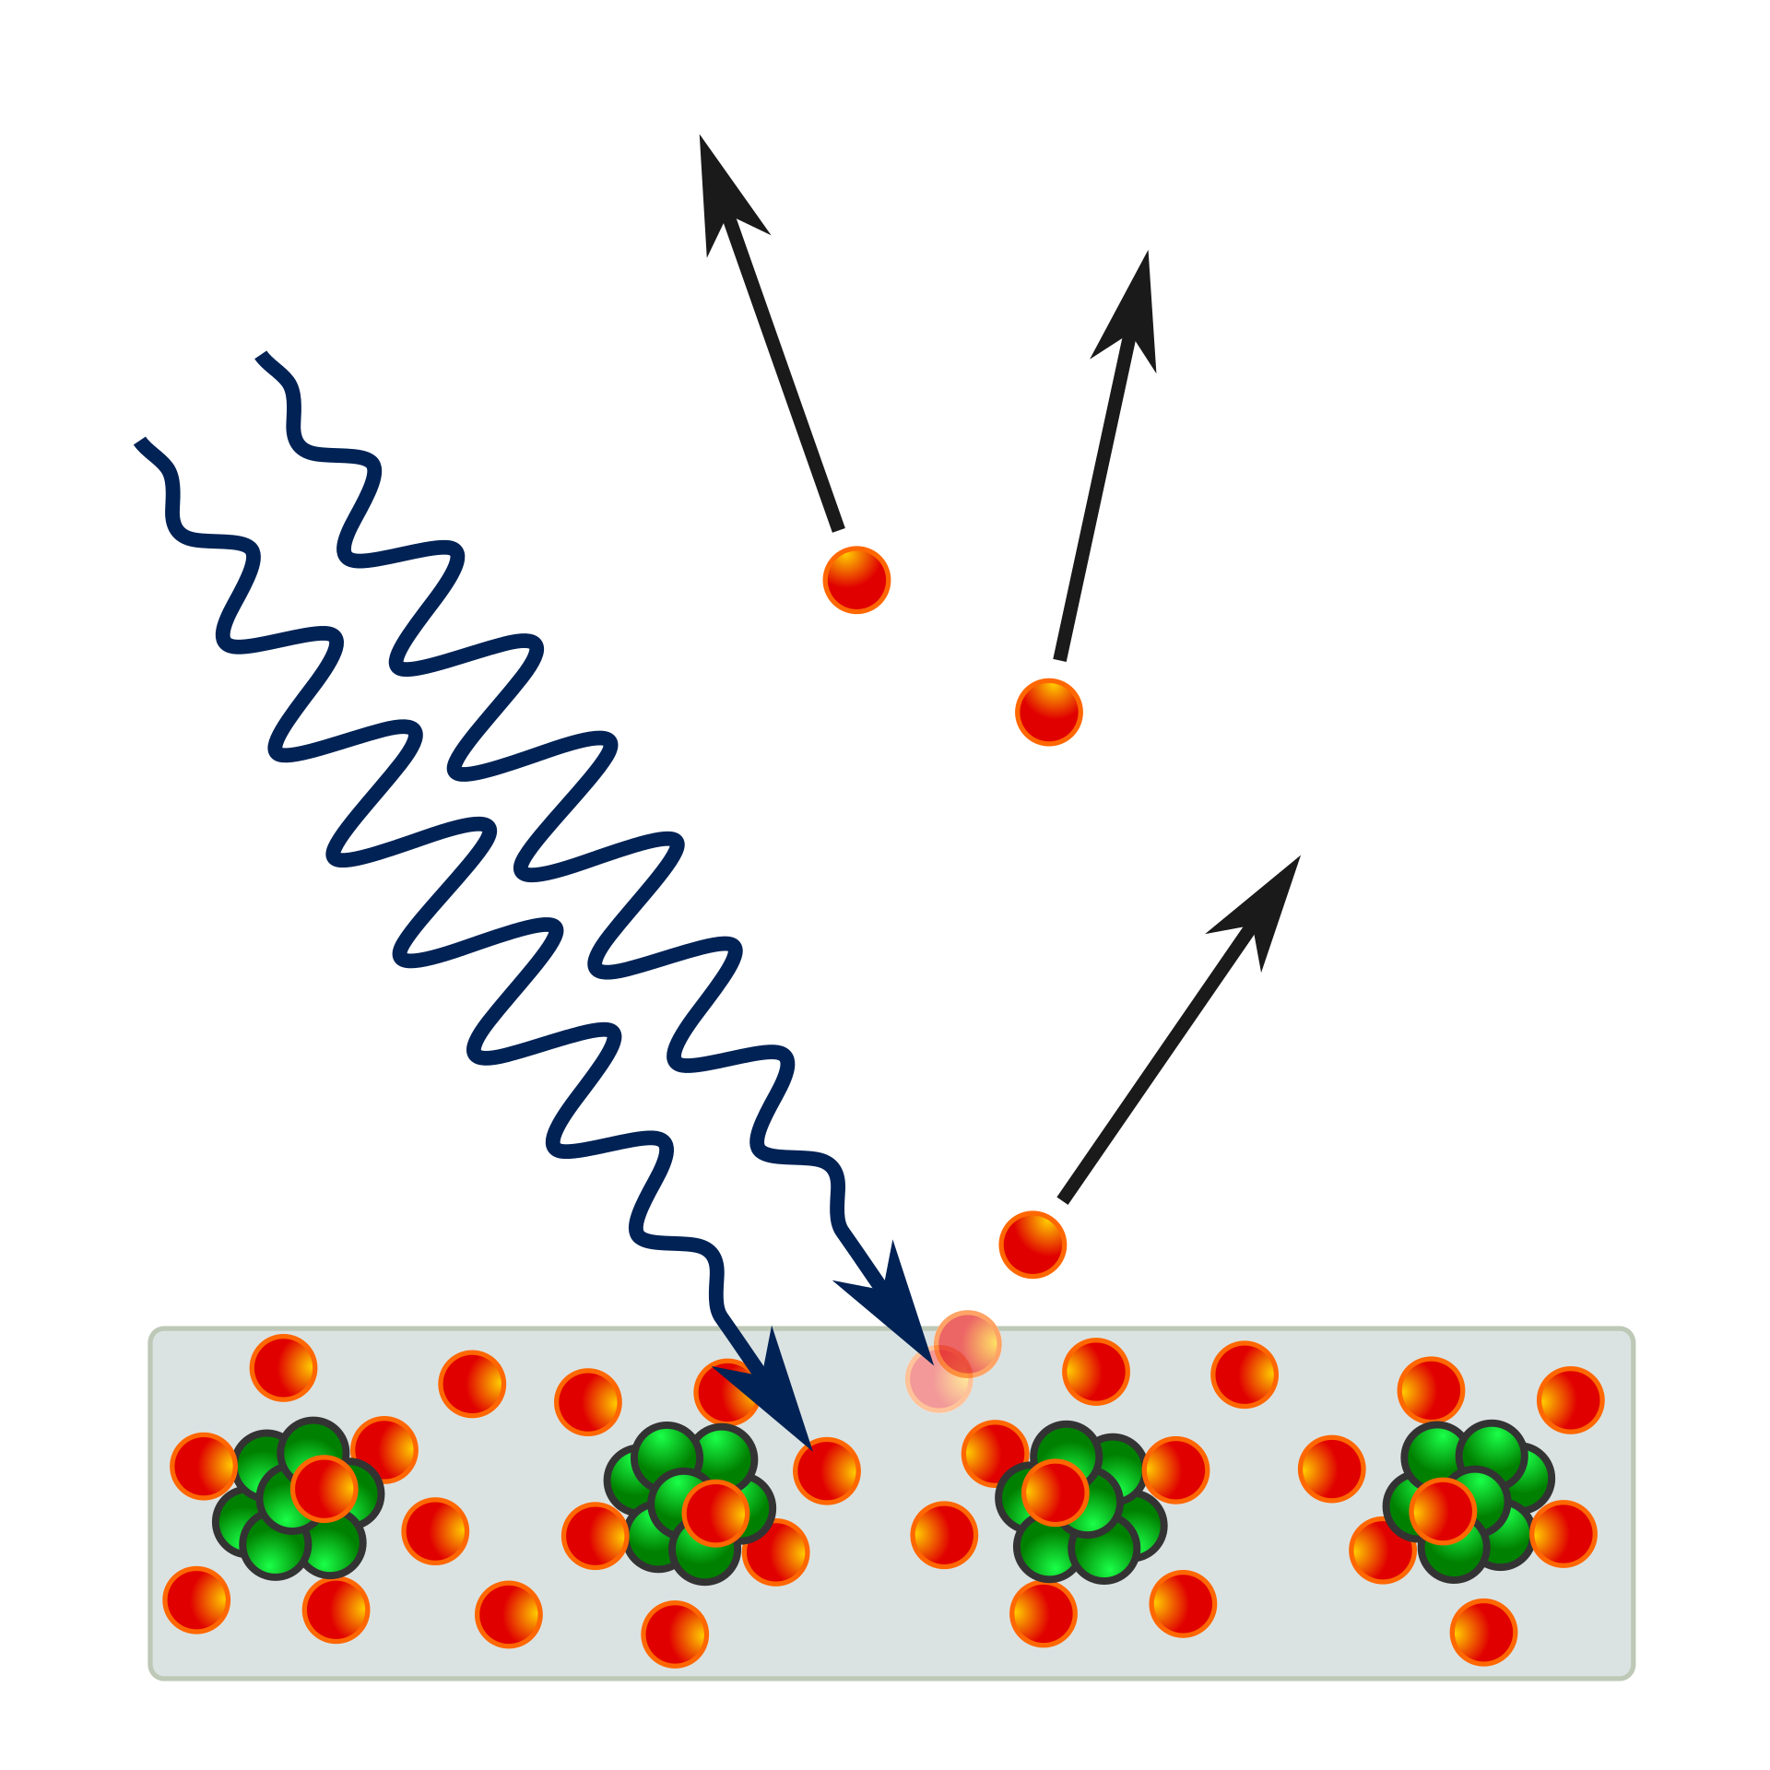
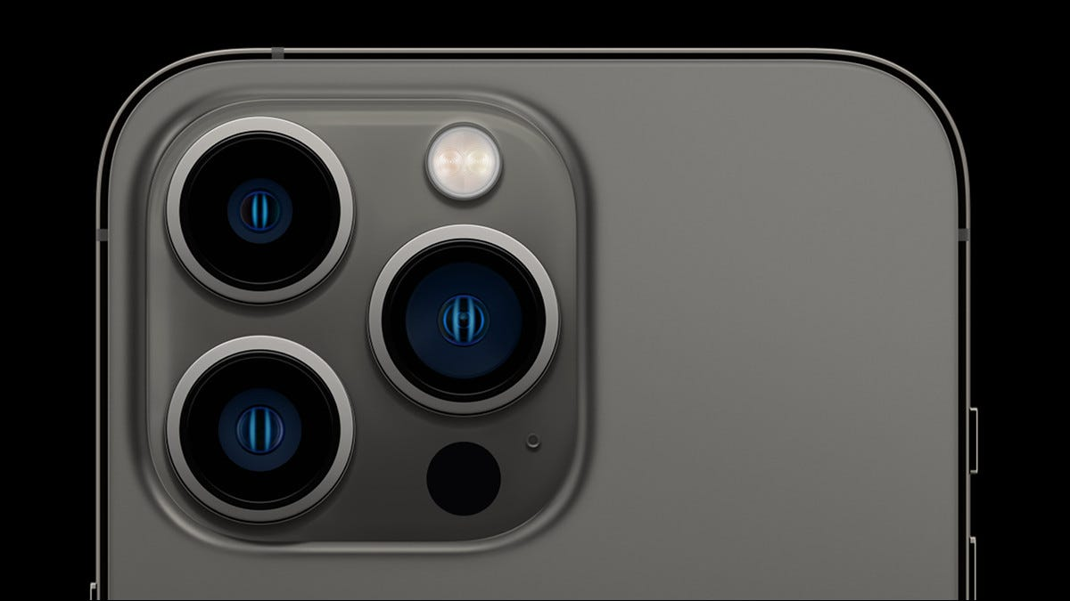
How do we capture light?
Photoelectric effect
https://contentgrid.homedepot-static.com/hdus/en_US/DTCCOMNEW/Articles/types-of-solar-panels-section-1.jpg, https://www.howtogeek.com/wp-content/uploads/2021/09/finishes_2_graphite__cu1a7xuepsq6_large_2x.jpg?width=1198&trim=1,1&bg-color=000&pad=1,1, https://upload.wikimedia.org/wikipedia/commons/thumb/a/a6/Photoelectric_effect_in_a_solid_-_diagram.svg/1920px-Photoelectric_effect_in_a_solid_-_diagram.svg.png

Slide 6
What factors impact light capture by a sensor ? (5 mins)
https://www.howtogeek.com/wp-content/uploads/2021/09/finishes_2_graphite__cu1a7xuepsq6_large_2x.jpg?width=1198&trim=1,1&bg-color=000&pad=1,1

Slide 7
What factors impact light capture by a sensor ? (5 mins)
Sensitivity of detector
Detector size
Noise (read, thermal, shot)
Quality of optics
Wavelength(s) of incident light
Readout mode
Readout speed
Integration time
Bit depth / dynamic range

Slide 8
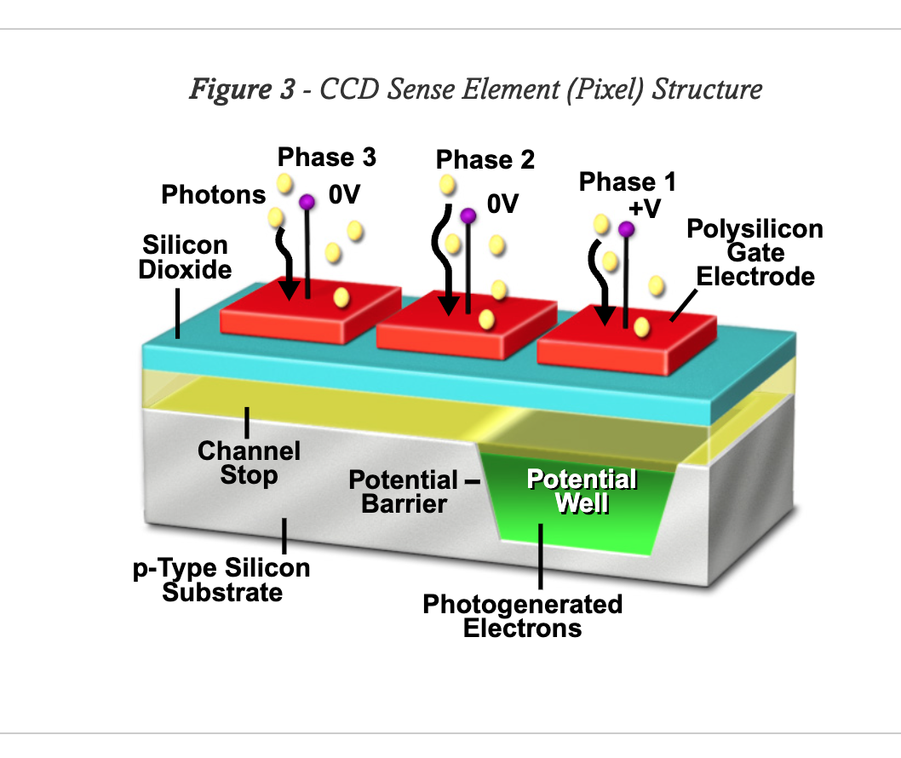
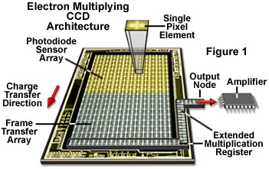
Sensors: CCDs
CCD = “Charge Coupled Device”
Charge accumulates in potential well when incident light hits pixels
Charge transferred to “register” to be converted to signal
50–70% QE, high read noise (4–10 e⁻)
Slow (~3–20 Hz at full frame)
https://www.atto-tec.com/ATTO-565.html?language=en, https://static4.olympus-lifescience.com/data/olympusmicro/primer/digitalimaging/concepts/images/emccdsfigure1.jpg?rev=878B

Slide 9
Sensors: EMCCDs
EMCCD = “Electron Multiplying Charge Coupled Device”
Design, principle of operation almost identical to CCD
Signal is amplified by e⁻ bombardment prior to signal conversion (at the cost of dynamic range)
95% QE (when back-thinned), very low read noise <1 e⁻
Slow (~3–20 Hz at full frame)
https://www.atto-tec.com/ATTO-565.html?language=en, https://static4.olympus-lifescience.com/data/olympusmicro/primer/digitalimaging/concepts/images/emccdsfigure1.jpg?rev=878B

Slide 10
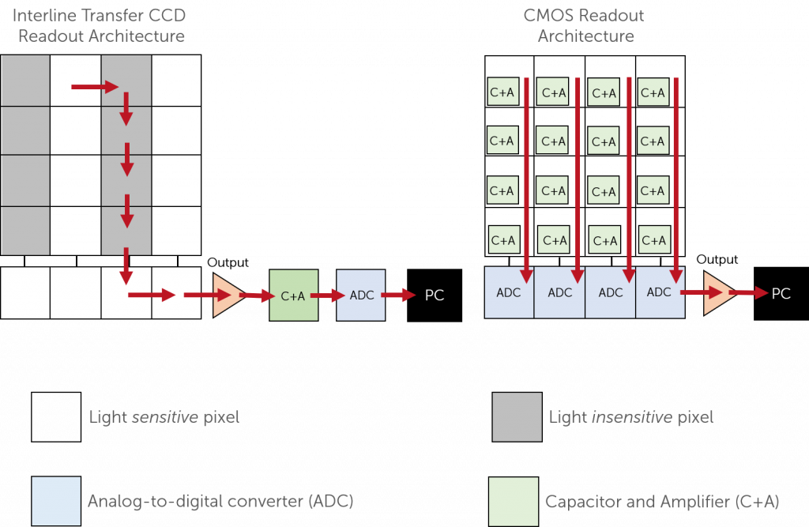
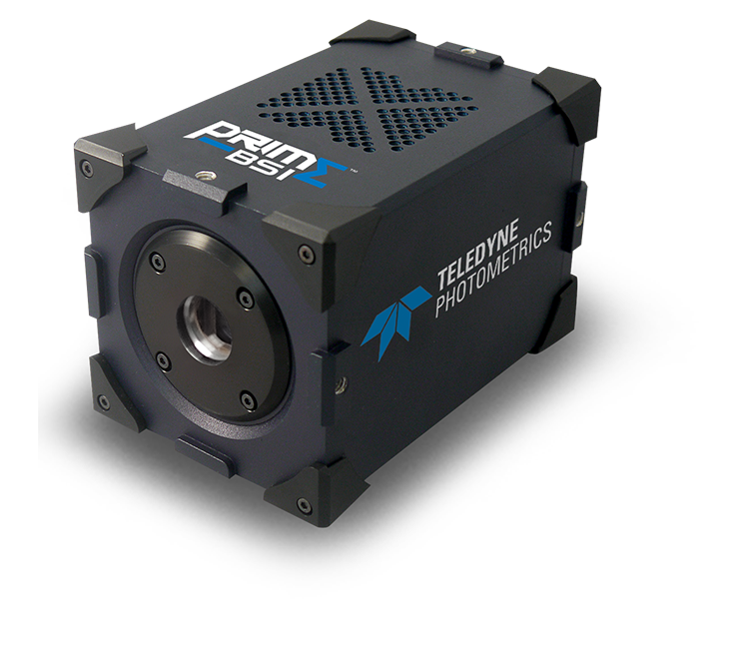
Sensors: sCMOS
sCMOS = “scientific Complementary Metal Oxide Semiconductor”
Principle similar to CCD, but each pixel has its own ADC
Allows for smaller pixels, lower energy consumption (phones!)
95% QE (when back-thinned), low read noise ~1–2 e⁻
Fast (100+ Hz at full frame)
https://www.princetoninstruments.com/wp-content/uploads/2020/08/sCMOS-readout-architecture-1536x1000.png, https://www.photometrics.com/wp-content/uploads/2019/09/prime-bsi-shadow-750x696.png

Slide 11
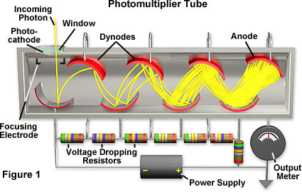
Sensors: PMTs
PMT = “Photomultiplier tube”
Signal amplified by “secondary emission” (similar to EMCCD)
No spatial resolution (ie, is not a sensor array)
20–40% QE, not effective in IR. Low read noise, but other noise can be high
Extremely fast (1000+ Hz), huge dynamic range
https://micro.magnet.fsu.edu/primer/digitalimaging/concepts/images/photomultiplier.jpg, https://www.sense-pro.org/images/lll-sensors/pmt_working-devices_w350.jpg

Slide 12
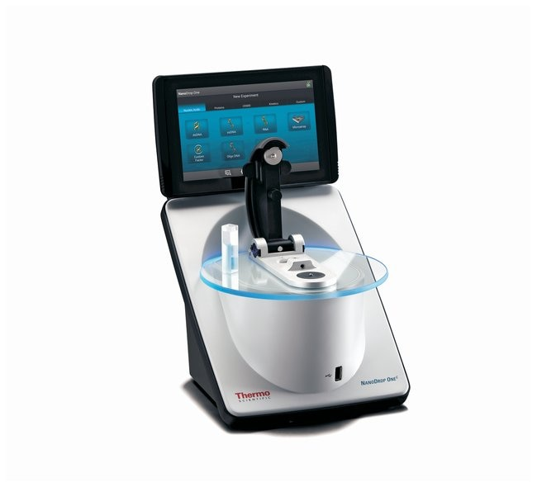
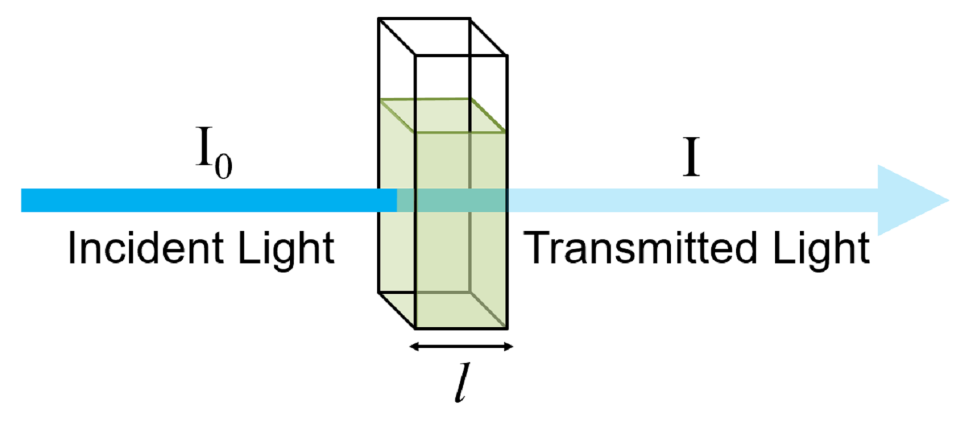
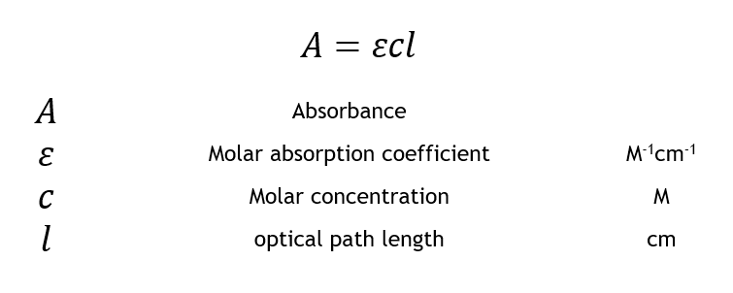
Challenge 1: How does this work?
https://assets.fishersci.com/TFS-Assets/CCG/product-images/F265788~p.eps-650.jpg, https://www.edinst.com/wp-content/uploads/2019/08/BLL-1.png, https://www.edinst.com/wp-content/uploads/2019/08/BLL-E4.png

Slide 13
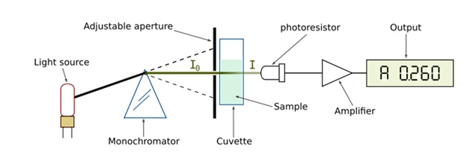
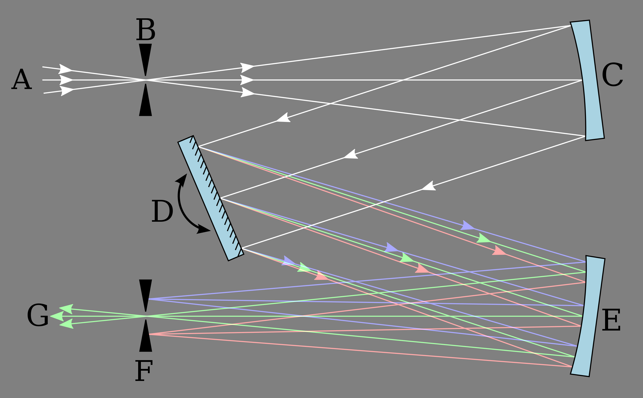
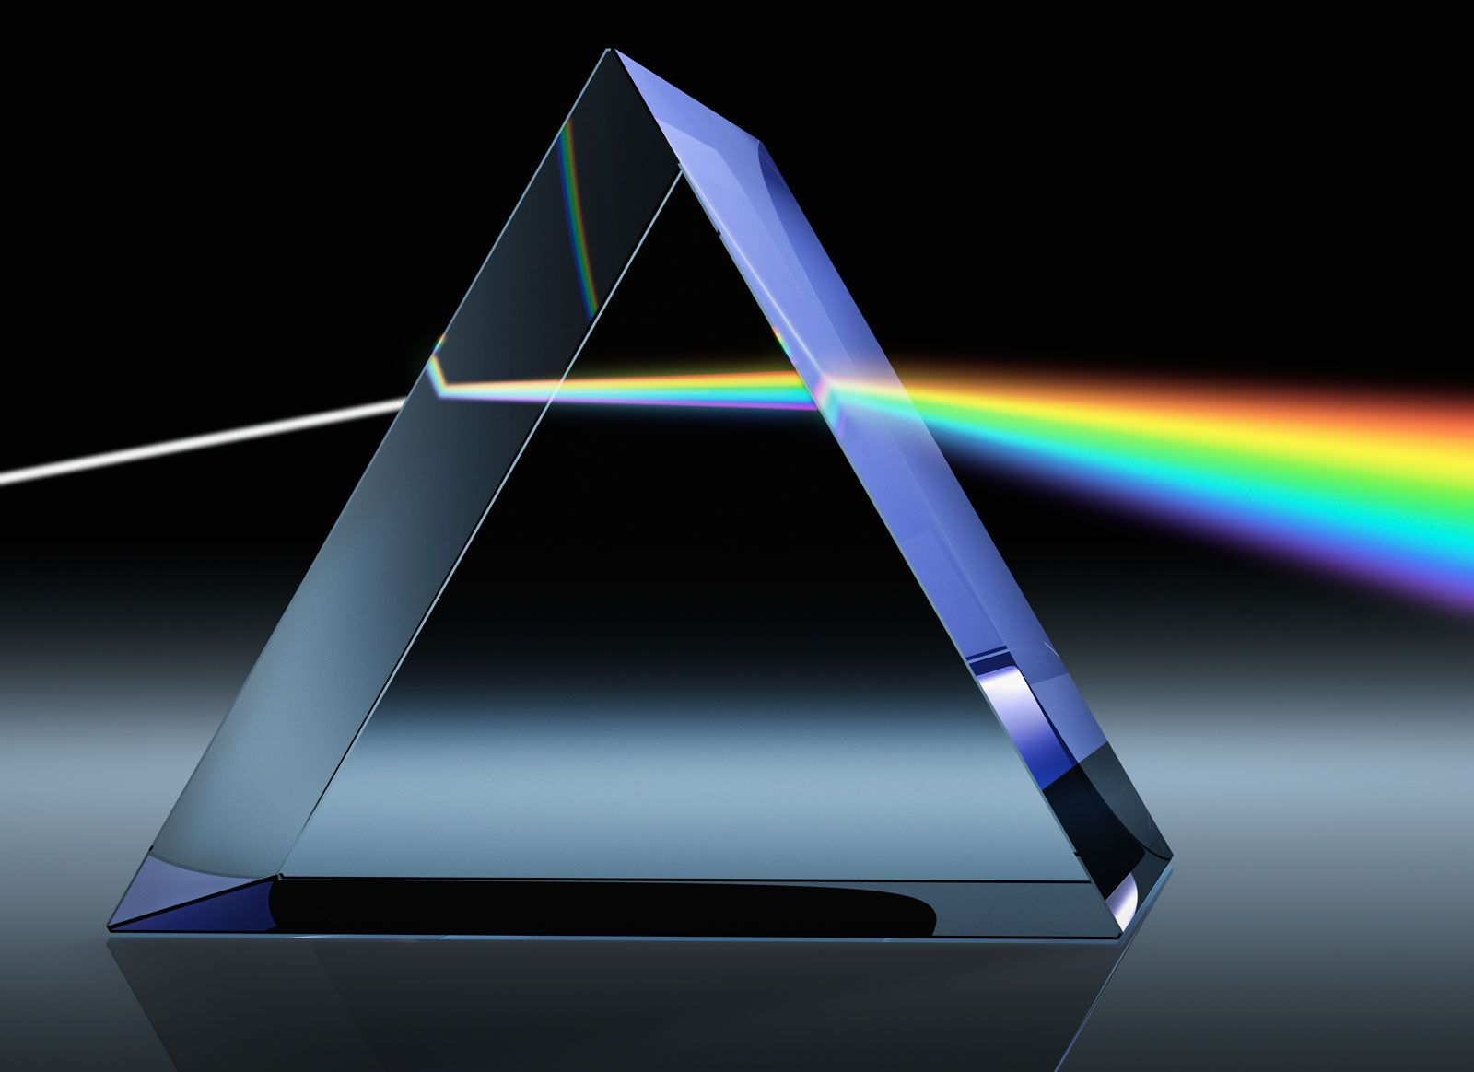
Challenge 1: How does this work?
https://assets.fishersci.com/TFS-Assets/CCG/product-images/F265788~p.eps-650.jpg, https://1.bp.blogspot.com/-WKn7l1iLAbs/WlI2RLYjuXI/AAAAAAAACW4/jgkGAPRayEMlSelvQMJbOstHmG49GxUZQCLcBGAs/s1600/1.jpg, https://upload.wikimedia.org/wikipedia/commons/thumb/d/d7/Czerny-Turner_Monochromator.svg/2560px-Czerny-Turner_Monochromator.svg.png, https://cdn.britannica.com/78/149178-050-F2421B64/light-prism-color-angle-colors-wavelength-wavelengths.jpg

Slide 14
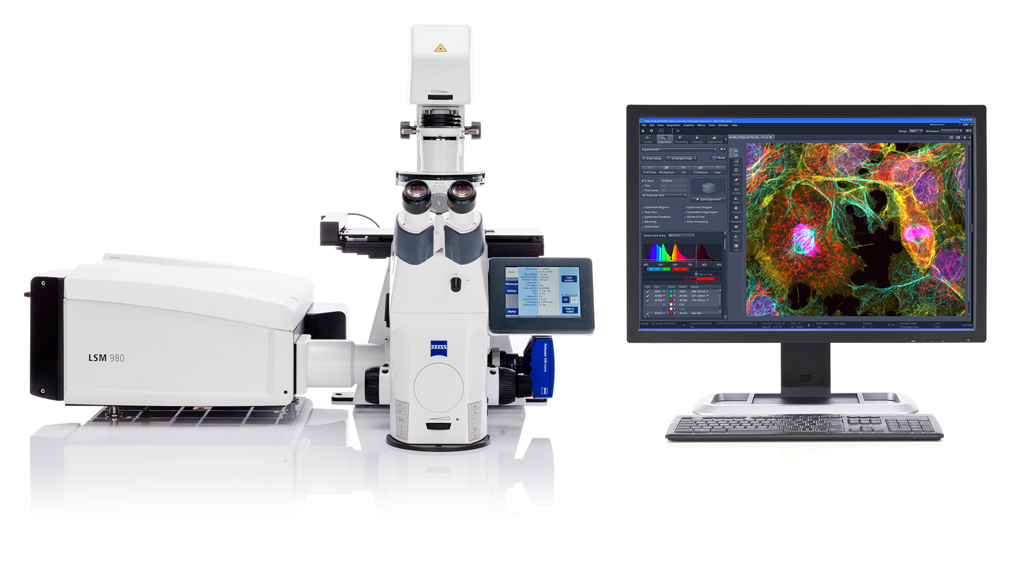
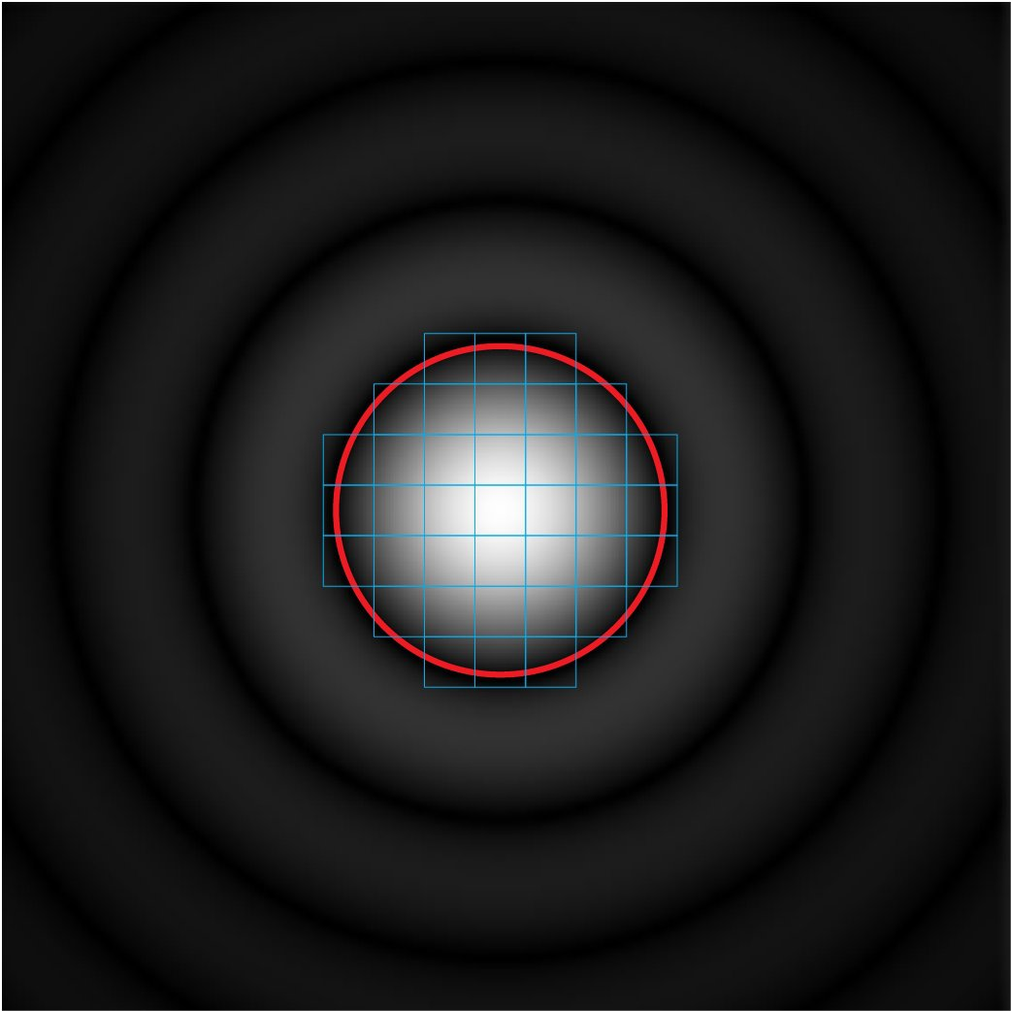
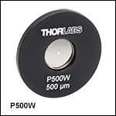
Challenge 2: How does this work?
https://www.zeiss.com/content/dam/Microscopy/Products/laser-scan/lsm-980/lsm-980-confocal-microscope.jpg, https://www.thorlabs.com/images/GuideImages/13948_P500W_SG.jpg, https://webcdn.leica-microsystems.com/fileadmin/academy/user_upload/Intro_HyV_Pinhole_Effect.jpg,

Slide 15
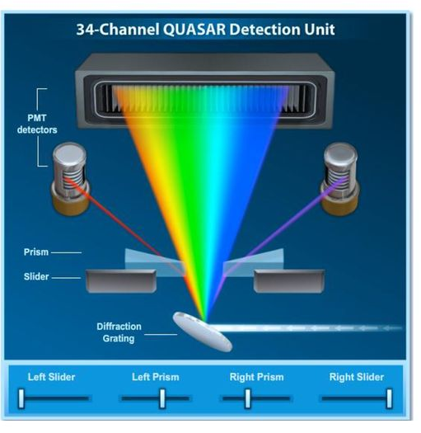
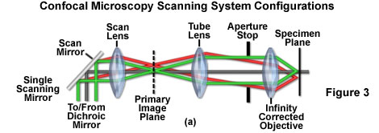
Challenge 2: How does this work?
Why not use a monochromator and have a “channel” per wavelength?
https://www.zeiss.com/content/dam/Microscopy/Products/laser-scan/lsm-980/lsm-980-confocal-microscope.jpg, https://static3.olympus-lifescience.com/data/olympusmicro/primer/techniques/confocal/images/scanningsystemsfigure3.jpg?rev=C040, https://slideplayer.com/slide/15394910/93/images/24/Zeiss+710+spectral+system+Images+from%3A.jpg

