Slide 1
What is the purpose of calibration?

Slide 2
Quantitative Analysis 101
What is does it mean to be quantitative?

Slide 3
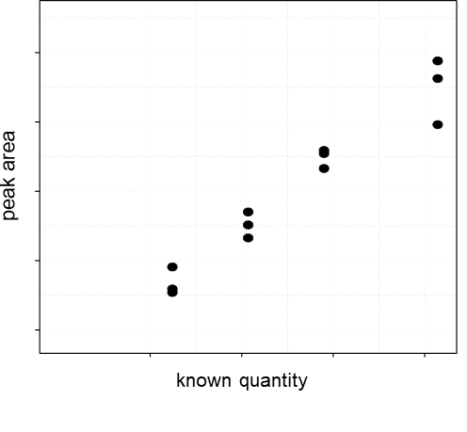
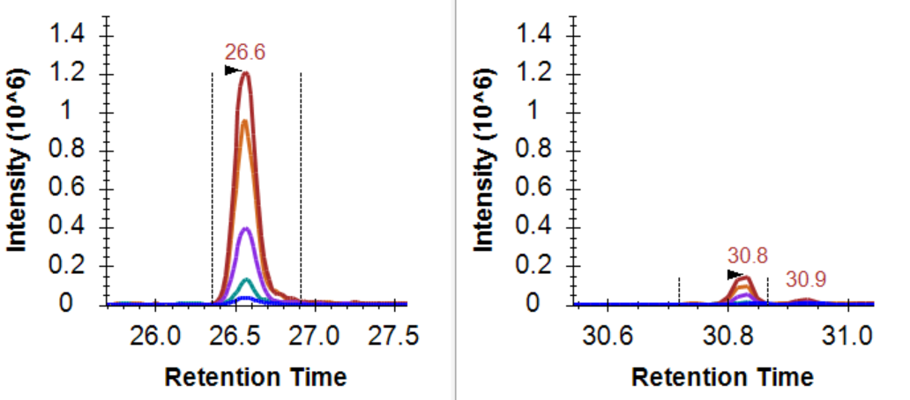
The change in signal should reflect the change in quantity

Slide 4
Quantitative Analysis 101
ULOQ
Linear Dynamic Range
Measured Intensity (Area)
LOD
LLOQ
Amount (moles)
LOD: Limit of Detection
LLOQ: Lower Limit of Quantitation
ULOQ: Upper Limit of Quantitation

Slide 5
Quantitative Analysis 101: Using an Internal Std
ULOQ
Linear Dynamic Range
Intensity Ratio (Area Ratio)
LOD
LLOQ
Amount (moles)
LOD: Limit of Detection
LLOQ: Lower Limit of Quantitation
ULOQ: Upper Limit of Quantitation

Slide 6
Quantitative Analysis 101
What is does it mean to be quantitative?
What does signal calibration mean?

Slide 7
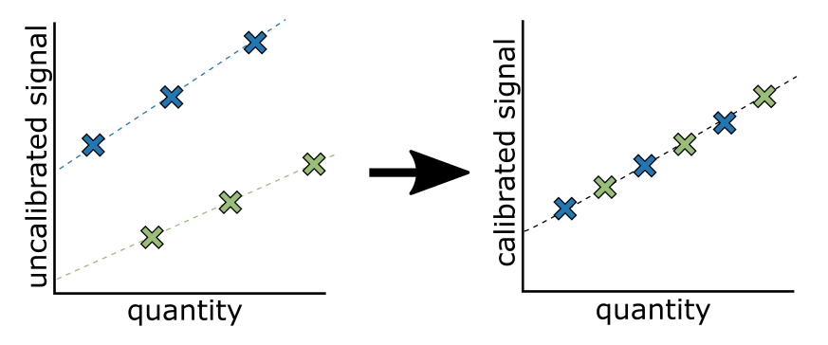
Measurements on different platforms are not measured on the same scale

Slide 8
Between Batch/Platform/Lab Signal Calibration
Purpose of signal calibration
Placing signal on the same scale
Often the scale is arbitrary
Kilogram = mass of a liter of water at freezing point
Meter = 1/10,000,000 the distance from the equator to the north pole
Pee dee belomnite (PDB) = reference for 13C, fossil found in Peedee Formation in South Carolina
Standard mean ocean water (SMOW) = reference for 18O, arbitrary mix of distilled water from different regions of the world.

Slide 9
What you calibrate against is important

Slide 10
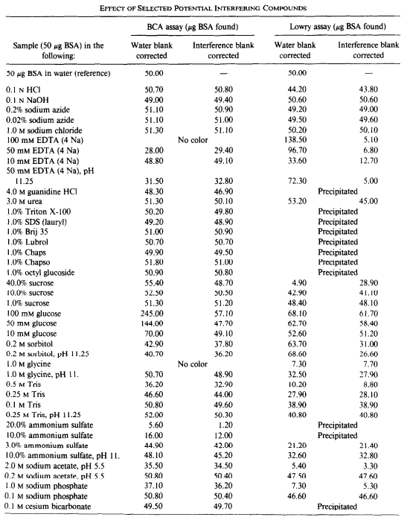
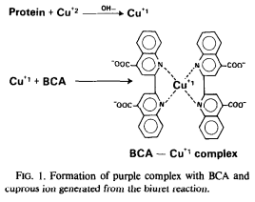
What you calibrate against is important
Bicinchoninic acid (BCA) is the current standard for measuring protein abundance.

Slide 11
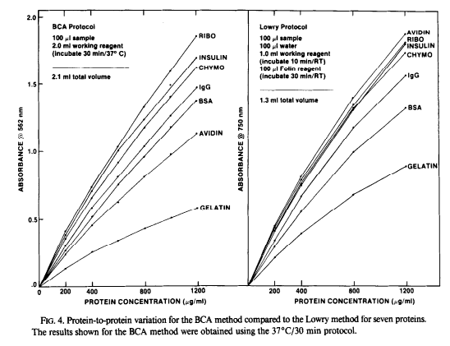
What you calibrate against is important
Smith et al., Anal Biochem 1985

