Slide 1
From last class: Selectivity vs Sensitivity

Slide 2
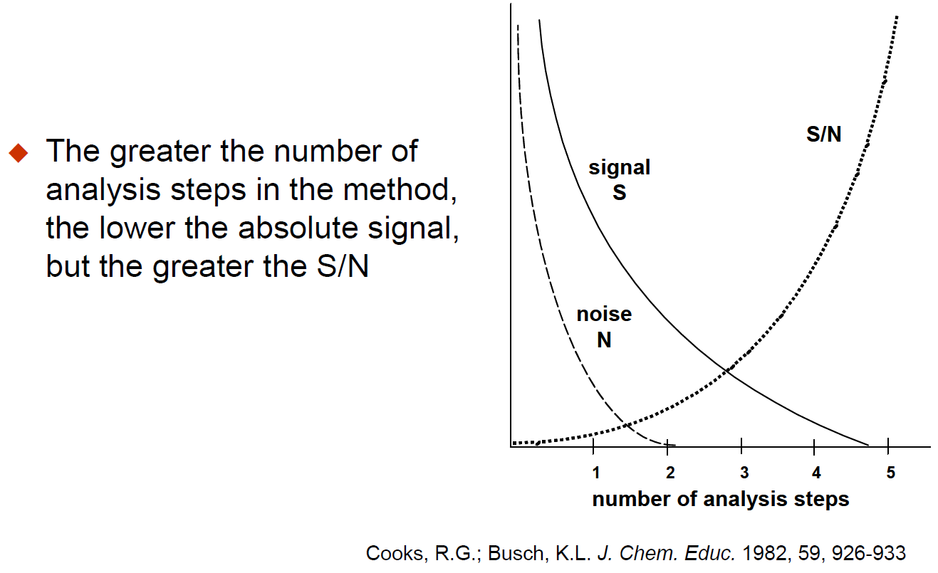

Slide 3
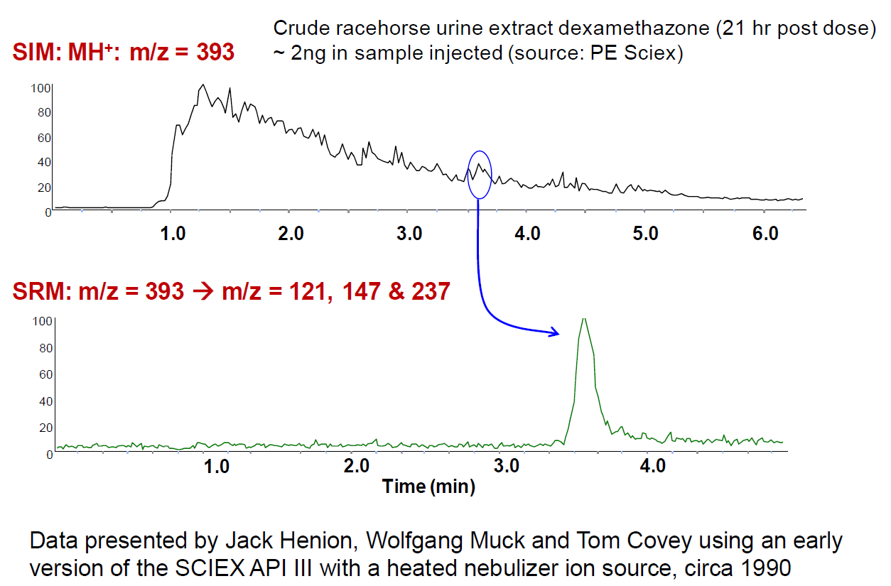

Slide 4
Fluorescence Advantage
Fluorescence is measured over a dark background, while absorbance is measured over a bright background.
Measuring signal over a large background is hard.
Chemical noise/background is a major limitation.

Slide 5
Quantitative Analysis 101
What does it mean to be quantitative?

Slide 6
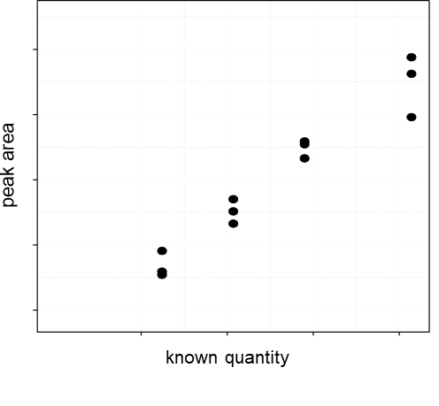
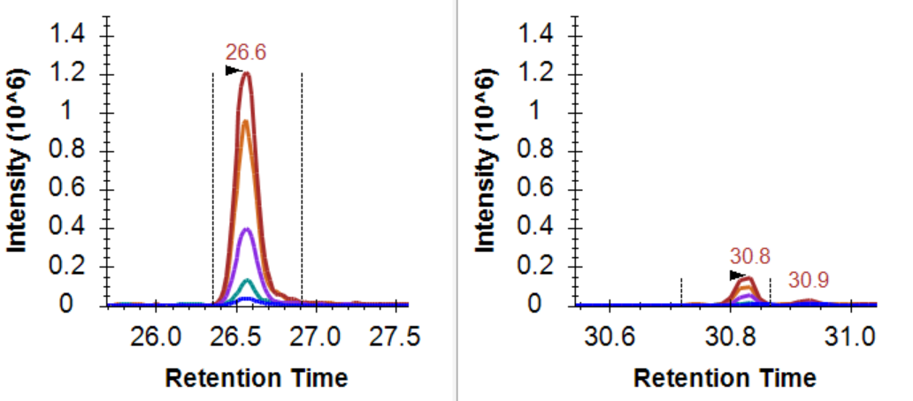
The change in signal should reflect the change in quantity

Slide 7
Quantitative Analysis 101
ULOQ
Linear Dynamic Range
Measured Intensity (Area)
LOD
LLOQ
Amount (moles)
LOD: Limit of Detection
LLOQ: Lower Limit of Quantitation
ULOQ: Upper Limit of Quantitation

Slide 8
Quantitative Analysis 101: Using an Internal Std
ULOQ
Linear Dynamic Range
Intensity Ratio (Area Ratio)
LOD
LLOQ
Amount (moles)
LOD: Limit of Detection
LLOQ: Lower Limit of Quantitation
ULOQ: Upper Limit of Quantitation

Slide 9
Quantitative Analysis 101
What does it mean to be quantitative?
What does signal calibration mean?

Slide 10
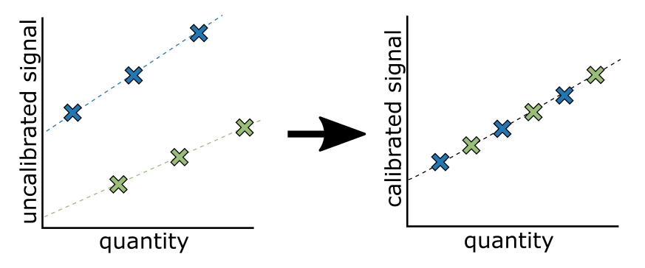
Measurements on different platforms are not measured on the same scale

Slide 11
Between Batch/Platform/Lab Signal Calibration
Purpose of signal calibration
Placing signal on the same scale
Often the scale is arbitrary
Kilogram = mass of a liter of water at freezing point
Meter = 1/10,000,000 the distance from the equator to the north pole
Pee dee belomnite (PDB) = reference for 13C, fossil found in Peedee Formation in South Carolina
Standard mean ocean water (SMOW) = reference for 18O, arbitrary mix of distilled water from different regions of the world.

Slide 12

Use of calibration curve to convert signal to quantity
Analyte (m/z = M)
$$A∝moles$$
M
A
Intensity
Intensity
m/z
time
Measured Signal (Area)
Known Amount
Where: k_{i}= is the slope of the standard curve A_{b} ≈ 0 Area from a blank

Slide 13
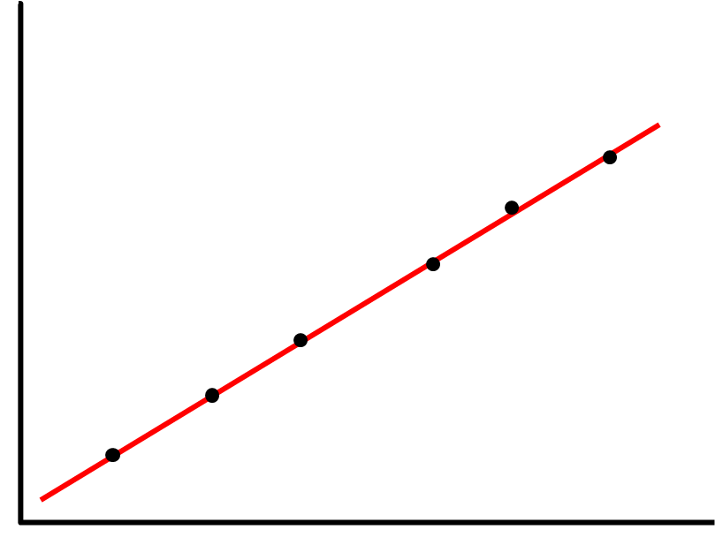
Use of calibration curve to convert signal to quantity
Sample (m/z = M) Spiked with
Internal Standard (m/z = M+i)
A₀
A_{i}
n₀
n_{i}
M+ i
R₀ =
∝
Intensity
Intensity
M
m/z
time
Measured Signal (Area Ratio)
Known Amount
Where: k_{0/i}= is the slope of the standard curve R_{i} ≈ 0 Area ratio from a blank … only internal std

Slide 14
What you calibrate against is important

Slide 15
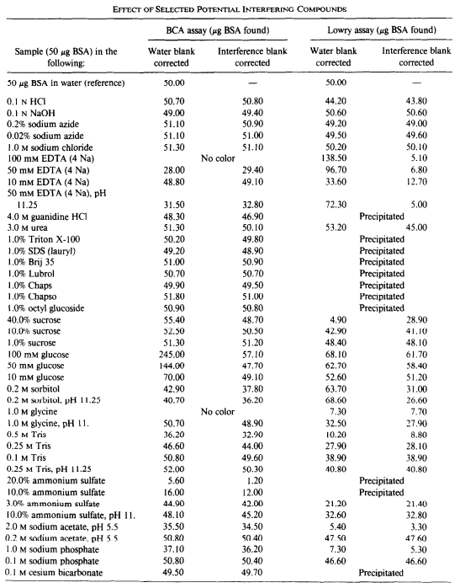
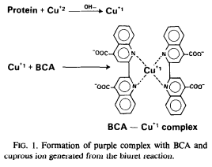
What you calibrate against is important
Bicinchoninic acid (BCA) is the current standard for measuring protein abundance.

Slide 16
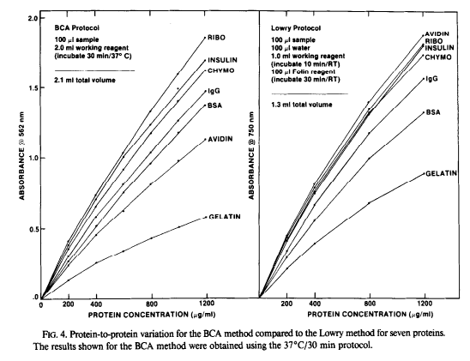
What you calibrate against is important
Smith et al., Anal Biochem 1985

Slide 17
What is the difference between relative and absolute quantitation?

Slide 18
What is the difference between a “differential” and a “quantitative” measurement?

Slide 19
What does it mean if these are the two points?
ULOQ
Linear Dynamic Range
Measured Intensity (Area)
LOD
LLOQ
Amount (moles)
LOD: Limit of Detection
LLOQ: Lower Limit of Quantitation
ULOQ: Upper Limit of Quantitation

Slide 20
Major Quantitative Figures of Merit
LOD – Limit of Detection
LLOQ – Limit of Quantitation
Precision
Within batch/day
Between batch/day

Slide 21
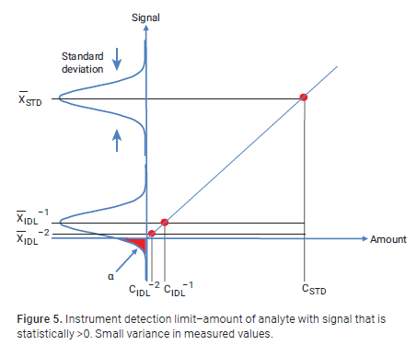
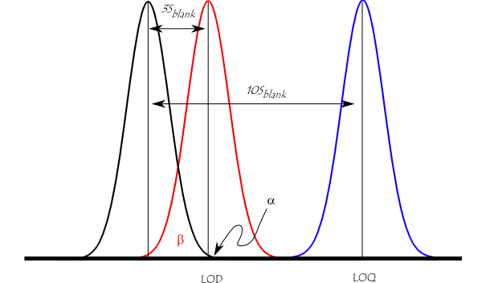
Limit of detection
Is a signal statistically different from a blank?

Slide 22

Limit of Quantitation
Does the change in quantity reflect the change in signal?
The limit of quantitation (LOQ; also referred to as the lower limit of the measuring interval (LLMI)) is defined by the Clinical and Laboratory Standards Institute as ″the lowest measurand concentration at which all defined performance characteristics of the measurement procedure are met.″
Our lab often chooses for LLOQ:
Must be >LOD
Must have a coefficient of variation <20% (aka S/N >5)

Slide 23
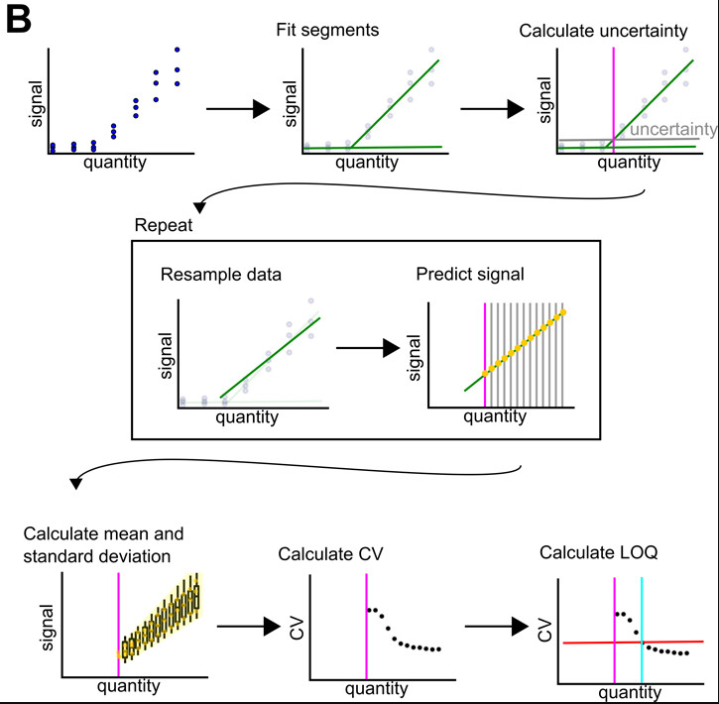
Limit of Quantitation
Does the change in quantity reflect the change in signal?
The limit of quantitation (LOQ; also referred to as the lower limit of the measuring interval (LLMI)) is defined by the Clinical and Laboratory Standards Institute as ″the lowest measurand concentration at which all defined performance characteristics of the measurement procedure are met.″

Slide 24
Questions:
Can a method be quantitative if you don’t know the range over which the signal reflects the quantity?
Design an approach to confirm linearity and LLOQ for peptides in a complex matrix?
Assume you have < 50 analytes in your assay.
Assume you have >1000 analytes in your assay?

Slide 25
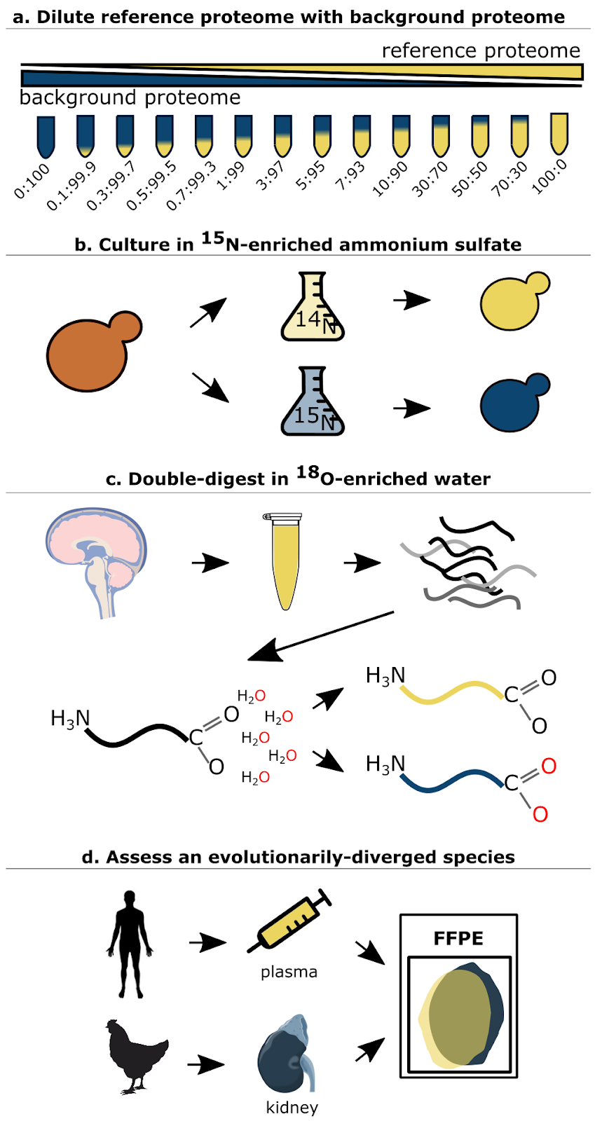
Matched Matrix Dilution Curves
Building on: Grant and Hoofnagle, Clin Chem 2014

Slide 26
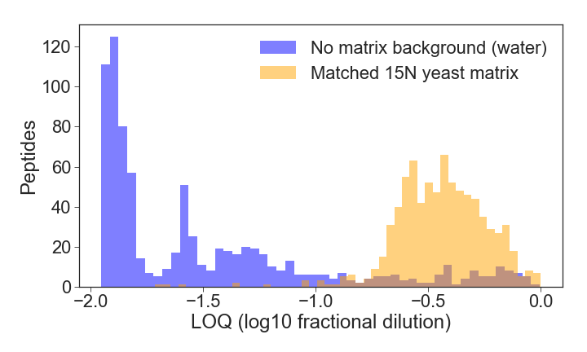
Matching the Matrix is Important

Slide 27
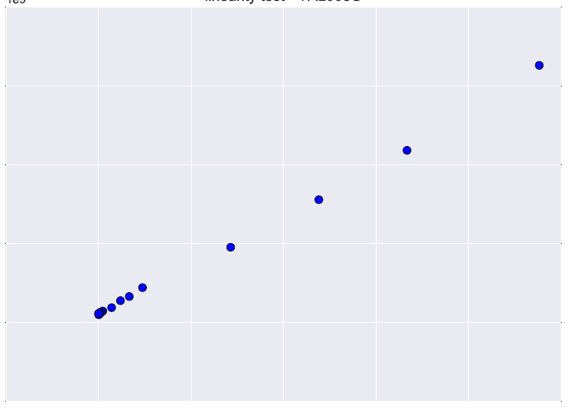
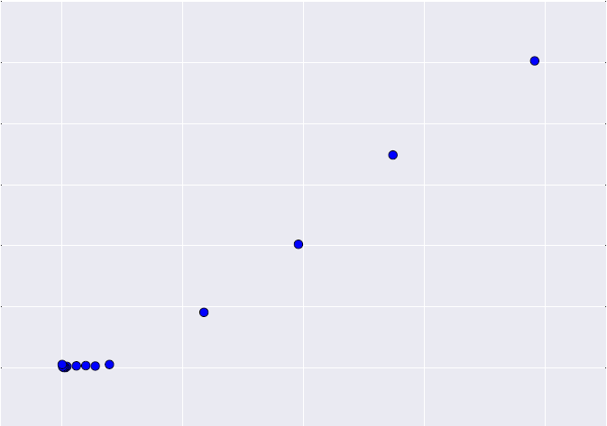
Reference Yeast BY4742 Diluted in 15N Yeast (S288c)
Protein SSA1 (2.69E+05 copies/cell)
Protein LSM2 (2.21E+03 copies/cell)
2
1.2
1.5
1.0
0.8
1
0.6
Peak area (1e9)
Peak area (1e7)
0.5
0.4
0.2
0
0
0
0.2
0.4
0.6
0.8
1
0
0.2
0.4
0.6
0.8
Fractional Dilution
Fractional Dilution
Notes:
Protein value = sum(peptides(sum(fragments))
function broken in post-3.4.0 MSstats builds, waiting to hear back from collaborator

Slide 28
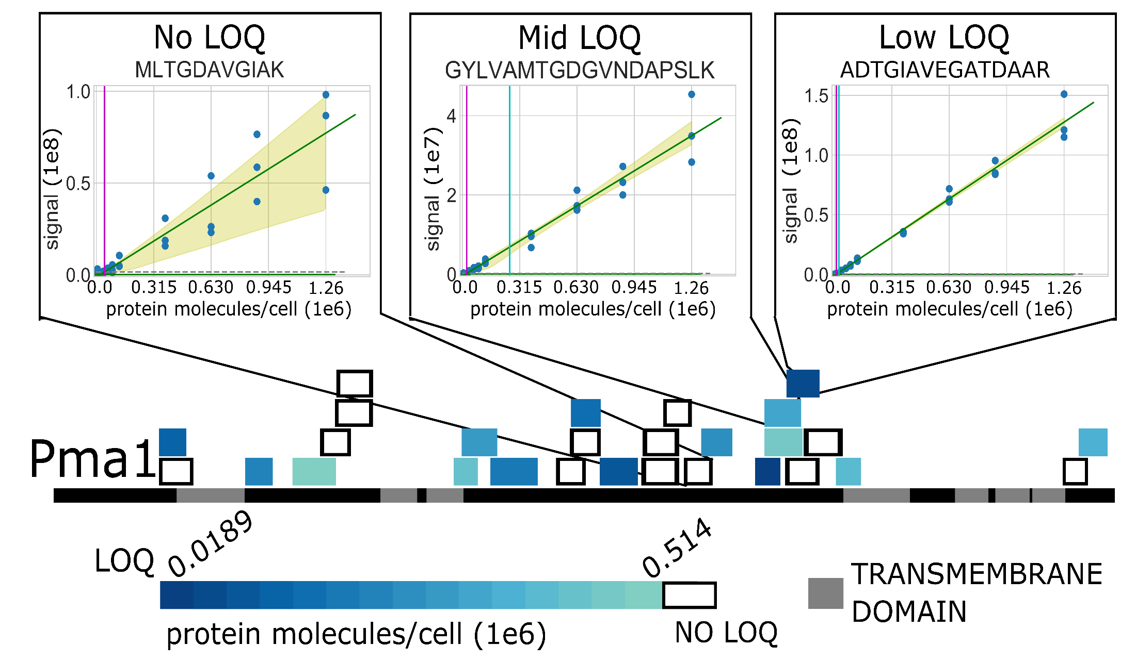
Not all Peptides are Equal Quantitative Proxies for a Protein
Notes:
plasma membrane ATPase (PMA1

Slide 29
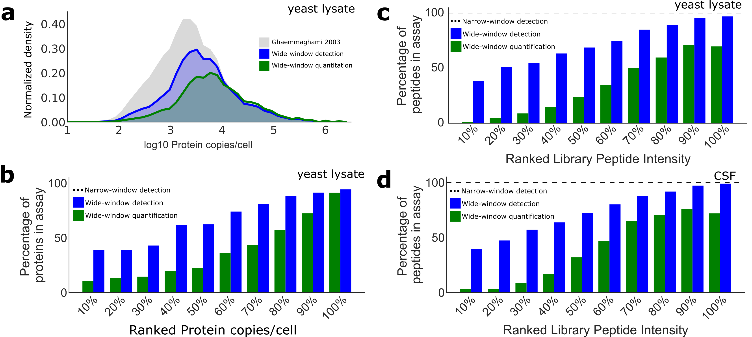
Not all Peptides are Quantitative

Slide 30
Method of Standard Addition
Can’t assess Limit of Quantification. Can only assess whether the sample us above the LOQ

Slide 31
Mixing two samples of extreme conditions
Assume that you have a healthy and a disease cohort.
You can take a pool of the healthy and a pool of the disease to demonstrate that the measurement is linear between the two conditions
Example
100% condition A
80% condition A, 20% condition B
50% condition A, 50% condition B
20% condition A, 80% condition B
100% condition B

