Slide 1
Fluorescent Labels
Genome 575: Fundamentals of Biomedical Instrumentation
Brian Beliveau

Slide 2
Recap from last time
Optical systems typically have a defined number of channels
The number of channels is bounded by several factors including label availability and transmission/detection efficiencies
Filters and dichroic mirrors are typically short pass, band pass, or long pass
Adding more channels -> reduced information you can get from any single channel

Slide 3

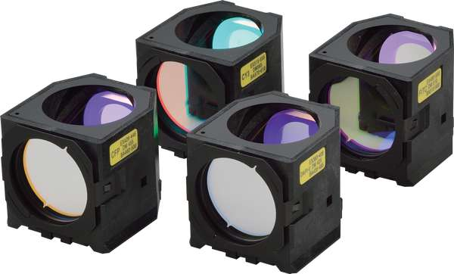
On filters…
It’s complicated!
Let’s walk through some real use cases
https://i.ytimg.com/vi/y4dJOFUVk30/maxresdefault.jpg, https://d33b8x22mym97j.cloudfront.net/production/imager/productphotos/827/filter-cubes-main_ec7d1033075031a0254a7350f4e87eb4.jpg

Slide 4
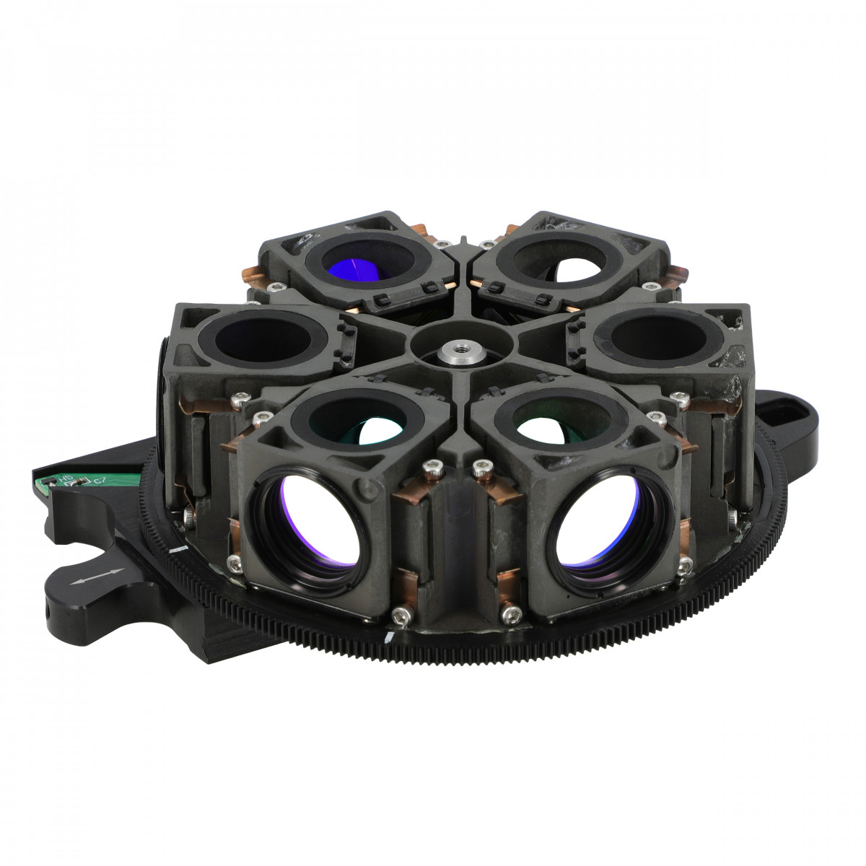
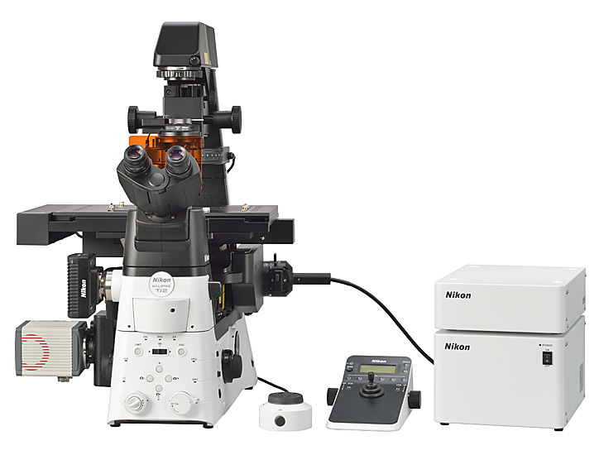
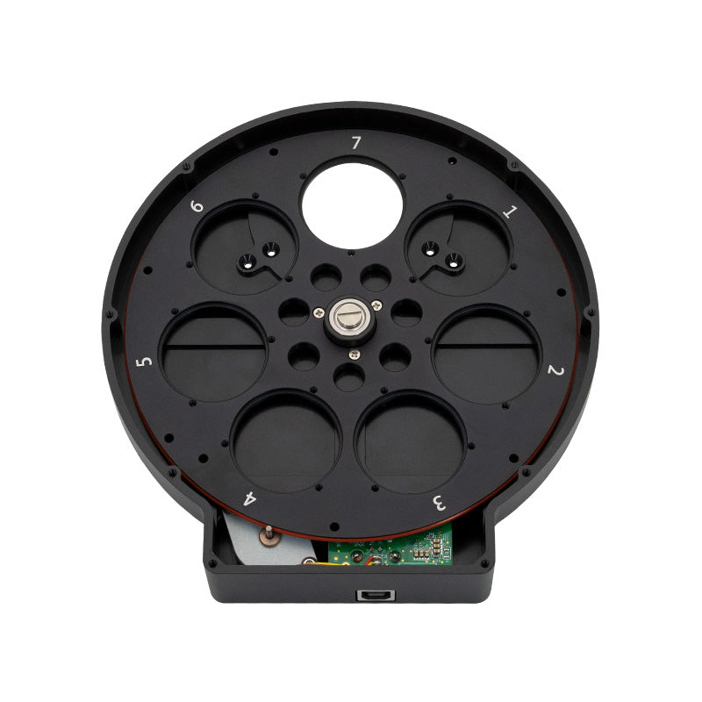
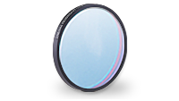
The Beliveau Lab microscopes
6 filter cubes
7 individual (Em) filters
https://www.nikon.com/news/2016/img/pic_161109_01.jpg, https://accu-scope.com/media/catalog/product/cache/1/thumbnail/1200x/17f82f742ffe127f42dca9de82fb58b1/6/0/600-3232.jpg, https://cdn.shopify.com/s/files/1/1594/4815/products/061_1200x.jpg?v=1618498984, https://i.ytimg.com/vi/y4dJOFUVk30/maxresdefault.jpg, https://d33b8x22mym97j.cloudfront.net/production/imager/productphotos/827/filter-cubes-main_ec7d1033075031a0254a7350f4e87eb4.jpg, https://www.chroma.com/sites/default/files/individual-filters-small.png

Slide 5
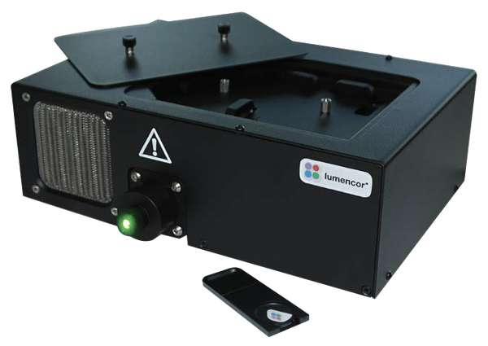
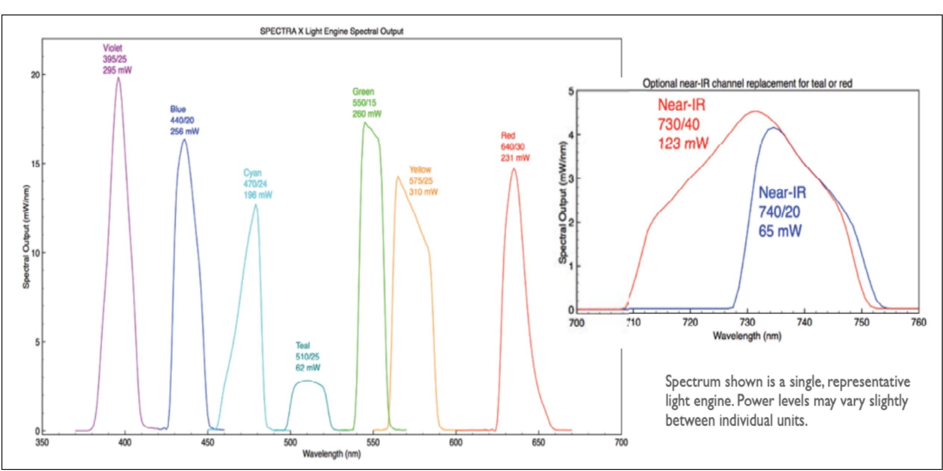
Use case 1: widefield LED imaging
Goal: Speed
7 -line LED system
395/25
438/29
474/28
510/25
555/28
640/30
730/40
https://cms.lumencor.com/system/uploads/fae/image/asset/565/xl_Lumencor_SPECTRAX_ProductGallery-5_2021.jpg, https://cms.lumencor.com/system/uploads/fae/file/asset/30/SPECTRA_X_Light_Engine.pdf?_gl=1*h2z2ow*_ga*OTc4OTE4MzE0LjE2NDk5NjUxNDk.*_ga_364GJZVK77*MTY1MDY2MjAzOS4xLjAuMTY1MDY2MjA1MS40OA..

Slide 6
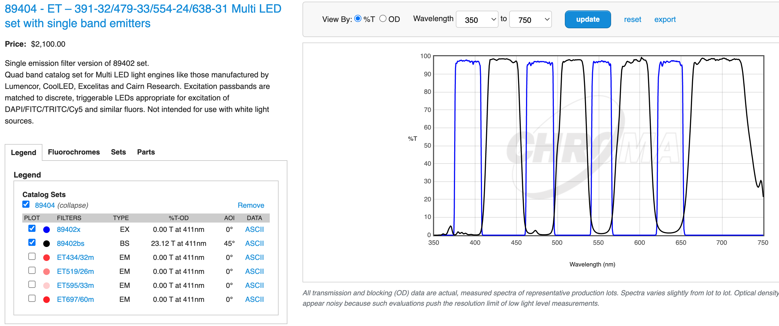
Use case 1: widefield LED imaging
Goal: Speed
7-line LED system
395/25
438/29
474/28
510/25
555/28
640/30
730/40
https://cms.lumencor.com/system/uploads/fae/image/asset/565/xl_Lumencor_SPECTRAX_ProductGallery-5_2021.jpg, https://www.chroma.com/products/sets/89404-et-391-32-479-33-554-24-638-31-multi-led-set-with-single-band-emitters, https://cdn.shopify.com/s/files/1/1594/4815/products/061_1200x.jpg?v=1618498984, https://i.ytimg.com/vi/y4dJOFUVk30/maxresdefault.jpg, https://d33b8x22mym97j.cloudfront.net/production/imager/productphotos/827/filter-cubes-main_ec7d1033075031a0254a7350f4e87eb4.jpg, https://www.chroma.com/sites/default/files/individual-filters-small

Slide 7
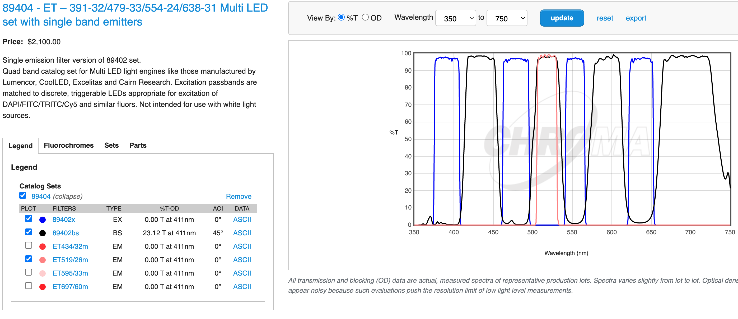
Use case 1: widefield LED imaging
Goal: Speed
7-line LED system
395/25
438/29
510/25
555/28
640/30
730/40
https://cms.lumencor.com/system/uploads/fae/image/asset/565/xl_Lumencor_SPECTRAX_ProductGallery-5_2021.jpg, https://www.chroma.com/products/sets/89404-et-391-32-479-33-554-24-638-31-multi-led-set-with-single-band-emitters, https://cdn.shopify.com/s/files/1/1594/4815/products/061_1200x.jpg?v=1618498984, https://i.ytimg.com/vi/y4dJOFUVk30/maxresdefault.jpg, https://d33b8x22mym97j.cloudfront.net/production/imager/productphotos/827/filter-cubes-main_ec7d1033075031a0254a7350f4e87eb4.jpg, https://www.chroma.com/sites/default/files/individual-filters-small

Slide 8
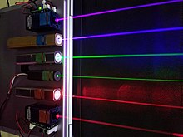
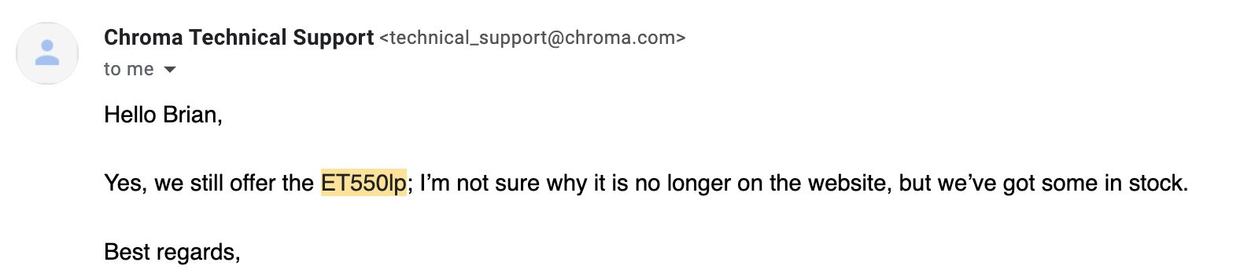
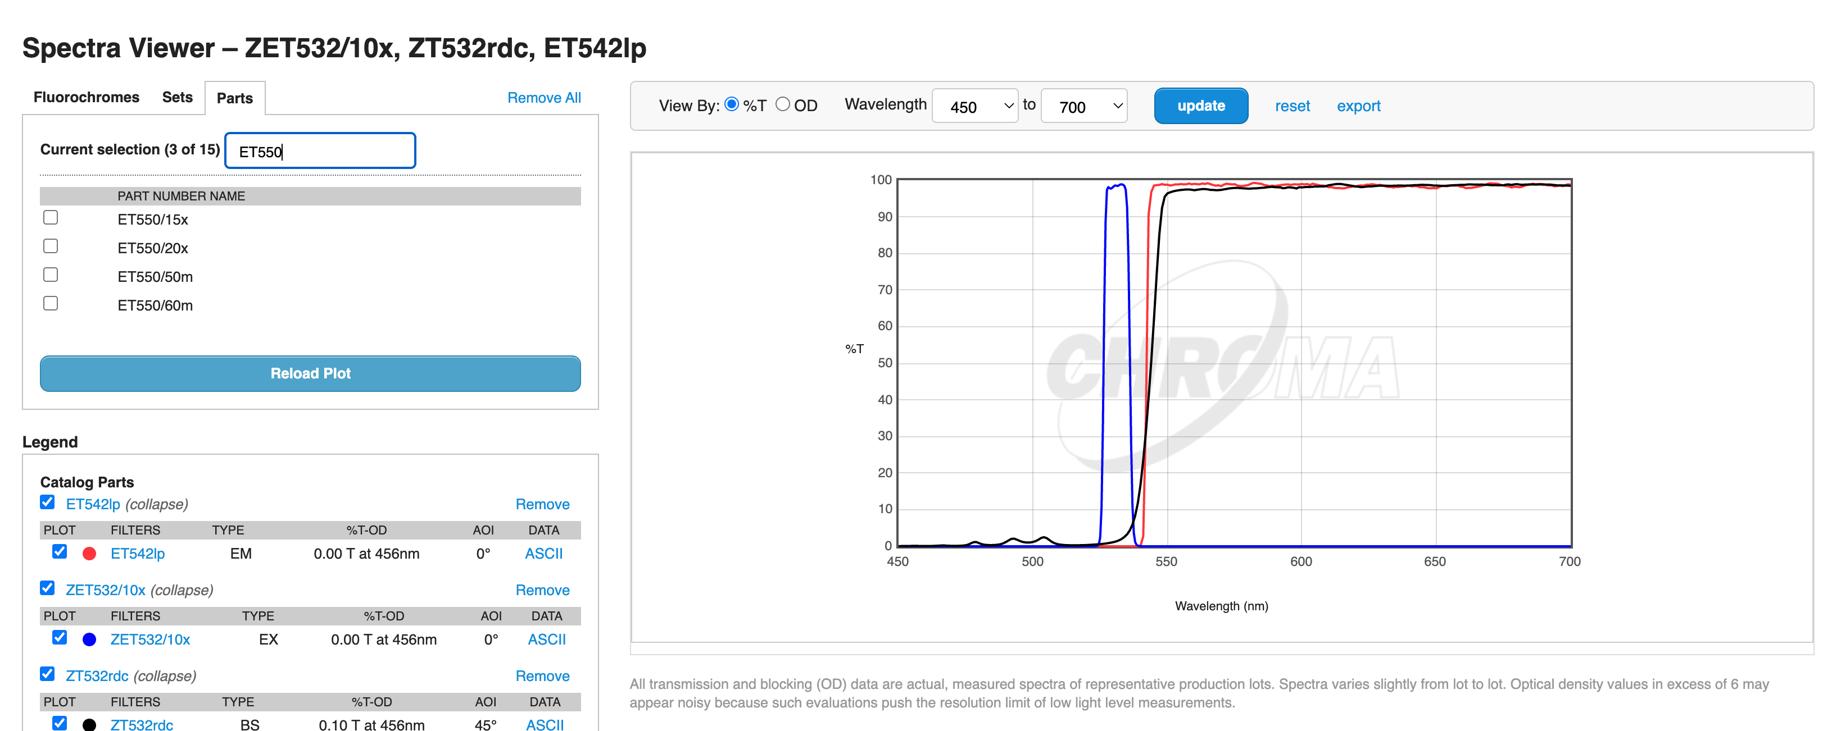

Use case 2: Super Resolution
532 nm
Goal: Photons
https://i.ytimg.com/vi/y4dJOFUVk30/maxresdefault.jpg, https://d33b8x22mym97j.cloudfront.net/production/imager/productphotos/827/filter-cubes-main_ec7d1033075031a0254a7350f4e87eb4.jpg, https://www.chroma.com/sites/default/files/individual-filters-small, https://www.chroma.com/spectra-viewer?parts=25787%2C25416%2C25506#tabs-spectra_viewer_plot-left-3

Slide 9
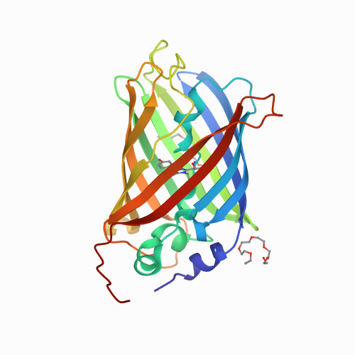
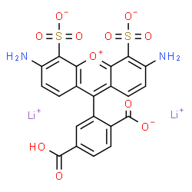
What makes a good label? (5 mins)
https://www.idtdna.com/site/Catalog/Modifications/Dyes, http://www.chemspider.com/Chemical-Structure.23107060.html

Slide 10
What makes a good label?
Brightness
Photostability
Duty cycle
Bio-orthogonality / inertness
Chemical stability (pH)
Size
Monovalency
Cost / availability
Thermal stability
Stokes shift
Em/Ex wavelengths
Solubility
https://www.idtdna.com/site/Catalog/Modifications/Dyes, http://www.chemspider.com/Chemical-Structure.23107060.html

Slide 11
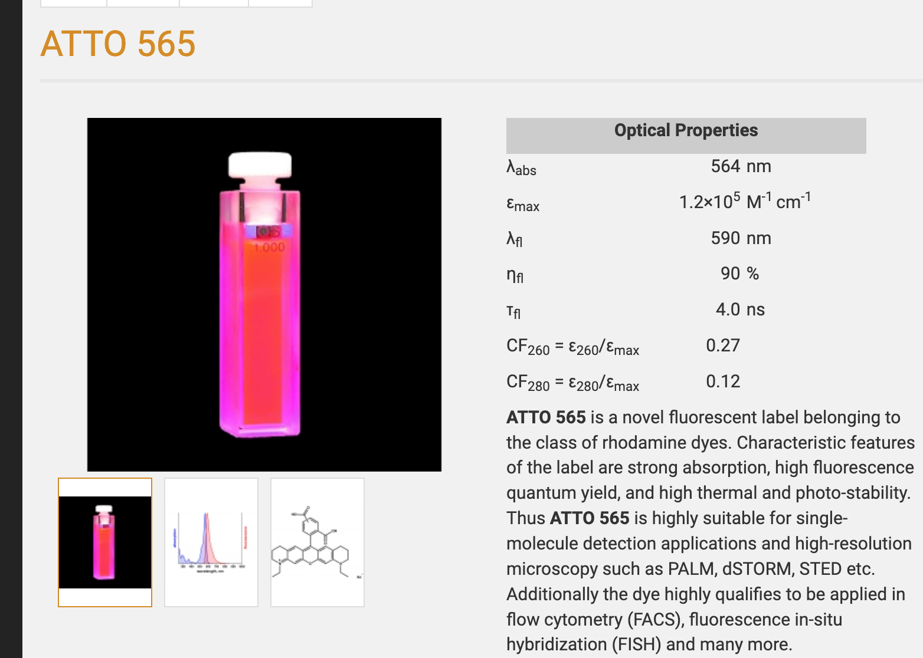
How do we evaluate labels?
https://www.atto-tec.com/ATTO-565.html?language=en

Slide 12
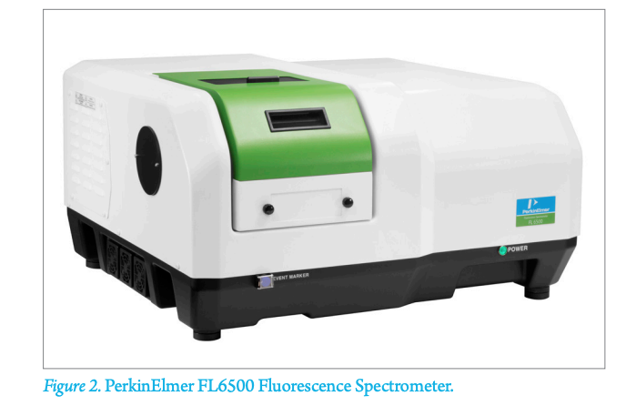
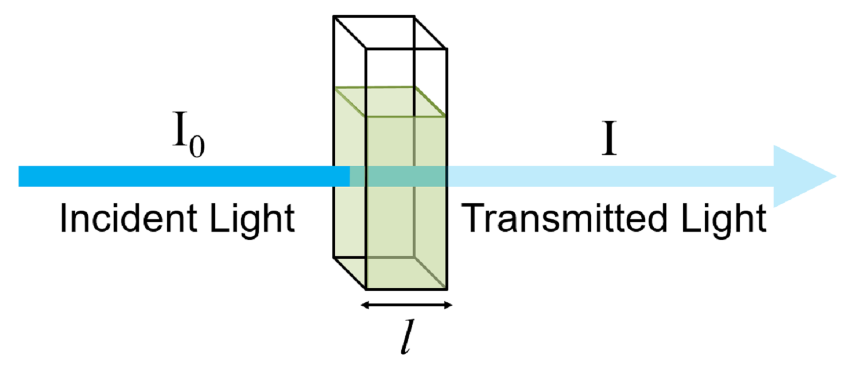
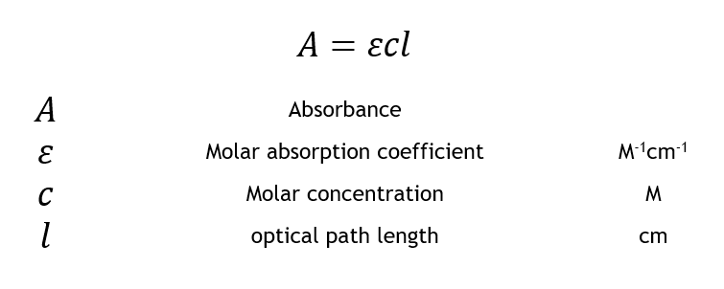
Measuring brightness: molar absorbance coeffcient (ε)
https://resources.perkinelmer.com/lab-solutions/resources/docs/APP_Determination_of_Relative_FluorescenceQuantum_Yields_using_FL6500_Fluorescence_Spect.pdf, https://www.edinst.com/wp-content/uploads/2019/08/BLL-1.png, https://www.edinst.com/wp-content/uploads/2019/08/BLL-E4.png

Slide 13
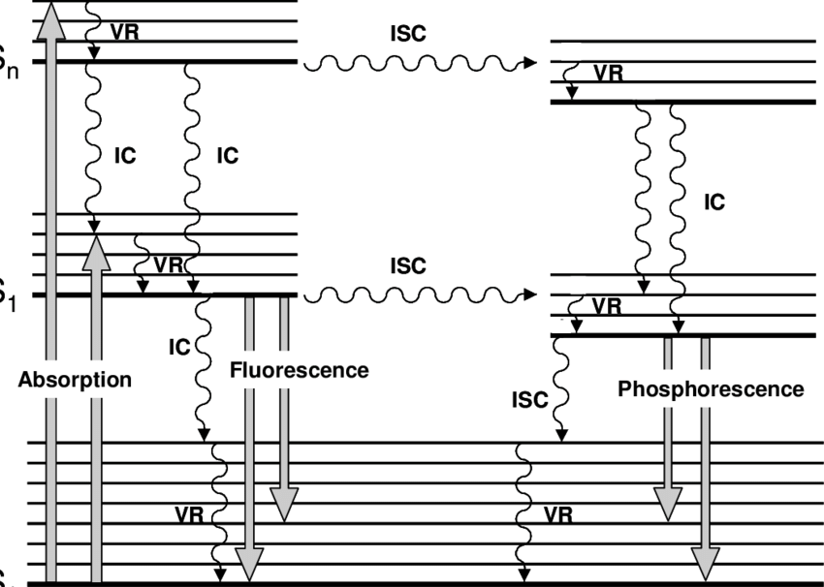
Measuring brightness: Quantum Yield (ɸ)
S_{n}
S₁
S₀
ɸ = emitted photons / absorbed photons
https://www.edinst.com/wp-content/uploads/2019/08/BLL-1.png , https://www.researchgate.net/profile/Henri-Pierre-Lassalle/publication/30513452/figure/fig1/AS:913119526273024@1594716068206/Jablonski-diagram-where-IC-stands-for-internal-conversion-ICS-for-intersystem.png

Slide 14
Measuring brightness
Brightness = ε * ɸ
https://www.atto-tec.com/ATTO-565.html?language=en

Slide 15
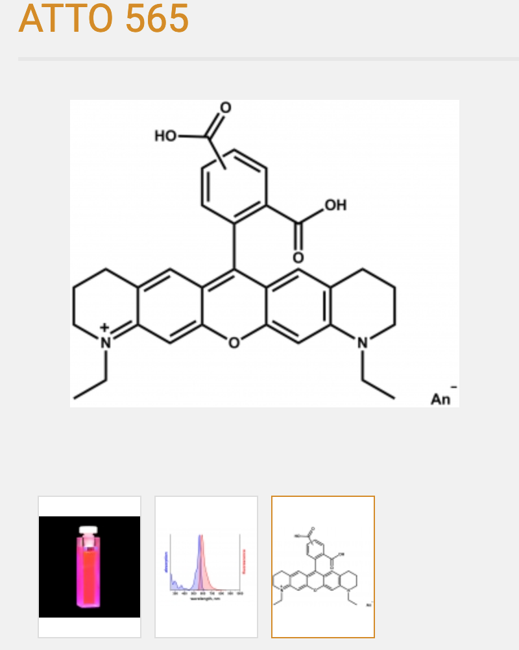
Labels: organic dyes
Hydrocarbon-based
~1 nm in size
Typically the best bang for buck in terms of brightness/stability, sample compatibility
https://www.atto-tec.com/ATTO-565.html?language=en, https://www.idtdna.com/site/Catalog/Modifications/Dyes

Slide 16
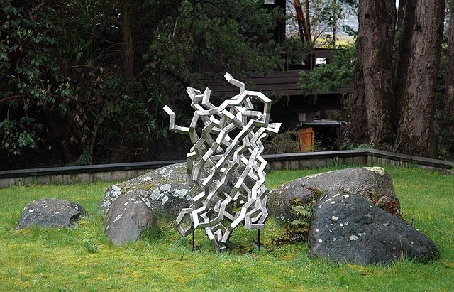
Labels: Fluorescent proteins
https://en.m.wikipedia.org/wiki/File:Steel_Jellyfish_%28GFP%29.jpg

Slide 17
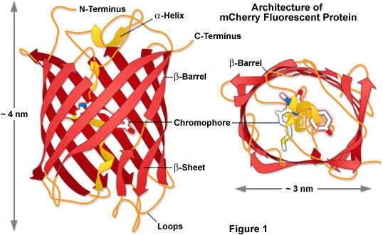
Labels: Fluorescent proteins
Genetically encoded
~5–10 nm in size
Typically 2–10x dimmer than organic dyes
Often multimeric (aggregation artifacts)
http://www.chemspider.com/Chemical-Structure.23107060.html, https://zeiss-campus.magnet.fsu.edu/articles/probes/images/anthozoafpintrofigure1.jpg

Slide 18
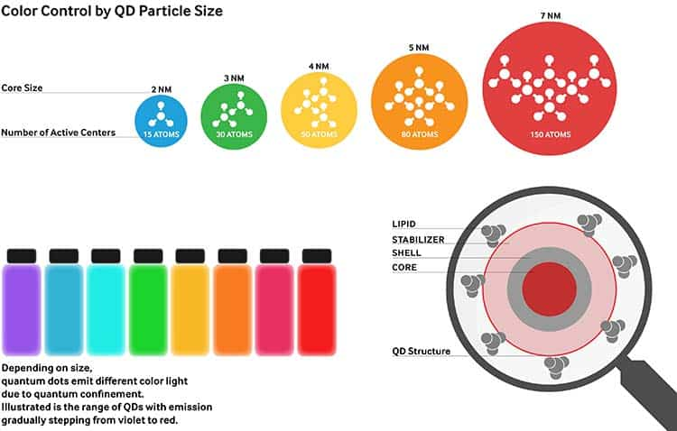
Labels: Quantum Dots
Have complex structure
~20–50 nm in size after coatings
Typically 2–10x brighter than organic dyes
Difficult to use in cellular systems*
https://www.displayninja.com/wp-content/uploads/2019/06/what-is-qled-technology.jpg

