Slide 1
Information Theory
Genome 575: Fundamentals of Biomedical Instrumentation
Brian Beliveau

Slide 2
Open questions from last week (2023) 1
How do decibels relate to SI units?
How does a speedometer know if the car is moving?
How are speedometers robust to tire/wheel size?
How does a boat speedometer work?
DBs are dimensionless
Sound pressure: Pa (kg, m, s)
It doesn’t 😓
They aren’t 😓
“Pitot tube” (water pressure -> air pressure). Or, GPS

Slide 3
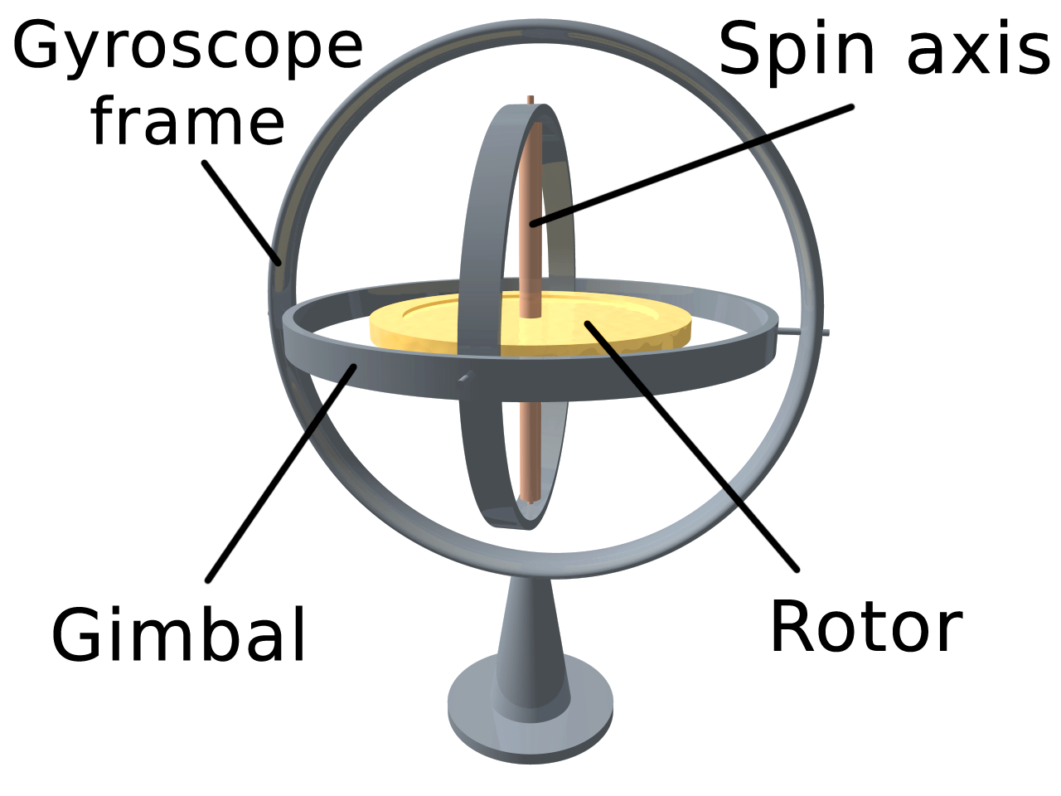
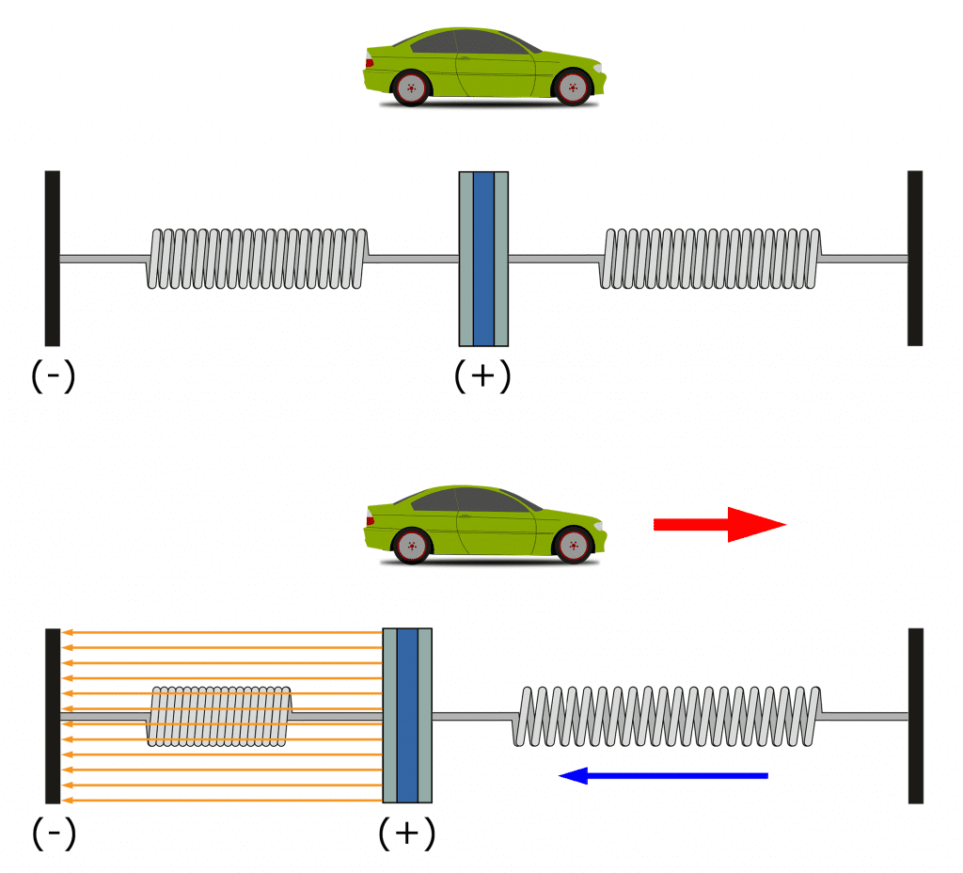
Open questions from last week (2023) 2
How do gyroscopes/accelerometers work?
Gyroscope: conservation of angular momentum
(practically, sensed similarly as accelerometers)
Accelerometer: motion-induced changes in capacitance
https://upload.wikimedia.org/wikipedia/commons/thumb/e/e2/3D_Gyroscope.png/500px-3D_Gyroscope.png, https://www.circuitbasics.com/wp-content/uploads/2021/09/How-to-Setup-an-Accelerometer-on-the-Arduino-Acceleration-Diagram.png

Slide 4
Recap from last time
The SI is defined by 7 base units and 7 associated constants
EM radiation behaves as both a wave and a particle
Photoelectric effect: incident photons with sufficient energy (h * f) can generate e⁻
Transducers convert energy between forms

Slide 5
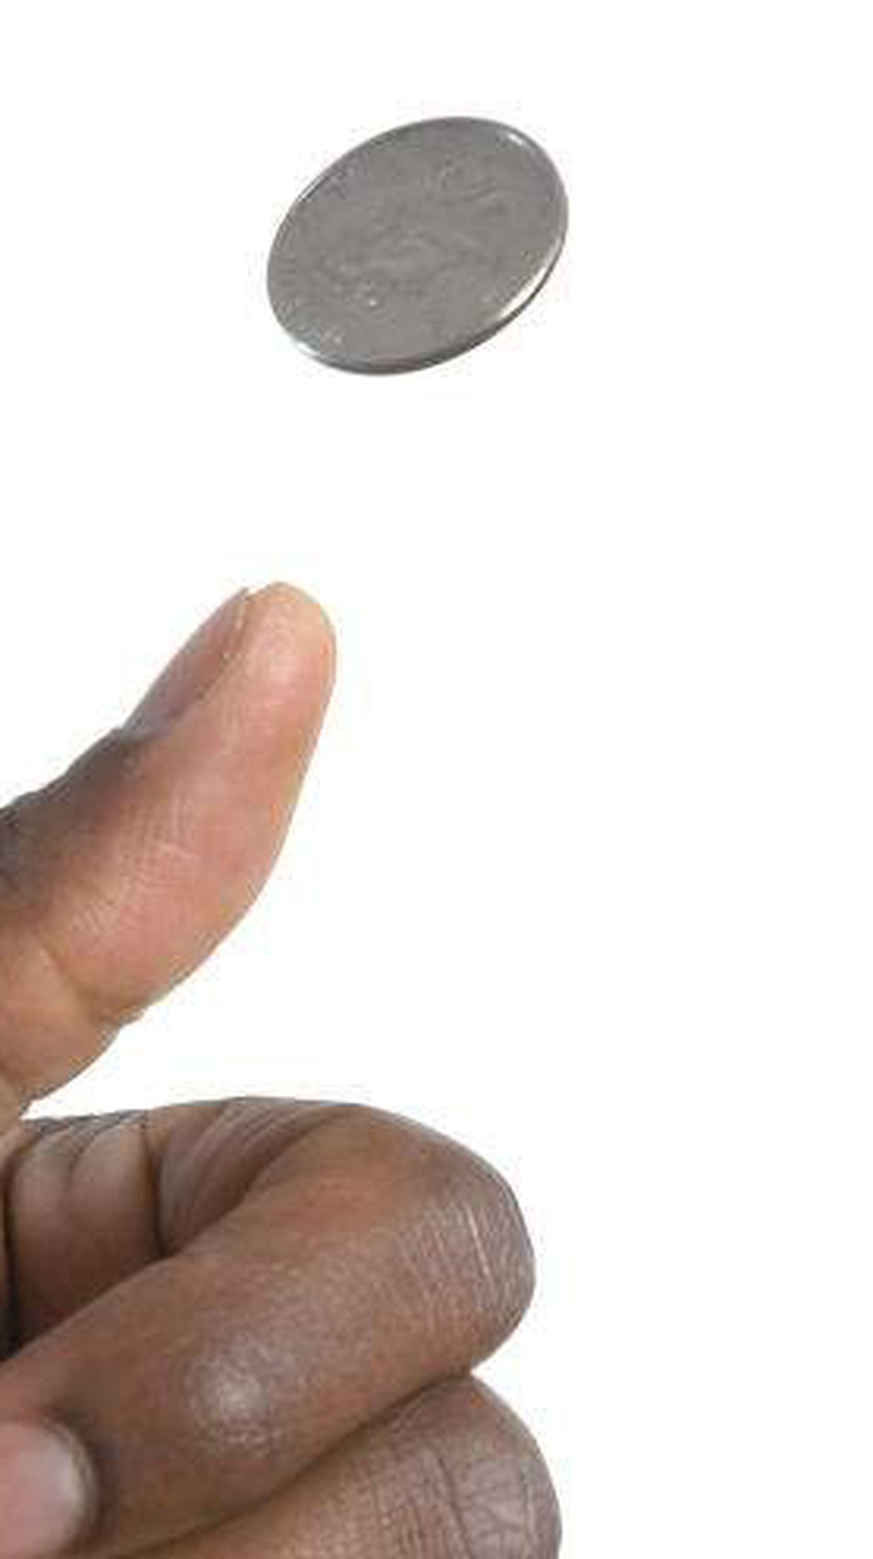

What is information?
Class activity (2 mins): What is your 1–2 sentence definition of ‘information’?
Information is the resolution of uncertainty.
Heads
❌
Tails
✅
https://www.tampabay.com/resizer/geVYWof5v2nP75k6cGzYunNkMRc=/1400x2500/smart/arc-anglerfish-arc2-prod-tbt.s3.amazonaws.com/public/KAE7GFWHDQI6TBKNIBWI6S7HAY.jpg

Slide 6
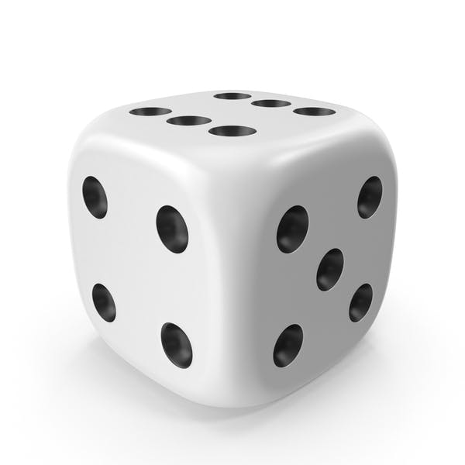
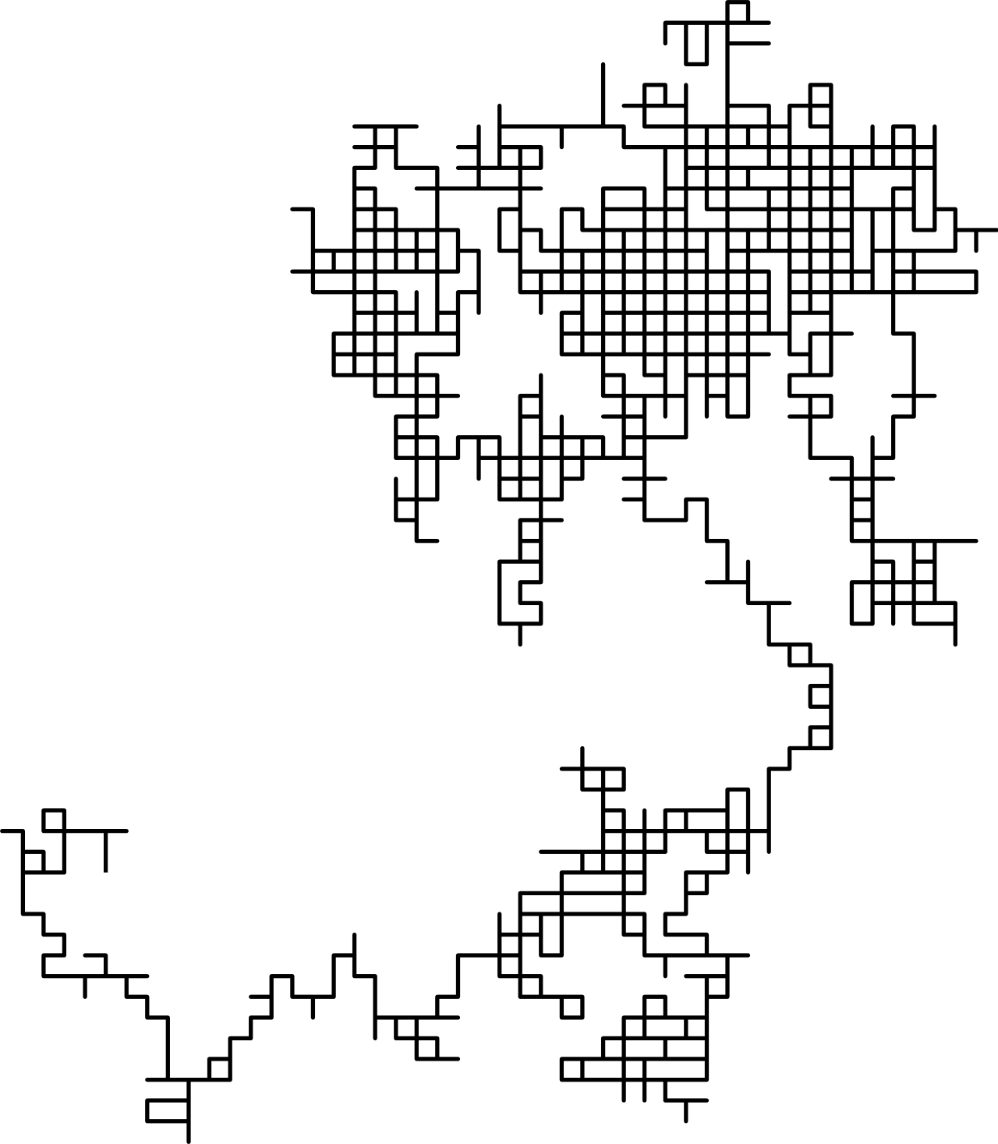
How do we use information?
Resolve/reduce uncertainty about the value of a random variable
Eg, a 6-sided die was rolled, the outcome was NOT {3, 5}
Resolve/reduce uncertainty about the outcome of a random process
Eg, N iterations of a 2D random walk
https://elements-cover-images-0.imgix.net/4452067a-740e-4bae-b81c-bb9f8e972ac4?auto=compress%2Cformat&fit=max&w=632&s=179f69732594f3c5dc283b11f4a800ca, https://upload.wikimedia.org/wikipedia/commons/thumb/7/7c/Random_walk_2500.svg/1280px-Random_walk_2500.svg.png

Slide 7

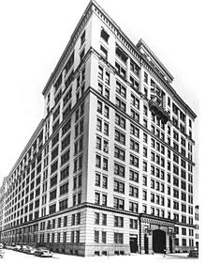
Information Theory: the backdrop
R&D branch of AT&T / Bell Systems conglomerate (monopoly)
Science and engineering powerhouse
Radio astronomy
Transistor
Laser
Photovoltaic cell
Charge-coupled device (CCD)
UNIX, C, C++, AWK, others
9 Nobel Prizes
Information Theory
https://upload.wikimedia.org/wikipedia/commons/thumb/4/4c/Bell_Laboratories_West_Street.jpg/440px-Bell_Laboratories_West_Street.jpg

Slide 8
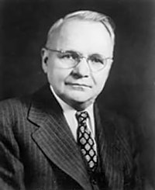
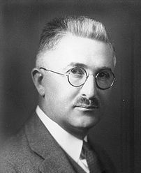
Information Theory: early contributions
Harry Nyquist
Ralph Hartley
Certain Factors Affecting Telegraph Speed (1924)
Framework for quantifying information transmission
Transmission of Information (1928)
Explicitly defined information as measurable
https://upload.wikimedia.org/wikipedia/en/b/b4/Harry_Nyquist.jpg, https://upload.wikimedia.org/wikipedia/commons/thumb/0/01/Hartley_ralph-vinton-lyon-001.jpg/440px-Hartley_ralph-vinton-lyon-001.jpg

Slide 9
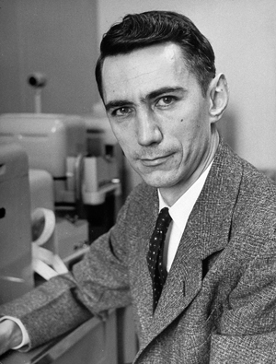
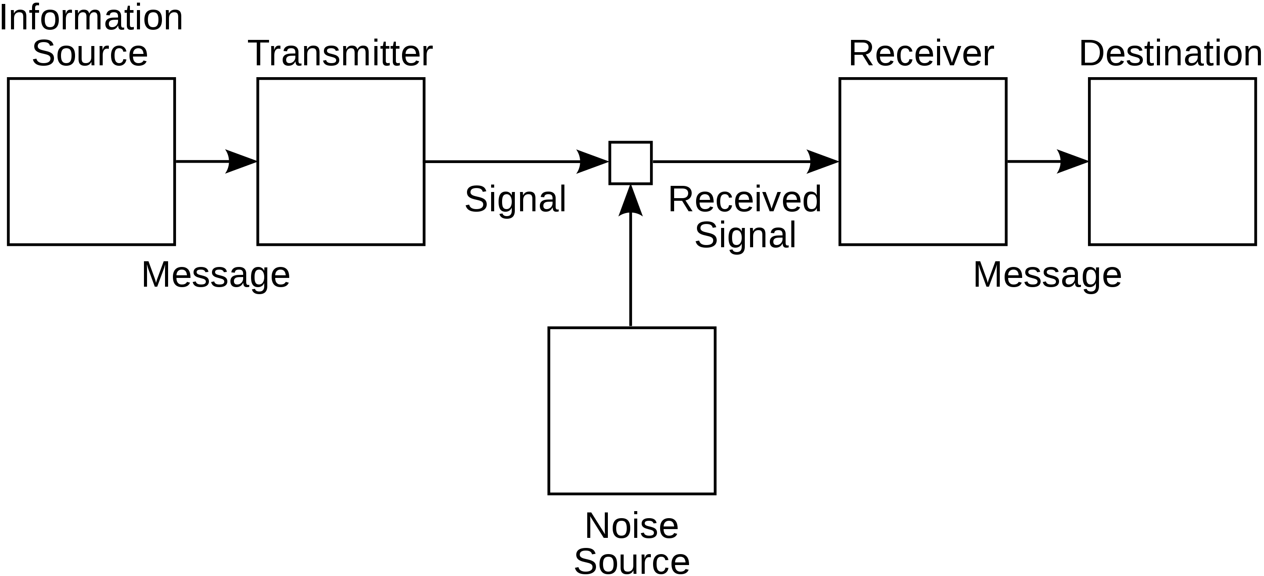
Information Theory
A Mathematical Theory of Communication (1948)
Established Information Theory
Claude Shannon
https://spectrum.ieee.org/media-library/img.jpg?id=25583467&width=600&quality=80, https://upload.wikimedia.org/wikipedia/commons/thumb/f/f3/Shannon_communication_system.svg/2880px-Shannon_communication_system.svg.png

Slide 10
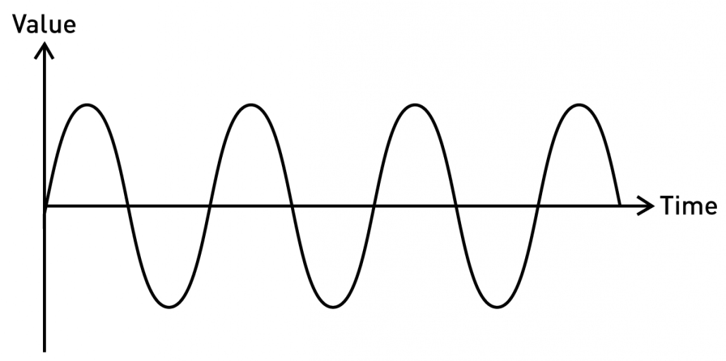
Types of information
Continuous / Analog
Fully defined. Ie, f(t) == val for any t (in some interval)
Properties such as f, wavelength, amplitude can convey information
https://blog.seeedstudio.com/wp-content/uploads/2020/06/sine-new-1030x512.png

Slide 11
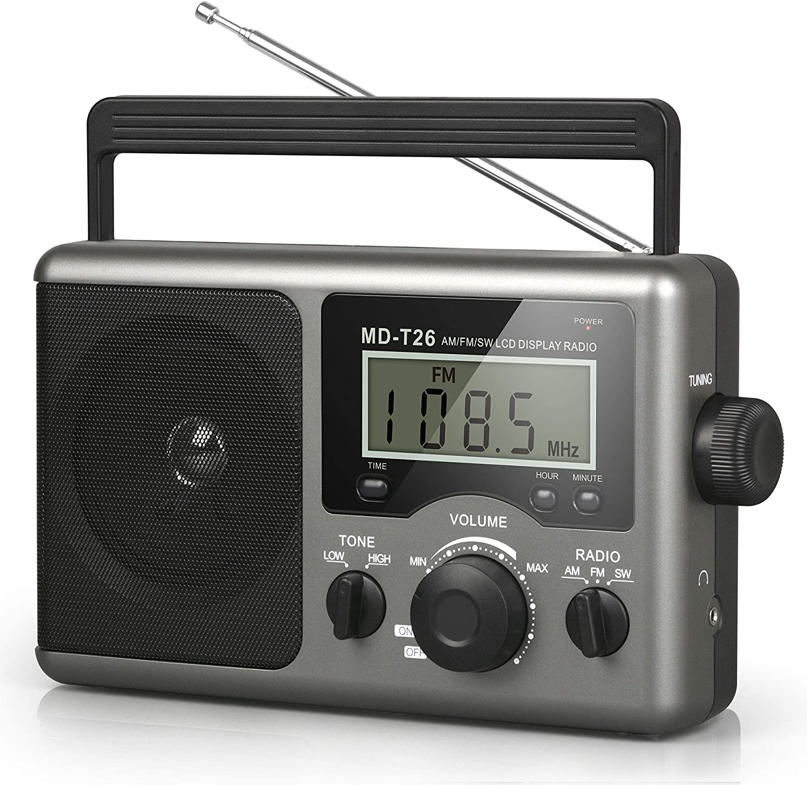
Information sources
Continuous / Analog
https://m.media-amazon.com/images/I/919+p6SXzfL._AC_SL1500_.jpg, https://upload.wikimedia.org/wikipedia/commons/a/a4/Amfm3-en-de.gif

Slide 12
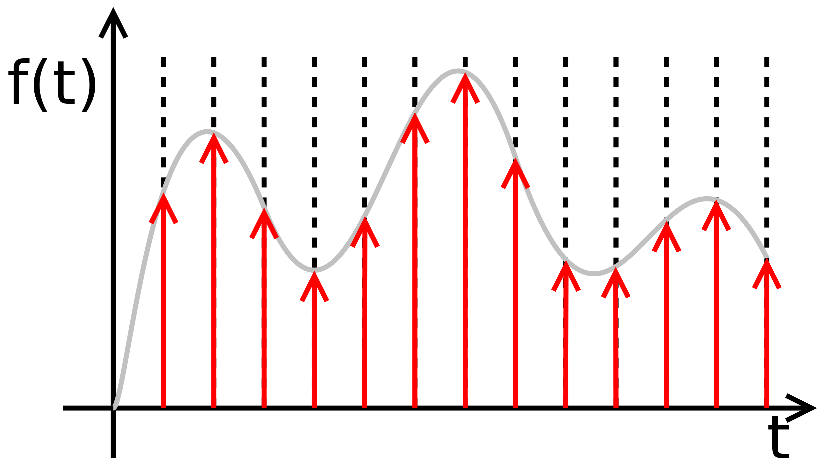
Sampling information
Continuous information can be sampled at discrete points
Choice of sampling rate / positions important
https://upload.wikimedia.org/wikipedia/commons/thumb/8/88/Sampled.signal.svg/2560px-Sampled.signal.svg.png

Slide 13
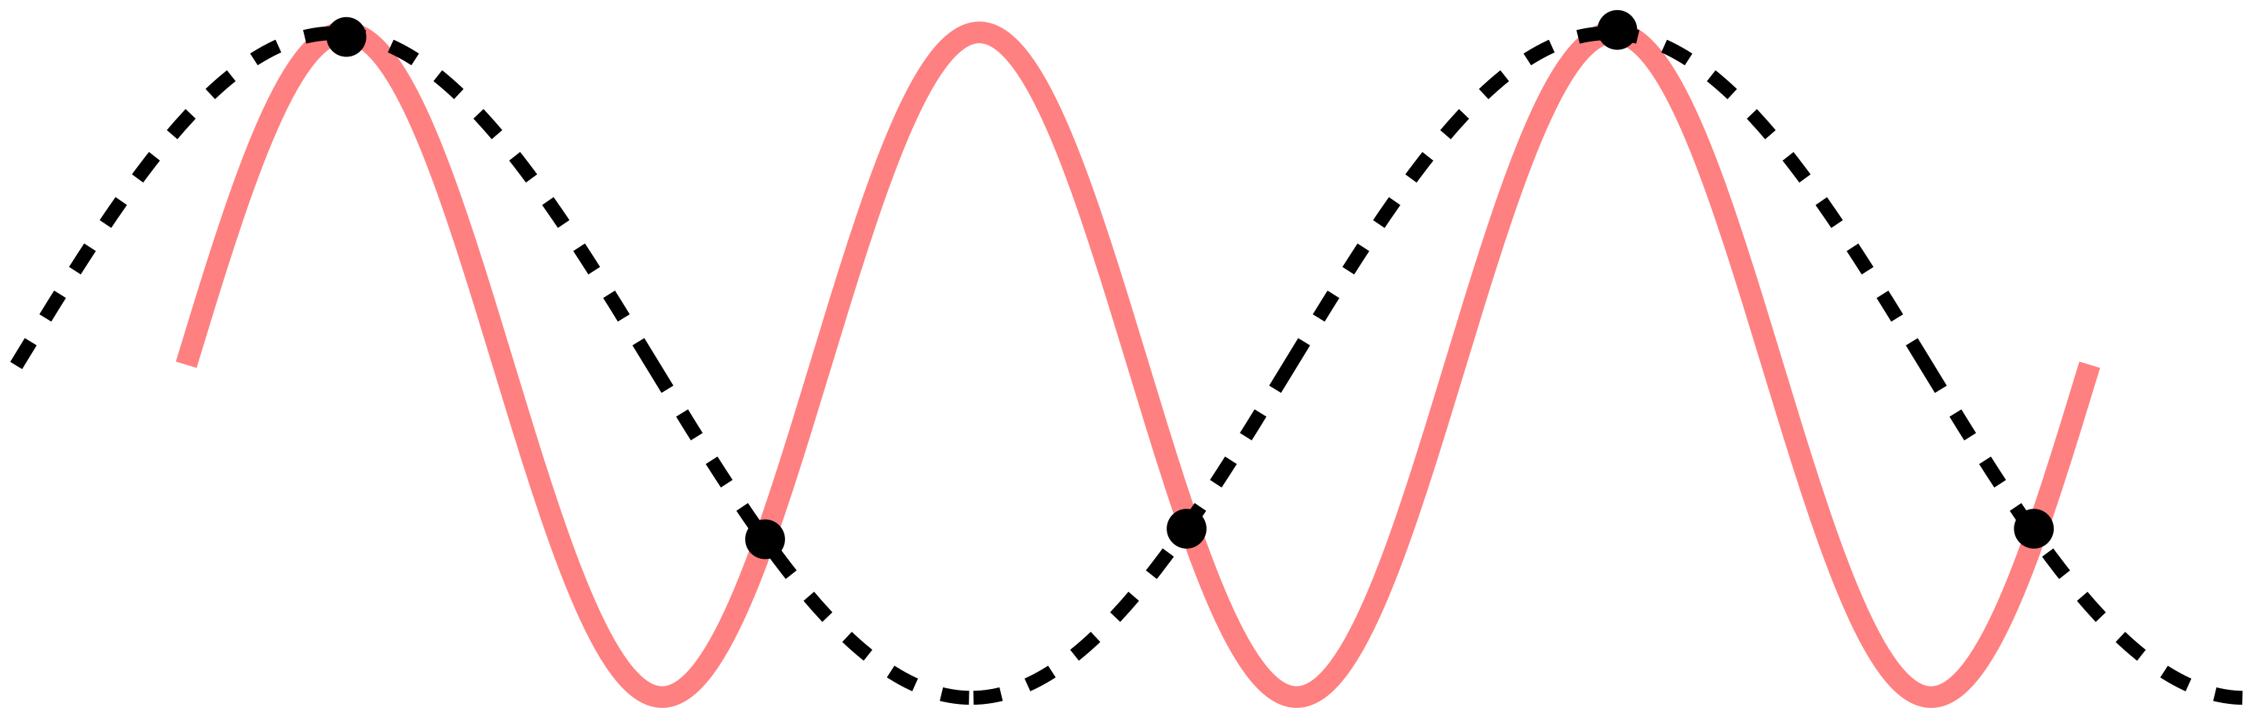
Shannon-Nyquist sampling
Sampling rate needs to be ≥2X the highest f
Undersampling can lead to aliasing
https://upload.wikimedia.org/wikipedia/commons/thumb/a/af/CPT-sound-nyquist-thereom-1.5percycle.svg/2880px-CPT-sound-nyquist-thereom-1.5percycle.svg.png

Slide 14
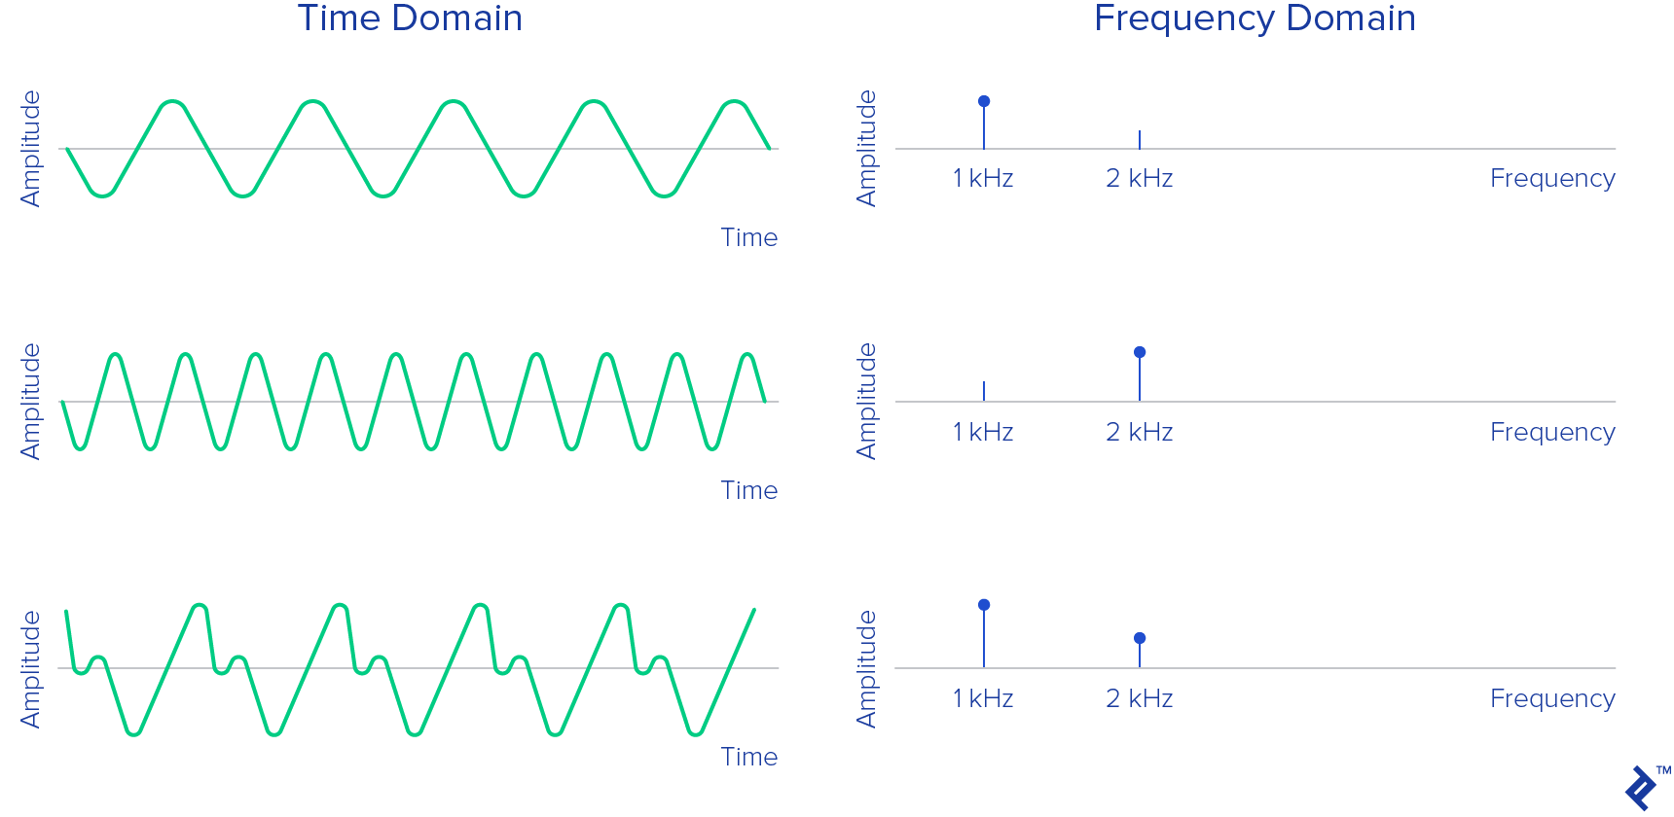
Discretizing continuous information
Discrete Fourier Transform / Fast Fourier Transform (DFT/FFT)
https://uploads.toptal.io/blog/image/125591/toptal-blog-image-1520338035137-556134ab6978d28ec618893041189e54.png

Slide 15
Digitizing continuous information
1
0
1
0
1
Discrete Fourier Transform / Fast Fourier Transform (DFT/FFT)
https://commons.wikimedia.org/wiki/File%3AFourier_synthesis_square_wave_animated.gif

Slide 16
Quantizing information
Heads
❌
Tails
✅
How do we quantize information?
How much information is contained in a coin flip?
https://www.tampabay.com/resizer/geVYWof5v2nP75k6cGzYunNkMRc=/1400x2500/smart/arc-anglerfish-arc2-prod-tbt.s3.amazonaws.com/public/KAE7GFWHDQI6TBKNIBWI6S7HAY.jpg

Slide 17
Quantizing information
Heads
❌
Tails
✅
Two possible outcomes (discrete, binary)
Fair coin: P(Heads) = P(Tails) = 1/2
Given Tails is observed, how much information was gained?
https://www.tampabay.com/resizer/geVYWof5v2nP75k6cGzYunNkMRc=/1400x2500/smart/arc-anglerfish-arc2-prod-tbt.s3.amazonaws.com/public/KAE7GFWHDQI6TBKNIBWI6S7HAY.jpg

Slide 18
Information entropy
Claude Shannon
H = entropy
X = a discrete random variable
P(x_{i}) = P(X = x_{i})
Log₂: bits/“shannons”
Ln: “nats”
Log₁₀: “dits” / “bans” / “hartleys”
https://spectrum.ieee.org/media-library/img.jpg?id=25583467&width=600&quality=80

Slide 19
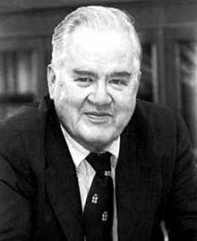
Storing information
John Tukey
Claude Shannon
Binary Digit -> “bit” (portmanteau)
8 bits = 1 byte (256 possible values)
16-bit camera (bounds value space) vs 25 MB file (size of chunked data for compute)
https://upload.wikimedia.org/wikipedia/en/e/e9/John_Tukey.jpg, https://spectrum.ieee.org/media-library/img.jpg?id=25583467&width=600&quality=80

Slide 20
Calculating information entropy
Heads
❌
Tails
✅
H(coin toss) = - [P(Heads) * log₂(P(Heads)) + P(Tails) * log₂(P(Tails))]
Fair coin: P(Heads) = P(Tails) = 1/2
H(coin toss) = - [1/2 * log₂(1/2) + 1/2 * log₂(1/2) ] = - [-1/2 + -1/2] = 1 bit
https://www.tampabay.com/resizer/geVYWof5v2nP75k6cGzYunNkMRc=/1400x2500/smart/arc-anglerfish-arc2-prod-tbt.s3.amazonaws.com/public/KAE7GFWHDQI6TBKNIBWI6S7HAY.jpg

Slide 21
Calculating information entropy
Heads
❌
Tails
✅
H(coin toss) = - [P(Heads) * log₂(P(Heads) + P(Tails) * log₂(P(Tails)]
Unfair coin: P(Heads) ≠ P(Tails); P(Heads) = 0.7, P(Tails) = 0.3
H(coin toss) = - [7/10 * log₂(7/10) + 3/10 * log₂(3/10) ] = - [0.7 * -0.52 + 0.3 * -1.7 ] = [-0.36 + -0.52] = 0.88 bits
Why is there less information?
https://www.tampabay.com/resizer/geVYWof5v2nP75k6cGzYunNkMRc=/1400x2500/smart/arc-anglerfish-arc2-prod-tbt.s3.amazonaws.com/public/KAE7GFWHDQI6TBKNIBWI6S7HAY.jpg

Slide 22
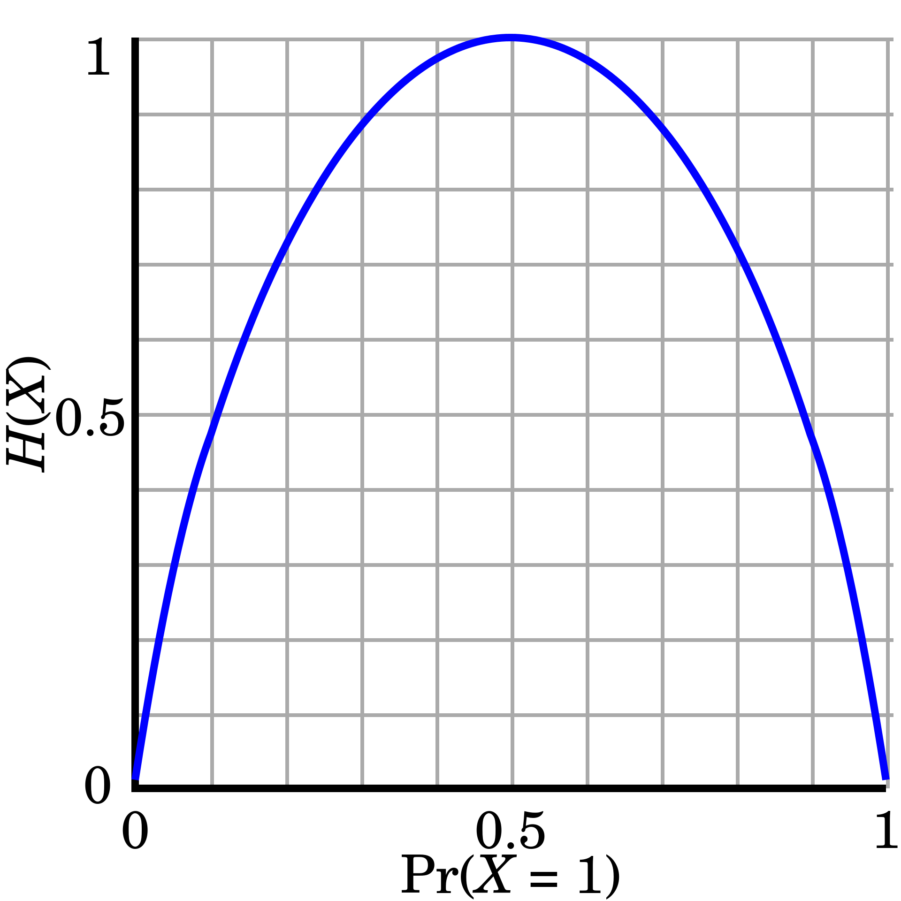
Entropy measures “surprisal”
Outcomes where P=1: no surprise, H=0
As uncertainty increases, H increases
Greater uncertainty in outcome, more likely to be “surprised”
https://upload.wikimedia.org/wikipedia/commons/thumb/2/22/Binary_entropy_plot.svg/1920px-Binary_entropy_plot.svg.png

Slide 23
Information gains
Heads
❌
Tails
✅
I(x) = - log(P(X=x))
Fair coin: I(Tails) = - log₂(1/2) = 1 bit
Unfair coin with P(Tails) = 0.7: I(Tails) = - log₂(7/10) = 0.52 bits
Unfair coin with P(Tails) = 0.3: I(Tails) = - log₂(3/10) = 1.74 bits
Why does scenario three have the greatest I?
https://www.tampabay.com/resizer/geVYWof5v2nP75k6cGzYunNkMRc=/1400x2500/smart/arc-anglerfish-arc2-prod-tbt.s3.amazonaws.com/public/KAE7GFWHDQI6TBKNIBWI6S7HAY.jpg

Slide 24
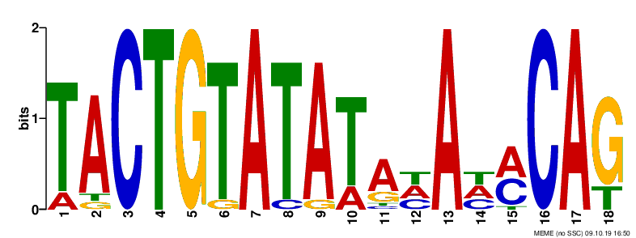
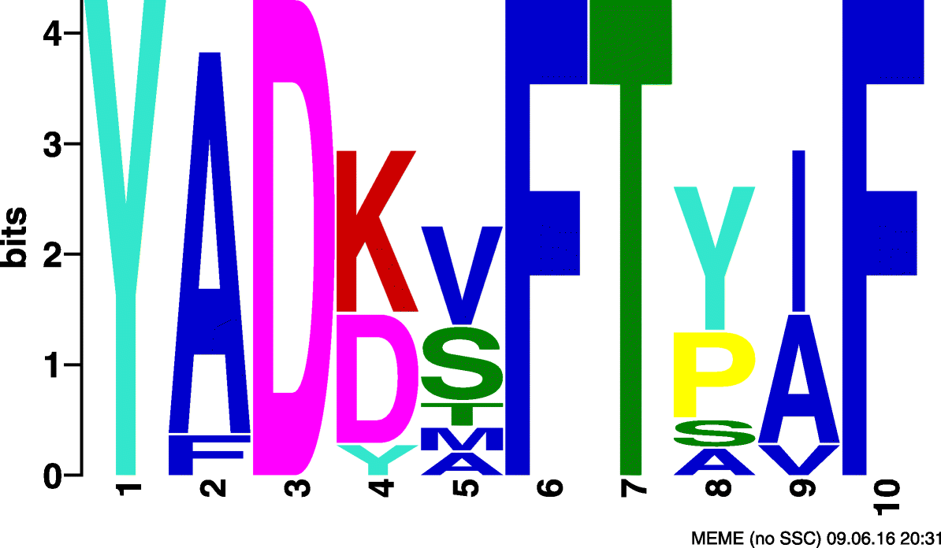
Information in bioinformatics
Base = [A,T,C,G]
4 = 2² possibilities
2 bits of information
Residue = [A,C,..,Y]
20 = 2^{4.32} possibilities
4.32 bits of information
https://gensoft.pasteur.fr/docs/meme/5.1.1/meme.html, https://bmcbioinformatics.biomedcentral.com/articles/10.1186/s12859-018-2378-9/figures/10

Slide 25
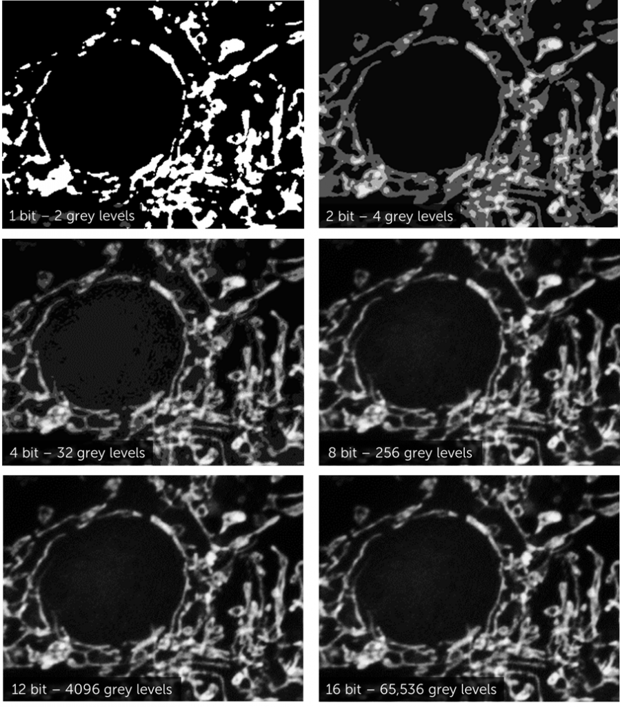
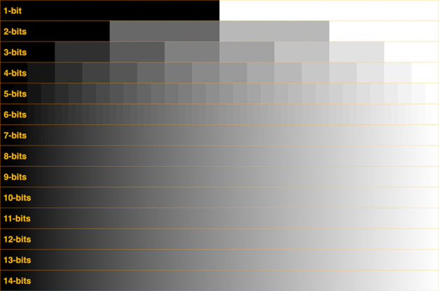
Information in microscopy
How are these different?
We live in an 8-bit world
https://www.photometrics.com/learn/camera-basics/bit-depth

Slide 26
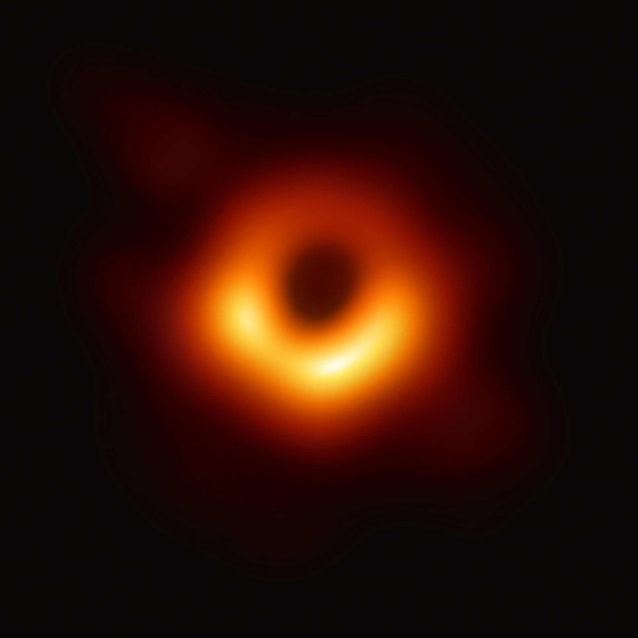
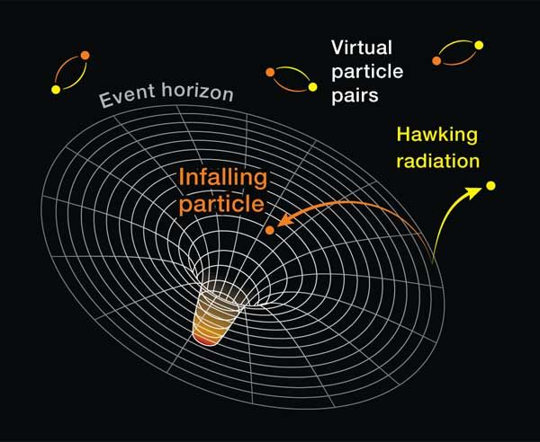
Information in quantum physics
Black holes predicted to (very slowly) evaporate
Is the information about what disappears preserved?
Information cannot be destroyed in quantum theory. ”Black hole information paradox”
https://en.wikipedia.org/wiki/Black_hole_information_paradox#/media/File:Black_hole_-_Messier_87_crop_max_res.jpg, https://www.secretsofuniverse.in/hawking-radiation-from-black-holes/

Slide 27
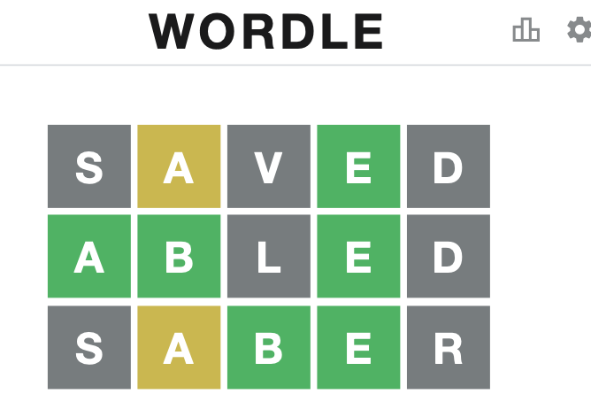
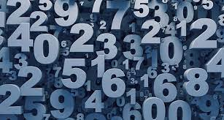
Game time!
Two teams
Phones/computers away
https://www.sciencenews.org/wp-content/uploads/2018/05/050718_EC_numbers_feat.jpg, https://www.phillyvoice.com/wordle-strategies-how-to-play/

Slide 28
Game 1: Guess that number!
N = randint(1,100)
Your guess: a integer between 1–100
The reveal: “Match” OR “higher” OR “lower”

Slide 29
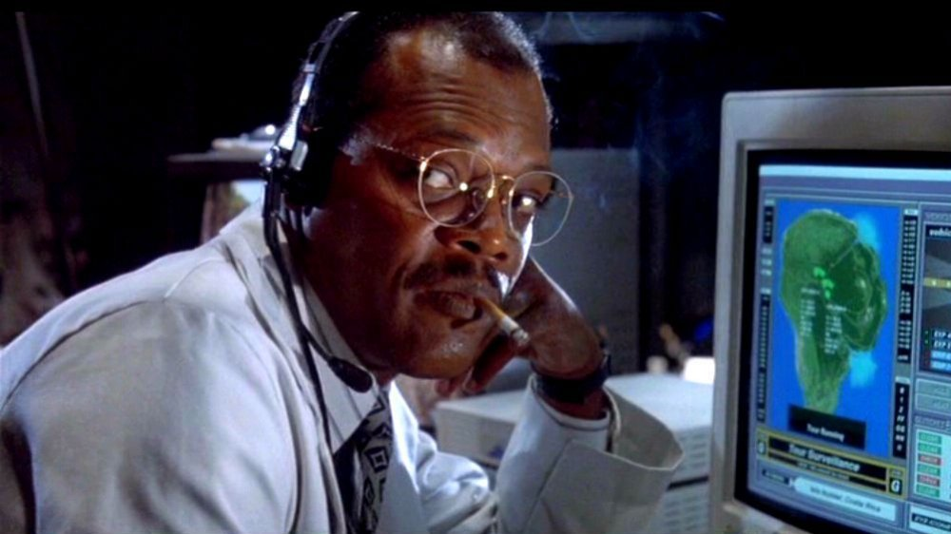
Game 2: Wordle!
https://www.phillyvoice.com/wordle-strategies-how-to-play/, https://www.looper.com/218228/the-wild-true-story-behind-samuel-l-jacksons-famous-jurassic-park-line/

