Slide 1
Genome 575: Fundamentals of Biomedical Instrumentation
Introductions
Name
Preferred pronouns
Science you are interested in
Where are you from
Fun Fact
Purpose of the Class … how it came to be
An introduction to the fundamentals of instrumentation commonly used in biomedical research settings including mass spectrometers, biochemical separations, optical microscopes, and DNA sequencers. Emphasis on a practical understanding of the physical and chemical properties that underlie operation and sources of uncertainty, noise, and error.

Slide 2
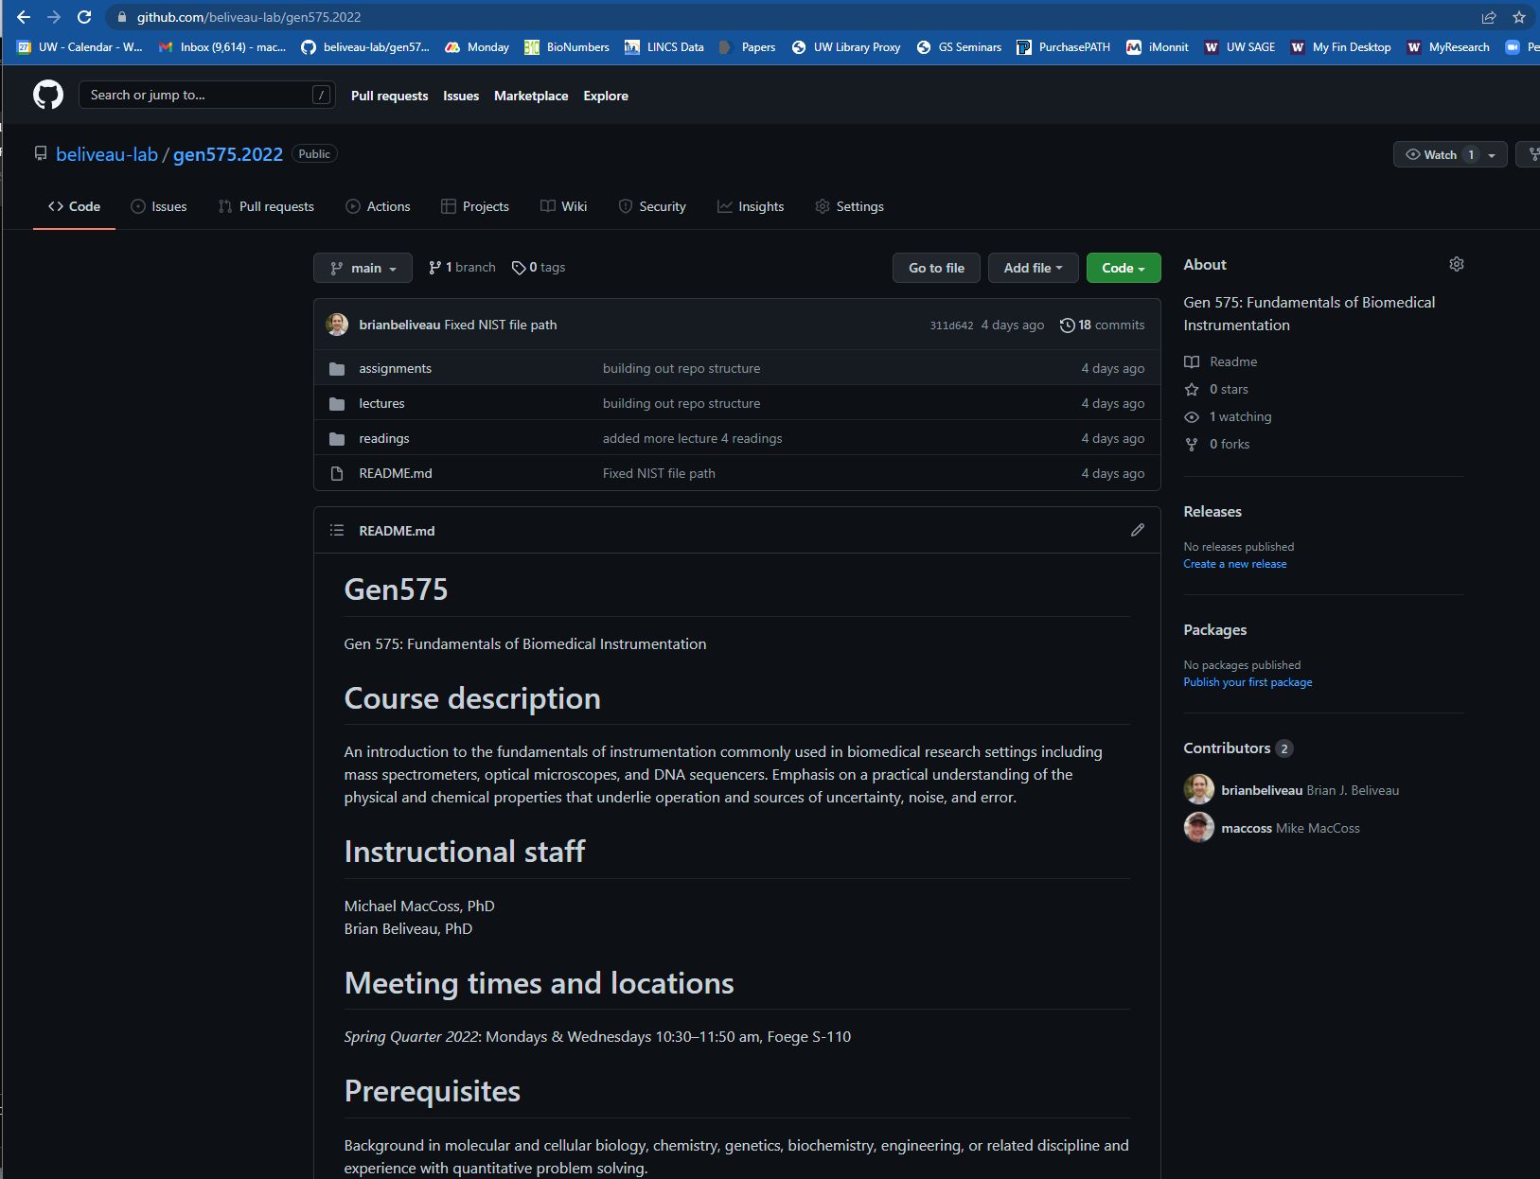
Website https://github.com/beliveau-lab/gen575.2022
Lecture Topic | Date | Instructor
1: Intro to the course | 03/28/2022 | Mike
2: Signal-to-noise | 03/30/2022 | Mike
3: Quantitative Analysis 101 and Calibration | 04/04/2022 | Mike
4: Information Currencies | 04/06/2022 | Brian
5: Information Theory | 04/11/2022 | Brian
6: Evaluating Information | 04/13/2022 | Brian
7: Light sources | 04/18/2022 | Brian
8: Multispectral imaging | 04/20/2022 | Brian
9: Fluorescent labels | 04/25/2022 | Brian
10: Optical detection | 04/27/2022 | Brian
11: Optical methods survey 1 | 05/02/2022 | Brian
12: Optical methods survey 2 | 05/04/2022 | Brian
13: Principles of Separation | 05/09/2022 | Mike
14: Mass Spectrometry 1: Ionization and Mass Analyzers | 05/11/2022 | Mike
15: Mass Spectrometry 2: Intro to qualitative peptide and protein analysis | 05/16/2022 | Mike
16: Mass spectrometry 3: Quantitative Analysis | 05/18/2022 | Mike
17: Proteomics: Alternatives to mass spectrometry | 05/23/2022 | Mike
18: Spatial and Single-cell Proteomics | 05/25/2022 | Mike

Slide 3
Grades:
Participation: 40%
Problem sets: 60% (6, worth 10% each)
Details:
Absence is ok but please let us know about travel and known absences in advance. Communicate illness and emergencies ASAP.
Late homework will be accepted but penalized (10% per day)

Slide 4
What you should expect
You should expect to be challenged!
There should be material that you know but also there should be material that we present that you don’t know.
You should expect to have a better fundamental understanding of the principles that define many biomedical instruments
There will be some topics presented multiple times during the class in different contexts and different ways.
You might even hear contradictory things from Brian and I
This year is the first time we have taught this class! There will be hiccups.

Slide 5
What we expect
We expect you to participate!
The more you participate the more we will all get out of the course.
Don’t hesitate to ask a question. If you have a question, it is almost certain that someone else has it too. Interrupt us.
We want feedback and to hear if content isn’t working.
We expect you all to come from different scientific backgrounds and interests.
We expect to learn from you!

Slide 6
New directions in science are launched by new tools much more often than by new concepts.
The effect of a concept-driven revolution is to explain old things in new ways.
The effect of a tool-driven revolution is to discover new things that have to be explained.
Freeman J. Dyson, Mathematician and Technological Visionary
What tools have shaped your research? How have they changed in the last decade?

Slide 7
The last 40 years have seen a revolution in analytical instrumentation
Examples:
4 color sequencer (Lee Hood, Lloyd Smith, Mike Hunkapillar, Tim Hunkapiller)
Electrospray ionization MS (John Fenn, Nobel Prize)
Overcoming the diffraction limit in fluorescence microscopy (Betzig, Hall, and Moerner, Nobel Prize)
Protein Structure Determination by NMR (Kurt Wuthrich, Nobel Prize
Cryo-Electron Microscopy
Massively parallel sequencing (aka NGS) (Church, Mitra, Shendure, etc..)

Slide 8
What needs to be measured?
Who – Need methods that can determine the identity of molecules in a mixture
What – Assess function and Role
Where – Localization
Intracellular
Intercellular
When – At all points and time and under different perturbations
With Whom – Determine interactions between molecules
How much – Assess quantities
Stability – Production and Disposal

Slide 9
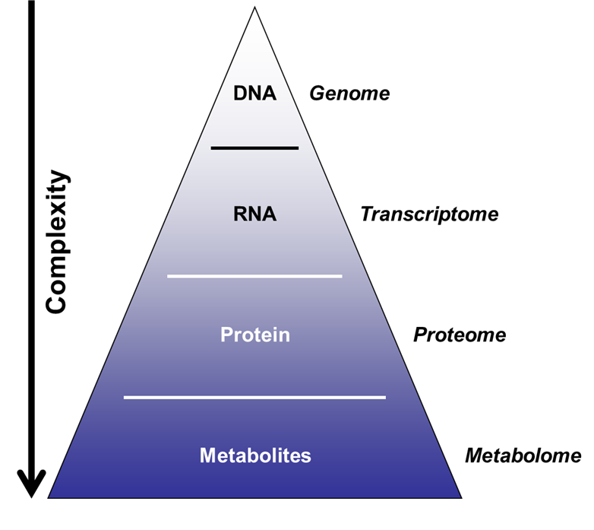
Major Biological Macromolecules Classes
Nucleic acids
DNA and RNA
Storage and transfer of genetic information
Proteins
Enzymes, hormones, antibodies, catalysts, structure, transport, motor, toxins
Carbohydrates
Energy source, structural, signaling
Lipids
Energy, compartmentalization, signaling

Slide 10
Localization can complicate quantitation

Slide 11
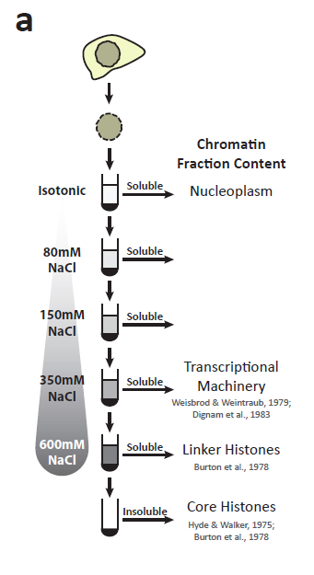
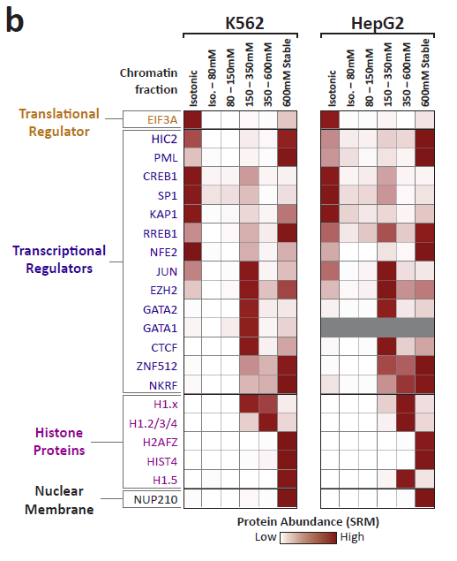
Segregation of transcription factors into discrete chromatin compartments
Data Andrew Stergachis

Slide 12
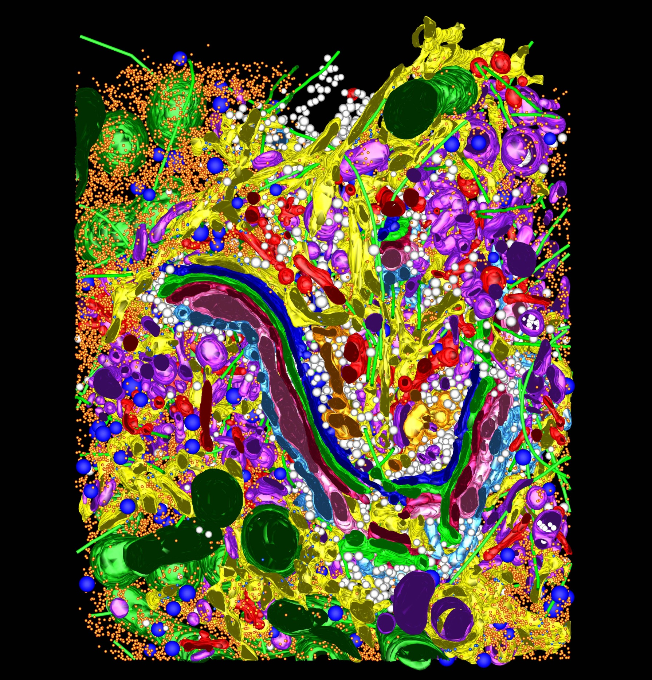

Slide 13
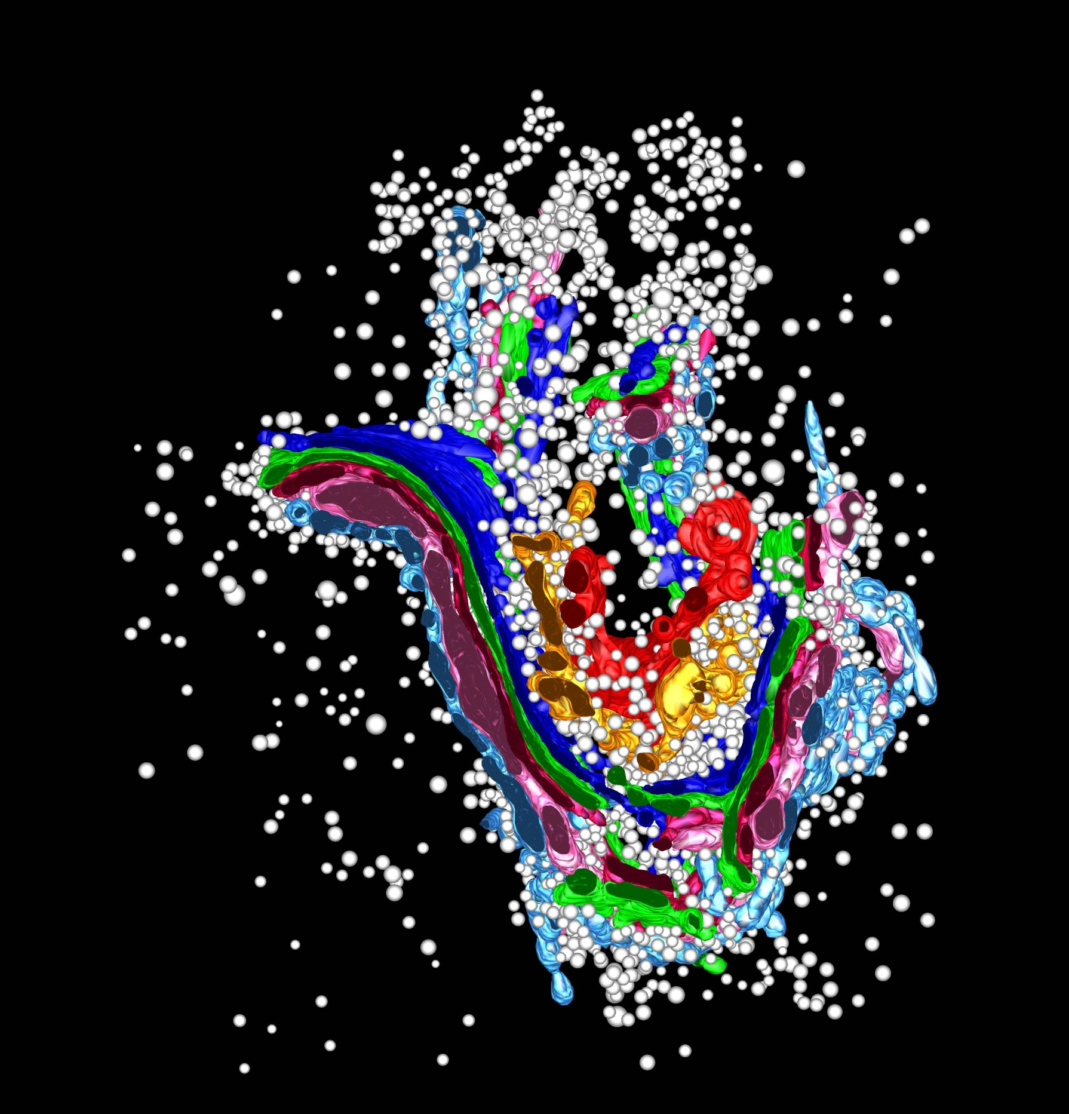

Slide 14
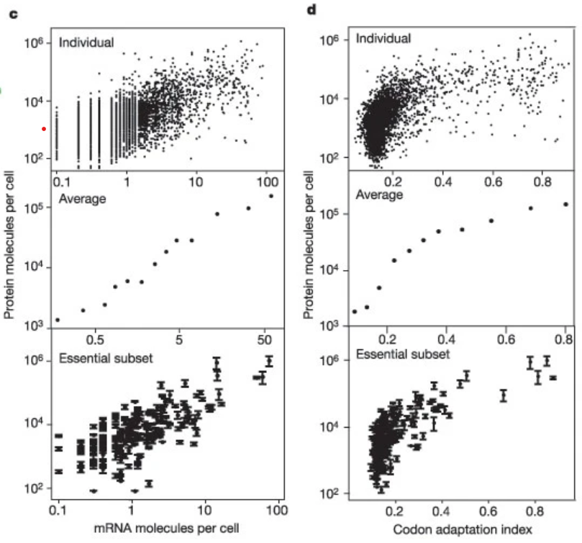
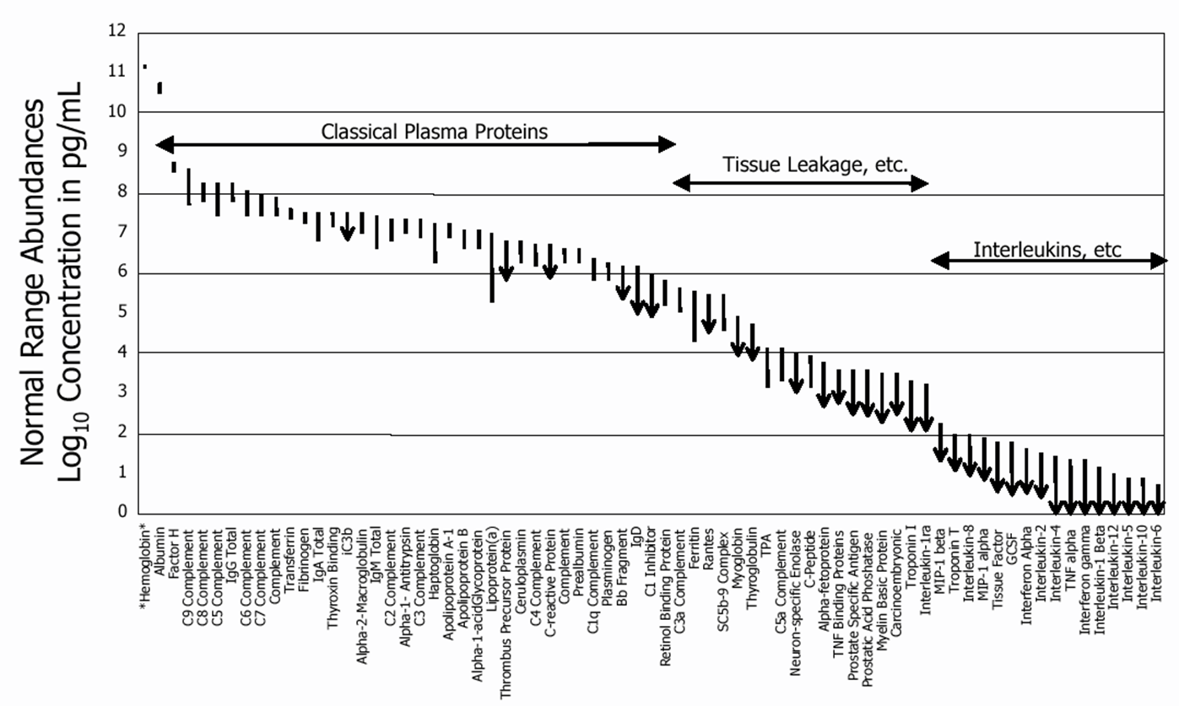
Dynamic Range
21 Proteins Represent 99% of the Blood Protein Mass
The proteome spans a dynamic range of 10^6 to 10^12
Ghaemmaghami et al, Nature 2003
Anderson and Anderson, Molecular and Cellular Proteomics 2002

Slide 15
Dave Muddiman’s Analogy
Difficulty of detecting proteins in terms of distances traveled.
Assume albumin (the most abundant plasma protein) is like traveling 1 mile
Then the least abundant protein would be the equivalent of traveling around the earth at the equator ~400,000x.
What if done in a 747.
This would take about 2050 years
The fuel would cost >$80 billion
Muddiman, JPR, 2006

Slide 16
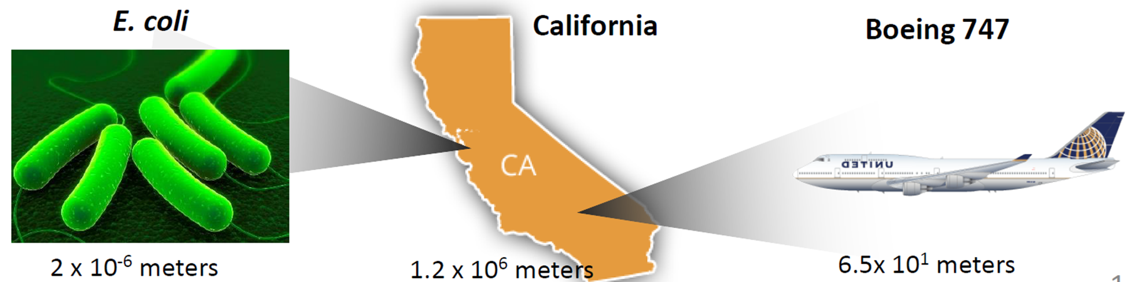
Where we need to be
Where we are at
If the most abundant protein represents the length of California, the least abundant proteins represent the length of E. coli. Most analytical methods only have 10⁴ to 10⁵ dynamic range. Representing the size of a 747.
Where we need to be to characterize the transcriptome: 4x10⁴ meters, ~marathon

