Slide 1
Multispectral Imaging
Genome 575: Fundamentals of Biomedical Instrumentation
Brian Beliveau

Slide 2
Recap from last time
Light in optical systems primarily comes from incandescence and fluorescence
Fluorescence relies on the excitation and decay of fundamental particles (usually e⁻)
The propagation of light can be altered by reflection, refraction, and absorption
Fluorescent microscopes have distinct excitation and emission paths

Slide 3
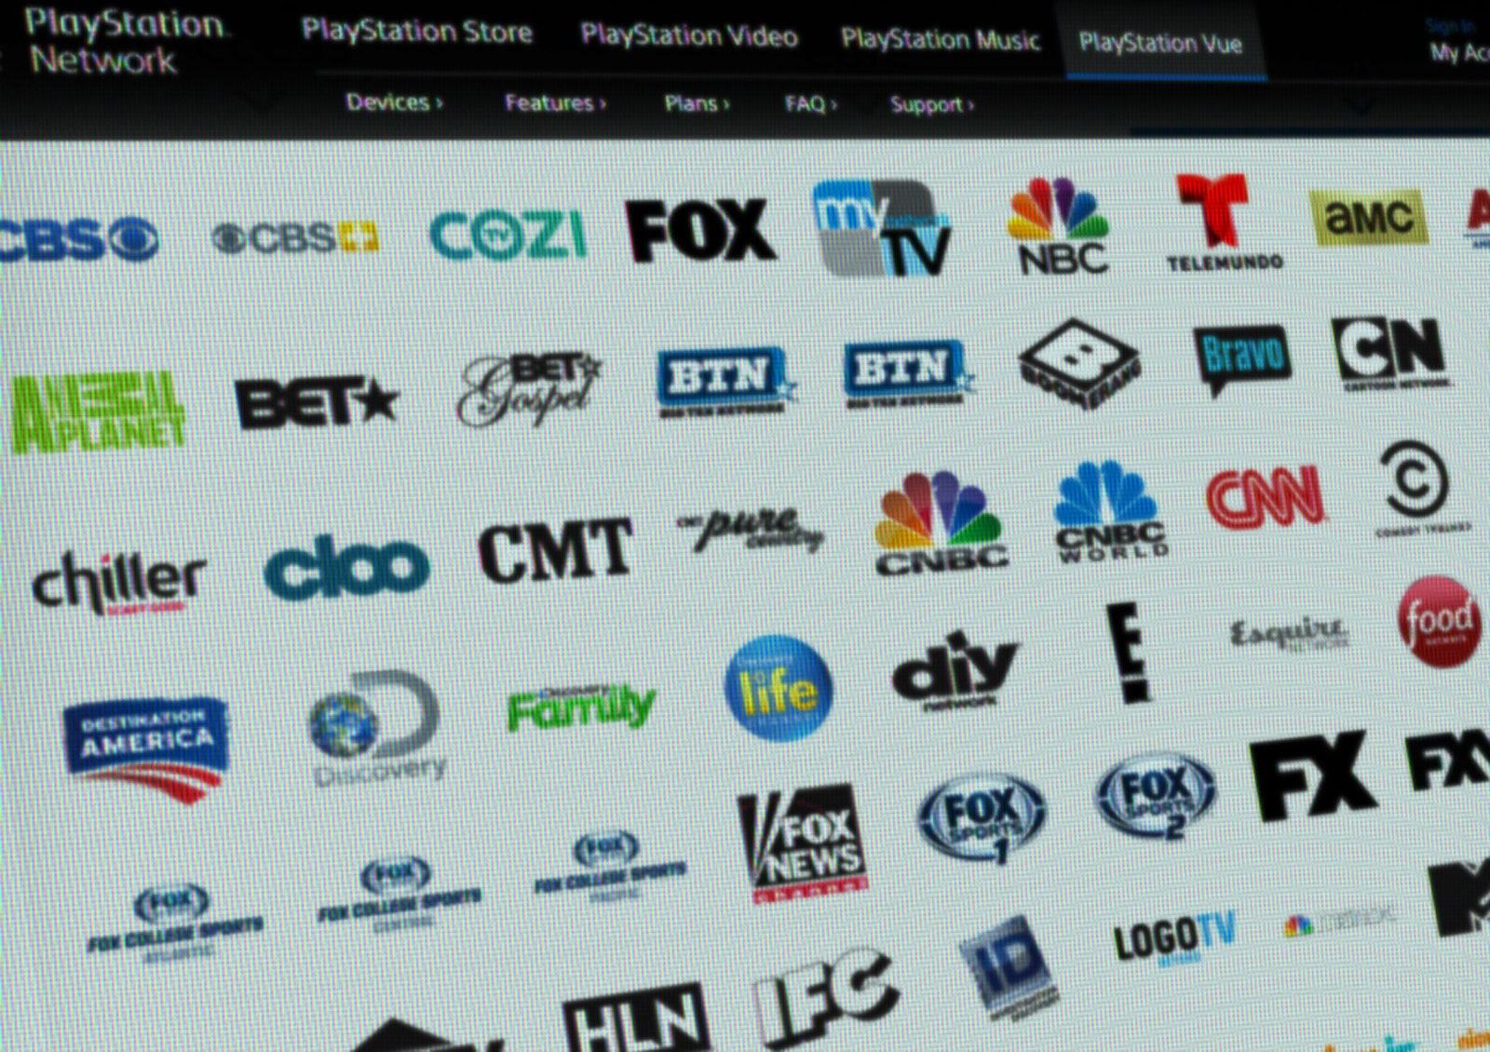
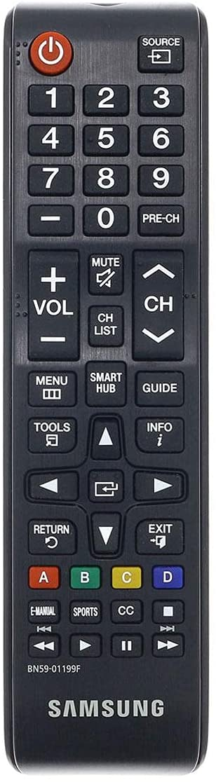
Picking your imaging bundle
How many channels are in a typical microscope?
What bounds this number?
https://media.newyorker.com/photos/59096d2b6552fa0be682fed7/master/pass/Wu-Dreaded-Bundle-Comes-to-Internet-TV1.jpg, https://m.media-amazon.com/images/I/51ZSG3TqyAS._AC_SL1500_.jpg

Slide 4
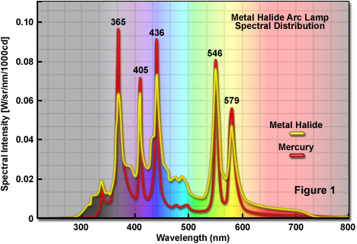
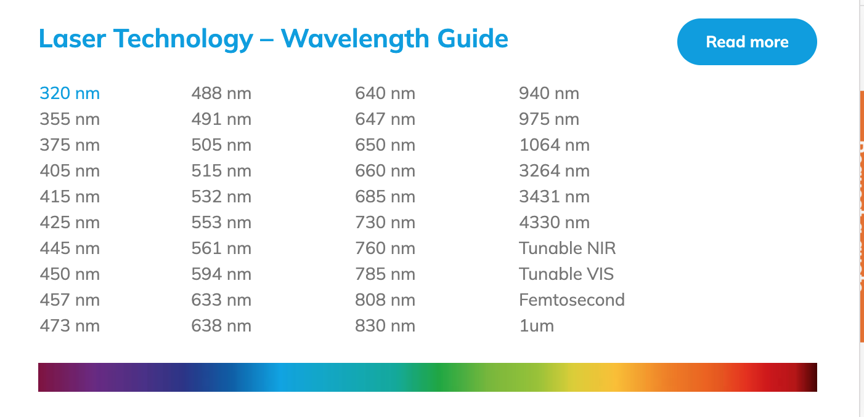
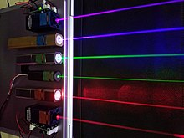
Multiplexing challenges: light sources
Most effective light sources bounded in UV-A, vis, near-IR
UV challenging to use with biological samples
https://en.wikipedia.org/wiki/File:Lasers.JPG , https://zeiss-campus.magnet.fsu.edu/articles/lightsources/images/metalhalidelampsfigure1.jpg, https://hubner-photonics.com/products/lasers/multi-line-lasers/

Slide 5
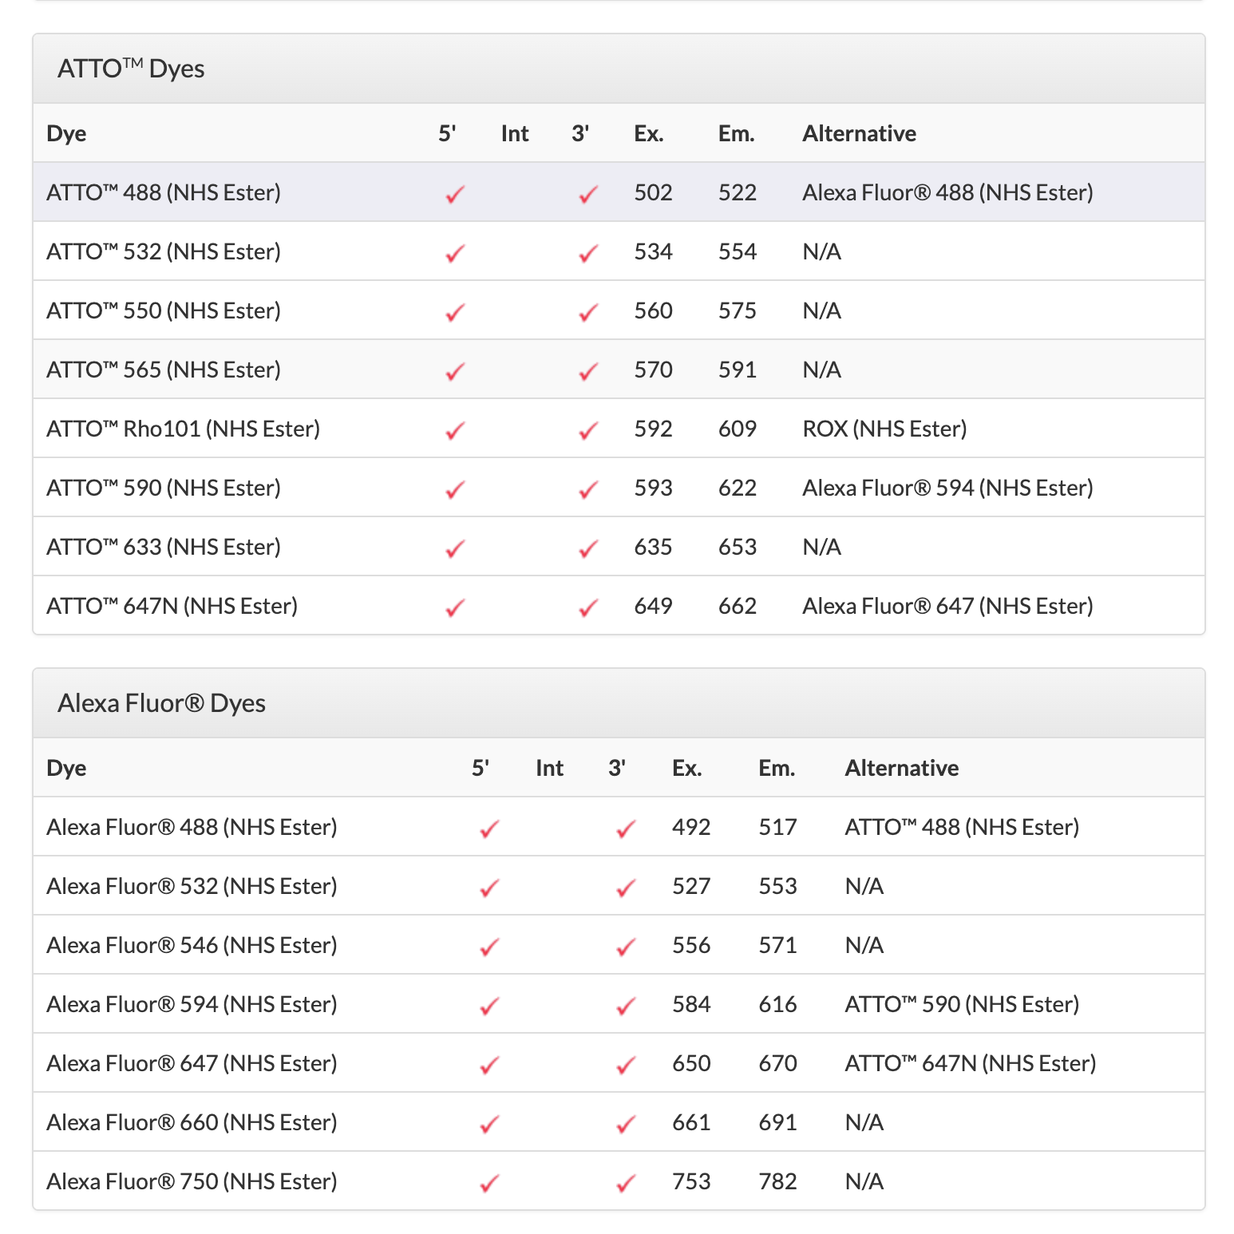
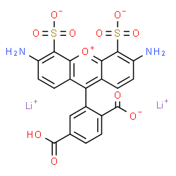
Multiplexing challenges: labels
AlexaFluor 488
Most effective dyes/labels concentrated in vis/near-IR
Rational design of organic dyes / FPs challenging
https://www.idtdna.com/site/Catalog/Modifications/Dyes, http://www.chemspider.com/Chemical-Structure.23107060.html

Slide 6
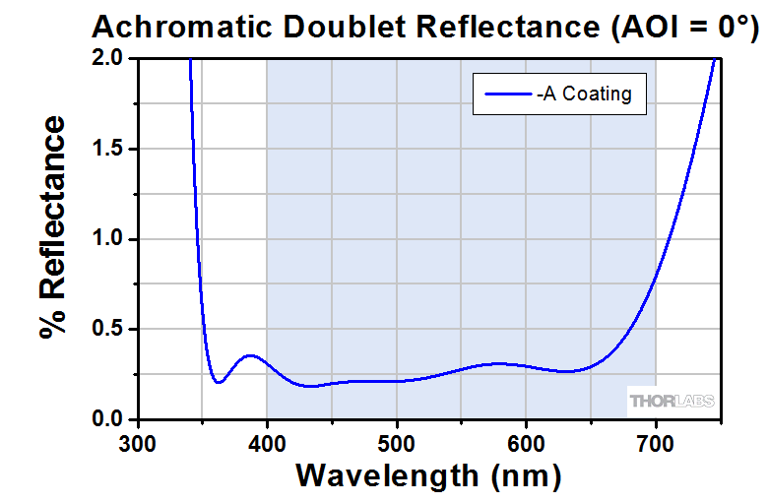
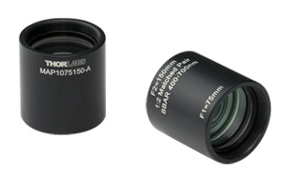
Multiplexing challenges: optics
“Achromatic doublet”
Most optics can only transmit over defined ranges
𝝀-dependent differences lead to chromatic aberration
https://www.thorlabs.com/images/TabImages/MAP_A_Reflectance-780.gif, https://www.thorlabs.com/Images/GuideImages/1716_MatchedDoublet_6.jpg

Slide 7
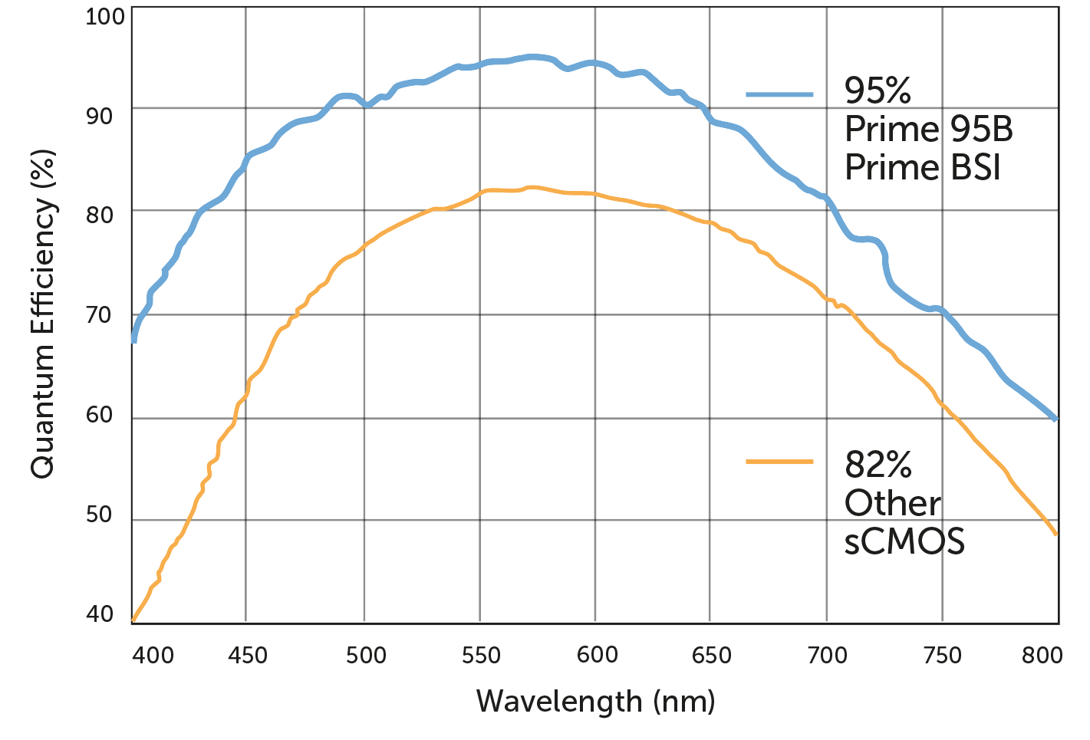
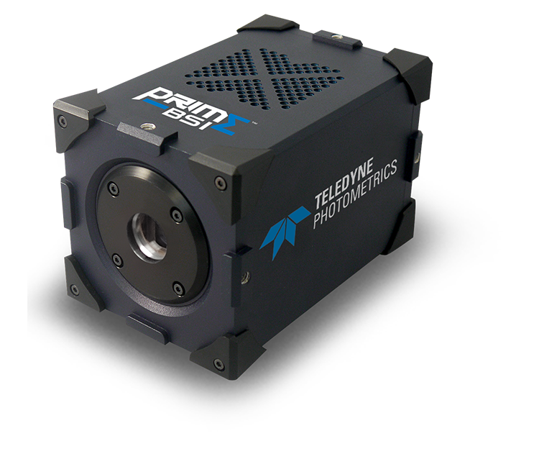
Multiplexing challenges: detectors
CCD/sCMOS sensors most effective in vis
PMTs (laser scanning confocals/FACS) drop off a cliff in IR
https://www.photometrics.com/wp-content/uploads/2019/09/QE-curve.png, https://www.photometrics.com/wp-content/uploads/2019/09/prime-bsi-shadow-750x696.png

Slide 8
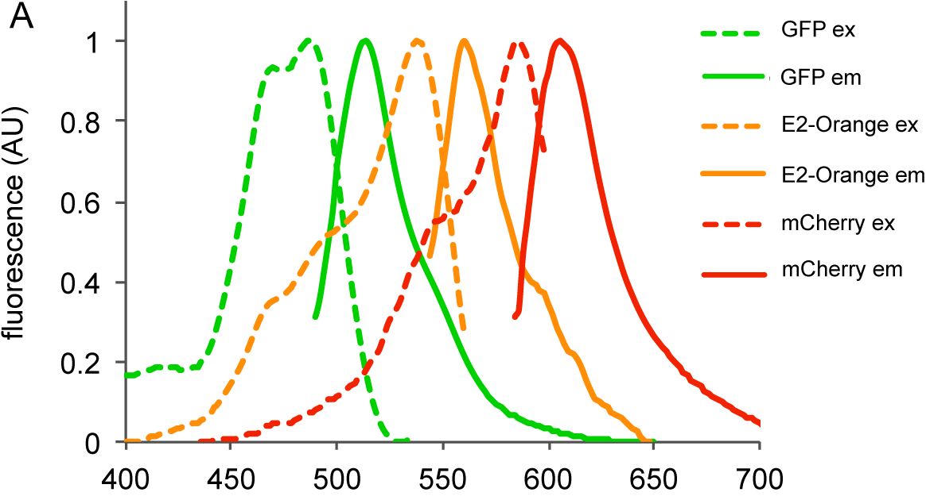
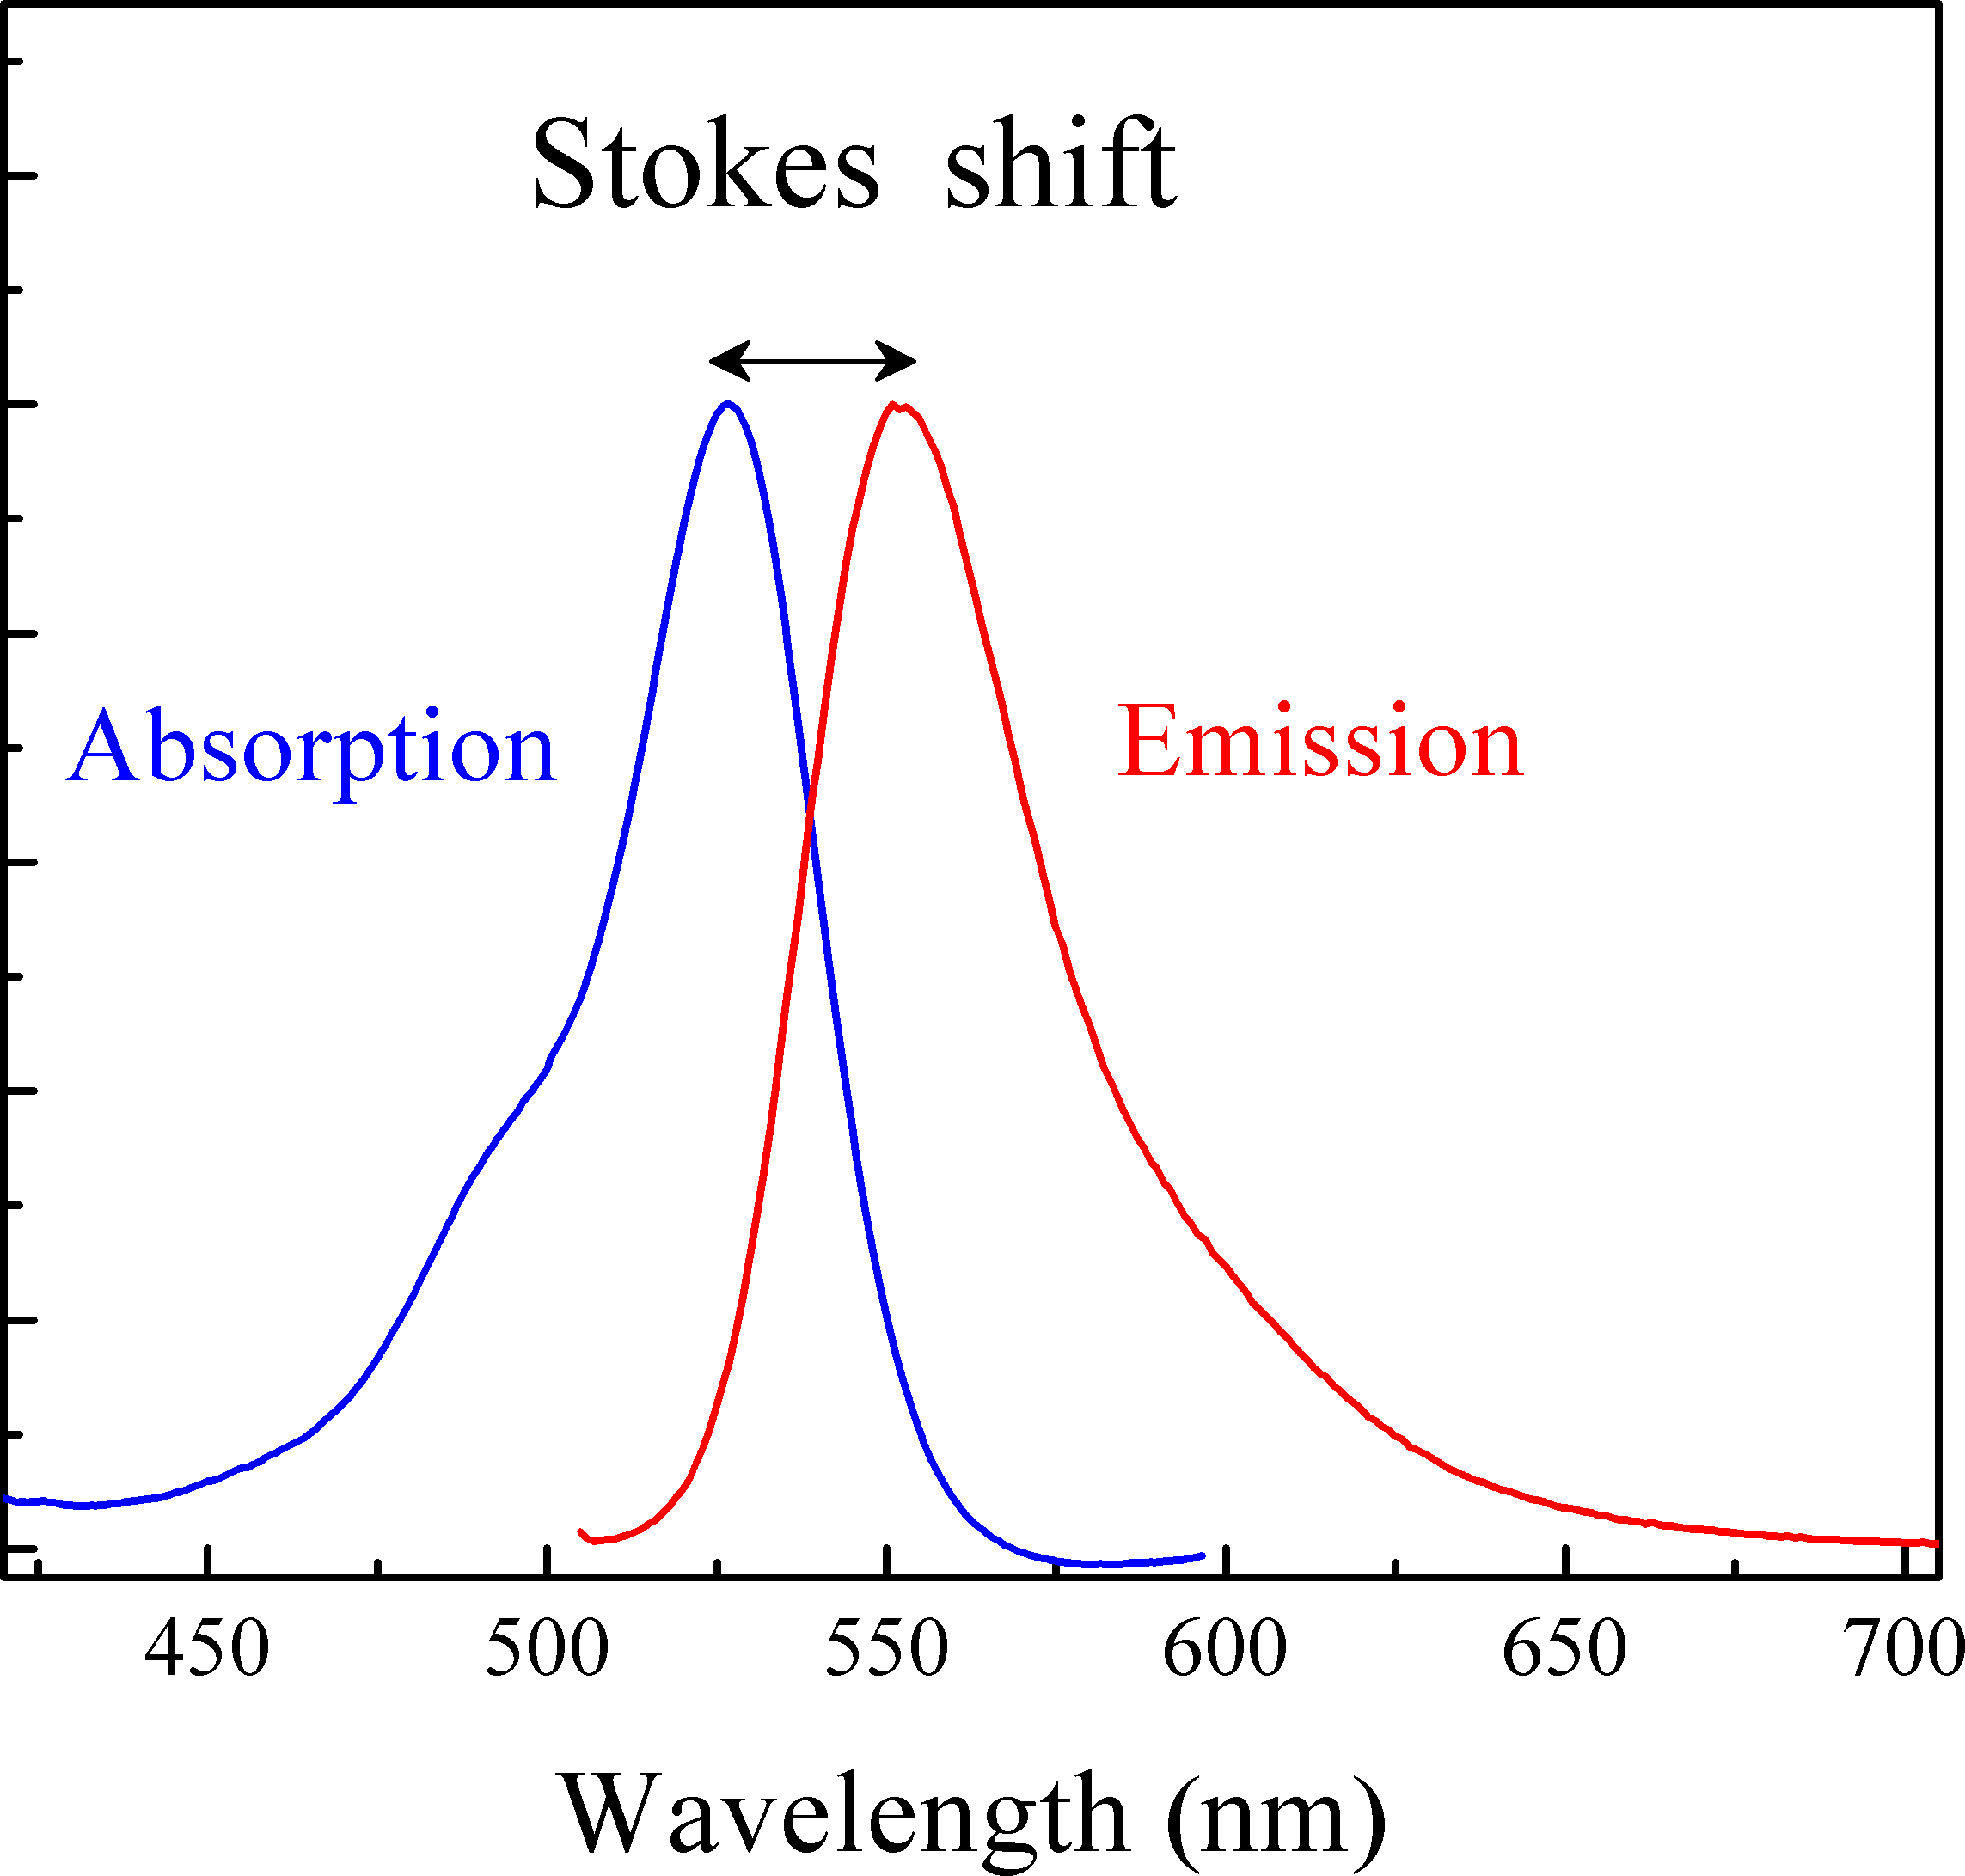
Multiplexing challenges: Stokes shifts
Stokes shift: max(Em) – max (Ex)
Width, spacing of Ex/Em peaks a huge factor in multiplexing
https://journals.plos.org/plosone/article/file?id=10.1371/journal.pone.0122848.g001&type=large, https://upload.wikimedia.org/wikipedia/commons/3/3f/Stokes_shift-_Rh6G.png

Slide 9
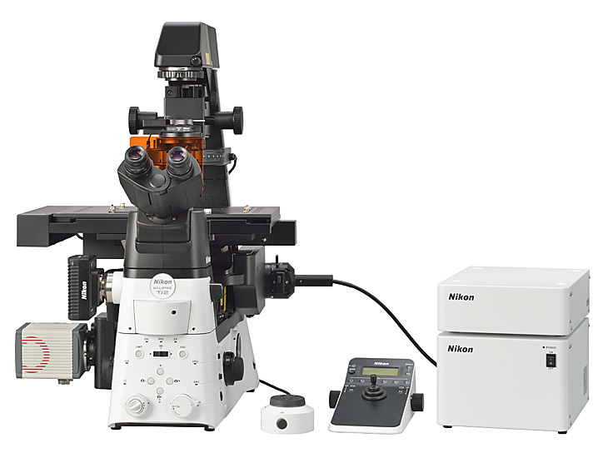
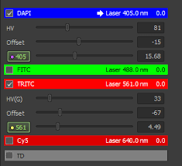
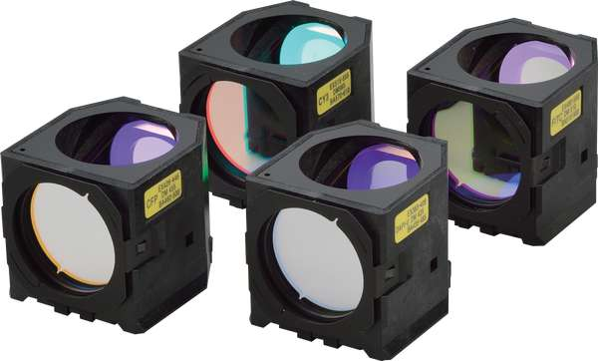
Defining an imaging channel
How is the microscope sub-setting the EM spectrum around a defined “channel”
Light source (?), filter cube
https://encrypted-tbn0.gstatic.com/images?q=tbn:ANd9GcQGjmZByoM2TiwIz-P2benxkUGzlX3QJBgl2X7lUi5taLUpQLx0SmSb66f9A6v6PA0ui30&usqp=CAU, https://www.nikon.com/news/2016/img/pic_161109_01.jpg, https://d33b8x22mym97j.cloudfront.net/production/imager/productphotos/827/filter-cubes-main_ec7d1033075031a0254a7350f4e87eb4.jpg

Slide 10
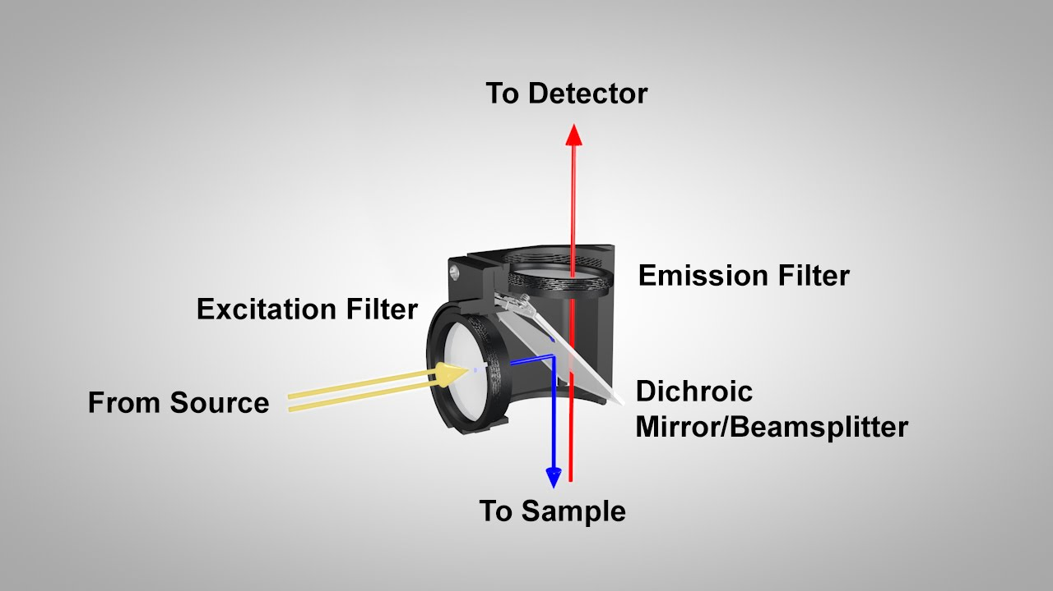
The anatomy of a filter cube
Ingredients: Ex filter (bandpass), DM (long-pass), Em fiter (bandpass)
Flip orientation 180º for inverted microscopes
https://i.ytimg.com/vi/y4dJOFUVk30/maxresdefault.jpg, https://d33b8x22mym97j.cloudfront.net/production/imager/productphotos/827/filter-cubes-main_ec7d1033075031a0254a7350f4e87eb4.jpg

Slide 11
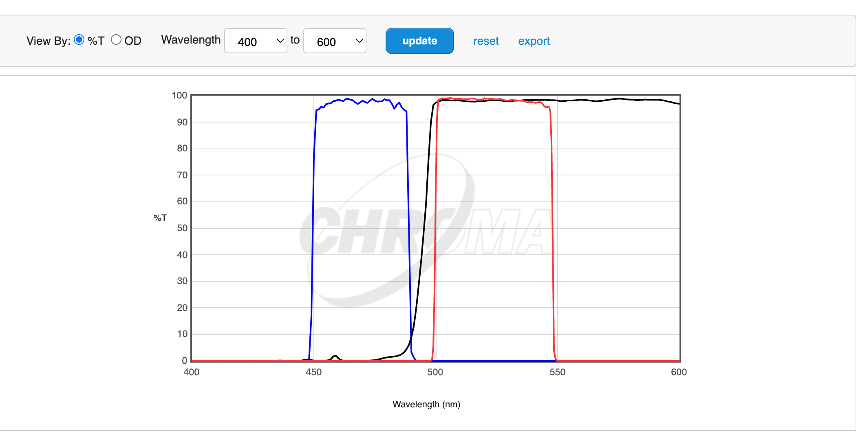
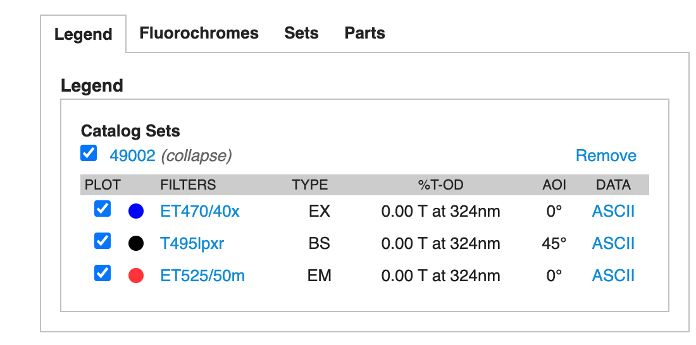
An example filter cube
https://d33b8x22mym97j.cloudfront.net/production/imager/productphotos/827/filter-cubes-main_ec7d1033075031a0254a7350f4e87eb4.jpg, https://www.chroma.com/products/sets/49002-et-egfp-fitc-cy2

Slide 12
Class activity 1: design a filter set (15 mins)
Assume you have the following laser lines: [405 nm, 488 nm, 532 nm, 561 nm, 594 nm, 640 nm]
Go to https://www.fpbase.org/spectra/
Select the dye “Cy3B” under the ‘Fluorophores’ tab and your choice(s) of laser in the ‘Light Sources’ tab
Design an “ideal” custom filter set (Ex, DM, Em) in the ‘Filters’ tab. You can substitute a long-pass “LP” filter for the DM (ie, only consider the transmission band)
Report your ‘Efficiency’ for Cy3B detection. You can set T% to 100 for all filters. Allow no excitation light to come through.

Slide 13
Class activity 2: design a filter set pair (15 mins)
Assume you have the following laser lines: [405 nm, 488 nm, 532 nm, 561 nm, 594 nm, 640 nm]
Add the dye “Alexa Fluor 647” to the mix
Design an ideal filter set for Alexa 647 and if needed redesign your Cy3B filter set
Report your ‘Efficiency’ for Cy3B and Alexa Fluor 647 detection. You can set T% to 100 for all filters.

Slide 14
Class activity 3: design a filter set trio (15 mins)
Assume you have the following laser lines: [405 nm, 488 nm, 532 nm, 561 nm, 594 nm, 640 nm]
Add the dye “Alexa Fluor 488” to the mix
Design an ideal filter set for Alexa 488 and if needed redesign your Cy3B and Alexa Fluor 647 filter sets
Report your ‘Efficiency’ for Cy3B, Alexa Fluor 647, and Alexa Fluor 488 detection. You can set T% to 100 for all filters.

