Slide 1
Basics of Biomedical Separation

Slide 2
What types of properties do we want/need to separate biomolecules?

Slide 3
What types of properties do we want/need to separate biomolecules?
Mass
Isoelectric point/charge
Hydrophobicity/Hydrophilicity
Size
Solubility
Affinity
Density
Boiling point
Activity

Slide 4
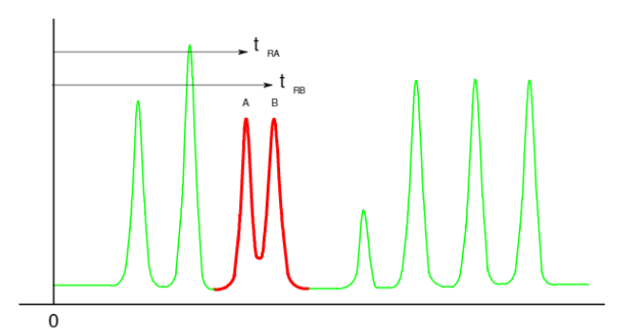
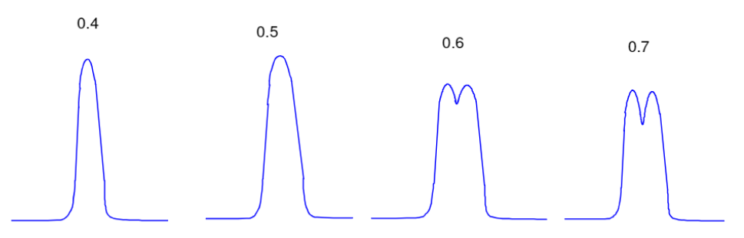
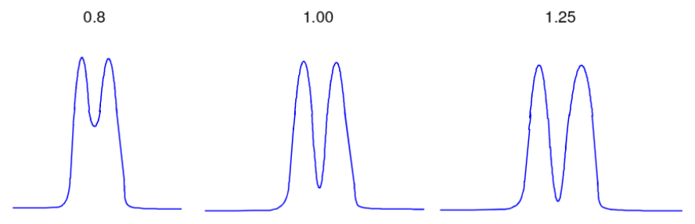
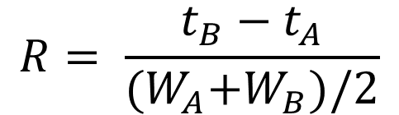
How do we evaluate separations?
Resolution – How well separated are two components
$$R= \frac{t_{B}−t_{A}}{{(W}_{A}+W_{B})/2}$$
W = width at base
W

Slide 5
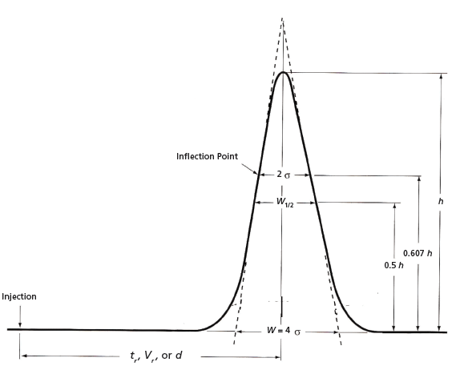

How do we evaluate separations?
Peak Capacity – maximum number of molecular species that can be separated
$$P_{c}= \frac{t_{l}−t_{f}}{\overline{W}}$$

Slide 6
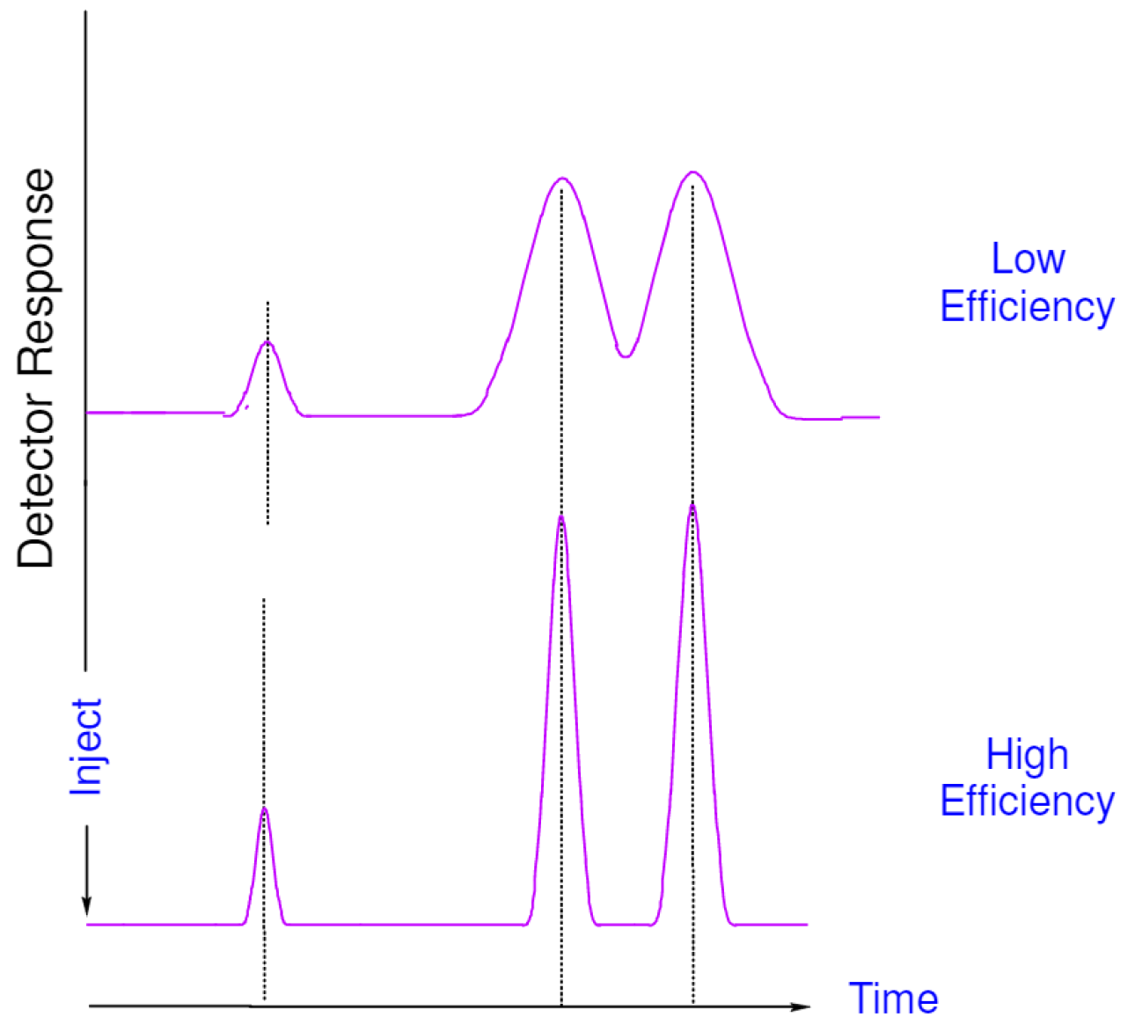

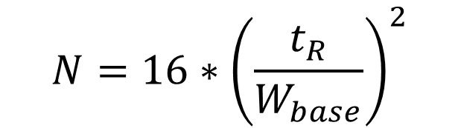
How do we evaluate separations?
Theoretical Plates – is a measure of the efficiency of the separation
$$N= {\left(\frac{t_{R}}{σ}\right)}^{2}$$
$$N=16∗{\left(\frac{t_{R}}{W_{base}}\right)}^{2}$$

Slide 7
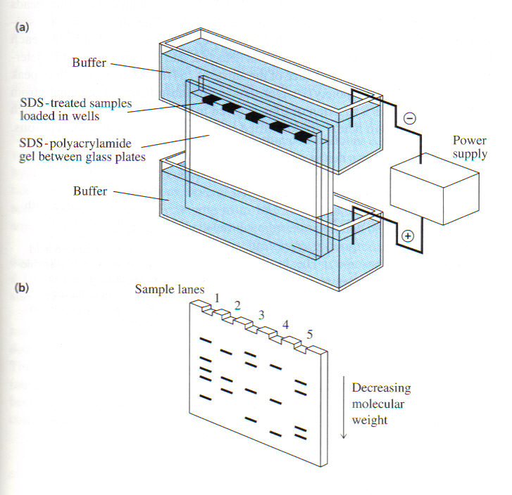
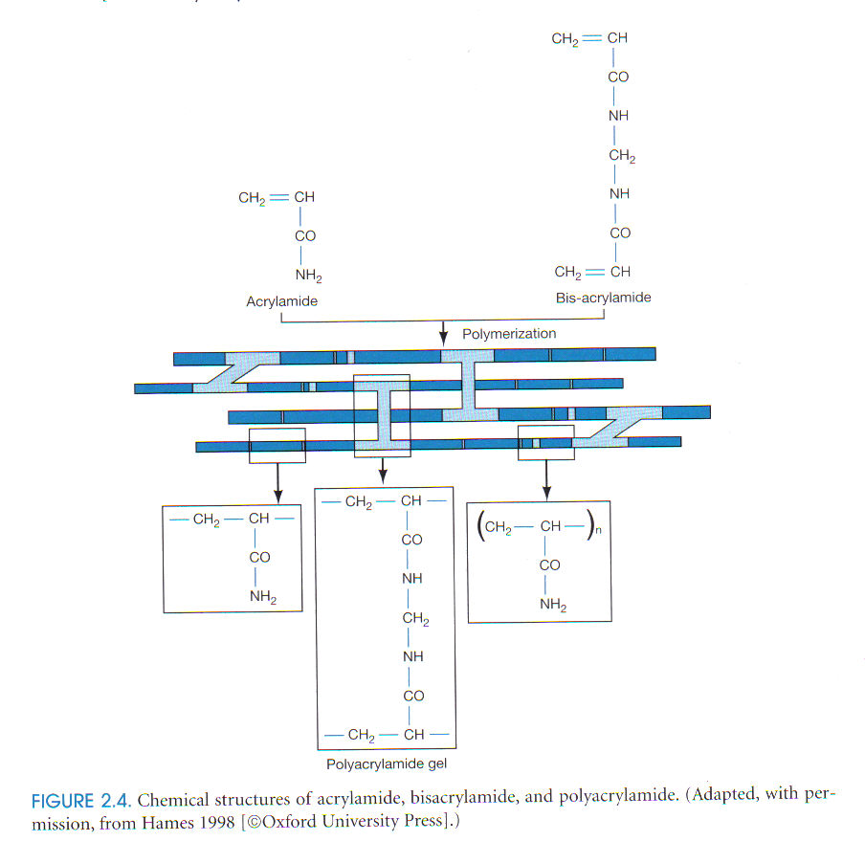
SDS-PAGE (sodium dodecyl sulfate–polyacrylamide gel electrophoresis)
Separation by molecular weight
Any charge swamped by negatively charged SDS molecules
SDS denatures the protein

Slide 8
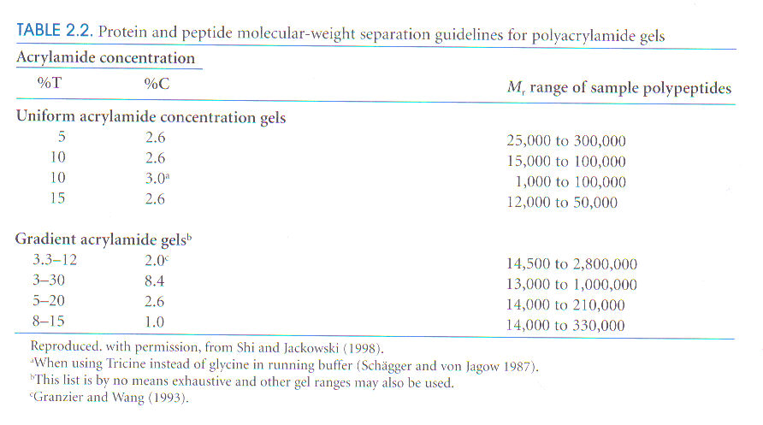
T = Percentage of acrylamide and bisacrylamide in grams / ml
C = Percentage of crosslinker bisacrylamide
Pore size reduced reciprocally to the %T

Slide 9
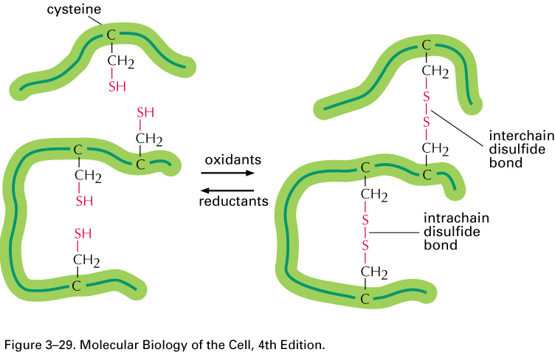
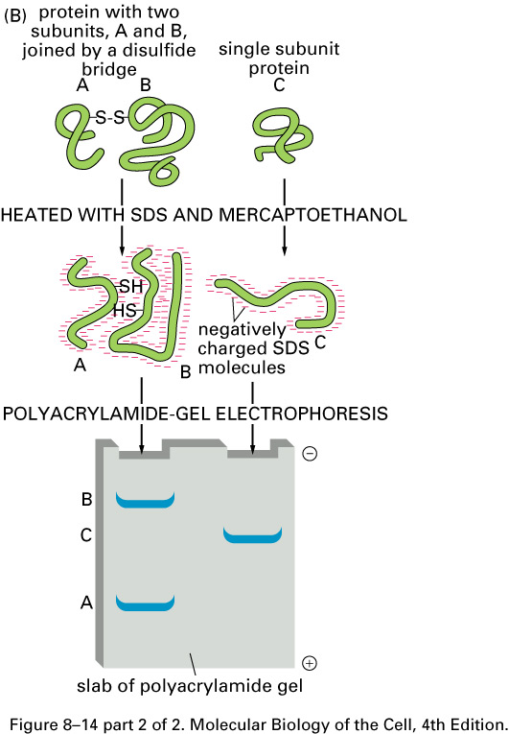


Slide 10
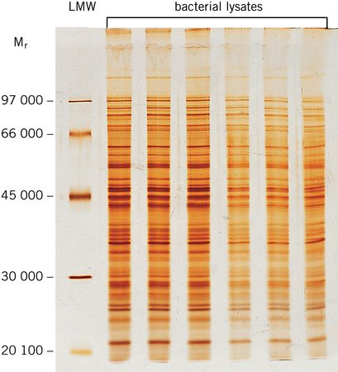
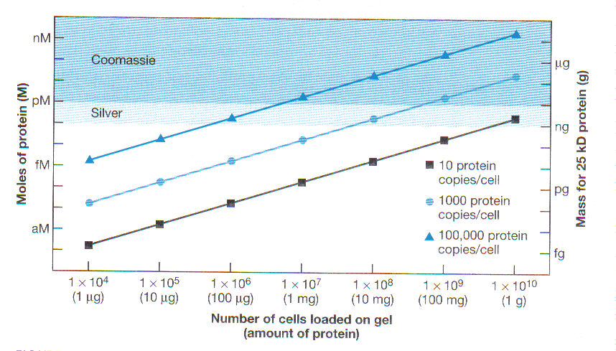

Slide 11
Uses of SDS-PAGE
Determine protein size
Identify protein
Determine sample purity
Identify existence of disulfide bonds
Quantify amounts of protein

Slide 12
Western Blotting
Combines resolution of SDS-PAGE with specificity of antibody detection.
What you can find out:
Presence of an antigen
Amount of an antigen present
Molecular Weight of antigen
Allows for the identification of a single protein in a complex mixture

Slide 13
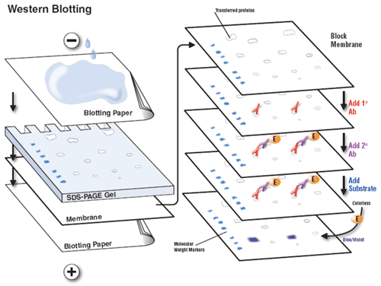

Slide 14
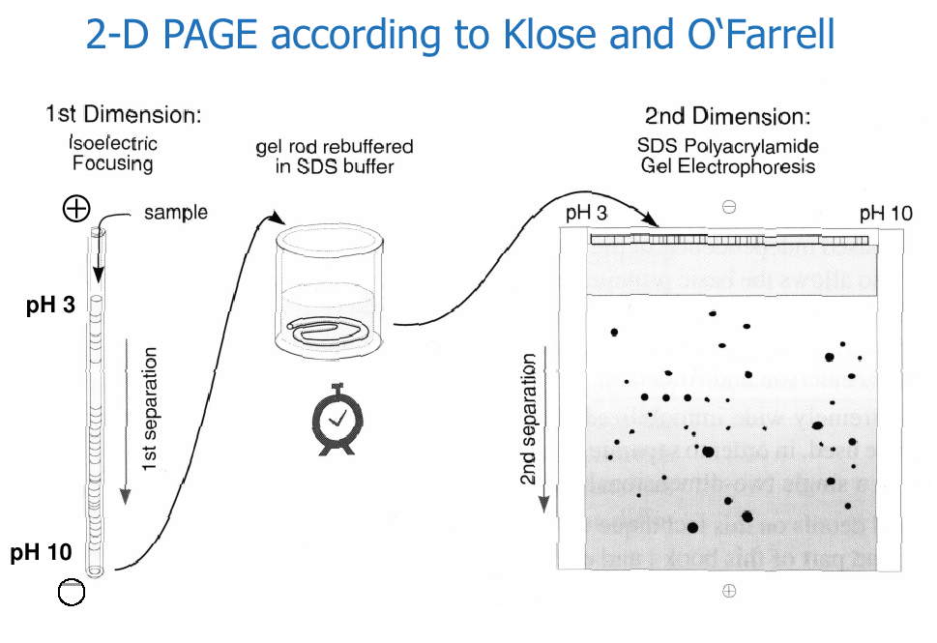

Slide 15
Evolution of 2D-Gel methodology
SDS-PAGE Gel size:
This “O’Farrell” techniques has been used for 20 years without major modification.
20 x 20 cm have become a standard for 2D-Gel.
Assumption: 100 bands can be resolved by 20 cm long 1D-Electrophoresis.
Therefore, 20 x 20 cm gel can resolve 100 x 100 = 10,000 proteins, in theory.
100
100

Slide 16
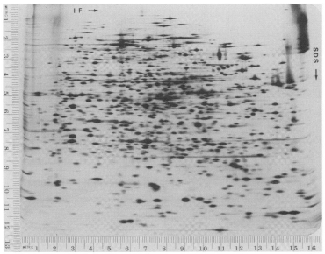
Separation of E. coli Proteins in 1975

Slide 17
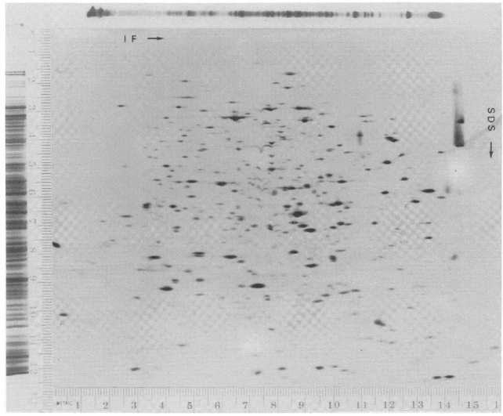
1D to 2D Comparison

Slide 18
Evolution of 2D-Gel methodology
Resolution for IEF: Immobilized pH gradients.
Reported first by Bjellqvist (1982, Biochem. Biophys Methods, vol 6, p317)
pH gradient are prepared by co-polymerizing acrylamide monomers with acrylamide derivatives containing carboxylic and tertiary amino groups.
The pH gradient is fixed, not affected by sample composition.
Reproducible data are presented.
Higher loading capacity than with carrier ampholytes
Modified by Angelika Gorg by using thin film to support the thin polyacrylamide IEF gel, named Strips. (1988, Electrophoresis, vol 9, p 531)
CH₂
CN
C
N
R
CH₂
CN
C
N
H
O
H
O
H
R = amino or carboxylic groups
Acrylamide

Slide 19
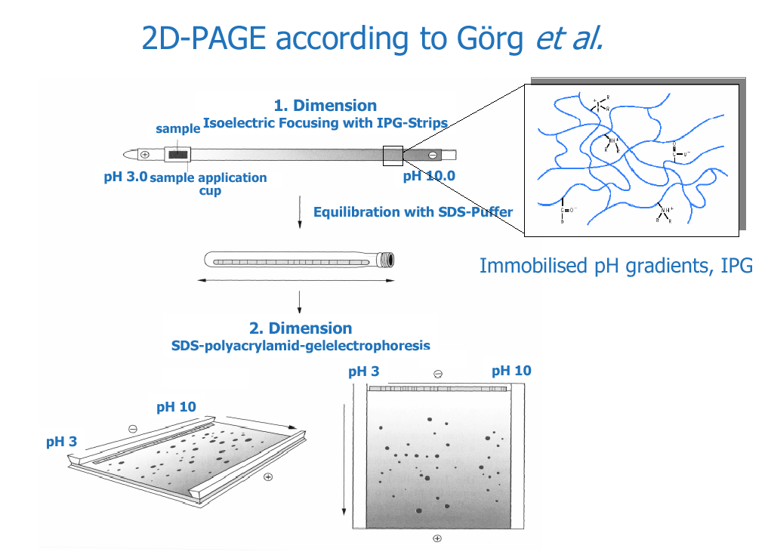

Slide 20
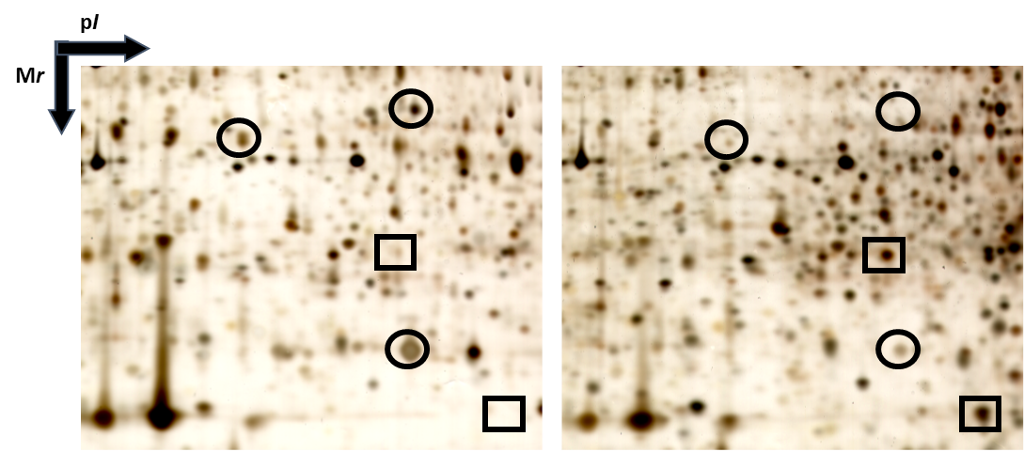

Slide 21
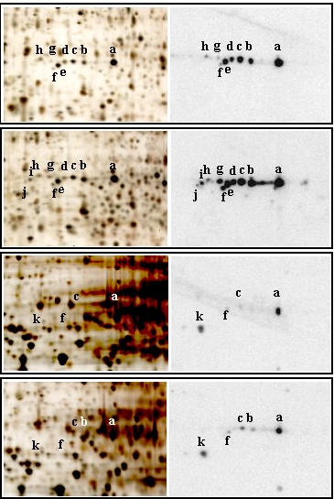
Silver
Immunoblot
CTL Golgi
CHX Golgi
CTL cytosol
CHX cytosol

Slide 22
