Slide 1
Light Sources
Genome 575: Fundamentals of Biomedical Instrumentation
Brian Beliveau

Slide 2
Recap from last time
There are many questions to ask about data
Continuous information can be evaluated or thresholded
Discrete information can be binarized around threshold values
The performance of a given threshold choice can be evaluated with ROC curves

Slide 3

Discussion point
What is the most surprising thing you’ve learned in the class so far?
https://images.emojiterra.com/google/android-11/512px/1f914.png

Slide 4
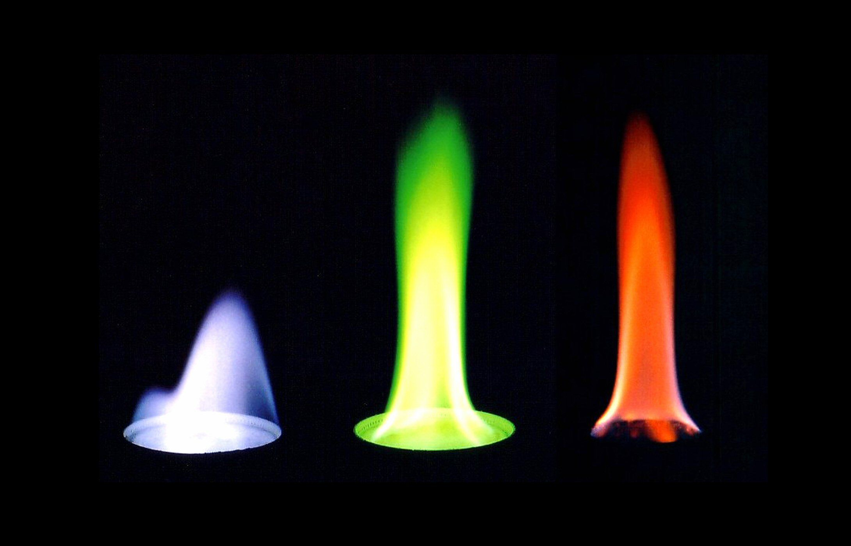
Let’s talk about (visible)light
What is light?
Where does it come from?
https://www.thoughtco.com/thmb/jEWJTLUBQRRgWgmKng6JPuX5E0M=/2180x1400/filters:fill(auto,1)/90191671-56a1322a3df78cf772684fbf.jpg

Slide 5
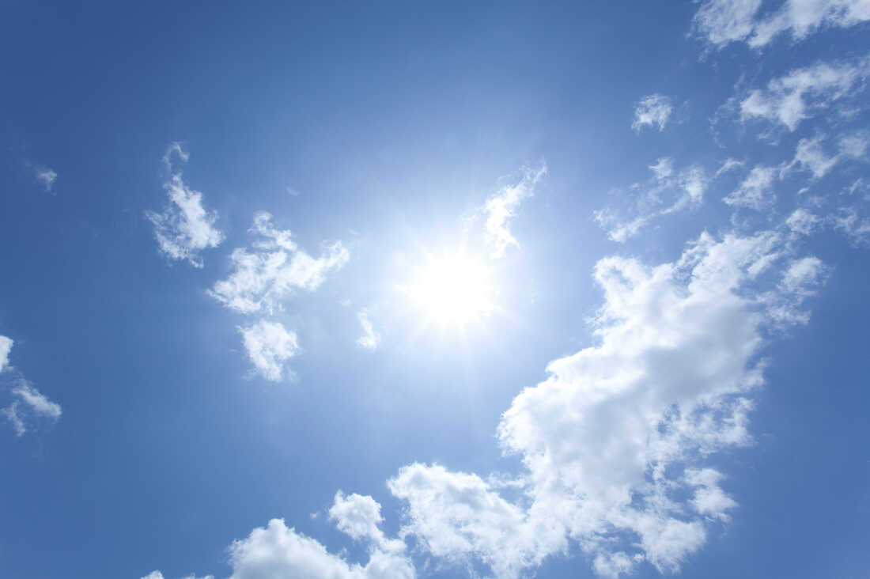
Sunlight
What is the source of visible sunlight?
https://media.npr.org/assets/img/2020/04/17/gettyimages-102853378_custom-322a77f3aa92129f4a84f4d2dd98ac2ca1a078b8-s1100-c50.jpg

Slide 6
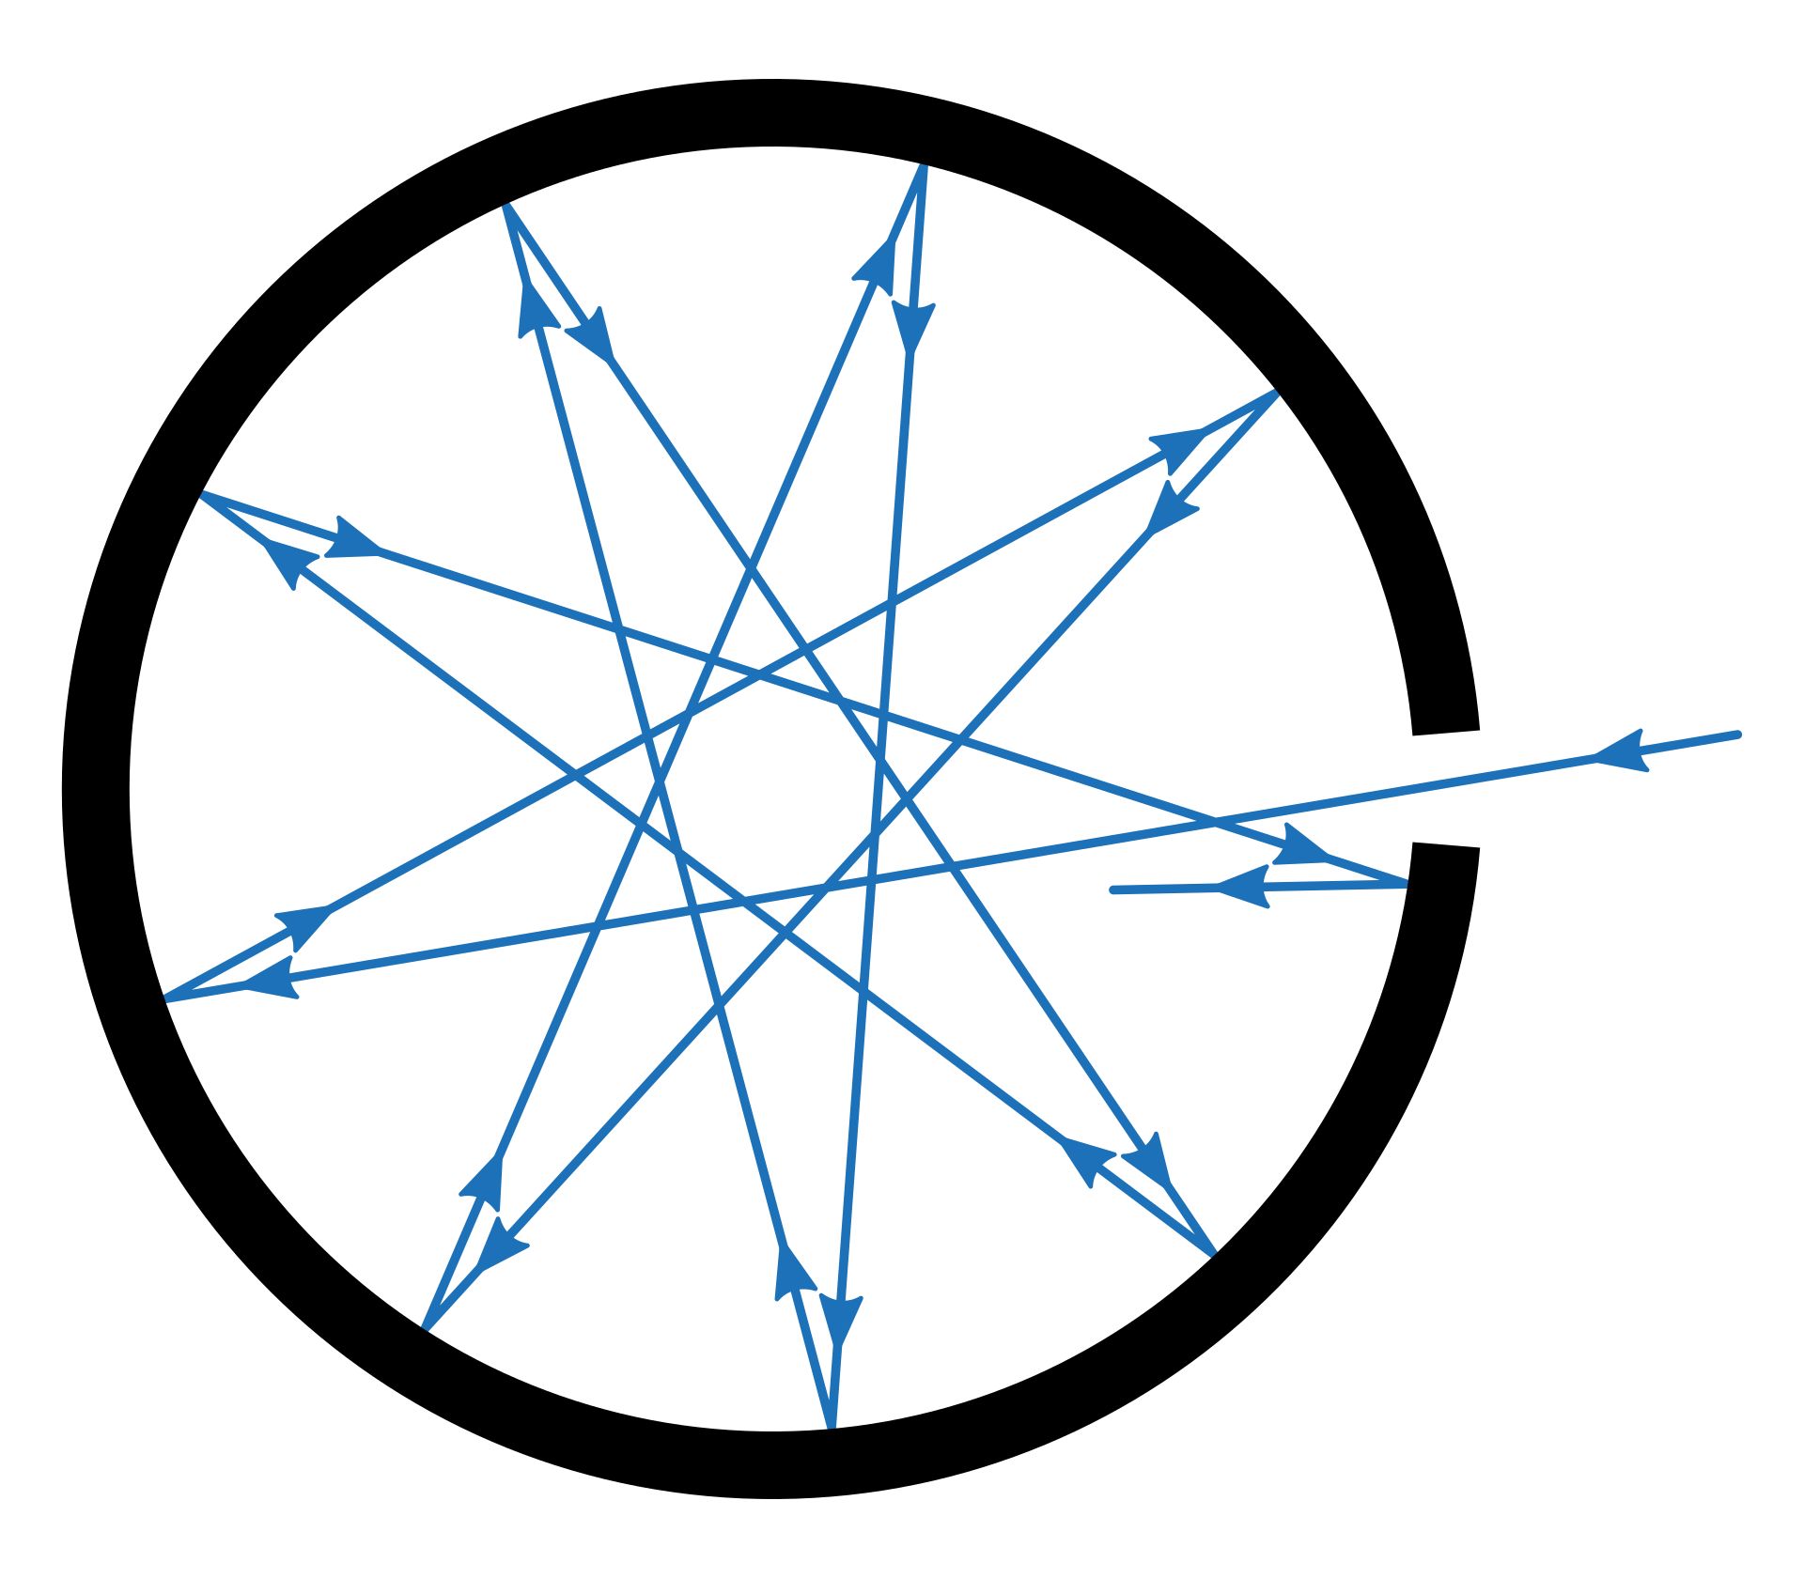
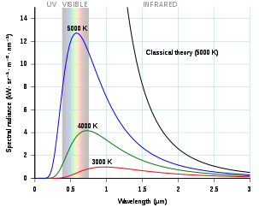
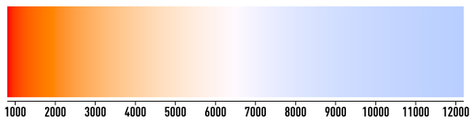
Black body radiation
Radiation emitted by all matter above 0 K due to thermal motion of elementary particles (e⁻, p⁺)
“Black body”: isolated system in thermal equilibrium
E = hf (Planck’s constant originated by quantizing changes in black body radiation as a function of f)
https://upload.wikimedia.org/wikipedia/commons/thumb/d/d8/Black_body_realization.svg/1920px-Black_body_realization.svg.png, https://upload.wikimedia.org/wikipedia/commons/thumb/e/e9/Color_temperature_black_body_800-12200K.svg/1024px-Color_temperature_black_body_800-12200K.svg.png, https://upload.wikimedia.org/wikipedia/commons/thumb/1/19/Black_body.svg/606px-Black_body.svg.png

Slide 7
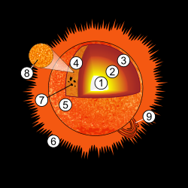
Black body radiation and the sun
EM radiation from the sun matches closes to black body radiation with T = ~5800K
EM radiation from sun is emitted from the photosphere (4 in diagram above), which has a T of ~5800k
https://upload.wikimedia.org/wikipedia/commons/thumb/7/76/Sun_diagram.svg/500px-Sun_diagram.svg.png , https://media.npr.org/assets/img/2020/04/17/gettyimages-102853378_custom-322a77f3aa92129f4a84f4d2dd98ac2ca1a078b8-s1100-c50.jpg, svg.png, https://upload.wikimedia.org/wikipedia/commons/thumb/e/e9/Color_temperature_black_body_800-12200K.svg/1024px-Color_temperature_black_body_800-12200K.svg.png

Slide 8
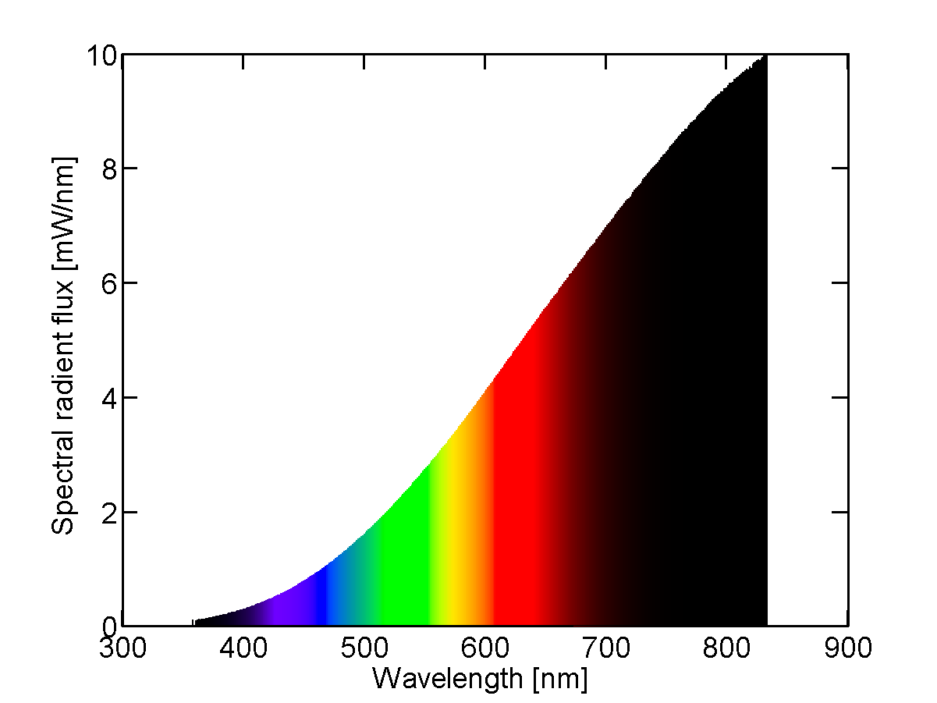
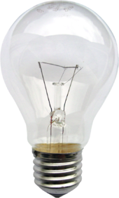
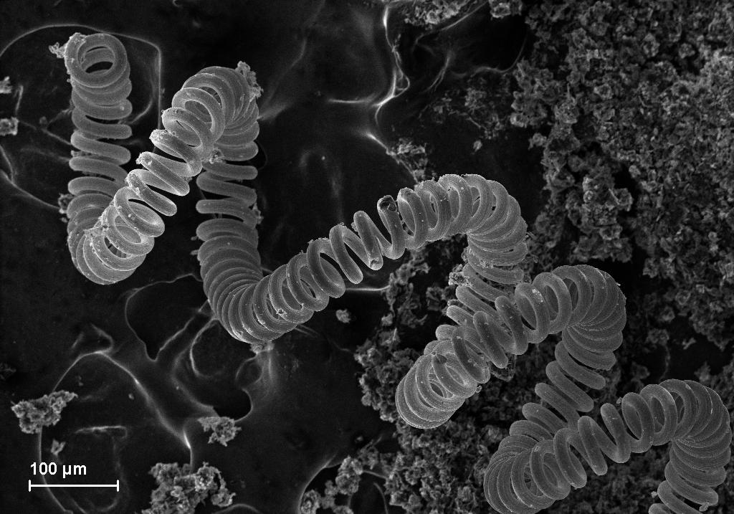
Incandescent lights
Electric current used to heat a filament -> thermal radiation
Inefficient: most energy lost as heat (5% goes to visible light)
https://upload.wikimedia.org/wikipedia/commons/thumb/b/b4/Gluehlampe_01_KMJ.png/340px-Gluehlampe_01_KMJ.png, https://upload.wikimedia.org/wikipedia/commons/1/17/Tungsten_filament.JPG, https://upload.wikimedia.org/wikipedia/commons/b/be/Spectral_power_distribution_of_a_25_W_incandescent_light_bulb.png

Slide 9
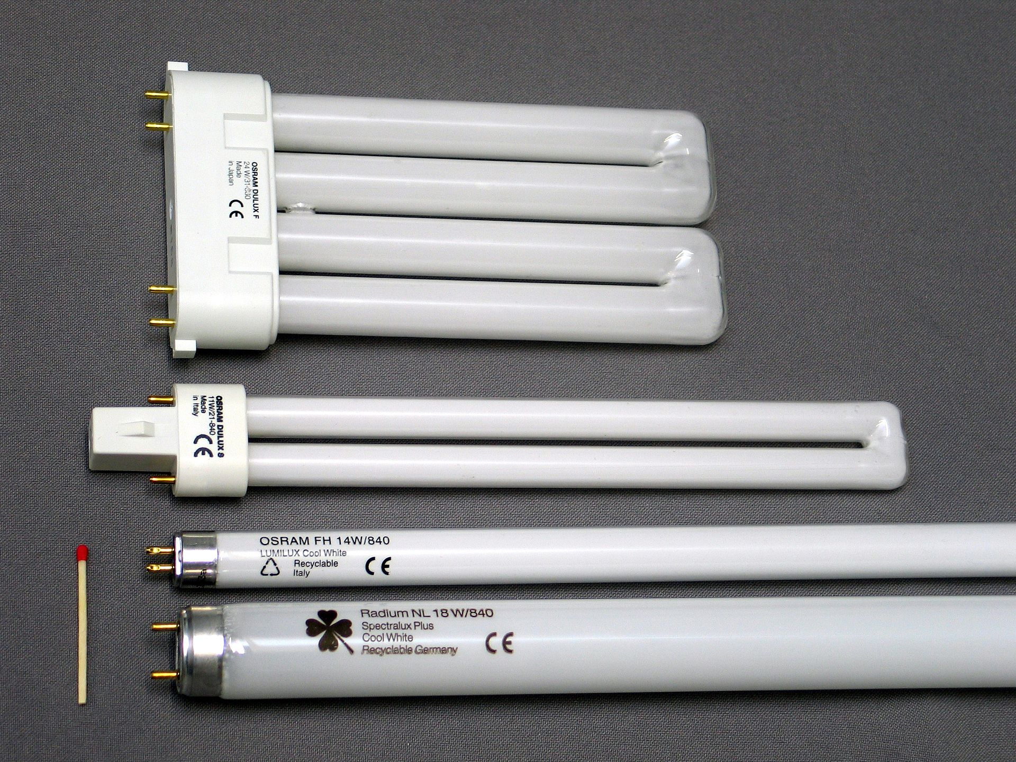
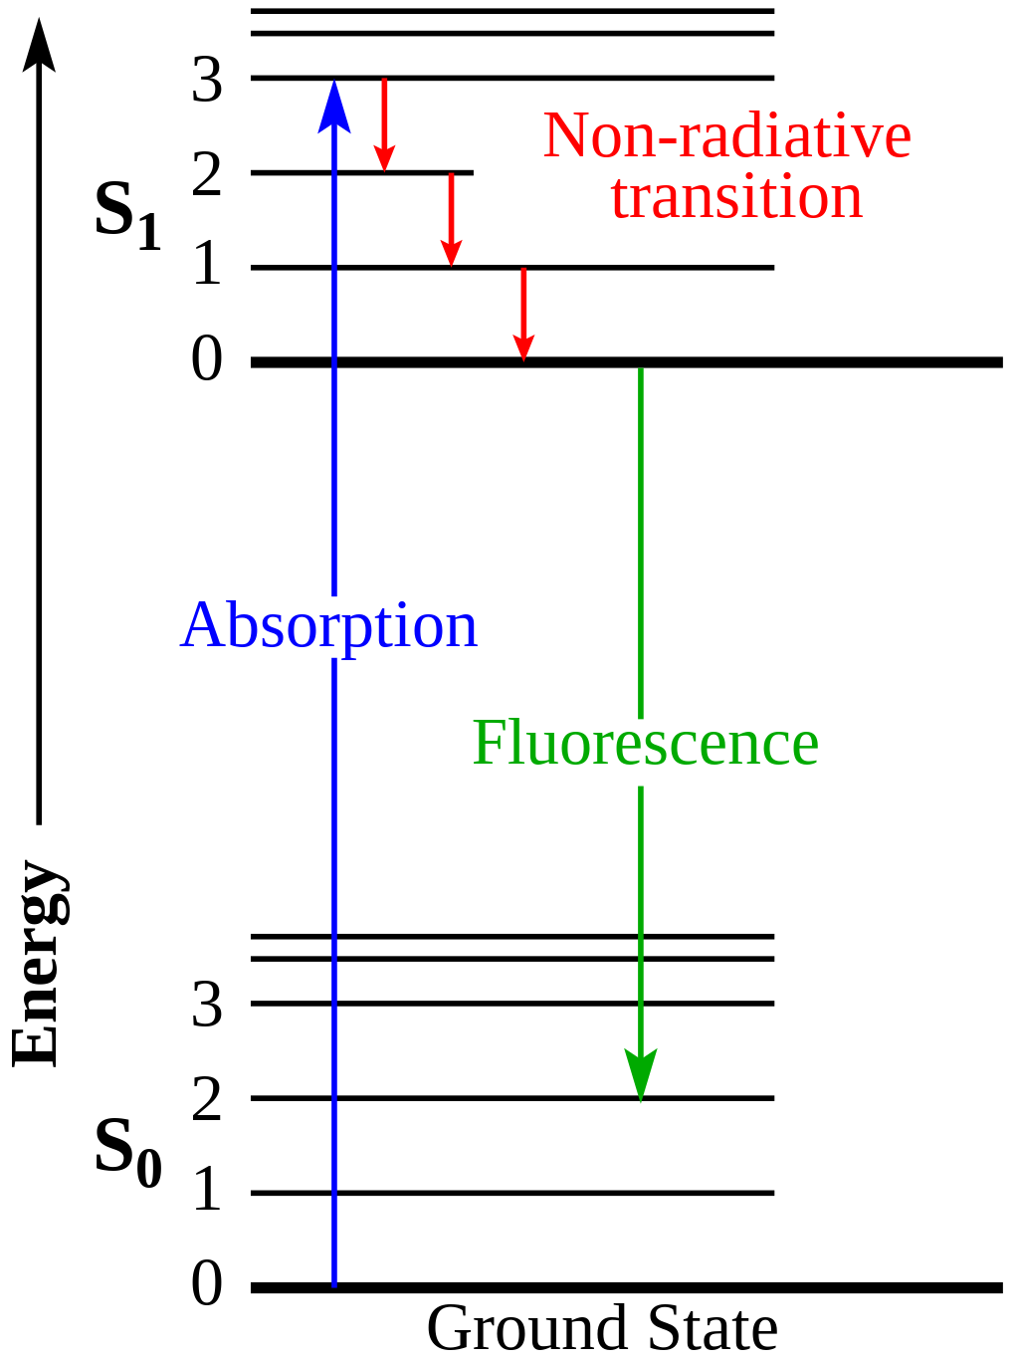
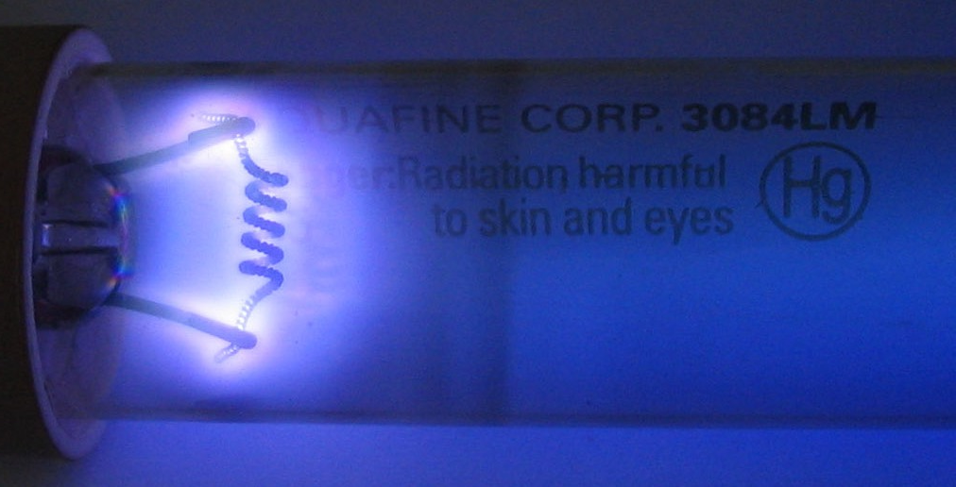
Fluorescent lights
Jablonski diagram
An ionized (ie, plasma) mix of Hg and inert gas sealed
Electrical discharge sent through bulb, electrons collide with Hg
Collisions -> UV photons -> collision with surface coating -> vis photons
https://upload.wikimedia.org/wikipedia/commons/thumb/5/5b/Leuchtstofflampen-chtaube050409.jpg/1920px-Leuchtstofflampen-chtaube050409.jpg, https://upload.wikimedia.org/wikipedia/commons/8/8e/Germicidal_UV_discharge_tube_glow.jpg https://upload.wikimedia.org/wikipedia/commons/thumb/5/53/Jablonski_Diagram_of_Fluorescence_Only-en.svg/1024px-Jablonski_Diagram_of_Fluorescence_Only-en.svg.png

Slide 10
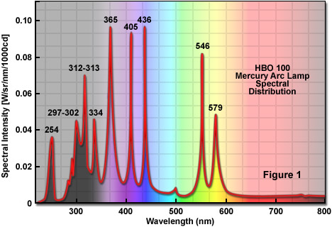
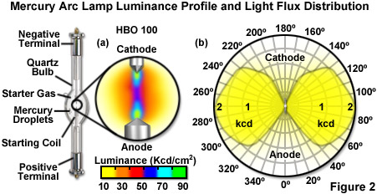
HBO “Burner” lamps
Specialized version of fluorescent lights using Hg
Useful bands of intensity for common fluorescent labels
Do not last super long; break easily
https://zeiss-campus.magnet.fsu.edu/articles/lightsources/images/mercurylampsfigure2.jpg, https://zeiss-campus.magnet.fsu.edu/articles/lightsources/images/mercurylampsfigure1.jpg

Slide 11
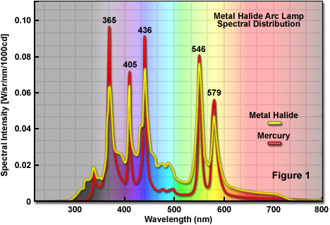
Metal halide lamps
Similar to HBO in mechanism of action
Better coverage of “dip” in blue/green part of spectrum
Longer lasting than HBO (have largely replaced)
https://zeiss-campus.magnet.fsu.edu/articles/lightsources/images/metalhalidelampsfigure1.jpg

Slide 12
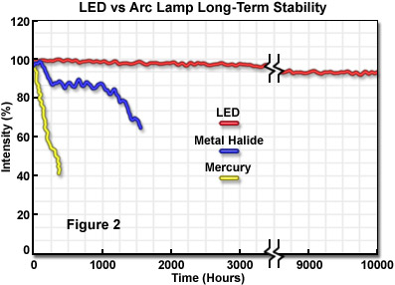
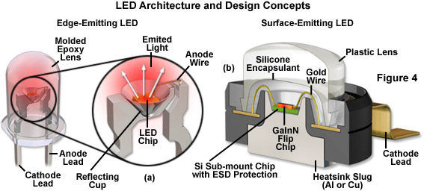
LEDs
Semi-conductor driven excitation/relaxation of e⁻ over defined ‘band gaps’
Possible to precisely tune 𝝀, generate high power
Single wavelength and white light options
Extremely durable. The new standard.
https://zeiss-campus.magnet.fsu.edu/articles/lightsources/images/ledsfigure4.jpg, https://zeiss-campus.magnet.fsu.edu/articles/lightsources/images/ledsfigure2.jpg

Slide 13
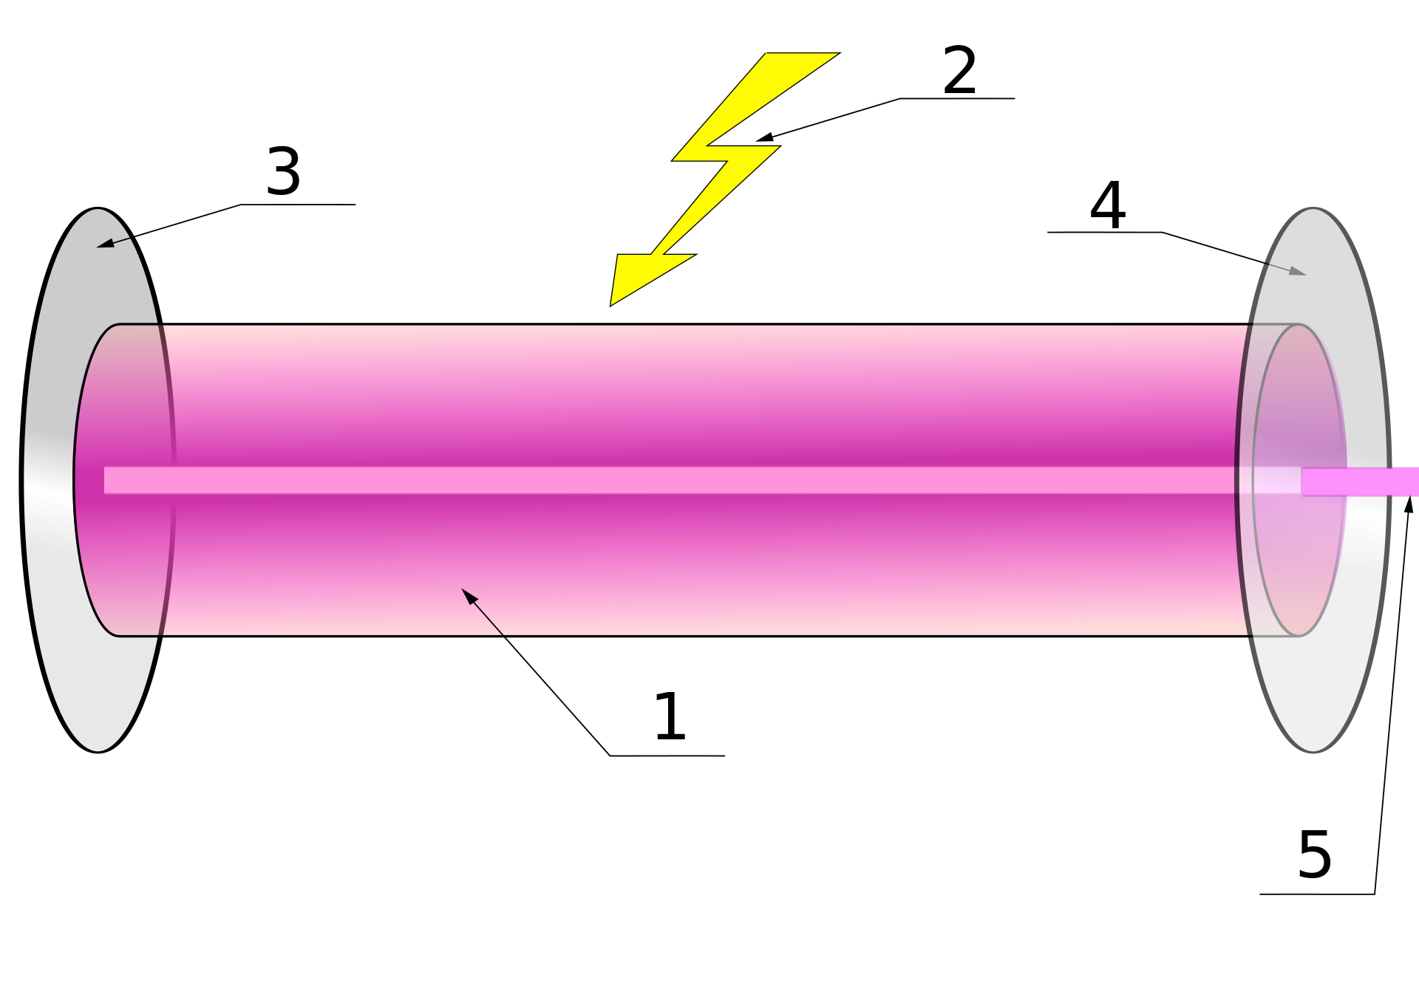
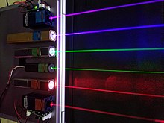
Lasers
LASER = “Light Amplification by Stimulated Emission of Radiation”
More accurately: LOSER / “Light Oscillation by Stimulated Emission of Radiation”
As name suggests, works via stimulated emission
https://en.wikipedia.org/wiki/File:Lasers.JPG, https://en.wikipedia.org/wiki/File:Laser.svg

Slide 14
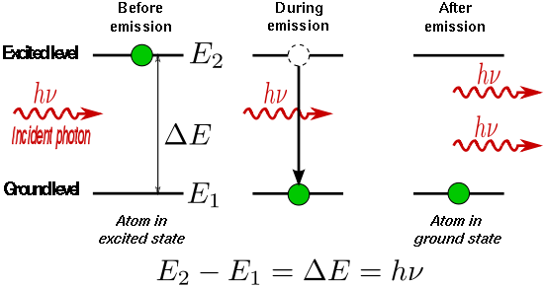
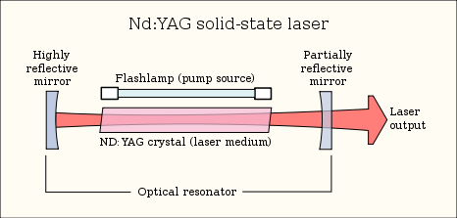
Stimulated Emission
Initial excitation events driven by spontaneous emission
Collisions between incident photons and excited gain medium lead to stimulated emission events
Stimulated emission -> monochromatic, coherent light
Very high powers, “clean” point sources can be generated
https://en.wikipedia.org/wiki/File:Stimulated_Emission.svg, https://upload.wikimedia.org/wikipedia/commons/thumb/9/92/Lasercons.svg/466px-Lasercons.svg.png

Slide 15
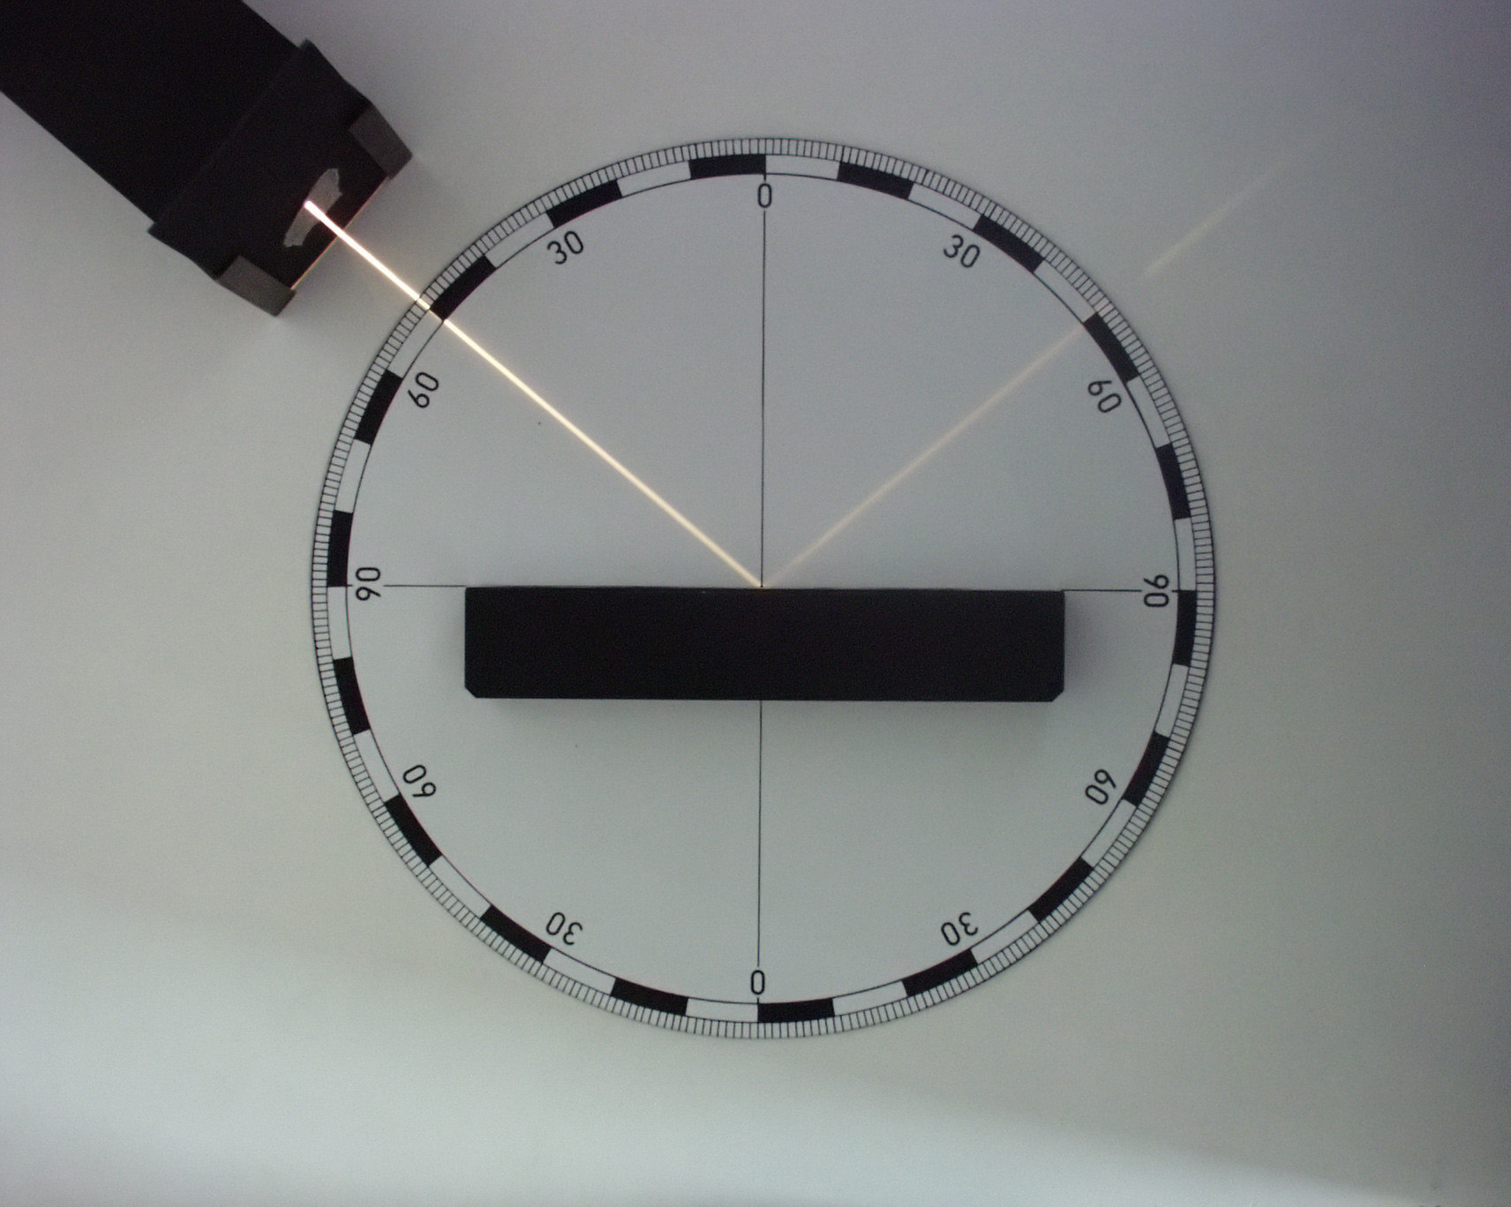
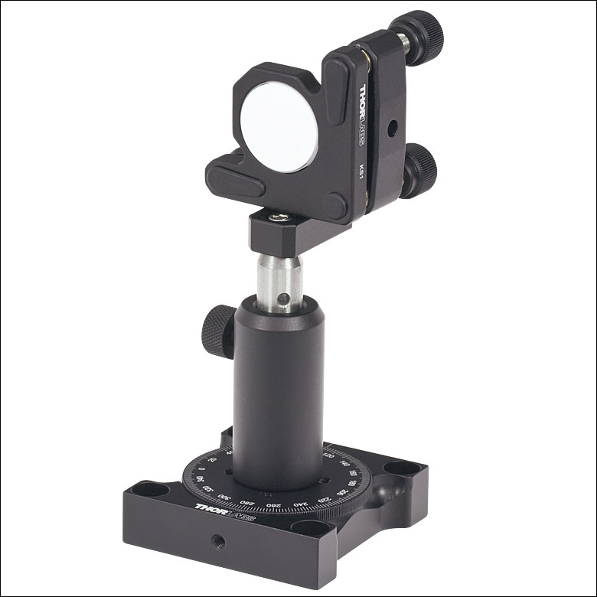
Properties of light: Reflection
Mirror
https://upload.wikimedia.org/wikipedia/commons/e/e3/F%C3%A9nyvisszaver%C5%91d%C3%A9s.jpg, https://www.thorlabs.com/images/TabImages/Variable_Centering_Plate_A1-150.jpg

Slide 16
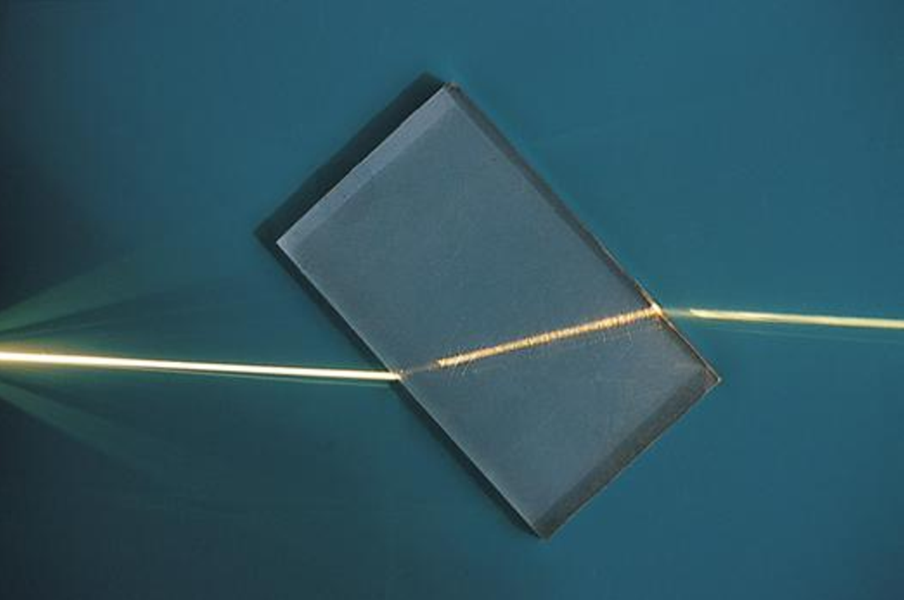
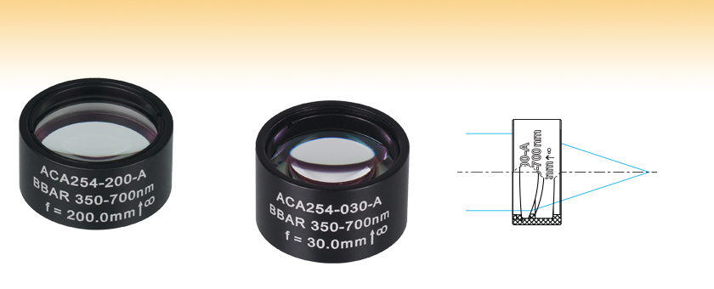
Properties of light: Refraction
Lenses
https://upload.wikimedia.org/wikipedia/commons/8/85/Refraction_photo.png,

Slide 17
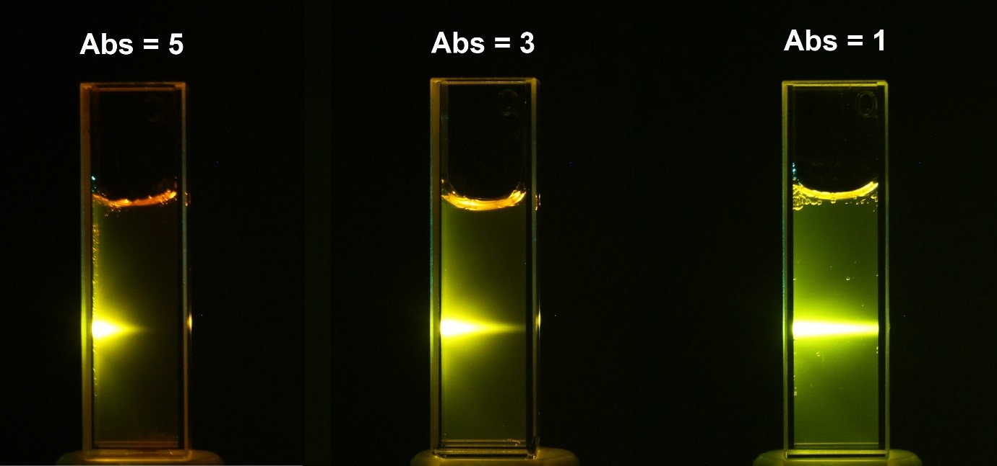
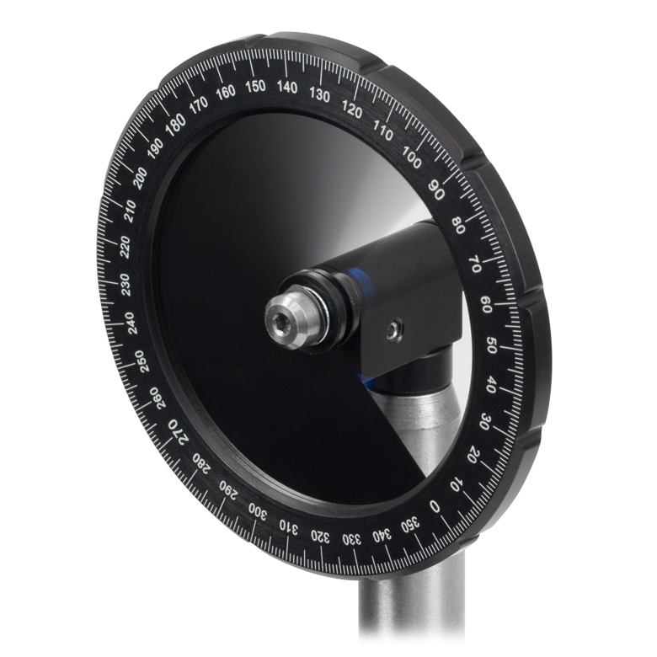
Properties of light: Absorption
Filters
https://www.edinst.com/wp-content/uploads/2019/08/BLL-2.jpg, https://www.thorlabs.com/images/TabImages/Variable_ND_Filter_A5-780.jpg

Slide 18
Challenge 1: Be the microscope
Two teams. Phones/computers away
Each person given one of seven cards. Assemble in the order prompted.
https://i.kym-cdn.com/entries/icons/original/000/001/707/thecakeisalie.jpg, https://dnm.nflximg.net/api/v6/2DuQlx0fM4wd1nzqm5BFBi6ILa8/AAAAQYwP3BYZ2Ri_-P-sY4_vtR9_fv6KPptWKKniY2_VxxOzqurvjAbe7bi4XPq2NbcH4vw99f1gFDyU_TZe7bkeHOBKNYccZkoFBoRsCHFtqWFtHPYk16RT26YMxUs8PffGpvROrvismA_Kt8PHRAuviZLp.jpg?r=b5e

Slide 19
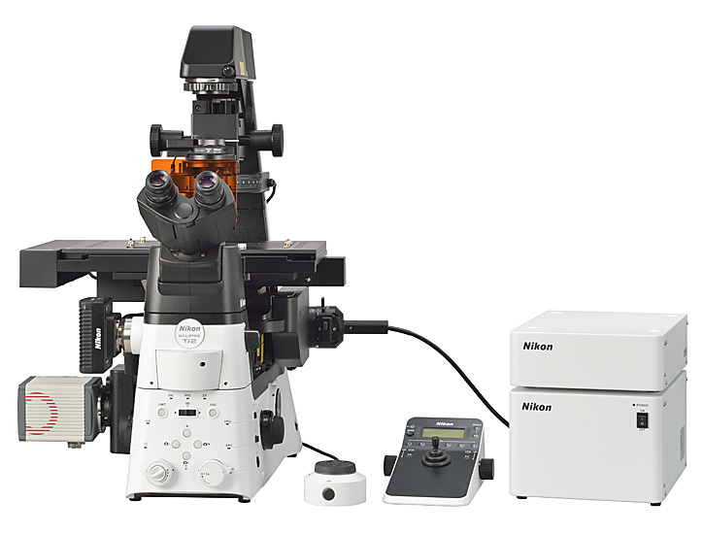
Challenge 1: Be the microscope
Two teams. Phones/computers away
Each person given one of seven cards.
Assemble in the order prompted.
https://www.nikon.com/news/2016/img/pic_161109_01.jpg

Slide 20
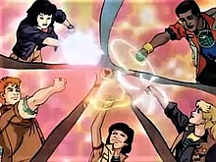
Challenge 1: Be the microscope
Assemble into the Excitation Path
https://upload.wikimedia.org/wikipedia/en/thumb/b/bd/ThePlaneteers.JPG/220px-ThePlaneteers.JPG, https://www.nikon.com/news/2016/img/pic_161109_01.jpg

Slide 21
Challenge 1: Be the microscope
Assemble into the Emission Path
https://upload.wikimedia.org/wikipedia/en/thumb/b/bd/ThePlaneteers.JPG/220px-ThePlaneteers.JPG, https://www.nikon.com/news/2016/img/pic_161109_01.jpg

Slide 22
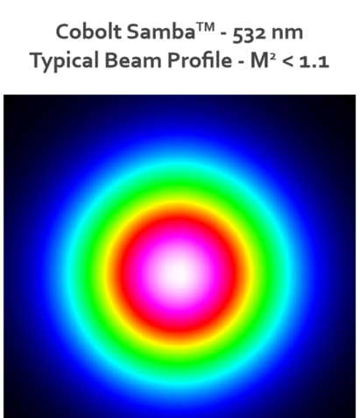
Challenge 2: Power density “consultants”
Your camera chip (white) and Gaussian laser beam profile are shown ->
Is this set-up ideal for quantitative imaging? Why or why not?
Given the assumptions below, calculate the power density of the cyan box in kW/cm^2. How does this compare to the intensity of the sun?
The central white + purple area is roughly uniform in intensity at 100 mW
The cyan box is 1024 x 1024 100 nm pixels
Devise an engineering solution to make the illumination intensity uniform over the white box
https://hubner-photonics.com/wp-content/uploads/2020/05/Performance-data-beam-profile-04-01-Series.png

