Slide 1


Group 2 Bacchus Winery
Giabella Apo, Brandon Benavides, Violet Gonzalez, Thunder Harding, Roald Medendorp

Slide 2












Meet our Team:
Giabella Apo
Brandon Benavides
Violet Gonzalez
Thunder Harding
Roland Medendorp

Slide 3
Bacchus Winery Case Study
Bacchus Winery is now under new management and owners, Stan and Davis Bacchus, are looking to modernize their operations and enhance their customer service.
Stan and Davis want to improve their inventory management and online ordering capabilities for their suppliers and distributors.
They need detailed reports on deliveries, employee hours, and wine sales to help ensure their business is running as efficiently as possible.
By addressing these challenges, the Bacchus Winery aims to increase their efficiency, product quality, and ensuring customer satisfaction.

Slide 4
Assumptions that informed design decisions
The winery has a stable number of employees with no immediate plans for expansion or reduction
The suppliers are consistent and do not change frequently
The dates for orders, expected and arrived deliveries
The supplies and quantities ordered will remain the same and be placed at similar times as previous orders
The client will compare previous and future data to determine more efficient methods
Each of the employees only belongs to their specified department
Employee work time should remain the same as in previous quarters
Each of the distributors can carry multiple types of wine

Slide 5

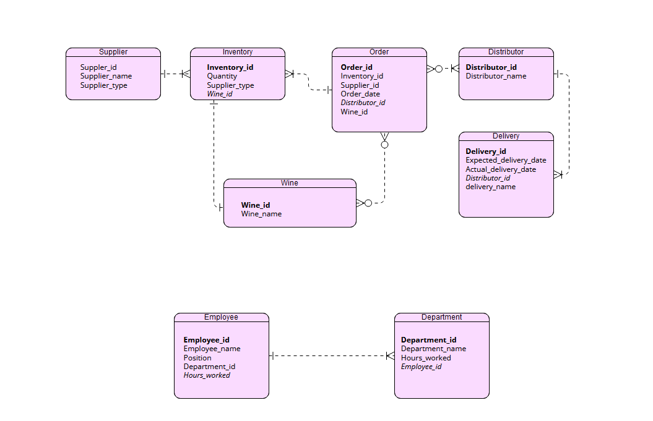
Finalized ERD

Slide 6
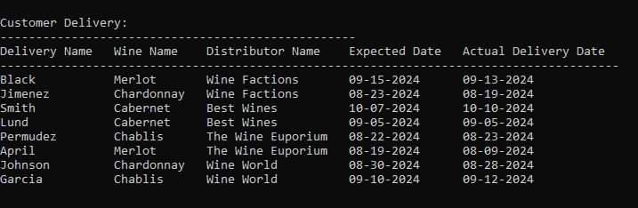
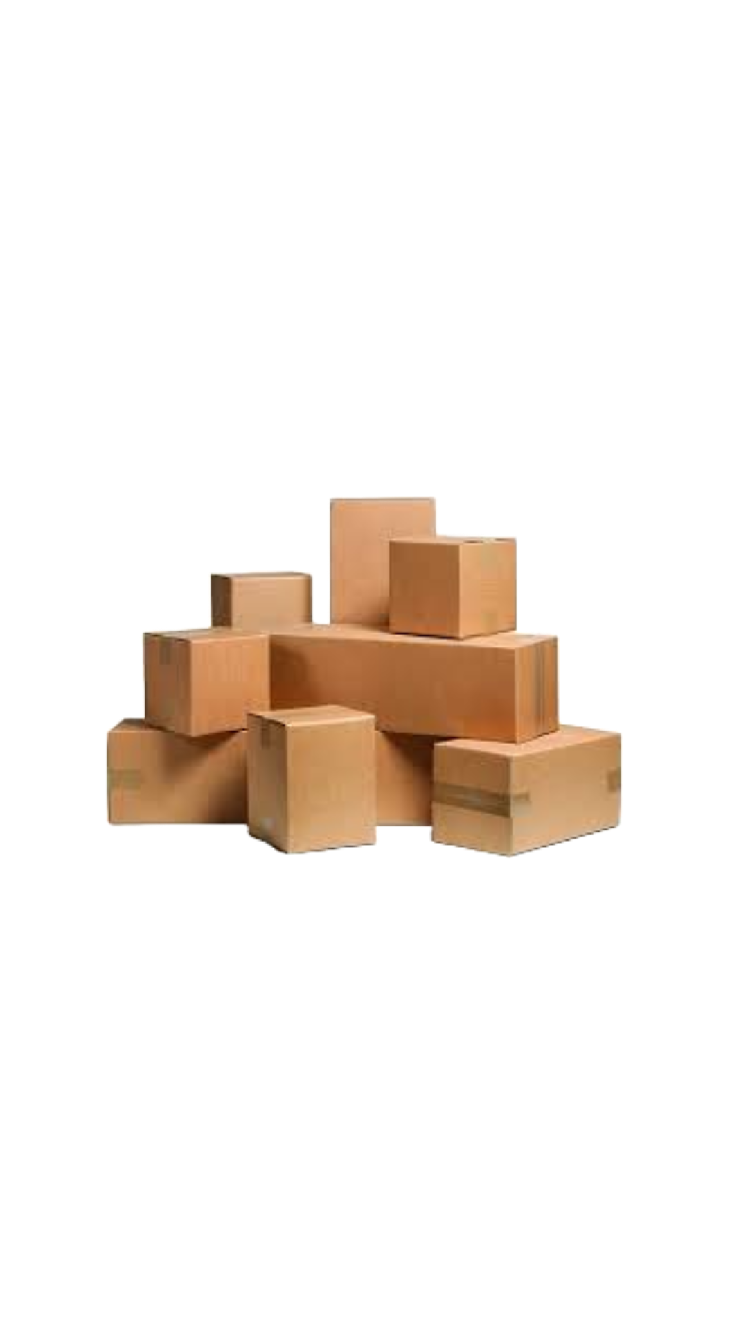
Customer Delivery Report
The purpose of this repost is to help show if the supplier is delivering on time. The information provided within this report shows the delivery name, distributer, wine, expected date, and actual date.

Slide 7
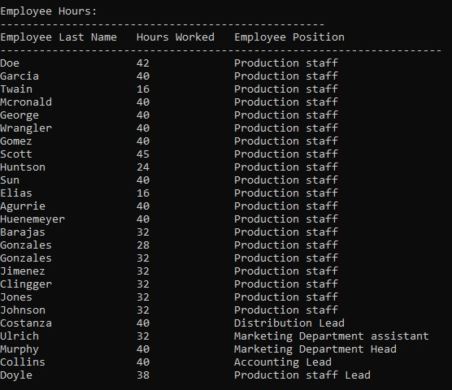

Employee Hours Report
The report to the left illustrates the number of hours worked by all employees in their last four quarters. It also includes, the employee's last name, position, and total hours that they worked

Slide 8

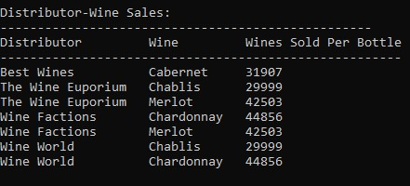
Distributor-Wine Sales
This report aims to help indicate which wines the distributor is selling and how much of that wine they are selling. From this report, we can determine which distributor sells the most wines and which are selling better than others.

Slide 9


Conclusion
Through the various reports gathered from our database, Bacchus Winery can implement data-driven strategies to help elevate its business to the next level. The reports allow the winery to monitor its supply chain's efficiency and reliability and ensure consistent employee productivity.

