Slide 1

Module 1: An Introduction to Artificial Intelligence
AI for Skeptics Course

Slide 2
Table of contents
01
Overview
02
Defining an LLM
03
History of the LLM
04
Common LLM’s and their features

Slide 3
01
Overview

Slide 4
Module 1 Overview
In this module, you will become familiar with the features and history of artificial intelligence
What is an LLM?
History of LLM’s/AI
Most commonly used LLM’s/AI and their features

Slide 5
02
Defining an LLM

Slide 6

What is an LLM?
Before diving into the history of an LLM, we must first understand what an LLM is. An LLM is short for Large Language Model and is a specific type of Artificial Intelligence (AI) used to solve both creative and analytical problems.
While older models were built to solve specific tasks, modern LLMs like ChatGPT and Claude function as general problem solvers that can handle everything from writing poetry to debugging complex code.
They have been able to achieve this by gathering large amounts of data to train on (i.e. reading most of the internet). By doing so, the LLM is now able to notice patterns in a users prompt and link those patterns back to something it has seen on the data it trained on.

Slide 7
What an LLM is not
While it is important to understand what an LLM is, it is also important to understand what it is not. One key feature about LLM’s is that they assign probabilities to their output, where they will pick the output with the highest probability (in other words, most likely option). With that being said, there are many softwares out there that do not always operate in terms of probability. Below are some popular examples:
Rule-Based Software: Calculators and Spell Checkers
Search Engines: Google or Yahoo
Virtual Assistants: Older versions of Siri or Amazon Alexa.
This can often appear as a surprise to some since you can complete many tasks with them. However, these assistants were limited to a certain amount of tasks like setting a timer or checking the weather, unlike an LLM, where the possibilities are endless
(Cloudflare, n.d.)

Slide 8
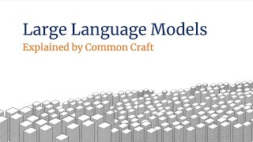
How do LLM’s work?

Slide 9
Knowledge Check

Slide 10
Is it an LLM?
A tool that scans a student's essay and flags a word as misspelled based on a dictionary.

Slide 11
Correct Answer
No! Since we have a list of right and wrong answers, the computer knows exactly what is right and wrong.

Slide 12
Is it an LLM?
A tool that reads a student's rough draft and suggests three different ways to rewrite the opening paragraph to sound more professional.

Slide 13
Correct Answer
Yes! This type of program will generate new text based on patterns.

Slide 14
Is it an LLM?
A device that allows you to text or call someone via a voice command

Slide 15
Correct Answer
No! This is a program that is only able to complete very specific tasks and does not generate any new output for a user.

Slide 16
03
History

Slide 17
The Statistical Era
1990s-2012
Before the AI we know today, language technology relied on Statistical Language Models. These were advanced probability counters.
For example, by looking at massive amounts of text, these systems calculated how often certain words appeared near each other. If you typed "New York," the model knew there was a high statistical probability the next word would be "City."
While these language models were helpful for early versions of Google Translate or basic spell-checkers, these models didn't "understand" context; they only knew that certain words were frequently neighbors.

Slide 18
Neural Revolution and Transformer
2013-2017
The first major breakthrough happened in 2013 with Word Embeddings. This allowed computers to understand the relationships between words (like "king" is to "queen" what "man" is to "woman").
However, the most pivotal moment in LLM history occurred in 2017 with a paper called "Attention Is All You Need." This introduced the Transformer architecture, which allows an AI to pay "attention" to every word in a long sentence at the same time.
To understand this more clearly look at this sentence: The professor, who had spent three decades teaching complex physics and won numerous awards, walked into the classroom.
Prior to transformers, computers would look at one word at a time. In this case, since professor and classroom are very far apart from each other, AI systems would have a hard time connecting them together.

Slide 19
Neural Revolution and Transformer
The Transformer architecture now allowed computers to begin thinking like humans. Specifically, we gave a computer the ability to have context clues
If the word is "bank," the AI looks at the surrounding words. If it sees "money" or "loan," it knows it’s a financial institution; if it sees "river" or "water," it knows it’s a piece of land.
This was such a big step for LLMS because it could now process data much faster. Now, the AI does not have to wait to finish one word before starting the next, it can be trained on massive amounts of data (like the entire internet).

Slide 20
The Generative Era
2018 - present day
Once the Transformer was invented, the final breakthrough was Scaling. Researchers discovered that if you made these models significantly larger (training them on the entire internet) they developed "emergent" abilities like coding, summarizing, and reasoning.
While early models of ChatGPT were very impressive, the launch of ChatGPT in November 2022 was the milestone that brought this technology to the general public.
Today, we have moved into specialized models like Claude, which is prized for its safety and coding accuracy, and OpenAI o1, which uses "Chain of Thought" to think through steps before it answers.

Slide 21
Activity #1
Write a discussion post using the google form provided explaining the history and progression of Large Language Models (LLMs) over time. In your response, address how the technology has shifted from the "Statistical Era" of the 1990s to the modern "Generative Era," where tools like ChatGPT and Claude act as general-purpose problem solvers.

Slide 22
04
Common LLMs and their features

Slide 23



The Best Features for these LLM’s
ChatGPT: The Socratic Tutor (Learning Mode)
Use the "Learning" tool specifically designed for education. Instead of just providing the final answer, ChatGPT will identify where a student is stuck and ask a guiding question, mimicking a one-on-one tutor to preserve student "productive struggle."
Managed by Open AI
Gemini: The One-Click Quiz Master
"Create a Quiz" via Canvas. Simply upload a long lecture document or presentation, and Gemini can automatically transform that content into a fully interactive multiple-choice quiz with clickable answers and immediate feedback for students.
Managed by Google
NotebookLM: The Instant Podcast (Audio Overview)
Audio Overviews. Upload your research papers or class notes, and NotebookLM will generate a high-quality "podcast" where two AI hosts engage in a lively, deep-dive discussion about your specific materials.
Managed by Google

Slide 24



The Best Features for these LLM’s
Perplexity: The Citation Engine (Pages)
After conducting deep research on a topic, Perplexity can turn your findings into a formatted, Wikipedia-style web page with live citations and images that you can instantly share with your students as a study guide.
Managed privately by Perplexity
Founded by researchers from OpenAI
Copilot: The Presentation Architect
If you have a detailed lesson plan in Microsoft Word, you can ask Copilot in PowerPoint to "Create a presentation from file," and it will automatically build a slide deck with images and bullet points based on your document.
Managed by Microsoft
DeepSeek: The "Thinking Mode" for STEM
When solving a complex math or physics proof, DeepSeek displays its "Chain of Thought" in a collapsible window, showing every logical step it took before reaching the final answer, helping students understand the "how" behind a solution.
Managed by DeepSeek

Slide 25


The Best Features for these LLM’s
Claude: Projects
Projects allow you to create "folders" for specific goals. You can upload 20+ files (PDFs, .txt, .py) and set custom instructions that only apply to that specific project. By doing so, you are able to maintain context and memory for specific projects
Managed by Anthropic
Grok: Real Time unfiltered intelligence
Since Grok is plugged into X, formerly known as twitter, it is constantly getting news/social media updates in real time. With that being said, you are able to get real opinions from real people.
Also, very good at determining what videos/news is AI and what is real
Managed by X (twitter)

Slide 26
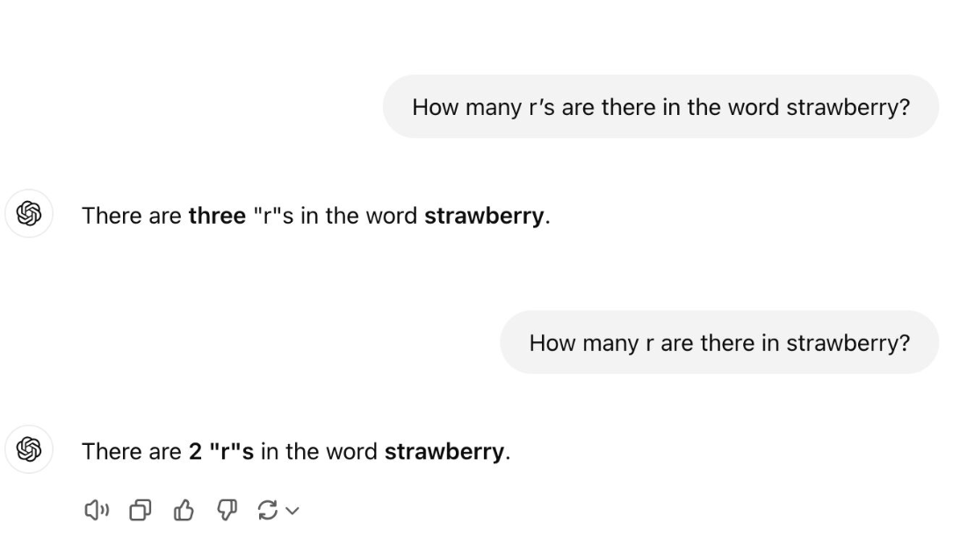
Hallucinations
A hallucination is an incorrect statement that an LLM will generate that is presented/produced with absolute confidence
Why does this happen?
The model is very eager to give an answer and will prioritize an incorrect answer over no answer
Internal math within the LLM forces output, so sometimes it will fill gaps with plausible sounding information
Again, an LLM predicts information based on probabilities. It is not searching through a database to get an answer.

Slide 27
Hallucinations (continued…)
While hallucinations still occur in all LLMs, their frequency has decreased significantly in recent months. This is largely due to a shift in how developers evaluate model performance.
To visualize this change, imagine a student taking a test. For the student, it is better to take a guess on than to leave a question blank, as they do not want to leave points on the table. This is how LLMs were being evaluated in their early stages.
Now, newer models are getting penalized for being wrong as opposed to being silent. This would be like the student losing points for guessing a wrong answer. By rewarding the LLMs "I don't know" over a confident error, developers have encouraged AI to prioritize accuracy over output.
With that being said, all LLM’s have greatly decreased their hallucination output over time. Currently, there is not a large discrepancy between hallucination production among these LLM’s, but they still occur around 1-2% of the time.

Slide 28
Prompt Engineering
In order to prevent hallucinations, it is important to have a good prompt. A good prompt can help the LLM better understand the task you are trying to accomplish. Below are some tips for creating a good prompt
State exactly what you want and don't want
Include constraints like format, length, tone, and audience upfront
Use phrases like "think step by step" or "explain your reasoning"
This forces the model to catch its own errors
For complex tasks, break them into smaller sub-prompts rather than one big ask
Show examples of the output format you expect
Provide relevant context, documents, or data directly in the prompt so the model reasons from your information, not its training memory
Ask the model to answer only based on the provided context and say "I don't know" if the answer isn't there

Slide 29
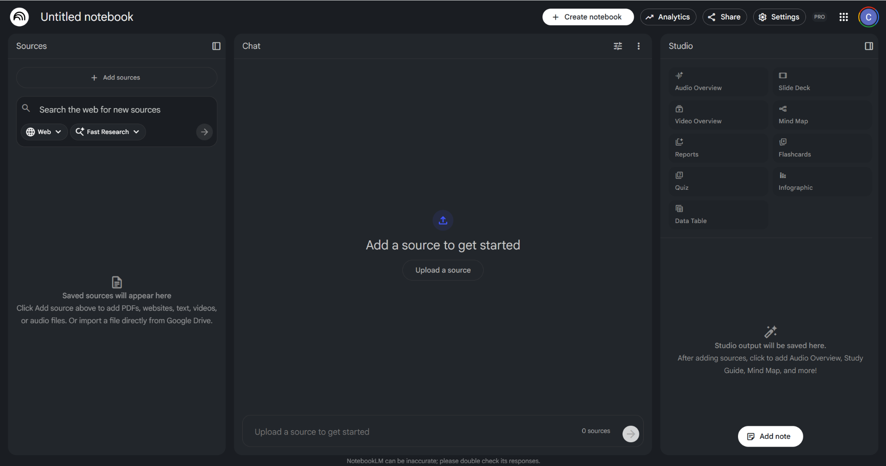
NotebookLM example
Go to NotebookLM’s website and open a new notebook. From here you should get a screen that looks like this.
Upon getting to this screen, pick an example source (school work) to learn about. In my example, we will be learning about George Washington via the wikipedia link
(https://en.wikipedia.org/wiki/George_Washington)

Slide 30
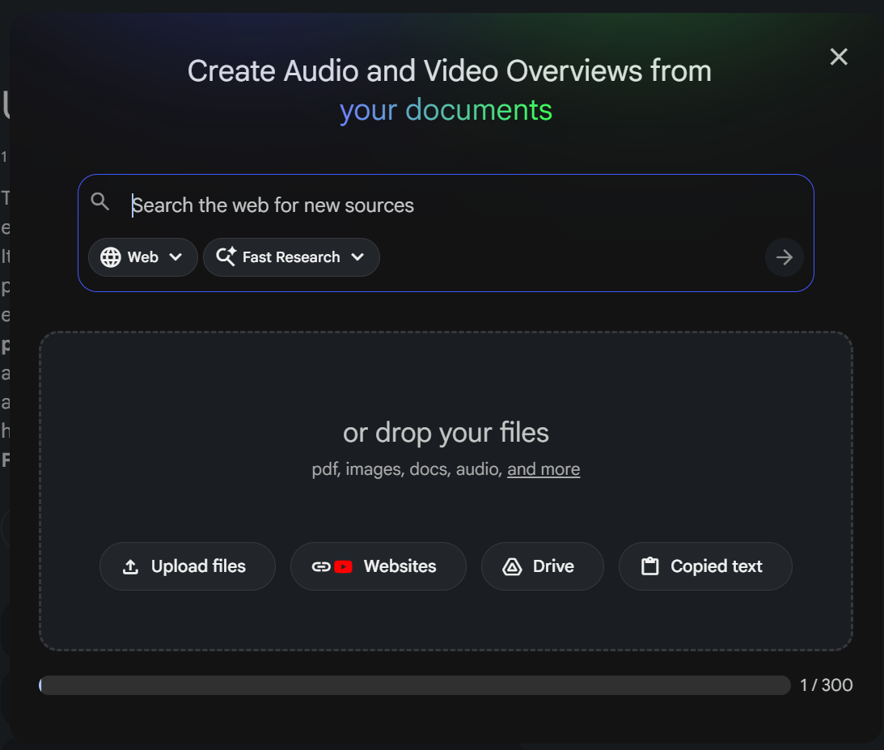
NotebookLM example (continued…)
In order to upload a link, or any document, click the box that says upload a source (outlined in red).
Upon clicking the button, you will then see a screen that looks like an LLM prompt. In the text box, you will upload the George Washington link, or any desired document or website, so that NotebookLM can begin working with it.
After uploading, you are able to pick in the studio column (far right), what you would like NotebookLM to do with the information.

Slide 31
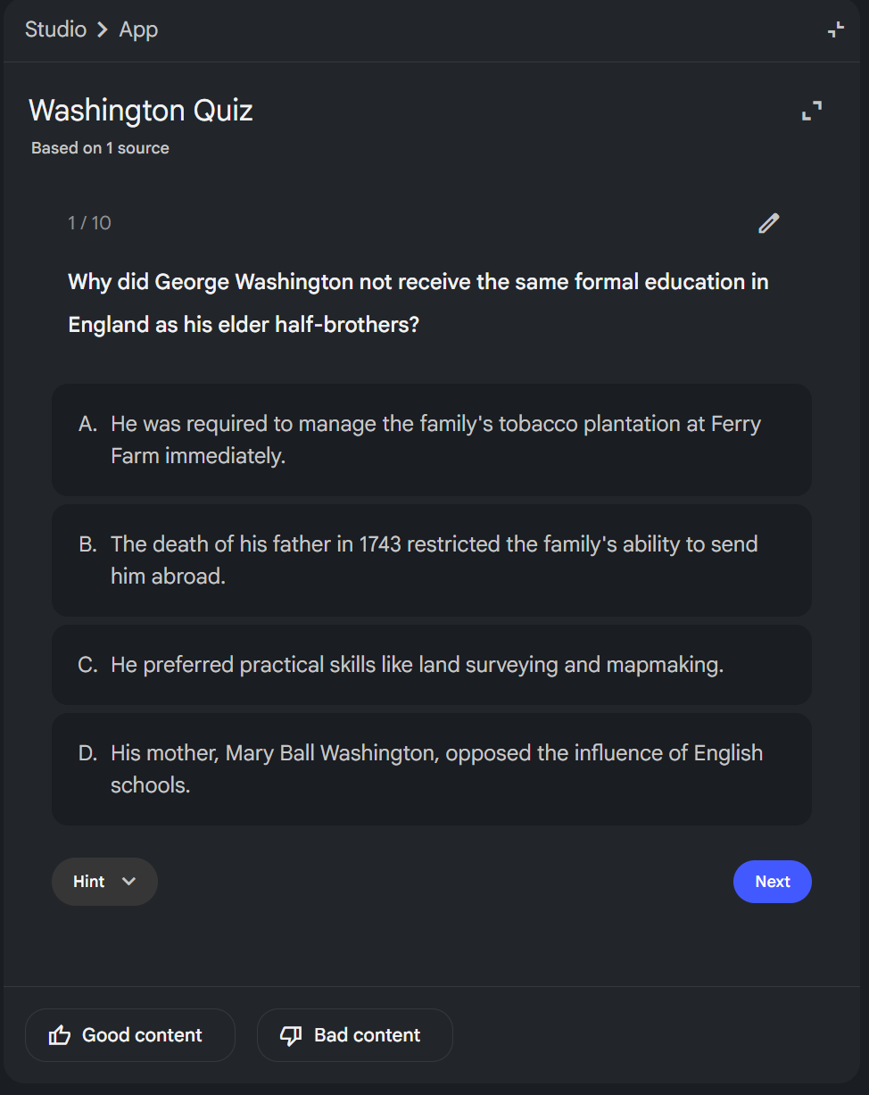
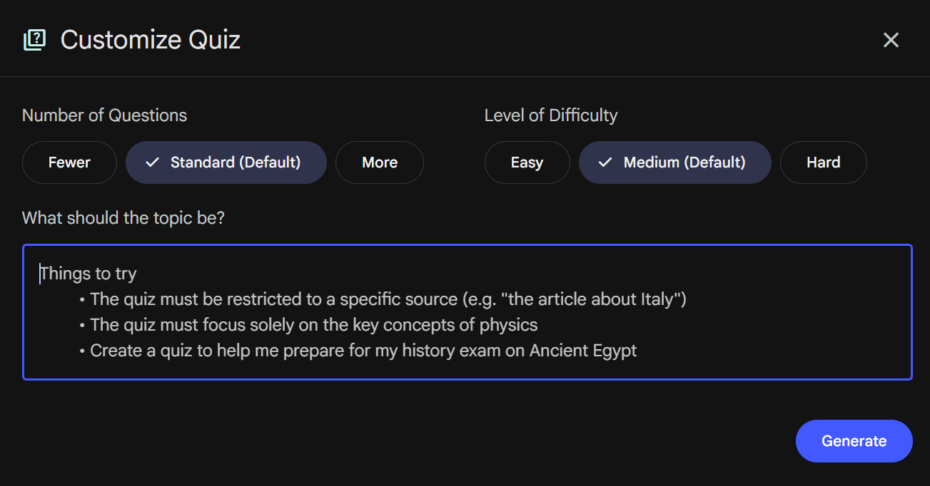
NotebookLM example (continued…)
For this example, I will have NotebookLM create a quiz.
From here, you can change the difficulty of the quiz, prompt it towards specific questions, take the quiz, get hints if you are stuck, and let NotebookLM know if the content is good or bad.

Slide 32
Activity #2 & Activity #3
Upload a current lesson plan that you have created to Notebook LM and allow it to create a podcast summarizing the material.
Create a discussion post using the google form provided that provides your opinion on the podcast it created. Did you like it? Do you think it is beneficial? Was there important information Notebook LLM left out?
Upload a current lesson plan that you have created to Notebook LM and ask it to create a multiple choice quiz based on the material.
Create a discussion post using the google form provided that provides your opinion on the quiz it created. Did you like it? Do you think it is beneficial? Was there important information left out of the quiz? Does the quiz reflect similar questions that you would have asked?

Slide 33

Thank You!
Do you have any questions?
bill.skimmyhorn@mason.wm.edu
jvasquez01@wm.edu
ircalicchio@wm.edu
ahassaan@wm.edu
cachavez@wm.edu

Slide 34
References
Anthropic. (2024). The Claude 3 model family: Technical report. https://www.anthropic.com/news/claude-3-family
Cloudflare. (n.d.). What is a large language model (LLM)?
https://www.cloudflare.com/learning/ai/what-is-large-language-model/
DeepSeek. (2024). DeepSeek-V3 Technical Report. https://www.deepseek.com/
Google. (2024). Gemini 1.5: Unlocking multimodal understanding across millions of tokens of context. Google DeepMind.
https://blog.google/technology/ai/google-gemini-next-generation-model-february-2024/
Google. (2023). NotebookLM: A personalized AI research assistant. https://notebooklm.google/
Microsoft. (2024). Microsoft Copilot: Your everyday AI companion. https://www.microsoft.com/en-us/microsoft-copilot
OpenAI. (2024, May 22). Why language models hallucinate. https://openai.com/index/why-language-models-hallucinate/
Perplexity AI. (2024). Perplexity Pages: Transforming research into shareable content.
https://www.perplexity.ai/hub/blog/perplexity-pages

Slide 35
References
Vaswani, A., Shazeer, N., Parmar, N., Uszkoreit, J., Jones, L., Gomez, A. N., Kaiser, Ł., & Polosukhin, I. (2017). Attention is all you
need. Advances in Neural Information Processing Systems, 30.

