Slide 1
Machine Learning with Tree-Based Models in R
Bella Feng
OCRUG 03/20/2018

Slide 2
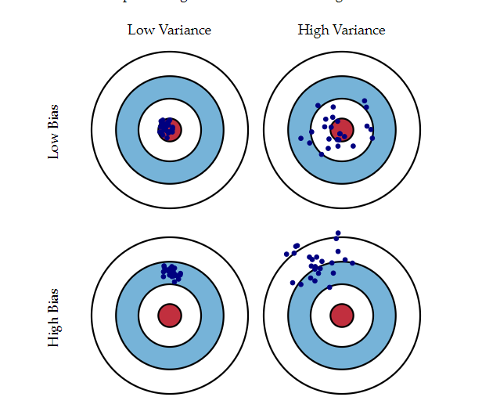
The Bias-Variance Tradeoff
Bias: distance to the target
Variance: for a given data point, different realizations of the model

Slide 3
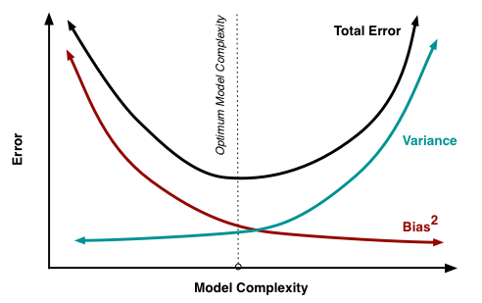
Optimal Model Complexity
Underfitting
Overfitting

Slide 4
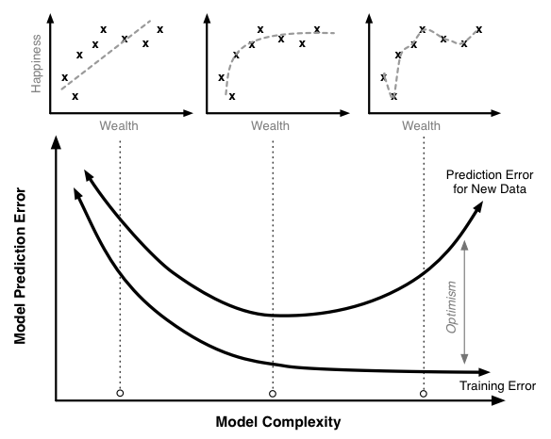
Simple example

Slide 5
Advantages of Decision Trees
✔ Simple to understand, interpret, visualize
✔ Can handle both numerical and categorical features (inputs) natively
✔ Can handle missing data elegantly
✔ Robust to outliers
✔ Requires little data preparation
✔ Can model non-linearity in the data
✔ Can be trained quickly on large datasets

Slide 6
Disadvantages
✖ Large trees can be hard to interpret
✖ Trees have high variance, which causes model performance to be poor
✖ Trees overfit easily

Slide 7
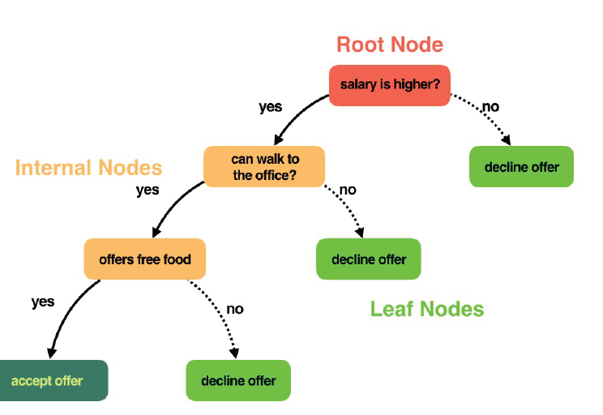
Decision tree terminology: nodes

Slide 8
Agenda:
Build and evaluate the four models
Classifier
Regression Tree
Bagged Trees
Random Forest
Tune model parameters for optimal performance
Discussion or help Bella with functional programming

Slide 9
Train
1. credit_model <- rpart(formula = default~., data = credit_train, method = "class")
2. grade_model <- rpart(formula = final_grade ~ ., data = grade_train, method = "anova")
3. credit_model <- bagging(formula = default ~ ., data = credit_train, coob = TRUE)
4. credit_model <- randomForest(formula = default ~ ., data = credit_train)

Slide 10
Predict
1. class_prediction <- predict(object = credit_model, newdata = credit_test, type = "class")
2. pred <- predict(object = grade_model, newdata = grade_test)
3. class_prediction <- predict(object = credit_model , newdata = credit_test, type = "class")
4. class_prediction <- predict(object =credit_model , newdata = credit_test, type = "class")

Slide 11
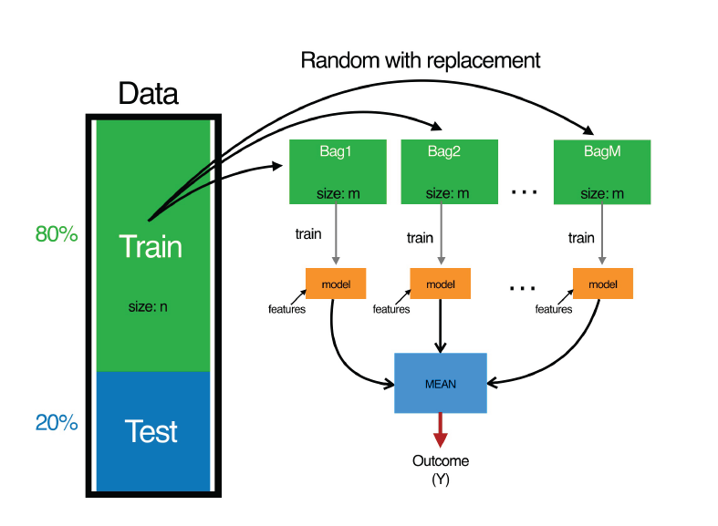
Bagging

Slide 12
Random Forest
In Random Forest, only a subset of features are selected at random at each split in a decision tree.
In bagging, all features are used.
Random Forest:
better performance
sample subset of the features
improved version of bagging
reduced correlation between the sampled trees

Slide 13
Evaluate Classification Trees
Accuracy
Confusion Matrix
Log-loss
AUC
Notes:
accuracy =n of correct predictions/n of total data points
Motivation for confusion matrix: rare disease diagnosis

Slide 14
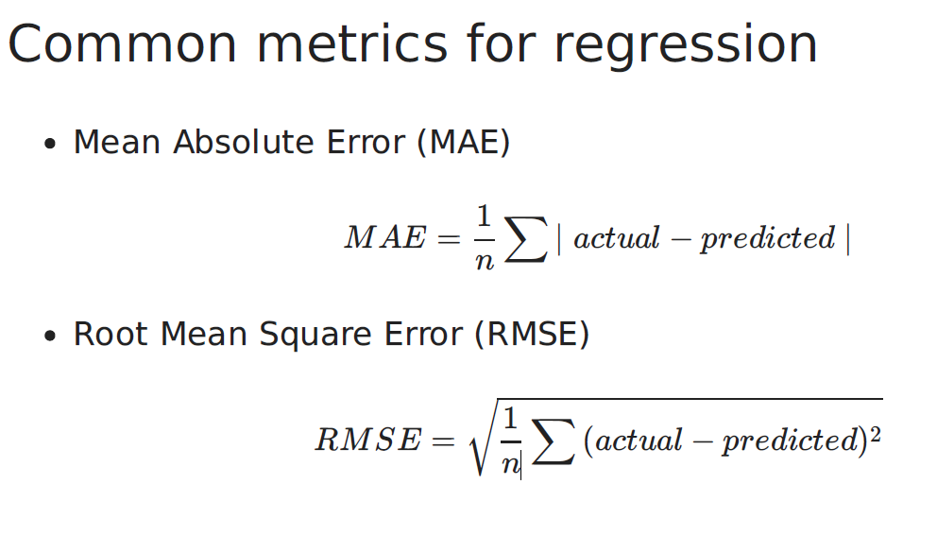
Regression Trees
Notes:
MAE: averge (absolute value of distance between the actual vs. the predicted)
RMSE: sample standard deviation of the differences, RMSD root mean squired deviation
Both: indifferent to direction, lower better.
RMSE square the errors before they are averaged. High weight to large error, punished large errors more harshly. More useful when large errors are particularly undesirable. Depends on your use case to use which one.

Slide 15
Decision tree hyperparameters
minsplit: minimum number of data points required to attempt a split
cp: complexity parameter
maxdepth: depth of a decision tree
Notes:
Size/complexity
Minsplit: 20
CP: 0.1, penalty term to control tree size, always monotonic with # of splits, the smaller the more complex. optimal cp value is the one with min(cross-validated error)
maxdepth: 30, limit the max # of nodes between leaf and root.
Grid search (optional)

Slide 16
Random Forest Hyperparameters
ntree: number of trees
mtry: number of variables randomly sampled as candidates at each
split
sampsize: number of samples to train on
nodesize: minimum size (number of samples) of the terminal nodes
maxnodes: maximum number of terminal nodes

Slide 17
Accuracy Comparison(default setting)
gini info bagging rf
Accuracy 0.705 0.725 0.78 0.765

