Slide 1
AirBnB_Seattle_2016_Listing_Dashboard
File created on: 5/21/2024 3:31:51 AM

Slide 2
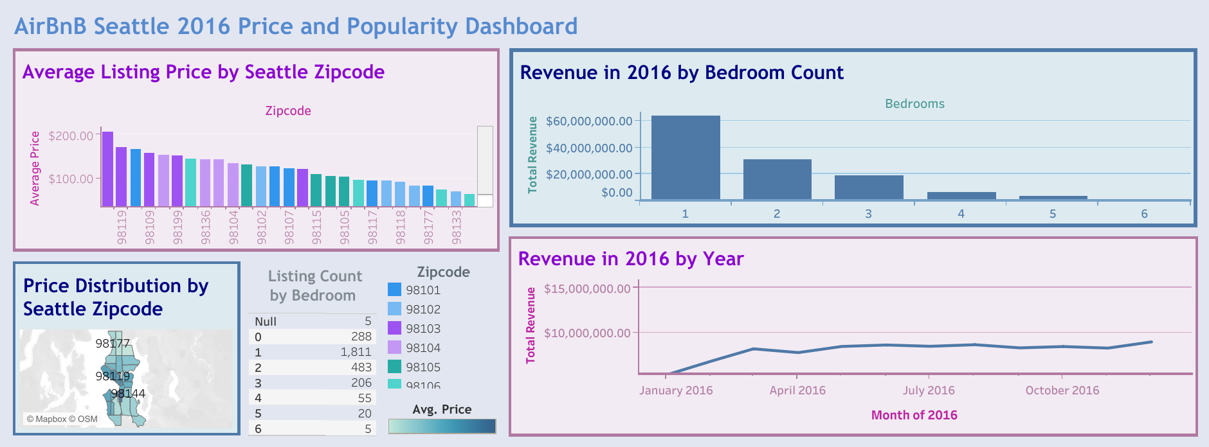

Slide 3
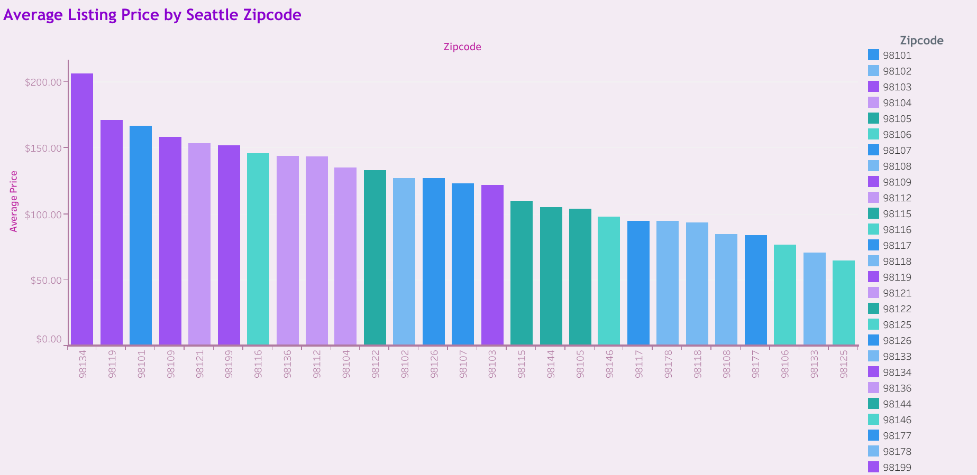

Slide 4
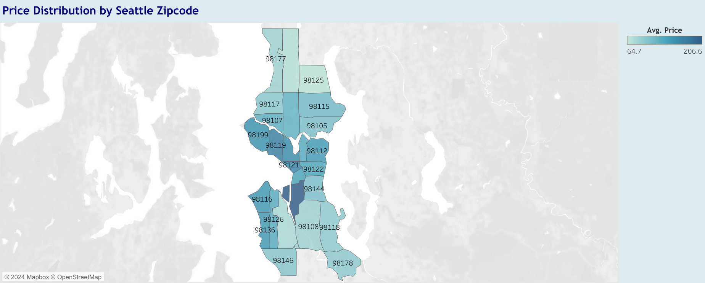

Slide 5
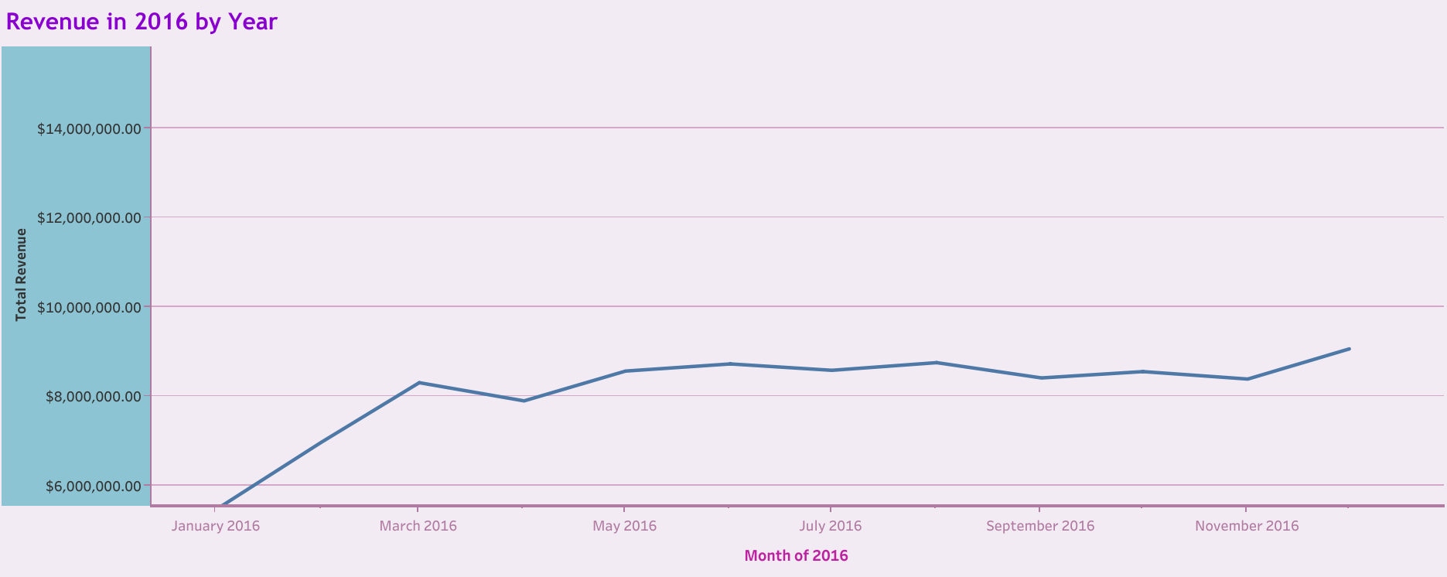

Slide 6
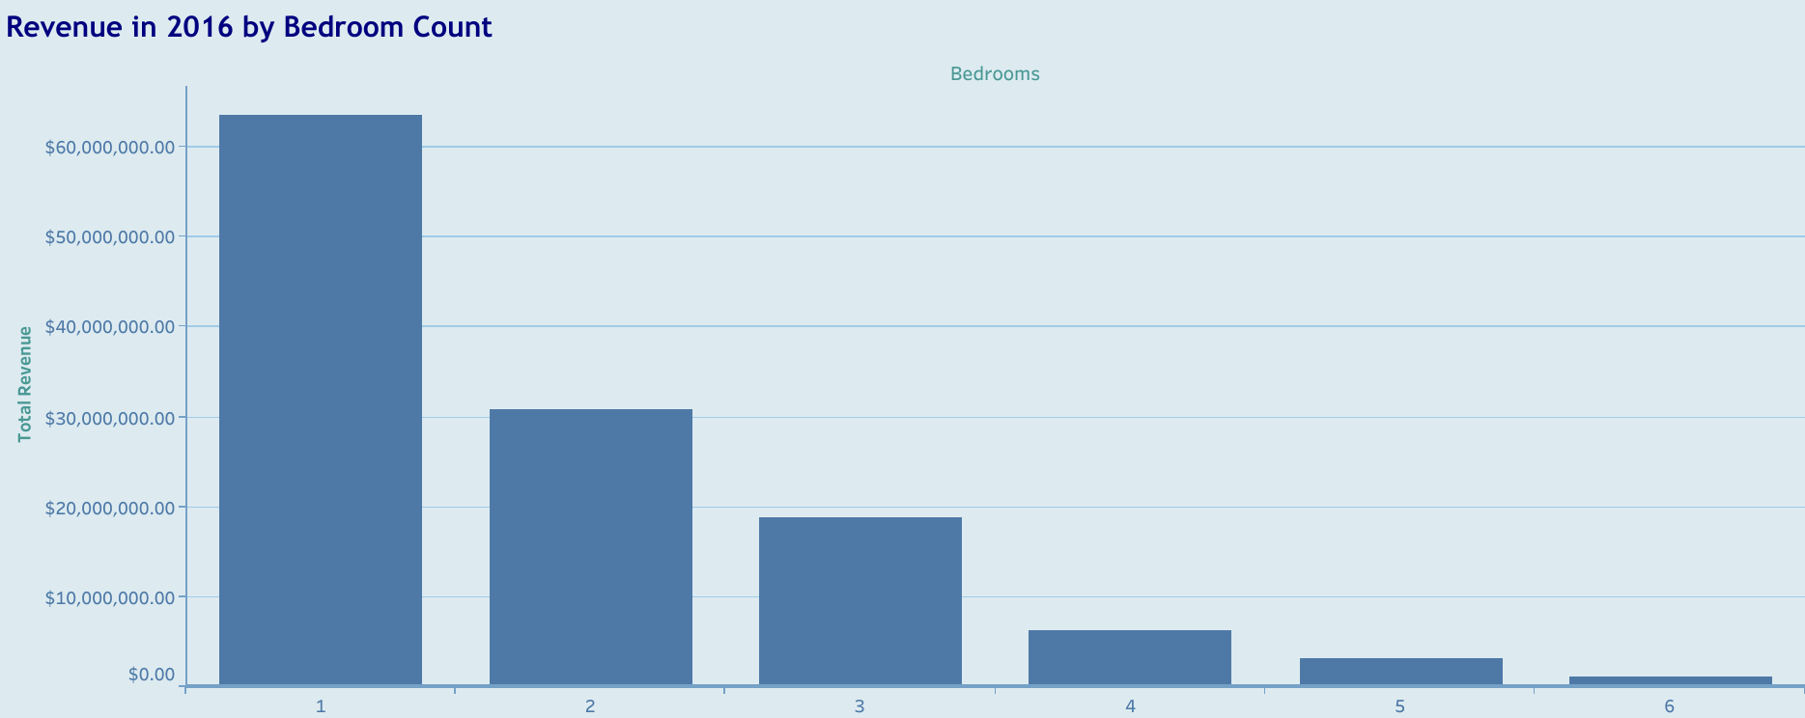

Slide 7
