Slide 1
File Downloader
C# · WinForms · .NET 8 — async/await, OOP, multithreading
OOP CONCEPTS USED
Interfaces
Abstract Class
Inheritance
Encapsulation
IDownloadable
IProgressReporter
DownloaderBase
shared helper methods
HttpFileDownloader
extends DownloaderBase
DownloadItem owns
its state + speed
define the contract
shared logic, no protocol
one concrete impl
private setters
async / await
SemaphoreSlim — 3 concurrent
CancellationToken
BeginInvoke (thread-safe UI)
Joel

Slide 2
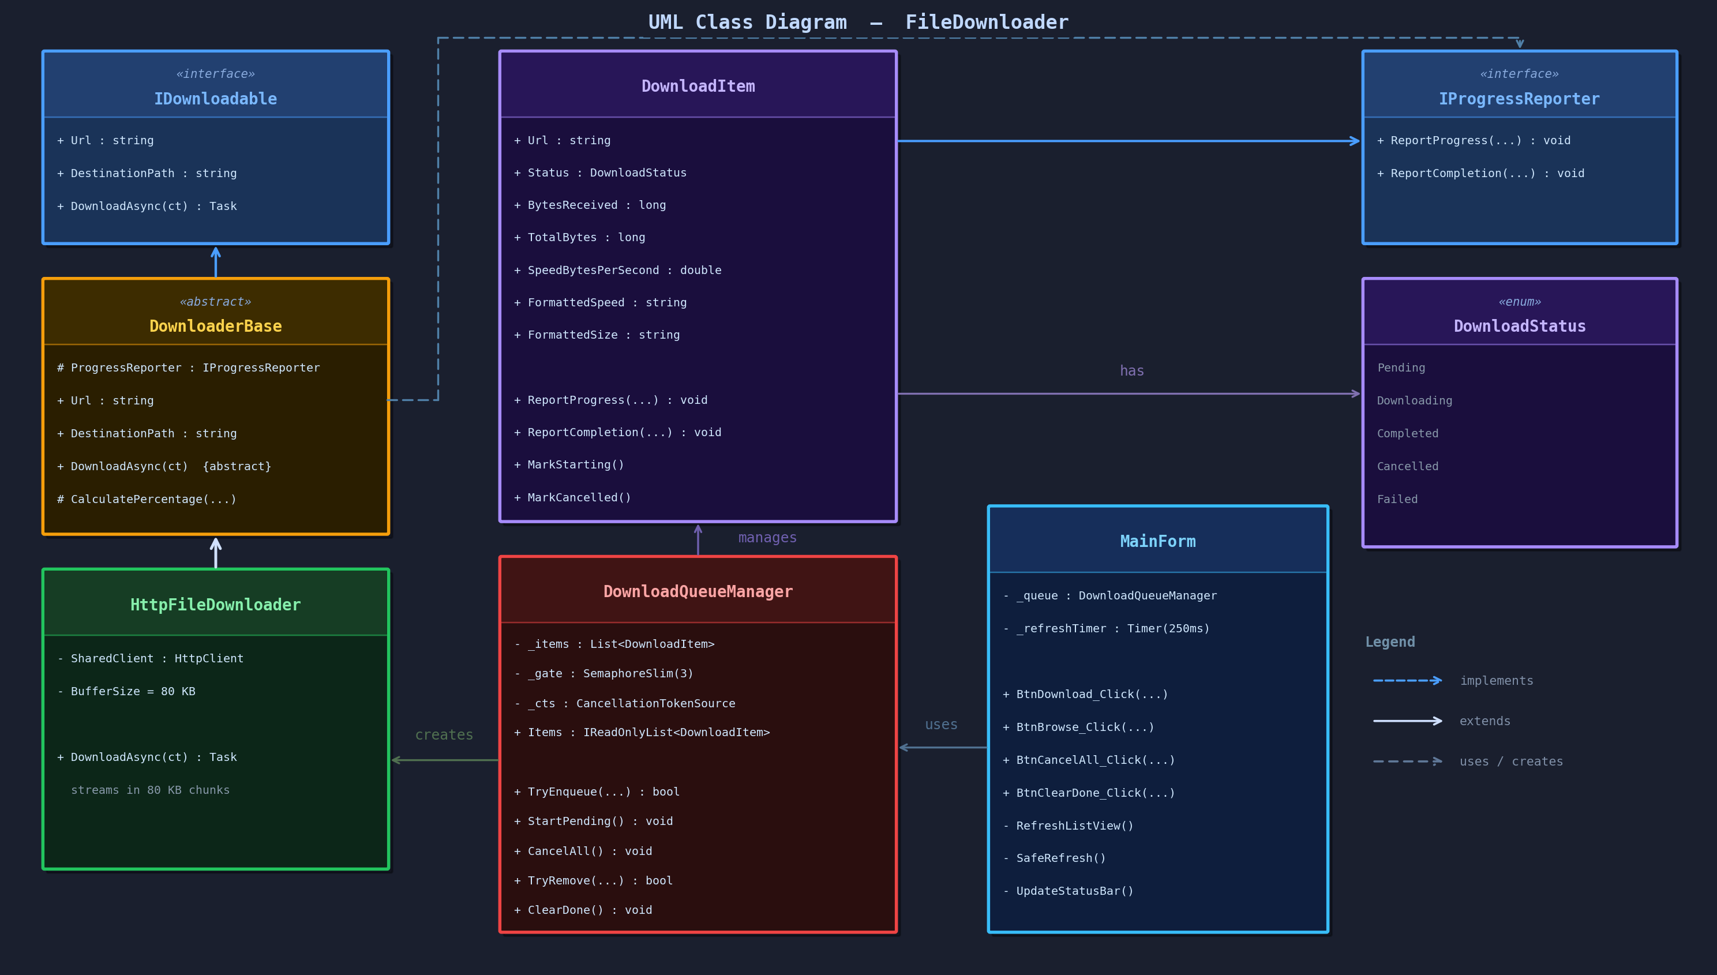

Slide 3
Code Walkthrough
Interfaces: IDownloadable and IProgressReporter
LAYER BREAKDOWN
interface IDownloadable {
Task DownloadAsync(CancellationToken token);
}
MainForm
The window. Shows the download list, handles button clicks, and refreshes every 250 ms without blocking downloads.
These are basically rule books for the code. IDownloadable says any downloader has to know a URL and be able to download it. IProgressReporter says anything tracking a download has to be able to receive updates. Because every class follows these rules, I can swap one out later without breaking anything else in the app.
↓
DownloadQueueManager
Abstract Class: DownloaderBase
The brain. Manages the queue, enforces the 3 at a time limit, and signals the UI whenever something changes.
abstract class DownloaderBase : IDownloadable {
protected static int CalcPct(long rx, long total);
public abstract Task DownloadAsync(CancellationToken ct);
}
↓
HttpFileDownloader
DownloaderBase is basically a template class. It handles the shared stuff like calculating the percentage and creating the save folder, but leaves the actual downloading blank for subclasses to fill in. HttpFileDownloader extends it and fills in that blank by connecting to the URL and reading the file in small chunks while reporting progress.
The worker. Opens a connection to each URL, streams the file in pieces, and reports speed and progress the whole time.
↓
Concurrency: 3 Downloads at a Time
DownloadItem
SemaphoreSlim _gate = new(3, 3);
await _gate.WaitAsync(token); // waits if 3 active
try { /* download */ } finally { _gate.Release(); }
The data. Keeps track of each URL's status, bytes received, download speed, and any error messages.
↓
IDownloadable · IProgressReporter
Only 3 files can download at the same time. If you add more URLs they just wait in line automatically until a slot opens up. The cancel button works by sending a stop signal to every active download and they all stop within milliseconds.
The rules. All the layers depend on these two interfaces instead of depending directly on each other.

Slide 4
Live Demo
01
I will be pasting 3 test URLs into the URL field
02
Click Download
03
Watch progress %, MB/s speed, and file size update live every 250 ms
04
Hit Cancel All
05
Click Clear Done

