Slide 1
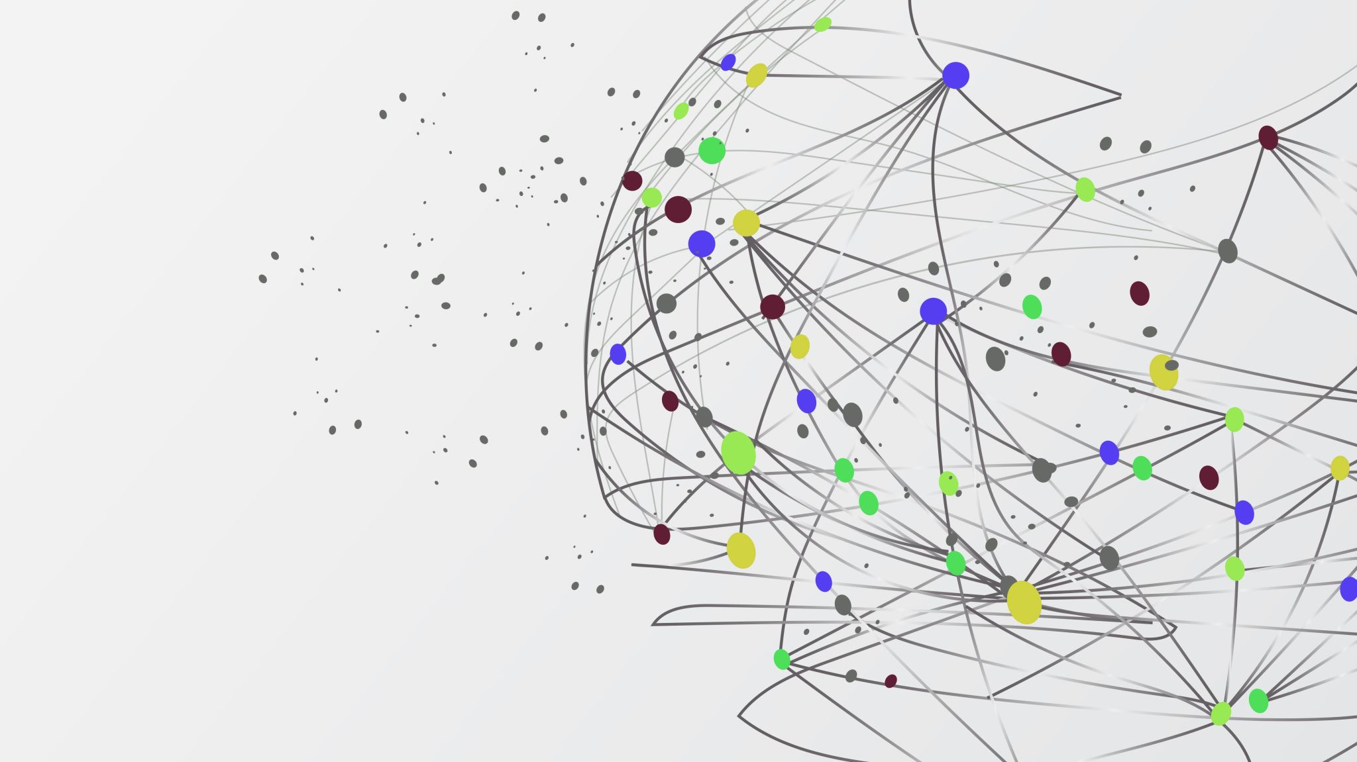
“Pain” related tweets—what can we learn?

Slide 2


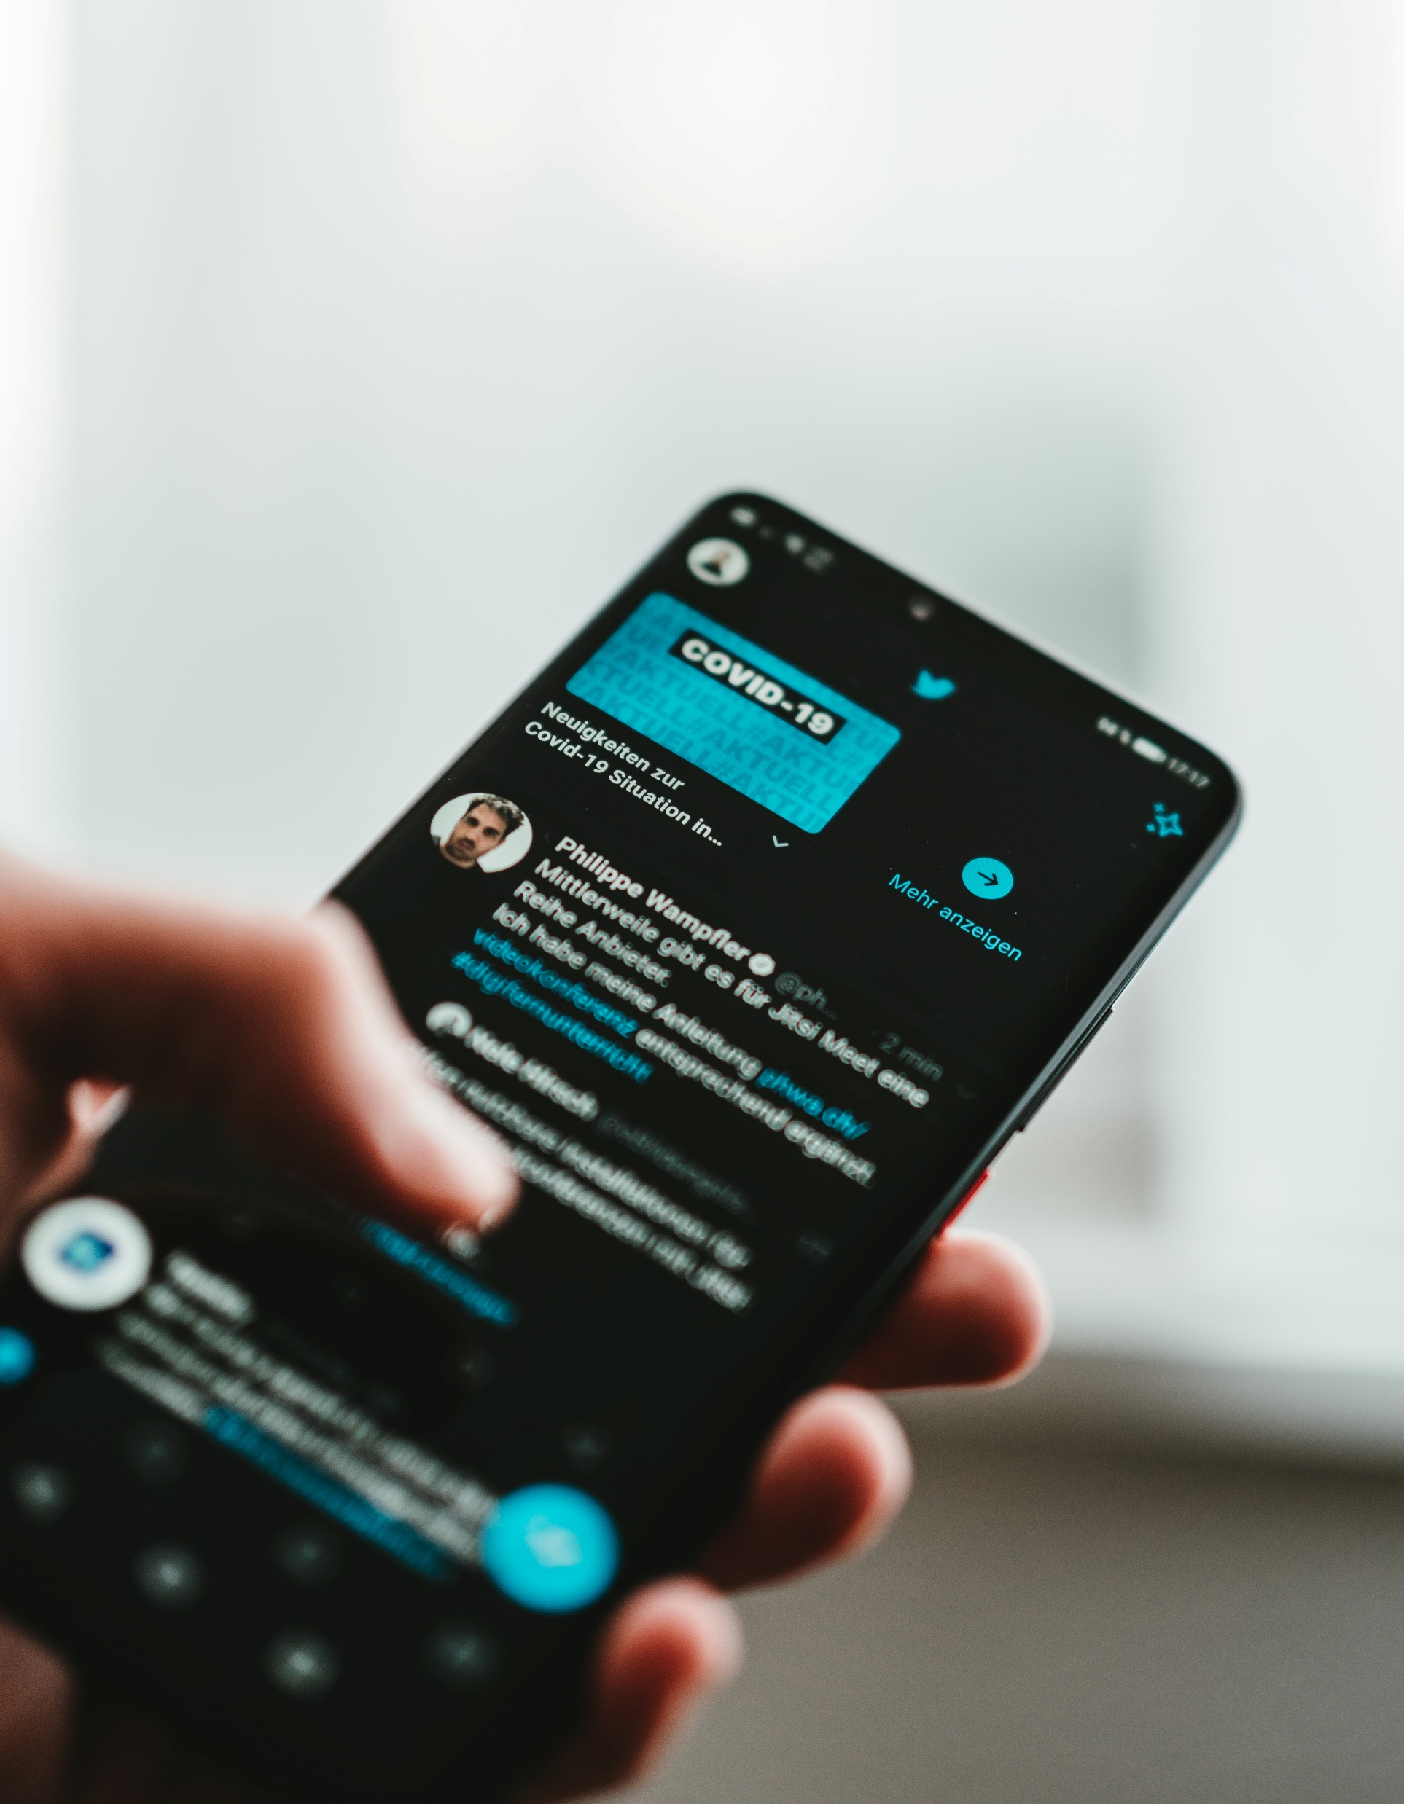
Importance of Twitter-supplied data analysis
Twitter as a social networking site is a great source of providing user-generated data on a different health related topics.
“Globally, around 3.2-billion people are connected to the Internet” hence great amount of self-reported data.

Slide 3

Role of technology in health-related analysis
“Online technologies are now ever-present in daily life, and they are influencing healthcare”
“The World Health Organization has defined this phenomenon as “eHealth” – the practice of medicine and public health supported by electronic processes and communication”
- Hopin Lee

Slide 4

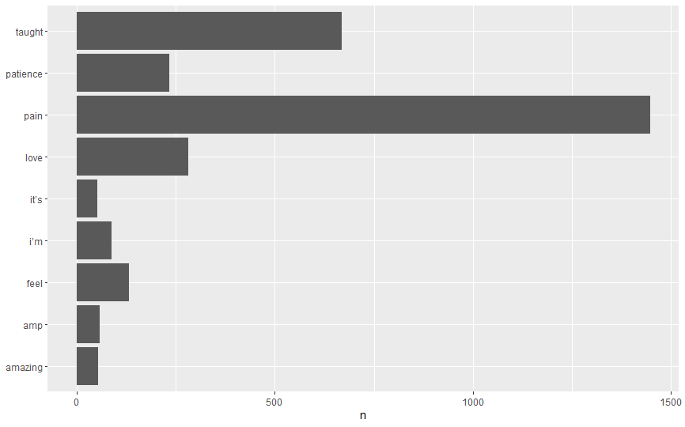
Words with frequencies more than 50
1. pain 1447
2. taught 670
3. love 282
4. patience 234
5. feel 132
6. i’m 88
7. amp 59
8. amazing 54
9. it’s 52

Slide 5

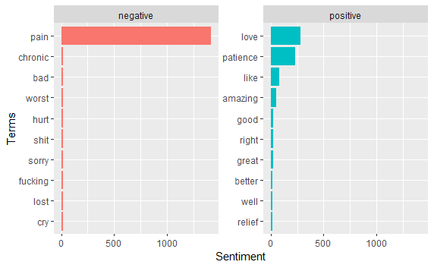
Top 10 positive and negative words

Slide 6
Top 10 positive and negative words analysis
Most popular negative word: pain (1415)
Other frequent negative words: chronic, bad, worse
Most popular positive word: love (279)
Other frequent positive words: patience, like, amazing

Slide 7
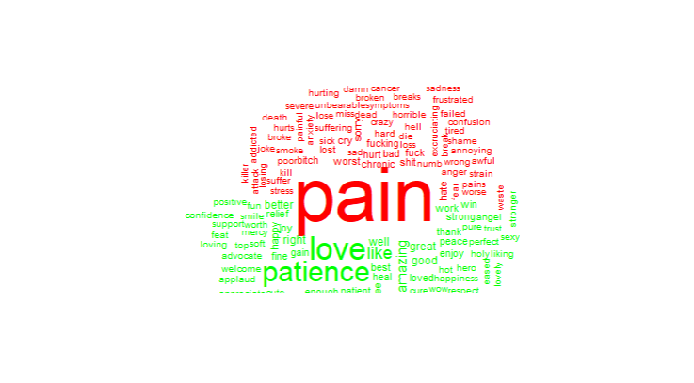
WordCloud
Various Words Which Came Up Throughout The Data Presented In A Cloud Shape
Larger The Word = More Prevalent

Slide 8
WordCloud Analysis
Largest word: Pain
Words to point out: crazy, f***ing, addicted, suffer, problems, stress
Size is relatively the same (other than the word pain)
Many words are synonyms of pain or are words used to describe pain

Slide 9
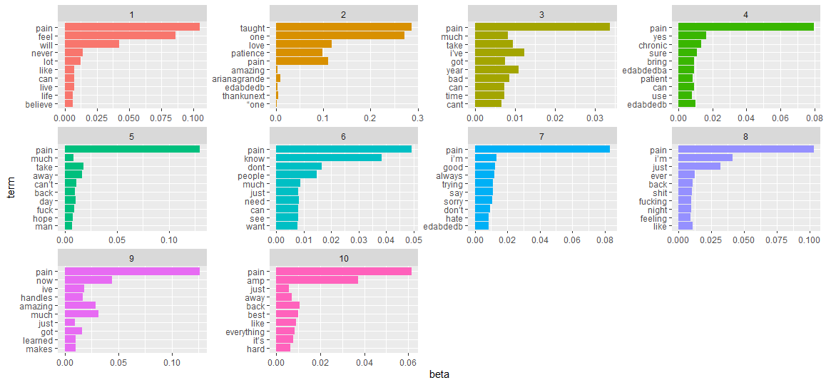
Topic Modeling
1. Awareness / Acknowledgements
2. Music Therapy
3. Pain Duration
4. Treatment
5. Overbearing pain
6. Actions/Verbs
7. Hiding pain
8. Enduring pain
9. Recover
10. Effect of pain on one's life

Slide 10
Topic Modeling Analysis
In Each Particular Topic The Largest Percentage Word Is Pain
Music Therapy Is Exception (Taught)
Edabded = ???
Contains Many Vulgar Words (f***, s***, etc.)
"Much" - Relating To Amount Of Pain/Suffering

Slide 11
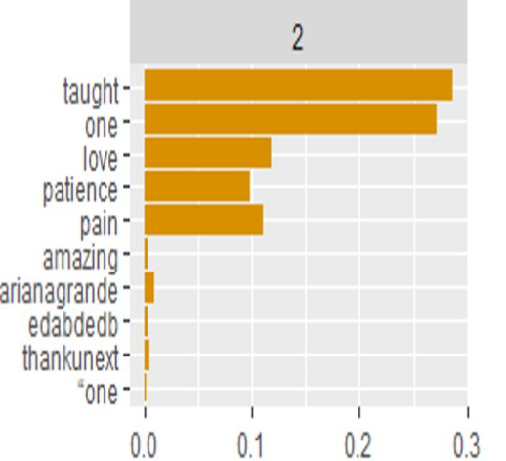
Music Therapy
The Singer Ariana Grande Comes Up
"Thankunext" - Referring to Ariana Grande Song
When Words Moved Around They Can Make Out Lyrics, "One taught me love, One taught me patience, One taught me pain"
3x Taught to 1x pain in the lyrics
Music therapy = Breakup song

Slide 12
Depression On Twitter
85 percent reported negative effects on self-image. 83 percent reported an increase in anxiety. 81 percent reported an increase in loneliness. 79 percent reported an increase in depression. (Healthline, 2020)
Almost 25% of teens view social media as having a negative effect. (Zauderer, 2022)
Is Social Media To Blame?

Slide 13


Conclusion
Pain Is The Largest Word, Followed By Other "Sad" Words
Twitter As An Indicator For Public Mood
What Action Can Be Taken By Twitter?
Using Word Sentiments To Flag Users Struggling With Mental Health
Using Word Sentiments To Change User Feed

Slide 14
Links To Mental Health Sources
https://www.verywellmind.com/how-to-cope-with-loneliness-3144939
https://www.health.harvard.edu/mind-and-mood/best-ways-to-manage-stress
https://life-care-wellness.com/how-to-manage-grief-and-loss/

Slide 15
References
Ahlwardt K., Tsoh J., Gerbert B., Heaivilin N., Gibbs, J., & Page J. (2012). What are people tweeting about pain: Implications of using social media to collect and deliver targeted health information. Research Gate. https://www.researchgate.net/publication/266821467_What_Are_People_Tweeting_About_Pain_Implications_of_Using_Social_Media_to_Collect_and_Deliver_Targeted_Health_Information
Lee, H. (n.d.). Tweeting back. International association for the study of pain. https://www.iasp-pain.org/publications/relief-news/article/tweeting-back-pain-study/

Slide 16
More References
Harvard Medical School. (January, 2015). Best ways to manage stress. Health.Harvard.edu. https://www.health.harvard.edu/mind-and-mood/best-ways-to-manage-stress
Scott E., Morin A. (November, 2022). How to cope with loneliness. verywellmind.com. https://www.verywellmind.com/how-to-cope-with-loneliness-3144939
Kelloway R. (May, 2019). How to manage grief and loss: 4 coping strategies. life-care-wellness.com. https://life-care-wellness.com/how-to-manage-grief-and-loss/

