Slide 1
System Programming Practices, Spring, 2016
Writing Your Own Unix Shell
Jake Choi <jichoi@dcslab.snu.ac.kr>

Slide 2
Process

Slide 3
Process
Instance of a computer program that is being executed
Consists of
Code of the program
Static data of the program
Dynamically created data of process
State of the execution(context)
Descriptor
etc...

Slide 4
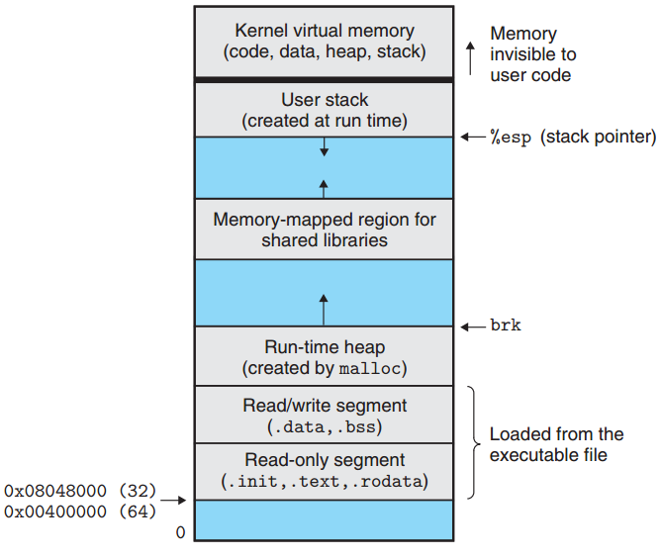
Process Address Space
Code and static data copied from program
Automatic data and dynamic data belong in stack and heap

Slide 5
Parent and Child Process
Process could create new child processes;
Creator be called as a parent process
There are root process of entire processes in system
Usually processes be represented as tree
$ pstree
init─┬─ModemManager───2*[{ModemMgr}]
├─NetworkManager─┬─dnsmasq
│ └─3*[{NetworkMgr}]
├─accounts-daemon───2*[{accountsd}]
├─acpid
├─bluetoothd
├─colord───2*[{colord}]
├─cron
├─cups-browsed
├─cupsd
└─dbus-daemon

Slide 6
Zombie Process
Process be terminated but not yet removed from system
It consumes system resource
Remains as zombie until its parent reap it
parent may want to know child’s termination
It could be reaped using waitpid()
If parent of zombie terminates without reaping its zombie, init process be parent of zombie and reap it
If long-running parent does not reap its zombies, system resource may be wasted

Slide 7
fork() & exec()
fork()
System call that creates new child process
Child process have memory space copied from parent(Actually, Copy-on-write)
exec()
Overwrite memory space of child process with new program
Child process could do works different with parent’s

Slide 8
Signal
An Inter-Process Communication method
Be used to notifies other process
Child let parent knows its status change
Parent delivers signal requested by user to childs
Could be handled by registering signal handler
If no handler registered, works as default

Slide 9
Assignment: shell

Slide 10
Handout
ssh to sp.snucse.org
$ cp /home/sp_files/shlab/shlab-handout.tar ./
$ tar xvf shlab-handout.tar
$ cd shlab-handout
(Type your name and Student ID in tsh.c)
$ make clean; make

Slide 11
Shell
Interactive command-line interpreter
Prints a prompt, waits for a command line
Do as requested by command line

Slide 12
Command Line
ASCII text words delimited by whitespace
First word could be
Name of a built-in command
e.g., quit, fg, bg, jobs
Be immediately executed by shell itself
Path to an executable file
Executes the file using fork()/exec()
Process created by the fork() called as a job

Slide 13
BackGround / ForeGround
Foreground jobs
Normal jobs
Shell waits for the job to terminated
At most one job can be running in the foreground
Background jobs
Job started by a command line ends with an `&`
Shell does not wait for the job to be terminated
Multiple jobs could be running in the background

Slide 14
Signal Forwarding
SIGINT
Delivered to each process in the foreground job when Ctrl-c typed
Terminate the process if SIGINT received for default
SIGTSTP
Delivered to each process in the foreground job when Ctrl-z typed
Place the process in stopped state if SIGTSTP received
Stopped process remains until it is awakened by the SIGCONT signal

Slide 15
Built-in Commands
jobs
List the running / stopped background jobs
bg <job>
Change a stopped background job to a running background job
fg <job>
Change a stopped or running background job to a running in the foreground
kill <job>
Terminate a job

Slide 16
Task
Implement a shell by completing tsh.c
tsh.c is a skeleton of a simple Unix shell
You should implement functions below
eval: Parses and Interprets the command line
builtin-cmd: Recognizes and interprets the built-in commands(quit, fg, bg, and jobs)
do_bgfg: Implements the bg and fg commands
waitfg: Waits for a foreground job to complete
sigchld_handler: Catches SIGCHILD signals
sigint_handler: Catches SIGINT signals
sigtstp_handler: Catches SIGTSTP signals

Slide 17
tsh: Specification
Should implement basic features of shell
Prompt should be the string `tsh> `
Need not support pipes or I/O redirection
Each job could be identified by either a Process ID or a job ID
Job ID be denoted on the command line by the prefix `%`
PID be denoted on the command line with no prefix
Should reap all of its zombie children

Slide 18
Tool: Reference Solution, tshref
Reference implementation of tsh
Could be used to compare correctness
$ ./tshref -h
Usage: shell [-hvp]
-h print this message
-v print additional diagnostic information
-p do not emit a command prompt

Slide 19
Tool: sdriver.pl
Executes a shell as a child process
Sends it commands and signals as directed by a trace file
captures and displays the output from the shell
Your tsh should show same result with tshref for same trace file except PIDs
$ ./sdriver.pl -h
Usage: ./sdriver.pl [-hv] -t <trace> -s <shellprog> -a <args>

Slide 20
Tool: trace files
trace{01-16}.txt
Lower-numbered trace files do simple tests
Higher-numbered trace files do more complicated tests
Usage example:
$ ./sdriver.pl -t trace01.txt -s ./tsh -a “-p”

Slide 21
Evaluation
90 Points for this assignment
80 point for correctness
5 points each for 16 trace files
10 points for code style
5 points for good comments and simple code
5 points for system call return value check

Slide 22
Submissions: Organize files
$ tree sp_practices5_2015-12345_Alice/
sp_practices5_2015-12345_Alice/
└── tsh.c
student id
name (use Korean, please)

Slide 23
Submissions: Archive into zip file
$ zip -r sp_practices5_2015-12345_Alice.zip

Slide 24
Submissions: Email
Send the zip file
to:tskim@dcslab.snu.ac.kr cc:
jichoi@dcslab.snu.ac.kr
Title as filename except the extension, zip

Slide 25
For Detail about Assignment
Refer to shlab.pdf inside handout file

