Slide 1
Optimizing the Performance of a Pipelined Processor - 1
System Programming Practices, Spring, 2015
Jake Choi <jichoi@dcslab.snu.ac.kr>

Slide 2
Contents
ISA Basics
Y86 ISA
HCL: Hardware Control Language
SEQ: an implementation of Y86
Assignments: Part A, Part B

Slide 3
Micro-Processor
Consists with state and operations
State: registers, memory, clock, ...
Operation: Add, load, store, rising clock, …
Different by each processor
Complex and programs are not reusable

Slide 4
ISA: Instruction Set Architecture
Abstraction layer between compiler writers and processor designers
In detail,
Description about state of a processor,
Instructions supported by a particular processor,
and their byte-level encodings

Slide 5
ISA: Compatibility
Different ISA for different “families”
e.g., IA32, PowerPC, and ARM
Different models in same family are compatible in ISA level
e.g., Snapdragon and Exynos

Slide 6
ISA: Policy and Mechanism
ISA implication: instructions be executed sequentially
ISA Implementation: If it seems like sequential execution to users by result, doesn’t matter how instructions be executed really
Main idea for performance optimization

Slide 7
Why ISA?
Better understanding of how computers work
Knowledges from computer manufacturers
Maybe you could be a processor designer
Just For Fun ;)

Slide 8
Y86
Simple ISA example for us
Subset of IA32(a.k.a X86)

Slide 9
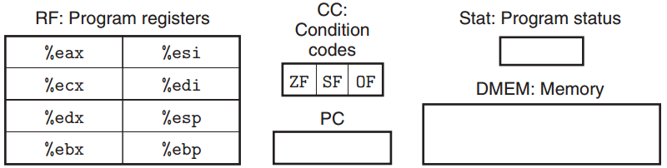
Y86: Programmer-Visible State
State on assembly level
esp: stack pointer used by push, pop, call, ret
PC: Program Counter
CC: Condition for Zero, Sign, and Overflow
Stat: for exception

Slide 10
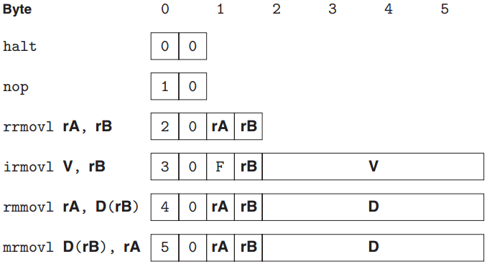
Y86: Instructions (1/2)
<source><dest>movl
r: register, m: memory, i: immediate
Only Base addressing mode

Slide 11
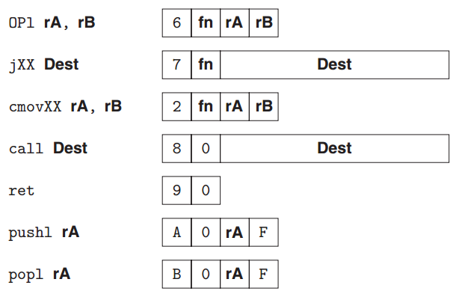
Y86: Instructions (2/2)
fn Operations: addl, subl, andl, and xorl
fn Conditions: [mp], le, l, e, ne, ge, and g

Slide 12
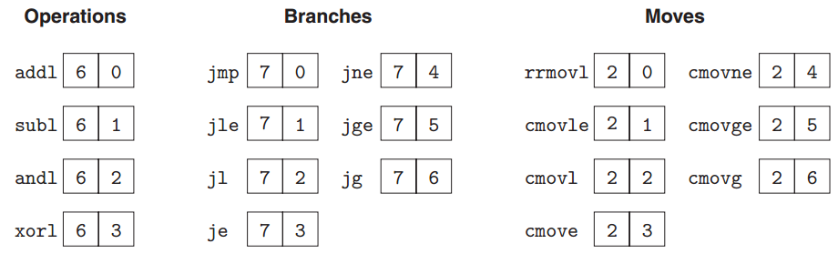
Y86: Instruction Encoding
First byte: 4-bit for code, following 4-bit for function

Slide 13
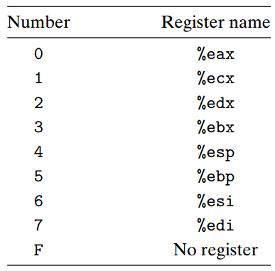
Y86: Register Identifier
F for Byte-align

Slide 14
Y86: Little Endian
Y86 uses Little endian like X86
rmmovl %esp, 0x12345(%edx)
little endian
40 42 45 23 01 00

Slide 15
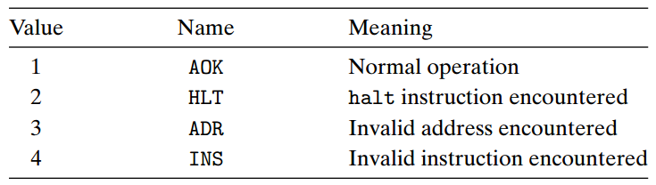
Y86: Exceptions
Exception recorded on Stat register
When exception occurred, Y86 just stop

Slide 16
Program: Y86 vs X86
1 int Sum(int *Start, int Count)
2 {
3 int sum = 0;
4 while (Count) {
5 sum += *Start;
6 Start++;
7 Count--;
8 }
9 return sum;
10 }

Slide 17
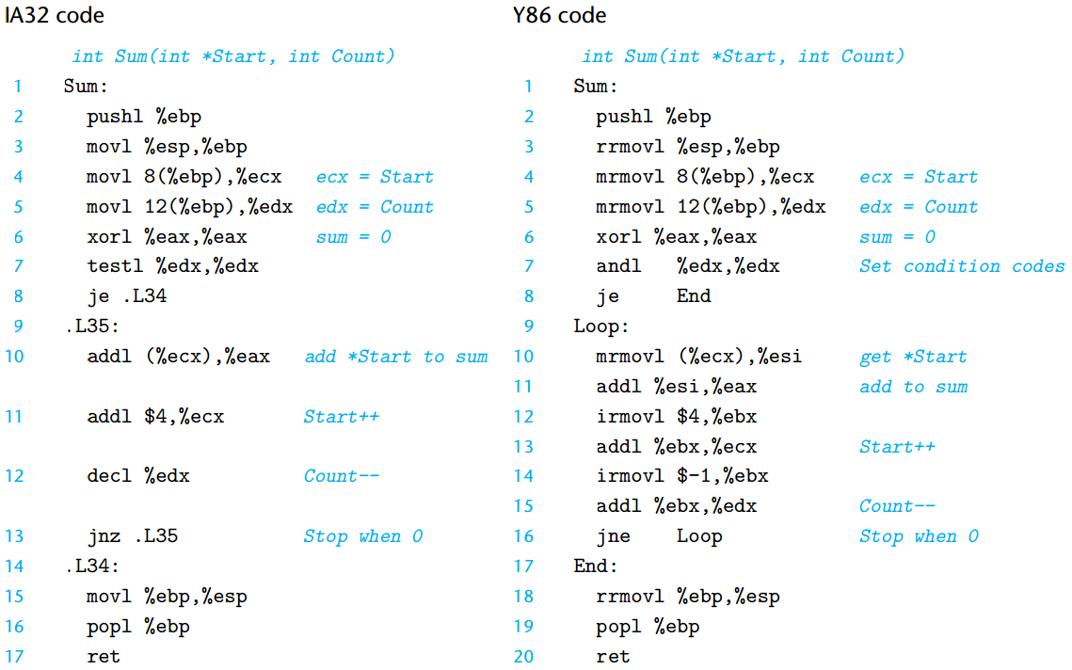
Program: Y86 vs X86

Slide 18
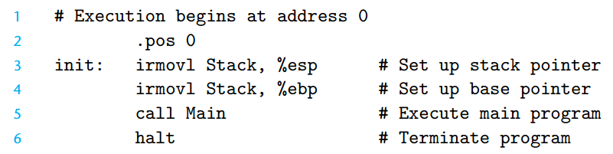
Complete Program in Y86 assembly
Program contains code and data.
Code and data will be loaded on memory.
‘.’ Says memory address to be loaded.

Slide 19
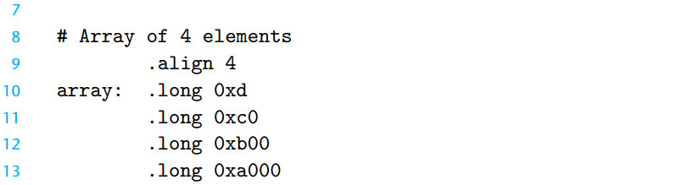

Complete Program in Y86 assembly
It’s just bits on memory.
Pointer is nothing ;)

Slide 20
Y86 Tools: YAS
Y86 Assembler
$ ls ./y86-code/asum.yo
ls: cannot access ./y86-code/asum.yo: No such file or directory
$ ./misc/yas ./y86-code/asum.ys
$ ls ./y86-code/asum.yo
./y86-code/asum.yo
$ tail -n 10 ./y86-code/asum.yo
0x078: 2054 | End: rrmovl %ebp,%esp
0x07a: b05f | popl %ebp
0x07c: 90 | ret
| /* $end sum-ys 0 */
|
| # The stack starts here and grows to lower addresses
0x100: | .pos 0x100
0x100: | Stack:
| /* $end code-ysa */
| /* $end code-yso */

Slide 21
Y86 Tools: YIS
YIS: Y86 Simulator
Shows status change before / after execution
$ ./misc/yis ./y86-code/asum.yo
Stopped in 52 steps at PC = 0x11. Status 'HLT', CC Z=1 S=0 O=0
Changes to registers:
%eax: 0x00000000 0x0000abcd
%ecx: 0x00000000 0x00000024
%ebx: 0x00000000 0xffffffff
%esp: 0x00000000 0x00000100
%ebp: 0x00000000 0x00000100
%esi: 0x00000000 0x0000a000
Changes to memory:
0x00e8: 0x00000000 0x000000f8
0x00ec: 0x00000000 0x0000003d
0x00f0: 0x00000000 0x00000014
0x00f4: 0x00000000 0x00000004
0x00f8: 0x00000000 0x00000100
0x00fc: 0x00000000 0x00000011

Slide 22
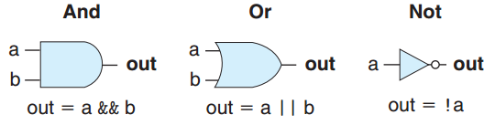
Logic Gates
Basic elements for digital circuits like AND, OR, NOT, etc…
Processor could be made by connecting lots of logic gates
Would be hard work…
Some guy do so just for fun, though

Slide 23
Circuit Design using HDL
HDL: Hardware-description language
Express relation between components on circuit
Looks like C: Human readable
Verilog and VHDL are most famous HDL
Logic synchesis program generates logic gate level circuit design from HDL description

Slide 24
HCL: Hardware Control Language
Describes the control logic of processor
Like HDL, but much simplified, restricted
Our tools create Verilog from HCL, then working microprocessor

Slide 25
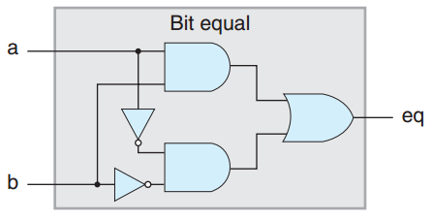
bit equality tester
In HCL,
bool eq = (a && b) || (!a && !b)

Slide 26
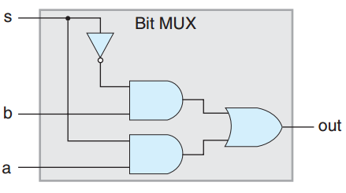
Multiplexer
In HCL,
bool out = (s && a) || (!s && b)

Slide 27
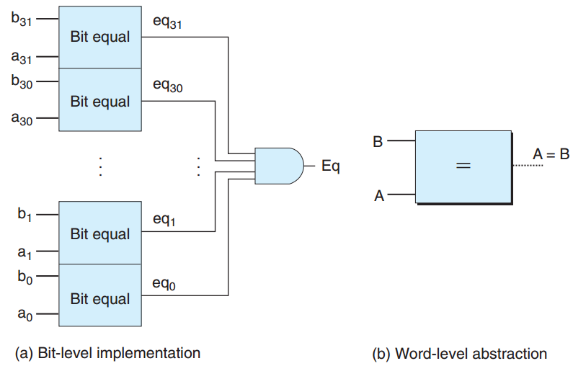
Word-level MUX
word-level signal as int
int A;
int B;
bool Eq = (A == B)

Slide 28
HCL case Expression
Is similar with switch-case in C language
[
select_1 : expr_1
select_2 : expr_2
…
select_k : expr_k
]

Slide 29
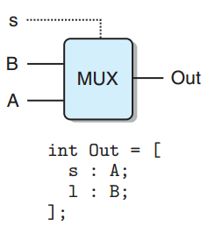
HCL case Expression on Circuit
Much easier to express
Most processor works can be done using MUX

Slide 30
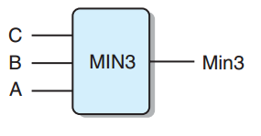
HCL for Minimum
int Min3 = [
A <= B && A <= C : A;
B <= A && B <= C : B;
1 : C;
];

Slide 31
HCL set Membership
bool s1 = code == 2 || code == 3;
bool s0 = code == 1 || code == 3;
could be expressed as:
bool s1 = code in {2, 3};
bool s0 = code in {1, 3};

Slide 32
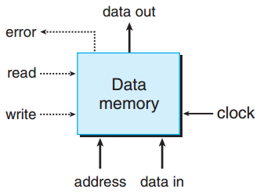
RAM on Our Processor
Receive address, data in, read, write and return data out and/or error

Slide 33
SEQ: Sequential Y86 Implementation
Using HCL, any ISA could be implemented
SEQ is a Y86 Implementation
SEQ uses sequential execution mechanism
(Policy & Mechanism is separated)
Source file: seq-full.hcl

Slide 34
SEQ
Do 5 stages sequentially for every instructions
Fetch: Fetch instruction from memory
Decode: Clarify operand registers
Execute: Set signal into ALU
Memory: Access memory
PC-update: update PC appropriately

Slide 35
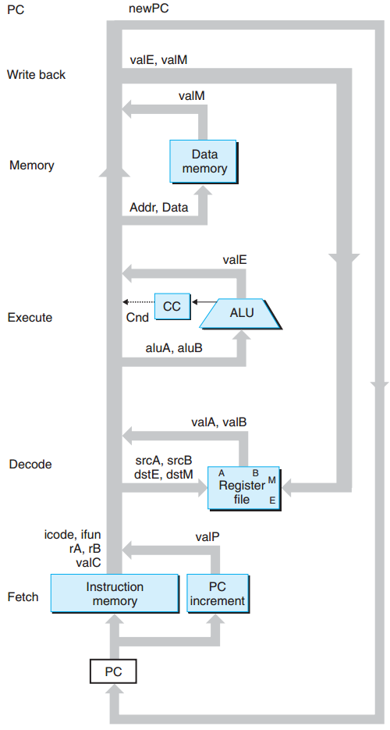
SEQ: Abstract View
Blue boxes are already implemented
seq-full.hcl just maps each signals

Slide 36
Assignments

Slide 37
Handout
ssh to sp.snucse.org
$ cp \
/home/sp_files/archlab/archlab-handout.tar ./
$ tar xvf archlab-handout.tar
$ cd archlab-handout
$ tar xvf sim.tar
$ cd sim
$ make clean; make

Slide 38
Part A
Create simple programs in Y86 assembly language
Useful tools: yas & yis
See usage on this slide

Slide 39
Part A: iterative sum
Create sum.ys which works as
typedef struct ELE {
int val;
struct ELE *next;
} *list_ptr;
/* sum_list - Sum the elements of a linked list */
int sum_list(list_ptr ls)
{
int val = 0;
while (ls) {
val += ls->val;
ls = ls->next;
}
return val;
}
source file: misc/examples.c

Slide 40
Part A: recursive sum
Create rsum.ys which works as
/* rsum_list - Recursive version of sum_list */
int rsum_list(list_ptr ls)
{
if (!ls)
return 0;
else {
int val = ls->val;
int rest = rsum_list(ls->next);
return val + rest;
}
}
source file: misc/examples.c

Slide 41
Part A: Memory Copy
Create copy.ys which works as
/* copy_block - Copy src to dest and return xor checksum of src */
int copy_block(int *src, int *dest, int len)
{
int result = 0;
while (len > 0) {
int val = *src++;
*dest++ = val;
result ^= val;
len--;
}
return result;
}
source file: misc/examples.c

Slide 42
Part A: Data
Data for sum.ys, rsum.ys
Data for copy.ys
# Sample linked list
.align 4
ele1:
.long 0x00a
.long ele2
ele2:
.long 0x0b0
.long ele3
ele3:
.long 0xc00
.long 0
.align 4
# Source block
src:
.long 0x00a
.long 0x0b0
.long 0xc00
# Destination block
dest:
.long 0x111
.long 0x222
.long 0x333

Slide 43
Part B
Implement iaddl and leave instruction on SEQ
iaddl: register A += constant
leave: rrmovl %ebp, %esp; popl %ebp
For instruction detail, Refer Homework problems 4.47, 4.49, 4.48, 4.50

Slide 44
Part B: Testing
Modify seq-full.hcl, implement iaddl and leave
Build modified simulator ssim by
$ make VERSION=full
Run test code using:
$ cd seq
$ ./ssim -t ../y86-code/asumi.yo
$ ./ssim -t ../y86-code/asuml.yo

Slide 45
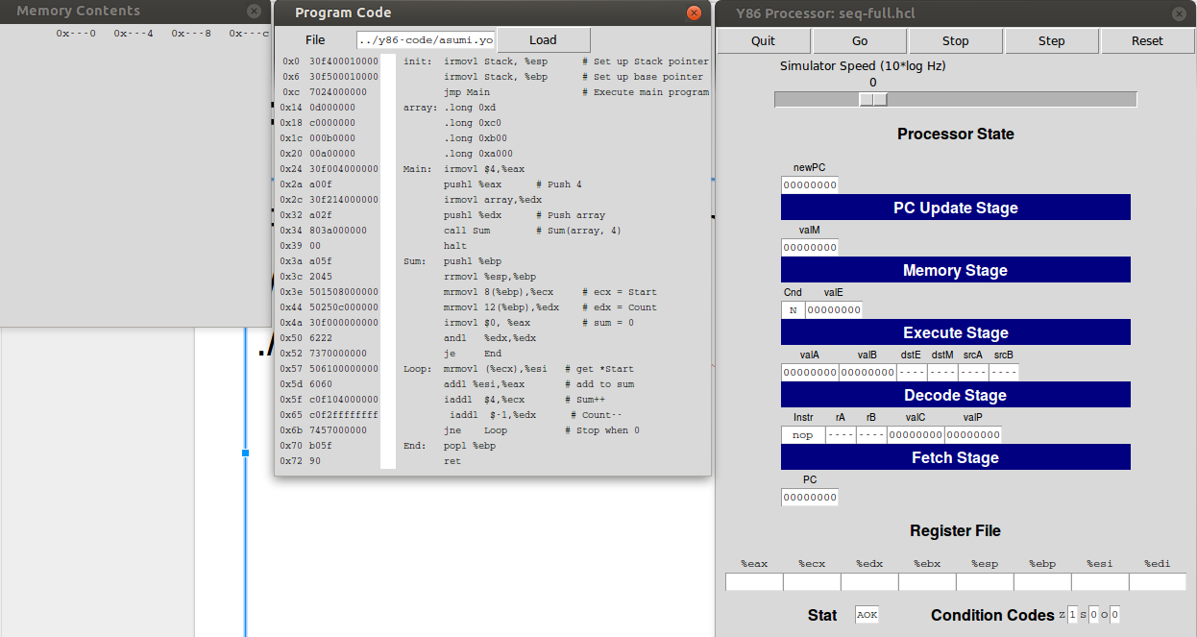
Part B: Debugging
For GUI mode simulation,
./ssim -g ../y86-code/asumi.yo
./ssim -g ../y86-code/asuml.yo
ssh -X on linux, xming on MS Windows

Slide 46
SEQ Correctness Test
$ cd ../y86-code; make testssim
This will not test iaddl and leave

Slide 47
SEQ Regression Test
To test everything except iaddl and leave:
$ cd ../ptest; make SIM=../seq/ssim
To test your implementation of iaddl:
$ cd ../ptest; make SIM=../seq/ssim TFLAGS=-i
To test your implementation of leave:
$ cd ../ptest; make SIM=../seq/ssim TFLAGS=-l

Slide 48
Failed Test Output
$ cd ../ptest; make SIM=../seq/ssim TFLAGS=-i
./optest.pl -s ../seq/ssim -i
Simulating with ../seq/ssim
Test op-iaddl-256-edx failed
Test op-iaddl-32-edx failed
Test op-iaddl-4-edx failed
Test op-iaddl-256-ebx failed
Test op-iaddl-32-ebx failed
Test op-iaddl-4-ebx failed
Test op-iaddl-256-esp failed
...

Slide 49
Passed Test Output
$ cd ../ptest; make SIM=../seq/ssim
./optest.pl -s ../seq/ssim
Simulating with ../seq/ssim
All 49 ISA Checks Succeed
./jtest.pl -s ../seq/ssim
Simulating with ../seq/ssim
All 64 ISA Checks Succeed
./ctest.pl -s ../seq/ssim
Simulating with ../seq/ssim
All 22 ISA Checks Succeed
./htest.pl -s ../seq/ssim
Simulating with ../seq/ssim
All 600 ISA Checks Succeed

Slide 50
Submissions: Organize files
$ tree sp_practices2-1_2015-12345_Alice/
sp_practices2-1_2015-12345_Alice/
├── part_a
│ ├── copy.ys
│ ├── rsum.ys
│ └── sum.ys
└── part_b
└── seq-full.hcl
2 directories, 4 files
student id
name
(use Korean, please)

Slide 51
Submissions: Archive into zip file
$ zip sp_practices2-1_2015-12345_Alice.zip sp_practices2-1_2015-12345_Alice/
adding: sp_practices2-1_2015-12345_Alice/ (stored 0%)
$
$
$ file sp_practices2-1_2015-12345_Alice.zip
sp_practices2-1_2015-12345_Alice.zip: Zip archive data, at least v1.0 to extract

Slide 52
Submissions: Email
Send the zip file to:tskim@dcslab.snu.ac.kr cc:jichoi@dcslab.snu.ac.kr Title as filename except the extension, zip

Slide 53
For Detail about Assignment
Refer to pdf file inside handout folder
/home/sp_files/archlab/ in sp.snucse.org

