Slide 1
System Programming Practices, Spring, 2015
Optimizing the Performance of a Pipelined Processor - 2
Jake Choi <jichoi@dcslab.snu.ac.kr>

Slide 2
Pipeline

Slide 3
Problem of SEQ
Based on single-step sequential execution
Every instruction should be finished in a clock
Slow enough clock required
Execution time is limited by slowest instruction
Not every unit be fully utilized
e.g., Register file should wait for memory

Slide 4
Multi-Cycle Execution
Divide instruction execution into multiple steps
Do one step for each clock cycle
Advantages: Instructions consume only necessary cycles

Slide 5
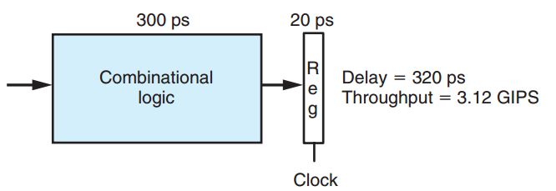
Problem of Sequential Execution
Not all unit fully-utilized during every steps

Slide 6
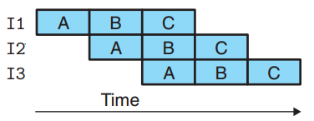
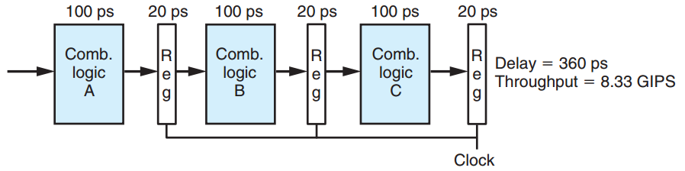
Pipelining
Divide instruction into multiple steps
Overlap execution of different steps

Slide 7
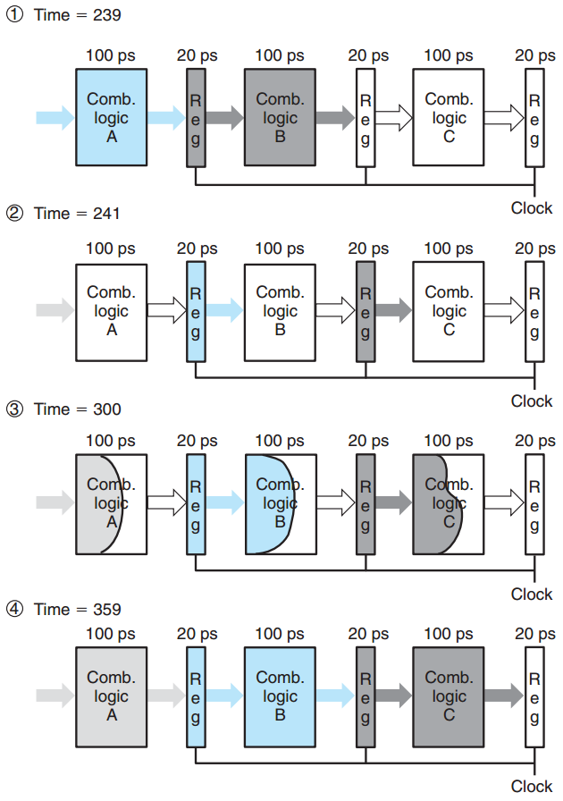
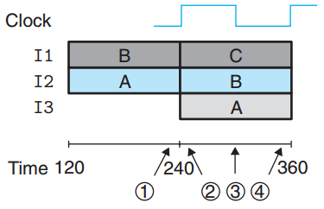
Pipelining in Detail

Slide 8
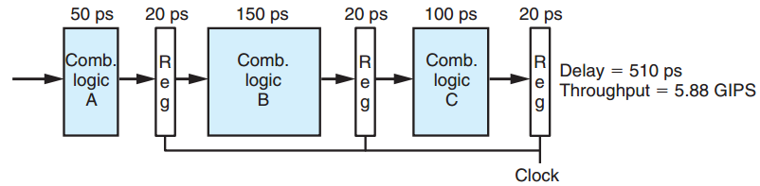
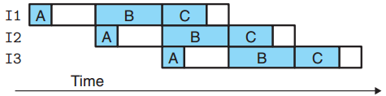
Pipelining: Non-uniform Cycles
Throughput is limited by slowest stage

Slide 9
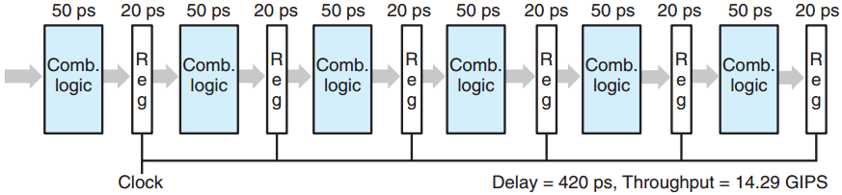
Pipelining Steps and Throughput
Throughput would enhances as dividing to smaller, faster steps

Slide 10
Pipelining Steps and Throughput
Register updating delay limit enhancement
14.29 / 8.33 = 1.71 ( != 2)

Slide 11
Pipelining Steps and Throughput
Modern processors use 15 or more stages
Maximize processor clock rate
Designers carefully minimize pipeline register delay

Slide 12
ISA Implication and Pipeline
ISA implicates sequential execution
Pipeline(Overlapped Execution) should guarantees the execution result is as same as result of sequential execution

Slide 13
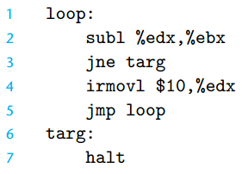
Control Dependency
Could not know next instruction until execution finished
What instruction should we fetch? line 4? or line 7?

Slide 14
Branch Prediction
Simply believe branch condition will be taken
Roll back status if the prediction was wrong.

Slide 15
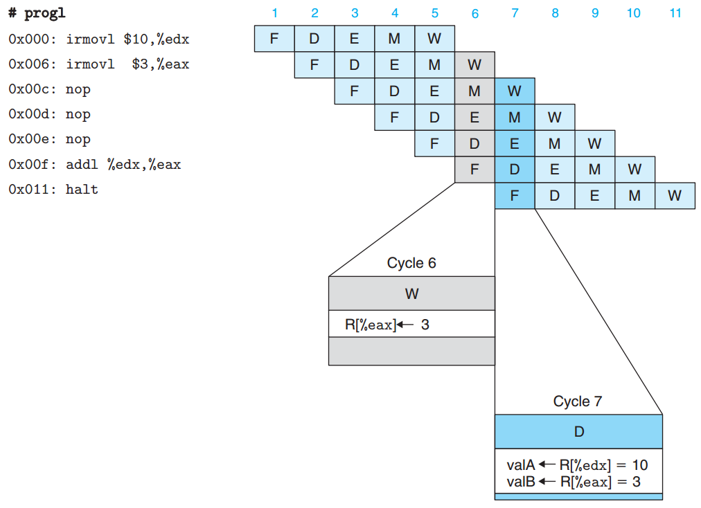
Data Dependency
If 0x00c-0x00e was not nop, ISA implication would be fail (Data Hazard)

Slide 16
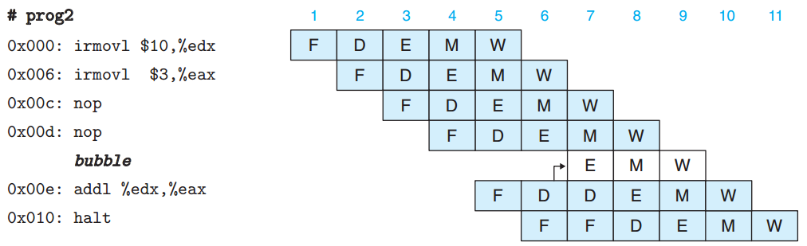
Stalling for Data Dependency
Just stall Pipeline until timing met

Slide 17
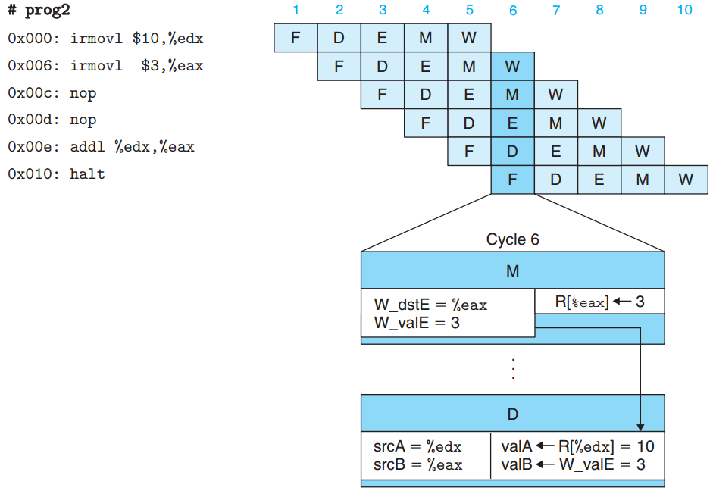
Forwarding for Data Dependency
Forward calculated data immediately

Slide 18
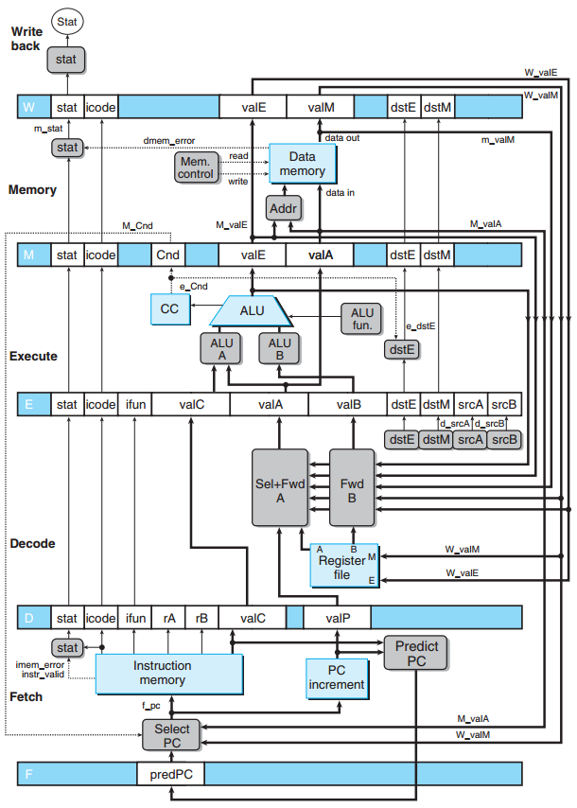
Pipe-full.hcl
Y86 HCL Implementation using Pipelining

Slide 19
Assignment: Part C

Slide 20
Handout
ssh to sp.snucse.org
$ cp \
/home/sp_files/archlab/archlab-handout2.tar ./
$ tar xvf archlab-handout2.tar
$ cd archlab-handout2
$ tar xvf sim.tar
$ cd sim
$ make clean; make

Slide 21
NOTICE
Every command example from now should be executed from archlab-handout2/sim/pipe

Slide 22
ncopy program
Copy specified length of data from src to dst
Returns number of copied positive number
sim/pipe/ncopy.c
sim/pipe/ncopy.ys
sim/pipe/pipe-full.hcl
int ncopy(int *src, int *dst, int len)
{
int count = 0;
int val;
while (len > 0) {
val = *src++;
*dst++ = val;
if (val > 0)
count++;
len--;
}
return count;
}

Slide 23
Task
Reduce execution time of ncopy on y86 pipe simulator by modifying
ncopy.ys
pipe-full.hcl
Each file should begin with a header comment with
name and student ID
Description of your code (how / why you modified the code)

Slide 24
You may...
Implement new instruction on PIPE
Re-order instructions of ncopy
Use Loop Unrolling technique on ncopy
Replace groups of instructions with sigle instructions
Delete some instructions

Slide 25
Coding Rules 1/2
ncopy.ys should work for arbitrary array size
ncopy.ys should run correctly with YIS
Data should be copied from src to dst
Correct return value resists in %eax

Slide 26
Coding Rules 2/2
Size of ncopy.yo should not be more than 1000 bytes long
$ ../misc/yas ncopy.ys
$ ./check-len.pl < ncopy.yo
pipe-full.hcl must pass the regression tests

Slide 27
Building
After ncopy.ys modification
$ make drivers
Creates sdriver.yo and ldriver.yo
After pipe-full.hcl modification
$ make psim VERSION=full
Creates pipe simulator, psim
To create everything at once
$ make VERSION=full

Slide 28
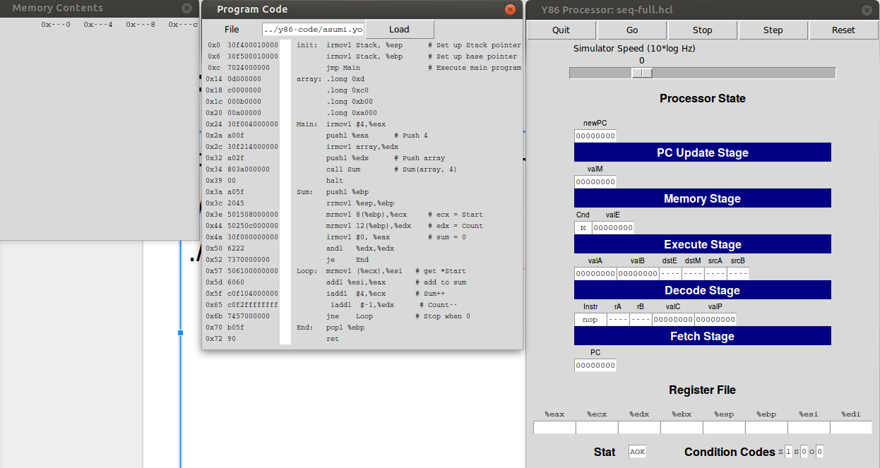
Running
Test on a 4-element array
$ ./psim sdriver.yo
Test on a 63-element array
$ ./psim ldriver.yo
For GUI mode, use -g option
ssh -X on linux, xming on MS Windows

Slide 29
Correctness on YIS
Run on YIS and check correctness on YIS
$ make drivers
$ ../misc/yis sdriver.yo

Slide 30
Correctness on Various Length
$ ./correctness.pl
Test with various length blocks using YIS
$ ./gen-driver.pl -f ncopy.ys -n K -rc > driver.ys
$ make driver.yo
$ ../misc/yis driver.yo
Test with K length block using YIS
If the program end with %eas as 0xaaaa, PASS

Slide 31
PSIM Correctness Test
$ cd ../y86-code; make testpsim; cd ../pipe
Compare psim correctness with YIS using benchmark
$ cd ../ptest; make SIM=../pipe/psim TFLAGS=-i
$ cd ../pipe
Compare psim correctness with YIS using regression tests
(TFLAGS=-i if you implemented iaddl)

Slide 32
ncopy Correctness on psim
./correctness.pl -p
Check ncopy correctness using psim

Slide 33
Evaluation
./benchmark.pl
Shows ncopy CPE for various length blocks
CPE of base implementation: 16.44

Slide 34
Submissions: Organize files
$ tree sp_practices2-2_2015-12345_Alice/
sp_practices2-2_2015-12345_Alice/
└── part_c
├── ncopy.ys
└── pipe-full.hcl
1 directory, 2 files
student id
name (use Korean, please)

Slide 35
Submissions: Archive into zip file
$ zip -r sp_practices2-2_2015-12345_Alice.zip

Slide 36
Submissions: Email
Send the zip file to:tskim@dcslab.snu.ac.kr cc:jichoi@dcslab.snu.ac.kr
Title as filename except the extension, zip

Slide 37
For Detail about Assignment
Refer to archlab.pdf inside handout file.

