Slide 1
System Programming Practices, Spring, 2016
Cache Lab: Understanding Cache Memories - 1/2
Jake Choi <jichoi@dcslab.snu.ac.kr>

Slide 2
Background: Cache

Slide 3
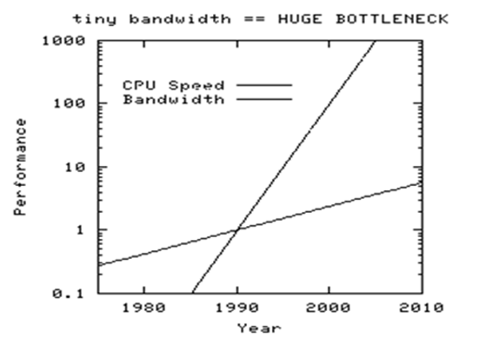
Evolution of Memory & CPU
Memory have been huge, but not so fast while CPU have been fast very much
It’s called the memory wall
http://media.community.dell.com/en/dtc/e5hxpogluagdjyonsovaua42962.png

Slide 4
Memory Hierarchies
Most storage have speed vs capacity trade-off

Slide 5
Memory Hierarchies
Most storage have speed vs capacity trade-off

Slide 6
Memory Hierarchies
Most storage have speed vs capacity trade-off

Slide 7
Memory Hierarchies
Most storage have speed vs capacity trade-off

Slide 8
Memory Hierarchies
Most storage have speed vs capacity trade-off

Slide 9
Memory Hierarchies
Most storage have speed vs capacity trade-off

Slide 10
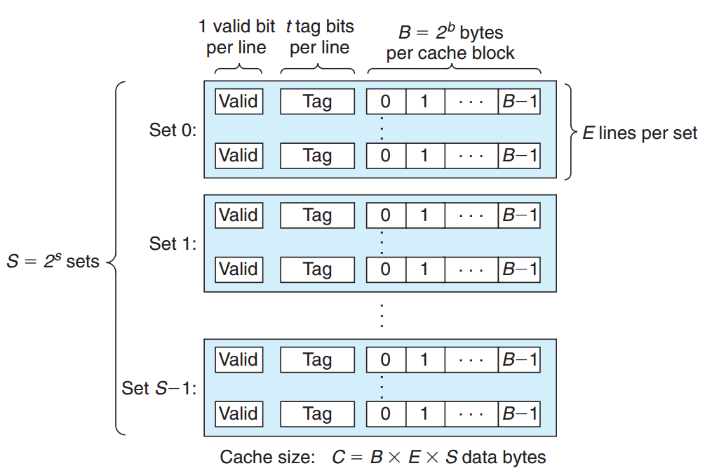
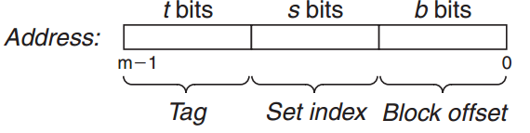
Generic Cache Memory Organization
A Cache consists with multiple sets
A Set consists with multiple lines
A Line consists with data block and few bits

Slide 11
Generic Cache Memory Organization
A Cache consists with multiple sets
A Set consists with multiple lines
A Line consists with data block and few bits

Slide 12
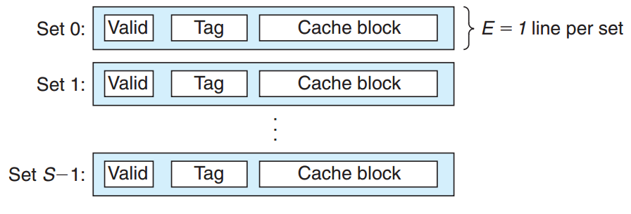
Direct-Mapped Caches
Cache with only one line per set
Easy to find data (one time comparison)
Line could be evicted at once

Slide 13
Direct-Mapped Caches
Cache with only one line per set
Easy to find data (one time comparison)
Line could be evicted at once

Slide 14
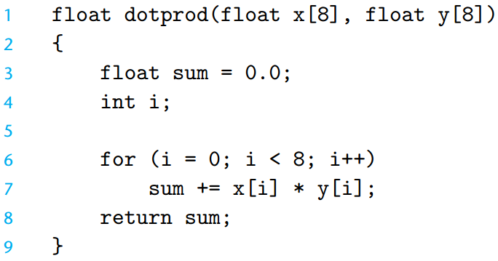
Conflict Misses in Direct-Mapped $
Suppose
x: m[0-31], y: m[32-63]
16 bytes block size cache

Slide 15
Conflict Misses in Direct-Mapped $
Suppose
x: m[0-31], y: m[32-63]
16 bytes block size cache

Slide 16
Conflict Misses in Direct-Mapped $
Suppose
x: m[0-31], y: m[32-63]
16 bytes block size cache

Slide 17
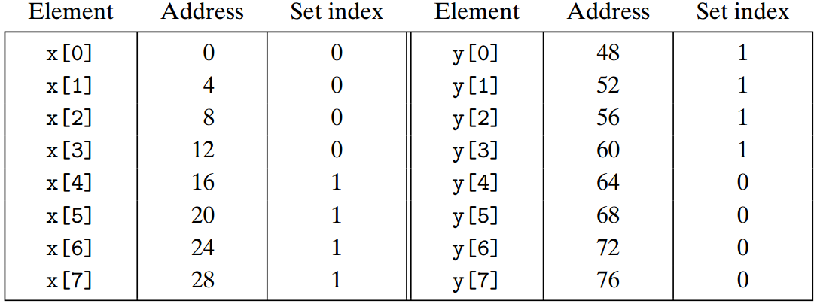
Solution for Conflict Misses
Add padding to scatter each set mapping

Slide 18
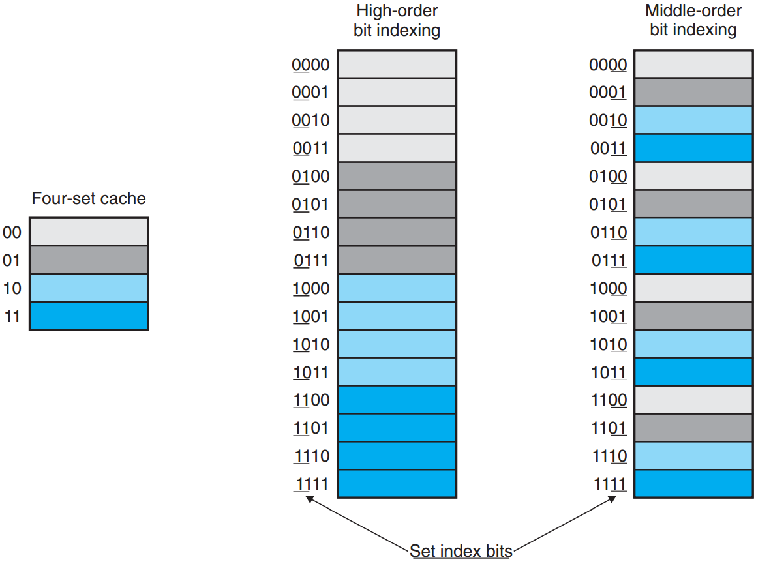
Why Middle bits as Index?
For high spatial locality program, high-order bit indexing could hold only a block

Slide 19
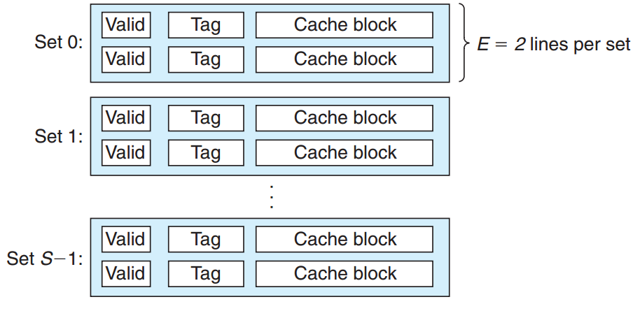
Set Associative Caches
Multiple lines in a set: 1 < E < C / B
Line selection could be slow and complex
Eviction could be delayed

Slide 20
Set Associative Caches
Multiple lines in a set: 1 < E < C / B
Line selection could be slow and complex
Eviction could be delayed

Slide 21
Eviction Policy
Not every conflict means eviction
Eviction victim: cache line that will not be used soon
Need accurate prediction
Least Frequently Used(LFU)
Least Recently Used(LRU)
Accurate prediction requires resource (time and h/w)

Slide 22
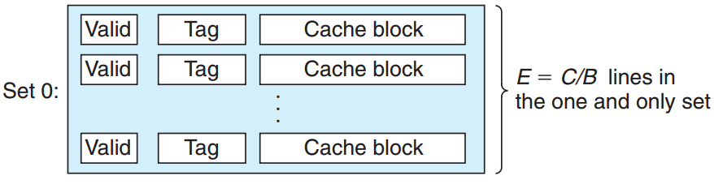
Fully Associative Caches
Cache with single set: E = C / B
Low eviction chance, complex line matching
Usually used for small caches like TLBs

Slide 23
Write Policy of Caches
When the data written to cache should be delegated to next layer?
When the write missed cache line should be loaded on higher layer?

Slide 24
Write-through
Writes data written on cache into lower layer immediately
Simple, but increases data traffic

Slide 25
Write-back
Write data written on cache into lower layer when the cache line be evicted
Minimize traffic, but needs complex resource
Complexity becoming less impediment as logic densities increase

Slide 26
Write-allocate
When write to cache have missed, load the block into the cache and write on the block
Enhance locality, increase traffic
Usually used with Write-back

Slide 27
No-write-allocate
When write to cache have missed, bypass cache and write to lower layer
Minimize traffic, but locality could be remain bad
Usually used with Write-through

Slide 28
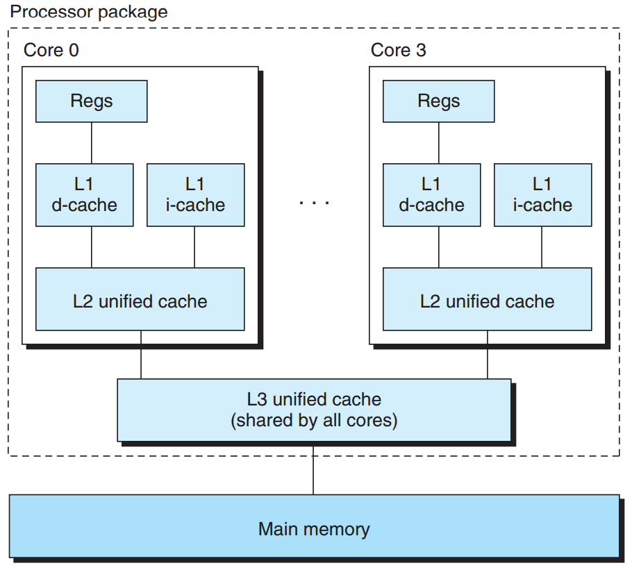
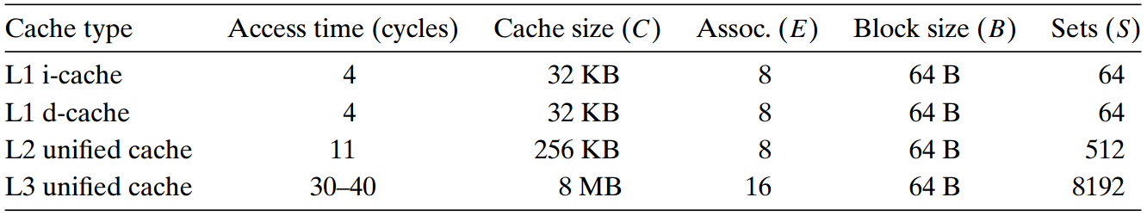
Intl i7 Cache Hierarchy

Slide 29
Intl i7 Cache Hierarchy

Slide 30
Performance and Cache Parameters
Miss rate: # of misses / # of accesses
Hit rate: 1 - miss rate
Hit time: time to deliver a word from cache to CPU
Miss penalty: additional time required by cache miss

Slide 31
Performance and Cache Parameters
Miss rate: # of misses / # of accesses
Hit rate: 1 - miss rate
Hit time: time to deliver a word from cache to CPU
Miss penalty: additional time required by cache miss

Slide 32
Performance and Cache Parameters
Miss rate: # of misses / # of accesses
Hit rate: 1 - miss rate
Hit time: time to deliver a word from cache to CPU
Miss penalty: additional time required by cache miss

Slide 33
Assignment: Part A

Slide 34
Assignment
You will write a small C program (about 200-300 lines) that will simulate the behaviour of cache memory.
It will take valgrind memory trace as input, simulates the hit/miss behavior, and output total number of hits, miss, and evictions

Slide 35
Handout
ssh to sp.snucse.org
$ cp /home/sp_files/cachelab/cachelab-handout.tar ./
$ tar xvf cachelab-handout.tar
$ cd cachelab-handout
$ make clean; make

Slide 36
Trace Files
In traces/, memory traces exist
Those traces are generated by valgrind
e.g., $ valgrind --log-fd=1 --tool=lackey -v --trace-mem=yes ls

Slide 37
Trace Files
Format: <operation> <address>, <size>
I: Instruction Load
M: Data modification(L + S)
L: Data Load
S: Data Store
Only I have space before <operation>
I 040012d3, 5
M 0421c7f0, 4
L 04f6b868, 8
S fff0004b8, 8

Slide 38
csim-ref
Cache simulator for valgrind memory trace
Receive valgrind memory trace as input
Outputs simulated # of hits, misses, evictions
Usage: ./csim-ref [-hv] -s <s> -E <E> -b <b> -t <tracefile>
-h: help message
-v: verbose output
-s <s>: Number of set index bits
-E <E>: Associativity
-b <b>: Number of block bits
-t <tracefile>: Path to valgrind memory trace file

Slide 39
csim-ref
Example
Simulates replay of yi.trace trace file on
16 set (-s 4)
direct mapping (-E 1)
16 bytes block size (-b 4) cache
$ ./csim-ref -s 4 -E 1 -b 4 -t traces/yi.trace
hits:4 misses:5 evictions:3

Slide 40
Task
Implement a cache simulator like csim-ref on csim.c
Should take same command line arguments, Make identical output
Optional arguments (-h, -v) are free to be implemented or not

Slide 41
Programming Rules
Include your Name, Student ID in header comment
Describe how the code works using comments
csim.c should compile without warnings
Simulate only data cache

Slide 42
Programming Rules
Use printSummary() to make output
/*
* printSummary - This function provides a standard way for your cache
* simulator to display its final hit and miss statistics
*/
void printSummary(int hits, /* number of hits */
int misses, /* number of misses */
int evictions); /* number of evictions */
Ignore data request sizes of trace, assume whole accesses are aligned properly

Slide 43
Evaluation: Correctness
Check correctness of following 8 cases
$ ./csim -s 1 -E 1 -b 1 -t traces/yi2.trace
$ ./csim -s 4 -E 2 -b 4 -t traces/yi.trace
$ ./csim -s 2 -E 1 -b 4 -t traces/dave.trace
$ ./csim -s 2 -E 1 -b 3 -t traces/trans.trace
$ ./csim -s 2 -E 2 -b 3 -t traces/trans.trace
$ ./csim -s 2 -E 4 -b 3 -t traces/trans.trace
$ ./csim -s 5 -E 1 -b 5 -t traces/trans.trace
$ ./csim -s 5 -E 1 -b 5 -t traces/long.trace
3 points for first 7 cases, 6 point for 8th case
(Total 27 points)

Slide 44
Evaluation: Style
Code should be consistent and easy to be read with sufficient, clear description comments
7 points for both Part A and Part B
Thus 3.5 points for Part A
and 3.5 points for Part B next week.

Slide 45
test-csim: auto-grading program
Example usage
linux> make
linux> ./test-csim
Your simulator Reference simulator
Points (s,E,b) Hits Misses Evicts Hits Misses Evicts
3 (1,1,1) 9 8 6 9 8 6 traces/yi2.trace
3 (4,2,4) 4 5 2 4 5 2 traces/yi.trace
3 (2,1,4) 2 3 1 2 3 1 traces/dave.trace
3 (2,1,3) 167 71 67 167 71 67 traces/trans.trace
3 (2,2,3) 201 37 29 201 37 29 traces/trans.trace
3 (2,4,3) 212 26 10 212 26 10 traces/trans.trace
3 (5,1,5) 231 7 0 231 7 0 traces/trans.trace
6 (5,1,5) 265189 21775 21743 265189 21775 21743 traces/long.trace
27

Slide 46
Hints
Start debugging using small traces, such as traces/dave.trace
-v is optional, but helpful for debugging
getopt function is useful for arguments parsing
Unlike L and S, M could result 2 hits or a miss and a hit plus a possible eviction

Slide 47
Submissions: Organize files
$ tree sp_practices3-1_2015-12345_Alice/
sp_practices3-1_2015-12345_Alice/
└── csim.c
1 directory, 2 files
student id
name (use Korean, please)

Slide 48
Submissions: Archive into zip file
$ zip -r sp_practices3-1_2015-12345_Alice.zip

Slide 49
Submissions: Email
Send the zip file
to:tskim@dcslab.snu.ac.kr cc:jichoi@dcslab.snu.ac.kr
Title as filename except the extension, zip

Slide 50
For Detail about Assignment
Refer to cachelab.pdf inside handout file

