Slide 1
Cache-Efficient Matrix Transposition
Written by :
Siddhartha Chatterjee and Sandeep Sen
Presented By: Iddit Shalem

Slide 2
Purpose
Present various memory models using the test case of matrix transposition.
Observe the behavior of the various theoretical memory models on real memory.
Analytically understand the relative contributions of the various components of a typical memory hierarchy ( registers, data cache , TLB).

Slide 3
Matrix – Data Layout
Assume row major data layout
implies A(i,j) memory location is ni+j

Slide 4
Matrix Transposition
Fundamental operation in linear algebra and in other computational primitives.
Seemingly innocuous problem, but lacks spatial locality – pairs up memory locations ni+j and nj+i.
Consider in-place NxN matrix transposition.

Slide 5
Algorithm 1 – RAM model
RAM Model
  Assumes flat memory address space .
  Unit-cost access to any memory location.
  Disregards memory hierarchy. Considers only operation count.
  In modern computer, this is not always a true predictor.
  Simple, successfully predicts the relative performance of algorithms.

Slide 6
Algorithm 1
  Simple C code for matrix in-place transposition:
  for ( i=0 ; i < N ; i++) {
  for ( j = i+1; j < N ; j++ ) {
  tmp = A[i][j];
  A[i][j] = A[j][i];
  A[j][i] = tmp;
  }
  }

Slide 7
Analysis in RAM model
  Inner loop executed N*(N-1)/2 times.
  Complexity O(N²).
  Optimal (number of operations).
  In presence of memory hierarchy, things are changed dramatically.

Slide 8
Algorithm 2 – I/O Model
I/O model
  Assumes most data resides on secondary memory, and should be transferred to internal memory for processing.
  Due to tremendous difference in speeds-
    Ignores cost of internal processing
    Counts only the number of I/Os.

Slide 9
I/O model – Cont’
  Parameters – M,B,N
    M – Internal memory size
    B - block size ( number of elements transferred in a single I/O)
    N – input size
    All sizes are in elements
  I/O operation are explicit.
  Fully associative

Slide 10
Analyze Algorithm 1 in the I/O model –
  For simplicity assume B divides N
  Assume N>>M.
  In a typical row – the first block is brought B times into the internal memory.
  See example. assume B=4

Slide 11
A:
i
i

Slide 12
A:
i
i

Slide 13
A:
i
i

Slide 14
A:
i
Transferred into
internal memory
for the 1st time
i

Slide 15
A:
i
Was probably
cleared out from
internal memory
i

Slide 16
A:
i
Transferred into
internal memory
For the 2nd time
i

Slide 17
A:
i
Was probably
cleared out from
internal memory
i

Slide 18
A:
i
Transferred into
internal memory
for the 3rd time
i

Slide 19
A:
i
Was probably
cleared out from
internal memory
i

Slide 20
A:
i
Transferred into
internal memory
For the 4th time
i

Slide 21
Analyze Algorithm 1 - Cont’
  Each typical block bellow the diagonal is brought into internal memory B times.
  Ω(N²) I/O operations.

Slide 22
Improvement
  Reuse elements by rescheduling the operations.
  Any Ideas?

Slide 23
  Partition the matrix into B x B sub-matrices
  A^{r,s} denotes the sub-matrix composed of elements-
  {a_{i,j}}, rB ≤ i < (r+1)B, sB ≤ j < (j+1)B
  Notice :
    Each sub-matrix occupies B blocks.
    The Blocks of a sub-matrix are separated by N elements.
    Clearly A^{s,r} <= (A^{r,s})^{T}

Slide 24
Block-Transpose(n,B)
For simplicity assume A is transposed is transferred to another matrix C=A^{T.} Not in-place
  Transfer each sub-matrix A^{r,s} to internal memory using B I/O operations.
  Internally perform transpose of A^{r,s.}
  Transfer it to C^{s,r} using B I/O operations

Slide 25
Total of 2B(N²/B²) = O(N²/B) I/O operations which is optimal.
Requirements M>B².
For an in-place version require M>2B². See example

Slide 26
Internal Memory:
A:
A^{r,s}
A^{s,r}

Slide 27
1.Transfer
Internal Memory:
A^{s,r}
A^{r,s}
A:
A^{r,s}
A^{s,r}

Slide 28
2.Internal Transpose
Internal Memory:
(A^{s,r})^{T}
(A^{s,r})^{T}
A:

Slide 29
3.Transfer back
Internal Memory:
(A^{s,r})^{T}
(A^{s,r})^{T}
A:
(A^{s,r})^{T}
(A^{s,r})^{T}

Slide 30
Definitions
  Tiling – In general an partitioning to disjoint TxT sub-matrices is called tiling.
  Tile - Each sub-matrix A^{r,s} is known as tile.

Slide 31
Algorithm 2
The Block-Transpose scheme runs into problem when M<2B².
Perform transpose using destination index sorting
M/B-way merge

Slide 32
5 9 13
6 10 14
7 11 15
8 12 16
1 5 9 13
2 6 10 14
3 7 11 15
4 8 12 16
Merge
Merge
1 2 5 6
9 10 13 14
3 4 7 8
11 12 15 16
Merge
1 2 3 4
5 6 7 8
9 10 11 12
13 14 15 16
1 2 3 4
5 6 7 8
9 10 11 12
13 14 15 16

Slide 33
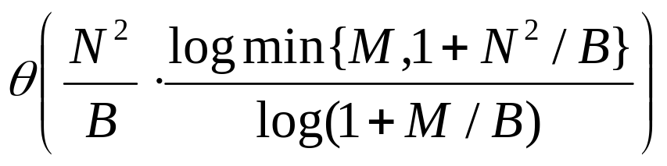
Complexity analysis –
  We have established the following exact bound on the number of I/O operation required for sorting
  When M=Ω(B²) this takes O(N²/B) I/O operations.

Slide 34
Algorithms 3 and 4 : Cache Model
Cache Model
  Memory consists of cache and main memory.
  Difference in access time is considerable smaller.
  Direct map
  I/O operation are not explicit.
  Parameters – M,B,N,L
    M - faster memory size
    B,N as before
    L normalized cache miss latency.

Slide 35
Analyze Block-Transpose algorithm
  Suppose M >2B^{2.}
  Still we can run into problems
    All blocks of a tile can be mapped to the same cache set. Ω(B²) misses per tile. Total of N² misses.
    We can not assume the existence of a tile copy in the cache memory
  We need to copy matrix blocks to and from contiguous storage.

Slide 36
Algorithms 3 and 4
These algorithms are two Block-Transpose versions called half-copying and full-copying

Slide 37
Half Copying
Full Copying
1. copy
1. copy
2. Transpose
3. Transpose
4. Transpose
3. Transpose
2. copy

Slide 38
Half copying increases the number of data movements from 2 to 3, while reducing the number of conflict misses.
Full copying increases the number of data movements to 4, and completely eliminates conflict misses.

Slide 39
Algorithm 5 : Cache oblivious
Cache Oblivious Algorithms – do not require the values of parameters related to different levels of memory hierarchy.
The basic idea is to divide the problem into smaller sub-problems. Small problems will fit into cache.

Slide 40
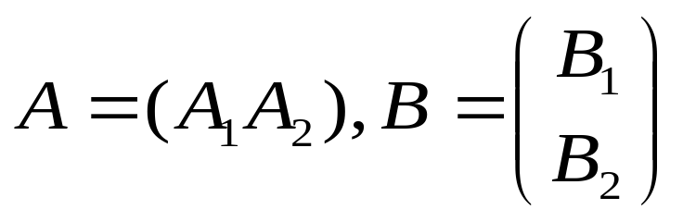
Cache oblivious algorithm for transposing an
n x m matrix.
  If n ≥ m, partition
  Recursivly execute Transpose(A₁,B₁)
  Was proved to involve O(mn) work and O(1+mn/L) cache misses. L is the cache line element size.

Slide 41
Algorithm 6 – Non linear array layout
Canonical matrix layout do not interact well with cache memories.
Favor one index. Neighbors in an un-favored direction become distant in memory
May cause repeatedly cache misses even when accessing only a small tile.
Such interferences are complicated and non-smooth function of the array size, the tile size and the cache parameters.

Slide 42
Morton Ordering
Was designed for various purposes such as graphics applications, database applications.
We will exploit benefits of such ordering for multi level memory hierarchies.

Slide 43
Morton Ordering
0 | 1 | 4 | 5 | 16 | 17 | 20 | 21
2 | 3 | 6 | 7 | 18 | 19 | 22 | 23
8 | 9 | 12 | 13 | 24 | 25 | 28 | 29
10 | 11 | 14 | 15 | 26 | 27 | 30 | 31
32 | 33 | 36 | 37 | 48 | 49 | 52 | 53
34 | 35 | 38 | 39 | 50 | 51 | 54 | 55
40 | 41 | 44 | 45 | 56 | 57 | 60 | 61
42 | 43 | 46 | 47 | 58 | 59 | 62 | 63
I
II
III
IV

Slide 44
Algorithm 6 recursively divides the problem into smaller problems until it reaches an architecture specific tile size, where it performs the transpose.
The matrix layout is Morton-ordered
=> Each tile is contiguous in memory and cache space – eliminates self-interference misses when tiles are transposed

Slide 45
Experimental Results
Reminder for 6 algorithms-
  Naïve algorithm ( RAM model ).
  Destination indices merge ( I/O Model ).
  Half copying ( Cache model ).
  Full copying ( Cache model ).
  Cache oblivious
  Morton layout

Slide 46
Running system
  300 MHz UltraSPARC-II system.
  L1 data cache - direct mapped,32-byte blocks, Capcity 16KB
  L2 data cache - direct mapped,64-byte blocks, Capcity 2MB
  RAM – 512 MB
  TLB – fully associative with 64 entries

Slide 47
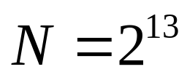
Total running time ( seconds) results for
Block size | Alg1 | Alg2 | Alg3 | Alg4 | Alg5 | Alg6
2⁵ | 13.56 | 6.38 | 4.55 | 4.99 | 6.69 | 2.13
2⁶ | 13.51 | 5.99 | 3.58 | 3.91 | 7.00 | 2.09
2⁷ | 13.46 | 5.74 | 3.12 | 3.35 | 6.86 | 2.35

Slide 48
Running time analysis –
  Algorithms 1 and 5 do not depend on block size parameters
  Performance groups
    Algorithms 6 and 3 emerge fastest
    Algorithm 4 coming in a close third
    Algorithms 2 and 5
    Algorithm 1

Slide 49
In order to better understand performance compared the following components
  Data references
  L1 misses
  TLB misses.

Slide 50
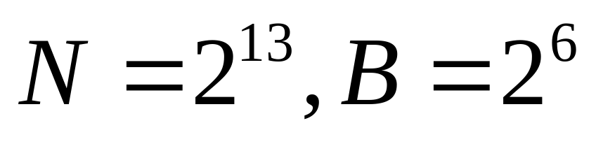
Alg. | Data refs | L1 misses | TLB misses
1 | 134,203 | 37,827 | 33,572
2 | 402,686 | 36,642 | 277
3 | 201,460 | 47,481 | 2,175
4 | 268,437 | 19,494 | 2,173
5 | 134,203 | 56,159 | 2,010
6 | 134,222 | 9,790 | 33
Counted in thousands.

Slide 51
Results analysis
  Data references are as expected
    minimum for algorithms 1,5 and 6.
    In algorithm 3 a 3/2 ratio.
    In algorithm 4 a 4/2 ratio.
    In algorithm 2 – depends on the number of merge iteration.
  TLB misses
    Algorithms 3,4 and 5 somewhat improved by virtue of working on sub-matrices.
    Dramatic reduced by Algorithm 2.
    Algorithm 6 optimal - tiles are contiguous in memory.

Slide 52
Data cache misses
  Less for algorithm 4 than in algorithm 3. With the growing disparity between processors and memory speeds alg 4 will outperform alg 3.
  Same comment for alg 2 vs. alg 3.

Slide 53
Conclusions
All algorithms perform the same algebraic operations. Different operation scheduling places different loads on various components.
Meaningful runtime predictions should consider the various memory components.
Relative performance depends critically on the cache miss latency. Performance needs to be reexamined as this parameter changes.
Morton layout should be seriously considered for dense matrix computation.

