Slide 1
System Programming Practices, Spring, 2016
Understanding Cache Memories - 2/2
Jake Choi <jichoi@dcslab.snu.ac.kr>

Slide 2
Cache and Program

Slide 3
Cache Mountain Drawing Code
double data[MAXELEMS]; /* The global array we’ll be traversing */
/*
* test - Iterate over first "elems" elements of array "data"
* with stride of "stride".
*/
void test(int elems, int stride) /* The test function */
{
int i;
double result = 0.0;
volatile double sink;
for (i = 0; i < elems; i += stride) {
result += data[i];
}
sink = result; /* So compiler doesn’t optimize away the loop */
}

Slide 4
Cache Mountain Drawing Code
Smaller elems enhances temporal locality
Smaller stride enhances spatial locality
double data[MAXELEMS]; /* The global array we’ll be traversing */
/*
* test - Iterate over first "elems" elements of array "data"
* with stride of "stride".
*/
void test(int elems, int stride) /* The test function */
{
int i;
double result = 0.0;
volatile double sink;
for (i = 0; i < elems; i += stride) {
result += data[i];
}
sink = result; /* So compiler doesn’t optimize away the loop */
}

Slide 5
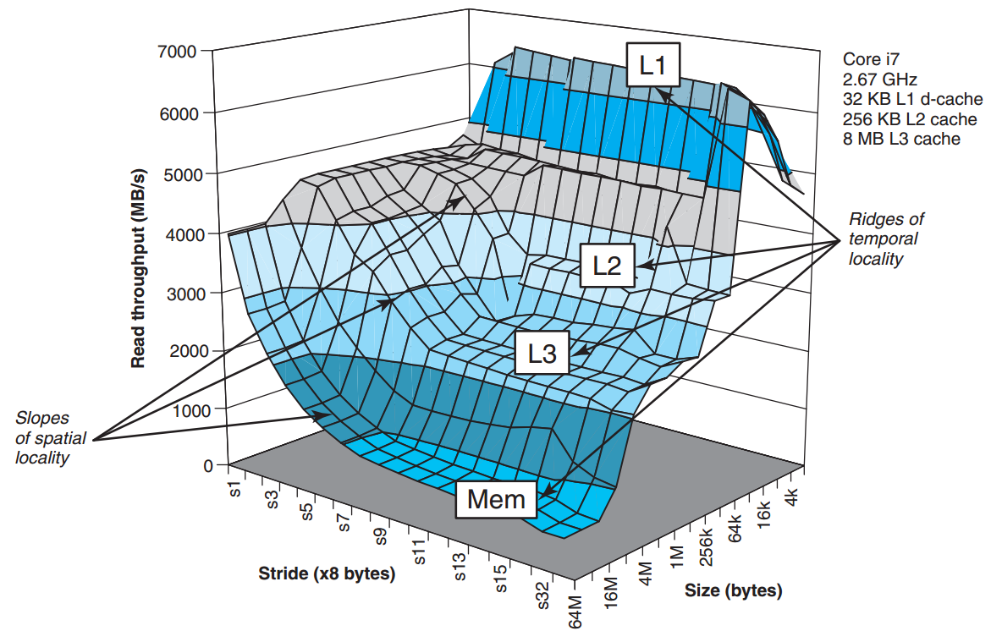
Memory Mountain

Slide 6
Memory Mountain
L1-L3, Memory ridges exist
Slope of spatial locality says spatial locality could enhances performance even within low temporal locality

Slide 7
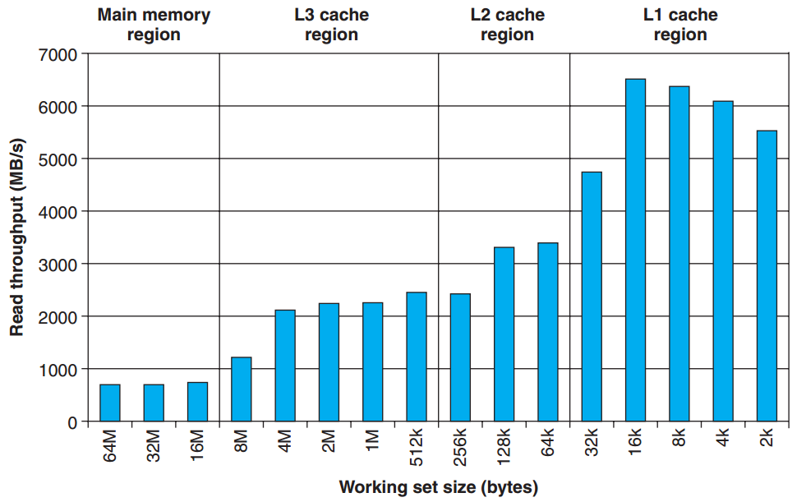
Ridges of Temporal Locality
Working set size shows temporal locality

Slide 8
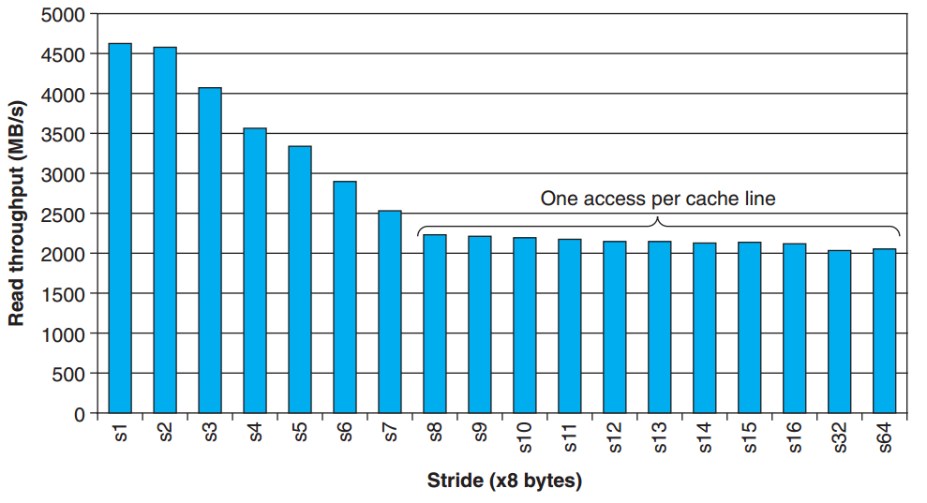
Slope of Spatial Locality
Stride shows spatial locality effects until it exceeds cache line

Slide 9
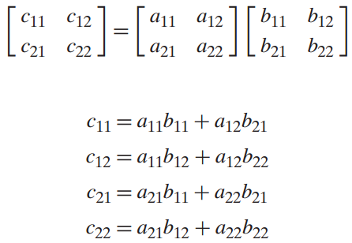
Matrix Multiplication
C = A * B
C: i columns and j rows
A: i columns and k rows
B: k columns and j rows

Slide 10
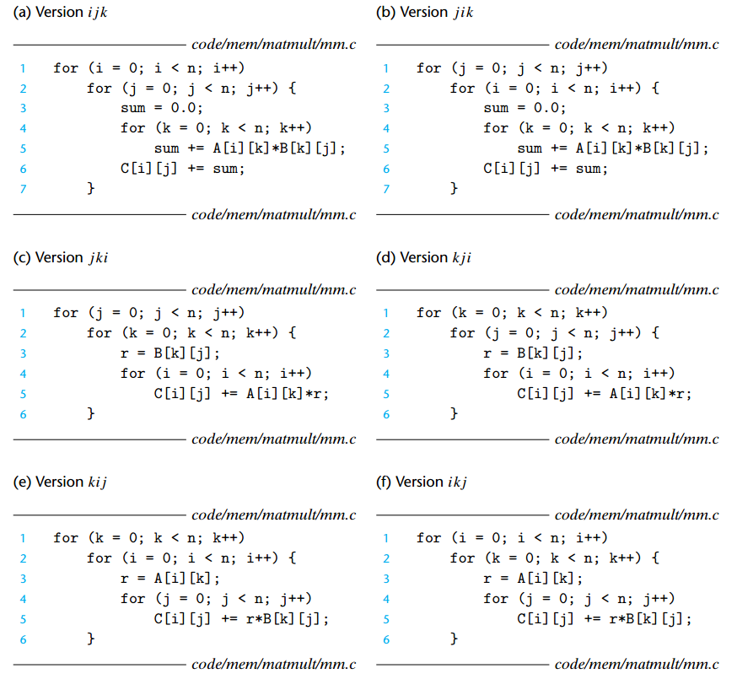
Six Implementations of MatMul
C = A * B
C: i x j
A: i x k
B: k x j

Slide 11
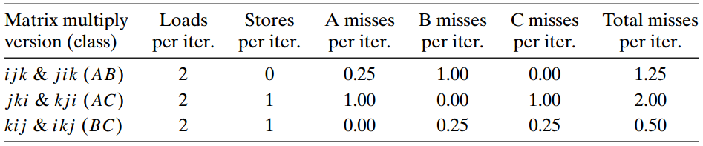
Analysis of Six Implementations
8 byte for each number in a matrix
32-byte block size single cache
Array size is larger than L1 cache
Compiler stores local variables in registers

Slide 12
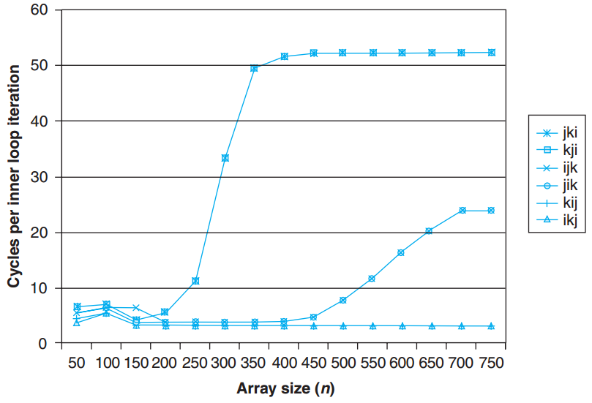
Matrix Multiply Performance

Slide 13
Exploiting Locality in Program
Focus attention on the inner loop
Maximize spatial locality by sequential load
Maximize temporal locality by using data as often as possible once it has been read

Slide 14
Assignment: Part B

Slide 15
Handout
Just use same folder as last week,
However, new PDF file is located in
Cachelab2 folder in sp_files
If you did not do last weeks assignment, then follow below:
ssh to sp.snucse.org
$ cp /home/sp_files/cachelab2/cachelab-handout.tar ./
$ tar xvf cachelab-handout.tar
$ cd cachelab-handout
$ make clean; make

Slide 16
Trace Files
In traces/, memory traces exist
Those traces are generated by valgrind
e.g., $ valgrind --log-fd=1 --tool=lackey -v --trace-mem=yes ls

Slide 17
Trace Files
Format: <operation> <address>, <size>
I: Instruction Load
M: Data modification(L + S)
L: Data Load
S: Data Store
Only I have space before <operation>
I 040012d3, 5
M 0421c7f0, 4
L 04f6b868, 8
S fff0004b8, 8

Slide 18
csim-ref
Cache simulator for valgrind memory trace
Receive valgrind memory trace as input
Outputs simulated # of hits, misses, evictions
Usage: ./csim-ref [-hv] -s <s> -E <E> -b <b> -t <tracefile>
-h: help message
-v: verbose output
-s <s>: Number of set index bits
-E <E>: Associativity
-b <b>: Number of block bits
-t <tracefile>: Path to valgrind memory trace file

Slide 19
csim-ref
Example
Simulates replay of yi.trace trace file on
16 set (-s 4)
direct mapping (-E 1)
16 bytes block size (-b 4) cache
$ ./csim-ref -s 4 -E 1 -b 4 -t traces/yi.trace
hits:4 misses:5 evictions:3

Slide 20
Matrix Transpose
Matrix A^{T} is Transpose of Matrix A if
A[i][j] == A^{T}[j][i]
1 2
3 4
1 3
2 4
is transpose of

Slide 21
Task
Implement a transpose function
that causes as few cache misses as possible
Implement in trans.c with name transapose_submit()
Use registerTransFunction() with transpose_submit_desc

Slide 22
Programming Rules
Include your Name, Student ID in header comment
Describe how the code works using comments
Should compile without warnings
Do not use recursion

Slide 23
Programming Rules
At most 12 int local variables are allowed
Including helper functions
Do not modify array A. No matter with B.
Do not define arrays, do not use dynamic memory allocation like malloc

Slide 24
Evaluation: Performance
Will check number of cache misses m with following 3 cases
32 x 32: 8 points if m < 300, 0 if m > 600
64 x 64: 8 points if m < 1,300, 0 if m > 2,000
61 x 67: 10 points if m < 2,000, 0 if m > 3,000
(Total 26 points)

Slide 25
Evaluation: Style
Code should be consistent and easy to be read with sufficient, clear description comments
7 points for Part A and Part B

Slide 26
test-trans: auto-grading program
Check correctness and performance automatically
Generates a trace using valgrind
Calculates cache misses using csim-reference with (s = 5, E = 1, b = 5)

Slide 27
test-trans: auto-grading program
Example usage
$ make
$ ./test-trans -M 32 -N 32
Function 0 (2 total)
Step 1: Validating and generating memory traces
Step 2: Evaluating performance (s=5, E=1, b=5)
func 0 (Transpose submission): hits:870, misses:1183, evictions:1151
Function 1 (2 total)
Step 1: Validating and generating memory traces
Step 2: Evaluating performance (s=5, E=1, b=5)
func 1 (Simple row-wise scan transpose): hits:870, misses:1183, evictions:1151
Summary for official submission (func 0): correctness=1 misses=1183
TEST_TRANS_RESULTS=1:1183

Slide 28
Hints
test-trans gives trace of function <n> as trace.f<n> file
Use csim-ref with trace.f<n> traces for detail
Trans function will be evaluated on direct-mapped cache(E=1)
Conflict misses are a potential problem
See Blocking technique
http://csapp.cs.cmu.edu/public/waside/waside-blocking.pdf

Slide 29
Submissions: Organize files
$ tree sp_practices3-2_2015-12345_Alice/
sp_practices3-2_2015-12345_Alice/
└── trans.c
student id
name (use Korean, please)

Slide 30
Submissions: Archive into zip file
$ zip -r sp_practices3-2_2015-12345_Alice.zip

Slide 31
Submissions: Email
Send the zip file
to:tskim@dcslab.snu.ac.kr cc:
jichoi@dcslab.snu.ac.kr
Title as filename except the extension, zip

Slide 32
For Detail about Assignment
Refer to cachelab.pdf inside cachelab2 folder

