Slide 1
System Programming Practices, Spring, 2015
Writing a Dynamic Allocator
Jake Choi <jichoi@dcslab.snu.ac.kr>

Slide 2
Notice
For Shell Lab due tomorrow,
If you submitted last week, please submit again because our lab mailserver was temporarily being repaired.
Thank you

Slide 3
Dynamic Memory Allocation

Slide 4
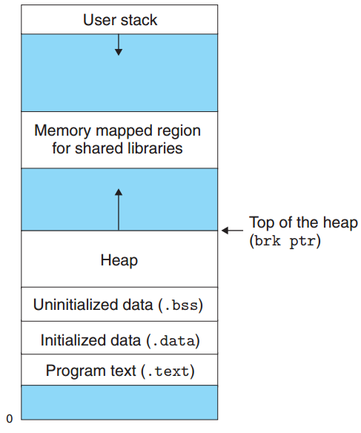
Memory Allocation
Allocation from Stack
For automatic variables (variables declared inside a block)
Allocated before entering the block, after leaving the block
Allocation from Heap
For undefined life cycled variables
Allocation done with explicit request
brk ptr could be adjusted using system call, sbrk()

Slide 5
Explicit / Implicit Dynamic Allocators
Explicit allocators
Not only allocation, but also freeing should be requested explicitly
Most popular interface: malloc() / free()
e.g., C, C++, Rust, …
Implicit allocators
Freeing could be done implicitly using garbage collection
Implemented inside programming language
e.g., Lisp, Java, Python, golang, ...

Slide 6
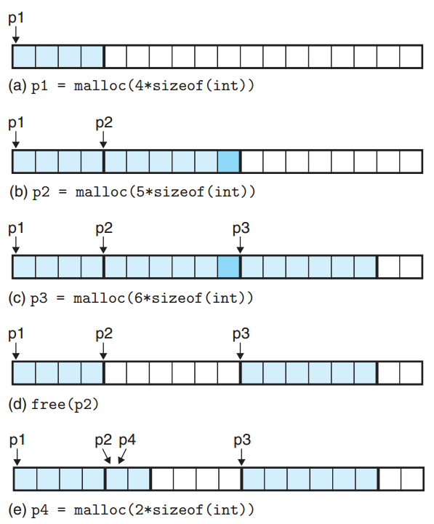
Explicit Allocator: example

Slide 7
Allocator Requirements
Handling arbitrary request sequences
Requests could be came without any assumptions
Making immediate responses to requests
Not allowed to reorder or buffer requests for performance
Using only the heap
Any non-scalar data for allocator itself should be stored in the heap itself
Aligning blocks
Blocks inside heap should be aligned to be able to hold any type of data object
Usually double-word alignment in most systems

Slide 8
Allocator Goals
Maximizing throughput
Response as many requests as possible
Maximizing memory utilization
Size of physical memory is limited
As it utilizes memory well, less swapping, better system performance possible

Slide 9

Fragmentation
Memory could be fragmented by allocations
Allocation could fail due to fragmentation though total free area is larger than requested
http://www.bloombergtradebook.com/content/uploads/sites/2/2013/08/fragmentation.jpg

Slide 10
Internal Fragmentation
Inside allocated block, padding for alignment could waste system memory
Could be big problem for frequent small allocations
Need efficient space usage
Payload
Padding
Payload
Padding
Payload
Padding
Double words align
3 words(50 % of entire memory) are wasted
due to internal fragmentaiton

Slide 11
External Fragmentation
No free block has enough size though sum of free blocks have
Need efficient placement
Allocated
Free
Allocated
Free
Allocated
Free
Requested

Slide 12
Implementation Issues
Free block organization
How to keep track of free blocks
Placement
Which free block should be allocated
Splitting
How to split remainder of free block after allocating a little area inside a large free block
Coalescing
Need to coalesce free blocks to eliminates external fragmentation

Slide 13
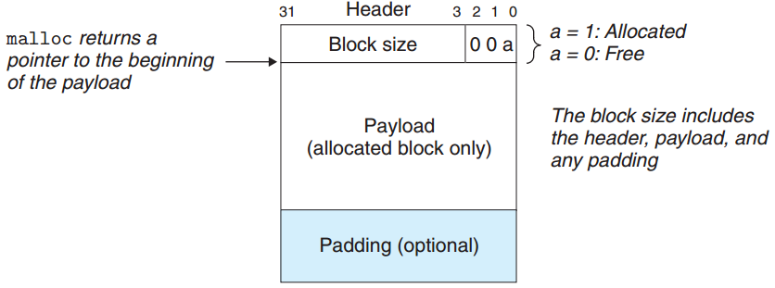
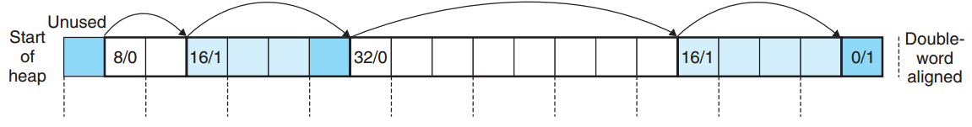
Implicit Free Lists
Construct the heap as a list of blocks by adding metadata inside a block as a head

Slide 14
Placing Allocated Blocks
First fit
Search appropriate size free block from start of heap
Increase search time for larger block
Next fit
Search appropriate size free block from last selected block
Suffer from worse memory utilization than first fit
Best fit
Select only best-fitting size free block
Best for memory utilization, worst for search time

Slide 15
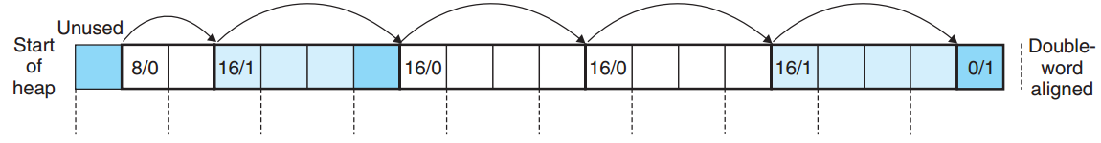
Coalescing Free Blocks
Adjacent, not coalesced free blocks could cause false fragmentation
Could be done immediately or later in batch
Hard to coalesce previous block

Slide 16
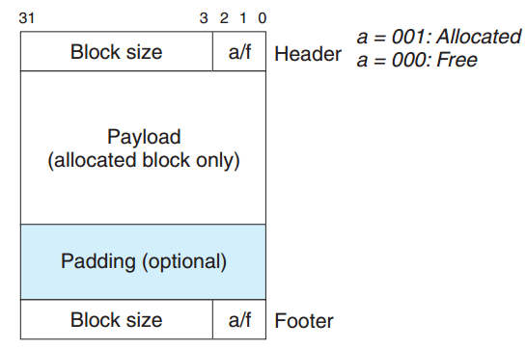
Coalescing with Boundary Tags
By boundary tag, the heap could be double-linked list
With double-linked list, coalescing is easy for previous block, too
Cons: more memory is wasted for meta-data

Slide 17
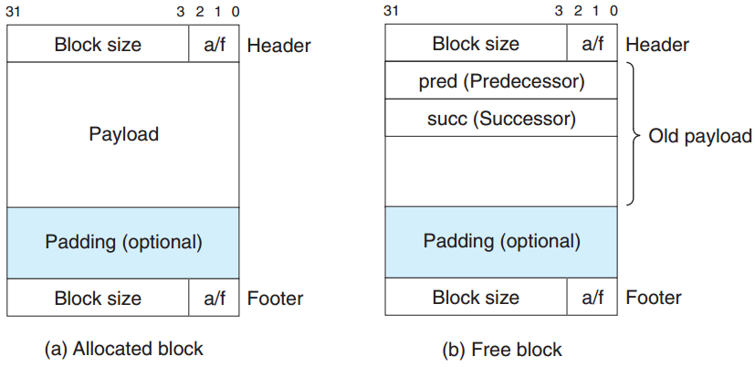
Explicit Free Lists
List only free blocks by adding pointer to predecessor / successor free block
Because body of free block is free to be used, memory is not wasted

Slide 18
Segregated Free Lists
Classify free blocks based on size of the block
Maintains a list per a class of free blocks
Could approximates best-fit algorithm
size 1
size 2
size 3-4
size 5-8
...

Slide 19
Buddy Allocator
Special case of segregated free lists
Linux also uses the allocator
Maintains power of two size classes
Find most nearest power of two size free block for request
If not found, split the larger block until it met
Coalesce adjacent same size block(buddy)
power of two size rule not broken

Slide 20
Summary
Dynamic memory allocation necessary for realistic programs
Throughput / Memory utilization is two goals of dynamic memory allocator
To achieve those goals, need careful design and policy

Slide 21
Assignment: malloc

Slide 22
Handout
ssh to sp.snucse.org
$ cp /home/sp_files/malloclab/malloclab-handout.tar ./
$ tar xvf malloclab-handout.tar
$ cd malloclab-handout
(Type your name and Student ID in mm.c)
$ make clean; make

Slide 23
Task
Implement a dynamic memory allocator
You should implement functions below. Should works as similar as libc version does
mm_init: Be called by user program at first
mm_malloc: Allocate memory and return address
mm_free: Free the allocated region
mm_realloc: Allocates again with new size

Slide 24
Support Routines
Use the following functions in memlib.c
void *mem_sbrk(int incr)
Expands the heap by incr bytes
void *mem_heap_lo(void)
Returns a pointer to the start of the heap
void *mem_heap_hi(void)
Returns a pointer to the end of the heap
size_t mem_heapsize(void)
Returns the current size of the heap in bytes
size_t mem_pagesize(void)
Returns the system’s page size in bytes

Slide 25
Heap Consistency Checker
Implement heap checker and use it for your debugging (Will be scored 5 points)
The checker would check…
Is every block in the free list marked as free?
Are there any contiguous free blocks that somehow escaped coalescing?
Is every free block actually in the free list?
Do the pointers in the free list point to valid free blocks?
Do any allocated blocks overlap?
Do the pointers in a heap block point to valid heap addresses?

Slide 26
Tool: mdriver
Test mm.c for correctness, space utilization, and throughput using trace files(*rep)
Default trace files are located at /home/sp_files/malloclab/traces/
$ ./mdriver -h
Usage: mdriver [-hvVal] [-f <file>] [-t <dir>]
Options
-a Don't check the student structure.
-f <file> Use <file> as the trace file.
-g Generate summary info for autograder.
-h Print this message.
-l Run libc malloc as well.
-t <dir> Directory to find default traces.
-v Print per-trace performance breakdowns.
-V Print additional debug info.

Slide 27
Programming Rules
Should not change any interfaces in mm.c
Should not invoke memory management related library calls or system calls
Should not define any global or static data structures. e.g., arrays, structs, trees, lists
Only scalar variables are allowed e.g., integers, floats, pointers, …
mm_malloc should align pointers to 8-bytes boundaries
e.g., Should returns 0, 8, 16, 24, …. not 1, 9, 13, ...

Slide 28
Evaluation
0 point if not correct
20 points for correctness
35 points for performance
10 points for style

Slide 29
Evaluation: Correctness (20 pts)
0 point if code is buggy and / or crashes the driver (No points from performance / style)
Will be evaluated using mdriver
Partial credit for each correct trace

Slide 30

Evaluation: Performance (35 pts)
Performance will be evaluated with space utilization and throughput via formula below
P: performance
w: constant, 0.6
U: utilization
T: throughyput
T_{libc}: Throughput of libc version

Slide 31
Evaluation: Style (10 pts)
Use as few global variables as possible
Code should begin with a header comment that describes the code
Each subroutine should have a header comment that describes what / how it does
Heap consistency checker should be thorough and well-documented
5 points for heap consistency checker

Slide 32
Submissions: Organize files
$ tree sp_practices6_2015-12345_Alice/
sp_practices6_2015-12345_Alice/
└── mm.c
student id
name
(use Korean, please)

Slide 33
Submissions: Archive into zip file
$ zip -r sp_practices6_2015-12345_Alice.zip

Slide 34
Submissions: Email
Send the zip file
to:tskim@dcslab.snu.ac.kr cc:
jichoi@dcslab.snu.ac.kr
Title as filename except the extension, zip
Submission due date: Wednesday 18, May 23:59

Slide 35
For Detail about Assignment
Refer to malloclab.pdf inside handout file

