Slide 1
Scaling IP Addresses
NAT/PAT and DHCP
CCNA 4 version 3.0

Slide 2
Overview
Identify private IP addresses as described in RFC 1918
Discuss characteristics of NAT and PAT
Explain the benefits of NAT
Explain how to configure NAT and PAT, including static translation, dynamic translation, and overloading
Identify the commands used to verify NAT and PAT configuration
List the steps used to troubleshoot NAT and PAT configuration
Discuss the advantages and disadvantages of NAT
Describe the characteristics of DHCP
Explain the differences between BOOTP and DHCP
Explain the DHCP client configuration process
Configure a DHCP server
Verify DHCP operation
Troubleshoot a DHCP configuration
Explain DHCP relay requests

Slide 3
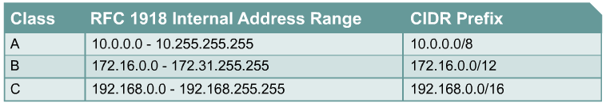
Private addressing
172.16.0.0 – 172.31.255.255: 172.16.0.0/12
  Where does the /12 come from?
12 bits in common
10101100 . 00010000 . 00000000 . 00000000 – 172.16.0.0
10101100 . 00011111 . 11111111 . 11111111 – 172.31.255.255
-------------------------------------------------------------
10101100 . 00010000 . 00000000 . 00000000 – 172.16.0.0/12

Slide 4
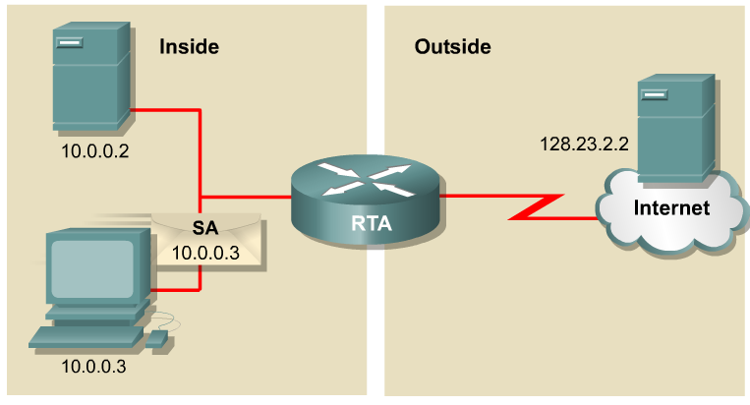
Introducing NAT and PAT
NAT is designed to conserve IP addresses and enable networks to use private IP addresses on internal networks.
These private, internal addresses are translated to routable, public addresses.
NAT, as defined by RFC 1631, is the process of swapping one address for another in the IP packet header.
In practice, NAT is used to allow hosts that are privately addressed to access the Internet.
NAT translations can occur dynamically or statically.
The most powerful feature of NAT routers is their capability to use port address translation (PAT), which allows multiple inside addresses to map to the same global address.
This is sometimes called a many-to-one NAT.

Slide 5
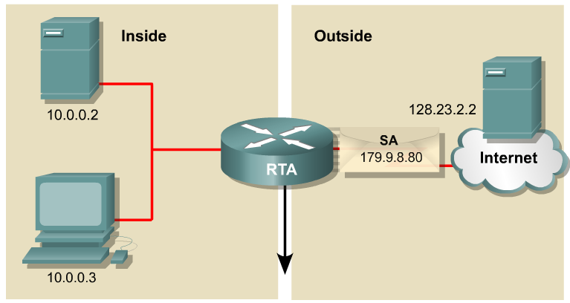
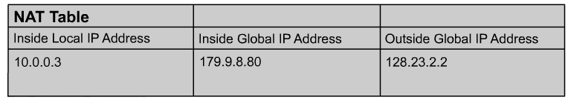
NAT Example
Inside local address – The IP address assigned to a host on the inside network. This address is likely to be an RFC 1918 private address.
Inside global address – A legitimate (Internet routable or public) IP address assigned by the service provider that represents one or more inside local IP addresses to the outside world.
Outside local address – The IP address of an outside host as it is known to the hosts on the inside network.
Outside Global Address

Slide 6
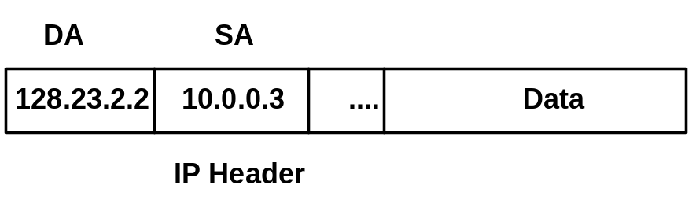
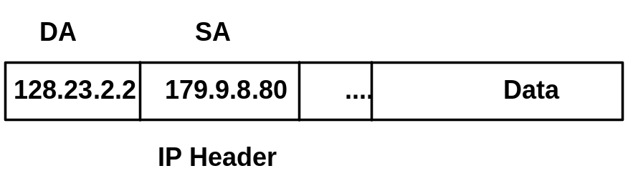
NAT Example
2
1
1
2
The translation from Private source IP address to Public source IP address.

Slide 7
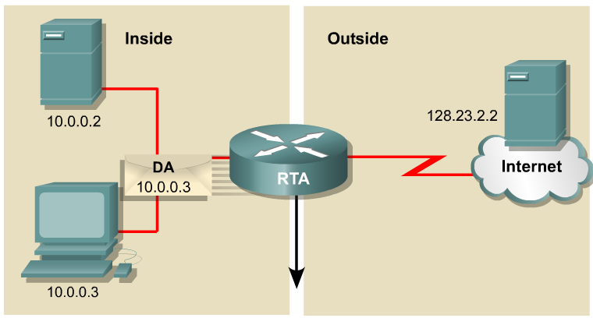
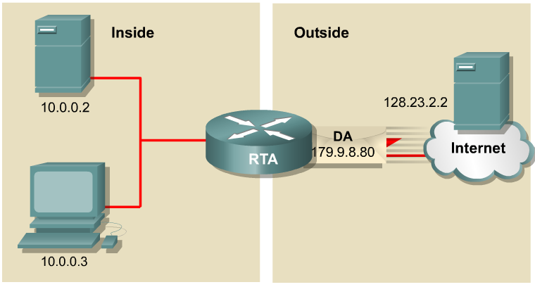
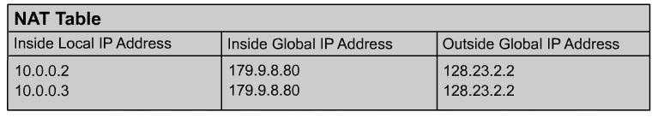
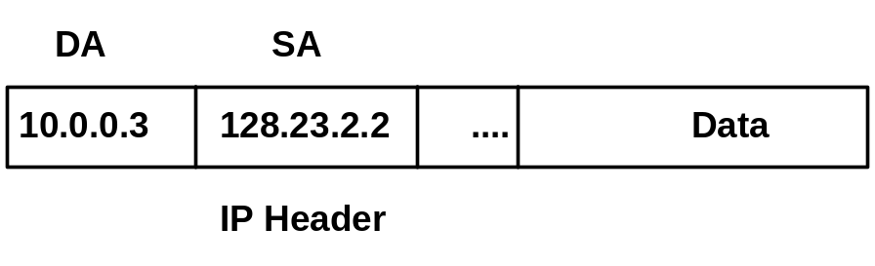
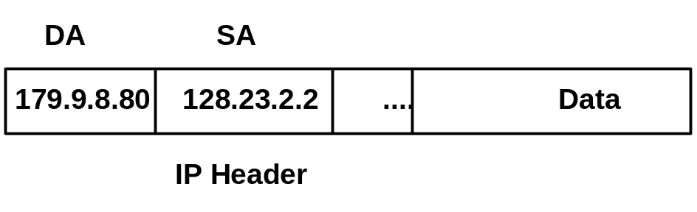
NAT Example
4
3
4
3
Translation back, from Public destination IP address to Private destination IP address.

Slide 8
Configuring Dynamic NAT
Define the pool of public IP addresses, using the ip nat pool command:
router(configI#ip nat pool HR-Global 199.99.9.65 199.99.9.95 netmask 255.255.255.224
Define an access list that matches the inside private IP addresses:
router(config)#access-list 1 permit 10.10.10.0 0.0.0.25
Define the NAT translation from inside the list to outside the pool:
router(config)#ip nat inside source list 1 pool HR-Global
Specify the interfaces:
router(config)#int fa 0/0
router(conf-if)ip nat inside
router(config-if)int s0/0
router(config-if) ip nat outside

Slide 9
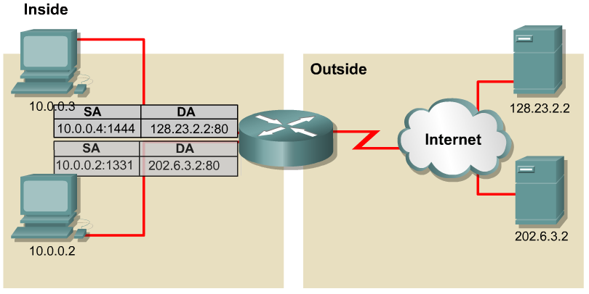
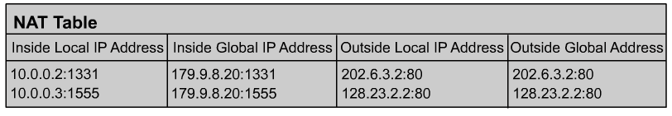
PAT – Port Address Translation
PAT (Port Address Translation) allows you to use a single Public IP address and assign it up to 65,536 inside hosts (4,000 is more realistic).
PAT translates and records the TCP/UDP source port address to track inside Host addresses.

Slide 10
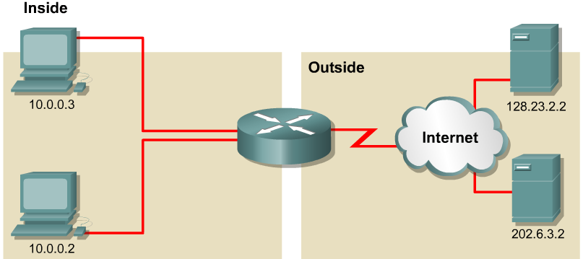
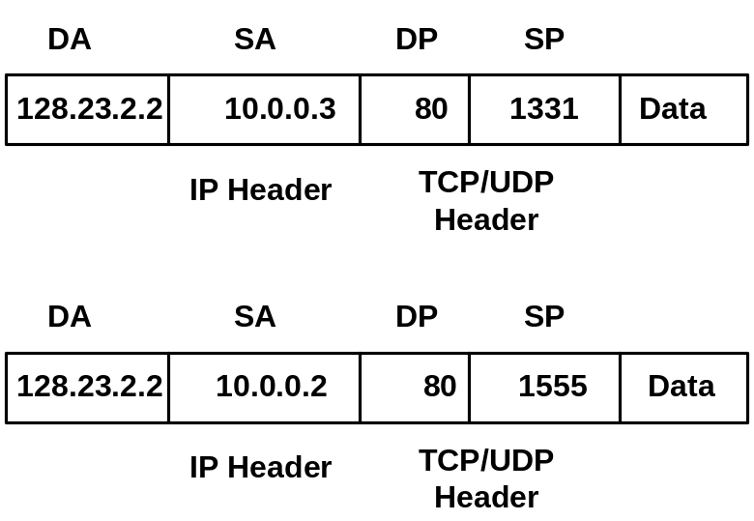
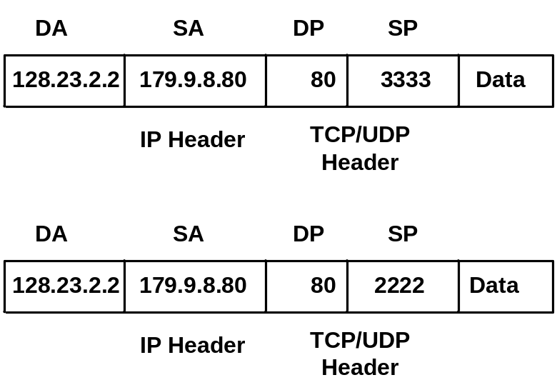
PAT Example
NAT/PAT table maintains translation of:
DA, SA, SP
1
2
1
2

Slide 11
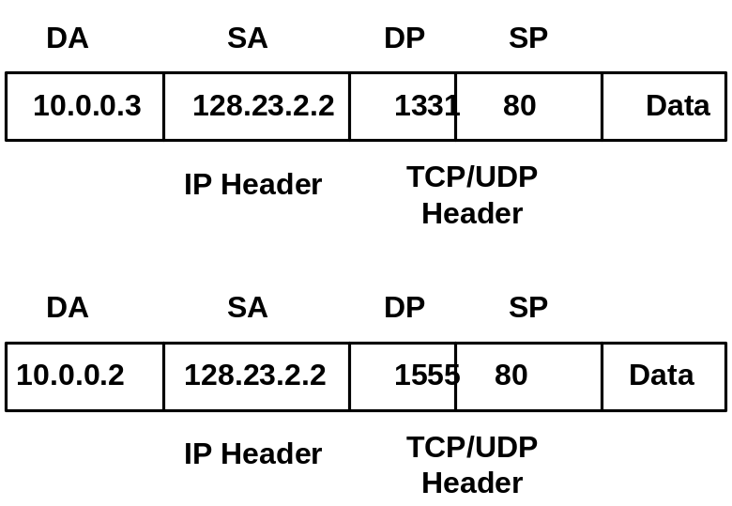
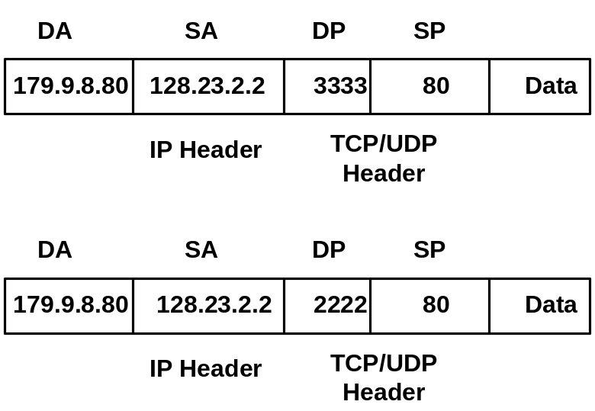
PAT Example
How Would the NAT Table Look
NAT/PAT table maintains translation of:
SA (DA), DA (SA), DP (SP)
4
3
4
3

Slide 12
PAT – Port Address Translation
With PAT a multiple private IP addresses can be translated by a single public address (many-to-one translation).
This solves the limitation of NAT which is one-to-one translation.

Slide 13
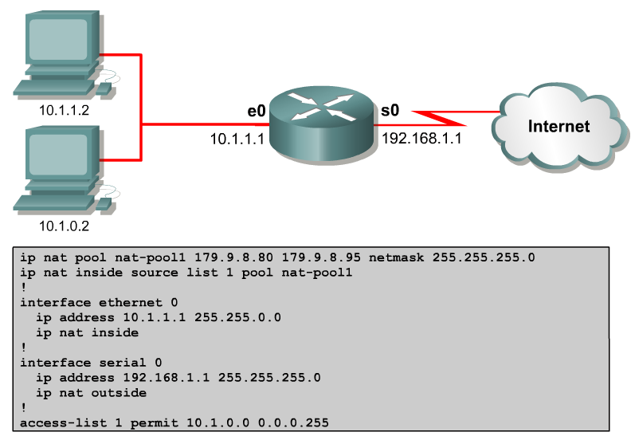
Configuring Dynamic NAT with PAT
Translate to these outside addresses
Start here
Overload
Source IP address must match here

Slide 14
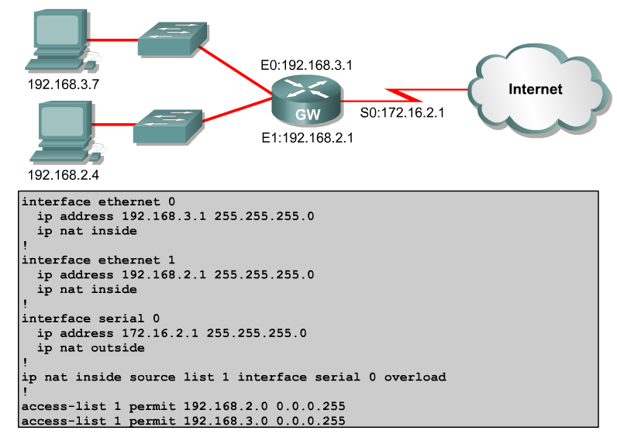
Configuring Dynamic NAT with PAT (Scenario#2)
This is a different example, using the IP address of the outside interface instead specifying a pool of inside-global IP addresses

Slide 15
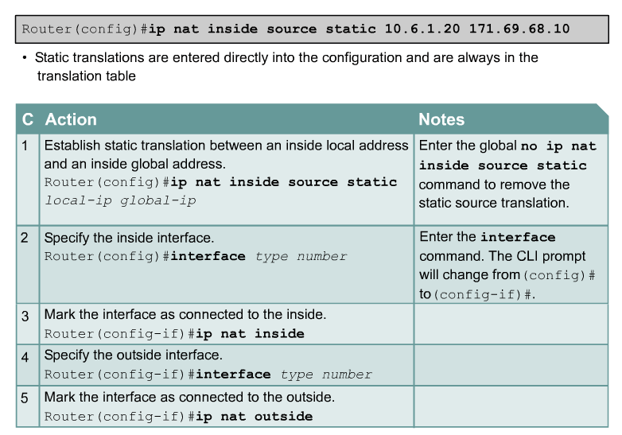
Static NAT

Slide 16
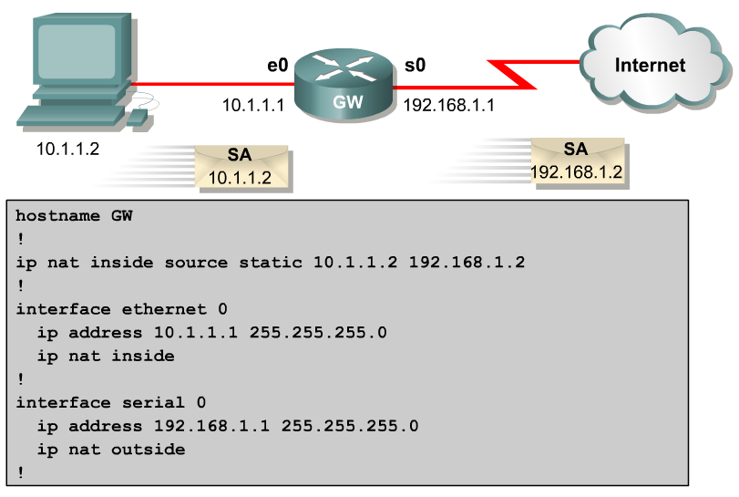
Configuring Static NAT

Slide 17
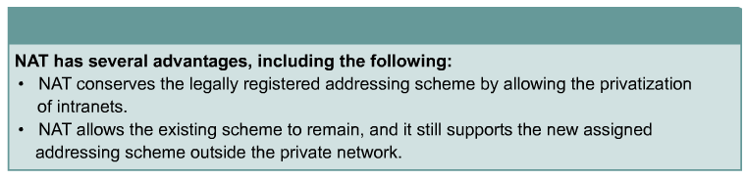
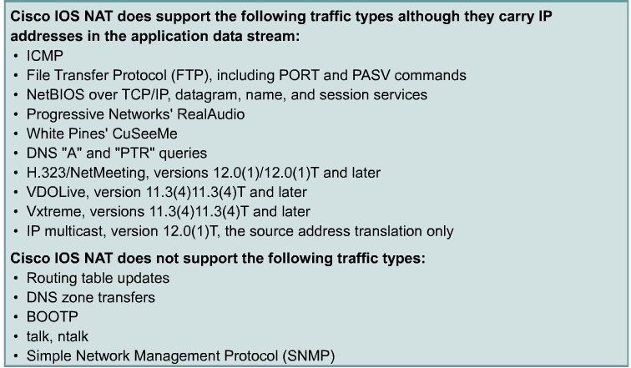
Issues with NAT/PAT
NAT also forces some applications that use IP addressing to stop functioning because it hides end-to-end IP addresses.
Applications that use physical addresses instead of a qualified domain name will not reach destinations that are translated across the NAT router.
Sometimes, this problem can be avoided by implementing static NAT mappings.

Slide 18
DHCP
Dynamic Host Configuration Protocol
The first several slides should be a review of DHCP from CCNA 1.
We will start with the discussion of configuring DHCP on a Cisco router.
Please read the online curriculum if you need a review.

Slide 19
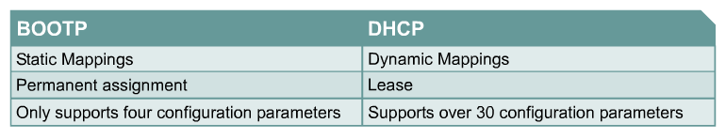
BOOTP and DHCP differences
There are two primary differences between DHCP and BOOTP:
DHCP defines mechanisms through which clients can be assigned an IP address for a finite lease period.
  This lease period allows for reassignment of the IP address to another client later, or for the client to get another assignment, if the client moves to another subnet.
  Clients may also renew leases and keep the same IP address.
DHCP provides the mechanism for a client to gather other IP configuration parameters, such as WINS and domain name.

Slide 20
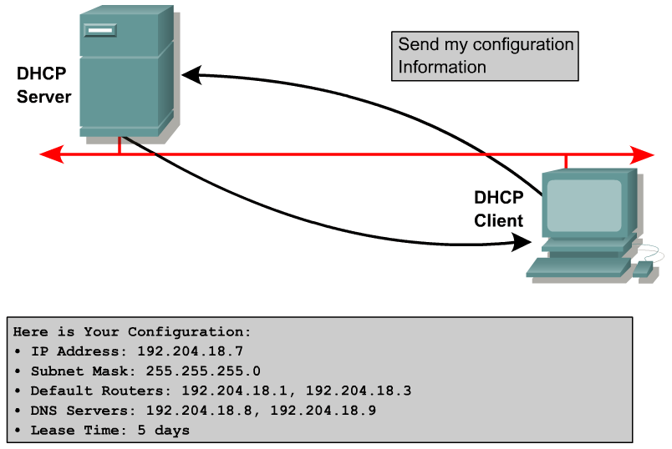
Major DHCP features

Slide 21
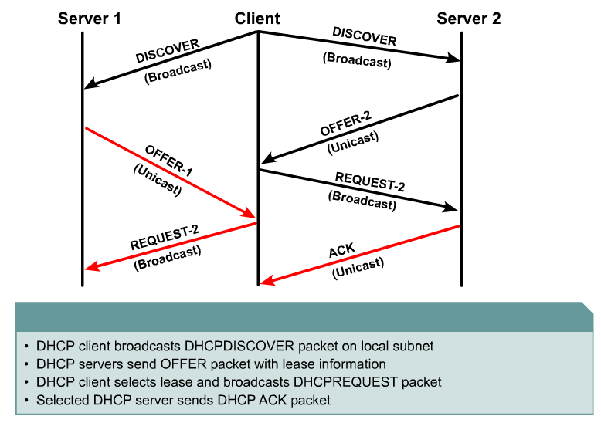
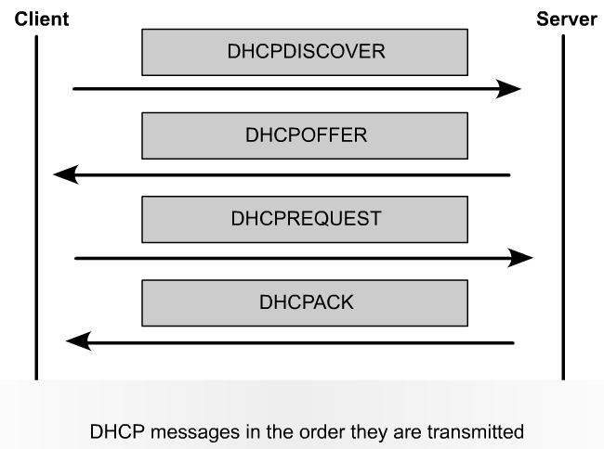
DHCP Operation

Slide 22
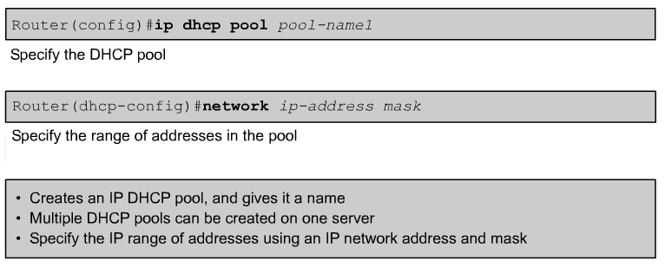
Configuring DHCP
Note: The network statement enables DHCP on any router interfaces belonging to that network.
  The router will act as a DHCP server on that interface.
  It is also the pool of addresses that the DHCP server will use.

Slide 23
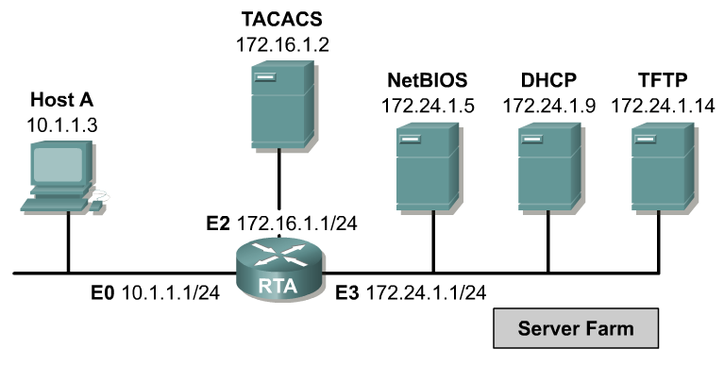
DHCP Relay
DHCP clients use IP broadcasts to find the DHCP server on the segment.
What happens when the server and the client are not on the same segment and are separated by a router?
  Routers do not forward these broadcasts.
When possible, administrators should use the ip helper-address command to relay broadcast requests for these key UDP services.

Slide 24
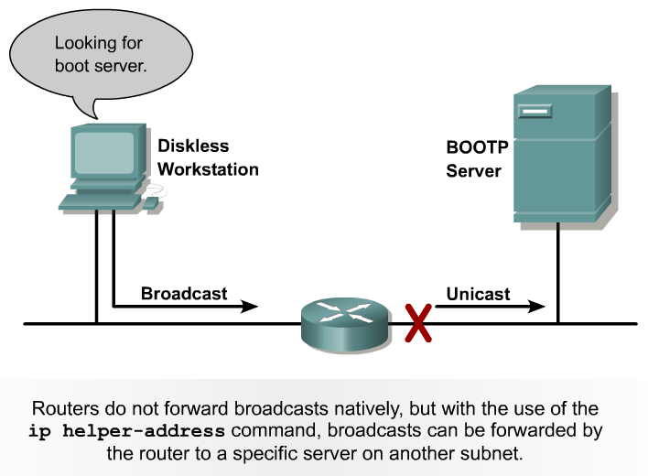
Using helper addresses

Slide 25
Configuring IP helper addresses
L3 Broadcast
L2 Broadcast
Helper address configuration that relays broadcasts to all servers on the segment.
RTA(config)#interface e0
RTA(config-if)#ip helper-address 172.24.1.255
RTA(config)#interface e3
RTA(config-if)#ip directed-broadcast

