Slide 1
Project 3
Semantic Analysis

Slide 2
Projects
Lexical analyzer
Yacc programming
Semantic analysis
Code generation

Slide 3
Overview
Embedded action
Grammar
Semantic check
Output format & Tips
Submission

Slide 4
Embedded Action

Slide 5
Embedded Action
thing: A B ;
thing: A { printf(“seen an A”); } B ;
thing: A fakename B ;
fakename: /* empty */ { printf(“seen an A”); } ;
thing: A { $$ = 17; } B { printf(“%d”, $2); } ;
$$ $1 $2 $3 $4

Slide 6
Embedded Action
Embedded action can cause shift/reduce conflict in otherwise acceptable grammars
thing: abcd | abcz ;
abcd: ‘A’ ‘B’ ‘C’ ‘D’ ;
abcz: ‘A’ ‘B’ ‘C’ ‘Z’ ;
thing: abcd | abcz ;
abcd: ‘A’ ‘B’ ‘C’ ‘D’ ;
abcz: ‘A’ ‘B’ { somefunc(); } ‘C’ ‘Z’ ;
fakename

Slide 7
Grammar

Slide 8
Grammar
Cannot declare variable and initialize simultaneously
int a = 0; /* syntax error */
No anonymous struct declaration
struct { int x;, int y; } w; /* syntax error */

Slide 9
Grammar Change
No following ASSIGNOP
+=, -=, *=, /=, %=
No multiply, divide, modulo operation on binary expression
binary ‘*’ binary
Added Pre-increment/decrement operation
INCOP unary
DECOP unary

Slide 10
Semantic Check

Slide 11
Semantic Check
If the variable and function are declared
Re-declaration of same variables at same scope
No Type Casting
Pointer Operation
Operation on Structure
Structure Pointer Declaration
Function
LValue Checking
Operand Checking

Slide 12
Undeclared Variables & Functions
Defining variables or function call which is not declared makes error
variable
// int a;
a = 0; /* error */
function call
// void foo();
foo(); /* error */

Slide 13
Redeclaration of Same Variables at Same Scope
{
int a;
int a; /* error */
char a; /* error */
}
{
int a;
{
int a; /* OK */
}
}

Slide 14
No Type Conversion
No explicit type casting
ex) char a;
int b = (int) a; /* error */
No implicit type casting
0 cannot be used as NULL
0 != NULL
ex) int* b = 0; /* error */

Slide 15
NULL
0 is always integer
int *a[2];
int *b;
int c;
char *d;
char e;
a = 0; /* error (int** != int) */
b = 0; /* error (int* != int) */
b = 1; /* error */
c = 0; /* legal */
d = 0; /* error */
e = 0; /* error */

Slide 16
Pointer Operation
Only following operations are admitted
pointer operator
*, &
increment / decrement operator
++, --
relation operator
>, <, >=, ==, !=
pointer arithmetic
pointer + integer, pointer - integer

Slide 17
Operation on Structures
‘.’ must have structure type operand left.
‘->’ must have pointer to structure type operand left
ID following ‘.’, ‘->’ must be defined in the structure type
Only pointer can be operator of unary ‘*’

Slide 18
Structure Declaration
Structure type must be defined before declaration of the structure type instance
Redefining structure type is illegal
scope is not applied to struct type
remember this is against C/C++ standard

Slide 19
Structure Pointer Declaration
When structure pointer type variable is declared, lookup structure type
Link if the structure type is defined
Otherwise, generate incomplete type error
this is also against ANSI C/C++ standard

Slide 20
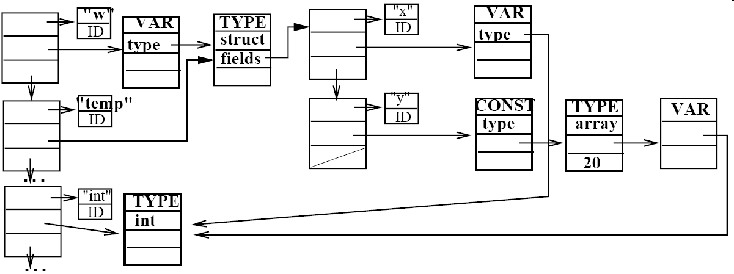
Structure Pointer Declaration
ex)
struct temp { int x; int y[20]; } w;
struct temp *w1;
Notes:
int는 reserved word에 해당, type initialize에서 생성됨

Slide 21
Structure Declaration
struct a {
struct b x; /* incomplete type error */
struct b* p; /* incomplete type error */
struct b { } y; /* OK!! */
};
struct b { /* error */
};
int func() {
struct b { } x; /* error */
}

Slide 22
Function
Check return type with the previous function declaration
check strictly, not using implicit rules
Check actual arguments with formal arguments
check strictly, not using implicit rules
Check type of the expression following return type of the function

Slide 23
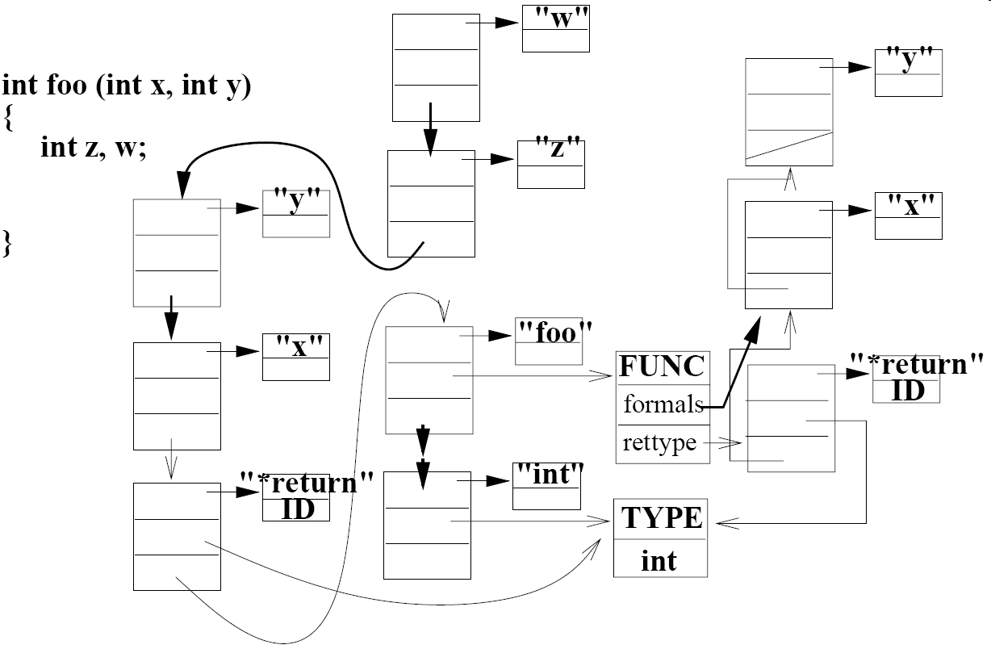
Function

Slide 24
LValue (Assignment) Checking
Should have same type
Exception : pointer = array
int *a[5];
int *b;
int c[10];
struct temp1 { int a; } *s1;
struct temp1 s2;
struct temp2 { int b; } *s3;
a = b; /* error (int**) != (int*) */
b = c; /* legal (int*) == (int array) */
s1 = s3; /* error (*temp1 != *temp2) */
s1 = s2; /* error */
s1 = &s2; /* legal */

Slide 25
LValue (Assignment) Checking
int a[10];
int *b;
a = 0; /* error */
a[0] = 0; /* legal */
b = a; /* legal */
b = &a; /* error */
b = &a[10]; /* legal */
b = &b; /* error */
b = &*(a+5); /* error */
b = &(b++); /* error */
b = &*(b++); /* legal */

Slide 26
LValue (Assignment) Checking
int *a;
int b[10];
a = b;
b
ID
CONST
TYPE
VAR
type
array
type
elementvar
a
ID
VAR
TYPE
VAR
Type
type
pointer
type
int
ptrto

Slide 27
Operand Check: Unary -
Only for integer
int a;
char b;
a = 10;
b = 'a';
a = -a; /* legal */
b = -b; /* error */

Slide 28
Operand Check: INCOP, DECOP
For char, int, pointer
int a;
char b;
int* c;
char d[10];
struct temp { int a;} e;
a++;
--a;
b++;
c++;
--d; /* error */
++e; /* error */

Slide 29

Operand Check: Binary +, -
Legal operand
int $±$ int
pointer $±$ int
int + pointer
Error operand
Array $±$ int
int + Array
…

Slide 30
Operand Check: Relop, Equop
>=, >, <=, <, ==, !=
char OP char
int OP int
pointer OP pointer (pointers must point same type)
return int variable as result
int *a;
int *b;
(a > b) || ( a == b )
1 or 0 1 or 0

Slide 31
Operand Check: Logical Operators
&&, ||, !
Only for int variable
int && int
int || int
! int
Input test file
int variables are derived from Relop, Equop, Logical op
Don’t need to check whether it is derived from relop/equop/logical op or not
ex) a = 5 * (b == 0) /* OK */

Slide 32
NULL
No null in input file
0 is always integer
int *a[2];
int *b;
int c;
char *d;
char e;
a = 0; /* error (int** != int) */
b = 0; /* error (int* != int) */
b = 1; /* error */
c = 0; /* legal */
d = 0; /* error */
e = 0; /* error */

Slide 33
Output & Tips

Slide 34
Output
Output format
filename:line: error: description
Use read_line() function to get line number
ex)
test.c:5 : error: ‘i’ undeclared (first use in this function)
test.c:11: error: invalid initializer

Slide 35
Skip error code
Should be able to proceed to next step when error occurs
Return null when error occurs
int a; char a; /* error */ a = 1; /* legal (int) = (int) */ a = 'c'; /* error */
Var_decl
: pointers ID {
if($1==0){ // Not pointer
if(check_is_declared($2))
declare($2,$$=makevardecl(NULL));
else
$$ = NULL;
}

Slide 36
Tips
Carefully follows the implementation in class handout.
Grammars are almost same.
Implement your own type check functions for data structures.
Improves code readability
Faster debugging
Be careful for segmentation fault(accessing NULL pointer)
Always beware of how information flows while reduce occurs.

Slide 37
Submission
제출 기한
11월 23일 23시 55분
제출 방법
newetl.snu.ac.kr을 통해서 제출
제출 파일
subc.l, subc.y, subc.h, hash.c, hash.h 등 소스파일과 Makefile, readme 파일, 결과 보고서을 압축해서 zip파일로 제출
결과 보고서에는 구현방법, 구현내용,각 제한사항에 대한 문제점에 대해서 작성한다
파일명: project3_학번.zip
readme 파일에는 이름, 학번, 이메일, 실행방법(Makefile을 변경하였을 경우)을 적는다.

Slide 38
Notice
수업 게시판 확인
수정 또는 추가되는 사항은 항상 게시판을 통하여 공지
제출 마지막날까지 공지된 사항을 반영해서 제출
소스코드에 자세히 주석달기
Cheating 금지 (F처리, 모든 코드 철저히 검사)
TA
정인창 (301동 851호)
E-mail: jic0729@altair.snu.ac.kr

