Slide 1
Moodster: An Intelligent Mood Music Generator
Bella Vann & William Rausch
iavann9172@ung.edu
wnraus1716@ung.edu

Slide 2
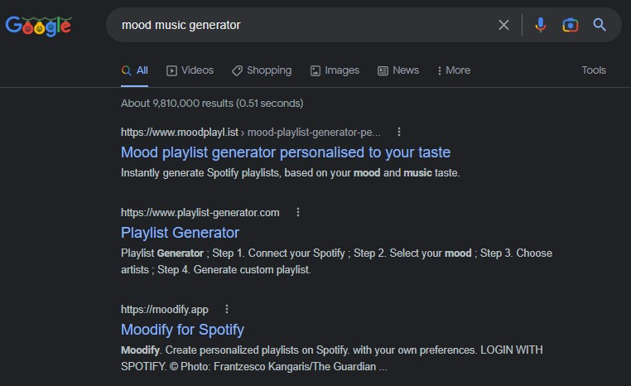
Problem
If you were to Google “mood music generator”:
Creates playlists based on your interests, not just mood.
Limited to Spotify.
Only has pre-existing songs.

Slide 3

Importance
Sometimes, when you are happy, or sad, you might be looking to hear a specific song. Other times, you might just want a song that suits your mood. When you are looking for this music, you don’t always want to think of a specific genre; you want to think of a mood and then just listen to music based on that very implicit preference. This can be difficult when other apps want you to think of what genre you want to listen to.

Slide 4

Description
Website.
Pulls songs based on a pre-set mood.
Generates songs based on a mood.

Slide 5





Building
HTML, CSS, JavaScript
API
Machine Learning

Slide 6
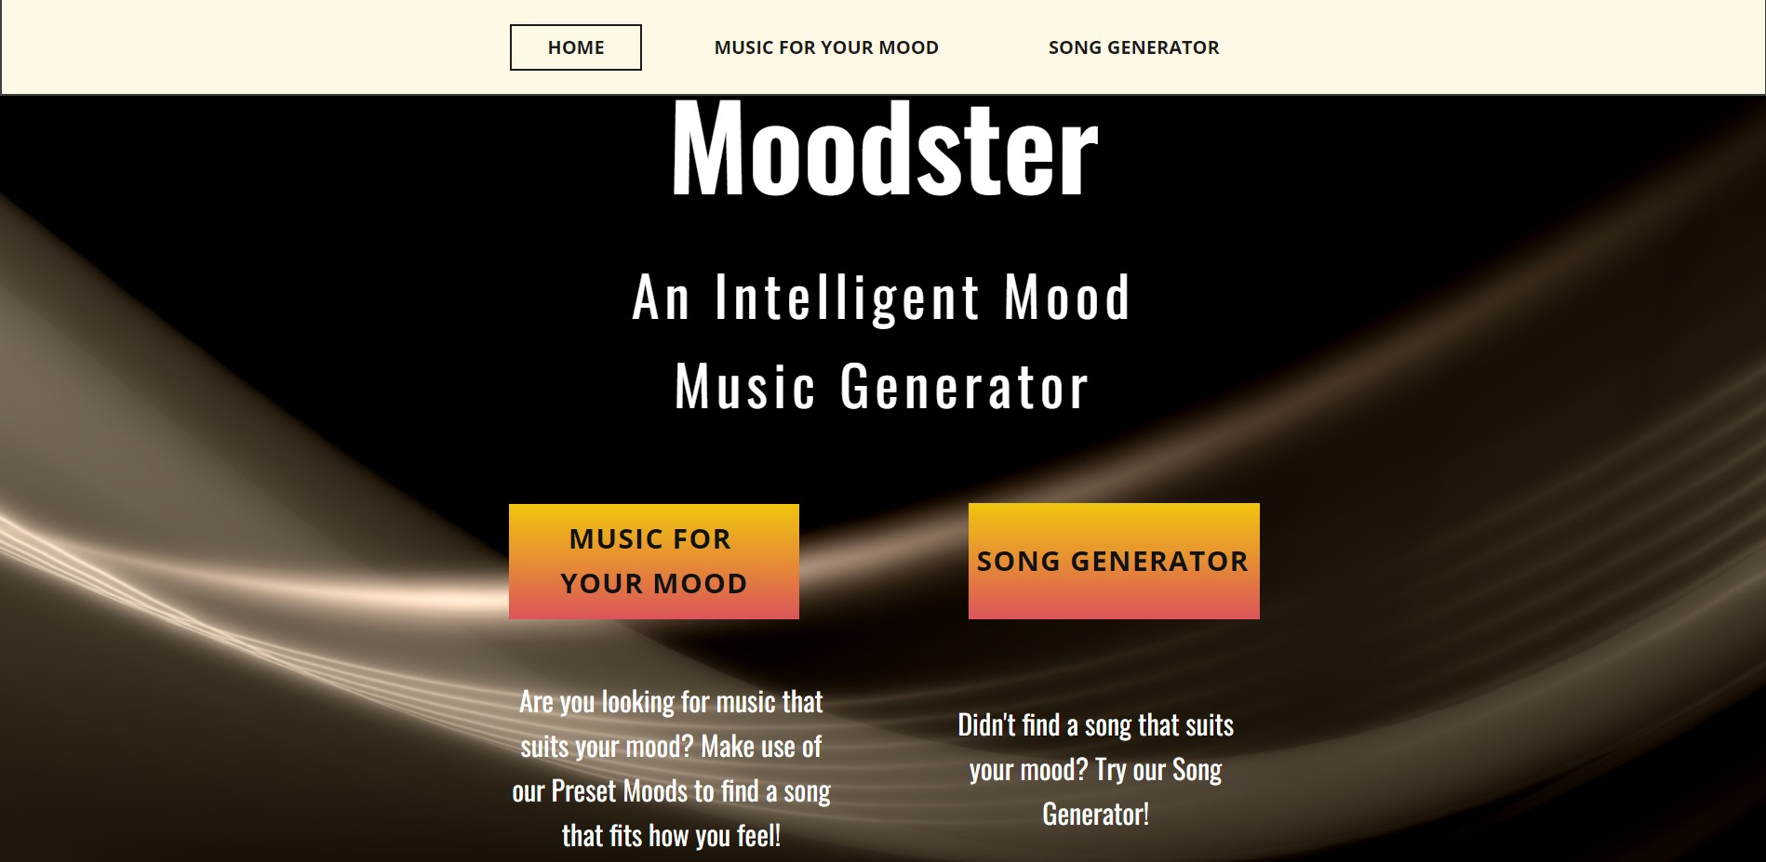
https://bellavann.github.io/Moodster/

Slide 7
Strengths & Weaknesses
Strength
Website successfully pulls from the iTunes API.
Strength
Song Generator creates new song each time it is triggered.
Weakness
Limited number of moods.
Weakness
Search feature occasionally plays song that does not match the mood.

Slide 8

Future Work
Add More Moods
Do More with Song Generator
Fix Bugs
Work on User Interface
Add More Functionality
More Specific ‘Search’ Function

