Slide 1
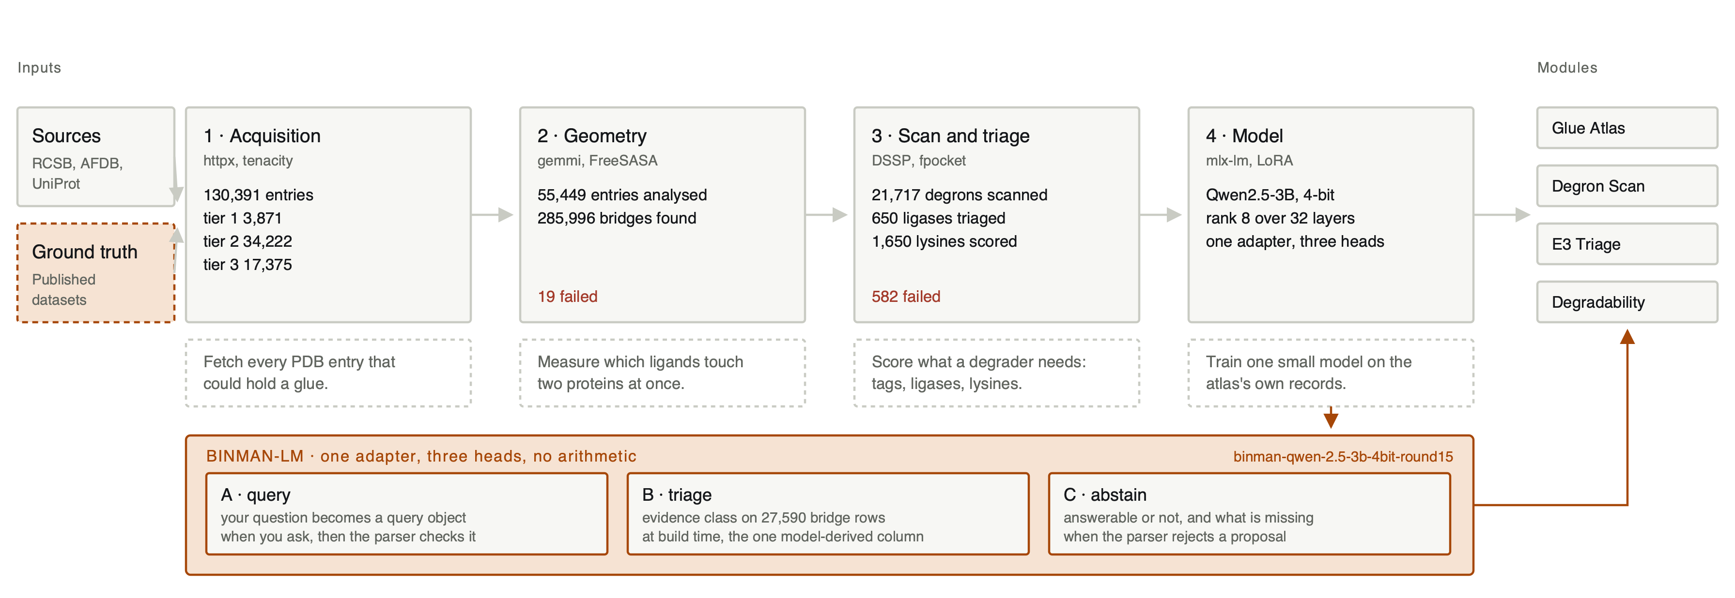
BINMAN
Marc C. Deller, D.Phil.
binman.mdeller.com
github.com/bellcheddar/BINMAN
Blind-spot INventory of Molecular Adhesives and Neosubstrates
Molecular glues have been sitting in the PDB for thirty years, deposited by crystallographers who were solving something else and had no reason to label the ligand as one. BINMAN finds them by geometry rather than annotation: every non-polymer entity that buries meaningful surface against two or more protein chains at once. 130,391 entries catalogued, 285,996 bridges measured, 15,804 that no curated glue database lists.
Four stages, left to right, then the four modules that read the result. The trained layer underneath is one small language model that does the text work and none of the arithmetic.
Notes:
BINMAN is an empirical atlas. Nothing here is predicted structure: every bridge is measured in a deposited crystal or cryo-EM structure. The four stages run left to right and each writes a manifest, so the whole thing is resumable. The next five slides take the same build apart five ways, for anyone who wants the software rather than the summary.

Slide 2
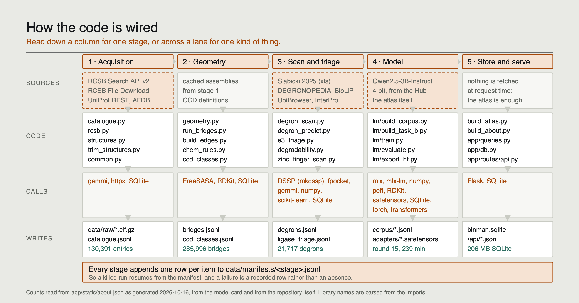
Notes:
Read down a column for one stage, or across a lane for one kind of thing. The CALLS lane is parsed out of the imports rather than written by hand, which is why it is worth trusting: a module that drops a library changes this figure at the next build. The band at the bottom is the part that makes the build survivable. Every stage appends one row per item to its manifest, so a run killed at hour nine resumes at item 90,000 rather than at item one.

Slide 3
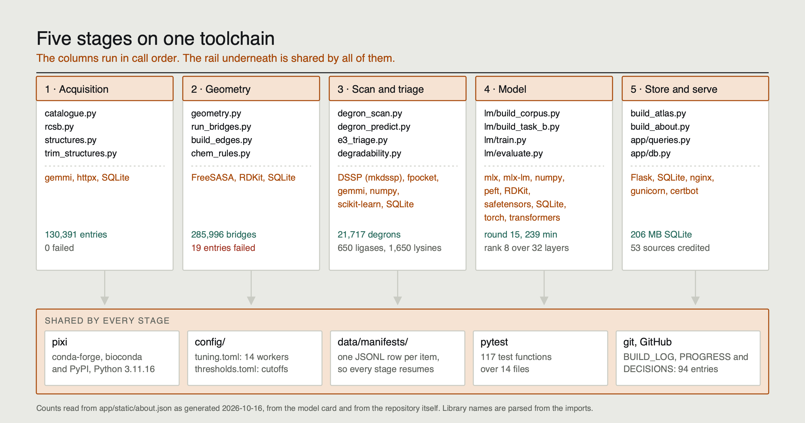
Notes:
The same five stages, with the machinery they share drawn once instead of five times. pixi pins one environment and one lock file; the thresholds live in a TOML file rather than in the Python, so no cutoff is buried in a function; the manifests make every stage resumable; the tests cover the pipeline and the serving layer in one run. The point of the rail is that these are not five scripts that happen to be in one folder.

Slide 4
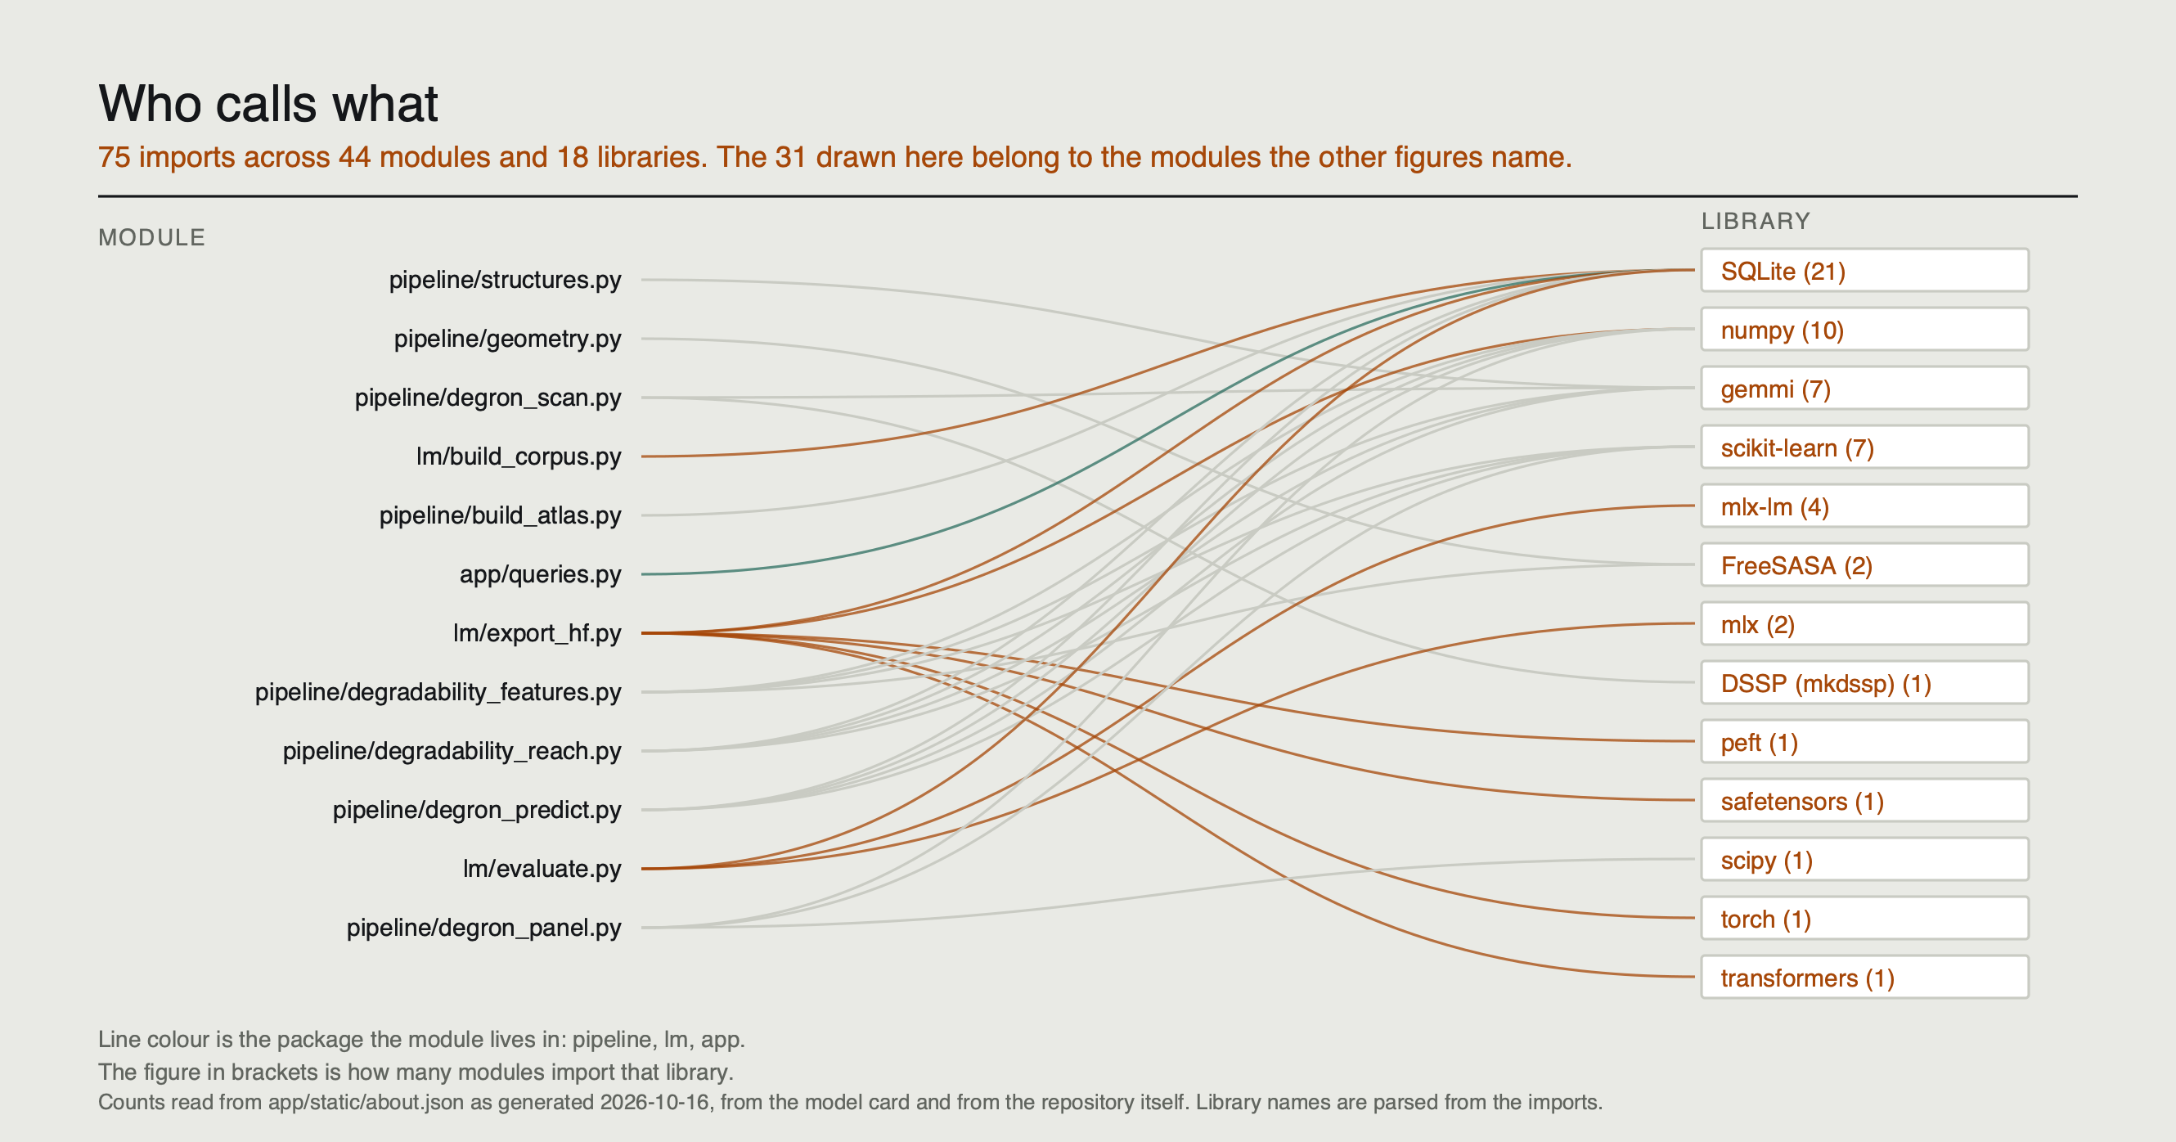
Notes:
This one is parsed, not drawn: every line is an import that exists in the repository. It is the honest answer to how the parts connect, and it is also the least comfortable to read, which is why it is here rather than on slide one. The shape is the useful part. SQLite and numpy are called from everywhere, mlx-lm from four places, peft from one. A library with one line into it is a library you can remove without touching the rest.

Slide 5
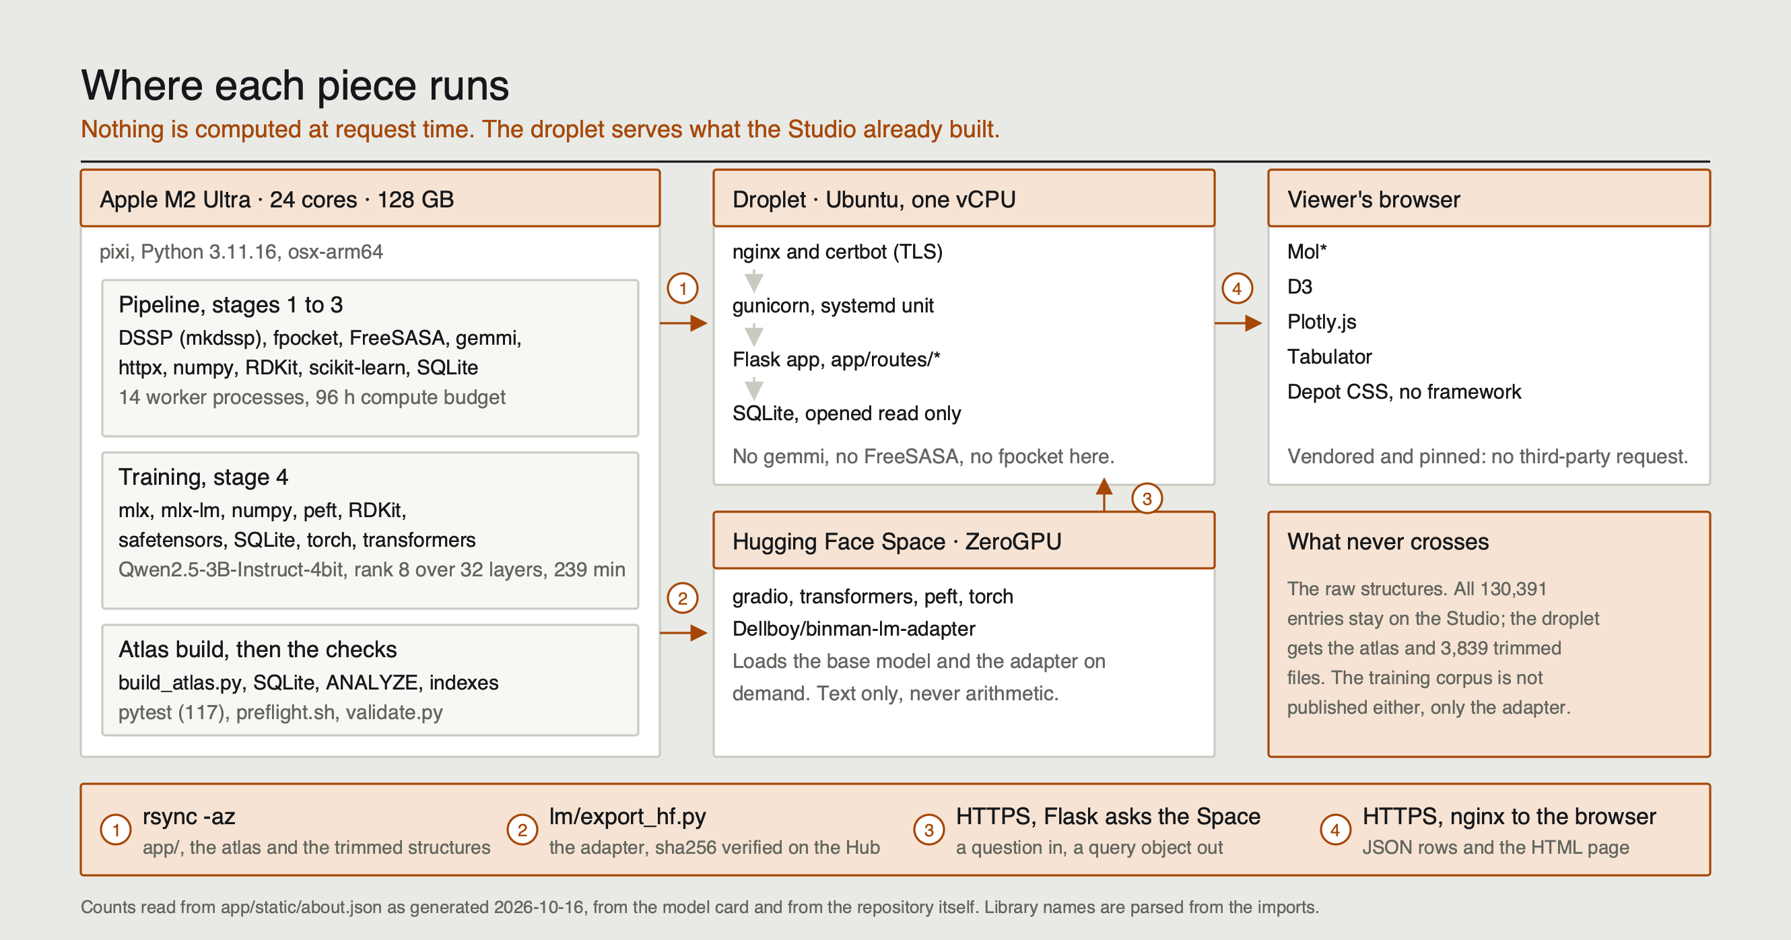
Notes:
Where each piece actually runs. The important claim is the one on the droplet: no gemmi, no FreeSASA, no fpocket at request time. It serves a precomputed SQLite file opened read only, which is why a page comes back in about a tenth of a second on one vCPU. The four numbered crossings are the only things that move between machines, and the raw structures are not among them.

Slide 6
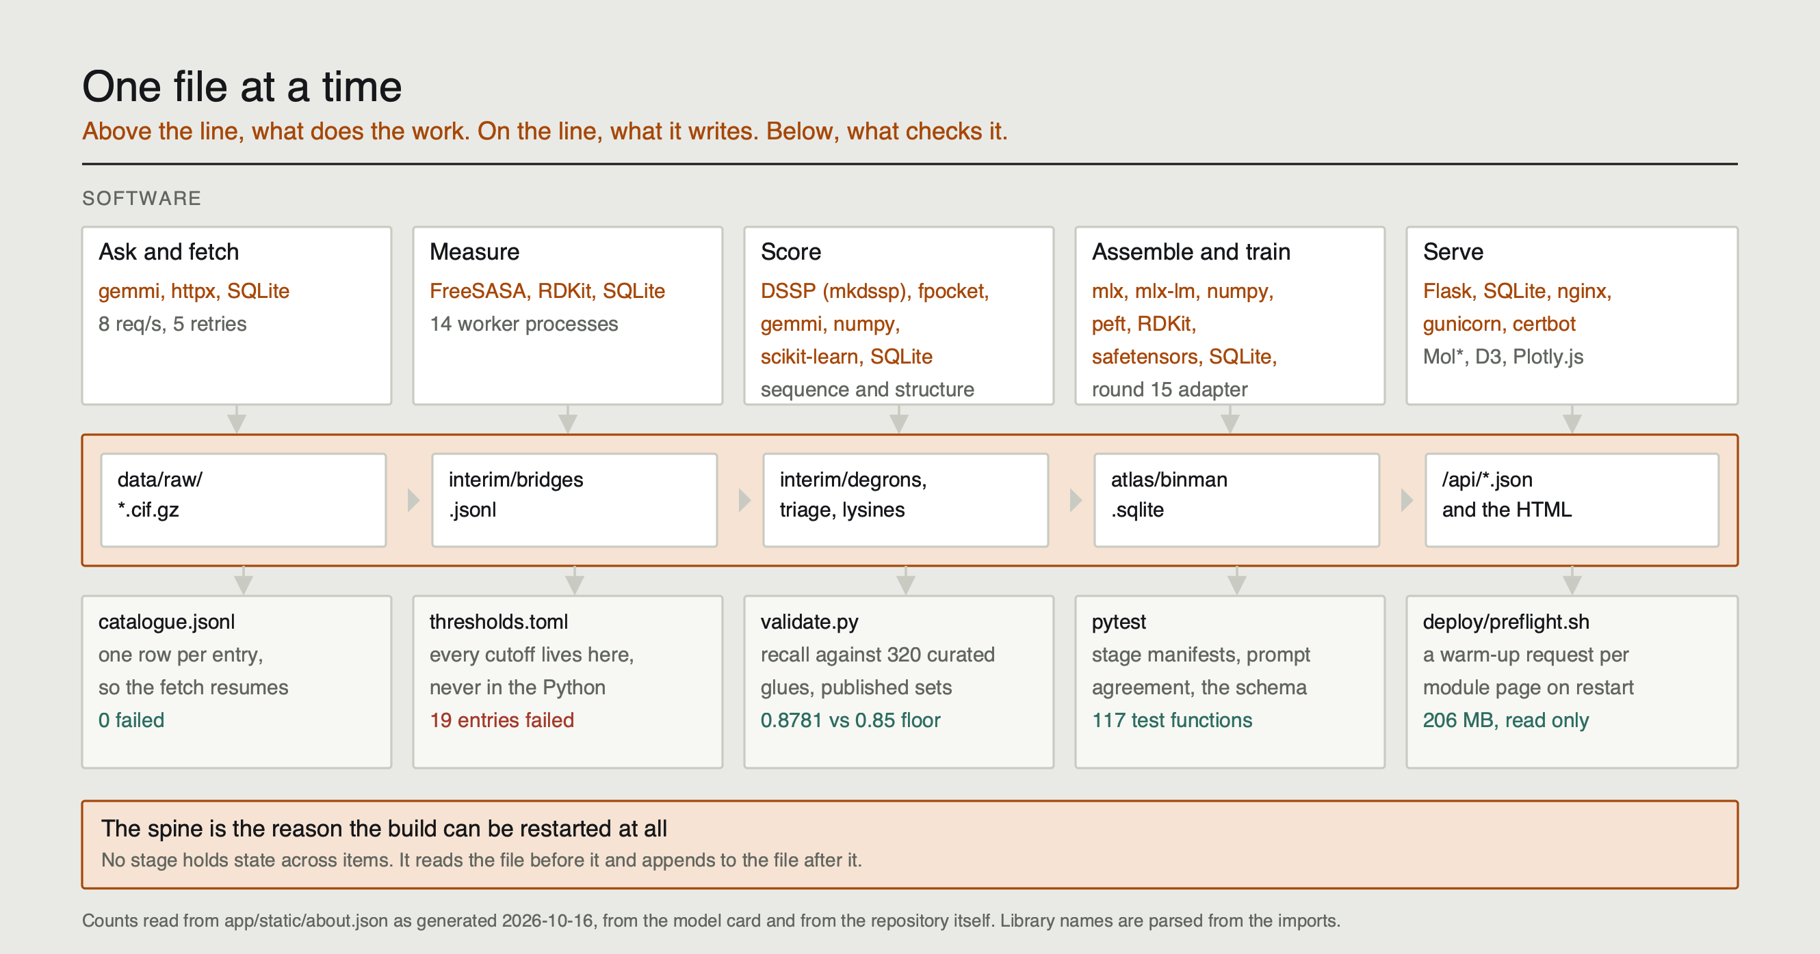
Notes:
The same build told as the files it writes. Each stage reads the file before it and appends to the file after it, and holds no state across items. That is what makes the whole thing restartable, and it is also what makes it checkable: the check under each hop is a real file in the repository, not a promise.

Slide 7
1
Acquisition
You cannot search the PDB for “molecular glue”. There is no such field.
The science. A glue is only recognisable once you have measured it, so the catalogue cannot be filtered by annotation. The only honest starting set is every entry that could hold one: at least two polymer chains for a ligand to bridge, and at least one non-polymer entity to do the bridging.
How the code does it. pipeline/catalogue.py asks the RCSB Search API that question and pages through the answer. Each entry is sorted into one of four tiers by how likely it is to matter, then pipeline/rcsb.py downloads its biological assembly and caches it on disk, so the download happens once and never again.
SOFTWARE
httpx
HTTP with connection pooling
tenacity
retry with backoff, so a flaky API does not lose a run
RCSB Search + File APIs
the public PDB services
130,391
0
WHY A NON-CODER SHOULD CARE
Every stage appends one line per item to a manifest file saying what happened to it. Kill the run halfway and it resumes from the manifest rather than starting again. It also means nothing fails silently: a failure is a recorded row, not an absence.
entries catalogued
failed
TIERS
tier 1 · 3,871 tier 2 · 34,222
tier 3 · 17,375 tier 4 · 74,923
Notes:
Tier 1 is the curated glue set, tier 4 is single-entity entries kept as the negative class for the triage model. Nothing is thrown away.

Slide 8
2
Geometry
A glue is a geometric fact, not a label. So measure the fact.
The science. A ligand that glues two proteins together buries surface against both of them at once. That is measurable and it needs no opinion: ΔSASA = SASA(ligand) + SASA(chain) − SASA(the two together), computed separately against each chain.
Bridging balance is the smaller buried area over the larger. Near 1.0 the ligand sits squarely between the two chains. Near 0 it is bound to one and brushing the other.
How the code does it. gemmi parses the assembly into chains and ligand instances, FreeSASA does the surface arithmetic, PLIP types the contacts at both half-interfaces. Symmetry copies are excluded, so a crystal contact cannot pose as a complex.
SOFTWARE
gemmi
mmCIF and assembly parsing
FreeSASA
solvent-accessible surface, Lee-Richards
PLIP
interaction typing at each half-interface
285,996
27,605
bridges measured
glue candidates
THE RULE THAT KEEPS IT HONEST
19
30,149
Crystallisation furniture — PEG, buffers, cryoprotectants — is classified, not deleted, so the counts reconcile. Every cutoff lives in config/thresholds.toml and never in the Python.
entries failed
distinct ligands
classified
Notes:
The 19 failures are recorded with their reason. Spec rule: a failure is data, not an exception.

Slide 9
3
Scan and triage
Finding the glue is a third of the problem.
The science. A degrader needs three things the glue itself does not supply: a degron on the target that the ligase can read, a ligase you can actually put a ligand on, and a lysine the E2 can reach once the complex forms. Each is scored on its own and against its own published dataset.
DEGRON SCAN
E3 TRIAGE
DEGRADABILITY
AlphaFold models from AFDB, DSSP for secondary structure, then the geometry of a β-hairpin with an exposed glycine at the tip — the shape CRBN reads.
21,717 candidates over 8,983 proteins
7,452 C2H2 zinc fingers, scored one finger at a time
fpocket finds and scores the druggable pocket on every human E3, combined with structural coverage, expression selectivity and family.
650 ligases ranked
638 carry a pocket score
Surface lysine accessibility and the Cβ–Cβ distance from the chosen binding site, against a reach window fitted on real ternary complexes.
1,650 lysines scored
window fitted on 43 complexes
570 degron scans and 12 ligases failed. Both counts are on the About page, because a stage that hides its failures is a stage nobody can audit.
Notes:
Each of these three becomes one of the four modules later. The fourth, Glue Atlas, comes straight out of stage 2.

Slide 10
4
Model
The model does the text work and never produces a number.
The science. An atlas is useless if the only way in is SQL. But a language model that invents a binding affinity is worse than no model, so BINMAN's has one hard constraint: every number on every page is computed in Python. The model only ever writes a query; the database answers it.
How it was trained. Qwen2.5-3B-Instruct at 4-bit, one LoRA adapter of rank 8 over 32 layers, trained with MLX on an Apple M2 Ultra. The training corpus is generated from the atlas itself and then validated by the app's own query parser: anything the parser rejected was dropped, so the corpus carries zero label noise by construction.
SOFTWARE
mlx-lm
LoRA fine-tuning on Apple silicon
PEFT + HF Spaces
served on ZeroGPU
0.9336
Task B macro F1,
held-out components
ONE ADAPTER, THREE HEADS
TODAY
A · query — your question becomes a query object, which the parser then checks
B · triage — evidence class on 27,590 bridge rows at build time
C · abstain — answerable or not, and what is missing when it is not
Task C specificity 0.0000 → 1.0000. The abstain head had learned that the answer is always no, because every training row was a refusal. Balancing the corpus fixed it.
Notes:
The round that fixed the abstain head finished this morning: 15,806 iterations, four hours on the Studio. Specificity is now 1.0 on twelve questions the atlas demonstrably answers.

Slide 11
A
Glue Atlas
Which deposited ligands already bridge two proteins, and which chemotypes nobody has written up.
285,996
15,804
82
0.8781
bridges
listed by no glue database
novel series
recall vs 320 curated glues
(floor 0.85)
The finding that matters most. Clustered on the protein pair they bridge rather than on their chemistry, the novel bridges resolve into 82 protein pairs carrying three or more distinct ligands each — a medicinal chemistry series somebody is already running, visible in the PDB and absent from every curated database. The largest is 14-3-3σ with p65: 34 ligands over 34 entries.
As a control it recovered the RAS(ON) tri-complex glues unprompted, and a real cereblon degrader series on the Helios zinc fingers that no database lists.
WORKED EXAMPLE
9OHL · ligand A1CBE
METTL5, an rRNA methyltransferase, and TRMT112, the subunit it needs to be active. One small molecule between them, 1.29 Å, deposited June 2025, called a glue by nobody.
442 and 581 Å² against the two chains
balance 0.761 · 79% of the ligand buried
EVERY SERIES CARRIES TWO MEASUREMENTS, NOT A VERDICT
Ligand share — how much of the interface the ligand buries, against how much the two chains bury on each other.
Interface retained — what survives in a structure holding both proteins and none of that series' ligands.
Notes:
Each series row carries two measurements rather than a verdict: ligand share, and how much of the interface survives in a structure without that chemistry.

Slide 12
B
Degron Scan
Which human proteins carry the shape cereblon reads?
The science. CRBN neosubstrate recognition is a β-hairpin presenting a glycine at its tip. The scan looks for that geometry across the AlphaFold human proteome, then asks whether geometry actually predicts degradation.
It does not, and sequence does. On a gene-disjoint split, the sequence model scores AUC 0.6334 against geometry's 0.5564. Combining them adds 0.0014, which is inside the split-to-split noise. That is reported, not buried.
The grammar transfers across chemistry. Trained on pomalidomide alone, the model is above chance on 24 of 29 analogues of a published screen, gene-disjoint, mean AUC 0.779, permutation p = 0.0005.
SOFTWARE
AlphaFold DB
predicted structures, with pLDDT as a confidence filter
DSSP
secondary structure assignment
21,717
7,452
degron candidates
zinc fingers scored
WHERE IT MISSES
Sensitivity 0.6562 against a 0.70 floor, specificity 0.3528 against 0.60. Both miss, both are diagnosed in FINDINGS.md.
Notes:
The scan fires on 65% of matched negatives because a C2H2 zinc finger IS a short hairpin with an exposed turn. That is the diagnosis, and it is why sequence beats geometry.

Slide 13
C
E3 Triage
There are about 650 human E3 ligases and the field uses four.
The science. Cereblon and VHL dominate because they were ligandable first, not because they are the best. The question a new company has to answer early is which of the other 646 are worth a ligand campaign.
How the code answers it. fpocket runs over every human E3 structure and scores the best pocket for druggability and volume. That is combined with how well the ligase is structurally covered, how selectively it is expressed across tissues, and its family, into a single rank with every component visible.
SOFTWARE
fpocket
pocket detection and druggability scoring
650
638
ligases ranked
with a pocket score
THE FIVE EXPLOITATION CLASSES
TOP OF THE RANKING
clinically validated · chemically validated · covalent handle only · ligandable unproven · orphan
The classification is derived from published ligand evidence, not assigned by opinion, and it is what the ranking is sorted within.
DCAF15 · rank 1
pocket score 0.988, chemically validated
DCAF8L1 · rank 2
pocket score 0.860, ligandable unproven
Notes:
The ranking is of the repertoire, not of fit to a particular target. Pairing a ligase with a substrate is what the Lens graph does.

Slide 14
D
Degradability
A ternary complex is not degradation. The E2 still has to reach a lysine.
The science. Once the glue has brought ligase and target together, ubiquitin has to be transferred onto a lysine on the target. Whether a usable lysine exists, and whether it sits within reach of the E2, is the last thing that can kill a programme and the first thing nobody checks.
How the code answers it. Surface lysines are scored on NZ relative accessibility and on Cβ–Cβ distance from the chosen binding site, against a reach window fitted on 43 real induced ternary complexes rather than on an assumption.
WHY IT FAILS, MEASURED
Reach from the ligand site scores 0.42 to 0.48, because the ligand site is where a substrate is recruited and not where ubiquitin is transferred.
The two published labellings disagree on 41% of lysines, which is most of the apparent signal in the easier version of this test.
0.502
43
THE RESULT A GLUE COMPANY MOST NEEDS
exposure AUC
against assayed negatives
ternary complexes
in the fit
Lysine exposure does not predict ubiquitylation.
Scored against 309,297 lysines that were assayed and found unmodified — not lysines nobody had annotated — exposure reads 0.502. Chance. Do not build a selection criterion on it.
Notes:
This is the negative result I would most want a collaborator to know before designing a target-selection funnel.

Slide 15
!
What did not work
Four things the project tried, measured, and could not make work. All four are in the repository.
GEOMETRY ALONE DOES NOT PREDICT DEGRADATION
COUNTING APO STRUCTURES CANNOT SEPARATE INDUCED FROM PRE-EXISTING
The specified geometry score is anti-predictive on the assayed set, and a quarter of it was never persisted to the database. Sequence carries the signal. Combining the two adds 0.0014, inside the noise between splits.
Three framings tried, each defeated by a cofactor: haemoglobin α+β has no ligand-free structure at all, because haem is a ligand, so the most obligate pair in the set looked induced. Recorded as not done rather than approximated.
LIGAND SHARE IS A MEASUREMENT, NOT A CLASSIFIER
ONE VALIDATION METRIC CANNOT PASS
A genuine CRBN degrader and a colchicine-site passenger both read 0.47. And on one structure it misleads outright: DNA gyrase read 0.97 on 30 Å² of chain contact, and the same two chains bury 3,284 Å² in another entry.
Seven of fifteen realistically phrased questions are scored against numeric thresholds the question never states, so the ceiling is 0.533 against a floor of 0.80. The floor was not moved: a floor chosen to be reachable is not a check.
Two training approaches were also abandoned: DPO collapsed the policy twice, and asking the abstain head before the query head refused all twelve of BINMAN’s own worked examples.
Notes:
DECISIONS.md carries 92 entries, each with the alternatives considered and the condition under which it should be reversed. The failures are not footnotes: they are the part a collaborator can act on.

Slide 16
→
Where this could go
Everything below is already built, measured and public.
WHAT YOU CAN USE TODAY
WHERE TO START READING
THE OBVIOUS NEXT MOVES
The whole atlas is one SQLite file that opens in any tool you already have.
A live interface at binman.mdeller.com, the code on GitHub, the trained adapter on Hugging Face.
README
what it is and what it found.
FINDINGS.md
every number with its method and its n, misses included.
DECISIONS.md
92 entries, each with how to reverse it.
Pick a series from the 82 and put it in front of a crystallographer.
Pair ligases to targets, which the ranking deliberately does not do.
Superpose glue-free structures to settle induced versus pre-existing properly.
THE TWO RULES THE WHOLE PROJECT IS BUILT ON
1 · Every module is validated against independently curated published datasets, never against controls written for this project.
2 · The language model never computes, estimates or reports a number. Every figure you have seen was computed deterministically in Python.
Marc C. Deller, D.Phil. · marc@marcdeller.com · binman.mdeller.com · github.com/bellcheddar/BINMAN
Notes:
Offer: a half-day walkthrough of the code with the atlas open, so the numbers can be checked live rather than taken on trust.

