Slide 1
Tom Fifield fifieldt@unimelb.edu.au
KEK Belle SE

Slide 2
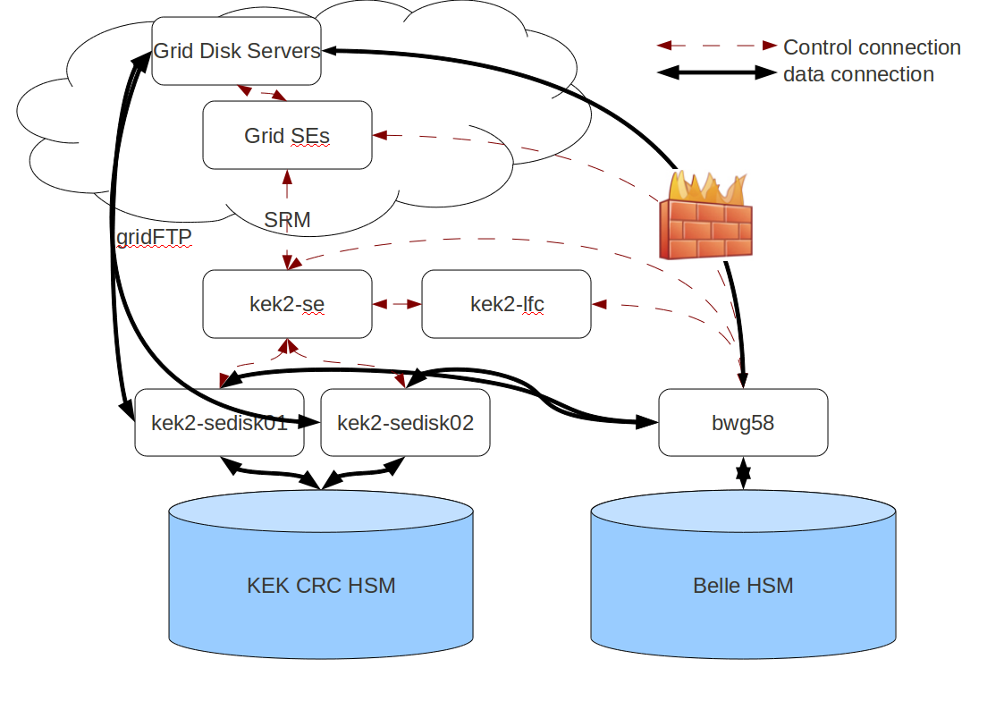
The copy problem

Slide 3
The copy problem
Can't copy directly to BHSM
BWG cannot copy from other grid sites
  Firewall = poor network performance
First replicate everything to KEK-SE
KEK CRC HSM
  2 tape drives, 1: typical 40MB/s, max 100MB/s
  Tape mount time 30-60secs ==> 20-25MB/s for 2GB file
  Halts randomly
  Requires a second verification that copy is OK
Once on BHSM, not grid accessible

Slide 4
The copy problem
Solutions
  SRM-SRB
    Has been difficult so far
  Install a grid storage element on bcomp
Results in:
  Direct copy of MC results from grid
    Saves weeks of my time!
  Data being accessible by Belle members via grid and bcomp

Slide 5
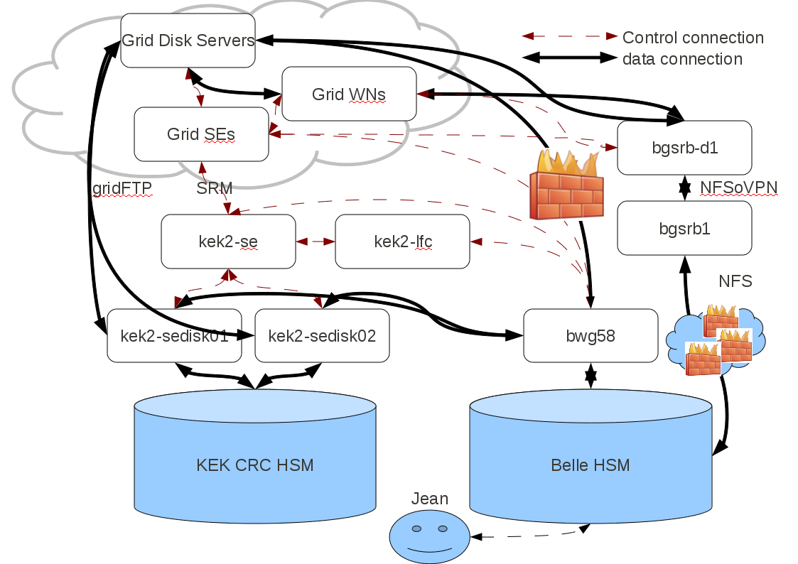
SE on B-computer

Slide 6

SE on B-computer
StoRM
  From INFN – Italian Tier 1
  Light, scalable, filesystem-independent
  Configured using gLite YAIM tools
  Allows us to use existing NFS
    Files automatically in SE

Slide 7
SE on B-computer
Ready soon...
  Here's your sneak-preview:
$ lcg-cp -v -b -T srmv2 srm://bgsrb-d1.kek.jp:8444/srm/managerv2?SFN=/belle/mcprod/dat/e000015/evtgen/charm/13/all/0807/on_resonance/06/evtgen-charm-13-all-e000015r000611-b20030807_1600.mdst test.mdst
VO name: belle
Checksum type: None
Trying SURL
srm://bgsrb-d1.kek.jp:8444/srm/managerv2?SFN=/belle/mcprod/dat/e000015/evtgen/charm/13/all/0807/on_resonance/06/evtgen-charm-13-all-e000015r000611-b20030807_1600.mdst ...
Source SE type: SRMv2
Source SRM Request Token: d57f41aa-e76e-4852-b85c-1090aed52d3c
Source URL:srm://bgsrb-d1.kek.jp:8444/srm/managerv2?SFN=/belle/mcprod/dat/e000015/evtgen/charm/13/all/0807/on_resonance/06/evtgen-charm-13-all-e000015r000611-b20030807_1600.mdst
File size: 324223344
Source URL for copy: gsiftp://bgsrb-d1.kek.jp:2811//bhsm/h216/mcprod/dat/e000015/evtgen/charm/13/all/0807/on_resonance/06/evtgen-charm-13-all-e000015r000611-b20030807_1600.mdst
Destination URL: file:/bwf/g58home/fifieldt/test.mdst
# streams: 1
0 bytes 0.00 KB/sec avg 0.00 KB/sec inst

Slide 8


© Copyright The University of Melbourne 2010

