Slide 1
Notice about FINNESSE installation
From Higuchi-san’s 2009 slides
“FINNESSE Developer’s guide (Belle note #791)”

Slide 2
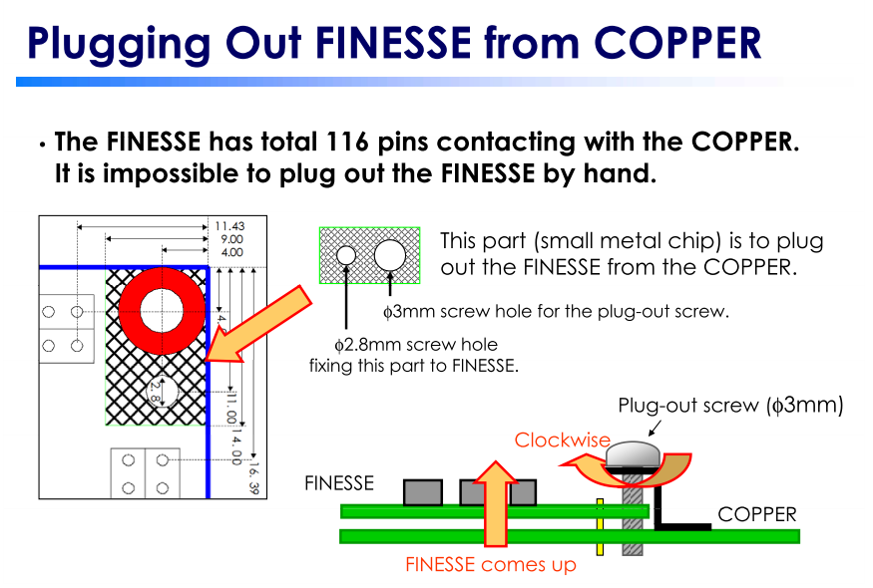
Do not forget to
attach these chips
on a FINESSE card,
before you install
it on a COPPER board.
(Metal chips are available
on Tsukuba B3F)
Otherwise you cannot plug
out it later!

Slide 3
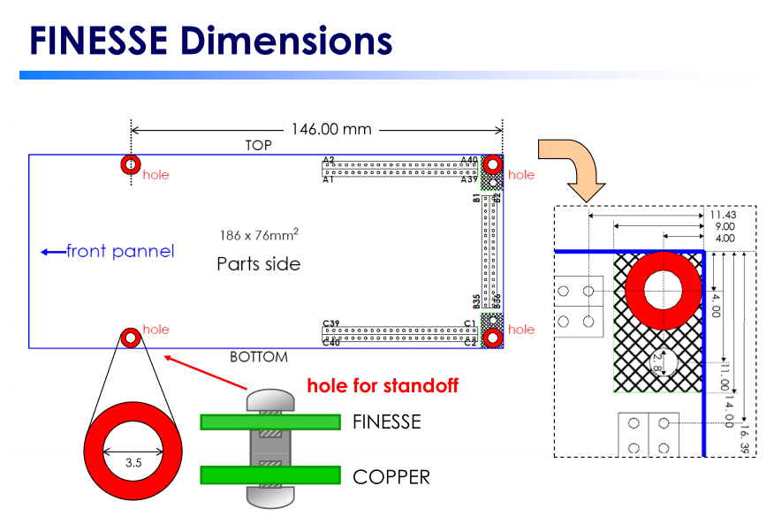

Slide 4
Appendix

Slide 5
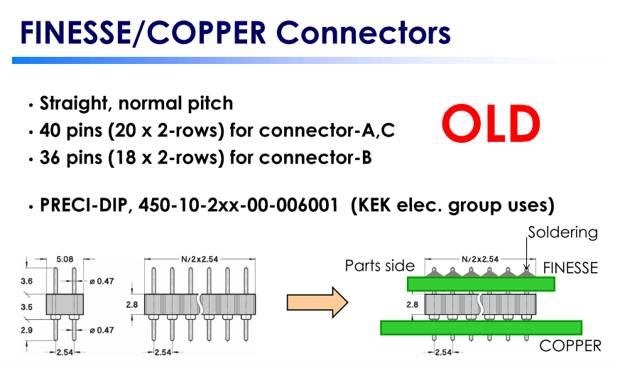

Slide 6
