Slide 1
RawCOPPER data format
May. 30, 2017 (ff5c3626434)
Satoru Yamada

Slide 2
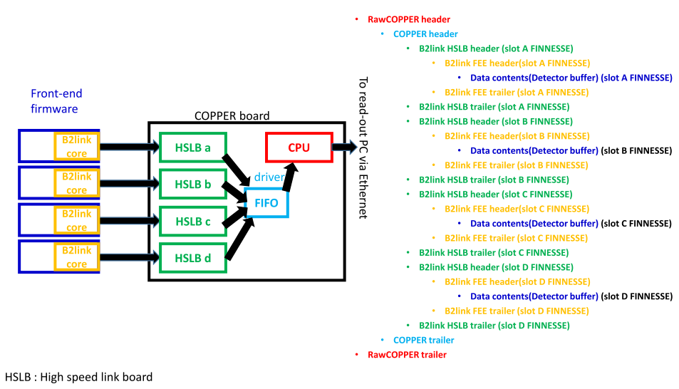
1, Overview of RawCOPPER format (one data block from a COPPER board)
RawCOPPER header/trailer -> See Sec. 2
COPPER header/trailer -> See Sec.3
B2link(FEE+HSLB) header/trailer -> See Sec.4
Detector buffer -> Untouched by DAQ

Slide 3
1-1, Online header/trailer reduction
COPPER
readoutPC
Old Raw header/trailer
COPPER header/trailer
B2link header/trailer
Old Raw header/trailer
COPPER header/trailer
B2link header/trailer
HLT input server
Before rev. 11234
( June, 2014)
Binary
data
RawCOPPER
format
RawCOPPER
format
RawCOPPER
format
RawCOPPER
format
Ropc disk
Ver. # = 0
Ver. # = 0
After rev. 11234
( June, 2014)
After
the update
COPPER
readoutPC
HLT input server
New Raw header/trailer
COPPER header/trailer
B2link header/trailer
New Raw header/trailer
Reduced COPPER header/trailer
Reduced B2link header/trailer
Binary
data
PreRawCOPPER
format
PostRawCOPPER
format
PostRawCOPPER
format
PreRawCOPPER
format
Ropc disk
PreRawCOPPER format : Ver # = 2 + 0x80 = 129
PostRawCOPPER format : Ver # = 2

Slide 4
• PreRawCOPPER format
• If you store data by COPPER CPU, then output data will be in Pre(reduction)RawCOPPER format.
• PostRawCOPPER format
• Store the data downstream from readout PC, the output data will be in Post(reduction)RawCOPPERFormat

Slide 5
2-1, “RawCOPPER header/trailer” format in PreRawCOPPER format (ver. 2+0x80)
Use this version number to distinguish
Different data format.
Ver.0 : to 2014. June(including DESY test)
ver.1 : from June.2014
Ver.2 : from Apr. 2015 (rev.17269)
* Same as ver.1
1 Number of total words
2 0x7f7f | Format ver.(8bit) | Number of words in this block ( 8bit )
3 exp no. (10bit=1024), run no.(22bit=4194304 including subrun )
4 event number(32bit)
From B2link FEE header 2 (TT-ctime | Trig-type)
From B2link FEE header 2 (TT-utime )
7 Node ID
8 b2link CRC error bit (4) | |truncation mask (truncated or not) / type of data
(compressed,calibration, …)
9 offset to 1st block of user’s data(FEE data)
10 offset to 2nd block of user’s data(FEE data)
11 offset to 3rd block of user’s data(FEE data)
offset to 4th block of user’s data(FEE data)
RawCopper Header(20words)
COPPER header (13words)
B2link(FEE/HSLB)
header
and
trailer
FINNESE A
Detector buffer(slot A)
FINNESE A
Detector buffer(slot B)
FINNESE A
Detector buffer(slot C)
FINNESE A
Detector buffer(slot D)
COPPER trailer(3words?)
1 reserved (maybe used for checksum)
2 termination word of this block = 0x7fff0006
RawCopper Trailer(2words)

Slide 6
2-2, “RawCOPPER header” and trailer format in PostRawCOPPER format (ver.0x02)
* Same as ver.1
Same as PreRawCOPPER format

Slide 7
2-3, tentative format of 32bit node ID
Format :
(31-24) Detector ID : 8bit=256 : detector ID
(9-0) lower bits of COPPER ID : 10bit (1024)
Detector ID :
Detector ID (Defined in rawdata/dataobjects/include/RawCOPPERFormat.h)
• #define SVD_ID 0x01000000 // tentative
• #define CDC_ID 0x02000000 // tentative
• #define BPID_ID 0x03000000 // tentative
• #define EPID_ID 0x04000000 // tentative
• #define BECL_ID 0x05000000 // tentative
• #define EECL_ID 0x06000000 // tentative
• #define BKLM_ID 0x07000000 // tentative
• #define EKLM_ID 0x08000000 // tentative
#define TRGDATA_ID 0x10000000 // tentative
#define CDCTRGDATA_ID 0x11000000 // tentative
#define TOPTRGDATA_ID 0x12000000 // tentative
#define ECLTRGDATA_ID 0x13000000 // tentative
#define KLMTRGDATA_ID 0x14000000 // tentative
#define GDLTRGDATA_ID 0x15000000 // tentative
Full COPPER ID :
Except for TRG, full COPPER ID can be reconstructed by “( Detector ID >> 24 ) * 1000 + COPEPR ID(12bit) “
e.g. NodeID = 0x0600000a -> COPPER ID = cpr6010
NodeID = 0x0100000a -> COPPER ID = cpr1010
For TRG data, full COPPER ID can be reconstructed by “ 9000 + COPEPR ID(12bit) “
Following a request from SLC part, hostname of TRG coppers will be assigned as follows: (Aug.27, 2015)
CDC TRG : cpr1100*
ECL TRG : cpr1200*
…
GDLTRG : cpr1500*
A label of COPPER ID will be attached on the front of a COPPER board
Node ID = “TTD ” = 0x54544420 and “FTSW” are reserved for VME CPU and FTSW now.

Slide 8
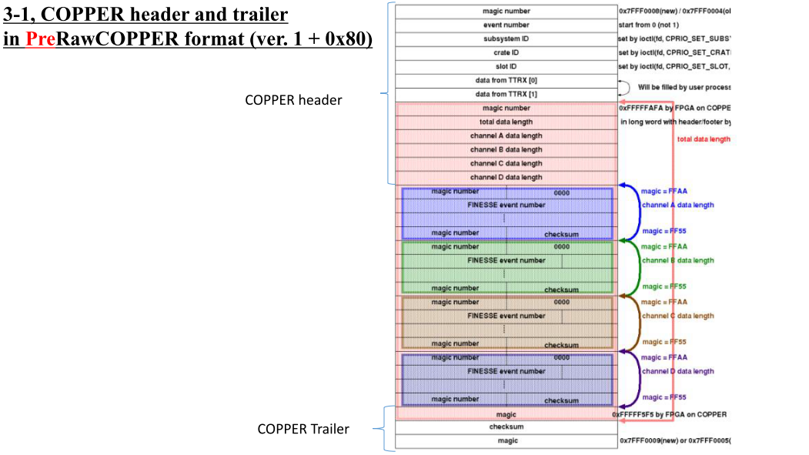
2
* Same as ver.1

Slide 9
3-2, COPPER header and trailer in PostRawCOPPER format (ver. 0x02 )
* Same as ver.1
No COPEPR header and trailer in Post reduction rawcopper format.

Slide 10
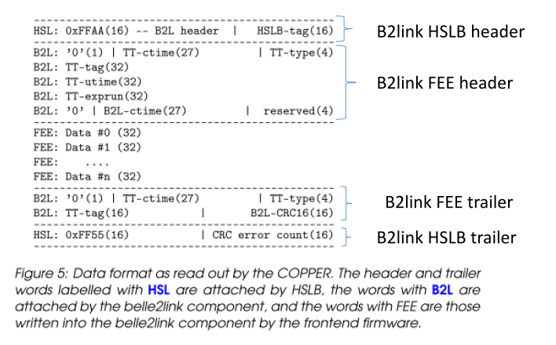
4-1, B2link FEE header/Trailer, B2link HSLB header/Trailer in
PreRawCOPPERFormat (ver. 0x02 + 0x80)
From Nakao-san’s Belle2link User guide (June 10, 2014):
You can download from 18 th B2GM indico page
http://kds.kek.jp/getFile.py/access?contribId=132&sessionId=28&resId=0&materialId=0&confId=15329
* Same as ver.1
NOTICE :
To produce this format, the b2tt core used in
the FEE firmware should be the latest.
Please see Nakao-san’s following e-mails :
[b2link_ml:0143] Belle2link version 0.01 -
SVN update
And
[b2link_ml:0144] Re: Belle2link version 0.01 -
SVN update .

Slide 11
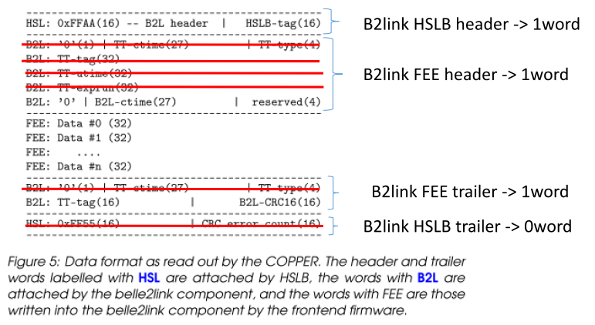
4-2, B2link FEE header/Trailer, B2link HSLB header/Trailer in
PostRawCOPPERFormat (ver. 0x02)
* Modified from ver.1
CRC error count(16)

Slide 12
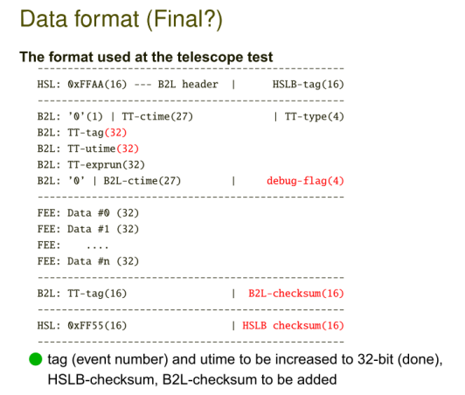
4-3, Older B2link header/trailer formats
At DESY test in January of 2014
From Nakao-san’s B2GM slides:
http://kds.kek.jp/getFile.py/access?contribId=143&sessionId=38&resId=0&materialId=slides&confId=13911

Slide 13
5-1, RawDataBlock object ( to handle Raw data from COPPER board )
RawFTSW
RawDataBlock
RawSVD
Source code :
https://belle2.cc.kek.jp/svn/trunk/software/rawdata/dataobjects/
RawCOPPER
RawCDC
Raw…
Example of data structure
RawDataBlock{
methods to access data;
int m_num_nodes; // # of nodes
int m_num_events;// # of events
int* m_buffer; -> buffer for data
}
Event # = n
Data From COPPER k₁
Event # = n
Data From COPPER k₂
In this example,
M_num_nodes = 4
M_num_events = 2.
# of data blocks = 4 * 2 = 8
Event n
Event # = n
Data From FTSW
Event # = n
Data From COPPER k₃
m_buffer
Event # = n + 1
Data From COPPER k₁
Event # = n + 1
Data From COPPER k₂
Event (n+1)
Event # = n + 1
Data From FTSW
Event # = n + 1
Data From COPPER k₃

Slide 14
Example of Data handling on COPPER (as of rev.12453)
RecvSendCOPPER.py
DeSerializerCOPPER.cc
Serializer.cc
Event()
Event()
// Read 50 evens per an event() loop
For( int I =0; i< NUM_EVT_PER_BASF2LOOP_COPPER(=50);i++){
…
Num_event = 1; num_nodes = 1;
temp_rawdblk = raw_dblkarray.appendNew();
temp_rawdblk->SetBuffer(temp_buf, m_size_word, delete_flag, num_events, num_nodes)
…
}
// Send each raw_dblkarray[i] event
separately.
For( int I =0; i< raw_dblkarray.getEntries();i++){
…
sendByWriteV( raw_dblkarray[ I ])
…
}
Send data
to a readout
PC
From
FEE
Raw_dblkarray.getEntries()=50
Raw_dblkarray->GetNumNodes()=1
Raw_dblkarray->GetNumEvents()=1
Raw_dblkarray.getEntries()=50
Raw_dblkarray->GetNumNodes()=1
Raw_dblkarray->GetNumEvents()=1
Dump a ROOT file

Slide 15
Example of Data handling on a readout PC (as of rev.12453)
RecvSendCOPPER.py
DeserializerPC.cc
Serializer.cc
COPPER
Event()
Event()
// Read 1 evens per an event() loop
For( int I =0; i< NUM_EVT_PER_BASF2LOOP_PC (=1);i++){
…
raw_datablkarray.appendNew();
…
}
For( int I =0; i< raw_dblkarray.getEntries();i++){
…
sendByWriteV( raw_dblkarray[ I ])
…
}
COPPER
Send data
to eb1tx
(sender
daemon)
Eb0(partial event building daemon)
…
Raw_dblkarray.getEntries()=1
Raw_dblkarray->GetNumNodes()= # of COPPERs
Raw_dblkarray->GetNumEvents()=1
Raw_dblkarray.getEntries()=1
Raw_dblkarray->GetNumNodes()=# of COPPERs
Raw_dblkarray->GetNumEvents()=1
COPPER
Dump a ROOT file

Slide 16
Example : # of events and nodes in one RawDataBock(Detector) object and StoreArray :
Readout PC
HLT input server
DeserializerPC.cc
Raw2DsModule.cc
StoreArray<RawDataBlock>
raw_datablockarray;
StoreArray<RawSVD>
raw_svdarray;
raw_datablockarray[0];
# of event = 1, # of nodes = 2
raw_svdarray[0];
# of event = 1, # of nodes = 1
SVD
COPPER A
RawDataBlock
Eve 0 : node A
RawSVD
Eve 0: node A
RawDataBlock
Eve 0 : node B
Belle II
Storage
raw_svdarray[1];
# of event = 1, # of nodes = 1
HLT, eb2
Ethernet
Ethernet
…
RawSVD
Eve 0 : node B
Event builder (eb0)
raw_datablockarray[NUM_EVT-1];
# of event = 1, # of nodes = 2
RawDataBlock
eve NUM_EVT-1 node A
COPPER B
SVD
RawDataBlock
eve NUM_EVT -1
node B
NUM_EVT -> 50 on COPPER(DeserializerCOPPER.cc)
1 on a readoutPC(DeserializerPC.cc)
test bench (PocketDAQ)
storage
StoreArray structure of stored data
may be different.

Slide 17
Example : how to store rawdata in RawDetector object by DAQ program
Full Belle II DAQ
HLT(High Levele Trigger) receives serialized binary data from readout PCs and stores them in RawDetector Class. This RawDetector objects will be stored in storage.
Module : daq/rfarm/event/modules/src/Raw2DsModule.cc
Pocket DAQ
DATA are stored as a RawDataBlock object
Example program can be used to convert RawDataBlock/COPPER to RawDetector objects
Module : daq/rawdata/modules/src/Convert2RawDet.cc

Slide 18
New RawCOPPER class
2-2, Rawdata Unpacker for new and old data formats
Data taken at the DESY beam test(old format) can be read with the latest rawdata package
-> by checking data ver. In header.
No change in style of the member functions -> No effect on derived class
Does not have a format information in itself
Format class contains format information
RawCOPPERformat.cc -> the latest format
RawHeader.cc
RawCOPPERformat_v0.cc -> an old format
RawHeader_v0.cc
Assgin a format class to m_access in CheckVersionSetBuffer()
Use m_access to access buffer contents
inline int RawCOPPER::GetExpNo(int n)
{
CheckVersionSetBuffer();
return m_access->GetExpNo(n);
}
inline int RawCOPPER::GetRunNo(int n)
{
CheckVersionSetBuffer();
return m_access->GetRunNo(n);
}
Notice :
• RawCOPPER class supports both formats for
a while (0.5-1 year after the format becomes
stable?).
• In that case, the latest RawCOPPER
class cannot be used to read old format
• Of course, you can use old rawdata
repository to read old format
• For ver.0 format, use rawdata
repository before 11228

Slide 20
Revision History of this document(1)
• Jan.5, 2014 rev. 8376 : Add definition of tentative subsysID format
• Dec. 16, 2013 rev.7974 :
• Add B2linkFEE header format
• Add comments about handling StoreArray when unpacking Raw*** data.
• Oct.21, 2013 :rev.7133
• Add instruction about Rawdata unpacking program
• Oct. 18, 2013 :rev. 7095
• 1 st draft
• Jun. 23, 2014 : rev. 11234
• Online (header/trailer) reduction scheme on readout PC is introduced
• RawHeader format is changed
• COPPER header/trailer format is changed
• Nakao-san updated B2LFEE/HSLB header/trailer format
• See [b2link_ml:0144] Re: Belle2link version 0.01 - SVN update
Aug. 23, 2014: rev. 12453
Add a description of how RawDataBLock objects are handled by the actual DAQ program.
Sep. 26, 2014 : rev.13065
Add TRG ID definition (0x09000000)
Oct. 24, 2014 : rev. 13460
Add a slide about # of events and nodes in one RawDataBock(Detector) object and StoreArray
and how to store raw data in RawDetector object by DAQ program (p.16. p.17)
Jan. 23, 2015: rev. 15030
Modify TRGDATA_ID and add ***TRGDATA_ID for trigger from sub-detectors
Mar.3, 2015 : rev. 15988
Use “node ID” instead of subsystem ID.

Slide 21
Revision History of this document(2)
• Apr. 21, 2015 rev. 17269 : Description about a new data format (ver.2 )
• Aug. 27, 2015 : Hostname of TRG COPPER are revised
May 30, 2017 : NODE_ID for ECLTRG and TOPTRG was swapped. (commit ID : ff5c3626434)

Slide 22
Backup

Slide 23
Modified part of data-format in the change from ver.1 to ver.2
4-2, B2link FEE header/Trailer, B2link HSLB header/Trailer in
PostRawCOPPERFormat (ver. 0x01)

