Slide 2
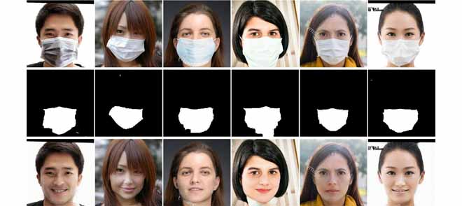
Din, A Novel GAN-Based Network for Unmasking of Masked Face
10.1109/ACCESS.2020.2977386

