Slide 2
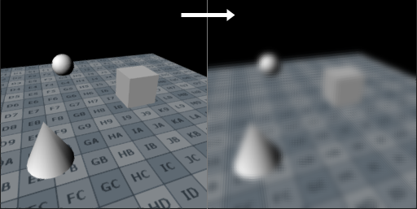
“Kernel” is a funny word
One meaning is a per-training-example-weight function that depends on (x_{i}-x_{j}) or (x_{i} dot x_{j})
Another meaning is the practice of expanding the feature vector space with functions of the features (polynomials or interaction terms) to give discriminator optimization more flexible functions to work with.

