Slide 1
A presentation on building services for a twin-duplex for mature students in the university of Ilorin
By Group 4
Lecturers in charge
Engr. Dr.(Mrs)Mokuolu , Engr. Akinola O.

Slide 2
Introduction
It is the job of civil engineers to construct buildings and ensure they serve the purpose for which they were constructed.
Building services are the activities carried out to ensure that the buildings are comfortable and habitable for the occupants.
The proposed building is a twin-duplex to be constructed in the University of Ilorin
As regards the buildings concerned, building services solutions are to be provided for water supply, lighting, ventilation, waste management and health and safety.

Slide 3
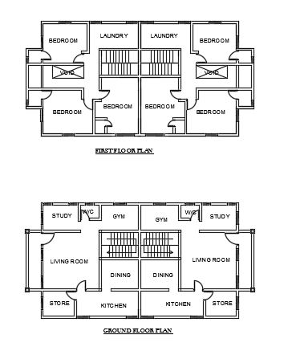
Introduction contd.
The architectural plan of the building is as showed. It is a twin duplex which is meant for residential purpose.

Slide 4
Water supply
Sources:
Primary: School dam
Secondary: a close-by borehole ( Arafims hostels)
Water treatment
Distribution and storage:
Two 4000-litre reservoirs dispensing at a discharge rate of 10 l/s.

Slide 5
Ventilation
Types of ventilation
Natural
Artificial : split ACs, Fans.

Slide 6
Health and safety
For falls, slips and trips:
railings, rough-surface tiles.
For fire outbreaks:
Fire escapes, fire extinguishers, smoke detectors, fire sprinklers, fire alarms.
For electrical safety:
Earthing, lightning conductor.
For injuries:
First aid box.
For caution:
Appropriate signage.

Slide 7
Lighting
Lighting options:
Day lighting: bilateral, screen wall at stairwell
Artificial lighting: energy saving white bulbs

Slide 8
Waste management
Waste segregation (colour coding)
Dry recyclables
Organic wastes
Mixed non-recyclables
Refuse storage
Waste collection

Slide 9
References
Garland, C. (2018). Operation waste management plan, (January), 27. R

Slide 10
THANK YOU

