Slide 1
Mo
Phones
Credit Portfolio Analysis
Data Analyst – Product & Credit Case Study
01
02
03
Portfolio Health
Credit × Experience
Data Quality
40% of evaluation
35% of evaluation
25% of evaluation
2025 Full Year • 5 Snapshots • 20,742 Loans

Slide 2
01 | Portfolio Health
PAR30+
NPL Rate
FPD Rate
Collection
Arrears
38–39%
13→18%
6.8→5.5%
~72%
KES 304M
Accounts 30+ days past due
Write-off rate rising all year
Improving — better screening
KES 28 in every KES 100 uncollected
3× growth in 12 months
Slide 2 of 9

Slide 3
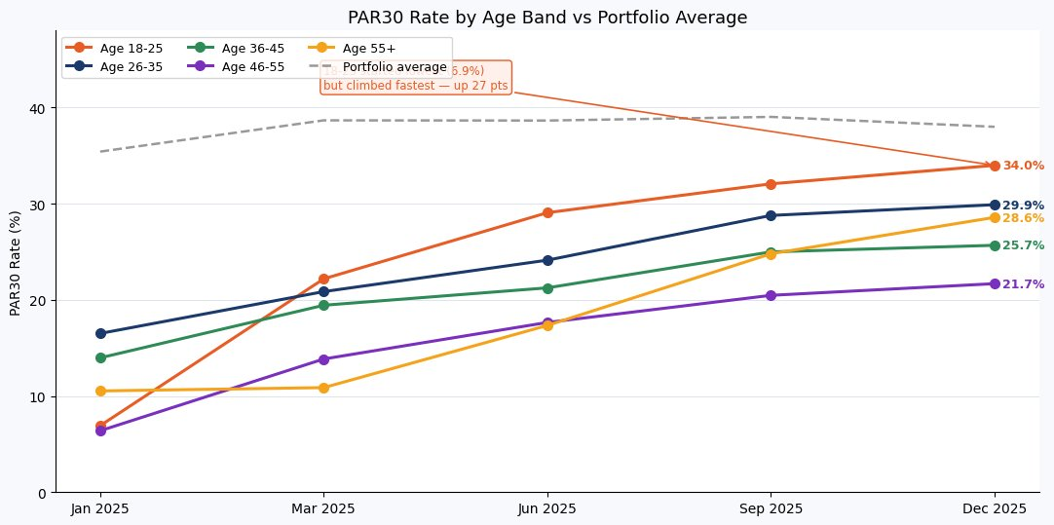
01 | Segment Deep-dive: Age 18–25 is the Fastest Rising Risk Group
22→34%
PAR30 climb in 9 months
27 pts
Steepest rise of any group
46–55
Most stable segment (6→22%)
Why this matters operationally
Young customers (18–25) typically earn irregular entry-level income. Once they miss one weekly payment, arrears compound and they disengage rather than call in. Collections teams are reaching them at Day 30+ when intervention at Day 7 is still effective. Fix: automate WhatsApp outreach at Day 3, call at Day 7, and apply tighter deposit requirements for this segment at origination.
Slide 3 of 9

Slide 4
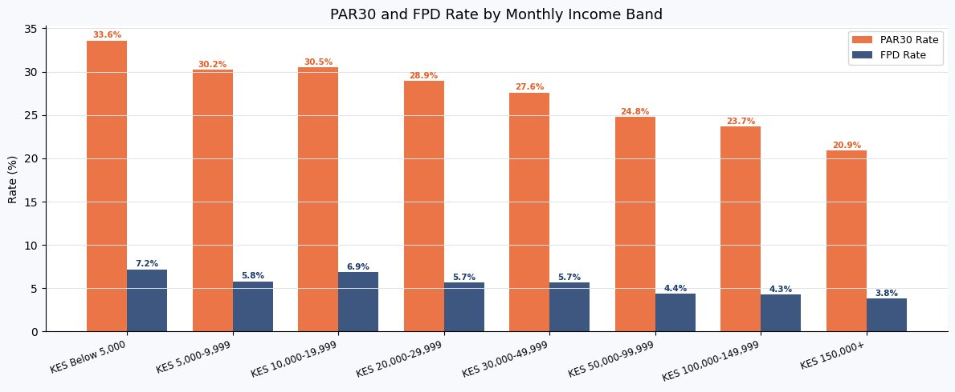
01 | Income Band: Lower Income Consistently Higher Risk
33.6%
PAR30 for
Below KES 5K
20.9%
PAR30 for
KES 150K+
13 pts
gap — income is
a real predictor
Income data only covers ~51% of the portfolio (linkage gap), so these figures are directional rather than definitive. Even so, the pattern is consistent: PAR30 falls 13 percentage points as income rises from Below KES 5K to KES 150K+. Affordability assessment at origination — not just credit bureau checks — would materially reduce front-end risk.
Slide 4 of 9

Slide 5
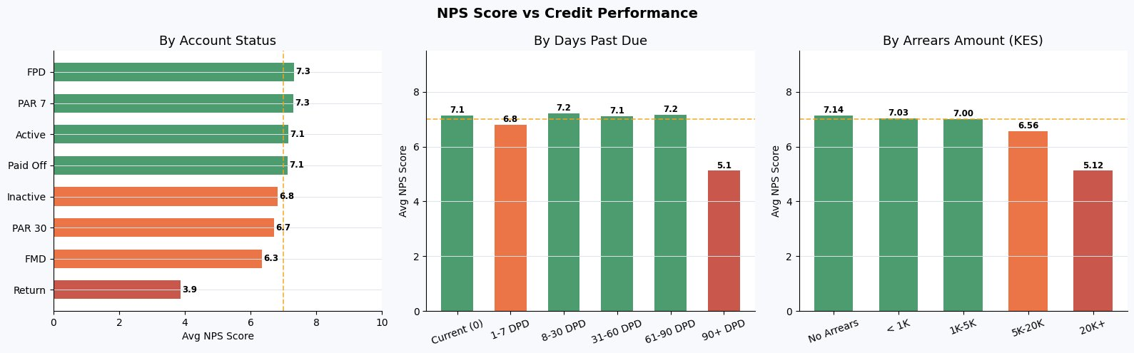
02 | NPS × Credit Performance
+5.9
Overall NPS Score
4,129 respondents
Promoters
n=1,705
42.8%
Passives
n=811
20.4%
Detractors
n=1,469
36.9%
Slide 5 of 9

Slide 6
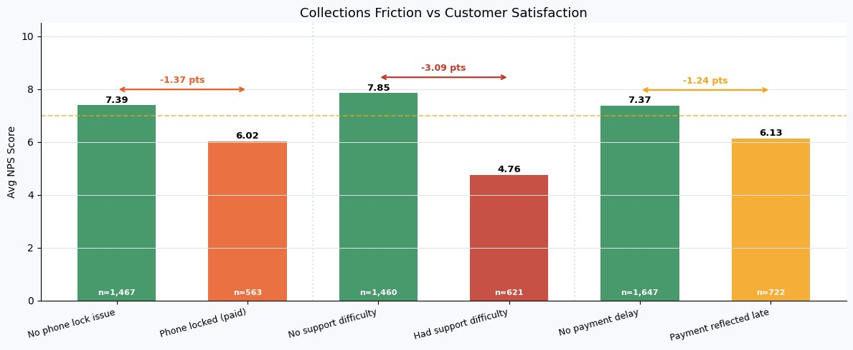
02 | Where Collections Friction Destroys Customer Experience
−1.37 pts
−3.09 pts
−1.24 pts
Phone locked despite paying
Support difficulty
Payment reflected late
563 customers locked after paying on time. Nearly half became Detractors.
Biggest single drop. 621 customers couldn't get through. Collections calls active, support not.
722 customers saw delays in M-Pesa reflection — triggering wrongful locks.
Slide 6 of 9

Slide 7
02 | Recommendation
Introduce a 48-hour payment grace-period alert before any phone lock is triggered
Before locking a customer's phone, the system sends a WhatsApp/SMS confirming the exact amount received and the remaining balance. A 48-hour window allows M-Pesa payments to reconcile. Accounts where payment was received but DPD hasn't cleared are flagged as 'pending reconciliation' and exempt from auto-lock.
+1.37 pts
Fewer calls
Zero cost
NPS recovery for wrongly-locked customers
Inbound support calls drop — the #1 NPS killer
M-Pesa webhook data already exists in the system
Issue | NPS Drop | Customers Affected
Phone locked (paid on time) | −1.37 pts | 563
Support difficulty | −3.09 pts | 621
Payment reflected late | −1.24 pts | 722

Slide 8
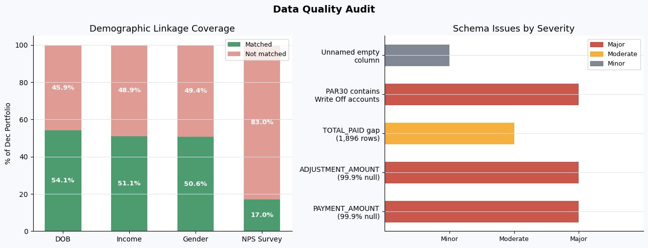
03 | Data Quality & Limitations
Severity | Issue | Detail
Major | CUSTOMER_AGE mislabelled | Correlation = 1.0 with days since sale. Field is loan age in days, not customer age.
Major | ~50% demographic gap | DOB, Income, Gender sheets have 98–99% null Loan IDs. Half the portfolio has no demographics.
Major | Status hierarchy broken | 3,617 Write Off accounts sit inside PAR 30 (L2). L1/L2 mapping is inconsistent.
Moderate | NPS timing mismatch | Surveys run Apr–Dec but joined to quarterly snapshots — up to 8 months apart.
Slide 8 of 9

Slide 9
03 | Three Specific Improvements
01
02
03
Introduce a Universal Customer ID
Fix and Document the Status Taxonomy
Attach NPS to Credit Status at Survey Time
All demographic tables (DOB, income, gender) are keyed to Loan ID. When a customer takes a second loan, their history is lost. Assign a CUSTOMER_ID at onboarding. All tables join to it. Raises demographic linkage from ~50% to ~95%.
Write Off accounts sit inside PAR 30. Add STATUS_CHANGE_DATE and PREVIOUS_STATUS fields. Publish a transition matrix defining which L1 values are valid under each L2. Rename CUSTOMER_AGE to LOAN_AGE_DAYS.
Today NPS is joined to quarterly snapshots months after the survey. Log the customer's DPD, arrears, and account status at the exact moment they submit the survey. Store as NPS_SNAPSHOT_STATUS alongside the response.
Linkage: 50% → 95%+
Enables cure rate & migration analysis
True causal NPS analysis
Slide 9 of 9

