Slide 1
Student Performance
Data Analysis
Exploring factors associated with academic performance
Python, Pandas, NumPy, Matplotlib, Seaborn, Scikit-learn, and some statistics
Public dataset: UCI Student Performance

Slide 2
Project Objective
Investigate factors associated with students’ final mathematics grades (G3).
Understand the structure and quality of the dataset before analysis.
Use visualization to identify patterns and formulate hypotheses.
Use appropriate statistical measures to quantify selected relationships.
2

Slide 3
Dataset Overview
Information from pd.Dataframe.info() :
The dataset has 395 records and 33 variables in total.
The dataset contains non-null values and is semicolon separated.
The dataset contains 5 discrete features, 11 ordinal categorical features, 12 binary categorical columns, and 5 nominal features
The dataset contains no negative or fractional values.
Visual analysis:
The dataset contains demographic, family, academic, social and behavioral variables.
G1 and G2 represent earlier grades; G3 represents the final mathematics grade.
The analysis uses the mathematics file: student-mat.csv.
Findings describe this dataset and should not be generalized directly to other student populations.
3

Slide 4
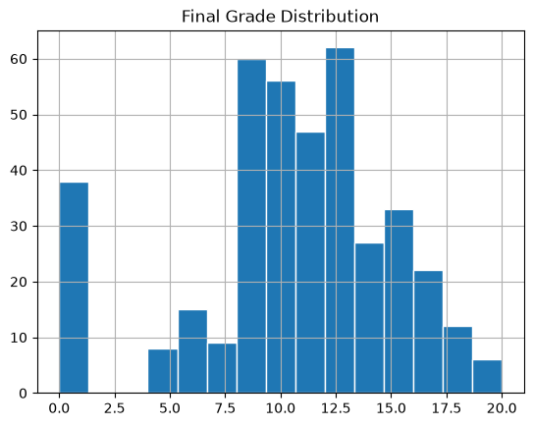
Final Grade Distribution (G3)
The distribution of the G3 feature is not a normal distribution due to its irregular shape.
The distribution contains a pronounced concentration at G3 = 0.
Most observations are concentrated around the middle of the grading scale (9-14).
Very high grades are rather rare.
Zero was treated as a valid observed grade rather than automatically as an outlier.
6

Slide 5
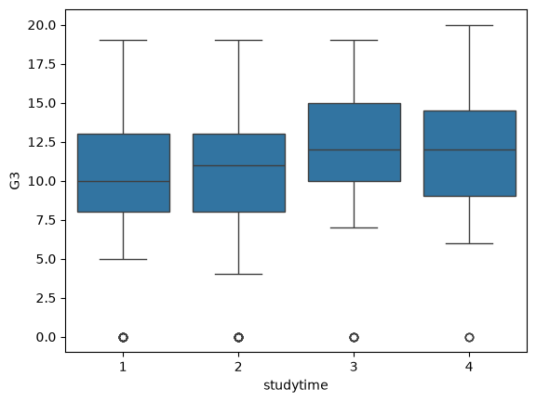
Visual And Statistical Summary
studytime versus G3
  Statistical result:
  Spearman ρ = +0.105170
Median G3 generally increased across study-time categories.
The distributions overlapped considerably.
The highest study-time category contained only 27 students.
The observed association was weak.
3

Slide 6
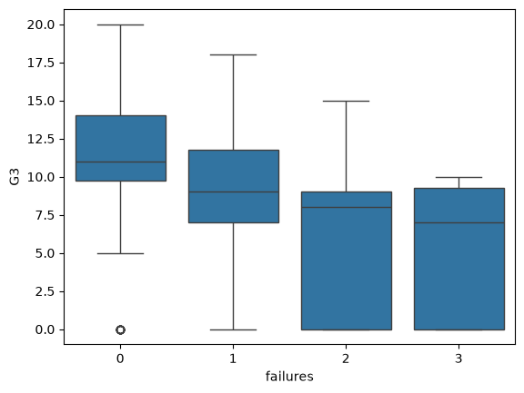
Visual And Statistical Summary
failures versus G3
  Statistical result:
  Spearman ρ = -0.3.61224
Approximate medians: 11 -> 9 -> 8.5 -> 7 as failures increased.
The relationship was visibly monotonic.
This was the strongest monotonic association among the variables quantified.
The 3 category represents three or more previous failures.
3

Slide 7
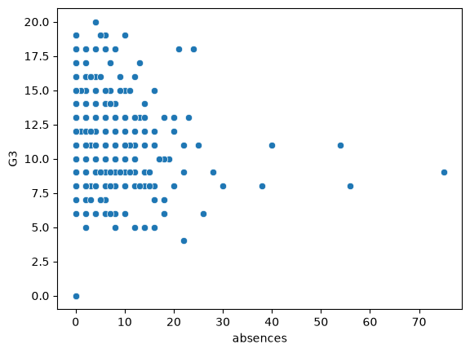
Visual And Statistical Summary
absences versus G3
  Statistical result:
  Spearman ρ = +0.017731
The scatter plot visually suggested a possible weak negative trend.
The Spearman result indicated essentially no monotonic association.
G3 varied substantially among students with similar absence counts.
Note: This should be given more focus for clearer interpretations.
Gave me quite the headache 😅
3

Slide 8
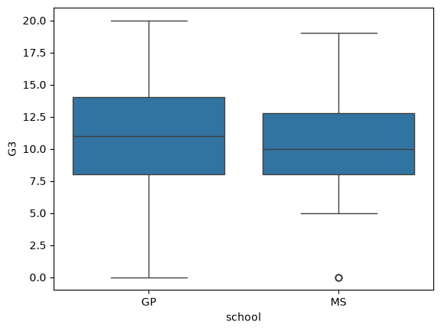
Visual And Statistical Summary
school versus G3
GP: 349 students, MS: 46 students.
Approximate medians: GP = 11, MS = 10.
The GP distribution showed greater spread.
The two distributions substantially overlapped.
Due to imbalance in data, visual interpretation is limited.
3

Slide 9
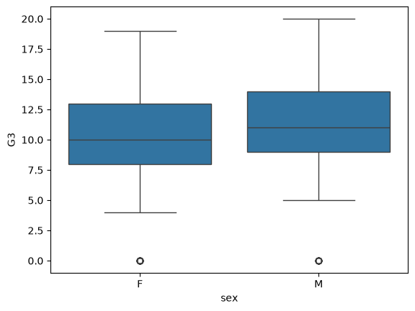
Visual And Statistical Summary
sex versus G3
Female: 208 students, Male: 187 students.
Approximate medians: Female = 10, Male = 11.
The groups had similar IQRs and broadly similar spread.
The distributions were overlapped substantially.
The result is descriptive and does not establish an effect that results to a cause.
I personally see no reason as to why Gender will affect academic performance 😅
3

Slide 10
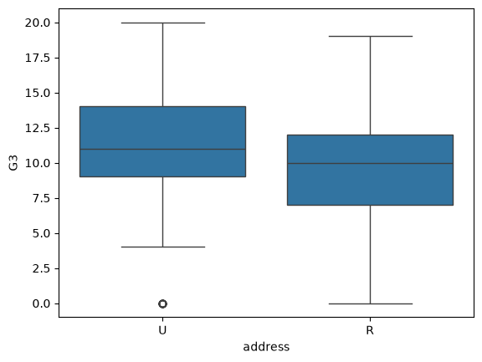
Visual And Statistical Summary
address versus G3
Rural: 88 students, Urban: 307 students.
Approximate medians: Rural = 10, Urban = 11.
The IQRs were quite similar.
The urban distribution appeared shifted toward higher grades.
Residential location may depend on many other associated circumstances, so no factual interpretation was assigned.
3

Slide 11
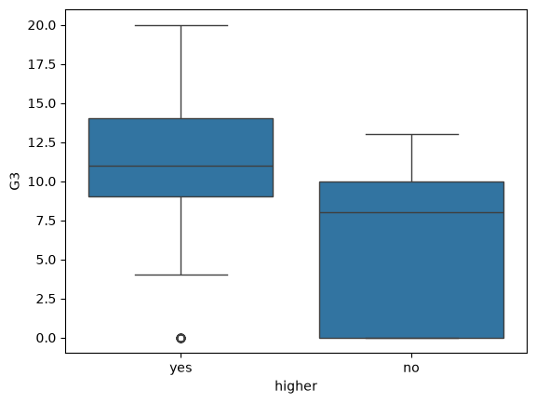
Visual And Statistical Summary
higher versus G3
Yes: 375 students, No: 20 students.
Approximate medians: Yes = 11, No = 8.
The distributions showed a more pronounced separation than several earlier comparisons.
The No category is very small, so its distribution should be interpreted cautiously.
The observed association does not establish that educational aspirations cause differences in performance.
3

Slide 12
Comparative Findings
Previous Failures
ρ = -0.361224
Strongest association examined.
Study Time
ρ = +0.105
Weak positive association.
Absences
ρ = +0.018
Essentially no association.
School, sex and address showed relatively modest median differences with substantial overlap.
The higher education intention comparison showed a larger visible difference, but its groups were highly imbalanced.
2

Slide 13
Conclusion
Main finding
Among the variables examined, previous failures showed the strongest observed monotonic association with final grade.
Study time showed a weak positive association with G3.
Absence count showed essentially no monotonic association with G3.
Several categorical comparisons showed considerable differences with substantial overlap.
The analysis put together the importance of combining visualization, statistical measurement and analytical reasoning.
All findings should be understood as associations/relations within this particular dataset.
17

Slide 14
Thank You
Student Performance Data Analysis
Exploring factors associated with academic performance

