Slide 1
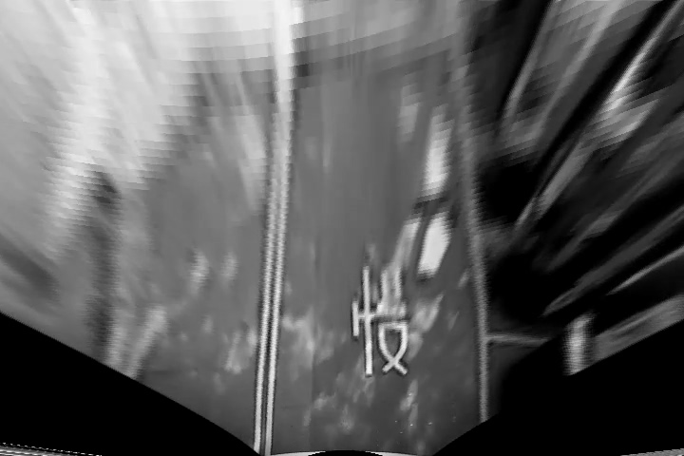
Introduction
Goal: Lane detection on bird-view video in 15 fps speed.

Slide 2
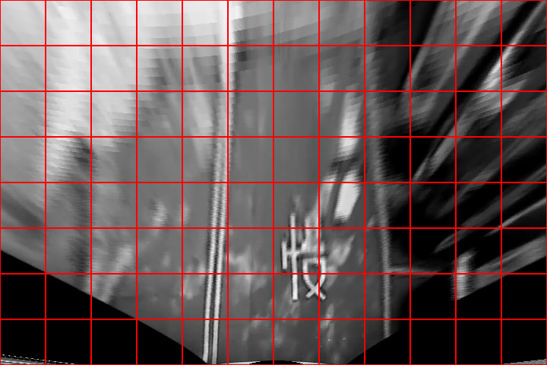
Training data
Extract 60*60 pixel patches from video frames using grid lines.

Slide 3
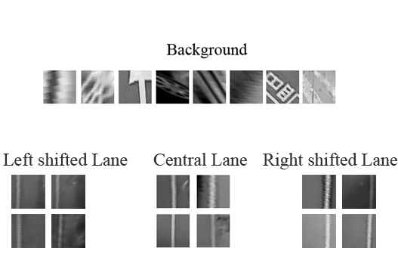
Training Data
Class 1: Background
Class 2: Central lanes
Class 3: Left-shifted lanes
Class 4: Right-shifted lanes

Slide 4
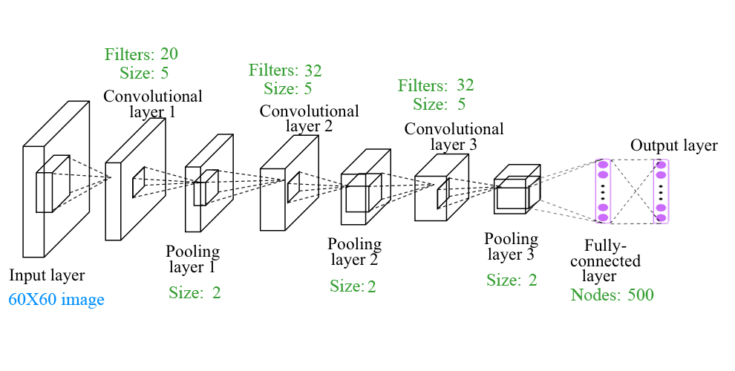
CNN Model
Three-layer CNN is implemented to the experiment.

Slide 5
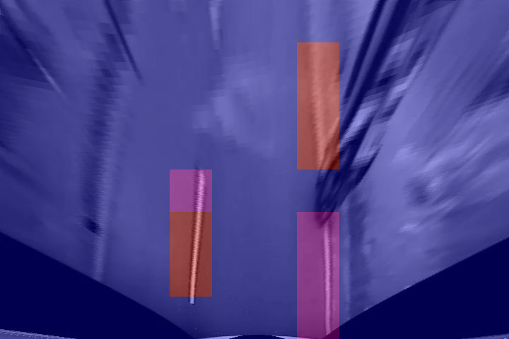
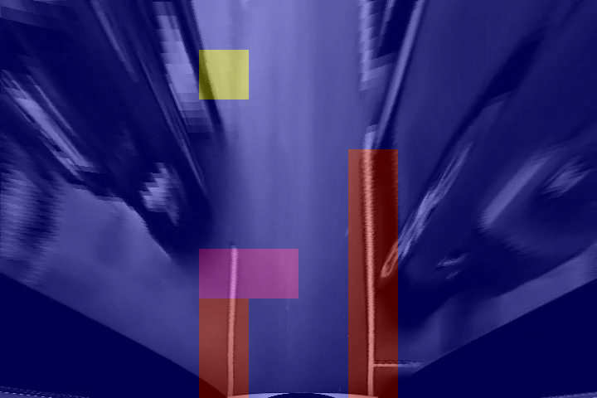
Experiment result
Frame in easy case :
Blue region: Background
Red region : Central lanes
Yellow region : Left-shifted lanes
Pink region : Right-shifted lanes

Slide 6
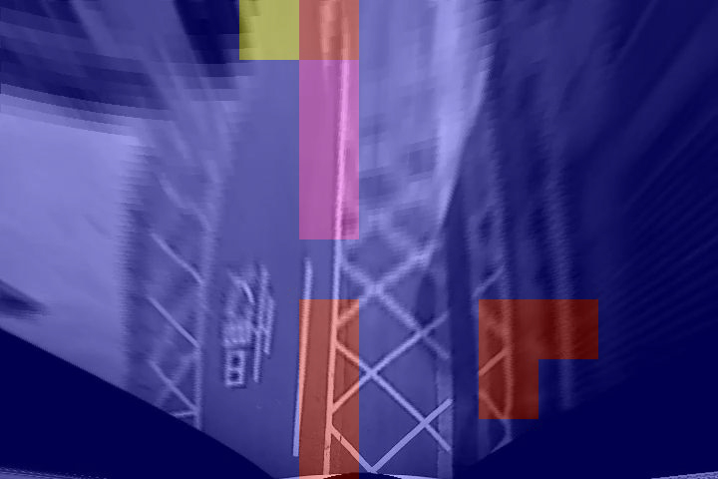
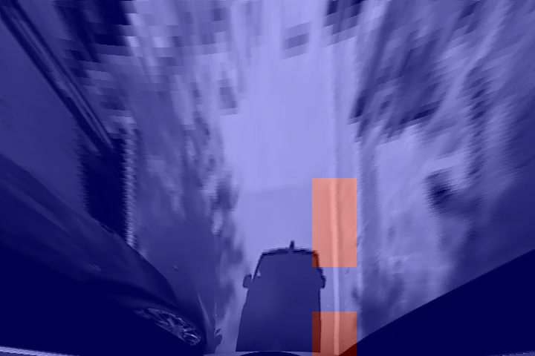
Experiment result
Frame in hard case :
Blue region: Background
Red region : Central lanes
Yellow region : Left-shifted lanes
Pink region : Right-shifted lanes

