Slide 1
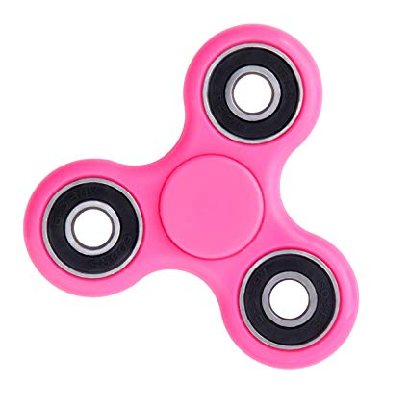
Attitude Determination & Control

