Slide 1

Mission - IRIDIUM
The Iridium-Next Constellation
Communication Principle
Pierre-Yves Schini – ISAE-SUPAERO

Slide 2
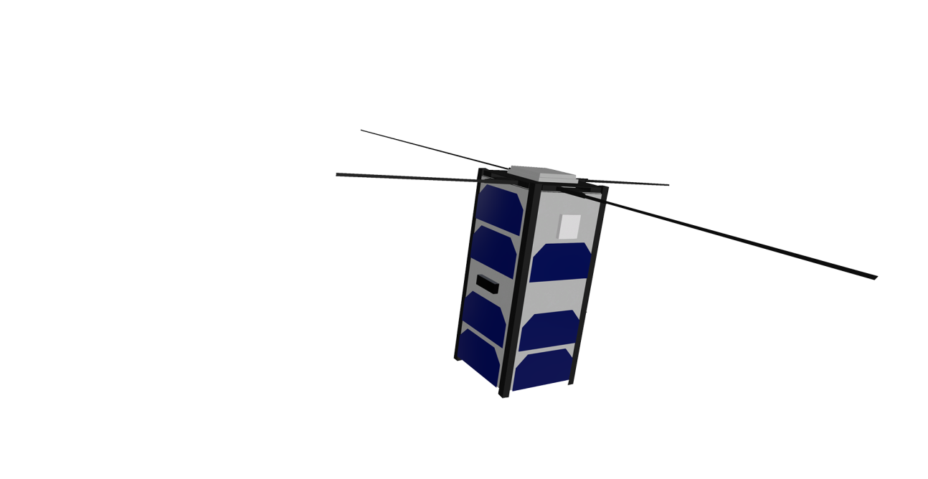
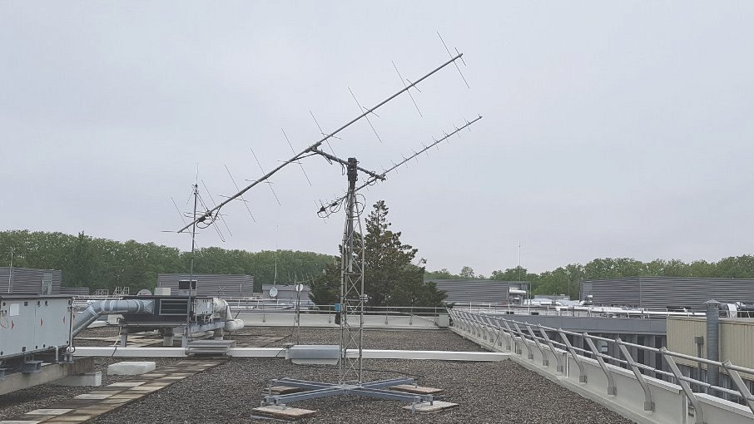
Introduction
IDM-View simulation of Tolosat
Few passes
Short passes
Imposed passage times
UHF-VHF earth station in ISAE-SUPAERO
(Picture Isae-Supaero)

Slide 3
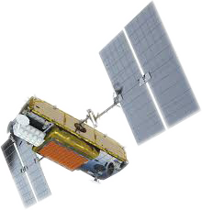

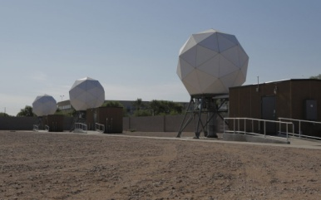
Concept
Use the Iridium-Next constellation as a relay to communicate with Tolosat
Pictures Iridium

Slide 4
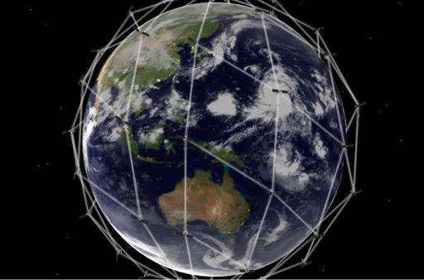
The Iridium-Next constellation Presentation
66 satellites
780-Kilometer polar orbit
6 orbital planes
48 L-band beams
«4,700-Kilometer footprint area on Earth» (Iridium)
Picture Iridium
I. The Iridium-Next Constellation

Slide 5
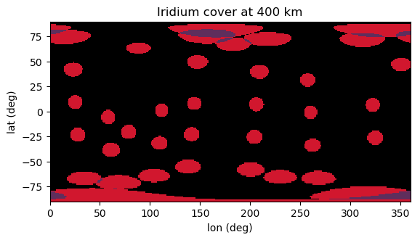
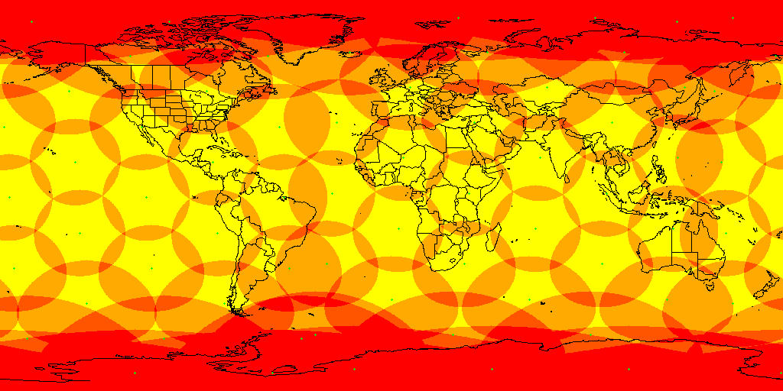
The Iridium-Next constellation Coverage
Iridium cover on the ground
I. The Iridium-Next Constellation

Slide 6
The Iridium-Next constellation Comparison
Criterion | Iridium | Direct UHF/VHF
Session length | 114s | 300s
Visibility | 24,7% | 1,39% (per ground station)
Data rate | 340 bps | 9600 bps
Data transmitted per day | 7,2 Mb | 11,5 Mb
I. The Iridium-Next Constellation

Slide 7
Communication principle
TC
TM & TC
TM
II. Communication Principle

Slide 8
Communication principle
Iridium Satellite
Modem
Flight software
Destination: DATA@sbd.iridium.com
Subject: IMEI number of the transceiver
Attachment: message.sbd
Email adress
Iridium Server
II. Communication Principle

Slide 9
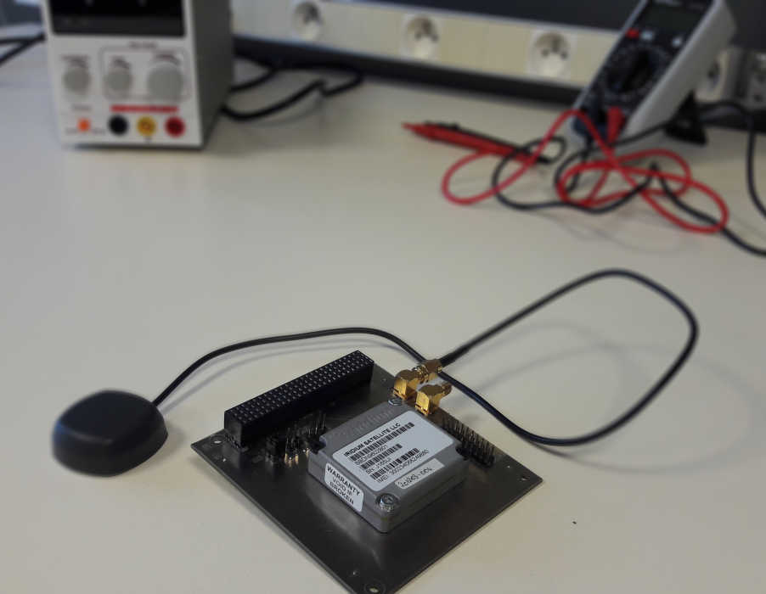
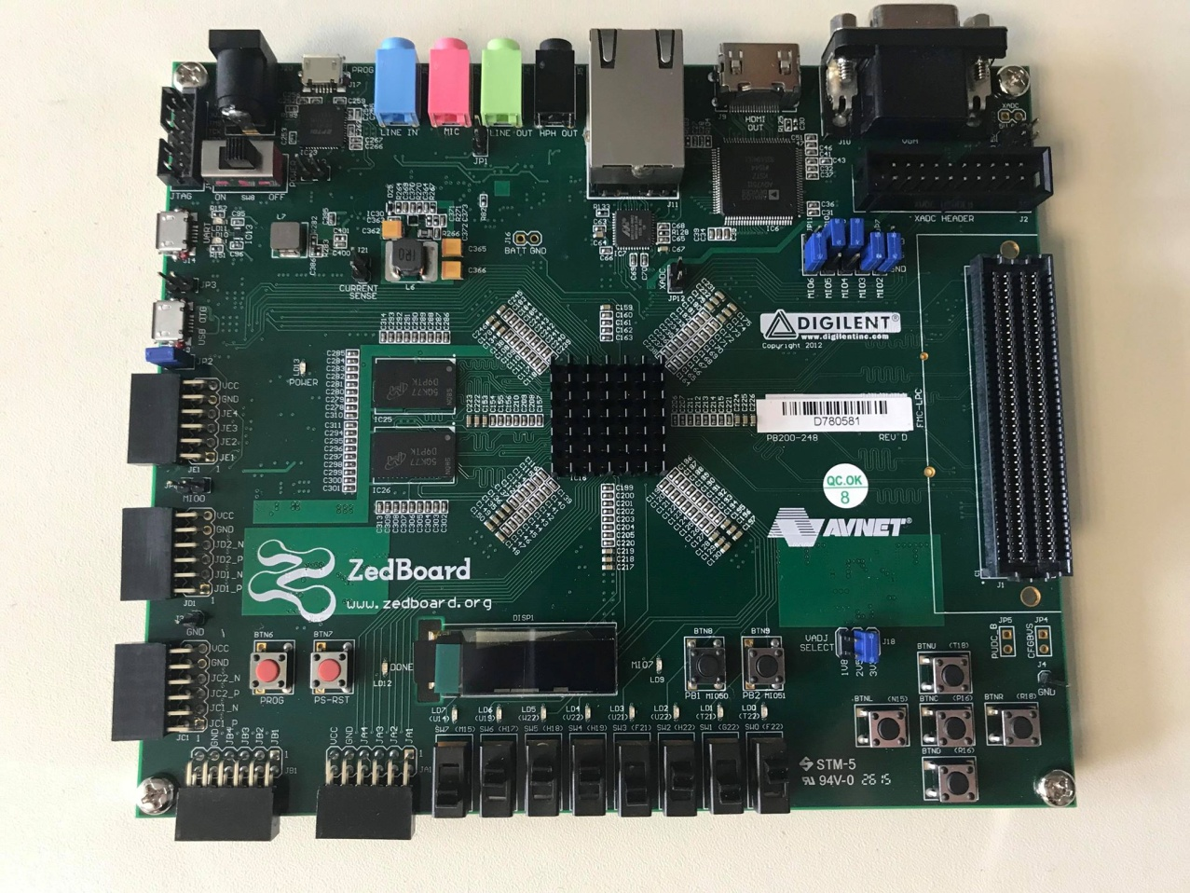
What is Next?
9602 Iridium-Modem lent by the CSUT
Onboard computer lent by the CSUT

Slide 10


Thank you for your attention!

