Slide 1
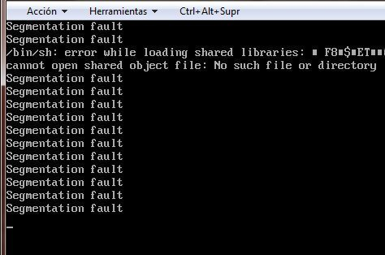
On-Board Data Handling
Niels Boulanger - UPS
Luc Bourguignon - ENSEEIHT

Slide 2
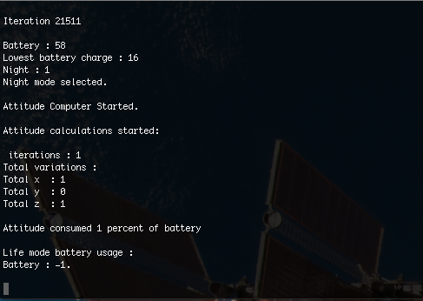
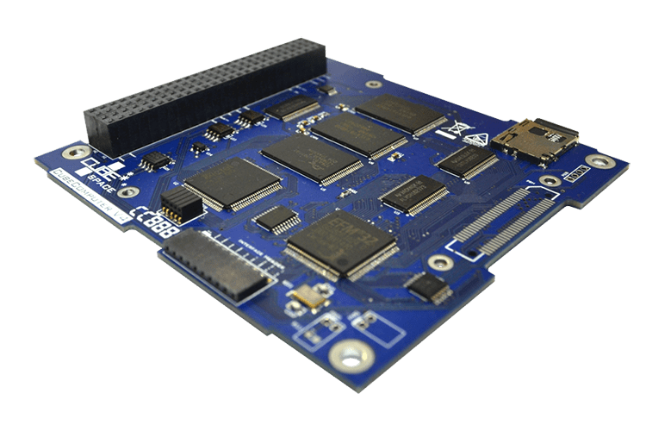
What we did :
- Selected a few OBC and analyzed them
- Created a first simulation about the different modes
- Data budgets, link budgets
- Thought about compression algorithms and scripts
- Studied our test board
- Folder names agreement (how to store data)
OBC / OBDH - Phase A

Slide 3
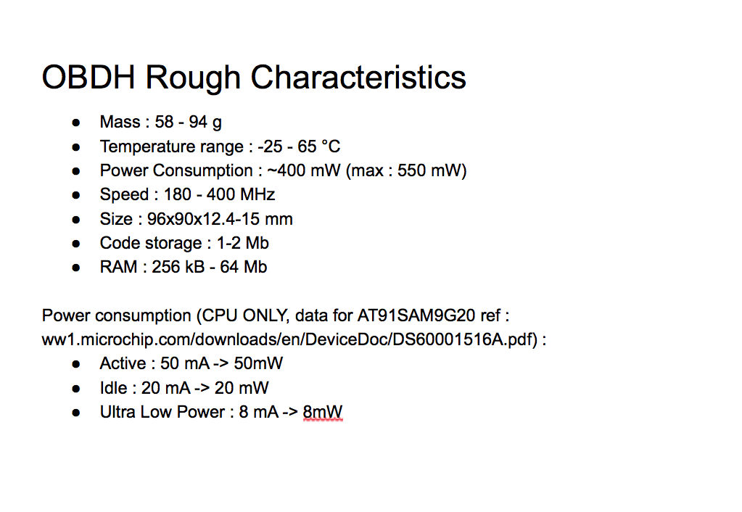
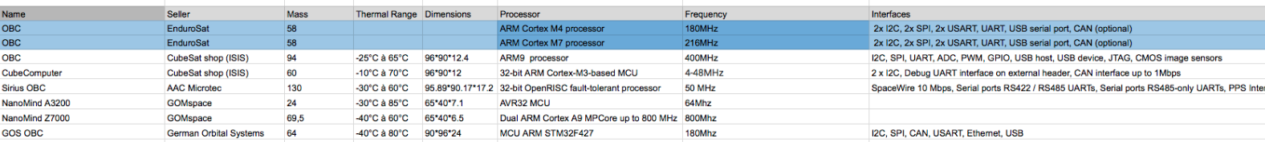
What we did : OBC Analysis
- Lots of different choices and sellers
- Finally selected the EnduroSat OBC as main board
for next Phase calculations and simulations
- Also tried KubOS (without success)
OBC / OBDH - Phase A

Slide 4
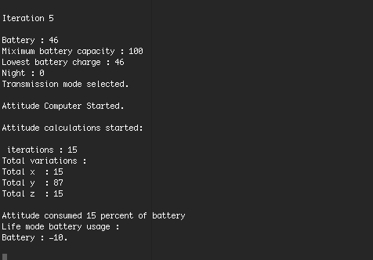
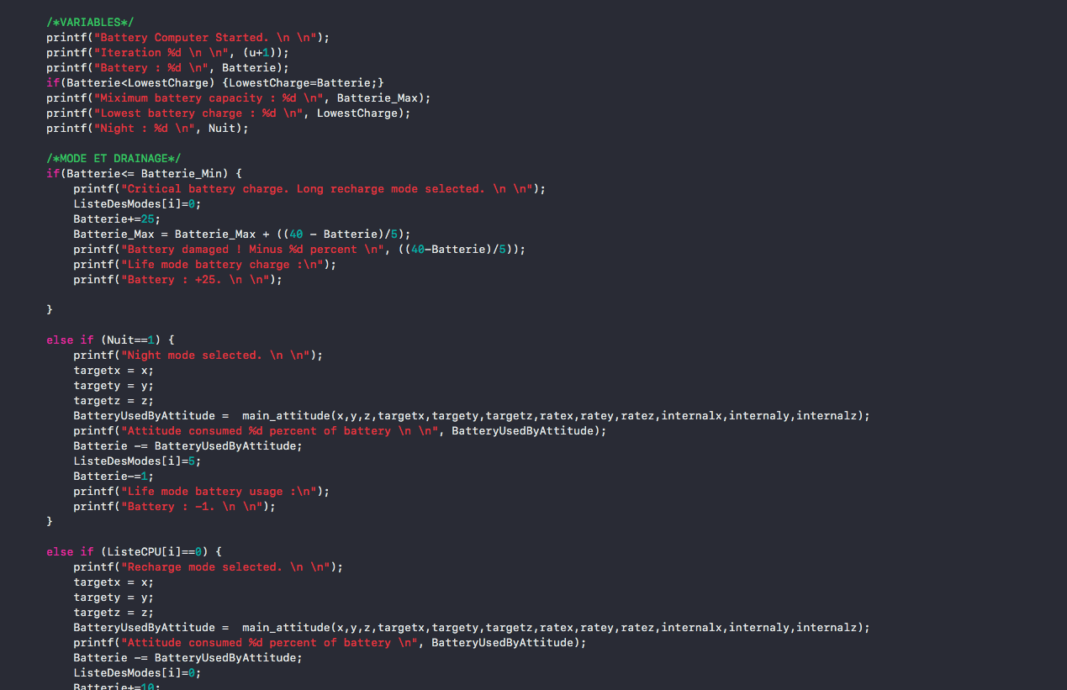
What we did : Simulation
- Represents the different modes the CubeSat will use
- Simple algorithms
- Will be filled with real data during Phase B
- Needs to be simplified
OBC / OBDH - Phase A

Slide 5
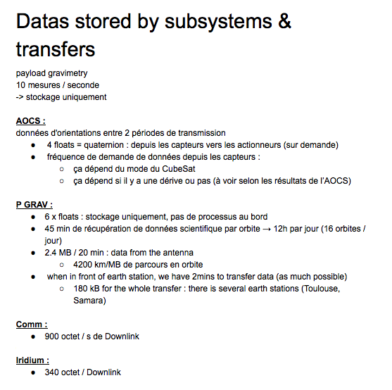
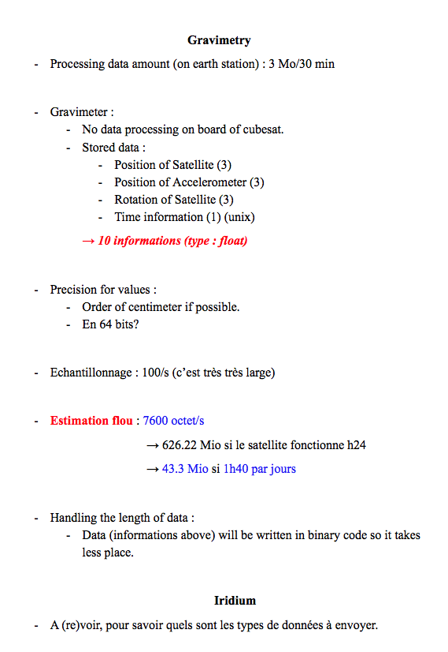
What we did : Budgets
- Talked with subsystems that will transfer or store
data
- Will be improved and
updated while working
- We will use a protected
SD card with high speed
and capacity
OBC / OBDH - Phase A

Slide 6
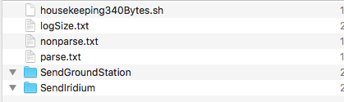
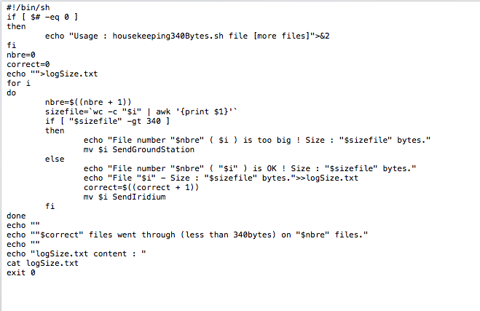
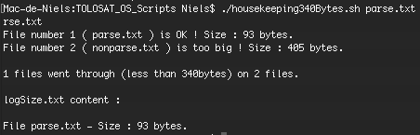
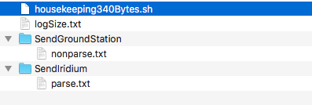
What we did : Scripts & Compression
- Reduce transmission time & size : compression required.
- Separate messages than can fit into Iridium network and others : Bash Shell scripts
OBC / OBDH - Phase A

Slide 7
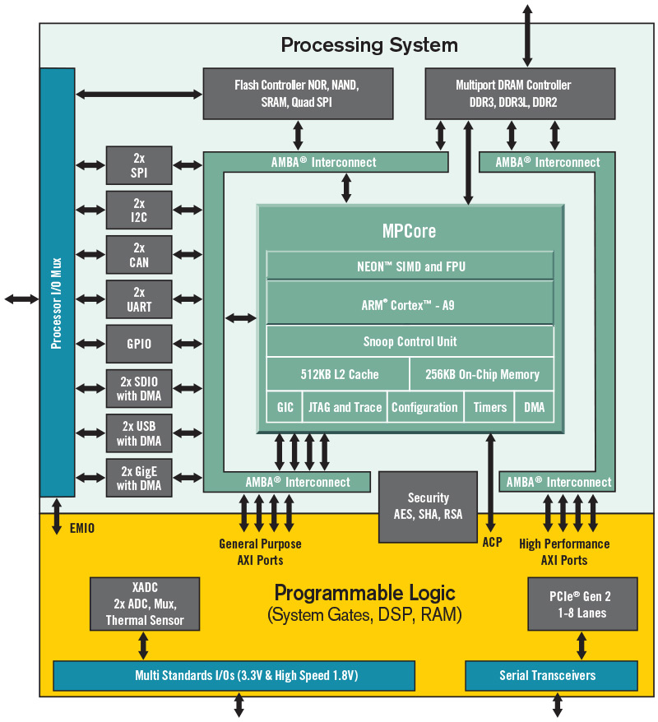
What we did : Received Test Board
- Started reading tutorials and manuals.
- Will work later on the Xilinx Zynq TestBoard : scripts, hardware links, internal Operating System…
- Our goal : a working FlatSat during Phase B
OBC / OBDH - Phase A

Slide 8
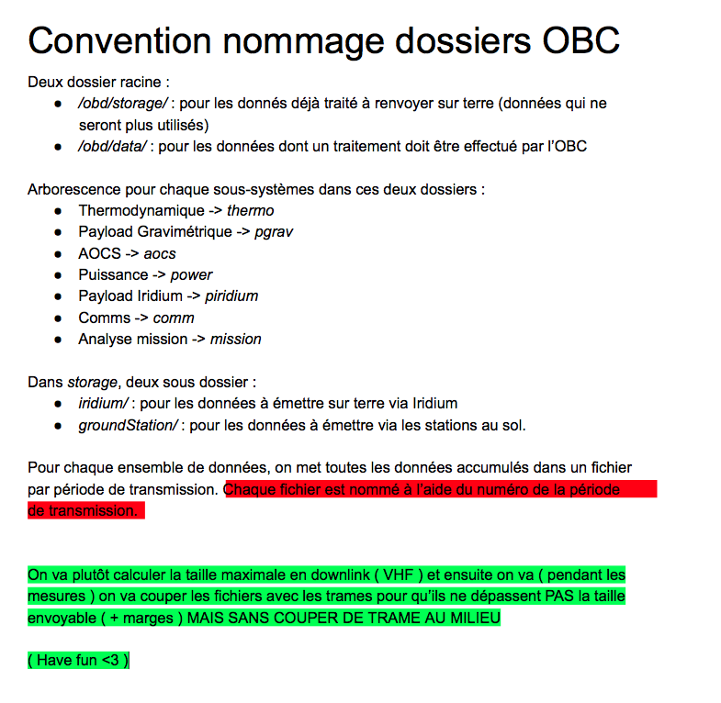
What we did : Naming agreement
- Looks useless but help working with the same ideas
- Reduces bug risks
- Helps with understanding of access and storage
- Each subsystem has its own folder, and data are
stored depending on their requirements :
post-process or simple transmission
- We will add a « save » folder in case of script
transmission
OBC / OBDH - Phase A

Slide 9

OnBoard Data Handling
27/05/2019
Thank you for your attention

