Slide 1
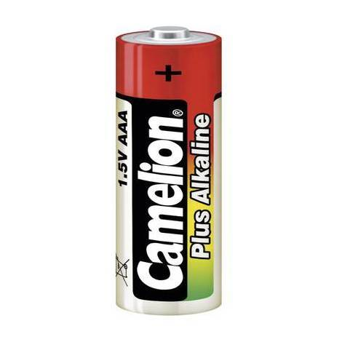
Power
Power Budget
Simulation results for components sizing
Outcomes
Aly N’Daw - INSA
Florian Parronaud - INSA

Slide 2
Power Budget
I. Power Budget

Slide 3
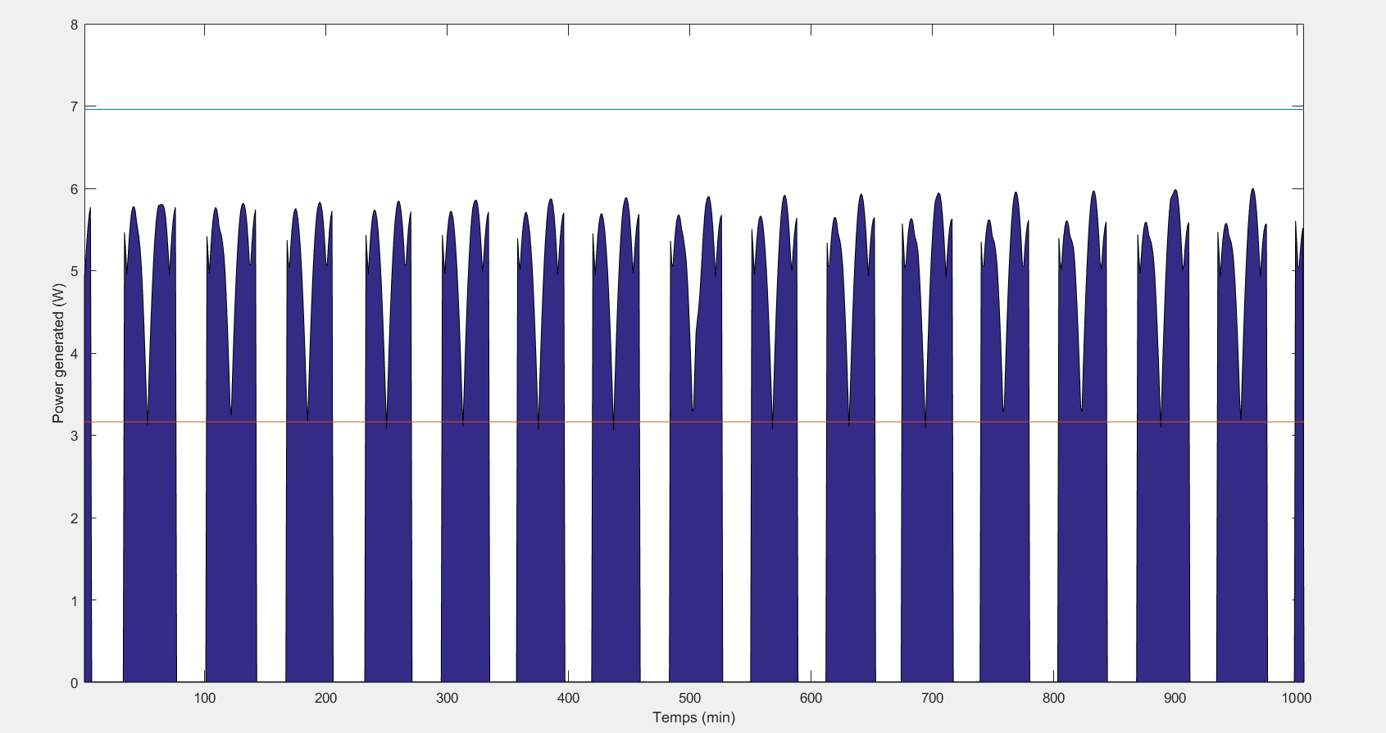
Power Generation
6,95 W max
3,1 W (mean)
II. Simulation results for components sizing

Slide 4
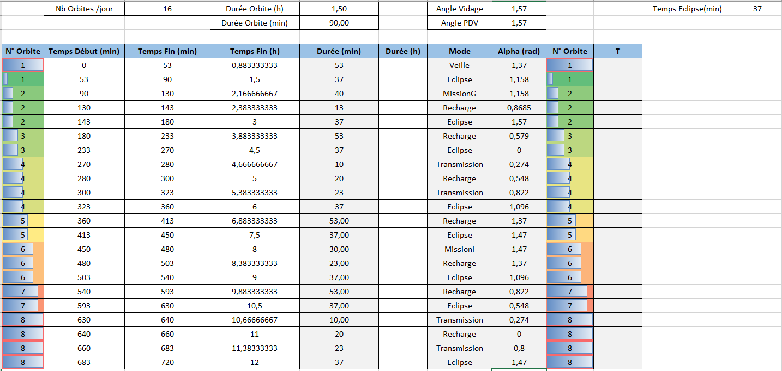
State of Charge simulation
II. Simulation results for components sizing

Slide 5
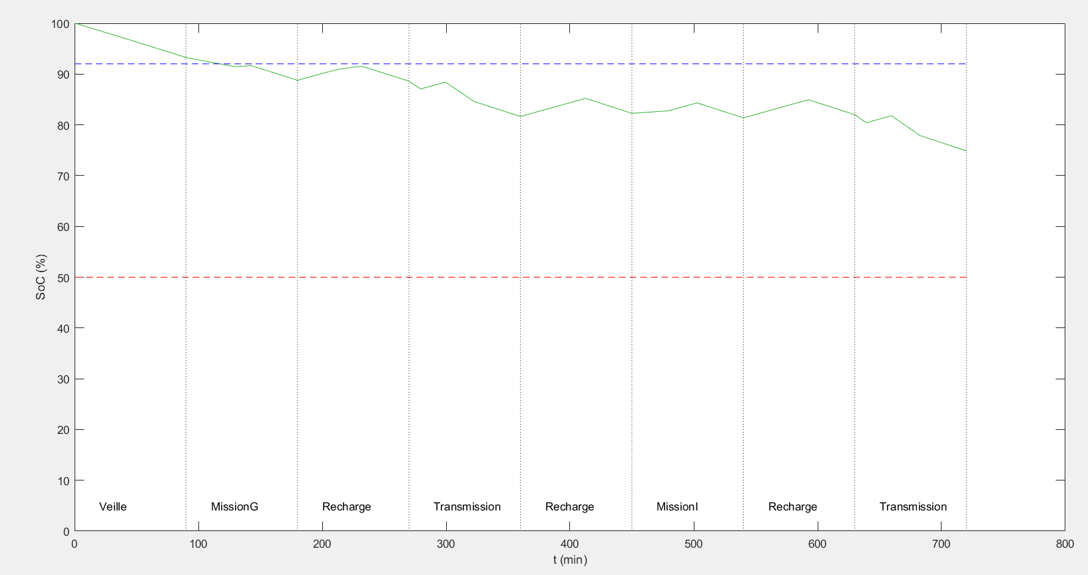
State of Charge simulation
II. Simulation results for components sizing

Slide 6
Outcomes
Battery capacity of 37.5 Wh (5.2 Ah) to stay above the 50% of SoC
8 solar panels minimum for the power generation computed
Work to do
Add the quaternions on the power generation to have a more precise value
Compare our simulations with the OPALIS results to validate the results
Study the hardware part and train on a real card
III. Outcomes

