Slide 1
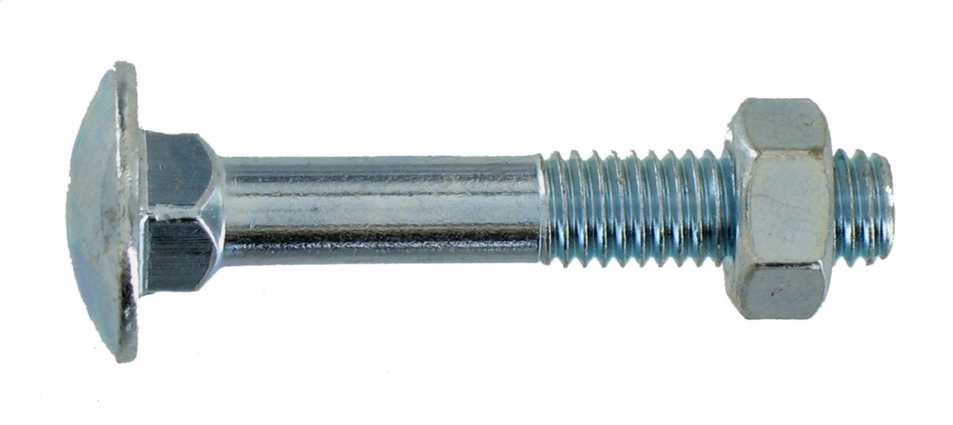
Structure
CAO Structure
Machining
Configuration
Adrien Cassagne - ISAE
Guillaume De Battisti - ISAE
Pierre Seeleuthner - ISAE

Slide 2
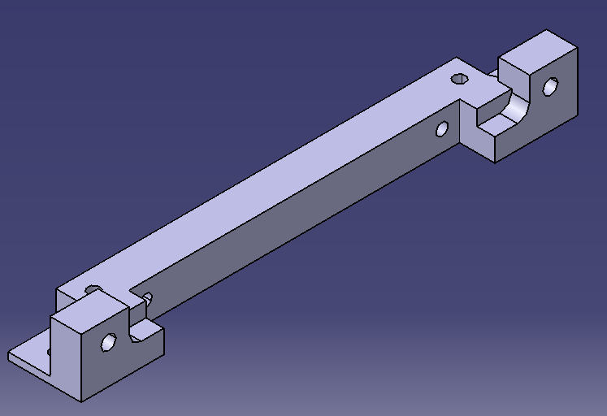
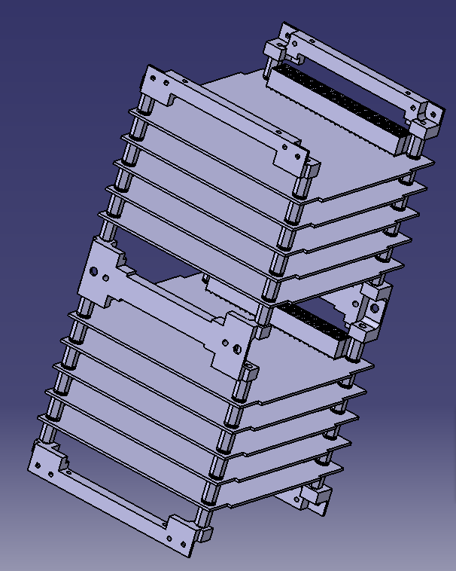
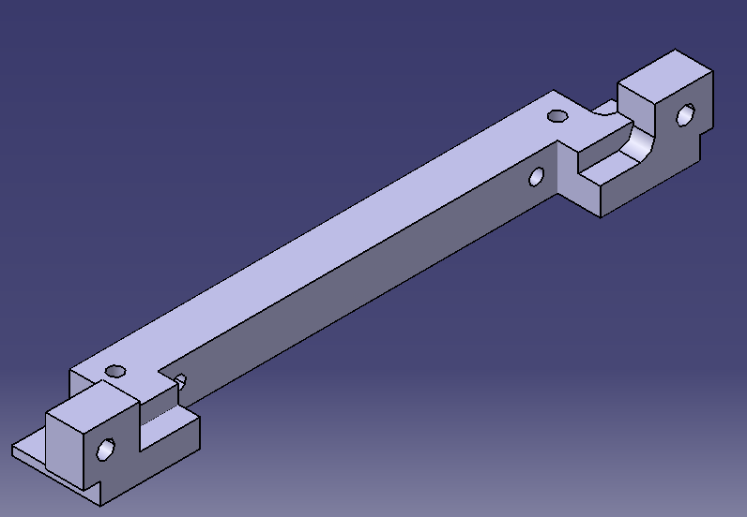
I- The current CAO of the structure
The internal structure :
The short rib: symetric
Stack of ten standardized PC-104 cards linked with the ribs
The long rib: assymetric
I. CAO Structure

Slide 3
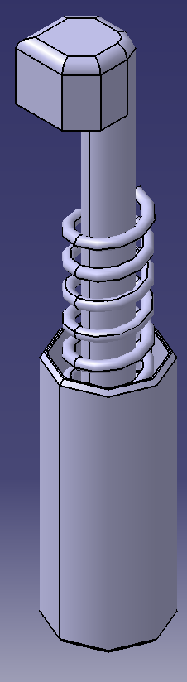
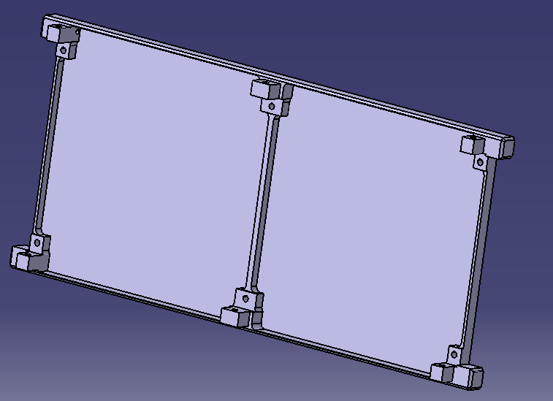
Structure CAO
The external structure:
Deployement switch: while the spring is compressed, all the functionalities of the cubesat are off.
Frame of the cubesat: the frame is directely fixed with the structure due to machining issues
I. CAO Structure

Slide 4
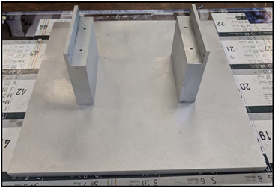
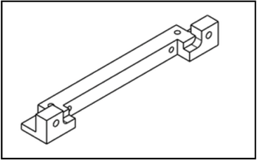
Machining
Training for use of a milling machine at SUPAERO
A support for the cubesat was first made
Next up are the ribs of the internal structure
II. Machining

Slide 5
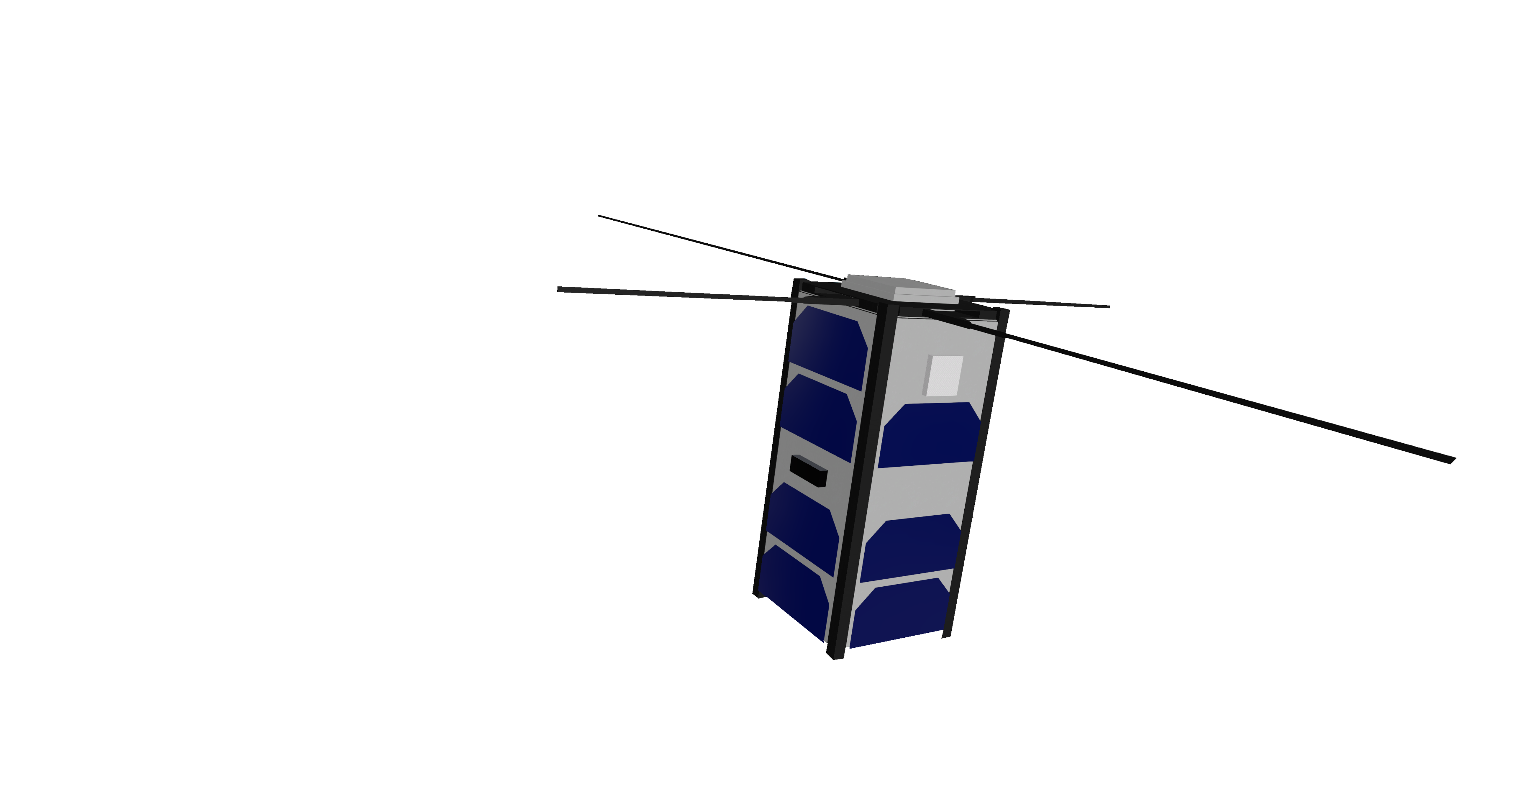
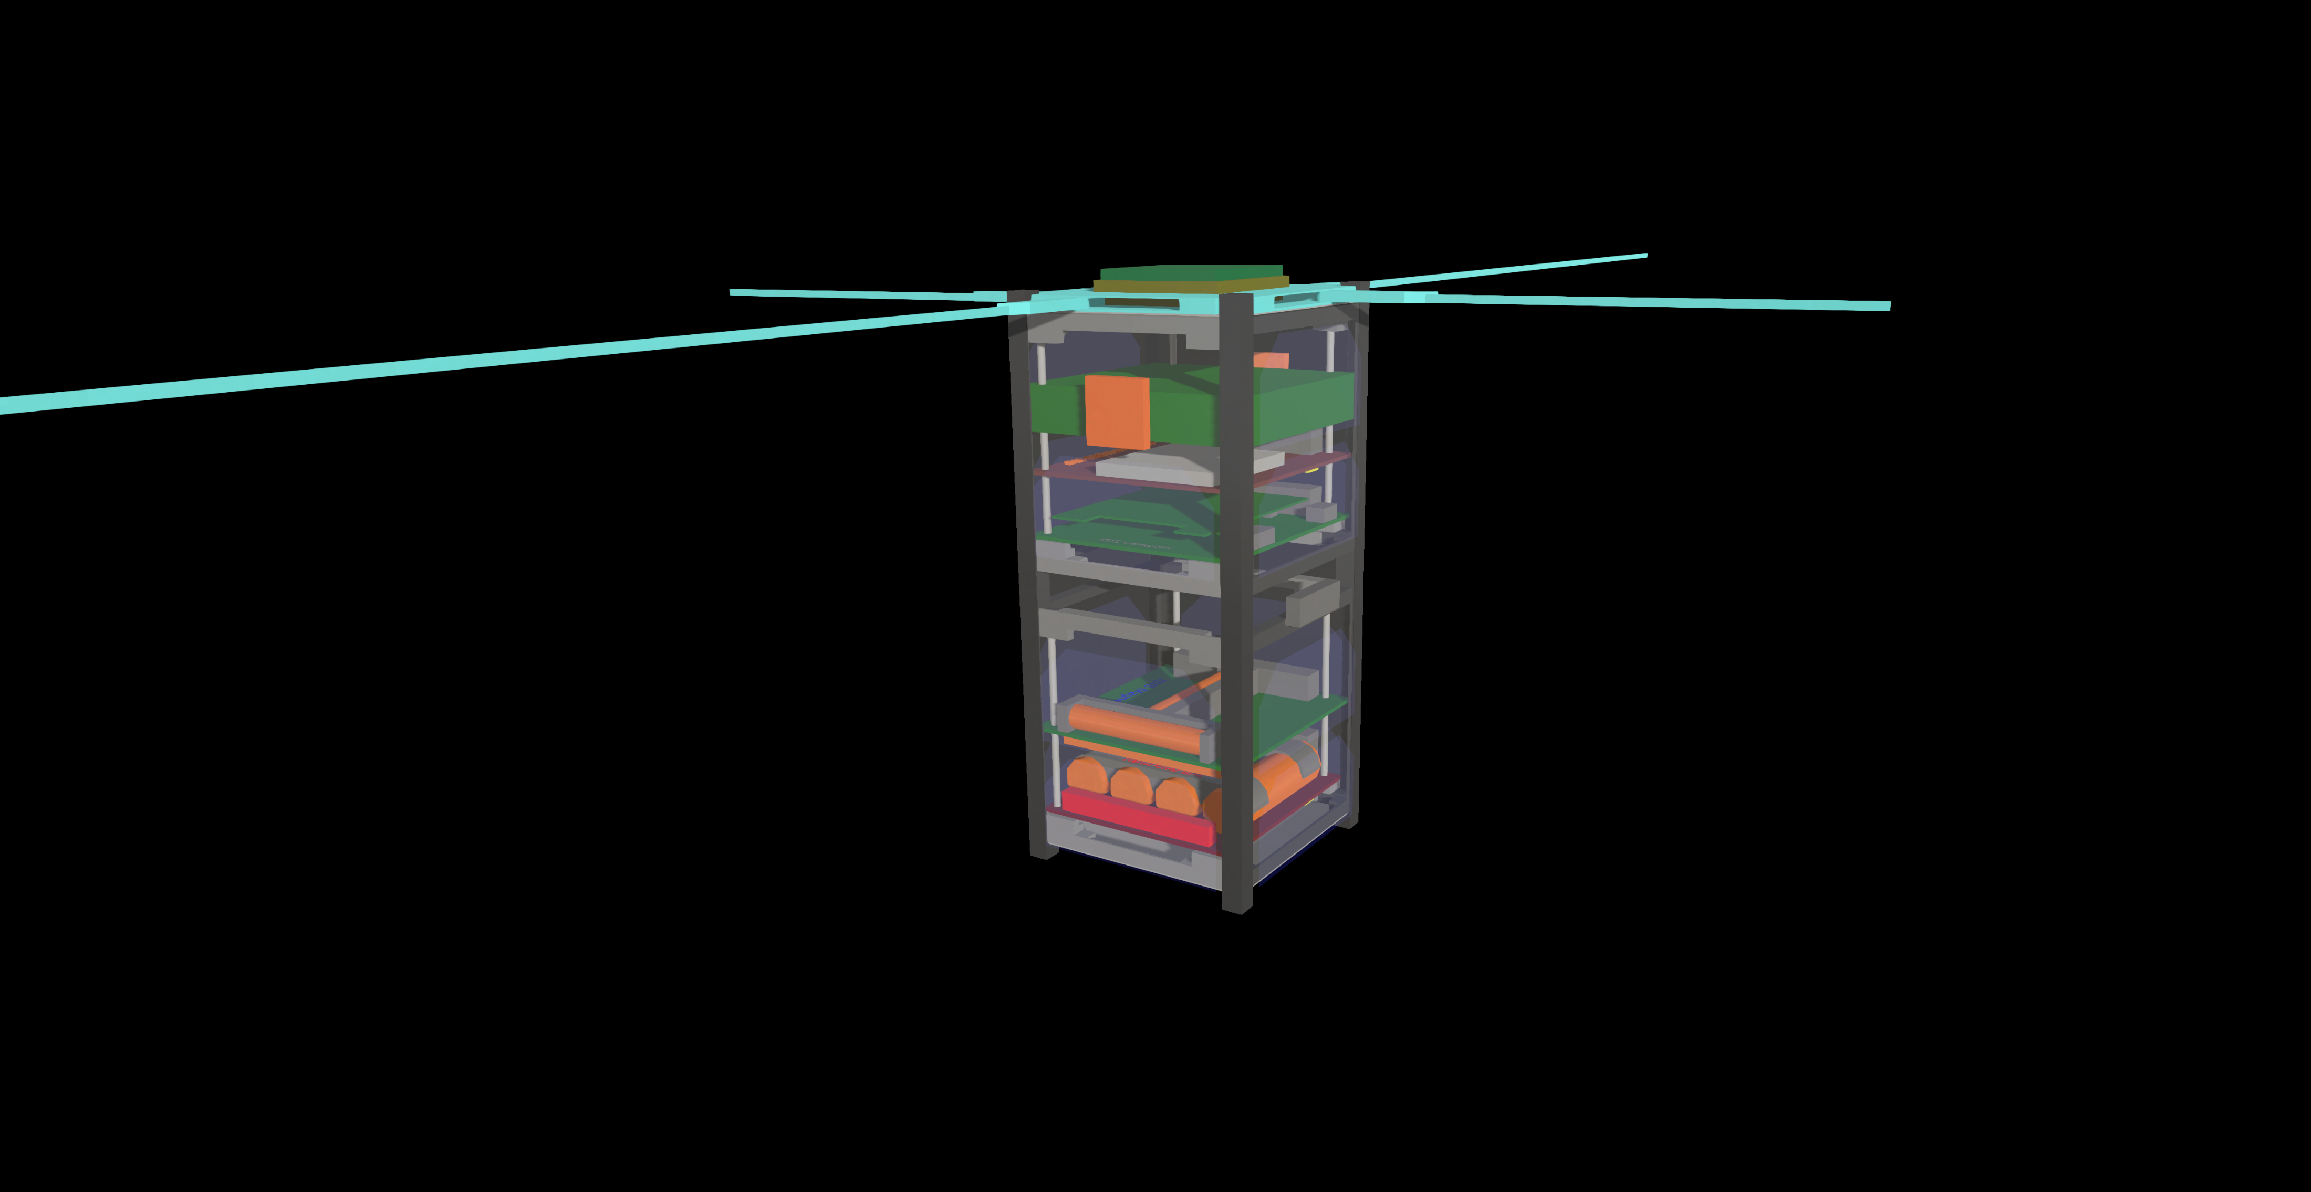

Configuration
III. Configuration

Slide 6
THANK YOU !

