Slide 1
Systems Engineering
System Requirements
Budgets
Model-Based Systems Engineering
Cédric Belmant - INSA
Pierre Seeleuthner - ISAE

Slide 2
System Requirements
ID | Requirement
SYS-001 | The orbit shall be circular, between 400 to 500 km with an inclination greater than 50°
SYS-005 | Ground stations shall include at least one that is located in Toulouse
SYS-006 | SatNOGS ground stations should be used complementarily for telemetry
SYS-015 | The system shall provide attitude control in compliance with the payload requirements
SYS-020 | The spacecraft shall transmit telemetry data every day
SYS-040 | The spacecraft shall comply with the Cubesat Design Specifications
I. System Requirements

Slide 3
Mass Budget
Subsystem | Mass (kg) | Margin | Total Mass (kg)
POWER | 0.69 | 5% | 0.72
STRUCTURE | 0.30 | 20% | 0.36
ADCS | 0.20 | 5% | 0.21
COMMUNICATIONS | 0.22 | 10.77% | 0.24
OBDH | 0.09 | 5% | 0.10
GRAVIMETRY PAYLOAD | 0.19 | 20% | 0.22
IRIDIUM PAYLOAD | 0.10 | 20% | 0.11
TOTAL | 1.79 | 20% system margin | 2.36
II. Budgets

Slide 4
Power Budget
Power Mode | ECLIPSE | RECHARGE | TRANSMISSION | IRIDIUM | GRAVIMETRY | TOTAL
Total consumed power (W) (Including 20% System Margin) | 1.2834 | 1.2834 | 7.9734 | 4.5504 | 2.9772 | -
Duty Cycle | 33% | 24% | 3% | 20% | 20% | -
Average consumed power (W) | 0.428 | 0.308 | 0.239 | 0.910 | 0.595 | 2.476
II. Budgets

Slide 5
Link Budget
SEE with the COMS subsystem ;)
II. Budgets

Slide 6




Financial Budget
Funding from schools
Partnerships with companies/organizations
Fondation INSA
ISAE, Fondation ISAE
ENSEEIHT
Financial partnerships (Thales)
Material partnerships
II. Budgets

Slide 7
Financial Budget
 | Estimated price | Comment
Communication | 9750 €
Power | 20900 € | 16 solar panels (1U form factor)
Structure | 1500 € | Homemade
Thermal | 0 €
ADCS | 8000 €
Iridium | 115 € | Low estimate
Gravimetry | 11550 €
OBDH | 4265 €
TOTAL with FYS | 61580 €
TOTAL Nanoracks | 113580 € | Raw estimate
TOTAL Electron | 221580 € | Raw estimate
II. Budgets

Slide 8
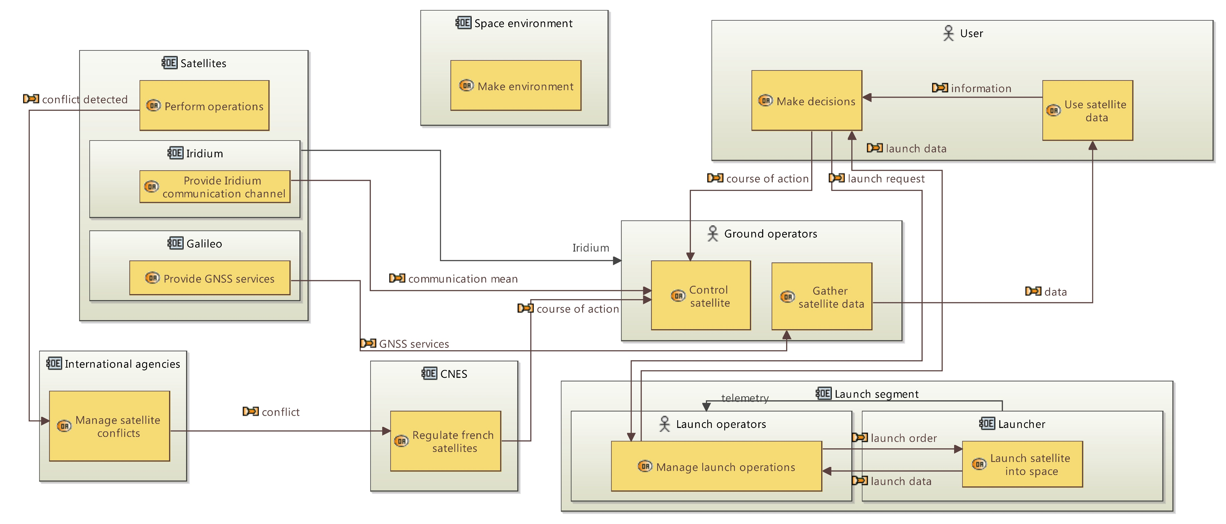
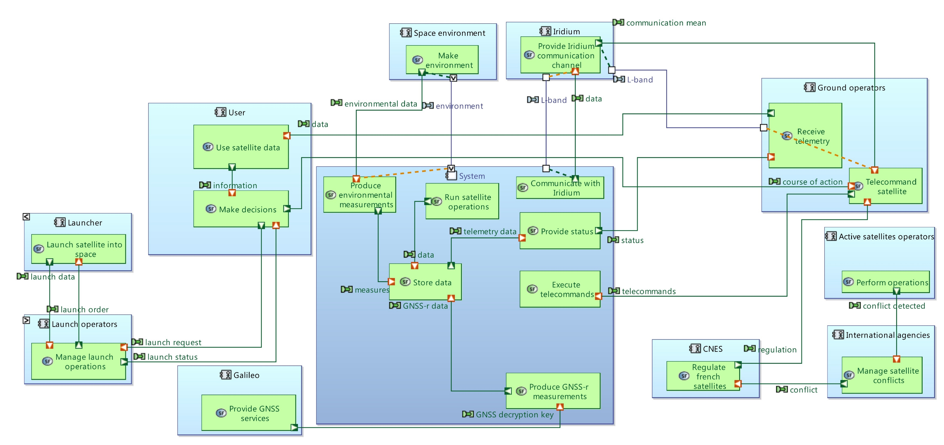
Capella
Learning in progress:
J-L. Voirin (Arcadia)
P. Roques (Capella)
Interests:
Team is regularly renewed
Greatly facilitates IVVQ
Integration of MBSE in phase B
III. Model-Based Systems Engineering

Slide 10


